Slide 1
Age Estimation in face images
Petean darius
Turcut stefan
Ungureanu mihai

Slide 2
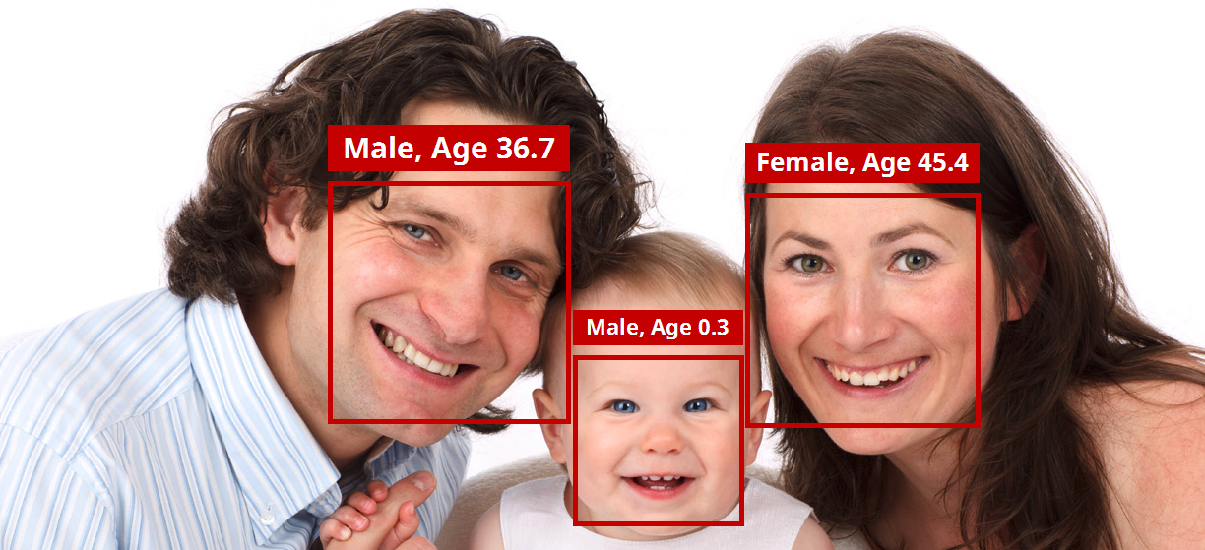
the goal
Predicting the age of a person solely based on a face picture

Slide 3
why/where do we need age estimation?
Enforcing age restriction policies
Detecting abuse or malicious intent towards vulnerable age groups
Social media features

Slide 4
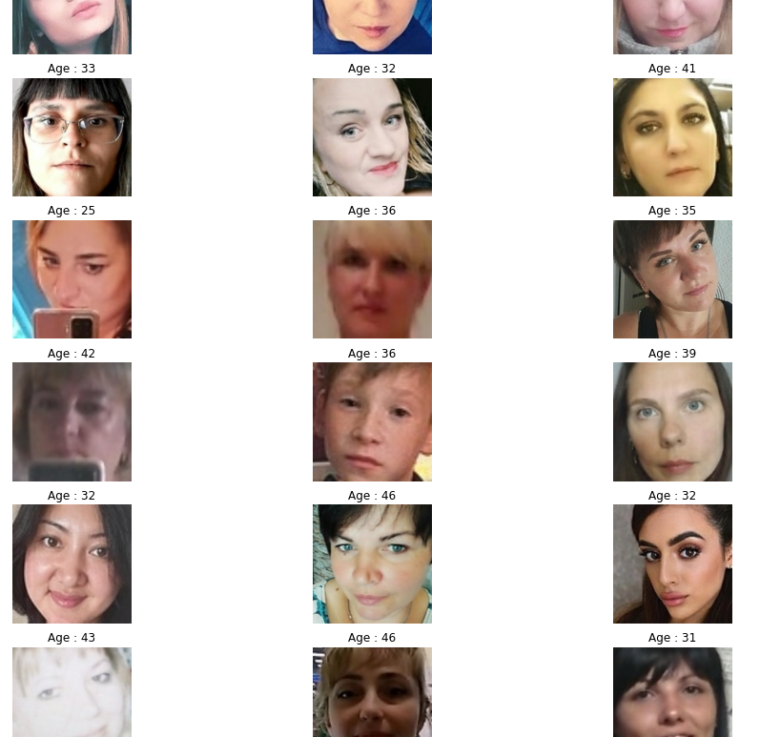

dataset
Source: Kaggle
Scraped, labeled automatically
=> imperfect

Slide 5
Other datasets we found
IMDb face
UTKface

Slide 6
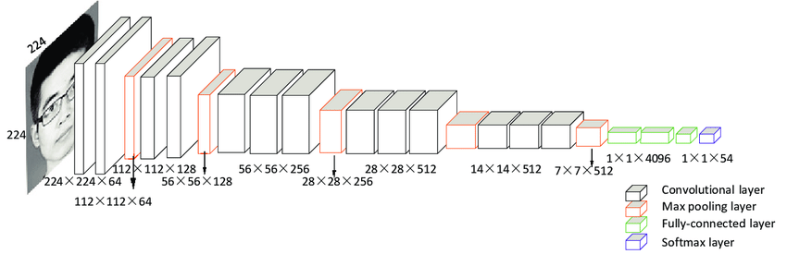
Our results with vgg-16:

Slide 7
What went wrong? Age detection pitfalls
The problem was more difficult than we thought:
-Apparent age vs biological age. Even us humans have problems sometimes
- Examples of factors that influence the apparent age: lighting, angles, haircut, make-up, plastic surgery, lifestyle, hormonal imbalance

Slide 8
Future plans for this problem: 1) facial Feature extraction
We can try extracting facial features (e.g. using OpenCV) and feeding that into a neural network as input instead of using the raw images directly
That way we can leverage the power of the powerful OpenCV model
Using the wheel to our favor instead of reinventing it

Slide 9
Future plans for this problem: 2) Labeling apparent/biological age
We can try to assemble a dataset labeled for both the apparent and biological age, and factoring these extra pieces of information in the training process

Slide 10
Thank you!

