Slide 1
Wrap-Up for 45-Degree View Geo-localization
Haoyue Shi
09/07/2016

Slide 2
What we have now
Crawled down the Google satellite images as database
Fine-tuned out a Siamese network model from VGG-CNN-M
Dataset: all the satellite images of which we have the geo-labels
Train: 80% of the dataset (with augmentation)
Test: 20% of the dataset (with augmentation)
Top 5 matching result on test dataset
VGG-CNN-M: 79.52%
Fine-tuned: 93.08%
This model is robust to rotating, shifting and zooming of images.
However, when localizing video frames, the model doesn’t work as well as it does on satellite images.
Hypothesis from observation: Salientness (buildingness) plays an important role in matching procedure.

Slide 3
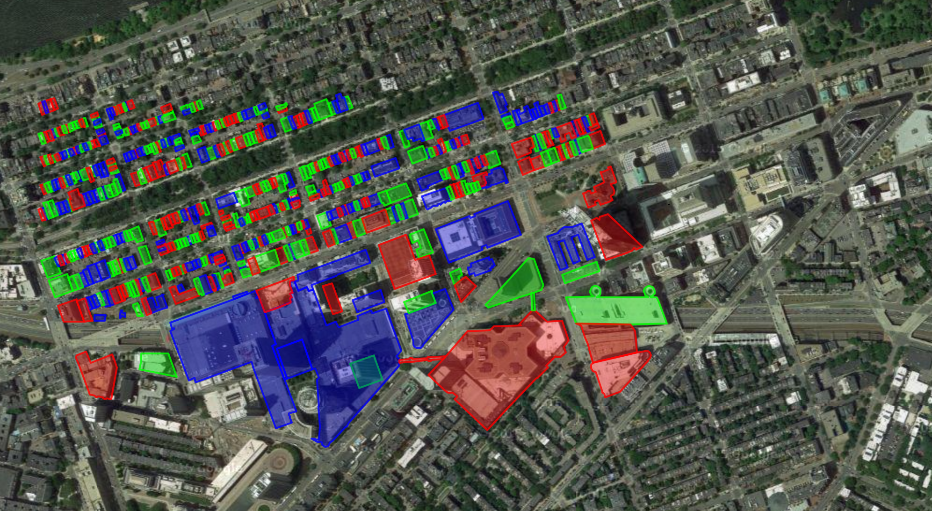
A General View of the Dataset
560 buildings
4 direction of view for each

Slide 4
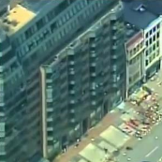
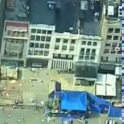
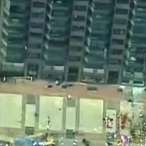
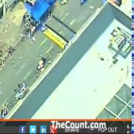

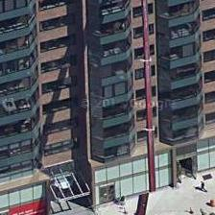
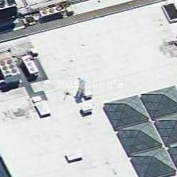

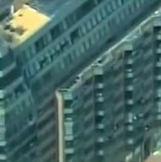
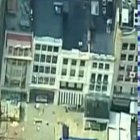

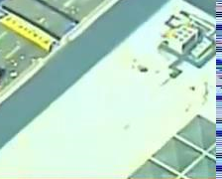
Demonstrate of the Hypothesis
Raw Frames from video MAP:28.85%
6 2/3 10 108
Ground Truth Ranking
Ground-truth (database)
Manually labeled building part
MAP: 58.33%
1 1/2 1 12
Ground Truth Ranking

Slide 5
What we have now
Salientness (“buildingness”) could be learnt out
Manually labelled 2,000+ regions of images
Fine-tuned out a classifier with SoftMax loss
Test set accuracy: 89.4%
Reached an accuracy of 93.6% using self-paced learning

Slide 6
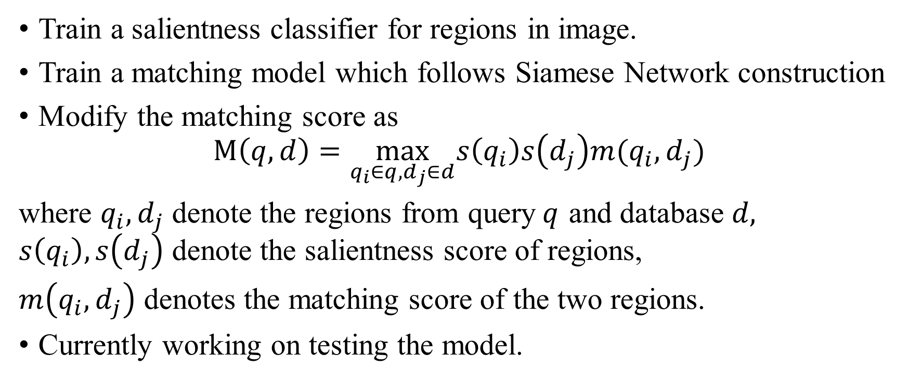
Salientness Guided Matching (Version 1)
Train a salientness classifier for regions in image.
Train a matching model which follows Siamese Network construction
Modify the matching score as
$$M\left(q,d\right)=\max_{q_{i}∈q,d_{j}∈d}s\left(q_{i}\right)s\left(d_{j}\right)m(q_{i},d_{j})$$
where $q_{i},d_{j}$ denote the regions from query$q$ and database $d,$ $s\left(q_{i}\right),s\left(d_{j}\right)$ denote the salientness score of regions,
$m\left(q_{i},d_{j}\right)$ denotes the matching score of the two regions.
Currently working on testing the model.

Slide 7
Next Step
Challenge: We don’t have enough confidence in the salientness estimation for video frames.
Assuming we have the matching labels for video frames and database images, we probably can build a joint model to both estimate region salientness & optimize matching.

