Slide 1


EstimateX — Predicting Project Time &
Cost Using Machine Learning
Mini project BCS-554 / 5th Sem
Team Members
1. VAISHNAVI DUTT [2400320101217]
2. VARNIKA SINGH [2400320101234]
3. VANDANA SINGH [2400320101219]
MENTOR
MS. DIVYA MAHESHWARI

Slide 2
ABSTRACT
The Problem: Project time and cost are usually just guessed based on someone's experience, which is unreliable and different every time.
Our Solution: We use machine learning to predict a project's time and cost based on real past project data, instead of guesswork.
Multiple Models: We test a few different ML methods and pick whichever gives the most accurate predictions.
Works Across Domains: The tool works for different types of projects - website, mobile app, enterprise software , not just one.
Explainable Results: It also shows which factors (like team size or complexity) affected the prediction, so it's not just a random number.
Impact: Helps teams plan budgets and timelines more reliably before starting a project.

Slide 3
OBJECTIVE
Build the Prediction Model: Create a machine learning model that predicts a project's development time and cost from its details (team size, complexity, type, etc.).
Compare Multiple Algorithms: Train a few different ML models and find out which one gives the most accurate predictions.
Measure Accuracy Properly: Test how good the predictions are using proper error checks, not just guesswork.
Make Results Explainable: Show which factors influenced the prediction the most, so it's easy to understand why.
Support Multiple Domains: Make sure it works for different types of projects, not just one specific kind.
Deliver a Usable Tool: Package everything into a simple website where anyone can enter project details and get an instant estimate.

Slide 4
Scope of the
Problem Statement
Who Can Use It: Any team or company that wants a rough time and cost estimate before starting a project - not limited to software companies alone.
Works Across Project Types: Covers different kinds of projects - websites, mobile apps, enterprise software, embedded systems - the user just tells the tool what type of project it is .
Helps With Planning: Useful for project managers, students, and startups to check their own plans against a data-based estimate before committing time and money.
Improves Over Time: Can be retrained with more project data later, making predictions more accurate as it's used more.
Limits of This Project: Focused on early-stage estimation based on project details - it does not track a project's actual progress once development has started.

Slide 5
RELATED WORK
IIETA study (2023): Compared several ML models on the same data, found Random Forest gave the most accurate predictions.
JARDCS study (2019): Used machine learning to predict software project effort and cost, found it more accurate than older formula-based methods.
ResearchGate survey (2007): Reviewed different ML techniques for this kind of prediction, found that clean data matters more than the exact method used.
SEER-AI (Galorath): An existing enterprise-grade estimation tool, but expensive and built for large-scale defense/aerospace projects, not accessible to small teams.
Marketing-style AI calculators (devtimate, idealink, etc.): Existing web tools that give a rough cost estimate, but are mostly lead-generation forms without real trained models or transparency.
Gap We're Addressing: No easily accessible, transparent, and explainable tool exists that works across multiple project domains - our project fills that gap.

Slide 6
APPLICATIONS
Software & IT Companies: Estimate project timelines and budgets before taking on client work or starting internal projects.
Startups: Get a quick, realistic budget/timeline check before pitching to investors or committing limited resources.
Project Managers: Cross-check their own manual estimates against a data-backed prediction before finalizing a plan.
Freelancers & Agencies: Give clients faster, more consistent quotes instead of relying purely on gut-feel pricing.
Academic & Training Use: Help students and new project managers understand what factors actually drive project cost and time.

Slide 7
LIMITATIONS
Limited Training Data: Public datasets are small, so accuracy can be improved later by collecting more real project data.
Software-Focused Data: Current data is mostly software-project-based - can be expanded with more non-software domain data over time.
No Real-Time Tracking: The tool only predicts before a project starts - could be upgraded later to track and update estimates as the project actually progresses.
Depends on Data Quality: If the input data is incomplete or inaccurate, the prediction quality drops too - same as any data-driven system, and can be improved with better data validation later.

Slide 8
CONCLUSION &
FUTURE SCOPE
Conclusion
Random Forest was the best-performing model on both datasets, cutting average error by about 68% versus the Linear Regression baseline on COCOMO-NASA (MAE 219.8 vs. 692.2).
Tested and compared four algorithms, Linear Regression, Random Forest, XGBoost, and SVR, with Random Forest winning on both COCOMO-NASA and Desharnais once accuracy and consistency were weighed together.
Works across two independent domains, NASA-style embedded systems and business software projects, through one deployed Flask web app with built-in explainability.
Future Scope
Add more real-world data to improve accuracy.
Support real-time tracking as projects progress.
Extend the tool to cover more non-software domains.

Slide 9
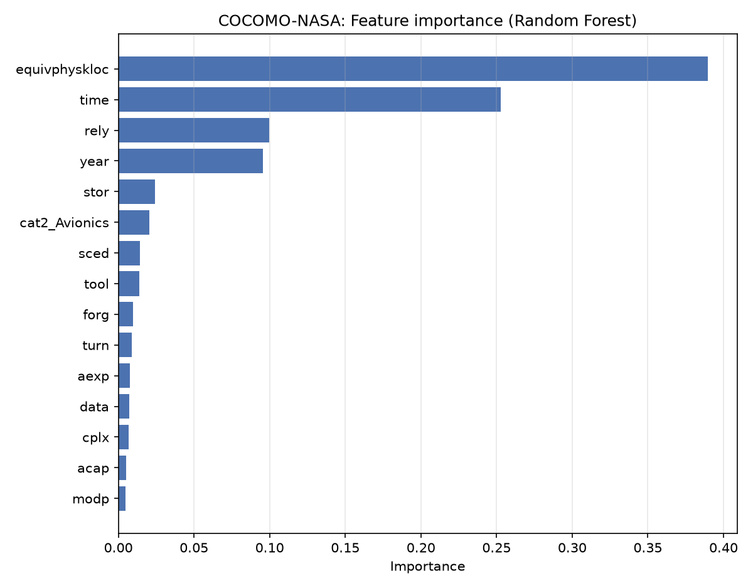
RESULTS
Winning Model
Random Forest — best combined MAE + PRED(25) on both datasets
COCOMO-NASA: MAE 219.8, PRED(25) 42.1% (full metrics in Table III)
Desharnais: MAE 2434.1, PRED(25) 25.0% (full metrics in Table III)
What Drove the Estimate
COCOMO-NASA: project size and runtime constraint
Desharnais: adjusted function points
Notes:
Random Forest came out on top for both datasets, cutting average error by roughly two-thirds compared to our plain Linear Regression baseline on COCOMO-NASA. It wasn't a clean sweep on every single metric, Linear Regression edged it out slightly on raw error on Desharnais, but Random Forest got about four times as many predictions within 25% of the actual value, so it's the more reliable choice overall. And because it's a tree-based model, we can see exactly what drove each prediction: project size is the biggest factor in both datasets, which matches what you'd expect intuitively, bigger projects cost more.

Slide 10
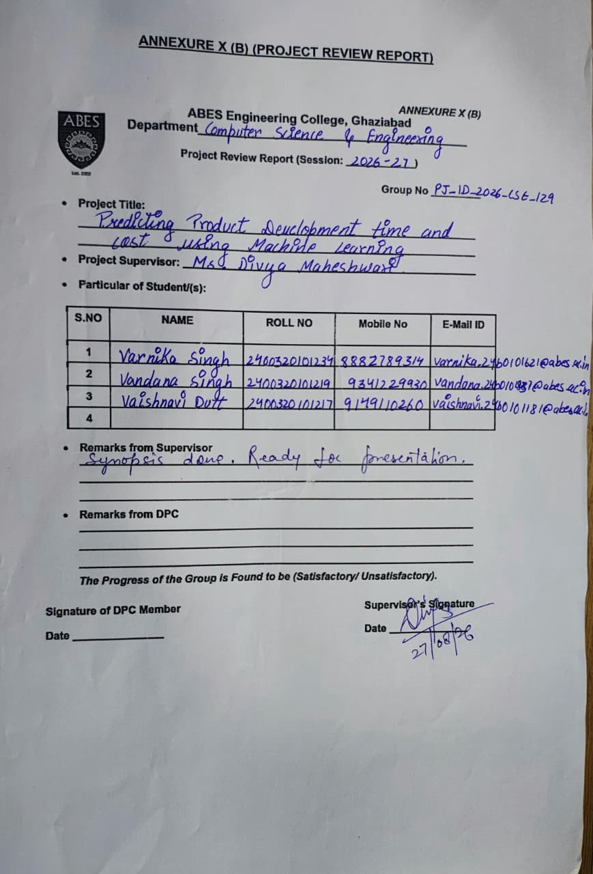
ANNEXURE 10 B

Slide 11
REFERENCES
Research Papers:
Analysis of Software Effort Estimation by Machine Learning Techniques : IIETA, 2023.
Predicting Effort, Duration and Cost in Software Development Using MLT : JARDCS, 2019.
Software Effort Estimation Using Machine Learning Methods : ResearchGate, 2007.
Official Documentation:
scikit-learn Docs : used for building and training the ML models.
XGBoost Docs : used for the gradient boosting model.
Flask/Streamlit Docs : used for building the web application.
Online Resources:
Kaggle & GitHub Repositories : for public effort estimation datasets and open-source ML project examples.

Slide 12
THANK YOU

