Slide 1
Testing real-time requirements in embedded CV systems
Quality Assured Vision
Matty Luriz (23206450)
Mohammed Yaacoub Abou Chlih (21138726)
GitHub: https://github.com/ExplosiveSalad/Quality-Assured-Vision

Slide 2
Accurate detection isn’t enough if it arrives late
Problem: CV systems get tested for accuracy, not latency, frame rate or load.
Stakeholders: Developers, QA Engineers, End Users, Safety reviewers.
Scope: Software-simulated pipeline, no physical hardware.

Slide 3
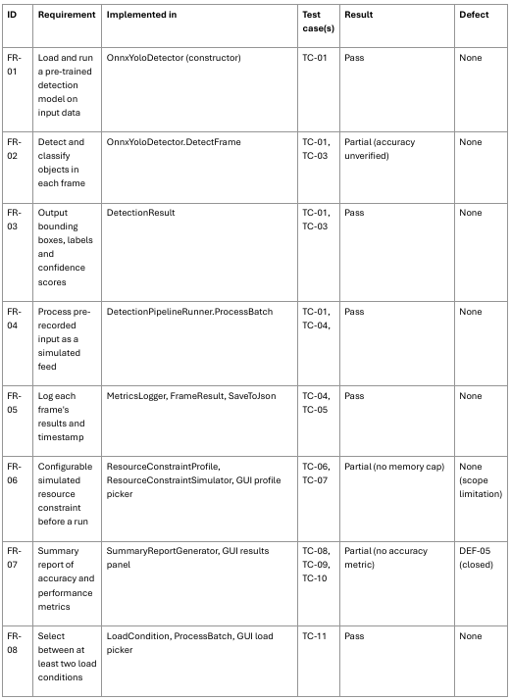
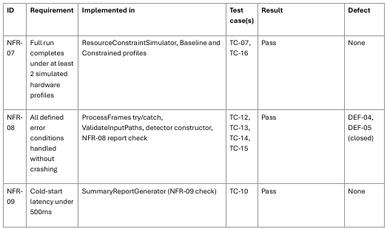
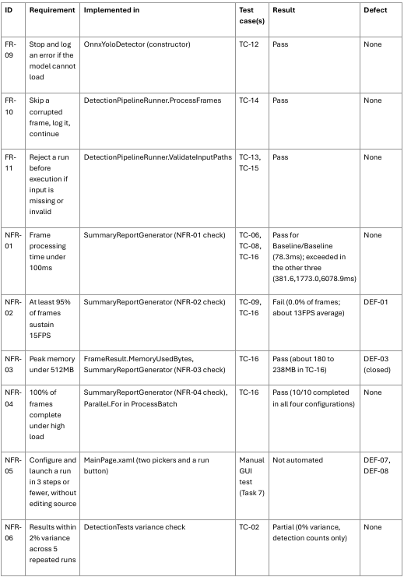
20 requirements, with measurable thresholds
11 Functional Requirements, 9 Non-Functional Requirements.
NFR-01 under 100ms
NFR-02 95% of frames at 15FPS or better
NFR-03 under 512MB
NFR-09 cold-start latency under 500ms

Slide 4
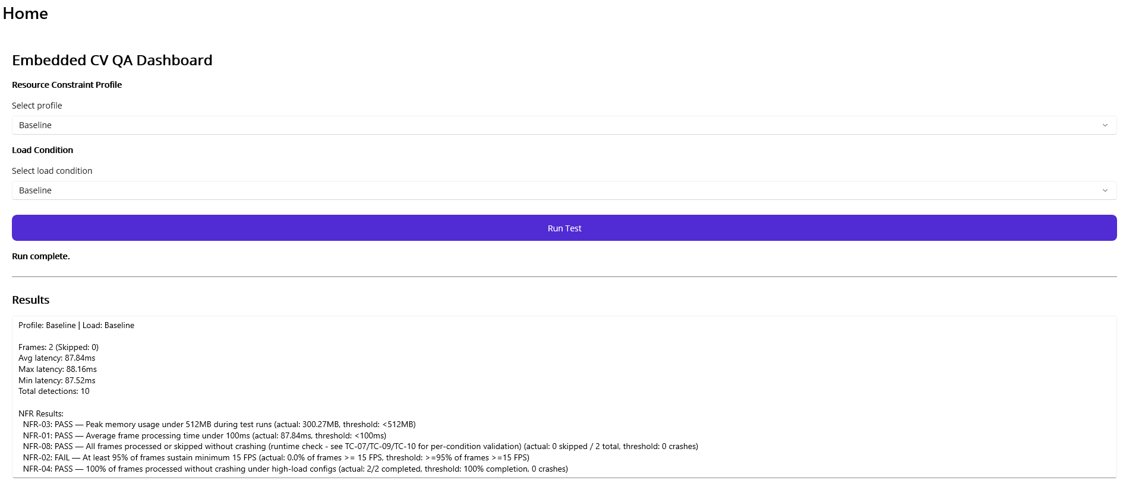
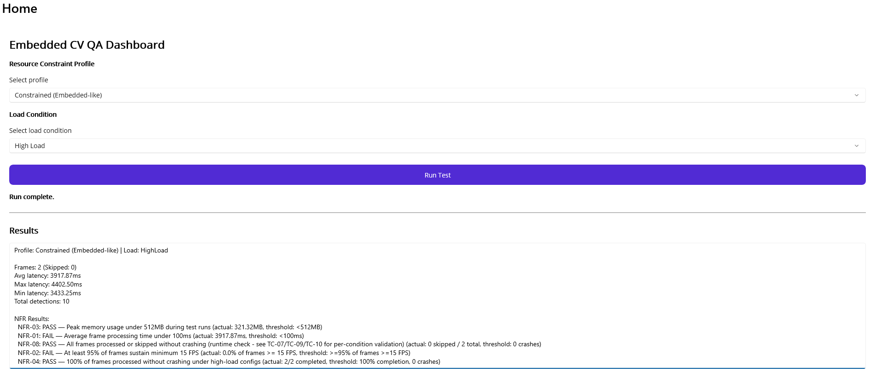
A working GUI runs any profile and load combination
YOLOv8n through YoloDotNet and ONNX Runtime
Baseline or constrained (1 core, +50ms latency)
Baseline or HighLoad
Report with NFR pass/fail

Slide 5
Assessment 2 closed the measurement and test gaps
NFR-03 memory now measured
NFR-02, 04, 06, 07 and all error conditions now tested
NFR-09 threshold revised from 2000ms to 500ms
Continuous Integration added

Slide 6
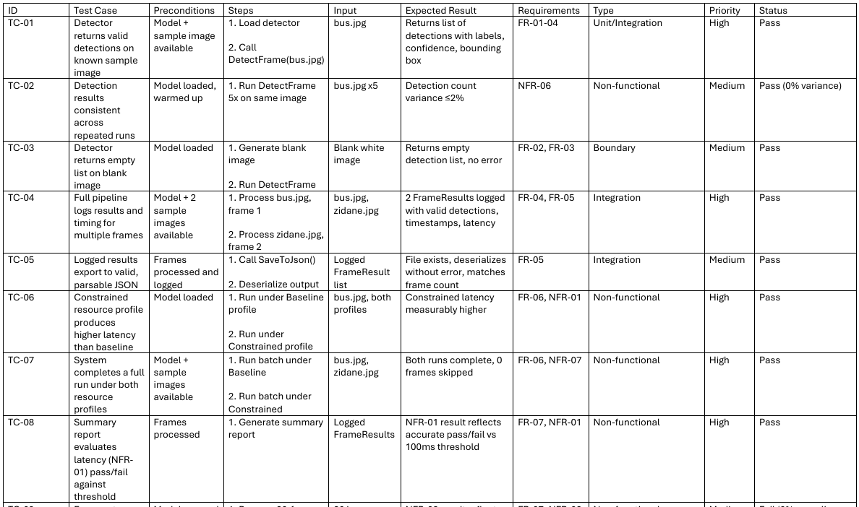
16 automated test cases across functional, non-functional and negative scenarios
16 tests in 7 MSTest classes, with positive, negative, boundary and error-handling cases
A Requirements traceability matrix maps every requirement to tests
Full RTM in report, Task 2

Slide 7
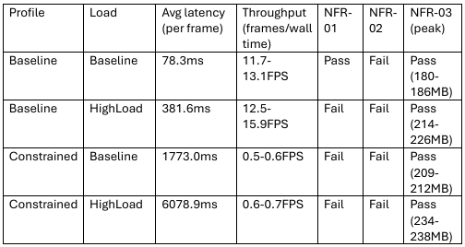
Only the baseline configuration meets the latency target
Baseline/Baseline 78.3ms passes NFR-01. The other three combinations fail it. NFR-02 fails everywhere.
No frame ever reached 15FPS
Closest 67.2ms vs 66.7ms needed.

Slide 8
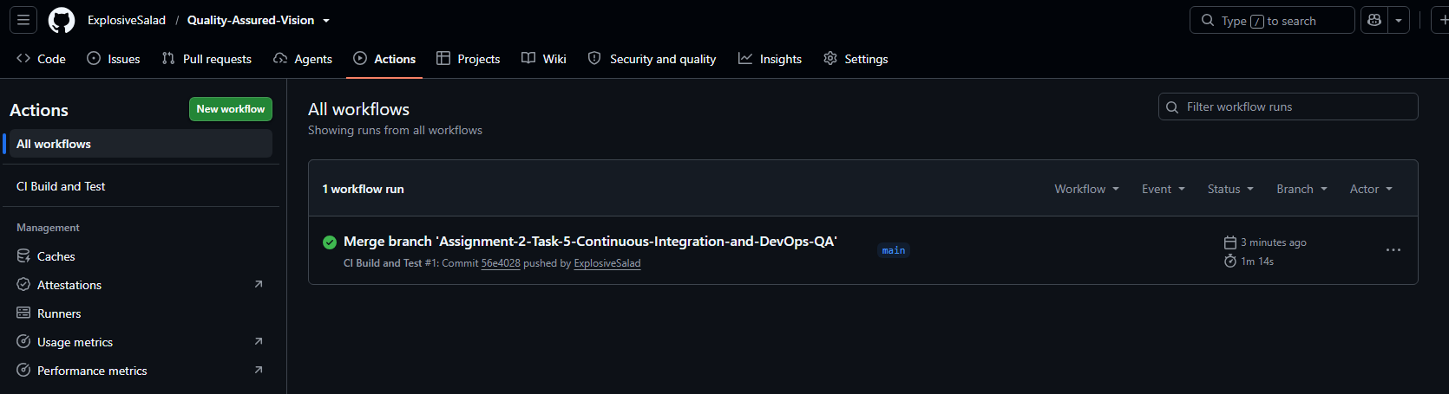
Every push builds and runs all 16 tests automatically
GitHub Actions on a Windows runner
Gates are build success and all tests passing
NFR thresholds are reported, not gated
MAUI excluded by design

Slide 9
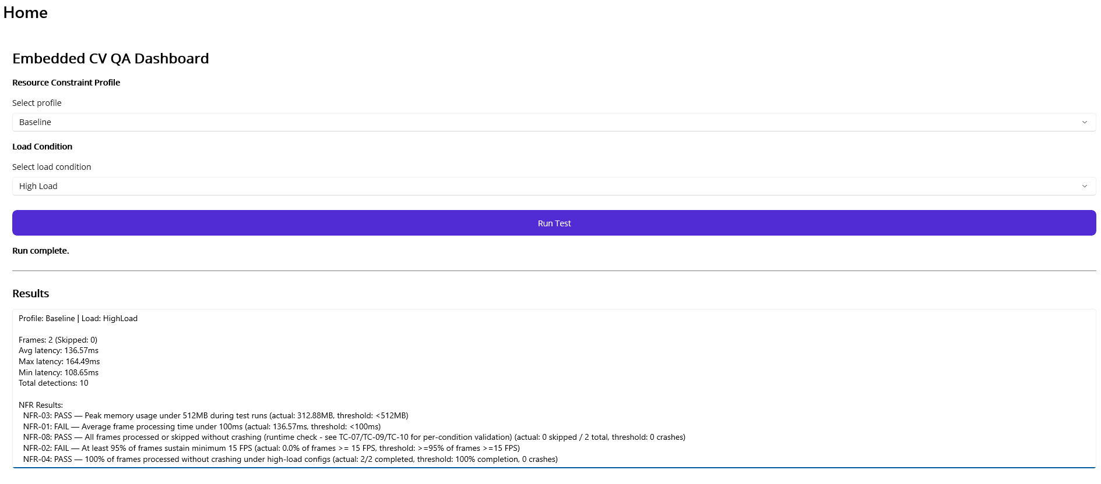
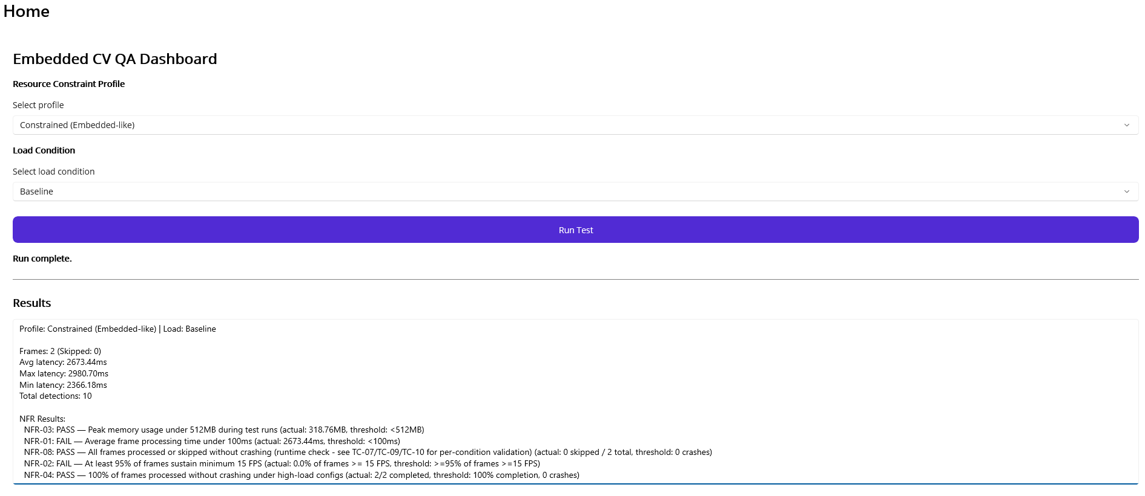
NFR-05 holds: three steps, no code edits
5 manual usability tests, 0 failed
Devon, an independent tester, completed a run in 3 steps
2 low-severity findings (silent defaults, unclear labels)

Slide 10
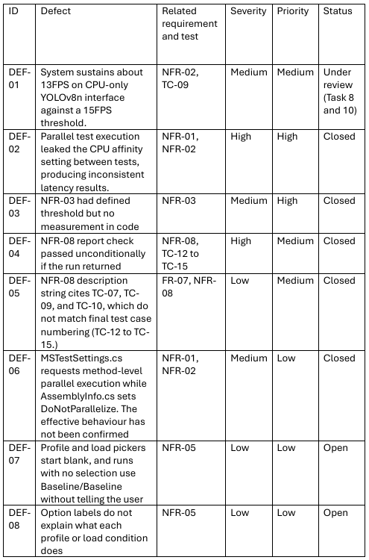
Eight defects found; the root cause was shared process state in parallel tests
5 Closed, 2 Open, 1 Under Review.
DEF-02: process-wide CPU affinity leaked between parallel tests, fixed by DoNotParallelize

Slide 11
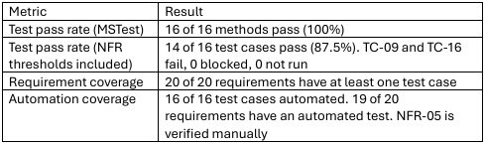
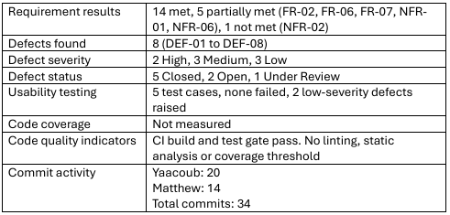
Conditionally ready: a QA prototype, not a real-time deployment
14 requirements met, 5 partial, 1 not met (NFR-02).
MSTest pass rate 100% with NFR thresholds 87.5%.
Conditions: Record NFR-02 as a limitation, review the threshold

Slide 12
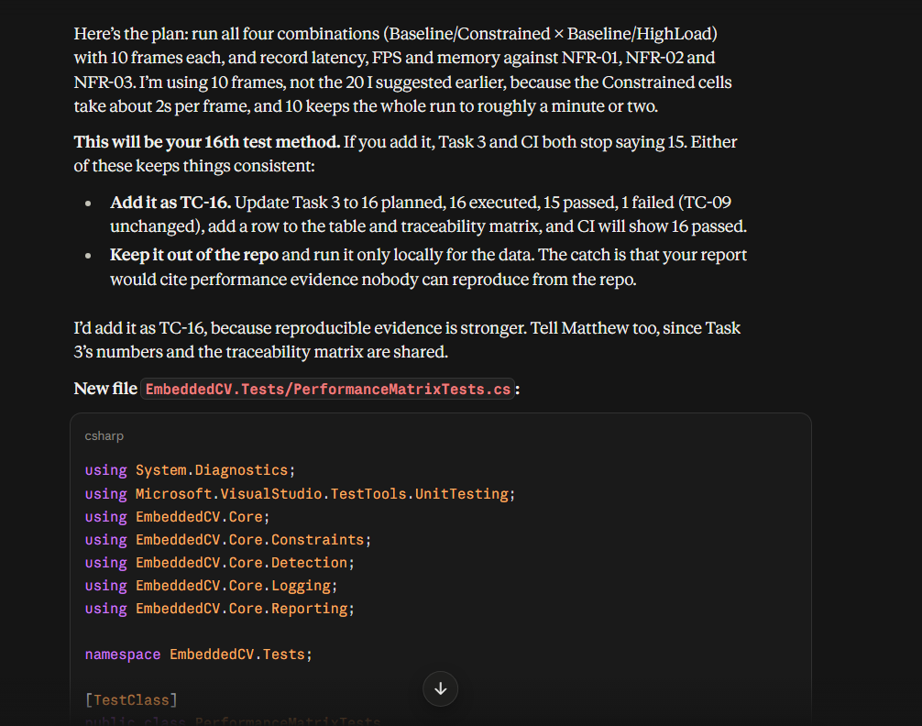
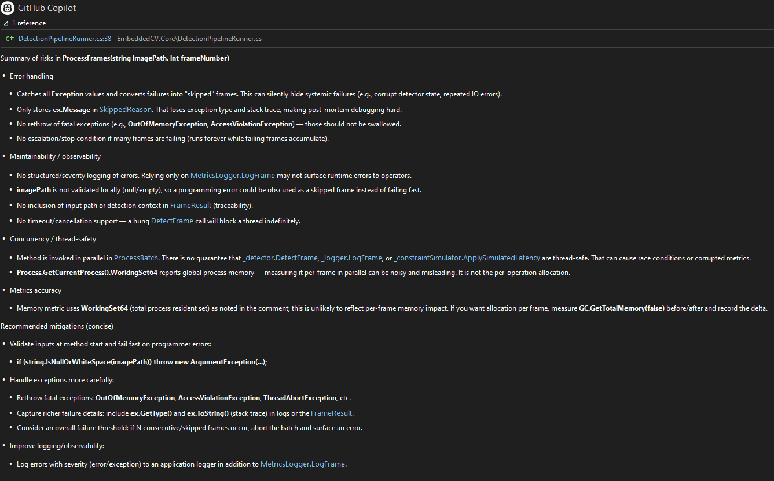
AI sped up creation, but every output needed checking
Claude scaffolded the modules
Copilot helped debug and review ProcessFrames
Wrong API assumptions fixed from decompiled source
Rejected suggestions: GC.GetTotalMemory, exception rethrows
Risks: AGPL license, thread-safety unverified

Slide 13
A passing test doesn’t mean the requirement is met
Lesson: TC-09 and TC-16 pass in MSTest while NFR-02 fails.
Next: Assert thresholds on a fixed machine, add accuracy checks with labelled data, mock IDetector, descriptive GUI labels, user datasets.

Slide 14
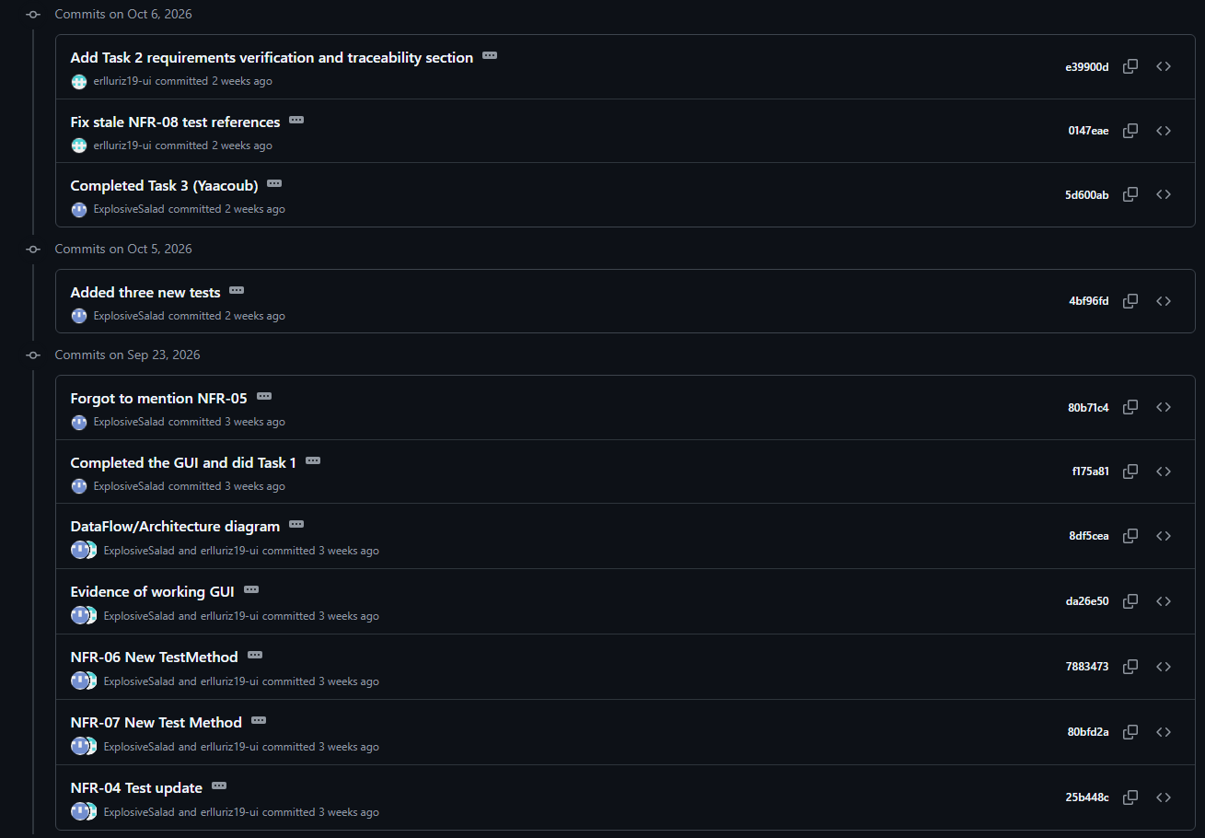
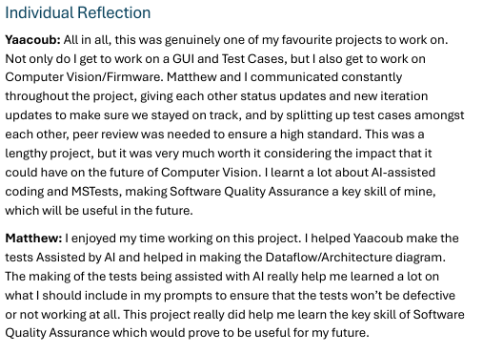
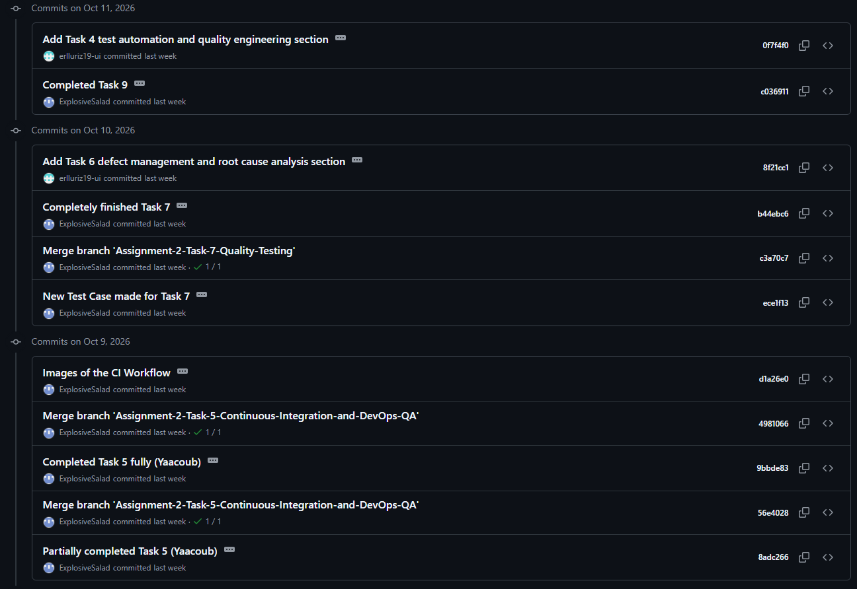
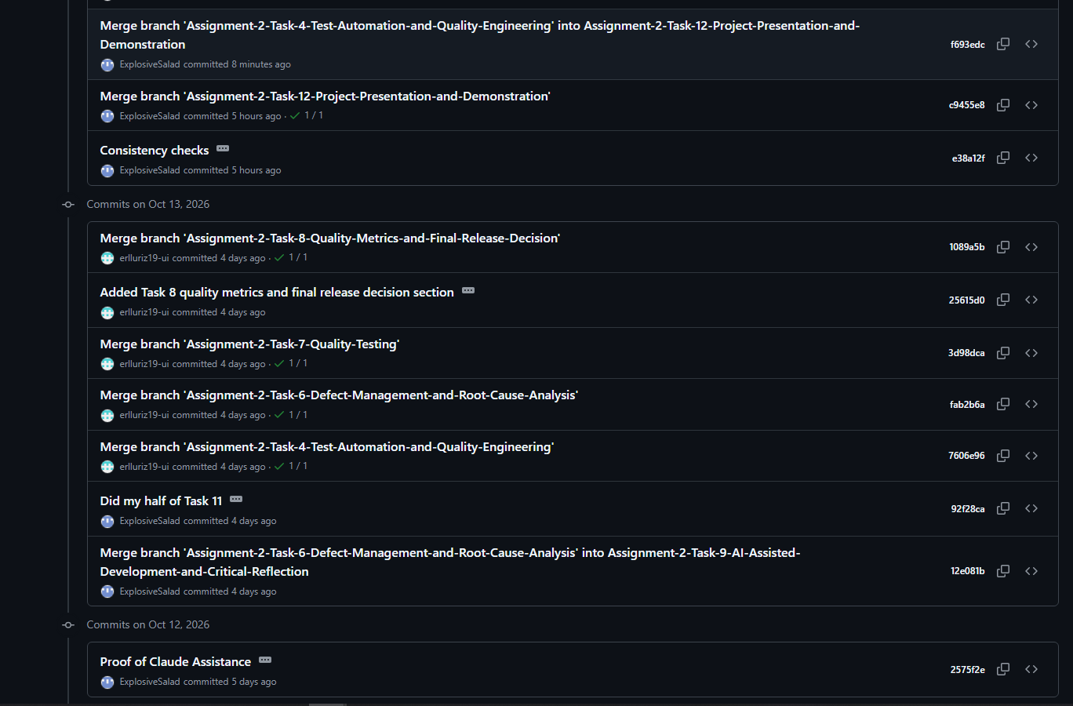
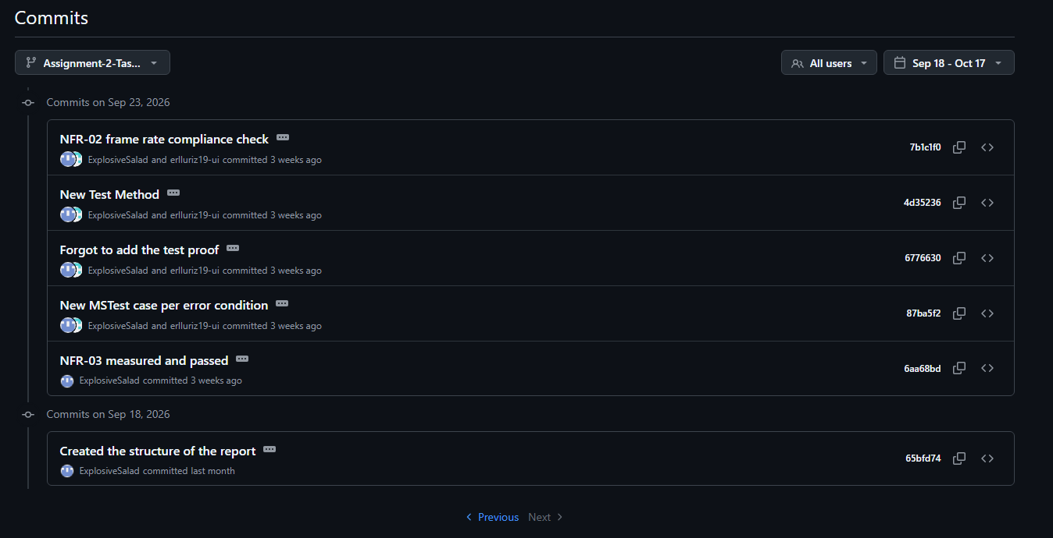
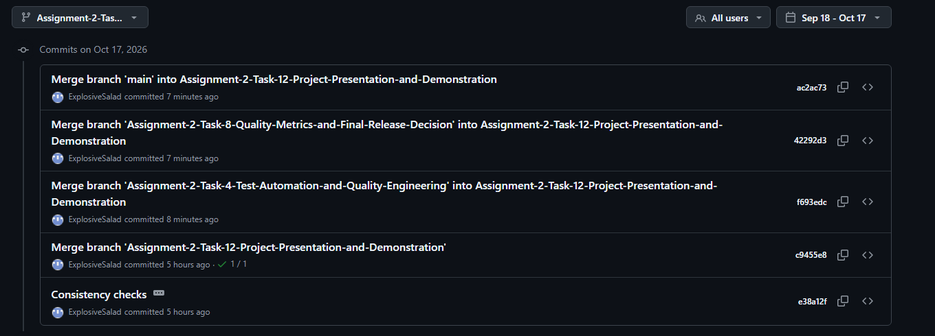
Contributions and evidence

Slide 15
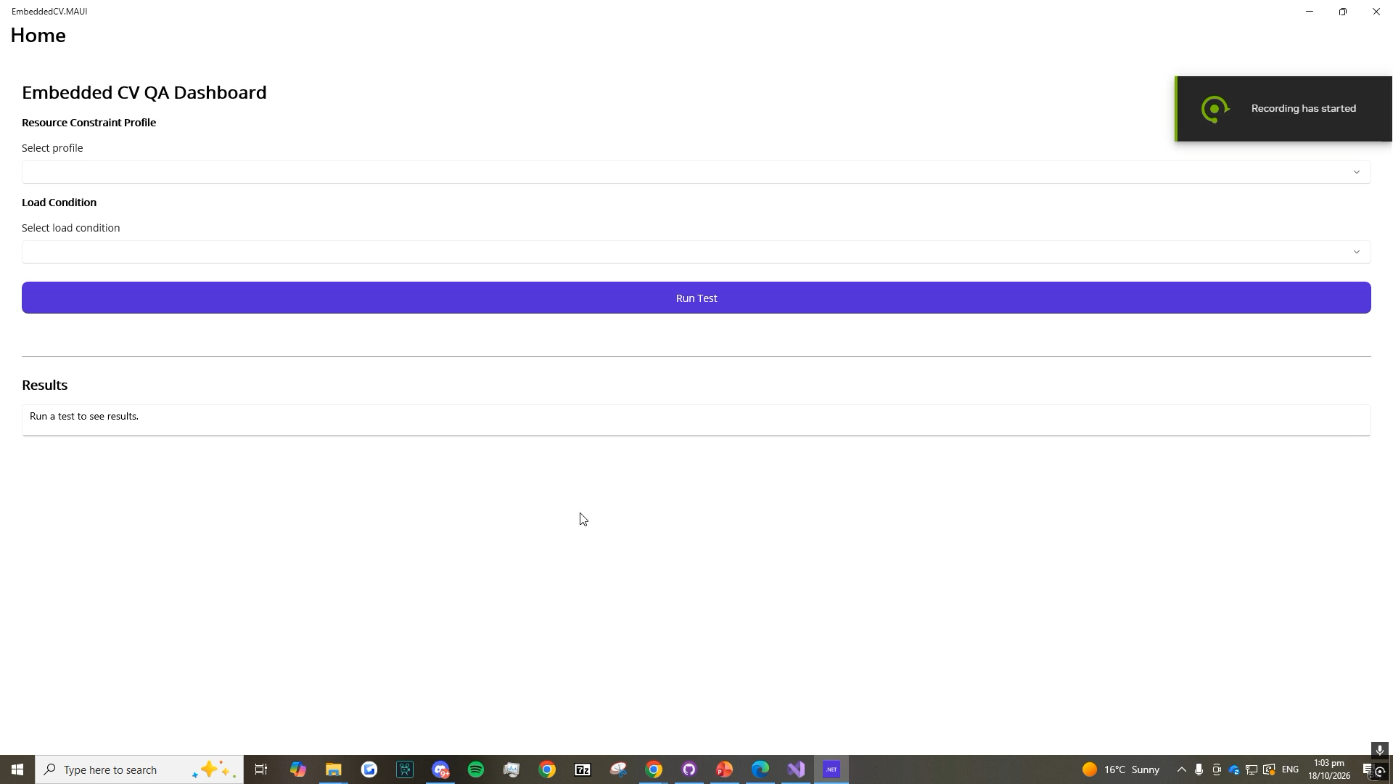
Demo: Baseline and Constrained, each at Baseline and HighLoad load
Baseline/Baseline passes NFR-01 at about 86ms. The other three exceed 100ms. See slide 7 for the average numbers.
If the video refuses to play, check the GitHub for the file under the main branch

