Slide 1
拥塞控制与资源分配
计 算 机 网 络
华中科技大学电信学院 2022

Slide 2
学习目标
掌握拥塞控制的概念，不同拥塞控制机制的分类；
掌握基于窗口的TCP拥塞控制机制，理解其与TCP流量控制的区别与联系；
理解加性增加乘性减少、慢启动、快速重传等TCP拥塞控制机制；
掌握流量控制的概念，TCP流量控制的基本机制。

Slide 3
提纲
引言
核心问题: 分配资源
资源分配
拥塞控制
拥塞避免
总结

Slide 4
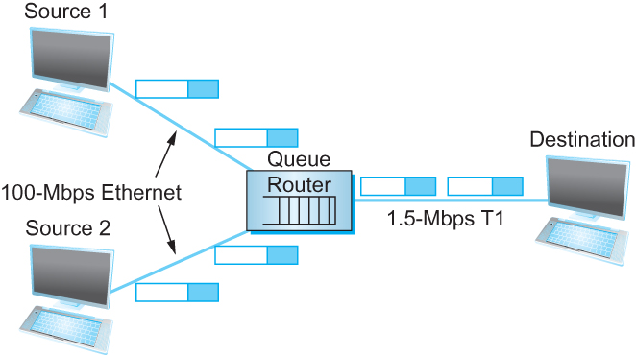
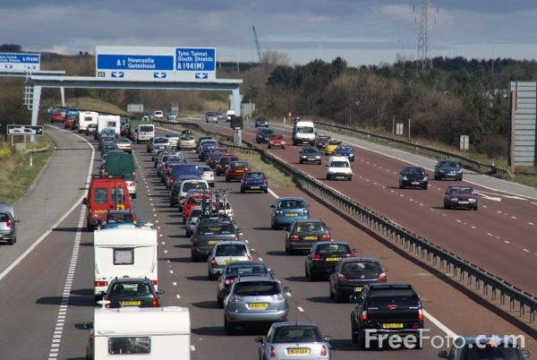
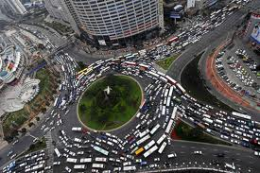
TCP可靠传输面临的新挑战
过多的TCP链接生成大量流量，
加重路由器负载

Slide 5

拥塞
当网络负载持续大于其承载能力则发生拥塞
拥塞现象的体现
持续的分组丢失
分组时延不断增加
R = 100 Mb/s
C
A
D
R = 1.5 Mb/s
B
E
分组队列
等待传输

Slide 6
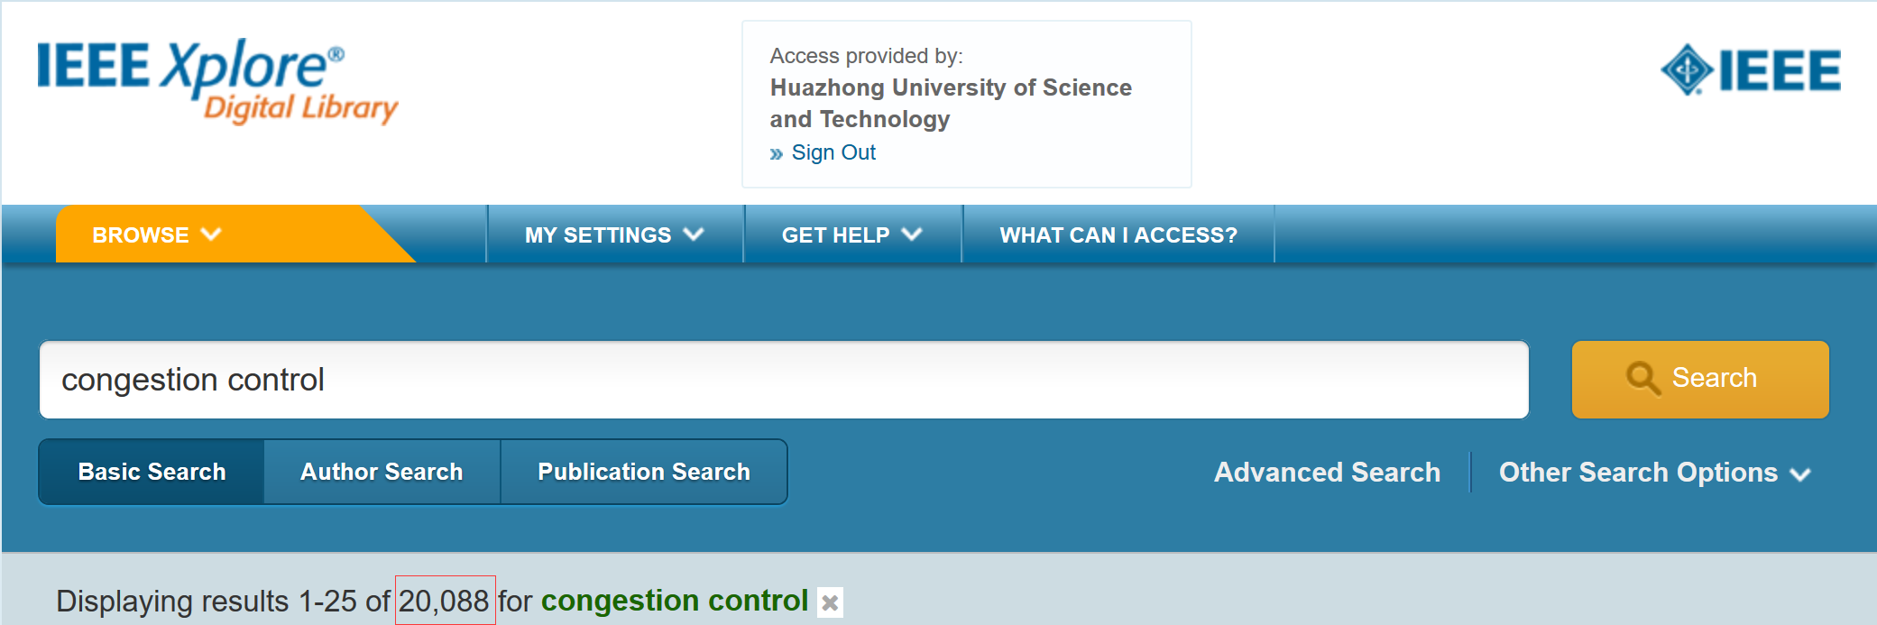
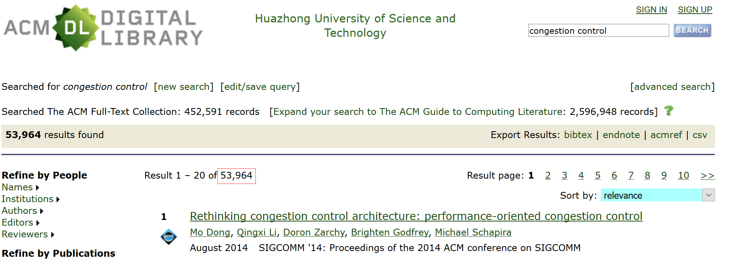
拥塞控制
a top-10 problem!

Slide 7

拥塞的原因/代价：场景1
original data: λ_{in}
throughput: λ_{out}
两个发送方，两个接受方
一个路由，无限缓存
输出链路容量: R
没有中继
Host A
unlimited shared output link buffers
Host B
R/2
λ_{out}
delay
λ_{in}
R/2
λ_{in}
R/2
maximum per-connection throughput: R/2
large delays as arrival rate, λ_{in}, approaches capacity

Slide 8
拥塞的原因/代价：情形2
一个路由器，有限缓存
发送方重新传输超时包
应用层输入 = 应用层输出: λ_{in} = λ_{out}
传输层输入包括重传 : λ_{in} λ_{in}
‘
λ_{in} : original data
λ'_{in}: original data, plus retransmitted data
λ_{out}
Host A
finite shared output link buffers
Host B

Slide 9
拥塞的原因/代价：情形2
R/2
理想化: 完备的知识
传送方只在路由器有缓存时传送
λ_{out}
λ_{in}
R/2
λ_{in} : original data
copy
λ'_{in}: original data, plus retransmitted data
λ_{out}
A
free buffer space!
finite shared output link buffers
Host B

Slide 10

拥塞的原因/代价：情形2
理想化: 已知丢失数据包可能会丢失，由于完整缓冲区而丢失在路由器上
发件人只有在已知丢失的数据包时才会重新发送
λ_{in} : original data
copy
λ'_{in}: original data, plus retransmitted data
λ_{out}
A
no buffer space!
Host B

Slide 11
拥塞的原因/代价：情形2
理想化: 已知丢失数据包可能会丢失，由于完整缓冲区而丢失在路由器上
发件人只有在已知丢失的数据包时才会重新发送
R/2
当在R / 2发送时，一些数据包是重传但渐近的吞吐量仍然是R / 2（为什么？）
λ_{out}
λ_{in}
R/2
λ_{in} : original data
λ'_{in}: original data, plus retransmitted data
λ_{out}
A
free buffer space!
Host B

Slide 12


拥塞的原因/代价：情形2
现实: 重复
由于完整缓冲区，数据包可能丢失，丢弃在路由器上
发件人过早地超时，发送两份副本，这两份副本都已送达
R/2
在R / 2发送时，一些数据包是重传，包括重复发送！
λ_{out}
λ_{in}
R/2
λ_{in}
copy
λ'_{in}
λ_{out}
timeout
A
free buffer space!
Host B

Slide 13
拥塞的原因/代价：情形2
现实: 重复
由于完整缓冲区，数据包可能丢失，丢弃在路由器上
发件人过早地超时，发送两份副本，这两份副本都已送达
R/2
在R / 2发送时，一些数据包是重传，包括重复发送！
λ_{out}
λ_{in}
R/2
拥塞的代价：
对于好的输出需要做更多工作
不需要的重传：链接携带pkt的多个副本减少投入

Slide 14
拥塞的原因/代价：情形3
Q: 当 λ_{in} 和 λ_{in}’ 增长时会发生什么
四个发送方
多跳路径
超时/重传
A: 当 λ_{in}’ 增长时,所有到达较高队列的蓝色包都将被丢弃， 蓝色的吞吐量g 0
Host A
λ_{in} : original data
λ_{out}
Host B
λ'_{in}: original data, plus retransmitted data
finite shared output link buffers
Host D
Host C

Slide 15
拥塞的原因/代价：情形3
C/2
λ_{out}
λ_{in}’
C/2
另一个拥塞的代价：
当数据包丢失时，用于该数据包的任何上游传输容量都被浪费了！

Slide 16
拥塞控制和资源分配
拥塞控制和资源分配是同一事物的两个方面.
以任意精度分配资源非常困难
资源是分布式部署在网络中
用户的观点
主机到主机, 端到端协议
网络的观点
多个“流”竞争资源
资源: 交换机或路由器的缓存, 链路的带宽
拥塞: 过多的分组竞争同一条链路, 队列溢出导致分组丢弃
如何在竞争的用户之间合理有效的分配资源?

Slide 17
拥塞控制和资源分配
拥塞控制和资源分配是同一事物的两个方面.
如果网络承担积极主动角色
资源分配
预先进行网络资源分配, 例如, 调度虚电路占用的物理链路
如果网络承担消极被动角色
拥塞控制
允许发送方想发多少数据就发多少数据, 当拥塞发生后再进行恢复

Slide 18

核心问题

Slide 19
提纲
引言
核心问题: 分配资源
资源分配
拥塞控制
拥塞避免
总结

Slide 20
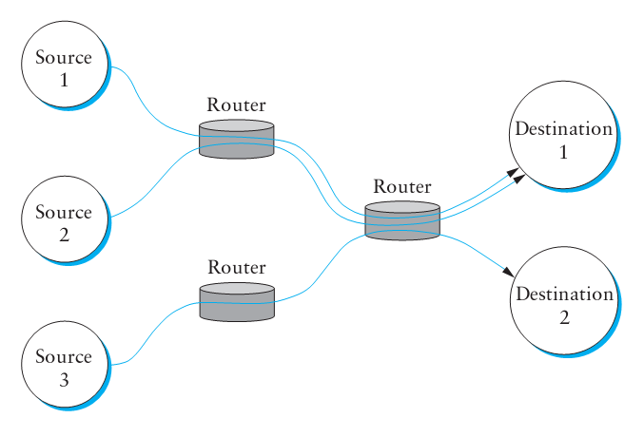
网络模型
分组交换网
无连接流
会话开始时无资源预留
流可以有不同粒度的定义(进程到进程, 源主机到目的主机, 等.)
服务模型
最大努力交付: 所有分组采用相同的方式处理

Slide 21
资源分配机制的分类
以路由器为中心 vs 以主机为中心
以路由器为中心: 路由器决定什么时候转发分组, 丢弃哪些分组, 通知主机允许的发送速率
以主机为中心: 端主机观测网络状态
以路由器为中心和以主机为中心并不完全相互排斥
基于预留方式 vs 基于反馈方式
基于预留方式: 事先预留资源, 如果资源无法获得则拒绝流
基于反馈方式: 端主机在未预留任何容量的情况下发送数据
显式或隐式反馈
基于窗口方式 vs 基于速率方式
基于窗口方式: 采用与可靠传输相同的窗口机制
基于速率方式: 接收方或网络控制速率

Slide 22
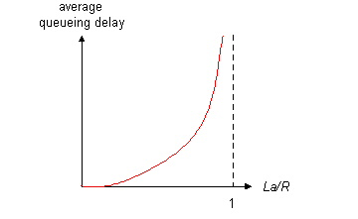

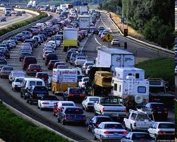
资源分配性能评估指标
评估指标用来定量分析资源分配的有效性
常用指标
吞吐量
时延
平衡性能
链路利用率越高(接近100%)，吞吐量越大
如果链路空闲，吞吐量会减小
链路利用率越高，在路由器缓存中等待传输的分组长度越长，增加了队列等待时延
Notes:
A good starting point for evaluating the effectiveness of a resource allocation scheme is to consider the two principal metrics of networking: throughput and delay.
Clearly, we want as much throughput and as little delay as possible.
Unfortunately, these goals are often somewhat at odds with each other.
One sure way for a resource allocation algorithm to increase throughput is to allow as many packets into the network as possible, so as to drive the utilization of all the links up to 100%.
We would do this to avoid the possibility of a link becoming idle because an idle link necessarily hurts throughput.
The problem with this strategy is that increasing the number of packets in the network also increases the length of the queues at each router. Longer queues, in turn, mean packets are delayed longer in the network

Slide 23
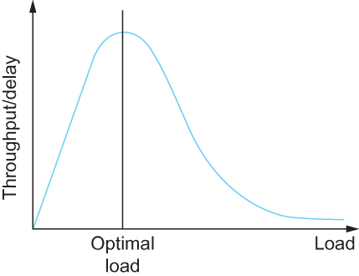
资源分配性能评估指标
有效资源分配
指标：网络能力(Power)
吞吐量(Throughput)
时延(Delay)
定义：
能力 = 吞吐量/时延
Notes:
Effective Resource Allocation
To describe this relationship, some network designers have proposed using the ratio of throughput to delay as a metric for evaluating the effectiveness of a resource allocation scheme.
This ratio is sometimes referred to as the power of the network.
Power = Throughput/Delay

Slide 24



资源分配性能评估指标
公平资源分配
缺乏共识：如何定义公平的资源分配？
基于预约的资源分配提供了受控的不公平方式
案例：某条链路上，我们可以预约1Mbps带宽用于传输视频流量，而相同链路上一个文件传输流仅获得10kbps
R1
1Mbps
R2
10kbps
Notes:
Evaluation Criteria
Fair Resource Allocation
The effective utilization of network resources is not the only criterion for judging a resource allocation scheme.
We must also consider the issue of fairness. However, we quickly get into murky waters when we try to define what exactly constitutes fair resource allocation.
For example, a reservation-based resource allocation scheme provides an explicit way to create controlled unfairness.
With such a scheme, we might use reservations to enable a video stream to receive 1 Mbps across some link while a file transfer receives only 10 Kbps over the same link.

Slide 25
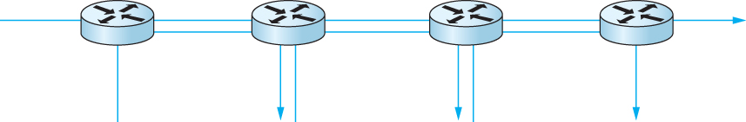
资源分配性能评估指标
公平资源分配
缺乏共识：如何定义公平的资源分配？
当多个数据流共享一段瓶颈链路，各个流应享有平等带宽份额
以上定义假设公平的带宽分配，意味着相同的带宽份额
但是，即使不考虑资源预留，相同的带宽可能并不等效于公平份额
假如我们考虑端到端的路径长度
1个4跳数据流与三个一跳数据流竞争带宽资源
Notes:
Evaluation Criteria
Fair Resource Allocation
In the absence of explicit information to the contrary, when several flows share a particular link, we would like for each flow to receive an equal share of the bandwidth.
This definition presumes that a fair share of bandwidth means an equal share of bandwidth.
But even in the absence of reservations, equal shares may not equate to fair shares.
Should we also consider the length of the paths being compared?

Slide 26
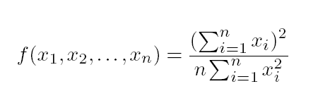
资源分配性能评估指标
公平资源分配
假设公平意味着相等，且所有的路径长度相等
Rai Jain提出公平指数，来评价拥塞控制算法的公平性
定义：假设n个数据流的吞吐量(x1, x2, . . . , xn)
公平指数是[0,1]的一个实数，1表示最公平
1个4跳数据流与三个1跳数据流竞争带宽资源
Notes:
Assuming that fair implies equal and that all paths are of equal length, networking researcher Raj Jain proposed a metric that can be used to quantify the fairness of a congestion-control mechanism.
Jain’s fairness index is defined as follows. Given a set of flow throughputs (x1, x2, . . . , xn) (measured in consistent units such as bits/second), the following function assigns a fairness index to the flows:
The fairness index always results in a number between 0 and 1, with 1 representing greatest fairness.

Slide 27

拥塞控制的实现
基于主机的拥塞控制
基于主机的拥塞控制
基于路由器的拥塞控制
基于主机的拥塞控制
基于主机的拥塞控制

Slide 28
拥塞控制方法分类
主要分为两大类:
端到端拥塞控制:
网络不提供明确反馈信息
终端主机通过观察丢包和时延推测拥塞情况
TCP所采用
网络协助拥塞控制:
路由器向终端系统提供反馈信息
单比特表明拥塞 (SNA, DECbit, TCP/IP ECN, ATM)
发送端明确控制发送速率

Slide 29
第6章 拥塞控制及资源分配
策略 | 路由器 | 主机 | 章节
基于主机的拥塞控制 | FIFO排队 | TCP 拥塞控制 | 6.2, 6.3
基于路由器的拥塞控制 | 主动队列管理(AQM) | TCP 拥塞控制
资源分配和拥塞避免 | 资源预留 提供QoS |  | 6.5

Slide 30
提纲
引言
核心问题: 分配资源
资源分配问题
拥塞控制机制
拥塞避免机制
总结

Slide 31
网络负载和拥塞
膝盖
吞吐量缓慢增加
时延开始快速增大
悬崖
吞吐量开始快速减少直至为0 (拥塞崩溃)
时延趋近于无穷大
分组丢弃
knee
cliff
吞吐量
拥塞崩溃
负载
时延
负载

Slide 32
拥塞控制和避免
增加路由器的缓存无法避免拥塞
避免拥塞的方式
源端减少负载 – 短期
流量工程 – 中长期
不断增加链路的容量 – 长期
knee
cliff
吞吐量
拥塞崩溃
Load
拥塞避免
拥塞控制

Slide 33
TCP 拥塞控制
TCP源端调整发送速率以避免网络过载
考虑网络的可用容量
两个基本问题
如何察觉网络拥塞?
以超时作为网络拥塞的标志
如何调整发送速率?
TCP维护一个CongestionWindow 变量

Slide 34
TCP拥塞窗口
每一个TCP的发送方维护一个拥塞窗口
给定时间内允许传送的最大数据量 (未确认的)
自适应拥塞窗口
分组丢失时减少: 退让
成功传送时增加: 乐观的探索
总是努力找到合适的传送速率
Tradeoff
优点: 不需要专门的网络反馈机制
缺点: 持续在“合适”的速率上下波动

Slide 35
接收窗口 vs 拥塞窗口
流量控制
避免快速发送方使慢速接收方过载
拥塞控制
避免多个发送方使网络过载
不同的概念, 但是采用类似的机制
TCP 流量控制: 接收窗口
TCP 拥塞控制: 拥塞窗口
发送方TCP窗口 =
min { 拥塞窗口, 接收窗口 }

Slide 36
累次增加/成倍减少(AIMD)
如何自适应变化?
分组成功传送, 将窗口大小加1，即多传输一个最大数据段大小 (MSS)的数据
一旦分组丢失, 则将拥塞窗口减半
减小拥塞窗口的速度要比加大窗口快得多，称为AIMD
加性增加(Additive Increase)
乘性减少(Multiple Decrease)
cwnd
TCP分段丢失
减半
t
Notes:
减小拥塞窗口的速度比加大窗口要快得多!
窗口过大 (导致分组丢失) 比 窗口过小 (使得吞吐量减少) 危害大的多
AIMD: TCP稳定的必要条件
TCP “锯齿”

Slide 37
新的数据流如何启动?
问题
需要设计一种机制控制窗口启动阶段的cwnd
初始值不能过大，需要从1开始，需要一个很长的时间
cwnd的增加速度要快，加性增加的速度慢了
最初的TCP发送窗口直接按照接收方的通知窗口设置，窗口值偏大，容易形成突发流量导致拥塞 → cwnd的窗口增加过程需要“慢”下来
cwnd
窗口大小
t
Notes:
慢启动(较小的CWND)避免网络过载
慢启动其实是指数级增加拥塞窗口的大小

Slide 38
慢启动
慢启动的解决方案
TCP初始启动时，设置拥塞窗口 cwnd 为1
慢启动阶段：以指数方式增加cwnd直到特定门限值ssthresh
ssthresh: slow start threshold
拥塞避免阶段：超过ssthresh后，cwnd加性增加
再次拥塞时，ssthresh值减半，重新进入慢启动阶段
慢启动
指数增长
拥塞避免
线性增加
超时
cwnd
检测到拥塞后ssthresh减半为12
cwnd增大
到24
ssthresh
初始值16
1
0
传输轮次

Slide 39
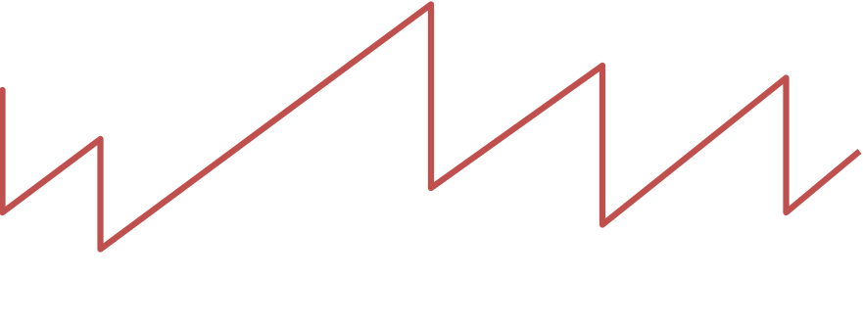
慢启动与TCP锯齿
窗口大小
丢失
减半
t
指数 “慢启动”
这种称呼（”慢”）是因为最初TCP无拥塞控制机制
源端启动时发送整个AdvertisedWindow
导致拥塞崩溃!

Slide 40
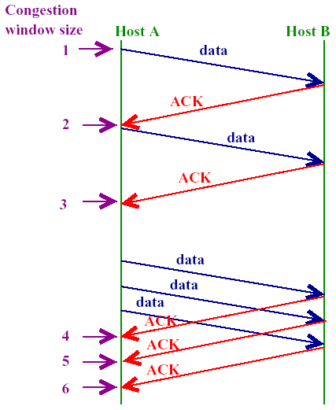
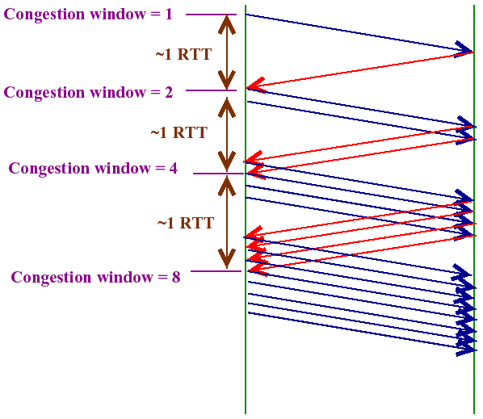
累次增加 vs 慢启动

Slide 41
TCP的两种丢包
超时
分组n丢失, 超时定时器超时
何时? n 是窗口的最后一个分组, 或者所有发送分组均丢失
超时后, 大的CWND会导致更严重的分组丢失
以较小的CWND重新开始
三个重复的ACK
分组n丢失, 但是分组 n+1, n+2, …等到达
如何检测? 接收方多次通过ACK表示期望接收分组n
何时? 收到分组n后续分组
收到三个重复的ACK后, 发送方快速重传分组n
CWND减半,再线性增加

Slide 42
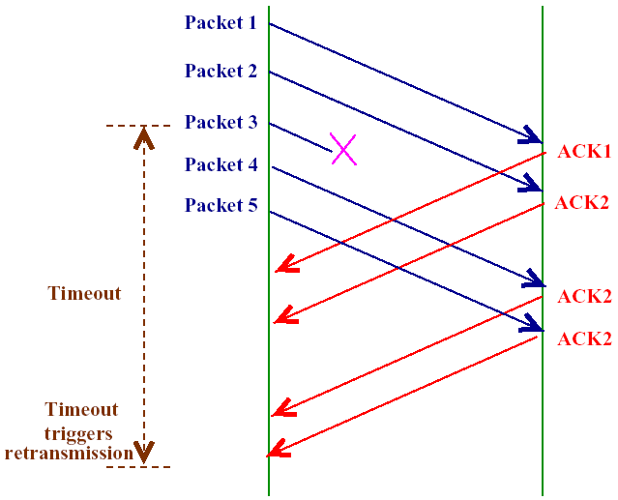
快速重传与快速恢复
如何检测拥塞的发生？传输超时 timeout
分组n丢失, 超时定时器超时
超时后, 大的cwnd会导致更严重的分组丢失，因此需要采用慢启动
有的情况，拥塞并未发生，而是偶尔丢包
这种情况可以通过
三个重复的ACK检测到
此时网络没有严重拥塞，
没有必要进行慢启动，
可以直接立即发起重传
这被称为“快速重传”

Slide 43
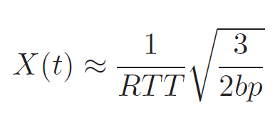
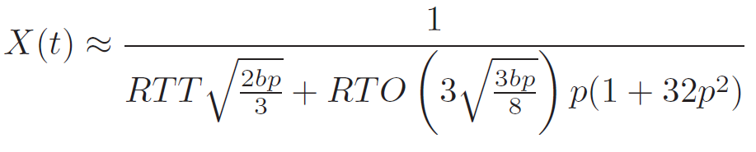
快速重传
快速重传的解决方案
检测到3次重复ACK后，不必等待超时计时器，立即重传未被确认的报文段
cwnd
慢启动
指数增长
拥塞避免
线性增加
超时
3次重复ACK
检测到拥塞后ssthresh减半为12
cwnd增大
到24
ssthresh
减半为8
ssthresh
初始值16
cwnd增大
到16
在稳定状态下, CongestionWindow 在最优窗口大小附近振荡
1
0
传输轮次
Padhye et al., “Modeling TCP throughput: a simple model and its empirical validation,” ACM SIGCOMM 98
Notes:
原始重传的问题
等待超时时会有很长一段时间连接无效
知道第一个分组丢失
动机
观测重复ACKs
分组丢失
乱序到达
解决方案
快速重传: 如果源端收到三个重复的ACKs则不需要等待超时而快速重传

Slide 44
快速恢复
基本想法：3次重复ACK时网络不是严重拥塞，不必使用慢启动过程，ssthresh仍然减半，但直接进入线性增加过程
cwnd
慢启动
指数增长
拥塞避免
线性增加
拥塞避免
超时
3次重复ACK
检测到拥塞后ssthresh减半为12
cwnd增大
到24
ssthresh
初始值16
cwnd增大
到16
cwnd
减半为8
1
0
传输轮次
Notes:
先前, 快速重传后慢启动
快速恢复
去除快速重传与累次增加之间的慢启动阶段
设置 CongestionWindow 为先前的一半 (成倍较少)

Slide 45
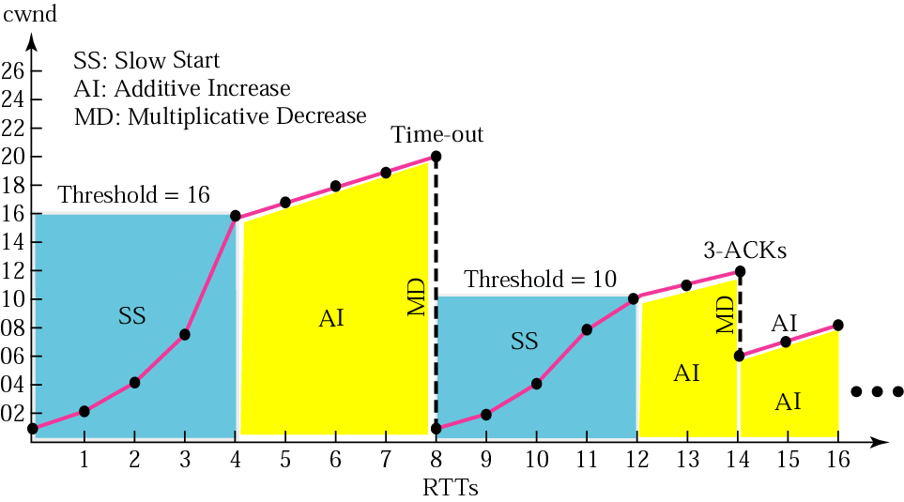
TCP拥塞控制示例

Slide 46
TCP的发展
RFC 793 (1981)
基于简单滑动窗口的流量控制机制.
Tahoe (1988)
慢启动, 拥塞避免, 快速重传.
Reno (1990)
快速恢复.
新版Reno (1995)
对快速重传进行了修订.

Slide 47
TCP的发展

Slide 48
TCP Reno及扩展
TCP Reno
当今最流行的TCP实现
集成AIMD, 慢启动, 快速重传和快速恢复
其他扩展
选择性ACK机制: TCP SACK
显式的拥塞通知: ECN(Explicit Congestion Notification)
基于时延的拥塞避免: TCP Vegas

Slide 49
TCP公平性
公平目标: 如果K个TCP会话共享瓶颈链路带宽R, 每个TCP流应获得平均吞吐量R/K
TCP流#1
瓶颈路由器
带宽R
TCP流#2

Slide 50
为什么TCP公平?
两个竞争TCP会话:
当吞吐量增加，加性增加拥塞控制窗口，带来吞吐量曲线斜率45度
乘性减小拥塞控制窗口带来成比例减少吞吐量
R
带宽平均分配
丢包: 对半减小拥塞窗口
R₂
避免拥塞: 加性增
#2链接吞吐量
丢包: 对半减小拥塞窗口
避免拥塞: 加性增
R₁
#1链接吞吐量
R

Slide 51
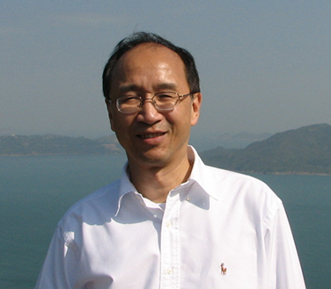
AIMD算法的公平性
DM Chiu and R Jain, "Analysis of the Increase and Decrease Algorithms for Congestion Avoidance in Computer Networks", Computer Networks and ISDN Systems Vol 17, pp 1-14, 1989.
Dah Ming Chiu, Professor
Department of Information Engineering, cuhk.edu.hk
Associate Editor, IEEE/ACM Transactions on Networking
IEEE Fellow

Slide 52
讨论：公平性
公平与UDP
多媒体应用经常不使用TCP
不希望数据率受限于拥塞窗口
使用UDP:
以定常数率传输音视频流量，容忍丢包
公平与并行TCP链接
应用可以建立多条并行TCP链路连接两台主机
Web浏览器采取此策略
例如, 已有10条链接共享链路数据率R:
新应用建立1条TCP链接, 获得数据率R/11
新应用建立10条TCP链接, 获得数据率R/2

Slide 53
提纲
引言
核心问题: 分配资源
资源分配
拥塞控制
拥塞避免机制
DECbit
随机早期检测(RED)
基于源的拥塞避免
总结

Slide 54
拥塞控制和避免
增加路由器的缓存无法避免拥塞
避免拥塞的方式
源端减少负载 – 短期
流量工程 – 中长期
不断增加链路的容量 – 长期
knee
cliff
吞吐量
拥塞崩溃
Load
拥塞避免
拥塞控制

Slide 55
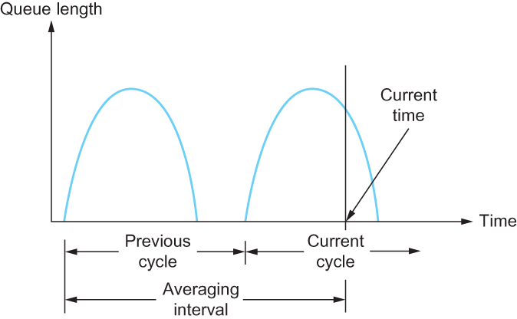
拥塞避免: DECbit
DECbit set
DECbit not set
ACK
ACK
ACK
DECbit 用于数字网络体系结构(DNA)，使用面向连接的传输层协议的一个无连接网络
路由器监视当前负载，在拥塞将发生时通过设置流经分组的DECbit通知端节点
目标主机将DECbit复制到传回源端的ACK
源主机根据收到的设置了DECbit位的ACK,控制发送窗口大小
1
Notes:
The first mechanism was developed for use on the Digital Network Architecture (DNA), a connectionless network with a connection-oriented transport protocol.
This mechanism could, therefore, also be applied to TCP and IP.
As noted above, the idea here is to more evenly split the responsibility for congestion control between the routers and the end nodes.
Each router monitors the load it is experiencing and explicitly notifies the end nodes when congestion is about to occur.
This notification is implemented by setting a binary congestion bit in the packets that flow through the router; hence the name DECbit.
The destination host then copies this congestion bit into the ACK it sends back to the source.
Finally, the source adjusts its sending rate so as to avoid congestion
A single congestion bit is added to the packet header. A router sets this bit in a packet if its average queue length is greater than or equal to 1 at the time the packet arrives.
This average queue length is measured over a time interval that spans the last busy+idle cycle, plus the current busy cycle.
Essentially, the router calculates the area under the curve and divides this value by the time interval to compute the average queue length.
Using a queue length of 1 as the trigger for setting the congestion bit is a trade-off between significant queuing (and hence higher throughput) and increased idle time (and hence lower delay).
In other words, a queue length of 1 seems to optimize the power function.
The source records how many of its packets resulted in some router setting the congestion bit.
In particular, the source maintains a congestion window, just as in TCP, and watches to see what fraction of the last window’s worth of packets resulted in the bit being set.
If less than 50% of the packets had the bit set, then the source increases its congestion window by one packet.
If 50% or more of the last window’s worth of packets had the congestion bit set, then the source decreases its congestion window to 0.875 times the previous value.
The value 50% was chosen as the threshold based on analysis that showed it to correspond to the peak of the power curve. The “increase by 1, decrease by 0.875” rule was selected because additive increase/multiplicative decrease makes the mechanism stable.

Slide 56
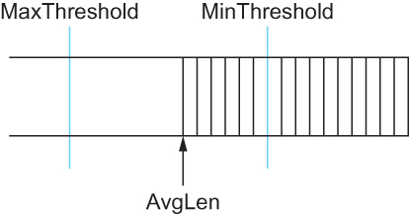
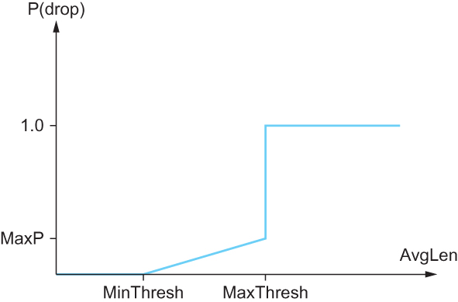
拥塞避免: RED
随机早期检测
ACK
ACK
ACK
随机早期检测
路由器监视平均队列长度，当检测到拥塞即将发生时源调整拥塞窗口
RED通过丢包隐式的通知源发生拥塞
RED应用早期随机丢弃分组
RED的参数设置影响系统性能
Notes:
A second mechanism, called random early detection (RED), is similar to the DECbit scheme in that each router is programmed to monitor its own queue length, and when it detects that congestion is imminent, to notify the source to adjust its congestion window. RED, invented by Sally Floyd and Van Jacobson in the early 1990s, differs from the DECbit scheme in two major ways:
The first is that rather than explicitly sending a congestion notification message to the source, RED is most commonly implemented such that it implicitly notifies the source of congestion by dropping one of its packets.
The source is, therefore, effectively notified by the subsequent timeout or duplicate ACK.
RED is designed to be used in conjunction with TCP, which currently detects congestion by means of timeouts (or some other means of detecting packet loss such as duplicate ACKs).
As the “early” part of the RED acronym suggests, the gateway drops the packet earlier than it would have to, so as to notify the source that it should decrease its congestion window sooner than it would normally have.
In other words, the router drops a few packets before it has exhausted its buffer space completely, so as to cause the source to slow down, with the hope that this will mean it does not have to drop lots of packets later on.
The second difference between RED and DECbit is in the details of how RED decides when to drop a packet and what packet it decides to drop.
To understand the basic idea, consider a simple FIFO queue. Rather than wait for the queue to become completely full and then be forced to drop each arriving packet, we could decide to drop each arriving packet with some drop probability whenever the queue length exceeds some drop level.
This idea is called early random drop. The RED algorithm defines the details of how to monitor the queue length and when to drop a packet.
Second, RED has two queue length thresholds that trigger certain activity: MinThreshold and MaxThreshold.
When a packet arrives at the gateway, RED compares the current AvgLen with these two thresholds, according to the following rules:
if AvgLen ≤ MinThreshold
→ queue the packet
if MinThreshold < AvgLen < MaxThreshold
→ calculate probability P
→ drop the arriving packet with probability P
if MaxThreshold ≤ AvgLen
→ drop the arriving packet
P is a function of both AvgLen and how long it has been since the last packet was dropped.
Specifically, it is computed as follows:
TempP = MaxP × (AvgLen − MinThreshold)/(MaxThreshold − MinThreshold)
P = TempP/(1 − count × TempP)
First, RED computes an average queue length using a weighted running average similar to the one used in the original TCP timeout computation. That is, AvgLen is computed as
AvgLen = (1 − Weight) × AvgLen + Weight × SampleLen
where 0 < Weight < 1 and SampleLen is the length of the queue when a sample measurement is made.
In most software implementations, the queue length is measured every time a new packet arrives at the gateway.
In hardware, it might be calculated at some fixed sampling interval.

Slide 57
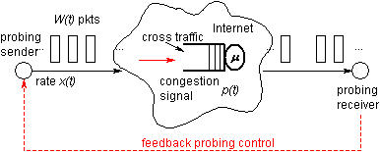
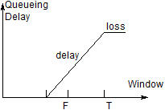
拥塞避免: 基于源
ACK
ACK
ACK
从终端主机上检测拥塞的初始阶段，即在丢失分组发生之前
当路由器的队列正在增加，如果不采取措施很快就会发生拥塞
e.g. (CurrentWindow − OldWindow)×(CurrentRTT − OldRTT)
Notes:
The general idea of these techniques is to watch for some sign from the network that some router’s queue is building up and that congestion will happen soon if nothing is done about it.
For example, the source might notice that as packet queues build up in the network’s routers, there is a measurable increase in the RTT for each successive packet it sends.
One particular algorithm exploits this observation as follows:
The congestion window normally increases as in TCP, but every two round-trip delays the algorithm checks to see if the current RTT is greater than the average of the minimum and maximum RTTs seen so far.
If it is, then the algorithm decreases the congestion window by one-eighth.
A second algorithm does something similar. The decision as to whether or not to change the current window size is based on changes to both the RTT and the window size.
The window is adjusted once every two round-trip delays based on the product
(CurrentWindow − OldWindow)×(CurrentRTT − OldRTT)
If the result is positive, the source decreases the window size by one-eighth;
if the result is negative or 0, the source increases the window by one maximum packet size.
Note that the window changes during every adjustment; that is, it oscillates around its optimal point.

Slide 58
高速TCP协议变型
基于丢包的拥塞避免 (LCA):
HS-TCP [Flo03], S-TCP [Kel03], BIC-TCP [XHR04], CUBIC-TCP [RX05], H-TCP [SL04], and E-TCP (for small buffer) [GTHZ07]
基于时延的拥塞避免 (DCA):
FAST TCP [JWL04]
混合式拥塞避免 (HCA):
TCP-Africa [KBR05], Compound-TCP [TSZS06]
DCA 和HCA协议的基本思想是基于RTT的变化来检测早期拥塞，但可能存在下面的不利因素
反向路径的排队时延影响
由于路由变化带来的传播时延变化
由于数据链路层带来的时延变化：Automatic Repeat reQuest (ARQ)

Slide 59
针对无线随机丢包的TCP协议变型
TCP Westwood [CGM+02, GM02]
基于带宽估计改进TCP拥塞控制
带宽估计方法: 带宽估计 (BE), 速率估计 (RE), 带宽/速率联合估计(CRB)
TCP Veno [FL03]: Vegas [BOP94] + Reno [Jac90]

Slide 60
总结：端到端拥塞控制/避免

Slide 61
提纲
引言
核心问题: 分配资源
资源分配
拥塞控制
拥塞避免
总结

Slide 62
拥塞控制
拥塞是不可避免的
Internet中不会预先进行资源分配
基于主机vs.基于路由器的拥塞控制
TCP 拥塞控制
采用分组丢失作为拥塞的判别标示
发送方采用CongestionWindow 适应网络
累次增加, 成倍减少
慢启动, 缓慢开始重启

Slide 63
TCP 设计: 问题及解决方案
No. | 问题及挑战 | 解决方案 | 章节
1 | 连接建立 | 建立: 三次握手 终止: 四次握手 | 5.2.3
2 | 超时定时器问题 | 采用Jacobson/ Karels算法估计RTT | 5.2.6
3 | 分组乱序到达 | 基于窗口的缓存管理 | 5.2.4
4 | 流量控制 | 通过AdvertisedWindow通告实现基于窗口的流量控制 | 5.2.4
5 | 拥塞控制 | 基于CongestionWindow实现拥塞控制 | 6.3
6 | 协议扩展 | TCP首部的Seq和AdvertisedWindow字段扩展 | 5.2.4
7 | 傻瓜窗口症状 | Nagle 算法: 基于ACK自计时 | 5.2.5

Slide 64
谢谢！
华中科技大学
电子信息与通信学院
网址：http://eic.hust.edu.cn

Slide 65
参考资料
Chapter 6 in L. L. Peterson and B. S. Davie, Computer Networking: A System Approach (5th edition), Morgan Kaufmann, 2012
Chapter 3/7 in James F. Kurose and Keith W. Ross, Computer Networking: A Top-Down Approach (7th edition), Pearson Education Inc., 2017
吴功宜，计算机网络（第4版）,清华大学出版社，2017

Slide 66
附录

