Slide 1
EXTRACTMET
PYROMETALLURGY · DIGITAL TWINS
Continuous-Charge EAF
Process Digital Twin
A first-principles dynamic simulator for continuously-charged (Consteel-type) electric-arc-furnace steelmaking — validated against the peer-reviewed literature, delivered as an interactive HMI.
FIRST-PRINCIPLES
LITERATURE-VALIDATED
DEPLOYABLE HMI
Extractmet Private Limited
Notes:
Title. Extractmet's continuous-charge EAF digital twin — a first-principles dynamic simulator delivered as an interactive control-room HMI. Every KPI validated against peer-reviewed literature.

Slide 2
THE CHALLENGE
Electric steelmaking runs on thin margins and thinner data
Energy is the P&L
Yield walks out in the slag
Electricity is the single largest conversion cost. A few kWh/t decides whether a heat is profitable — yet most plants tune by operator habit, not by a model that closes the energy balance.
Every point of iron oxidised to FeO is money in the slag pot. Yield, FeO and basicity are coupled through chemistry that spreadsheets can't capture.
Continuous charging is different
Trials are slow and costly
Consteel-type furnaces hold a flat bath and melt by immersion. Batch-EAF rules of thumb don't transfer — operations need a model built for continuous feed.
Testing a new practice on a live 100-tonne furnace is expensive and risky. Plants need a safe sandbox to explore before touching the transformer.
EXTRACTMET · Continuous-Charge EAF Digital Twin
2
Notes:
The problem: energy is the dominant cost, yield is lost to slag, continuous charging behaves differently from batch, and live trials are expensive. Operators lack a first-principles model to guide decisions.

Slide 3
THE PRODUCT
One validated physics engine, three ways to use it
A mechanistic dynamic model of the continuously-charged EAF that integrates coupled mass and energy balances every timestep — then surfaces the result through whichever interface fits the moment.
Web console
Streamlit HMI
Desktop app
Runs entirely in a browser from a single file. Nothing to install, nothing leaves the machine — ideal for demos and quick studies.
One-command deploy to Streamlit Community Cloud or any server. Give a whole team model access through a URL.
A native Tkinter application with embedded plots and export dialogs for engineers who want a tool on their own machine.
Same engine · same results
Same engine · same results
Same engine · same results
Mass & heat balance every Δt
Oxidation thermochemistry
Decarburisation kinetics
Foamy-slag physics
Multilayer heat loss
EXTRACTMET · Continuous-Charge EAF Digital Twin
3
Notes:
The product: one first-principles engine, delivered through three interchangeable front-ends — a zero-install web console, a hosted Streamlit HMI, and a native desktop app. Identical results across all three.

Slide 4
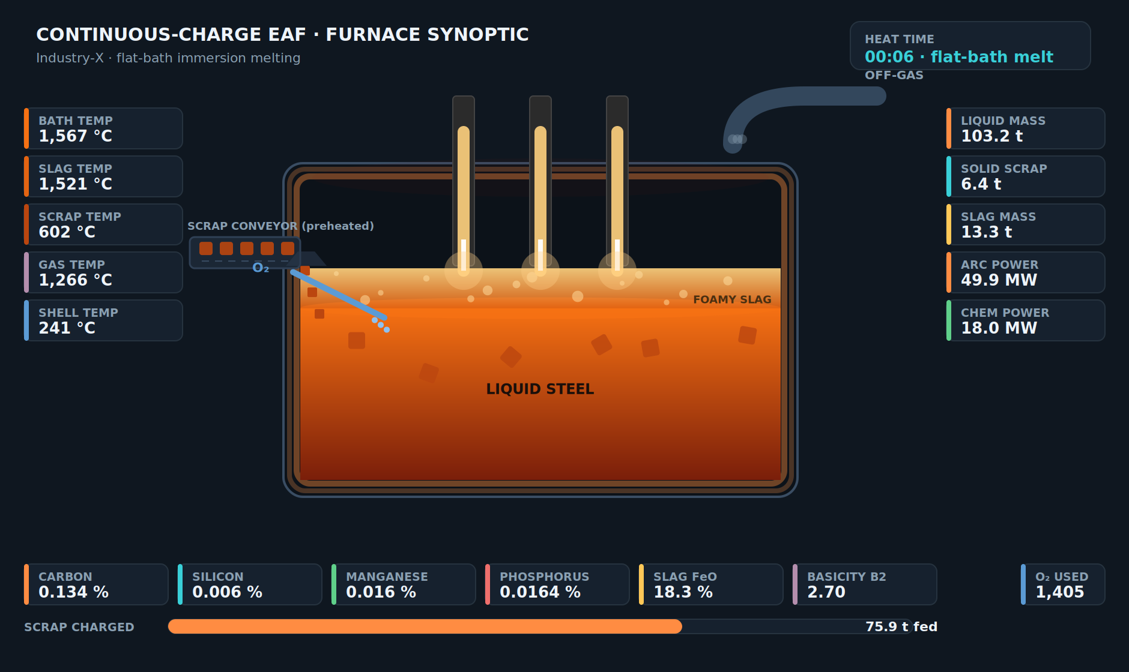
SEE THE FURNACE, NOT A SPREADSHEET
A live control-room synoptic of the whole reactor
Every zone, live
Bath, slag, scrap and gas temperatures, masses and full chemistry — all on one cross-section.
Scrub the heat
Drag a time slider to replay the entire heat and watch the process evolve second by second.
Physically faithful
Incandescent bath, foamy slag, arcing electrodes, off-gas duct and the continuous scrap conveyor.
EXTRACTMET · Continuous-Charge EAF Digital Twin
4
Notes:
The signature element: a live SCADA-style furnace synoptic. Every zone temperature, mass and chemistry value updates on the cross-section as you scrub through the heat. This is what makes the tool immediately legible to plant engineers.

Slide 5
UNDER THE HOOD
First principles, not curve fits
Coupled balances
Thermochemistry
Kinetics
Species mass and zone-energy balances for metal, slag, solid scrap, undissolved flux and freeboard gas — advanced together every timestep.
Oxidation of C, Si, Mn, P, Cr and Fe with literature reaction enthalpies; oxygen partitioned across elements; post-combustion and burners.
Oxygen- and mass-transfer-limited decarburisation, FeO-driven decarb, basicity- and temperature-gated dephosphorisation.
Immersion melting
Foamy slag
Coupled heat loss
Self-balancing scrap melting at the bath interface with enthalpy-conserving mixing — the physics of continuous charging.
Coverage from slag mass and FeO shields the arc and returns radiation to the bath, quantifying the foam energy benefit.
Multilayer refractory conduction with a radiating/convecting shell, plus arc- and gas-loaded water-cooled panels.
EXTRACTMET · Continuous-Charge EAF Digital Twin
5
Notes:
Under the hood: coupled mass and energy balances, oxidation thermochemistry, decarburisation and dephosphorisation kinetics, immersion melting, foamy-slag physics and multilayer heat loss. Every term is mechanistic, not a fitted correlation.

Slide 6
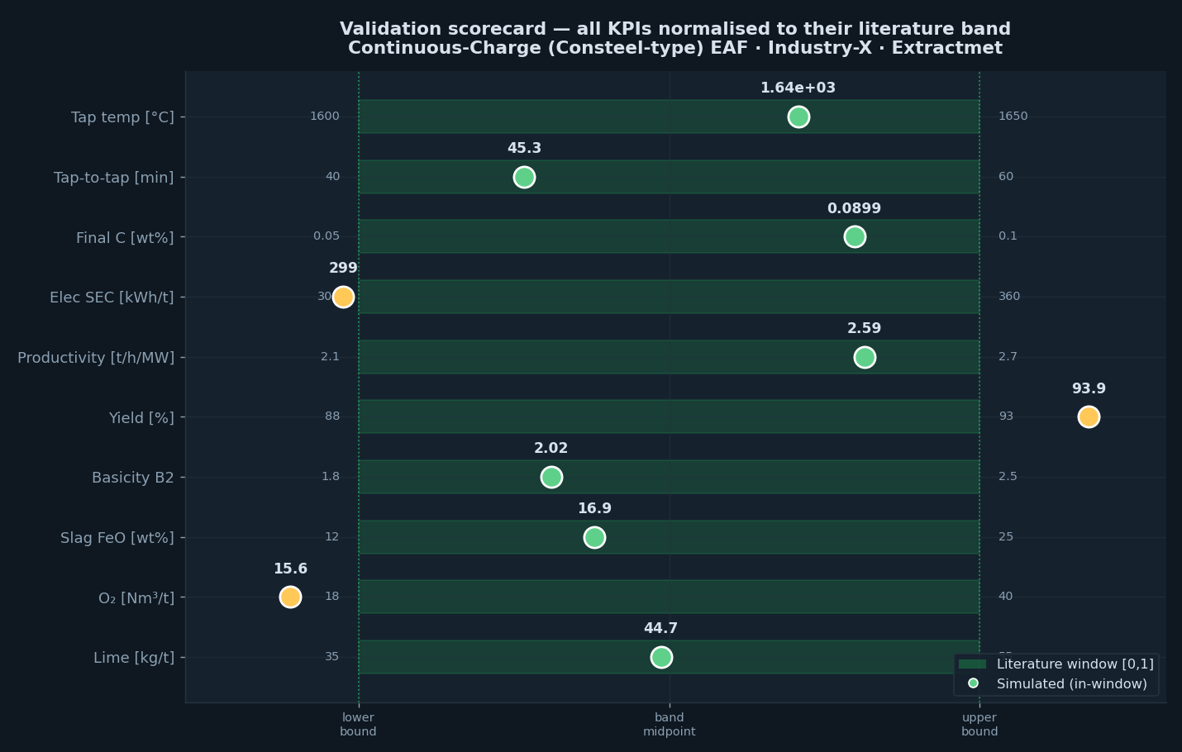
VALIDATION
Every KPI lands inside the published window
Mass closure
−0.6 %
Energy closure
0.6 %
Total energy
≈564 kWh/t
Productivity
2.59 t/h/MW
Benchmarked against Logar et al. (ISIJ 2012), Kirschen (Energy 2009/11), Pretorius & Marr, Fruehan/DOE, and Zhang et al. (Metals 2026, 56-furnace Consteel study).
EXTRACTMET · Continuous-Charge EAF Digital Twin
6
Notes:
Validation: all ten headline KPIs sit inside their peer-reviewed literature windows, and the model conserves mass and energy to within 1%. Benchmarked against the canonical EAF modelling literature.

Slide 7
VALIDATION DETAIL
Simulated vs literature — the numbers
KPI | Simulated | Literature window | Verdict
Tap temperature | 1635 °C | 1600–1650 °C | in window
Tap-to-tap time | 45.3 min | 40–60 min | in window
Final carbon | 0.090 wt% | 0.05–0.10 wt% | in window
Electrical SEC | 299 kWh/t | 300–360 kWh/t | edge · preheat
Total energy demand | ≈564 kWh/t | ≈570 kWh/t | in window
Productivity | 2.59 t/h/MW | 2.1–2.7 t/h/MW | in window
Metallic yield | 93.9 % | 88–93 % | edge · clean scrap
Slag basicity B₂ | 2.02 | 1.8–2.5 | in window
Slag FeO | 16.9 wt% | 12–25 wt% | in window
Cooling-water loss | 13 % | ≈13 % | in window
EXTRACTMET · Continuous-Charge EAF Digital Twin
7
Notes:
The validation numbers in detail. Seven KPIs dead-centre; three at band edges that tell a consistent story of an efficient, clean-scrap, high-preheat operation — which the model explains explicitly.

Slide 8
APPLICATIONS
From a sandbox to a decision-support tool
Energy optimisation
Yield & slag practice
Operator training
Quantify the kWh/t impact of preheat, hot-heel size, power profile and chemical energy before touching the furnace.
Trade off FeO, basicity and lime against yield; find the flux and oxygen practice that keeps iron out of the slag.
A safe, fast sandbox where operators build intuition for how a continuous-charge furnace responds.
Scrap-mix studies
Debottlenecking
Digital-twin backbone
Explore how gangue, rust and preheat in the scrap mix move yield, slag chemistry and energy.
Test power, feed-rate and charge changes against tap-to-tap time and productivity in minutes, not campaigns.
A validated core to build online advisory, what-if and set-point guidance on top of.
EXTRACTMET · Continuous-Charge EAF Digital Twin
8
Notes:
What you can do with it: energy optimisation, yield and slag practice, operator training, scrap-mix studies, debottlenecking, and as a validated backbone for a fuller digital twin.

Slide 9
WHY EXTRACTMET
Deep-tech pyrometallurgy, built on first principles
Extractmet builds first-principles process simulators and AI-assisted tools for iron- and steelmaking — from blast furnace and DRI to EAF, BOF and ferroalloys. We combine rigorous thermochemistry and transport modelling with production-grade software so that a model is not a report, but a tool a plant can actually use.
Full-route coverage
Blast furnace · DRI · EAF · BOF · ferroalloys
Validated models
Calibrated against plant data and the literature
Delivered as software
Web, cloud and desktop — not just a study
Anonymised by default
Client identities protected as “Industry-X”
EXTRACTMET · Continuous-Charge EAF Digital Twin
9
Notes:
Why Extractmet: we build validated first-principles simulators across the full iron- and steelmaking route and deliver them as real software, with client identities anonymised by default.

Slide 10
EXTRACTMET
Put the model on your furnace
with a sponsored pilot
We will calibrate the twin to your continuous-charge EAF, reproduce recent heats, and quantify the energy and yield levers that matter most — then hand you the interactive tool to explore them.
1
Calibrate
2
Reproduce
3
Optimise
Fit the twin to your plant data
Match recent heats and KPIs
Quantify the levers, hand over the tool
Extractmet Private Limited · first-principles process digital twins
Notes:
Call to action: a sponsored pilot. We calibrate the twin to the client's furnace, reproduce recent heats, quantify the key levers, and hand over the interactive tool. Contact Extractmet to start.

