Slide 1
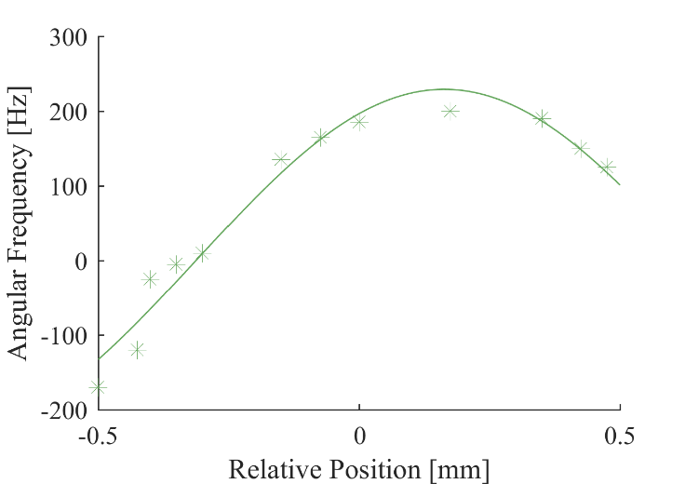
LPS Peak Frequency [Hz]
Relative Position [mm]

