Slide 1
First Impression counts !!
Finding Ideal First Date Location to blow your Partner's Mind and woo their Heart.
Applied Data Science Capstone
IBM Data Science Professional Certificate

Slide 2

Synopsis
Problem Description:
First Dates are everything when it comes to make a new relationships. What if there was an ideal way to set a perfect date by studying various locations and venues available there. To identify best location for a Date, First we'll have to define an ideal date.

Slide 3
An ideal Date can be broken down into Three Parts:
1. Food:
Food is an essential part of an outing, good food can brighten any dull evening and is great to get conversation started. Thus, we need to choose a location that can offer us great quality and variety of food.
2. Activity:
There is nothing better than a shared activity to bring kindered spirits together than sharing a Activity, watching a movie, a match or visiting a museum... Sharing an activity will bring you closer to your partner and lift up your spirits.
3. Drinks:
After such an amazing evening, it is time to relax with couple of drinks, so it will be great if we could find a great bar or pub nearby. A perfect end to a great evening.
Now that we have defined an ideal date, we need to find a location that can cater to all our needs so that we don't have to travel unnecessarily.
Thus, It will be very helpful, If some smart programmer can work out locations that are ideal for our dream date.
Therefore we'll create a notebook that gives us list of locations in Toronto and give us an idea whether they are ideal for us or not. From the list of locations returned we can choose our choice and get ready for an awesome date.

Slide 4
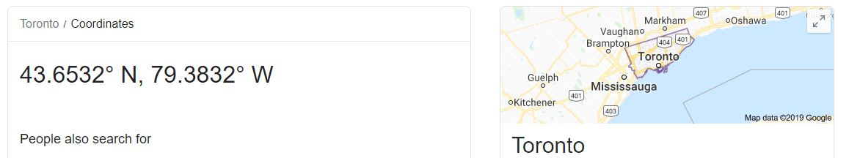
Synopsis
Data We Need
We will need geo-locational information about that specific borough and the neighborhoods in that borough. This is easily provided for us by the contractor, because the contractor has already made up his mind about the borough.
image is retrieved
from google.com

Slide 5
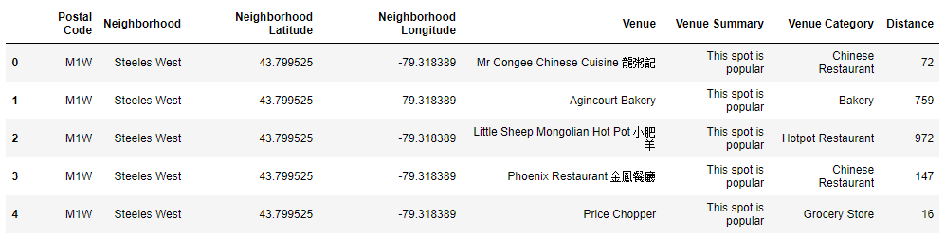
Synopsis
Data We Need
b) We will need data about different venues in different neighborhoods of that specific borough. In order to gain that information we will use "Foursquare" locational information. A typical request from Foursquare will provide us with the following information:

Slide 6
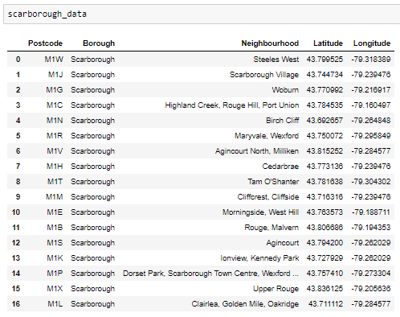
METHODOLOGY
Part 1: Identifying Postal Codes (and then Neighborhoods) in “Toronto"

Slide 7
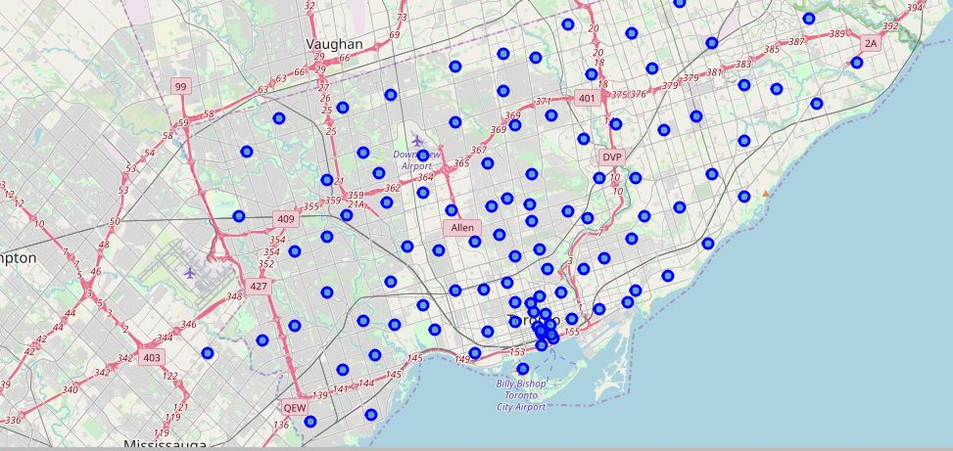
METHODOLOGY
Part 1: Identifying Postal Codes (and then Neighborhoods) in “Toronto"

Slide 8
Main Article
Part 2: Connecting to Foursquare and Retrieving Locational Data for Each Venue in Every Neighborhood
After finding the list of neighborhoods, we then connect to the Foursquare API to gather information about venues inside each and every neighborhood. For each neighborhood, we have chosen the radius to be 1000 meter. It means that we have asked Foursquare to find venues that are at most 1000 meter far from the center of the neighborhood.

Slide 9
Main Article
Part 3: Processing the Retrieved Data and Creating a DataFrame for All the Venues inside the Scarborough
When the data is completely gathered, we will perform processing on that raw data to find our desirable features for each venue. Our main feature is the category of that venue. After this stage, the column "Venue's Category" will be One-hot encoded and different venues will have different feature-columns. After On-hot encoding we will integrate all eateries as "Total Food Places", all bars and clubs as "Total Bars" and all fun activities as "Total Activities"¶
Now, the dataset is fully ready to be used for machine learning (and statistical analysis) purposes.

Slide 10
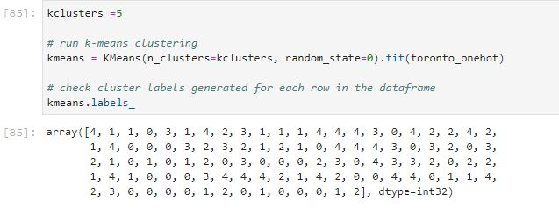
METHODOLOGY
Part 3: Processing the Retrieved Data and Creating a DataFrAme for All the Venues inside the Scarborough

Slide 11
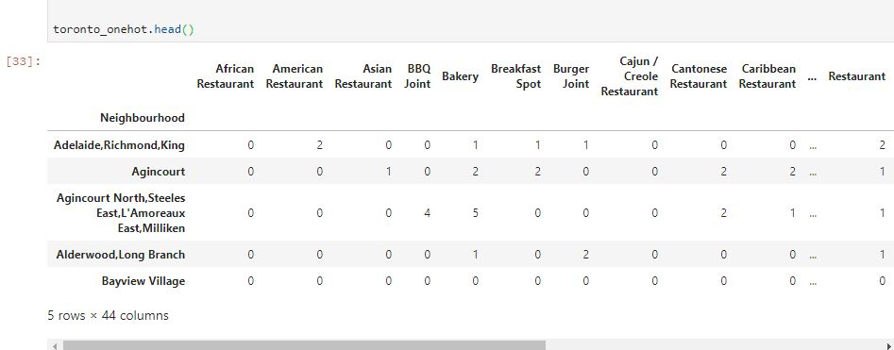
Now, the dataset is fully ready to be used for machine learning (and statistical analysis) purposes.

Slide 12
METHODOLOGY
Part 4: Applying one of Machine Learning Techniques (K-Means Clustering)

Slide 13
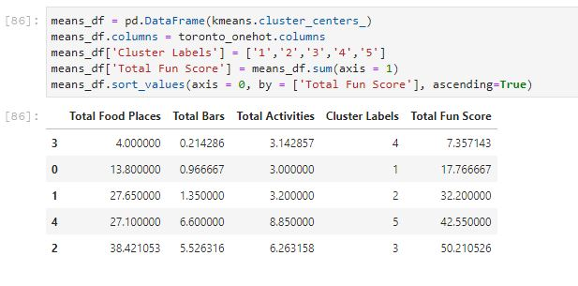
Decision Making and Reporting Results
Now, we focus on the centres of clusters and compare them for their "Total Food Places" "Total Bars" "Total Activities". The group which its centre has the highest "Total Fun Score" will be our best recommendation for a Date. However we recommend users to view results and decide best cluster for themselves as each cluster is unique in its own way
{Note: "Total Fun Score" = "Total Food Places" + "Total Bars" + "Total Activities"} This algorithm although is pretty straightforward yet is strongly powerful.

Slide 14
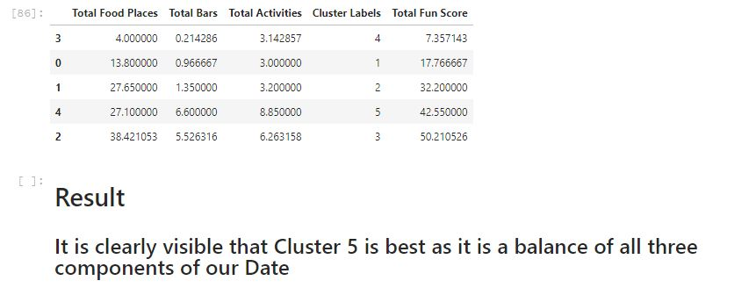
Decision Making and Reporting Results

Slide 15
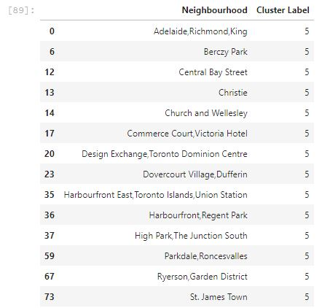
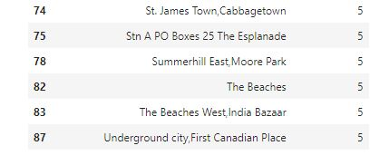
Decision Making and Reporting Results

Slide 16
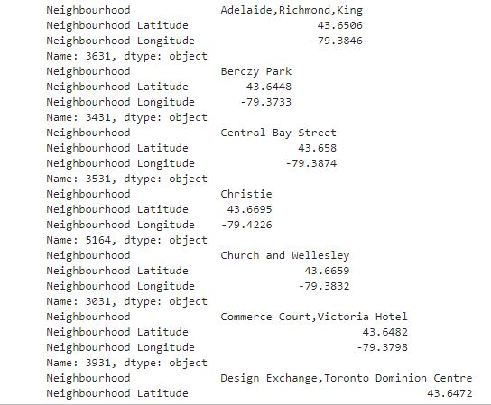
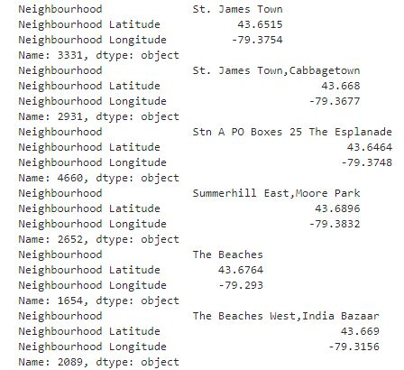
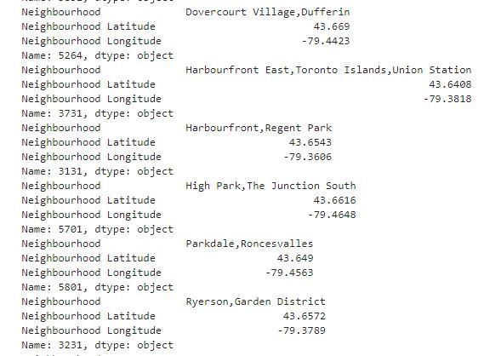
Decision Making and Reporting Results

Slide 17


