Slide 1
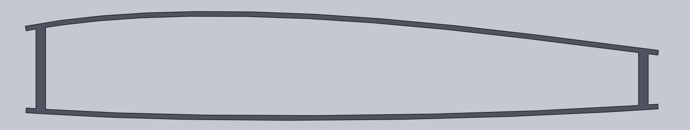
X-56A
Wing Box Construction
Upper and Lower Panels
S-2 Fiberglass – typically 2-3 ply face sheets
Rohcell foam core – typically 0.25” (some 0.375”)
Leading edge is separate part, solid laminate
Leading and Trailing Spars
Flat web with caps
Solid Laminate carbon fiber – [45,0,45]s
Ribs
Flat web with caps
Carbon Fiber – typically 2-3 ply face sheets
Mix of solid laminate and Rohcel foam core – typically 0.375”
Wing Molds:
Upper Skin
Lower Skin
Leading Edge
Front Spar
Aft Spar
Ribs (?)
Control Surfaces

Slide 2
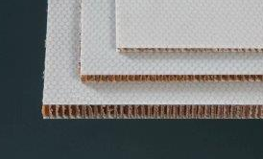
mAEWing2 Desired
Desire is to mimic a wing box structure with Ribs
Reduce number of molds required for fabrication
Use flat stock or a common custom ply layup for all parts
1/8” Core in flat stock, could do custom in skins
Simplify and Standardize where possible
Very limited design space
Some flexibility in placement and sizing of spars
Rib placement and sizing
Limited material selection
Froude Scaling as a Guide – 12ft (correcting to 0.125” core)
Carbon (IM7) in X-56A
E = 76 GPa, G = 3.8GPa - scales to - E = 21 GPa, G = 1.2 GPa
E-glass fiber is a decent match: E = 23 GPa, G = 3.5 GPa
Fiberglass (S-2 Glass) in X-56A
E = 28 GPa, G = 3.5 GPa - scales to - E = 7.6 GPa, G = 1.1 Gpa
Unobtainium?? (Vacuum formed thermoplastic ?)
Wing Molds:
Upper Skin (ambidex)
Lower Skin (ambidex)
Leading Edge (?)

Slide 3
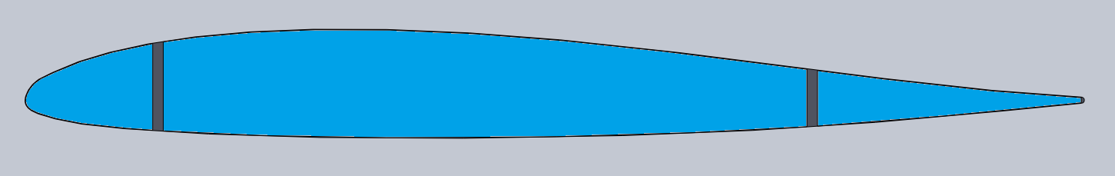
mAEWing2 Alternative 1
Alternate Concept
Use flat stock or a common custom ply layup for all parts
No Ribs
No Molds – Layup over foam core with spars
Requires the skins to carry the loads
Still may not be feasible without unobtainium
Unobtainium is limited to fabric carried thermo-sets due to temperature and pressure constraints
Very limited design space
Some flexibility in placement and sizing of spars
Material selection

Slide 4
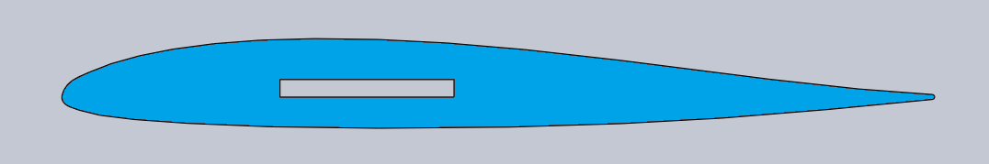
mAEWing2 Alternative 2
Alternate Concept
Same as BFF and MiniMUTT
No Ribs
No Molds – Layup over foam core with spar
Requires the skins to carry the loads
Limited design space
Spar placement, sizing, and materials vary the response significantly

