Slide 1
Matilda Bay: Crisis Forecasting & Fair Resource Allocation
Team Cyberslacking

Slide 2
Four Pods. Four Situations.
🌊 Pod 1
💊 Pod 2
Water
Medicine
🍞 Pod 3
✓ Pod 4
Food
None

Slide 3
THE CORE PROBLEM
Enough Resources.
Inefficient Distribution.
Total supply across all pods is collectively sufficient — the shortage is entirely in how it's split and moved.

Slide 4
No Transparency. No Trust.
❓ Don't Know
🔒 Won't Share
Who's in need — and how urgently
No exchange, no disclosure — hoarding and tolling follow
Reframe: this is a trust and information problem, not greed.

Slide 5



THE SOLUTION ARCHITECTURE
Council-Controlled. Fair Ranking + Market Incentives.
🏛️ Council
⚖️ Fair Ranking
📊 Marketplace
Central authority sets guardrails and enforces fairness
Priority determined by objective runway metrics
Voluntary trade in Bay Credits — incentivises sharing

Slide 6
A Stock Market, But for Resources.
Pods list surplus, bid for need, priced in Bay Credits. Council sets the guardrails.
Side
🌊 Water
💊 Medicine
🍞 Food
Offers
Pod 1 lists surplus
Pod 2 lists surplus
Pod 3 lists surplus
Bids
Pod 2, 3 bid
Pod 1, 3 bid
Pod 1, 2 bid

Slide 7
PRIORITY FORMULA
Priority by Runway Days.
Stock ÷ Consumption
= Runway Days
Consumption scales with population. Shorter runway = higher priority.

Slide 8
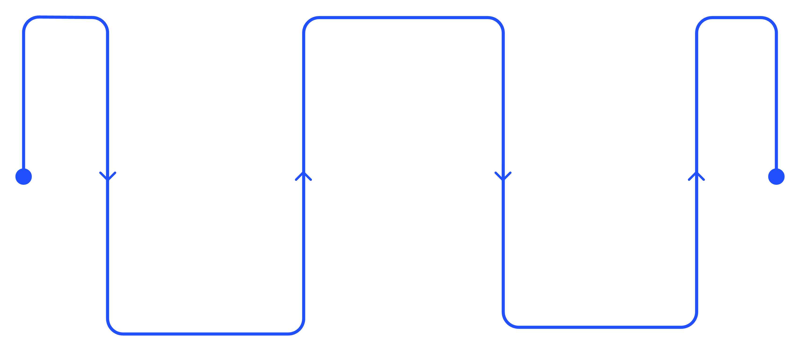
Fair Ranking in Action.
Calculate Runway
Stock ÷ consumption per pod
Measure Stock
Rank by Urgency
Inventory and daily use
Shorter runway = higher priority

Slide 9
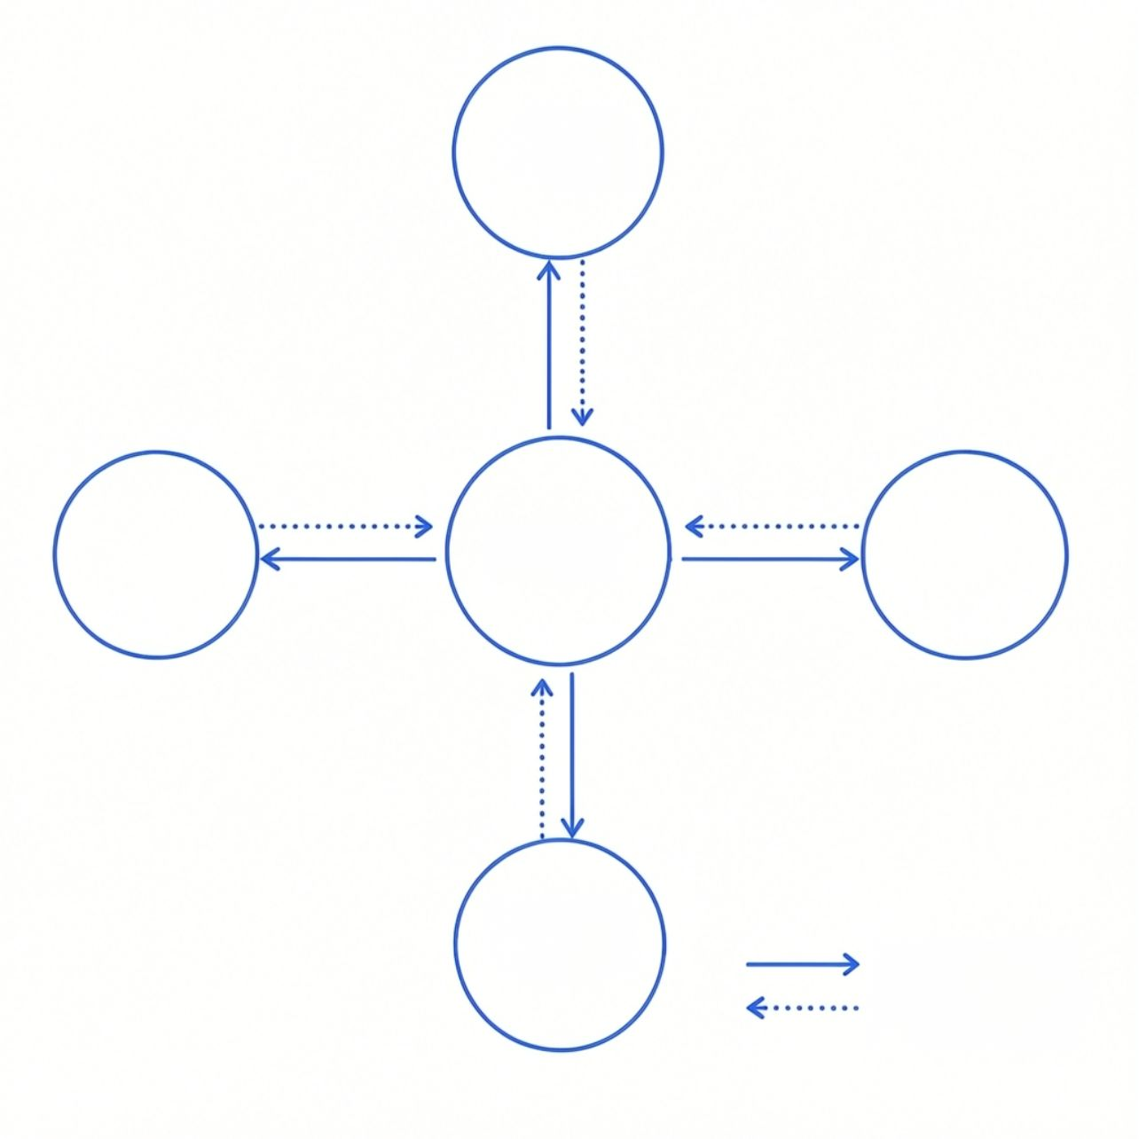

Demo
📊 Live Dashboard
Pod 1
(Water)
Runway days by pod — updated in real time
🚨 Silent-Pod Alerts
Pod 4
(Stable/None)
Council
Pod 2
(Medicine)
Auto-flag pods that go dark or stop reporting
💱 Live Trades
Pod 3
(Food)
Real-time data flows
Trade signals between
Council and each pod
Marketplace transactions visible to all pods

Slide 10

OUTCOME
Impact.
✓ Pods 1, 2, 3
🛡️ Pod 4
Trade freely in the marketplace — crises resolved through transparent exchange
Still protected — fair ranking applies, no trading required
Every pod is seen. Every need is ranked. No pod left behind.

