Slide 1
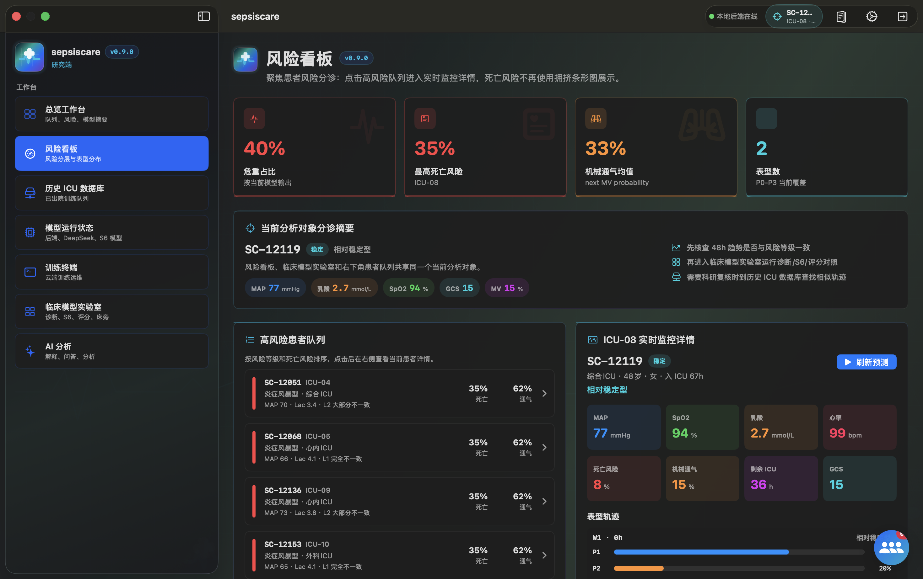
FINAL DEFENSE
SepsisCare
ICU sepsis risk stratification, dynamic phenotyping, and deployable multi-platform software
Course demo, not a clinical device
Research model
Working app
Security evidence
347,634
0.956
0.848
declared training patients
S7 phenotype Macro F1
mortality AUROC
Final package: model, apps, documentation, audits, deployment scripts, and explicit residual-risk boundaries.
SepsisCare final presentation | Project report dated 2026-06-03
01

Slide 2
Problem and Boundary
SCOPE
The project turns ICU time-series research into a demonstrable software system, while keeping clinical claims constrained.
Clinical problem
Course project goal
Hard boundary
Sepsis evolves quickly in ICU settings. Static scores cannot express 48-hour trajectory changes, missingness patterns, or phenotype transitions.
Show an end-to-end loop: data preparation, dynamic phenotyping, risk modeling, multi-role interfaces, deployment, and evidence-backed safety controls.
The outputs are for course demonstration and engineering validation. They are not autonomous clinical orders, diagnoses, or regulated medical-device claims.
Research layer: learn stable patient and window representations from de-identified ICU time series.
Engineering layer: ship app clients, HTTP APIs, model service, training terminal, and deployment scripts.
Assurance layer: add token gates, SSRF filters, data audits, artifact manifests, and explicit blocked-state reporting.
A good final demo is useful only if its limits are as visible as its metrics.
Source: current SepsisCare project documentation and verification notes
02

Slide 3
Data Foundation
DATA
Four ICU sources are normalized into a common 48-hour time-series interface.
11,986
40,331
94,458
200,859
347,634
PhysioNet 2012 main phenotype source
PhysioNet 2019 auxiliary sepsis source
MIMIC-IV external source
eICU large external source
declared S7 training patients
PhysioNet 2012
11,986
The model sees values, observation masks, static features, interventions, labels when available, and source provenance. Missing labels are handled through masked losses rather than forced fake labels.
PhysioNet 2019
40,331
MIMIC-IV
94,458
eICU
200,859
No restricted raw ICU database is packaged in the final delivery.
Source: 03_documentation/SepsisCare_Paper_Report.tex, dataset table
03

Slide 4
S0-S7 Research Roadmap
RESEARCH
The research path is a staged engineering argument: each stage keeps one useful idea and fixes one observed weakness.
1. Build stable representations
2. Make dynamics interpretable
3. Train the final deployable model
S0 builds 48h tensors and patient splits. S1 learns temporal structure. S1.5 stabilizes embeddings with contrastive patient views.
S2 discovers rolling phenotypes. S3 checks center transfer. S3.5 calibrates risk. S5 prepares real-time partial-history use.
S6 tests missingness-aware GRU inputs and domain robustness. S7 combines source balance, GroupDRO, phenotype CE, SupCon, and auxiliary tasks.
S0 / S1 / S1.5
S2 / S3 / S3.5 / S5
S6 / S7
Selection logic
Research output
Claim boundary
Keep a stage only when it improves interpretation, transfer, real-time use, or delivery evidence.
The pipeline produces embeddings, phenotype states, transition matrices, calibrated risks, and artifacts.
S7 is a course model and smoke-test target, not clinical held-out validation.
Source: current SepsisCare project documentation and verification notes
04

Slide 5
S0-S1.5: Representation Foundation
RESEARCH
The first research block turns raw ICU records into learnable patient trajectories before any final predictor is trusted.
S0: unified 48-hour tensors
S1: masked reconstruction
S1.5: contrastive augmentation
Align each ICU stay to hours 1-48. Build values X, masks M, static features A, interventions P, outcomes Y, and patient-level splits.
Hide observed values and train an encoder to reconstruct them. This checks whether ICU temporal structure is learnable before labels.
Create two augmented patient views and pull their embeddings together. This improves clustering geometry and risk ranking stability.
Input discipline
Learning signal
Why it was kept
Leakage control
Self-supervision
Embedding quality
Train-only normalization avoids seeing validation or test patients.
Masked MSE learns from sparse ICU measurements without dense labels.
S1.5 became the base for rolling-window phenotype discovery.
Decision: do not jump directly to a mortality classifier; first make the time-series representation stable enough to support phenotypes.
Source: report sections S0, S1, and S1.5
05

Slide 6
S2-S5: From Phenotypes to Real-Time Use
RESEARCH
The middle research block converts embeddings into dynamic states, validates their stability, then adapts them for online inference.
S2: rolling-window phenotypes
S3: cross-center validation
S3.5: risk readout
S5: horizon policy
Split each 48h trajectory into five 24h windows. Encode and cluster each window into P0-P3 states.
Train on Center A, apply to Center B, then check prevalence, mortality order, highest-risk state, and transitions.
Combine embeddings with statistical features. Compare classifiers and calibrate mortality risk.
Train with partial histories and add alert rules for history length, threshold, streak, and cooldown.
Interpretability gain
Validation gain
Deployment gain
Phenotype transitions explain how a patient moves through risk states.
Center transfer checks whether phenotypes are more than single-center noise.
Horizon augmentation matches what is known at hour h.
Decision: phenotype states became the bridge between research metrics and software explanation panels.
Source: report sections S2, S3, S3.5, and S5
06

Slide 7
S6-S7: Final Robust Training
RESEARCH
The final research block adds missingness-aware sequence modeling and source-balanced multi-task supervision.
S6: missingness-aware GRU
Domain robustness trials
S7: final objective
Each hour includes values, masks, intervention proxies, and time gaps. Missingness becomes a clinical signal.
Test source balance, DANN/CORAL, GroupDRO, GRU-D style inputs, and ensembles. Simple invariance was not enough.
Train all sources with source balance, GroupDRO, phenotype CE, SupCon, and auxiliary LOS/MV/RRT tasks.
347,634
31,319
0.971
0.956
0.968
declared training patients
model parameters
encoder Macro F1
smoothed Macro F1
ventilation AUROC
Final output: trajectory encoder, phenotype readout, transition matrix, model-service package, and smoke-testable deployment artifacts.
Boundary: S7 is the final course model, not a clinical external-validation claim.
Source: report sections S6, S7, and final result table
07

Slide 8
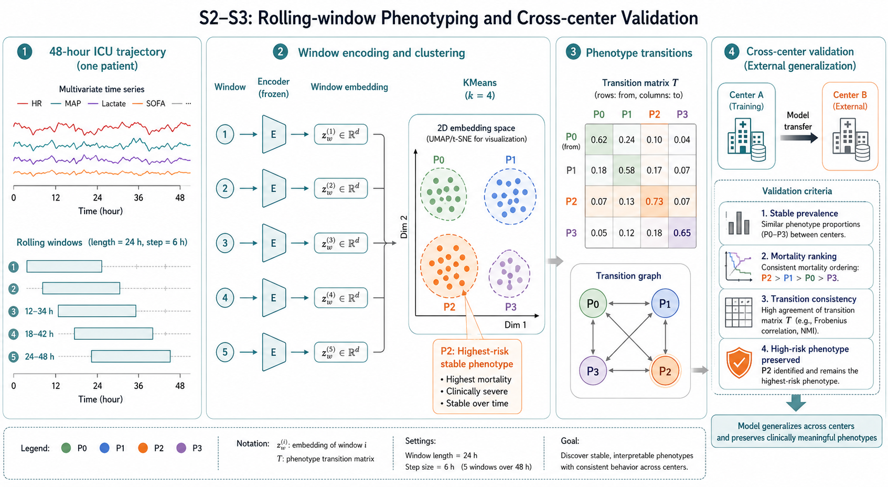
Dynamic Phenotyping
RESEARCH
The patient trajectory is represented as rolling windows, then clustered into interpretable phenotype states.
S2 discovers phenotype transitions; S3 checks whether the same structure survives a Center A to Center B transfer.
5 rolling windows
4 phenotypes
P2 retained as highest-risk stable state
Phenotypes are a communication layer between time-series embeddings and bedside interpretation.
This is why the app can explain not only risk level, but also trajectory and comparable historical cases.
Source visual: 03_documentation/figures/fig2_s2_s3.png
08

Slide 9
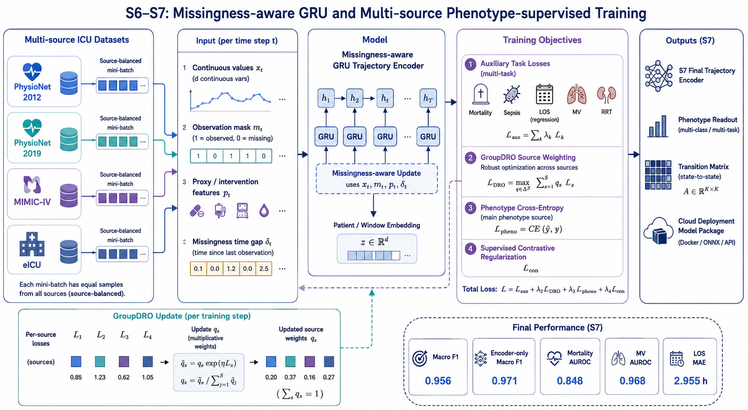
Final S7 Model
MODEL
Missingness-aware GRU plus source-balanced GroupDRO, phenotype CE, and supervised contrastive regularization.
The final encoder treats missingness as signal, not just an inconvenience.
31,319
7
parameters
GPU count
0.971
0.956
encoder-only Macro F1
smoothed Macro F1
Key design choice: combine auxiliary clinical tasks with phenotype-specific supervision so deployment can serve risk, trajectory, and explanation views.
Source visual: 03_documentation/figures/fig3_s6_s7.png
09

Slide 10
Key Results and Evidence Boundary
RESULTS
The metrics support course demonstration and engineering validation, not independent clinical claims.
0.956
0.832
0.848
0.968
2.955 h
encoder + transition Macro F1
full-patient match rate
mortality AUROC
next ventilation AUROC
remaining LOS MAE
Rule baseline
0.142
The strongest evidence is phenotype consistency on the demonstration monitoring split plus working API/model smoke tests.
S6 v2
0.821
GroupDRO
0.806
S7 encoder
0.971
S7 smooth
0.956
Do not present S7 as held-out external clinical validation.
Source: S7 result table and report boundary note
10

Slide 11
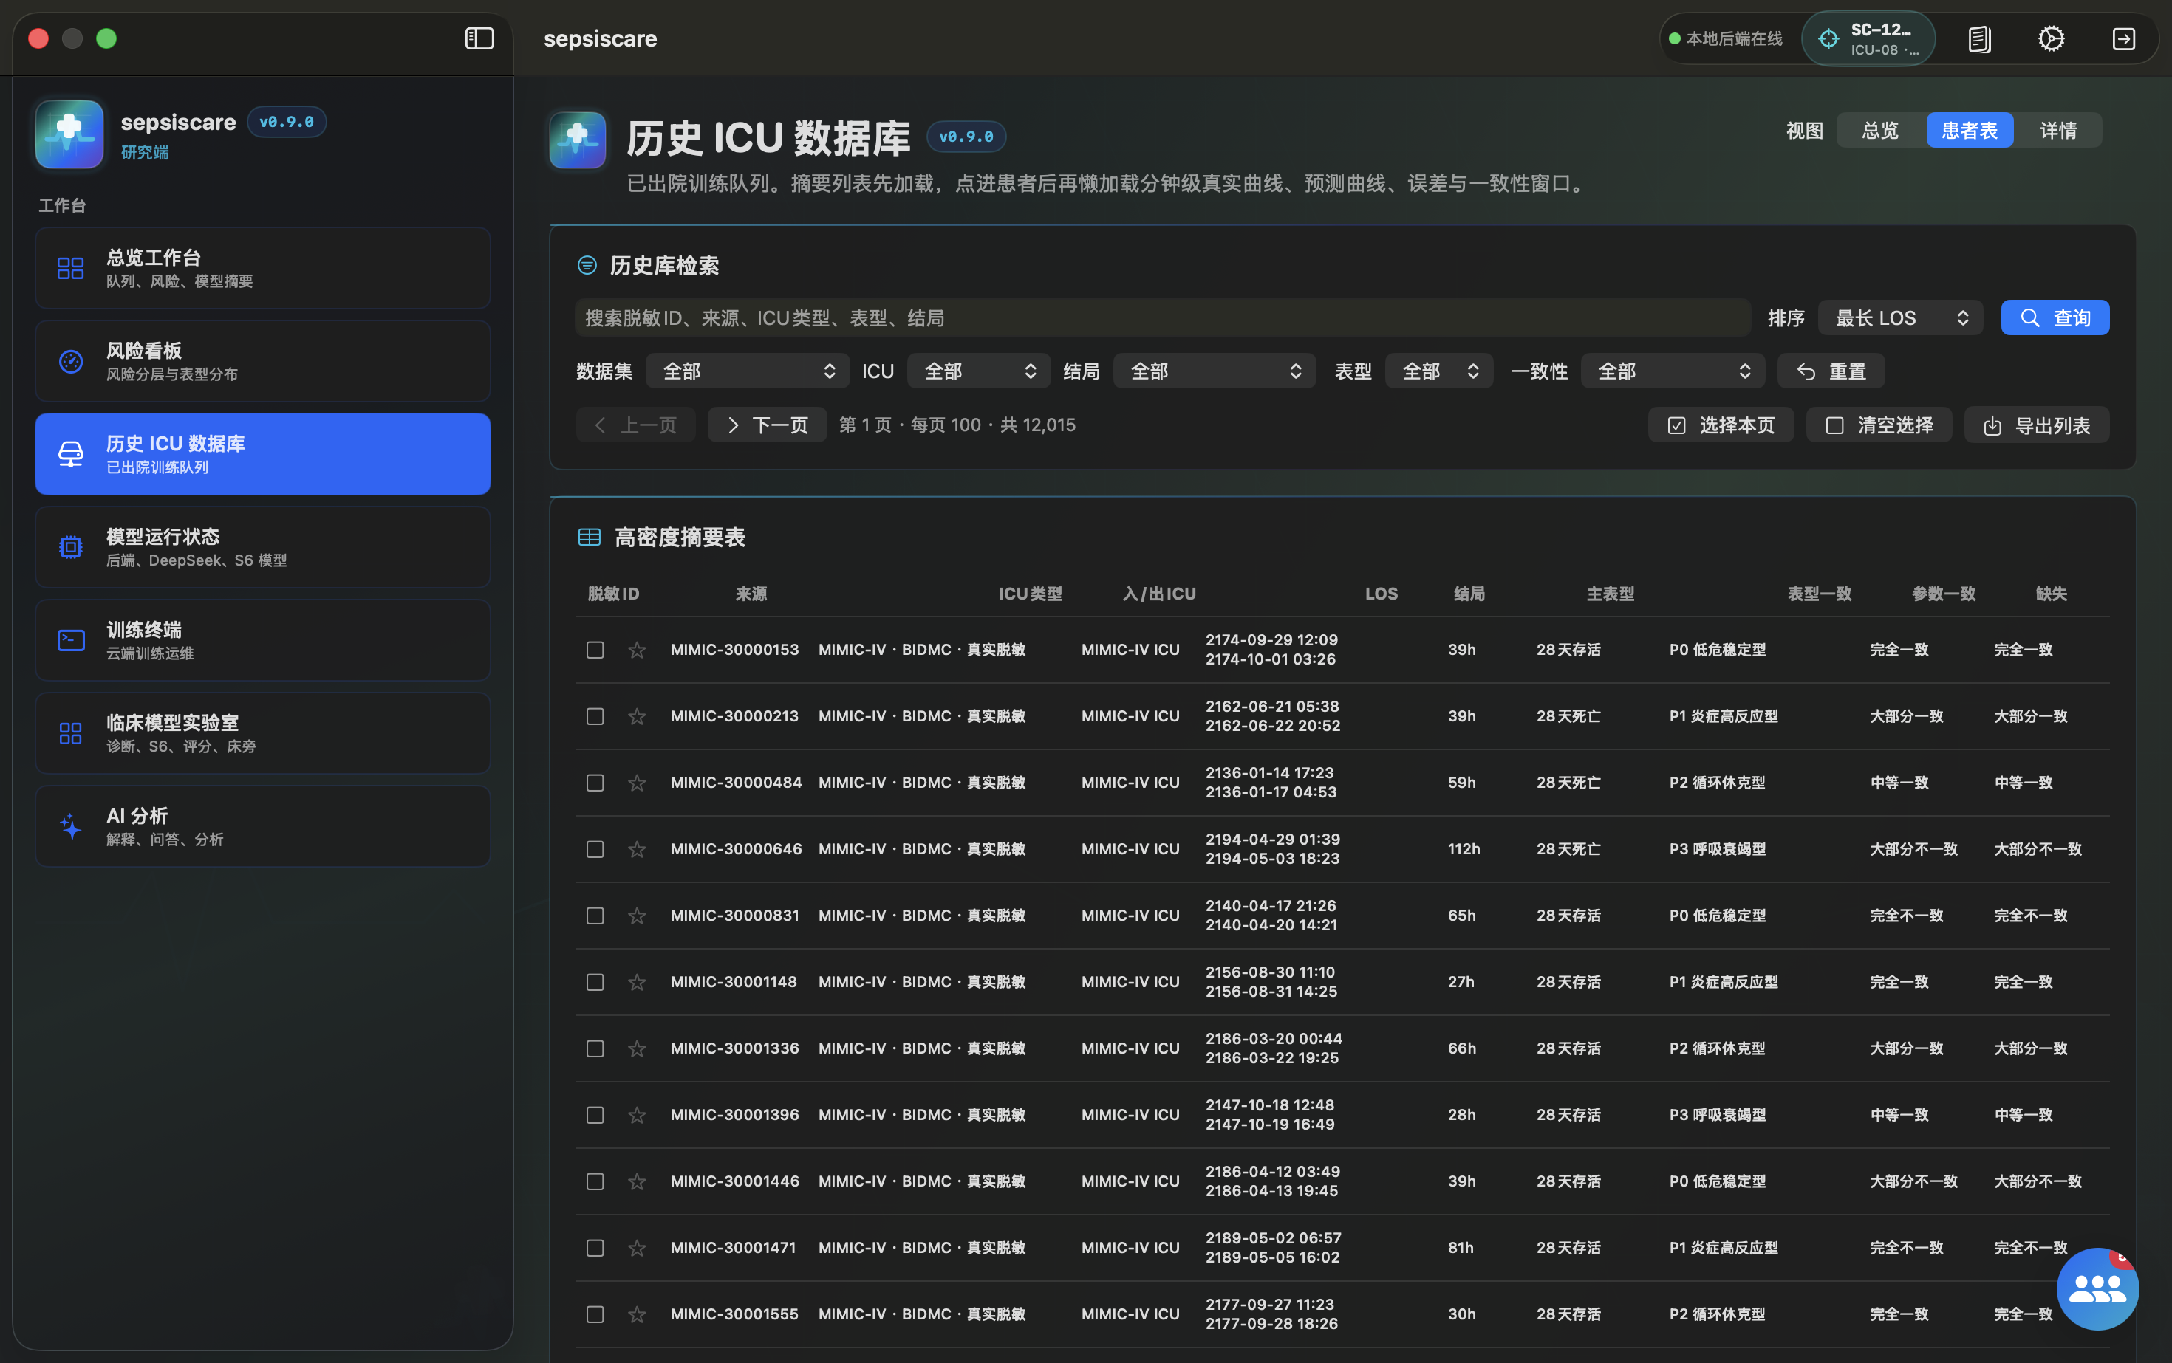
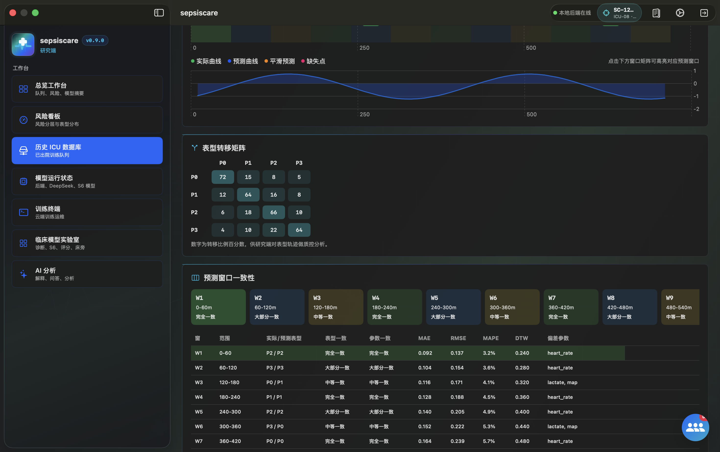
Multi-Role Product Experience
PRODUCT
The model is wrapped in workflows for doctors, researchers, family communication, and administration.
Doctor risk board
Historical ICU search
Admin / model status
Doctor view: current queue, risk explanation, trends, phenotype, and model status.
Research view: historical patients, detail panels, cohort evidence, and model experiment outputs.
Admin and family workflows: service monitor, AI explanation, account binding, and audit visibility.
Source visuals: installed-app screenshots in 03_documentation/figures
11

Slide 12
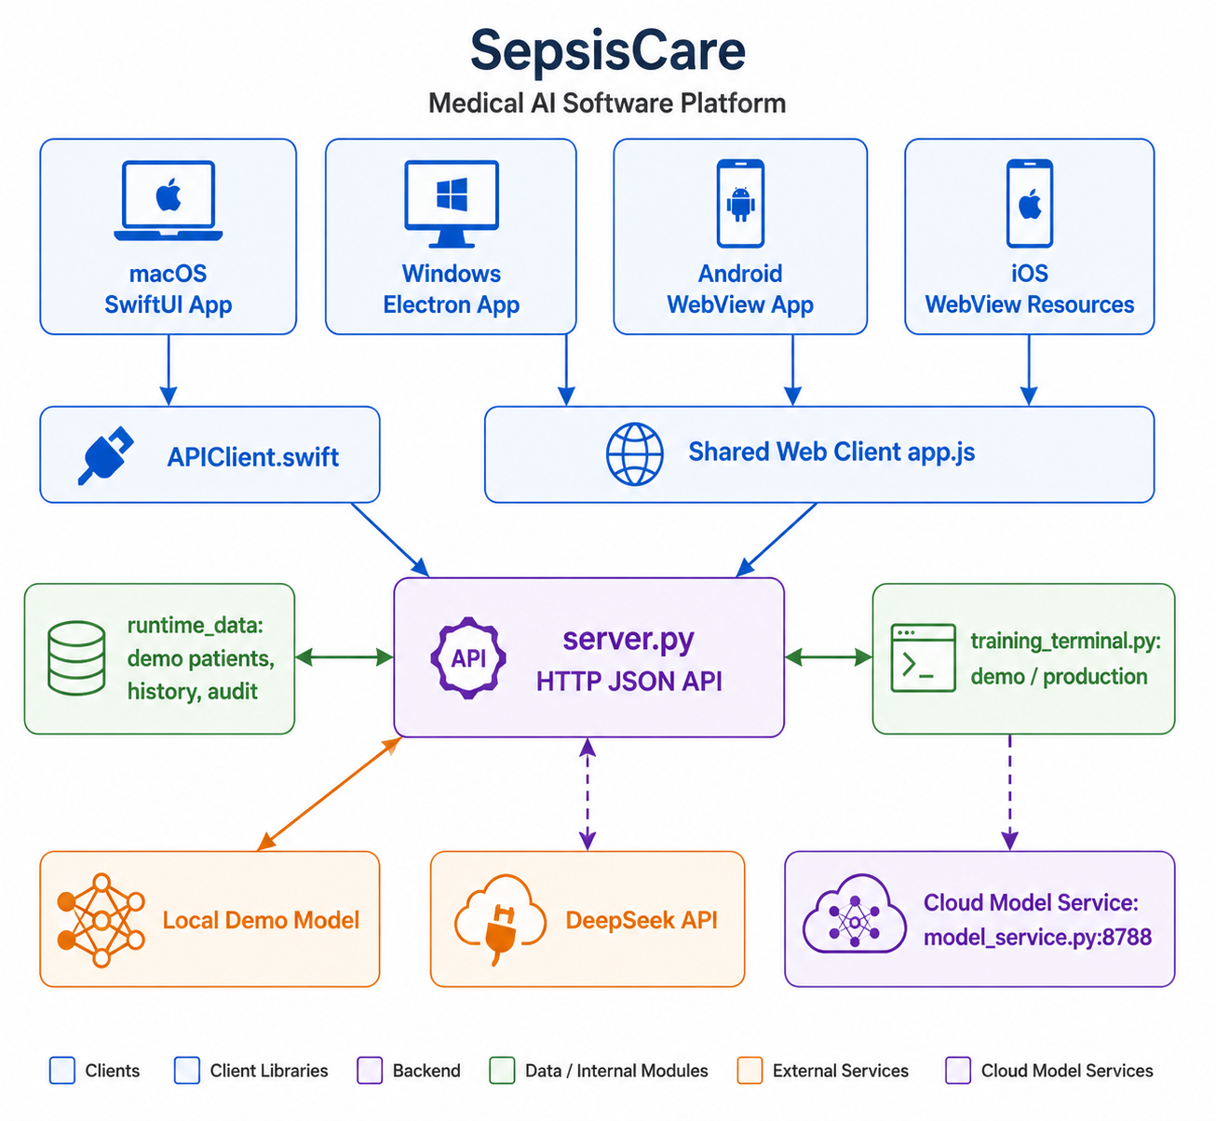
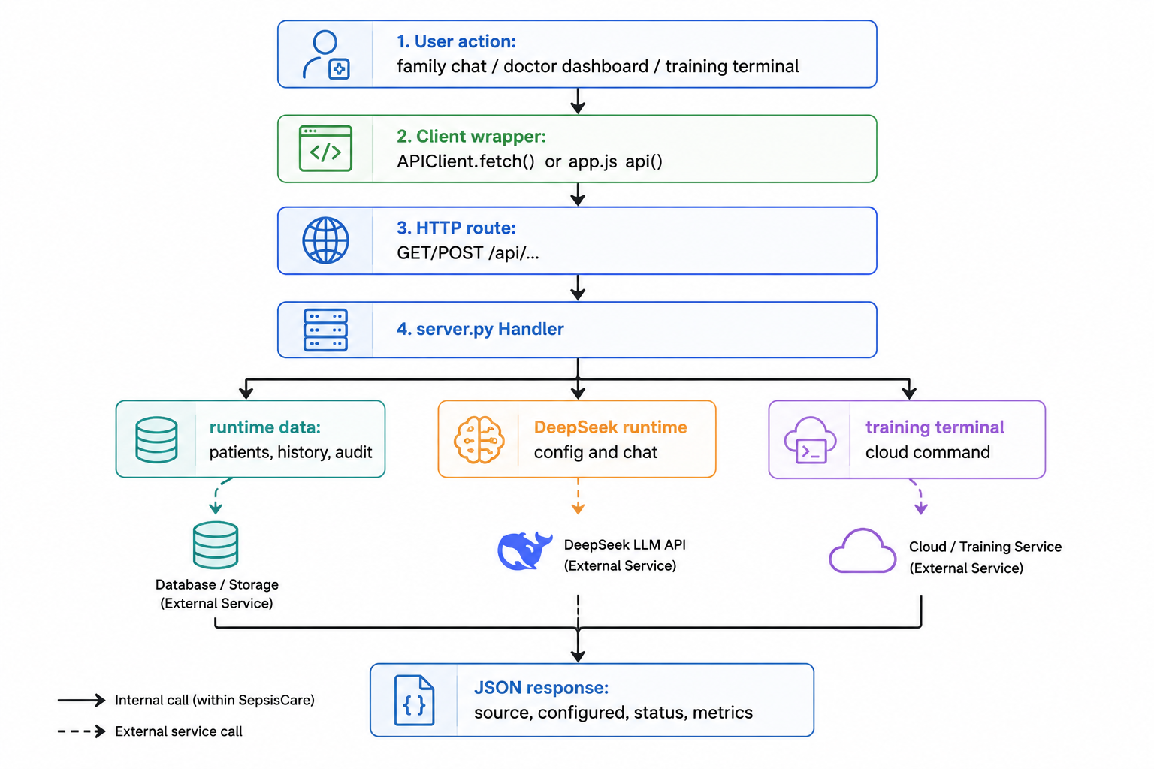
Software Architecture and API Flow
SYSTEM
Multiple clients share a standard HTTP API while model, AI, runtime data, and training terminal remain replaceable.
macOS / Windows / Android
server.py API gateway
model service
DeepSeek runtime config
A deployable system needs stable contracts, not just model weights.
Source visuals: 03_documentation/figures/fig3.png and fig4.png
12

Slide 13
Network Security Hardening
SECURITY
The project moved from demo-friendly local access toward explicit remote API boundaries.
Client session
Local API
Remote service
External calls
Audit log
Bearer token kept session-scoped; launch token parameters are stripped.
Loopback remains usable for development and installed-app demos.
Sensitive paths fail closed without strong configured Bearer tokens.
DeepSeek and training URLs pass SSRF-resistant URL constraints.
Auth failures are recorded without tokens or request bodies.
sessionStorage
CORS tightened
403 / 401 fail-closed
no metadata URL
no-store / nosniff
Important distinction: the shared client password 123123 is a demonstration gate, not production API security.
Residual boundary: the remote server should still run behind VPN or TLS with token rotation.
Source: SECURITY_PRIVACY_ETHICS_REVIEW.md network security section
13

Slide 14
Data Pollution and Artifact Integrity
ASSURANCE
Release data, static files, training metadata, and downloadable artifacts now pass repeatable checks.
Runtime data audit
Sensitive surface audit
Training metadata audit
Artifact verifier
Provenance, direct identifiers, duplicates, orphan details, clinical ranges.
Release roots scanned for high-confidence secrets and PHI-like text.
Source provenance, declared totals, target run, split-policy checks.
MANIFEST.sha256 plus optional HMAC over downloadable ZIP contents.
0
0
0
347,634
runtime fatal violations
sensitive-data findings
training metadata violations
declared train patients
This is release hygiene for a course package. It does not replace formal HIPAA expert determination or raw-source data governance.
Source: SECURITY_PRIVACY_ETHICS_REVIEW.md verification evidence
14

Slide 15
Deployment Orchestration
DEPLOY
Laptop-to-remote-server deployment became a tested sequence instead of a handwritten command list.
1
Pre-release gate
2
SSH preflight
3
Sync package
security checks before network actions
BatchMode and timeout
rsync model service without runtime/log cache
4
Remote restart
5
Mac smoke
6
Pull artifact
one-click doctor/start/smoke
API forwarding to remote server
download and verify latest bundle
break-glass requires reason
dry-run redacts Bearer token
artifact verifier supports HMAC
Ready state: local app/API/model service and orchestration scripts are reproducible and tested.
Boundary: the current deployment experiment was run from my laptop; a real remote server still needs independent end-to-end proof.
Source: DEPLOYMENT_TEST_REPORT.md and recent project report deployment section
15

Slide 16
Final Deliverables
DELIVERY
The project separates software, model package, documentation, and verification evidence.
Software installers
Model deploy package
Documentation
Assurance scripts
macOS app, Windows installers, Android APK, shared web assets, launch scripts, UI smoke coverage.
S7 model weights, phenotype readout, transition matrix, deployment service, runtime database, one-click scripts.
Installation guide, paper report, deployment notes, transfer README, SHA256 manifest, current boundary notes.
Pre-release gate, data audits, sensitive-surface scan, training metadata audit, artifact verifier.
Why split the package?
It keeps raw data and API keys out of installers, lets the model service move to a remote server, and gives the final review a traceable set of files and verification commands.
PPTX final deck
paper report PDF
03_documentation.zip
Source: 03_documentation report, transfer README, deployment report
16

Slide 17
Limitations and Next Work
NEXT
The final presentation should close with the same honesty as the system design.
Validation gap
Deployment gap
Governance gap
Build a true held-out external validation split. The current S7 monitoring split is useful for course delivery but overlaps training patients.
Bring a real remote server online, run the full laptop-to-remote-server command path, save smoke logs, artifact verifier output, and cross-machine evidence.
Run deeper security/threat-model coverage, review runtime display-summary warnings, and add managed key rotation before regulated use.
Final takeaway
SepsisCare demonstrates a complete course-grade path from ICU time-series modeling to multi-platform software delivery, with safety boundaries and release evidence made visible instead of hidden.
Demo-ready, evidence-backed, and still honest about what is not clinically proven.
Source: project report conclusion and residual-risk sections
17

