Slide 1
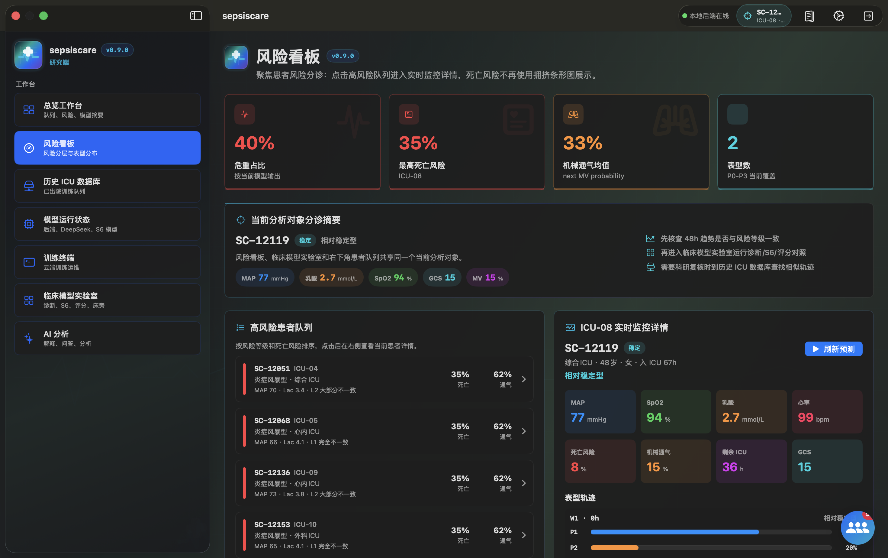
FINAL DEFENSE
SepsisCare
SepsisCare is a course project that expands an ICU time-series research prototype into an installable software system. Its goal is not to replace clinical diagnosis, but to demonstrate an end-to-end engineering workflow for sepsis risk stratification, dynamic phenotype trajectories, historical similar-case retrieval, a family communication agent, and a model training/operations terminal, based on de-identified ICU data and a local demonstration model.
Final package: model, apps, documentation, audits, deployment scripts, and explicit residual-risk boundaries.
SepsisCare final presentation | Project report dated 2026-06-03
01

Slide 2
Problem and Boundary
SCOPE
The project turns ICU time-series research into a demonstrable software system, while keeping clinical claims constrained.
Clinical problem
Course project goal
Hard boundary
Sepsis evolves quickly in ICU settings. Static scores cannot express 48-hour trajectory changes, missingness patterns, or phenotype transitions.
Show an end-to-end loop: data preparation, dynamic phenotyping, risk modeling, multi-role interfaces, deployment, and evidence-backed safety controls.
The outputs are for course demonstration and engineering validation. They are not autonomous clinical orders, diagnoses, or regulated medical-device claims.
Research layer: learn stable patient and window representations from de-identified ICU time series.
Engineering layer: ship app clients, HTTP APIs, model service, training terminal, and deployment scripts.
Assurance layer: add token gates, SSRF filters, data audits, artifact manifests, and explicit blocked-state reporting.
Source: current SepsisCare project documentation and verification notes
02

Slide 3
Data Foundation
DATA
Four ICU sources are normalized into a common 48-hour time-series interface.
11,986
40,331
94,458
200,859
347,634
PhysioNet 2012 main phenotype source
PhysioNet 2019 auxiliary sepsis source
MIMIC-IV
eICU
declared S7 training patients
PhysioNet 2012
11,986
The model sees values, observation masks, static features, interventions, labels when available, and source provenance. Missing labels are handled through masked losses rather than forced fake labels.
PhysioNet 2019
40,331
MIMIC-IV
94,458
eICU
200,859
No restricted raw ICU database is packaged in the final delivery.
Source: 03_documentation/SepsisCare_Paper_Report.tex, dataset table
03

Slide 4
S0-S7 Research Roadmap
RESEARCH
Each stage fixed one concrete weakness before the final deployable model was selected.
S0
S1
S1.5
S2
S3
S5
S6
S7
48h tensors
patient splits
masked
reconstruction
contrastive
self-supervision
rolling-window
phenotypes
cross-center
stability
real-time
horizon policy
missingness-
aware GRU
multi-source
phenotype supervision
Why this matters
What changed over time
What remains honest
The final model is not a single jump from raw ICU records to a score. It is a chain of representation learning, phenotype discovery, validation, deployment calibration, and multi-source supervision.
Early embeddings helped risk ranking. Rolling windows made dynamics visible. Missingness-aware sequence modeling and source-balanced training made the final package more robust.
S7 monitoring results are valid for course demonstration and smoke testing, but they are not independent held-out clinical validation.
Source: current SepsisCare project documentation and verification notes
04

Slide 5
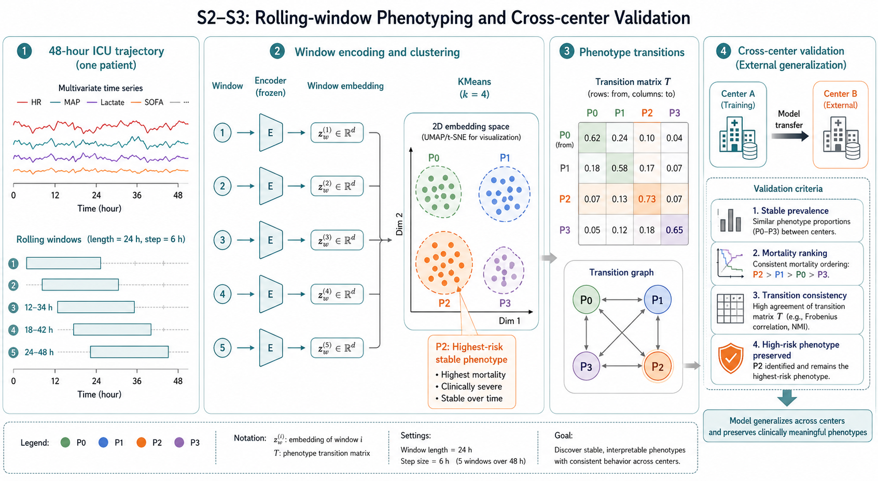
Dynamic Phenotyping
RESEARCH
The patient trajectory is represented as rolling windows, then clustered into interpretable phenotype states.
S2 discovers phenotype transitions; S3 checks whether the same structure survives a Center A to Center B transfer.
5 rolling windows
4 phenotypes
P2 retained as highest-risk stable state
Phenotypes are a communication layer between time-series embeddings and bedside interpretation.
This is why the app can explain not only risk level, but also trajectory and comparable historical cases.
Source visual: 03_documentation/figures/fig2_s2_s3.png
05

Slide 6
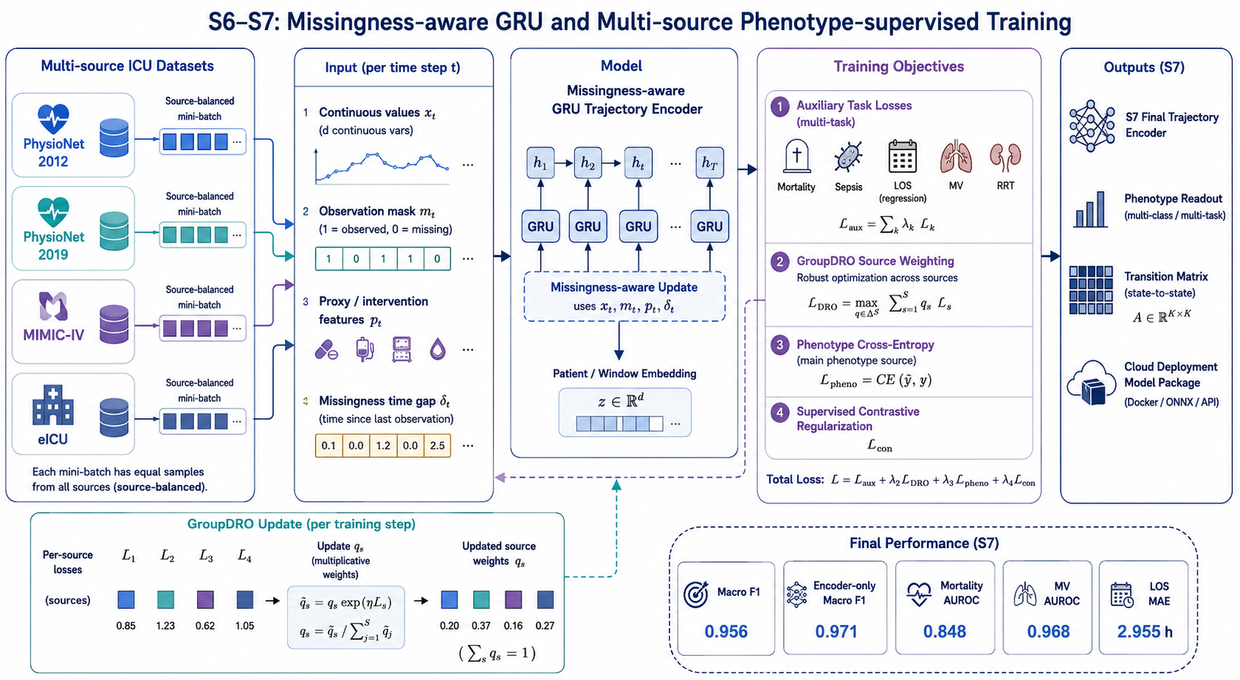
Final S7 Model
MODEL
Missingness-aware GRU plus source-balanced GroupDRO, phenotype CE, and supervised contrastive regularization.
The final encoder treats missingness as signal, not just an inconvenience.
31,319
7
parameters
GPU count
0.971
0.956
encoder-only Macro F1
smoothed Macro F1
Key design choice: combine auxiliary clinical tasks with phenotype-specific supervision so deployment can serve risk, trajectory, and explanation views.
Source visual: 03_documentation/figures/fig3_s6_s7.png
06

Slide 7
Key Results and Evidence Boundary
RESULTS
The metrics support course demonstration and engineering validation, not independent clinical claims.
0.956
0.832
0.848
0.968
2.955 h
encoder + transition Macro F1
full-patient match rate
mortality AUROC
next ventilation AUROC
remaining LOS MAE
Rule baseline
0.142
The strongest evidence is phenotype consistency on the demonstration monitoring split plus working API/model smoke tests.
S6 v2
0.821
GroupDRO
0.806
S7 encoder
0.971
S7 smooth
0.956
Source: S7 result table and report boundary note
07

Slide 8
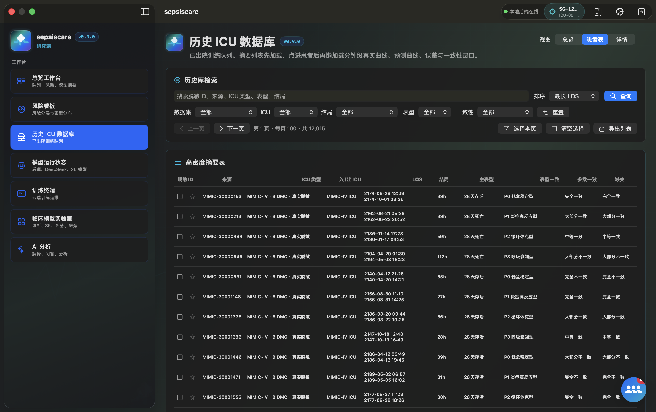
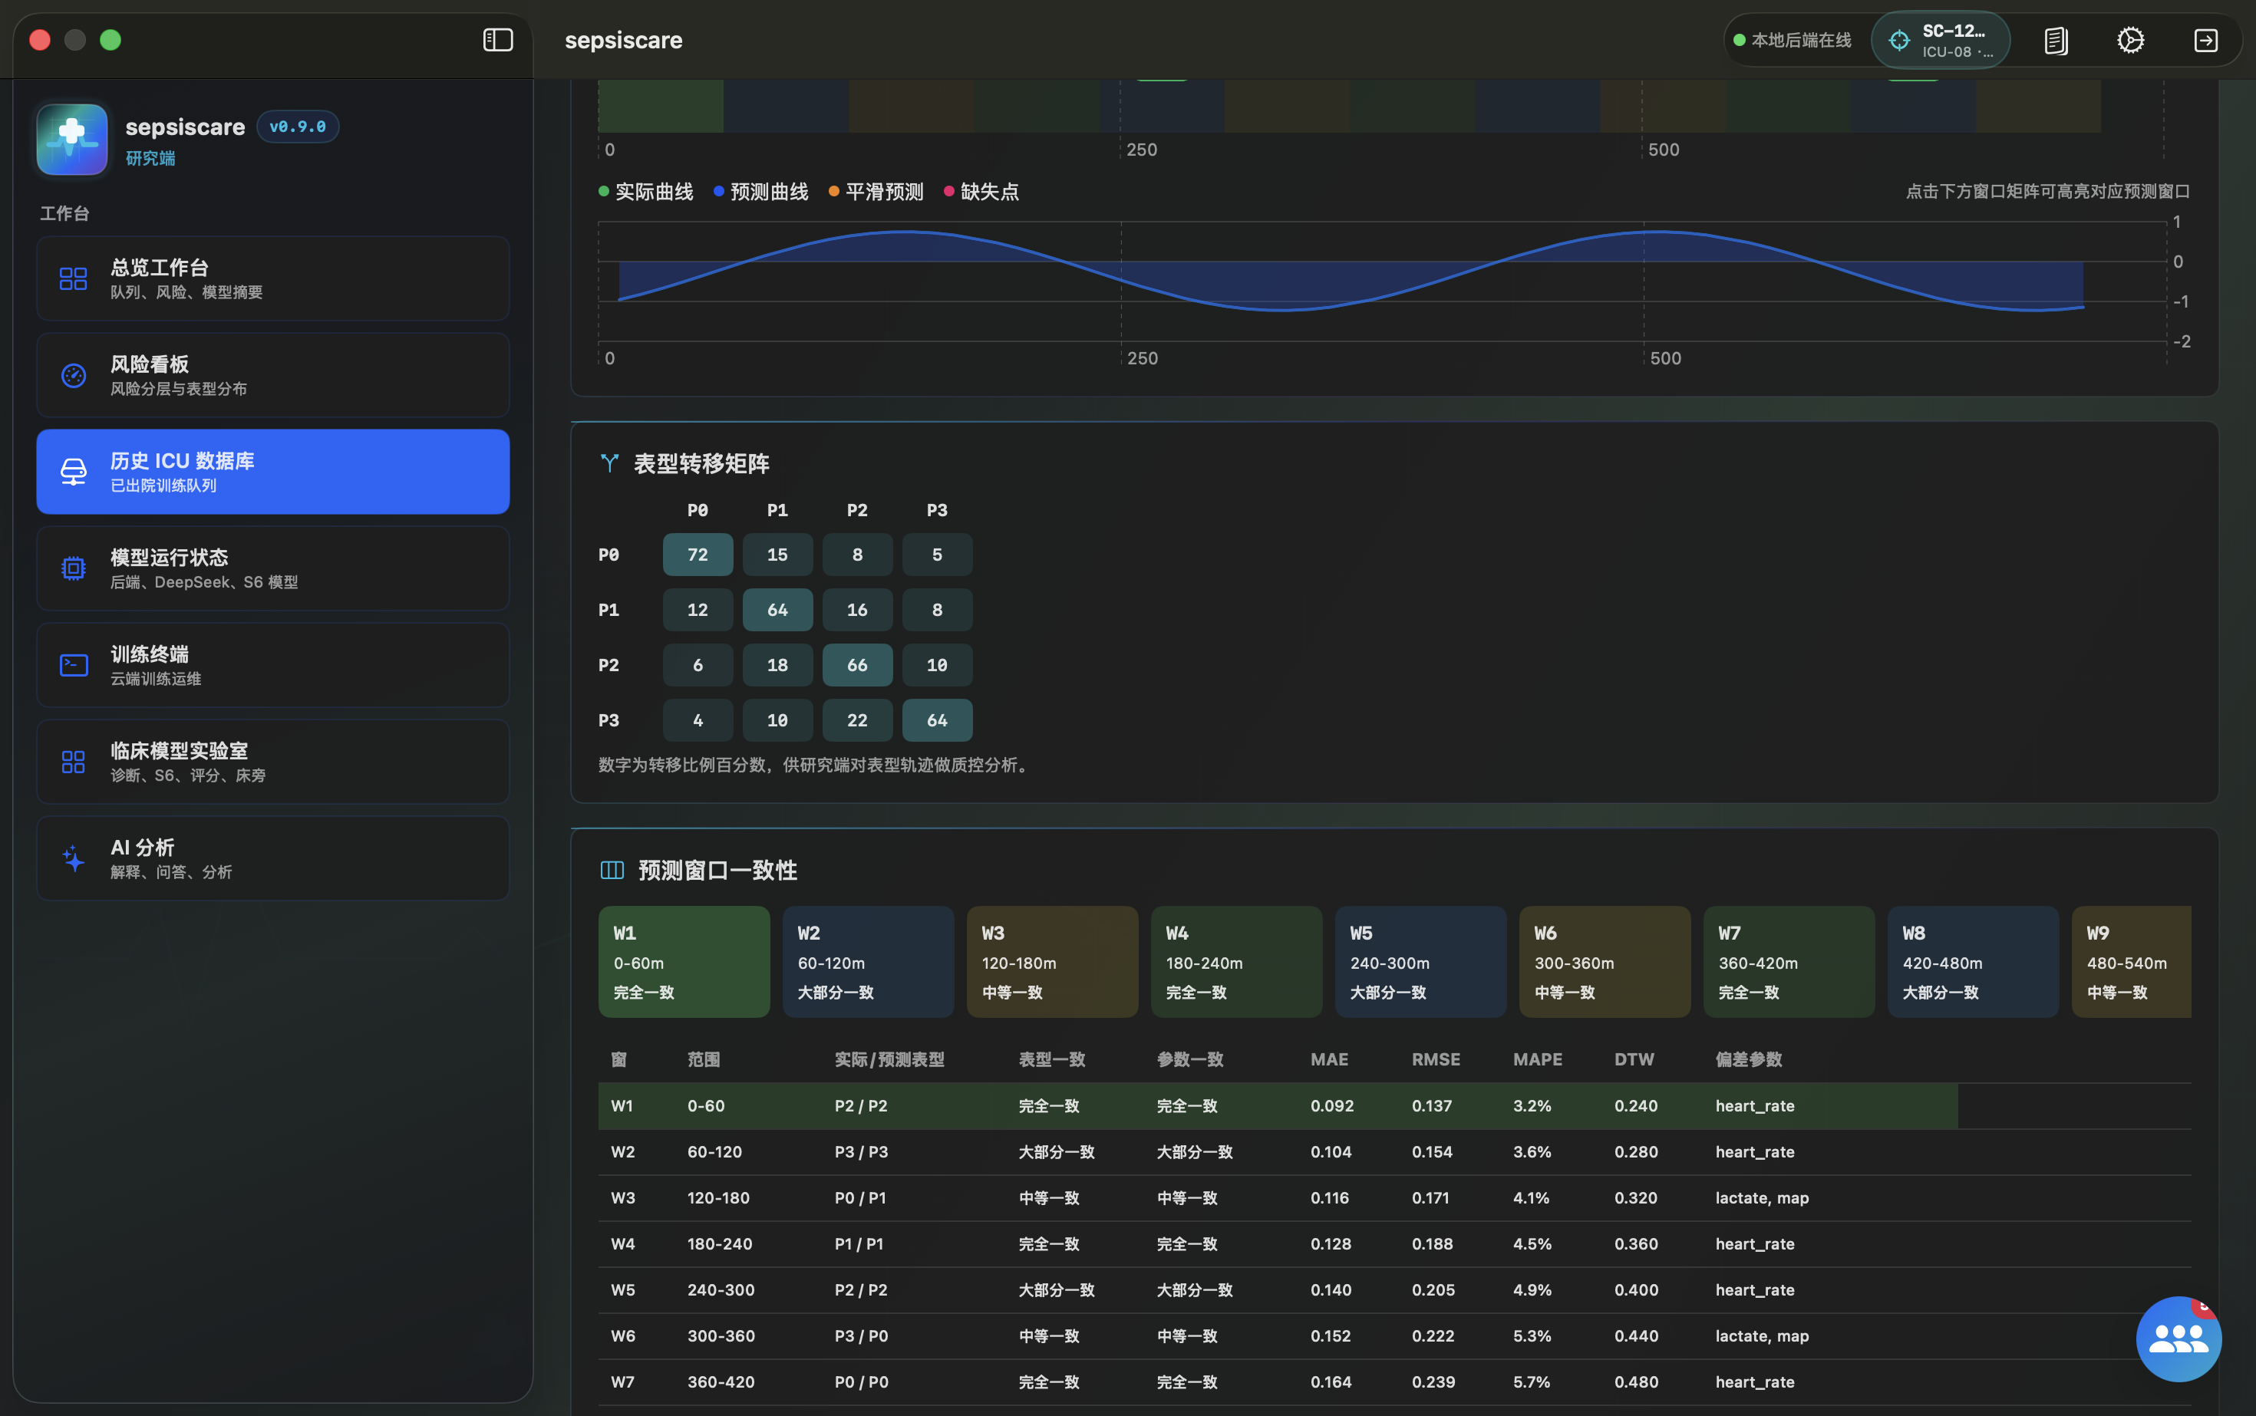
Multi-Role Product Experience
PRODUCT
The model is wrapped in workflows for doctors, researchers, family communication, and administration.
Doctor risk board
Historical ICU search
Admin / model status
Doctor view: current queue, risk explanation, trends, phenotype, and model status.
Research view: historical patients, detail panels, cohort evidence, and model experiment outputs.
Admin and family workflows: service monitor, AI explanation, account binding, and audit visibility.
Source visuals: installed-app screenshots in 03_documentation/figures
08

Slide 9
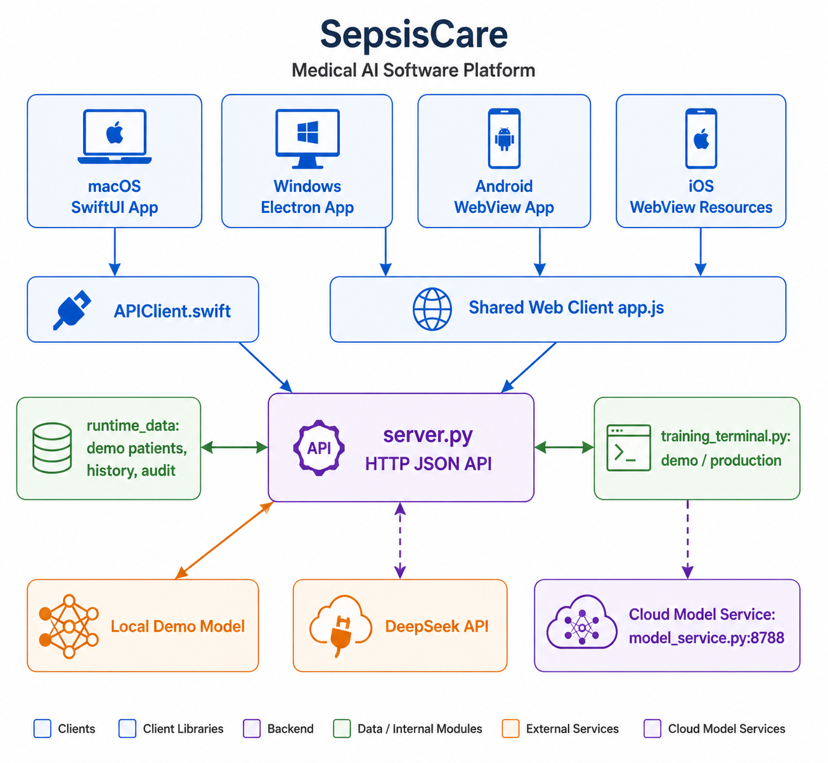
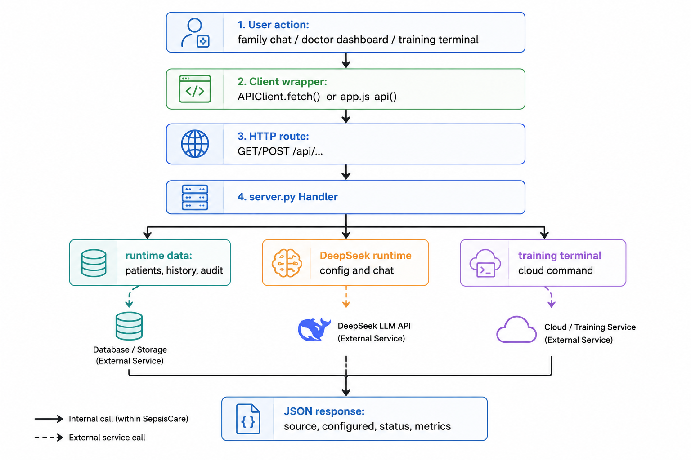
Software Architecture and API Flow
SYSTEM
Multiple clients share a standard HTTP API while model, AI, runtime data, and training terminal remain replaceable.
macOS / Windows / Android
server.py API gateway
model service
DeepSeek runtime config
Source visuals: 03_documentation/figures/fig3.png and fig4.png
09

Slide 10
Network Security Hardening
SECURITY
The project moved from demo-friendly local access toward explicit remote API boundaries.
Client session
Local API
Remote service
External calls
Audit log
Bearer token kept session-scoped; launch token parameters are stripped.
Loopback remains usable for development and installed-app demos.
Sensitive paths fail closed without strong configured Bearer tokens.
DeepSeek and training URLs pass SSRF-resistant URL constraints.
Auth failures are recorded without tokens or request bodies.
sessionStorage
CORS tightened
403 / 401 fail-closed
no metadata URL
no-store / nosniff
Important distinction: the shared client password 123123 is a demonstration gate, not production API security.
Source: SECURITY_PRIVACY_ETHICS_REVIEW.md network security section
10

Slide 11
Data Pollution and Artifact Integrity
ASSURANCE
Release data, static files, training metadata, and downloadable artifacts now pass repeatable checks.
Runtime data audit
Sensitive surface audit
Training metadata audit
Artifact verifier
Provenance, direct identifiers, duplicates, orphan details, clinical ranges.
Source provenance, declared totals, target run, split-policy checks.
MANIFEST.sha256 plus optional HMAC over downloadable ZIP contents.
Release roots scanned for high-confidence secrets and PHI-like text.
This is release hygiene for a course package. It does not replace formal HIPAA expert determination or raw-source data governance.
Source: SECURITY_PRIVACY_ETHICS_REVIEW.md verification evidence
11

Slide 12
Deployment Orchestration
DEPLOY
Laptop-to-remote-server deployment became a tested sequence instead of a handwritten command list.
Pre-release gate
SSH preflight
Sync package
Remote restart
Mac smoke
Pull artifact
BatchMode and timeout
rsync model service without runtime/log cache
one-click doctor/start/smoke
API forwarding to remote server
download and verify latest bundle
security checks before network actions
break-glass requires reason
dry-run redacts Bearer token
artifact verifier supports HMAC
Ready state: local app/API/model service and orchestration scripts are reproducible and tested.
Source: DEPLOYMENT_TEST_REPORT.md and recent project report deployment section
12

Slide 13
Limitations and Next Work
NEXT
The final presentation should close with the same honesty as the system design.
Validation gap
Deployment gap
Governance gap
Build a true held-out external validation split. The current S7 monitoring split is useful for course delivery but overlaps training patients.
Bring a real remote server online, run the full laptop-to-remote-server command path, save smoke logs, artifact verifier output, and cross-machine evidence.
Run deeper security/threat-model coverage, review runtime display-summary warnings, and add managed key rotation before regulated use.
Final takeaway
SepsisCare demonstrates a complete course-grade path from ICU time-series modeling to multi-platform software delivery, with safety boundaries and release evidence made visible instead of hidden.
Demo-ready, evidence-backed, and still honest about what is not clinically proven.
Source: project report conclusion and residual-risk sections
14

