Slide 1

SAMSUNG PRISM
Generative AI
Hackathon
3rd Edition 2026 – 27
Theme ID - 01
Team Name - ExynoX
College Name - SRM Institute of Science and Technology — KTR
Member Name & Email 1 - Mohammad Kashif Fazili — mf4545@srmist.edu.in
Member Name & Email 2 - Shaurya Barnwal — Sb6928@srmist.edu.in
Member Name & Email 3 - Vandana Patel — vp6939@srmist.edu.in
Member Name & Email 4 - Suryansh Nair — sn5478@srmist.edu.in
Submission Github link - https://github.com/ExynoX-Team/ExynoX-Code-Intelligence
AGENTIC CODE INTELLIGENCE
Understand • Search • Trace • Explain

Slide 2
02
Theme
Theme 01 — Agentic Code Intelligence
PROBLEM
Large voice-assistant codebases spread agents and tools across many files.
WHAT WE BUILD
Natural-language search, structural queries, and agentic retrieval.
CONTEXT LIMIT
The repository cannot fit into a single LLM context.
01 NATURAL-LANGUAGE CODE SEARCH
Matching snippets with file and line locations.
SLOW DISCOVERY
Finding where behavior happens is the bottleneck.
02 STRUCTURAL / USAGE QUERIES
Caller, dependency and usage relationships.
FIXING TAKES CONTEXT
Developers need exact code locations and relationships.
03 AGENTIC RETRIEVAL
Plan → search → read → refine.
TARGET ENVIRONMENT • JAVASCRIPT / TYPESCRIPT • SEMANTIC + STRUCTURAL RETRIEVAL

Slide 3
03
Existing Solutions & Gaps
Common approaches solve different parts of code discovery; our combination addresses meaning, structure and investigation.
KEYWORD SEARCH
Exact matching
Limited semantic understanding
ONE-SHOT LLM / LARGE CONTEXT
Single pass over context
Difficult to use over very large repositories
BASIC TEXT / SEMANTIC RETRIEVAL
Useful snippets
Weaker structural understanding
GAP
GAP
GAP
Limited semantic understanding
Difficult to use over very large repositories
Weaker structural understanding
SEMANTIC + STRUCTURAL + AGENTIC SEARCH
Meaning + relationships + iterative evidence gathering

Slide 4
04
Our Solutions & Architecture Diagram
Two stages: build compact code representations once, then investigate retrieved evidence at query time.
INDEXING TIME
CODEBASE
JavaScript / TypeScript
PARSE + CHUNK
Code-aware units
REPRESENT
Embeddings + symbols
INDEX
Vector + structural index
QUERY TIME
USER QUERY
Natural language
AGENT PLANNER
Choose evidence path
RETRIEVAL ORCHESTRATOR
Route retrieval
SEMANTIC SEARCH
Embeddings → vector index
STRUCTURAL SEARCH
Symbols / relationships
READ / INSPECT
Open relevant code
YES
TRACE
Callers / callees / usage
VERIFY / REFINE
Is evidence sufficient?
ANSWER
Evidence-backed
NO
MORE EVIDENCE → RE-PLAN

Slide 5
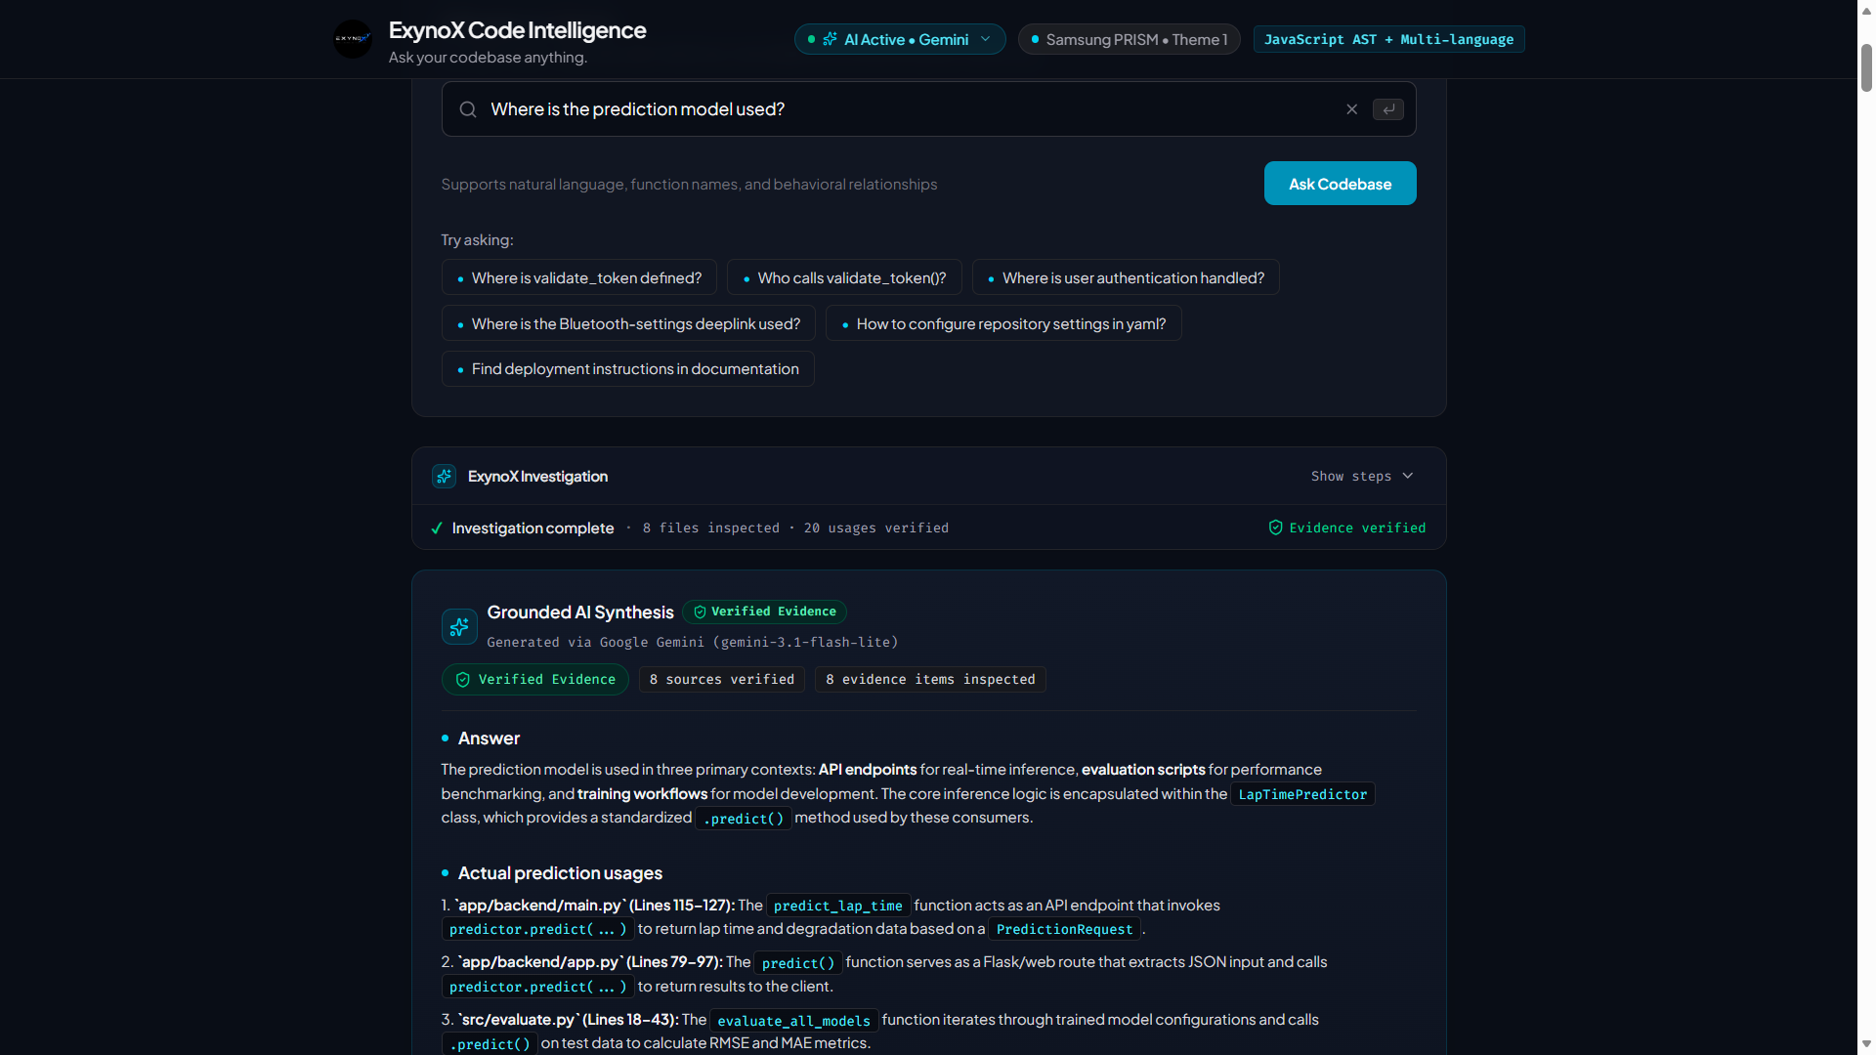
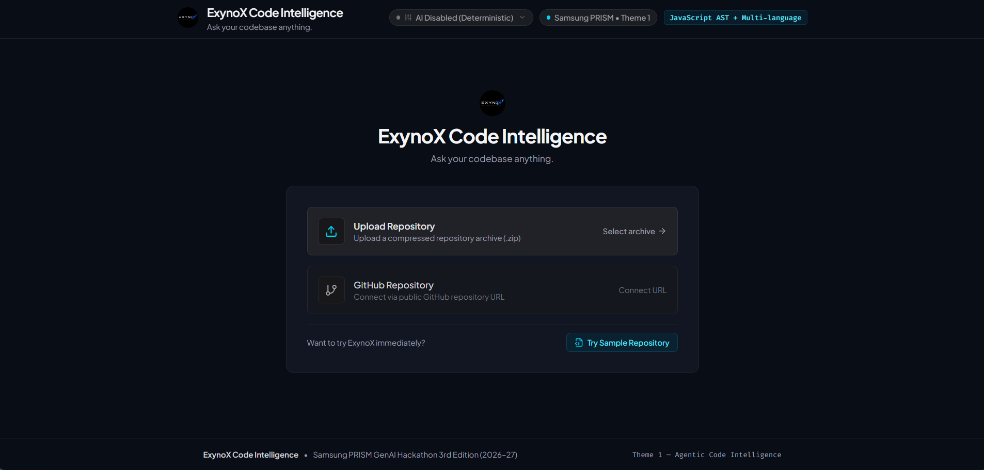
05
Demo & Product Walkthrough
User-facing flow: ask a code question, investigate evidence, trace relationships, then explain the result.
ASK
Question
PLAN
Evidence path
SEARCH
Semantic + structural
INSPECT
Candidate code
TRACE
Relationships
REFINE
Evidence gaps
ANSWER
Explanation
01
02
03
04
05
06
07
LIVE PROTOTYPE EVIDENCE
Repository entry • ZIP upload • GitHub URL • sample repository
QUERY
“Where is the prediction model used?”
AI Active • Gemini • Verified Evidence
▶ WATCH THE FULL DEMO VIDEO

Slide 6
06
Tools and tech stack used
Technology grouped by the role it performs in indexing, retrieval, reasoning and evaluation.
JAVASCRIPT / TYPESCRIPT
Primary target codebase
AST PARSING
Code structure
EMBEDDINGS
Semantic representation
VECTOR INDEX
Semantic retrieval
CALL GRAPH
Relationships
AGENT LOOP
Plan / retrieve / refine
EVALUATION METRICS
Precision@K • Recall • Latency • Indexing Cost
RESOURCE-AWARE RETRIEVAL
CPU-first / efficient retrieval where supported
RESOURCE-AWARE • KEEP THE REPOSITORY OUT OF CONTEXT WHEN IT IS NOT NEEDED

Slide 7
07
Impact & Use case
A developer moves from a natural-language question to searchable, traceable code context.
QUESTION
Natural-language intent
SEARCH
Find relevant evidence
EVIDENCE
Anchor to code
TRACE
Follow relationships
UNDERSTANDING
Build code context
DEBUGGING
Find where behavior originates
ONBOARDING
Understand unfamiliar code
IMPACT ANALYSIS
Trace dependencies and relationships
NAVIGATION
Locate feature usage
CODE UNDERSTANDING
Move from natural-language questions to evidence

Slide 8
08
Innovation highlights, evaluation and limitations
Evaluation framework on a small F1 Lap-Time Predictor repository; results are indicative, not representative of large-scale repositories.
INNOVATION HIGHLIGHTS
EVALUATION FRAMEWORK
LIMITATIONS
Agentic retrieval
Precision@K
Top-1 / Top-3 / Top-5 relevance
Indexing overhead
Semantic + structural retrieval
Recall
Relevant evidence coverage
Parser coverage
Evidence-first output
Latency
Mean + P90 query time
Chunking sensitivity
Multi-step tracing
Grounding Rate
Answers supported by verified evidence
Relationship-aware investigation
Structural limits
Benchmark scope: 10 reproducible evaluation queries
Indexing cost: files • lines • bytes • parsing time
MEASURE → REFINE → REPEAT

Slide 9
09
What's next
Future work is explicitly separated from the current prototype.
01
02
03
04
RICHER STRUCTURE
Call-graph + symbol reasoning
MULTI-HOP TRACE
Relationship tracing
SMARTER AGENTS
Tool planning + reranking
SCALE
Incremental indexing + larger repositories
NORTH STAR
Make large codebases searchable, traceable and explainable without loading the whole repository into context.
BUILD → TRACE → SCALE

Slide 10
10
Brownie Points / Differentiation
What distinguishes the approach: interaction between semantic retrieval, structural evidence and investigation.
SEMANTIC + STRUCTURAL
Semantic retrieval finds meaning; structural analysis finds relationships.
AGENTIC, NOT ONE-SHOT
Plan, inspect, trace and refine instead of answering from one retrieval call.
EVIDENCE-FIRST
Answers are accompanied by file, line and snippet evidence.
TRACEABLE
Users can follow relevant relationships through the codebase.
RELATIONSHIP-AWARE
Supports usages, callers, dependencies and code paths.
RESOURCE-CONSCIOUS
Keeps retrieval focused and avoids loading the whole repository into context.
ASK → PLAN → RETRIEVE → TRACE → EXPLAIN

Slide 11
11
Checklist — Updated on Public GitHub
Final submission readiness checklist.
WORKING PROTOTYPE
Public/shared GitHub repo
✓ CONFIRMED
https://github.com/ExynoX-Team/ExynoX-Code-Intelligence
README
Reproducible setup instructions
✓ CONFIRMED
DEMO VIDEO
Maximum 5 minutes
✓ CONFIRMED
https://drive.google.com/file/d/1lHp3Xx4LIlOMjY_iVLKTWf7x0VvgcM1i/view?usp=sharing
PRESENTATION FILE
PPT / PDF
✓ CONFIRMED
Final PPT/PDF included in submission
Required release tag: PRISM_GENAI_HACKATHON_Y2026 • Tag only after the final commit is complete.

Slide 12
Thank you
AGENTIC CODE INTELLIGENCE
EXYNOX • THEME 01
Mohammad Kashif Fazili
Shaurya Barnwal
Vandana Patel
Suryansh Nair
SRM Institute of Science and Technology — KTR
https://github.com/ExynoX-Team/ExynoX-Code-Intelligence
Organised by the Language AI Team and the PRISM Team, Samsung R&D Institute India

