Slide 1
第一幕；今日生成

Slide 2
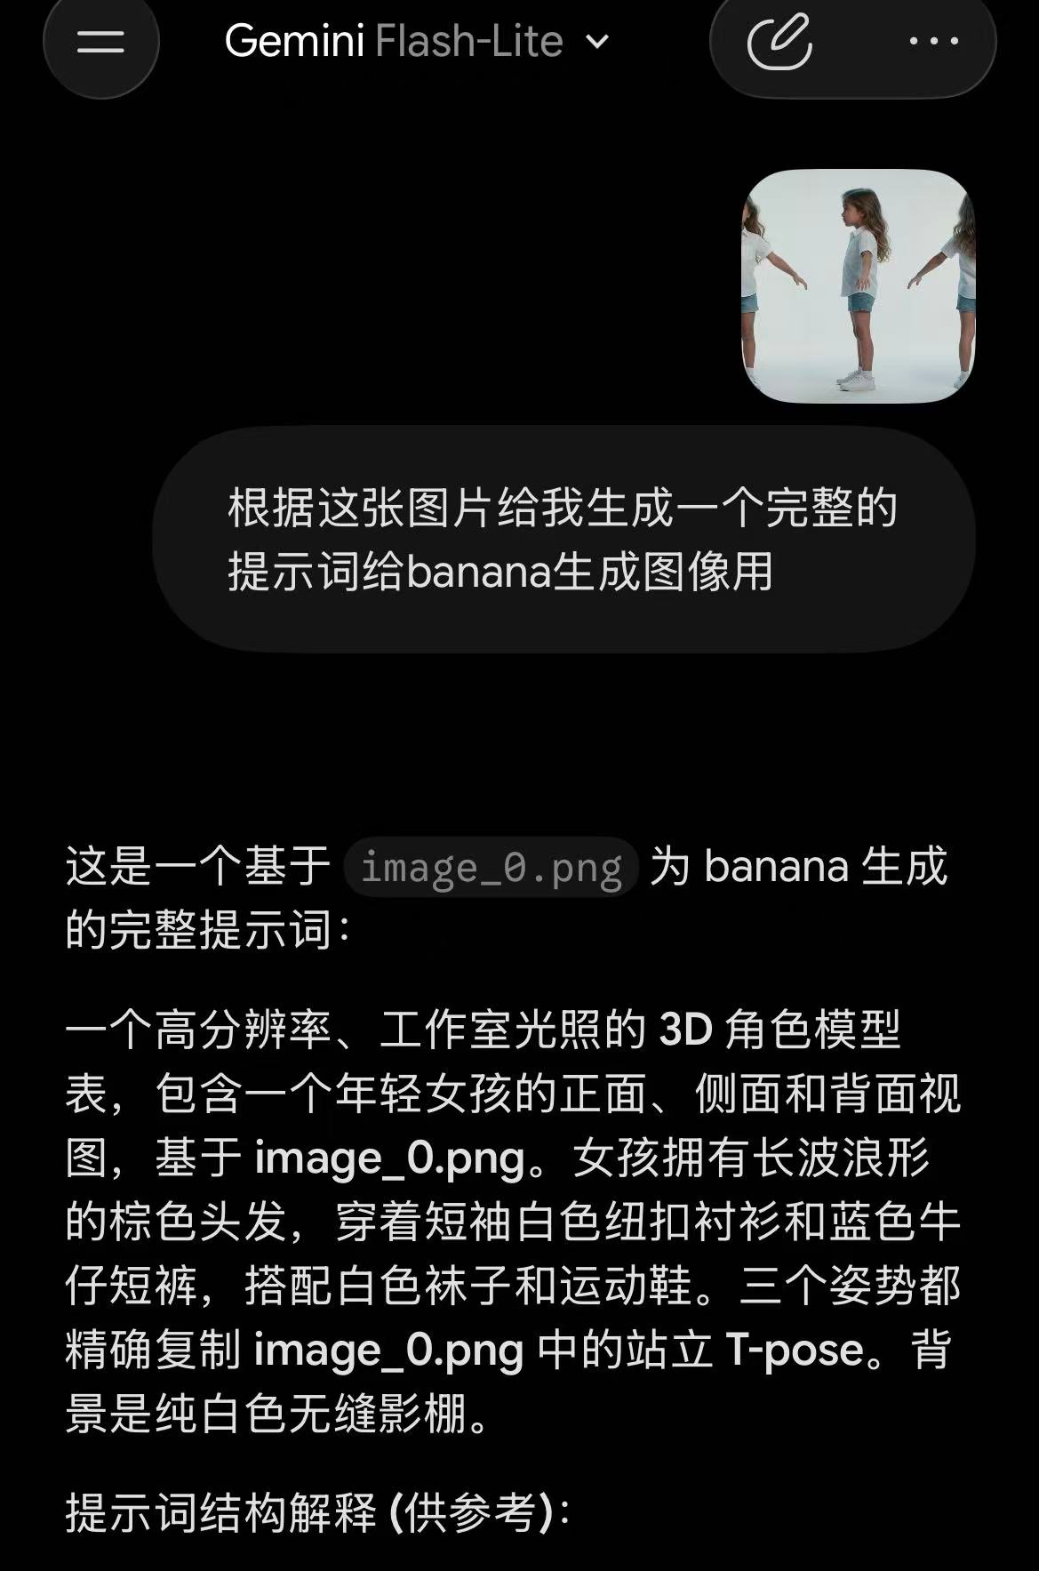
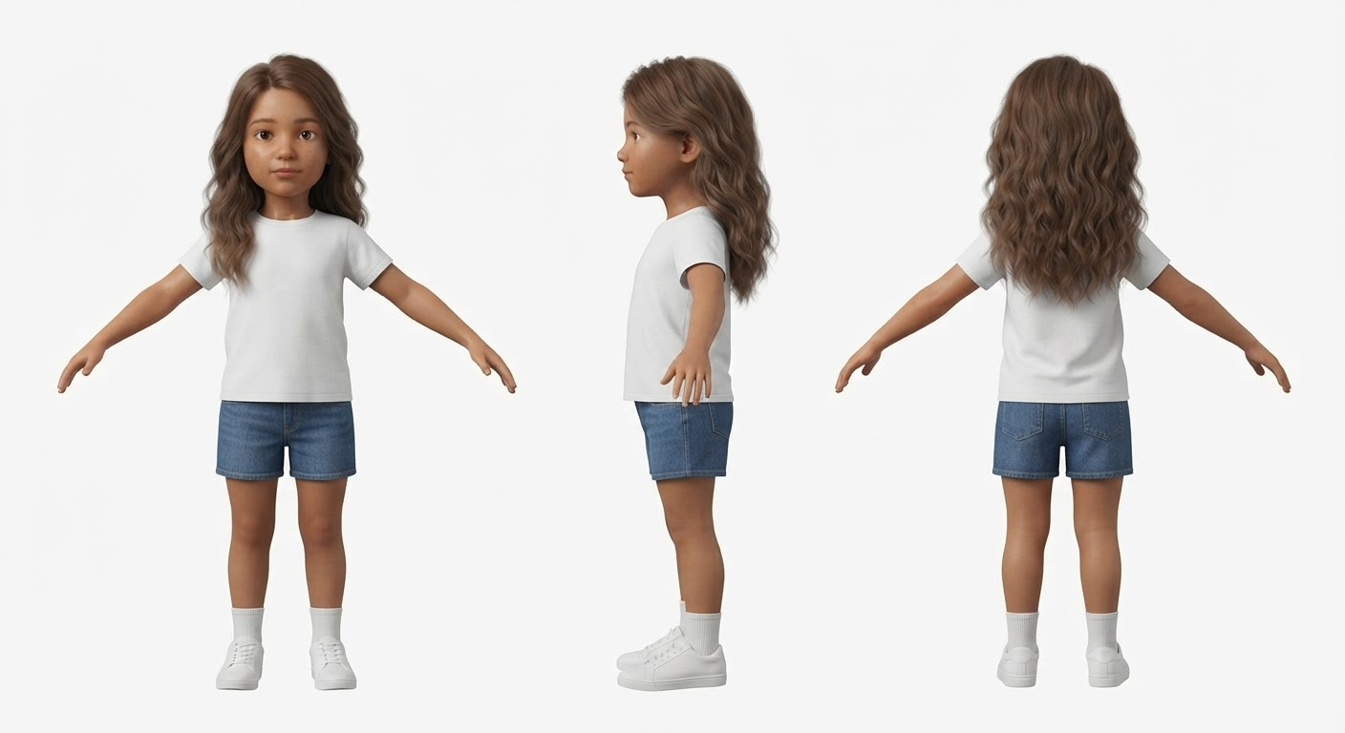
关于提示词
A professional high-resolution character sheet of a young girl, showcasing her from three angles: front view, side profile, and back view. The girl has long, wavy brown hair and is wearing a short-sleeved white button-up collared shirt, blue denim shorts, white ankle socks, and clean white sneakers. All three figures are depicted in a consistent T-pose stance, matching the reference image. The lighting is bright, even, studio-style lighting, isolated on a clean, solid white background. Photorealistic style, sharp focus, 8k resolution, neutral expression, symmetrical composition.
gemimi -flash-lite

Slide 3
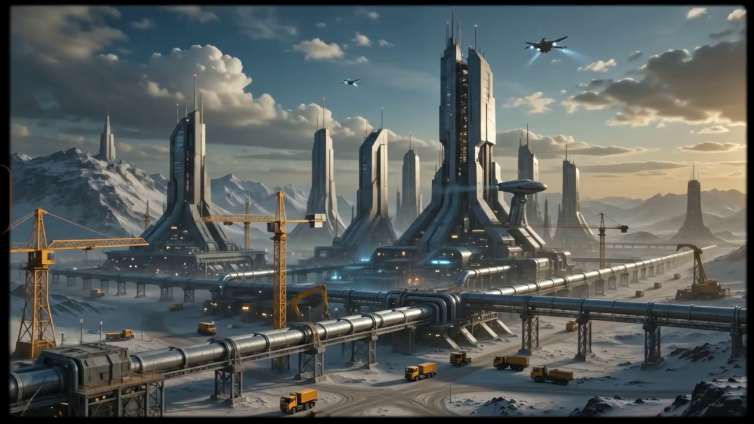
1
A sudden, jarring transition scene based on image_0.png. The entire screen instantly flashes to an intense, overexposed, blinding white, completely washing out all details of the industrial complex. The bright light pulses for a split second, creating a 'whiteout' effect, followed immediately by the screen cutting to black, simulating a character's eyes snapping open from a nightmare. This is a rapid, disorienting 1-second flash sequence. Extreme high-key lighting, zero detail, motion blur."

Slide 4
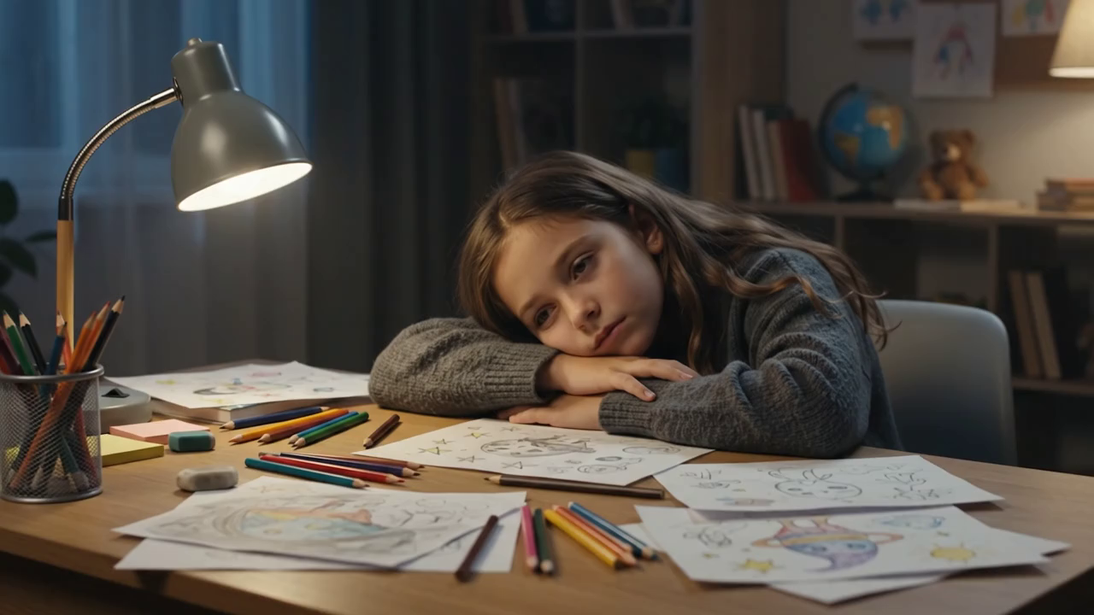
2
A cinematic realistic scene of a 10-year-old girl sitting alone at a desk late at night. She is resting her head on her arms, looking tired and frustrated, surrounded by messy unfinished drawings, scattered papers, pencils and creative sketches. The desk is filled with chaotic ideas that have no clear direction.
The girl looks disappointed and confused, staring at her unfinished drawings, feeling unable to turn her imagination into reality. A warm desk lamp creates a quiet and emotional atmosphere. The room is simple, realistic and slightly lonely.
Cinematic film style, emotional storytelling, realistic child expression, soft lighting, shallow depth of field, 35mm film texture, high-end movie scene, 16:9 widescreen.

Slide 5
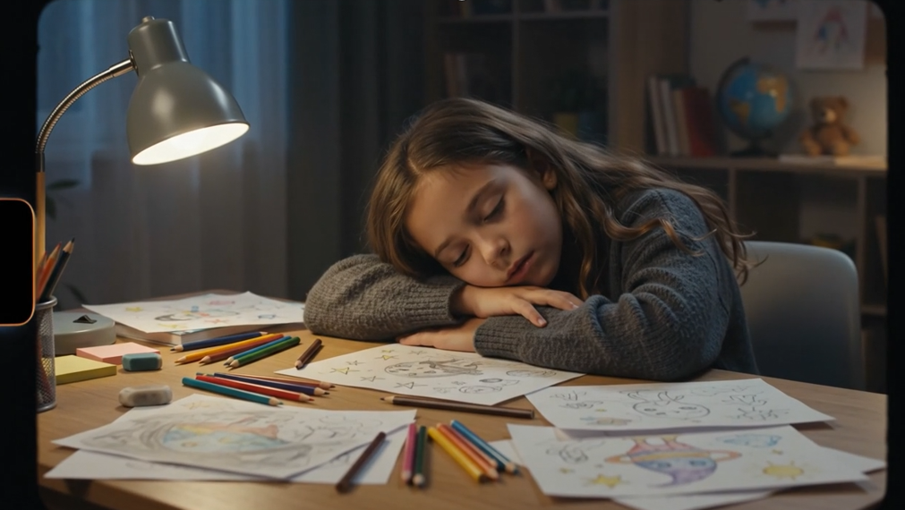
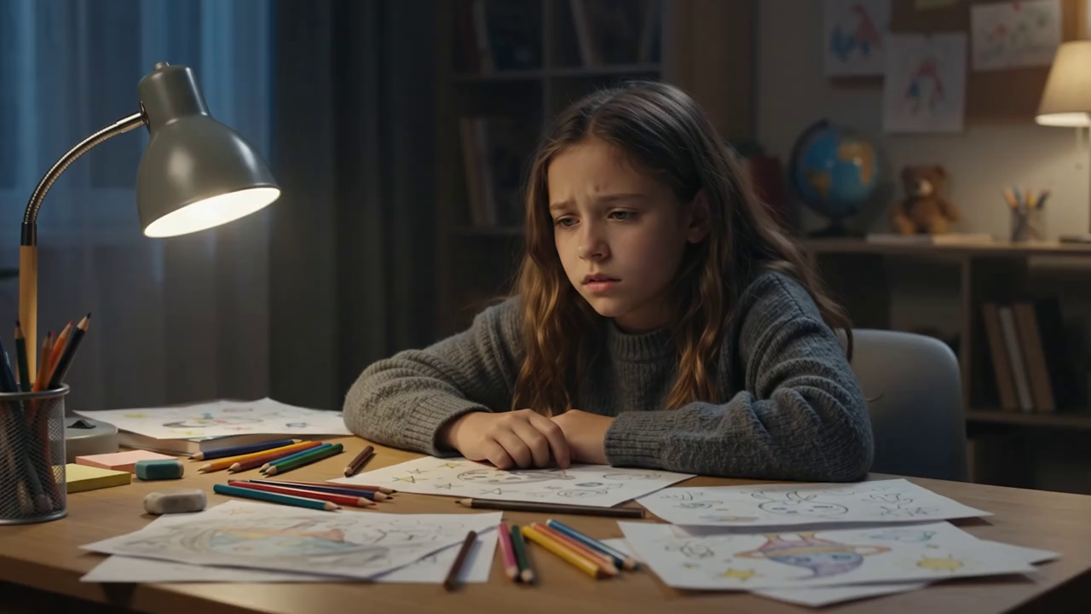
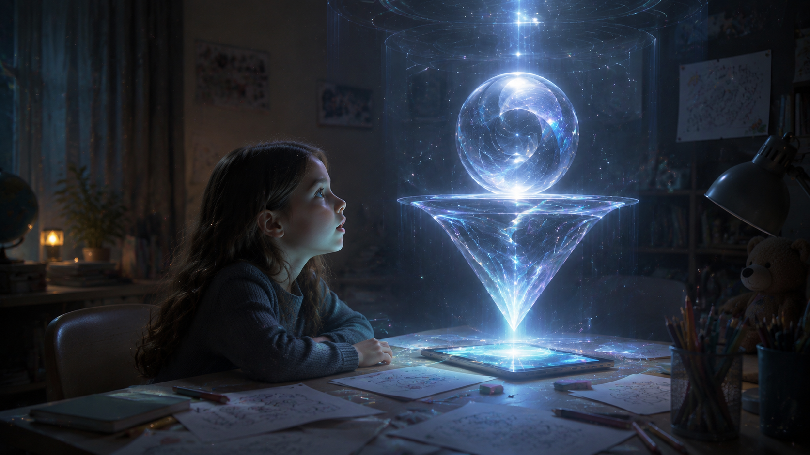
3
Cinematic sci-fi scene. A 10-year-old girl sits quietly at her desk in a dark room, surrounded by unfinished drawings and scattered sketches. She looks tired and confused, staring at her ideas without knowing how to continue.
Suddenly, the tablet on the desk slowly lights up. A soft blue-white glow spreads across the room. Tiny particles of light begin to emerge from the screen, floating gently in the air.
The particles gather together and gradually form the AI Envoy, not a humanoid robot, but a futuristic intelligent holographic structure. A transparent inverted triangular crystal core slowly appears, with a luminous glass sphere floating above it. The structure is made of elegant transparent materials, flowing energy patterns and advanced holographic technology.
The AI Envoy stabilizes in front of the girl. Light reflects on her face as she slowly raises her head, her expression changing from sadness and confusion to curiosity and wonder.
The camera slowly pushes in from the girl’s perspective, revealing the mysterious AI presence. The room remains realistic while futuristic light and particles blend with the environment.
Slow cinematic movement, emotional storytelling, realistic sci-fi movie style, IMAX quality, Apple futuristic design language, transparent glass material, soft volumetric lighting, 16:9 widescreen.

Slide 6
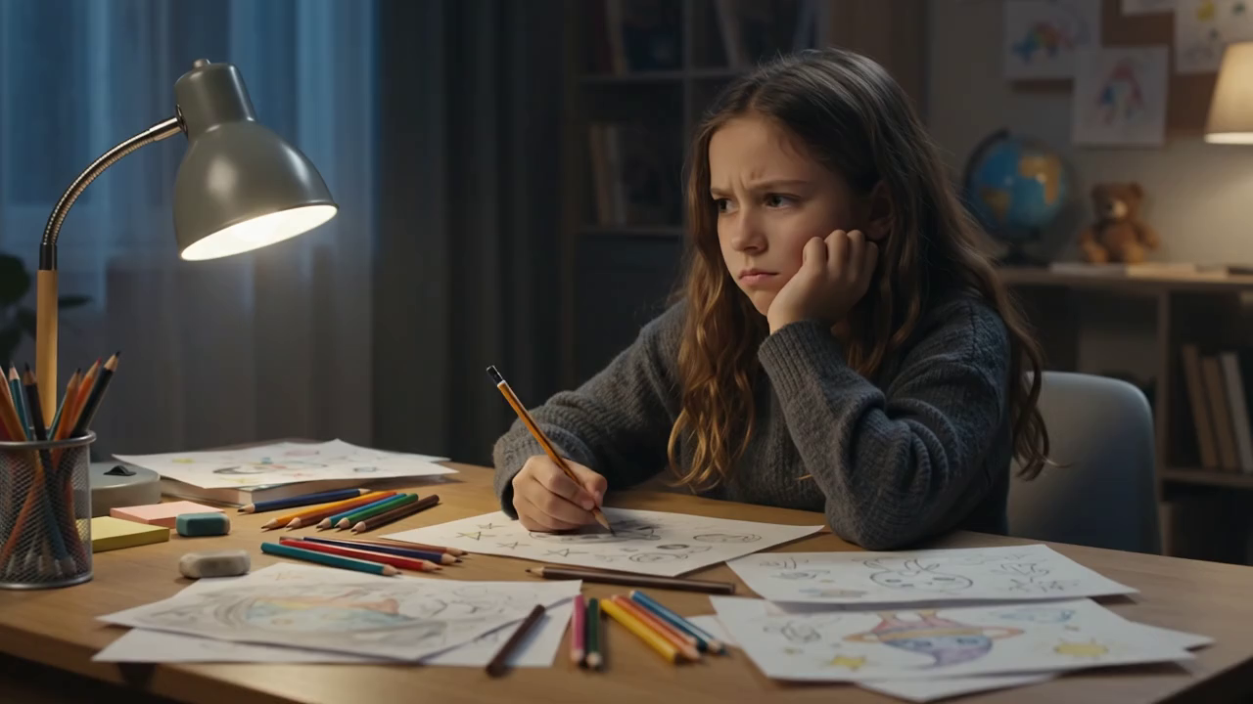
3.1（挑片段）

Slide 7
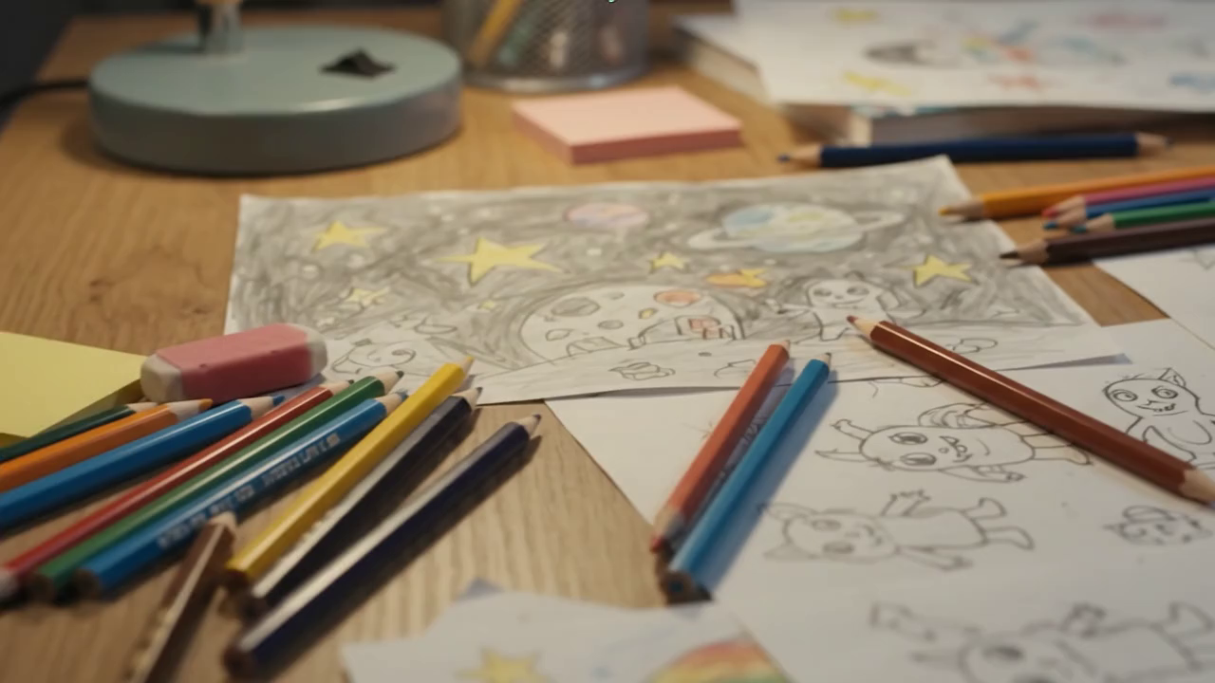
4
Cinematic close-up shot of a creative girl’s messy desk at night. The camera slowly moves across scattered hand-drawn sketches, colored pencils and unfinished ideas on paper.
The drawings show imaginative concepts, futuristic buildings, planets, stars and strange inventions, but they are incomplete and chaotic, like fragments of imagination waiting to be organized.
The girl sits in the background, quietly looking at her sketches with a thoughtful and slightly frustrated expression. Her hand slowly touches one unfinished drawing, hesitating because she doesn’t know how to turn her ideas into reality.
The camera slowly pushes in from the desk surface toward the main sketch. Focus shifts from the girl’s blurred silhouette to the detailed pencil lines on the paper.
Warm desk lamp lighting, realistic bedroom environment, emotional storytelling, cinematic film look, shallow depth of field, 35mm lens, soft shadows, realistic texture, high-end sci-fi movie style, 16:9 widescreen.

