Slide 1
PULSE AI
FINTECHATHON 2026 / TOPIC E
Your business has a heartbeat.
See the cash crisis
before it arrives.
PULSE AI
18 DAYS
The Financial Autopilot for SMEs
Decision support. Human control.
to the demo forecast shortfall
THE INVISIBLE FINANCIAL CRISIS
01
Notes:
Timing: 45 seconds. Open with the gap between financial history and the next obligation. In our synthetic example, cash is positive today but the engine forecasts a negative position in eighteen days. These are real outputs from our demonstration data, not a claim about a real customer or prediction accuracy. PULSE is a financial copilot, not a service that autonomously moves money. We use the term autopilot to describe continuous analytical support while the owner keeps control.

Slide 2
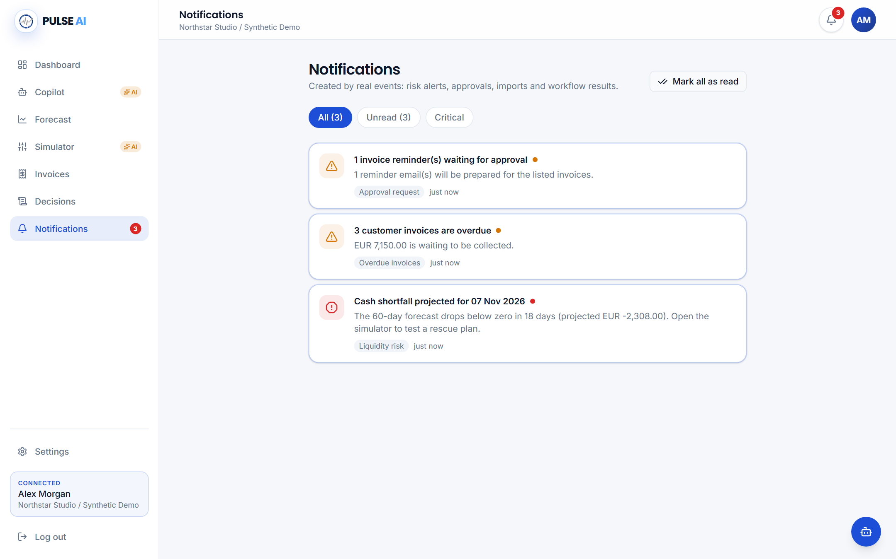
PULSE AI
FINTECHATHON 2026 / TOPIC E
Why SMEs Struggle
Positive history.
A negative cash date.
REACTIVE
Spreadsheets explain yesterday.
FRAGMENTED
One late invoice changes the picture.
UNSUPPORTED
Owners need evidence, not guesses.
WHY SMES STRUGGLE
02
Notes:
Timing: 50 seconds. SMEs may have accounting data without an integrated view of cash timing. Our demonstration has positive trailing net flow and no positive historical burn rate, yet the forecast sees a timing shortfall. The product connects invoices, transactions and recurring obligations so an owner can inspect the underlying reason. We do not claim market adoption, customer savings or forecast accuracy measurements. The problem and design are illustrated by our synthetic, reproducible business case.

Slide 3
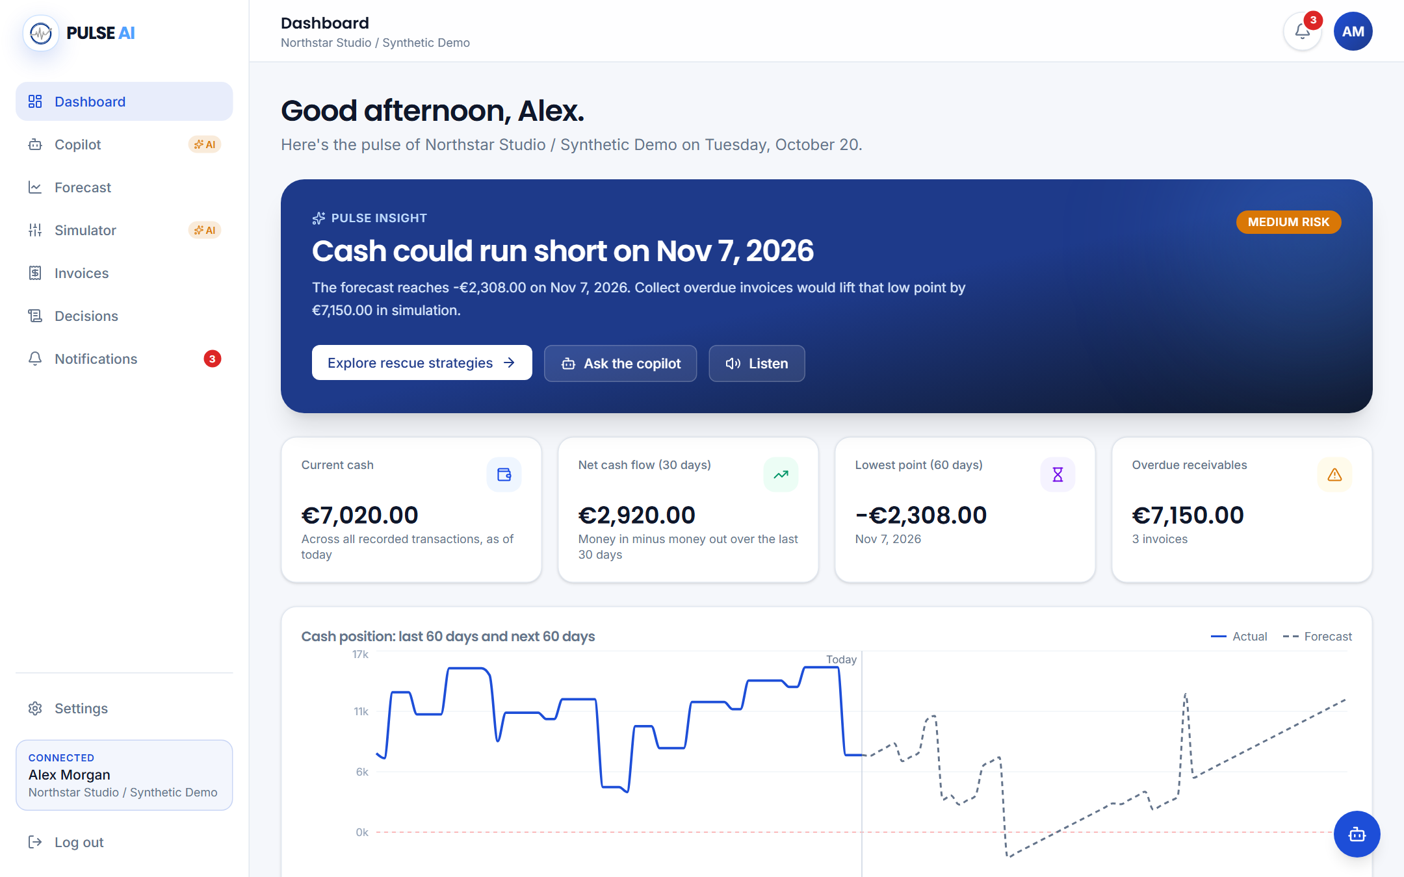
PULSE AI
FINTECHATHON 2026 / TOPIC E
Introducing PULSE AI
Understand.
Anticipate.
Simulate.
Decide.
Real calculations first.
Language generation is optional.
INTRODUCING PULSE AI
03
Notes:
Timing: 50 seconds. PULSE is a working React and FastAPI application backed by deterministic Python engines. Supabase PostgreSQL is our shared deployment database; this captured demonstration deliberately uses a separate SQLite fixture, so no private business data appears. The dashboard combines current liquidity, upcoming events, risks and candidate interventions. The no-key copilot remains functional because the numbers do not depend on an LLM. This separation is the core product architecture, not a claim that generated language can never make mistakes.

Slide 4
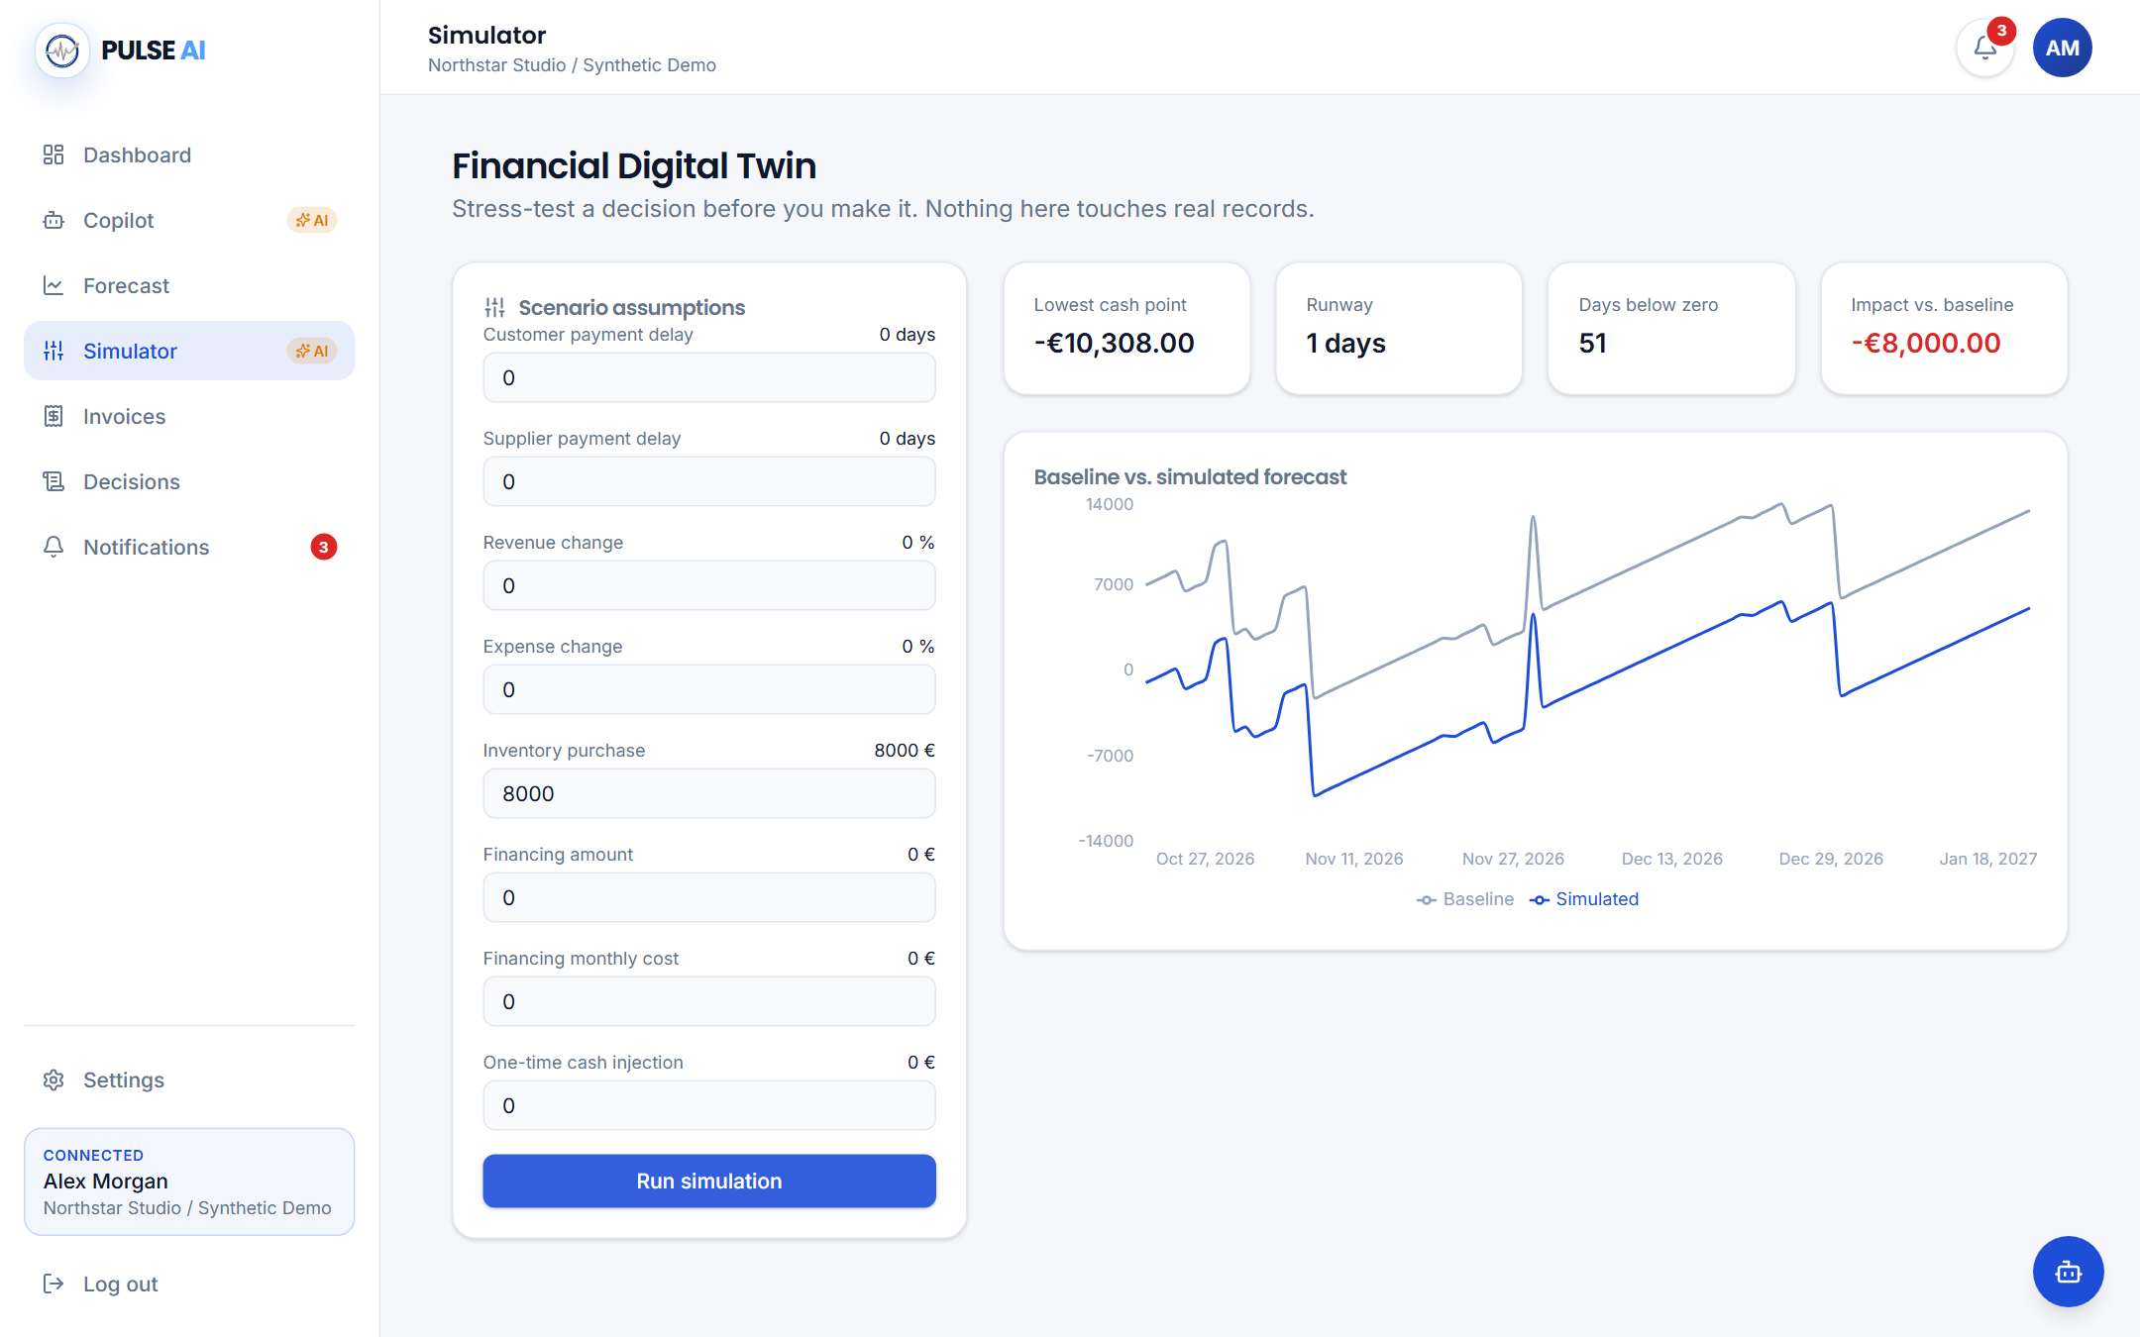
PULSE AI
FINTECHATHON 2026 / TOPIC E
The Financial Digital Twin
One business.
More possible
futures.
Payment timing
Inventory purchases
Revenue and expense shocks
Financing assumptions
Original financial records stay intact.
THE FINANCIAL DIGITAL TWIN
04
Notes:
Timing: 50 seconds. The Digital Twin copies inputs and runs the same forecast engine for both baseline and alternative. We can test payment delays, an inventory purchase, revenue or expense changes and financing assumptions. The EUR 8,000 purchase in our evidence shifts day-one cash by exactly EUR 8,000. We independently validate that result and check that the original invoice records remain unchanged. Scenarios are stored for comparison, but the financial records they model are not rewritten. Financing examples are illustrative terms, not real lender offers.

Slide 5
PULSE AI
FINTECHATHON 2026 / TOPIC E
Predicting Financial Risk
Known commitments + uncertain daily flow
EUR -2,308.00
lowest projected cash
7 DAYS
below zero in baseline
Actual 90-day engine output · synthetic business · estimates, not guarantees
PREDICTING FINANCIAL RISK
05
Notes:
Timing: 50 seconds. This chart is drawn from the actual forecast JSON, not a fabricated interface. Each day equals the previous balance plus known scheduled flow and an explicitly uncertain historical average. Recurring categories are excluded from that average to avoid one category-level double count. Confidence labels are heuristic and not statistically calibrated probabilities. The cash minimum is negative EUR 2,308, with seven negative-cash days. We also disclose model limitations such as month-end recurrence and possible overlap between invoice collections and average historical revenue.

Slide 6
PULSE AI
FINTECHATHON 2026 / TOPIC E
From Risk to Rescue
What if suppliers grant 15 more days?
BASELINE
SIMULATED
NEGATIVE DAYS
EUR -2,308.00
EUR 2,064.00
7 → 0
EUR 4,372 improvement in the lowest cash point.
A conditional scenario, not a guarantee. Collection and credit alternatives are also ranked by engine results.
FROM RISK TO RESCUE
06
Notes:
Timing: 50 seconds. We choose a specific intervention and state its assumption: suppliers agree to a fifteen-day extension. The simulated cash minimum rises from negative EUR 2,308 to positive EUR 2,064, an improvement of EUR 4,372. Negative-cash days fall from seven to zero in this case. The engine also ranks collection and illustrative credit strategies. These are conditional outcomes, not guaranteed rescue promises. Importantly, ending-cash impact and minimum-cash improvement are separate metrics: shifting timing can improve the minimum without changing the ending balance.

Slide 7
PULSE AI
FINTECHATHON 2026 / TOPIC E
Agentic AI Architecture
Specialist roles. Registered tools. Scoped data.
Financial Analyst
Forecast Analyst
Strategic Planner
Risk Guardian
Liquidity and invoices
Dates and risk drivers
Simulations and rescues
Tool scope and permissions
Orchestrator → deterministic tools → explanation / proposal
No RAG claim. No direct payment tool. LLM tool calling is optional.
AGENTIC AI ARCHITECTURE
07
Notes:
Timing: 55 seconds. These are logical specialist roles in one service, not four independently deployed AI services. The registry exposes financial summary, forecasting, simulation, rescue-plan, invoice and reminder-proposal tools. With an LLM key, a bounded tool loop chooses registered calls. Without a key, the deterministic path still works. The Risk Guardian enforces scope and permissions, but we do not claim a complete semantic verifier of all generated text. There is no RAG implementation or vector database. No tool directly sends money, and proposed reminders still need approval.

Slide 8
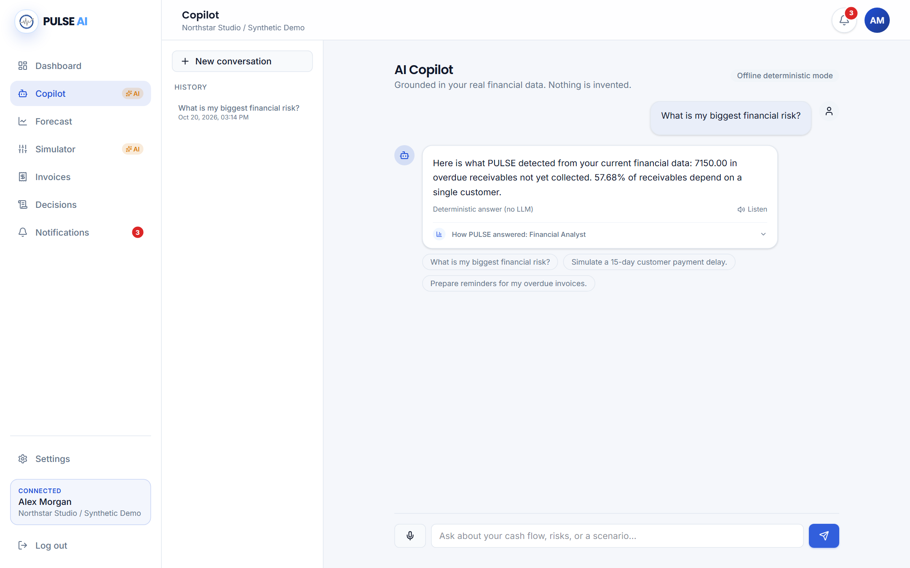
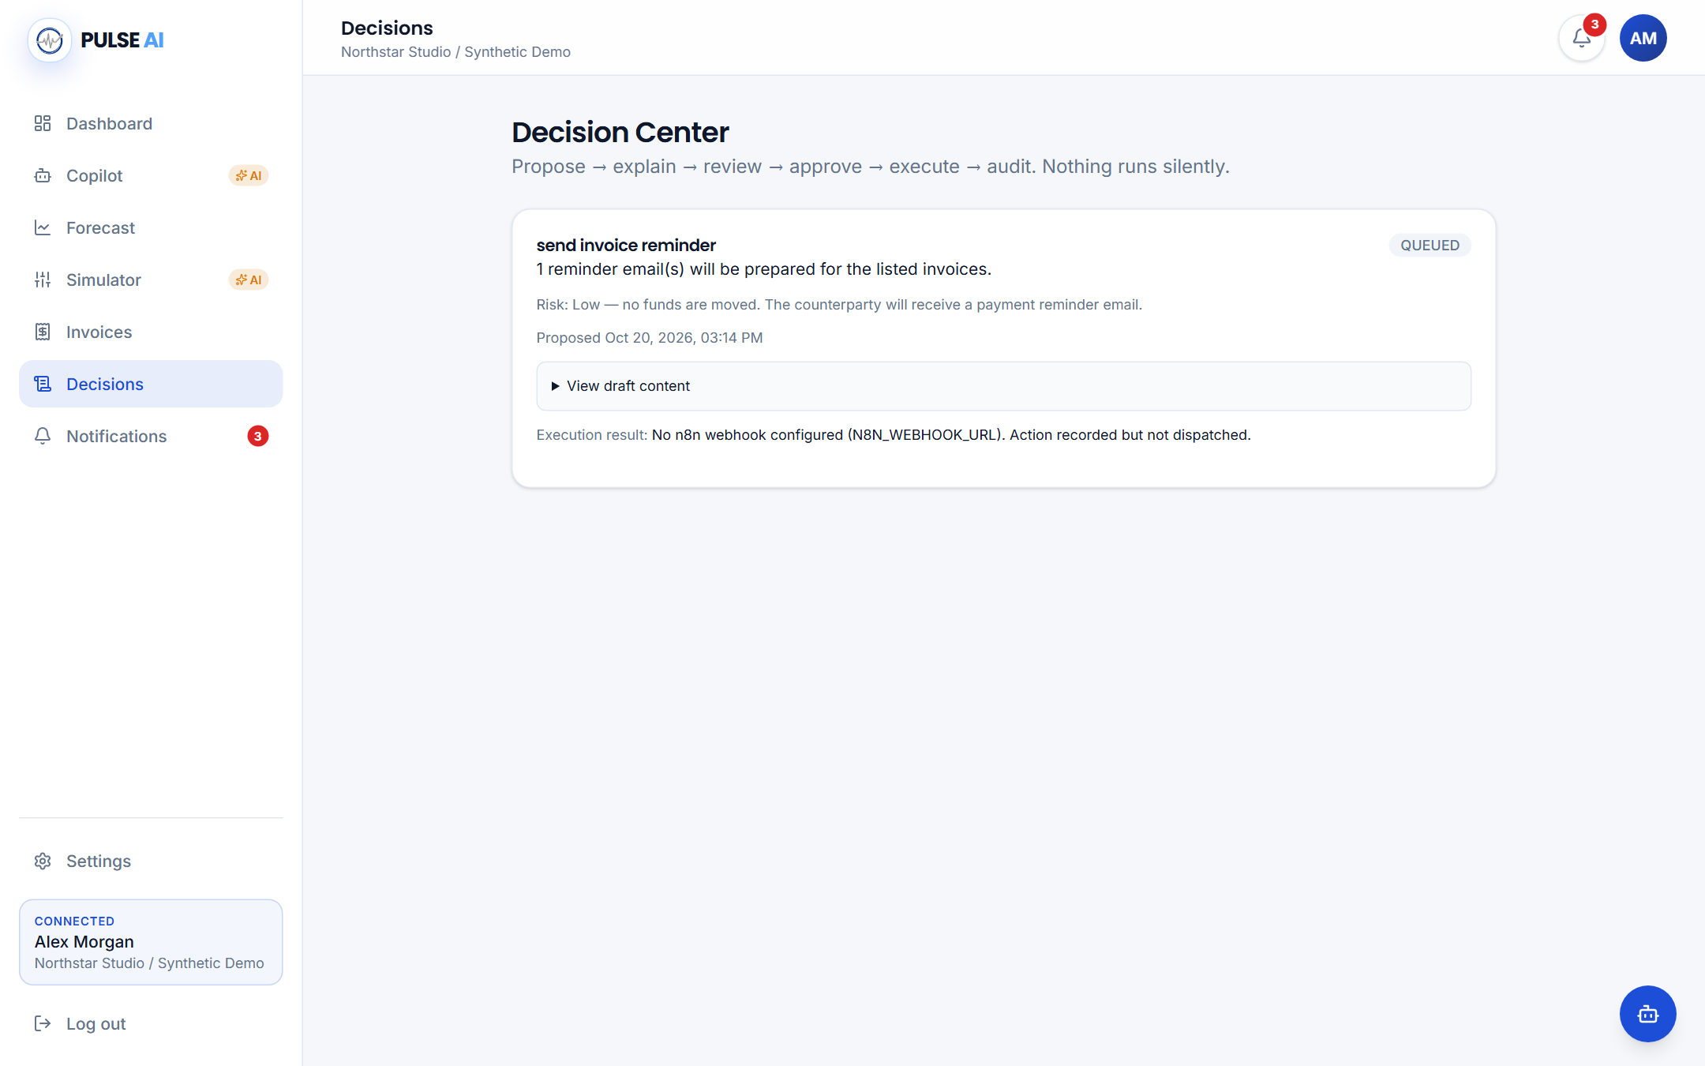
PULSE AI
FINTECHATHON 2026 / TOPIC E
Live Demo and Execution Evidence
86 tests passed · Real browser capture · No customer dispatch in this demo
LIVE DEMO AND EXECUTION EVIDENCE
08
Notes:
Timing: 120 seconds for the included genuine browser video, or about 60 seconds for the screenshot walkthrough. Show the dashboard, risk alert, copilot, purchase scenario, supplier extension, approval and queued execution. This prototype run uses synthetic data and deterministic copilot mode. It demonstrates an actual blocked execution before approval, human approval through the UI, queued action when no external channel is configured, and a blocked sequential replay. QUEUED must never be described as SENT. The separate n8n integration evidence confirms real SMTP workflows from the local integration session.

Slide 9
PULSE AI
FINTECHATHON 2026 / TOPIC E
Security and Human Control
Propose → Review → Approve → Execute → Audit
Identity
Scope
Control
JWT, bcrypt, email OTP
Organization and role checks
Approval before execution
Honest boundaries
Next: stronger concurrent idempotency, rate limits, session hardening and validated deployment policies.
SECURITY AND HUMAN CONTROL
09
Notes:
Timing: 50 seconds. Identity and tenant controls are implemented server-side. A platform administrator reviews account access but does not automatically gain tenant financial access. Action approval and audit history are real. We are also explicit about gaps: browser tokens are in localStorage, audit tables are not tamper-proof, and concurrency-safe execution and external provider idempotency need strengthening. Supabase is the selected shared database, but database-level RLS is not established by these tests. This is a self-assessment, not a certification or penetration-test result.

Slide 10
PULSE AI
FINTECHATHON 2026 / TOPIC E
Better foresight.
More deliberate decisions.
IMPLEMENTED NOW
Deterministic engine + Digital Twin + optional copilot + human-approved
workflows
NEXT CHAPTER
Shared Supabase deployment · Bank feeds · Calibrated uncertainty · Production hardening
IMPACT AND FUTURE VISION
10
Notes:
Timing: 50 seconds. Close on the concrete differentiation: the same engine powers insight, forecast, what-if comparison and evidence-based interventions. This reduces the gap between a business question and an inspectable decision. We do not claim a measured reduction in business failures or customer savings. Supabase PostgreSQL is our shared deployment direction; banking integrations, calibrated uncertainty and deeper operational hardening are future work. The competition package contains actual tests, API outputs, source instructions, screenshots and a genuine demonstration video so judges can reproduce the implementation.

