Slide 1
Tunisian Administrative Procedures Assistant
A local, source-grounded multi-agent RAG system for multilingual administrative guidance
Telegram · n8n · FastAPI · Qdrant · Ollama
French · English · Arabic · Tunisian Derja (Arabic and Latin script)
Advanced Deep Learning · Team of six · October 2026
Member 1 · Member 2 · Member 3 · Member 4 · Member 5 · Member 6
Notes:
Good morning. We are presenting the Tunisian Administrative Procedures Assistant: a local, source-grounded,
multi-agent system that answers questions about Tunisian administrative procedures in French, English, Arabic and
Tunisian Derja. I will introduce the problem and our objectives. My colleagues will then walk you through the
architecture, the prompt engineering, the retrieval, the agents, the multimodal part, a live demonstration, and
our results.

Slide 2
1 · Introduction and Use Case
Member 1
Fragmented, bilingual and risky to paraphrase
Fragmented
Language gap
High stakes
▪ Ministry of the Interior guides (FR / AR)
▪ RNE table of 95 procedures with fees and deadlines
▪ Laws and decrees as Official Journal PDFs
▪ Official text: French and Arabic
▪ Users often write Tunisian Derja, in Latin script with digits: “9adech ya5ou wa9t el passbor?”
▪ FR and AR passport pages state different stamp duties: 20/60 vs 25/80 TND
▪ A fluent but invented fee or document costs citizens time and money
Source: report §1; official pages interior passport guide FR/AR (data/raw), RNE formalities table
Tunisian Administrative Procedures Assistant · Advanced Deep Learning · October 2026
2
Notes:
Why this use case? Consider a citizen who wants to renew a passport or register a small company.
- **The information is fragmented.** The Ministry of the Interior publishes procedure guides in French and in
Arabic. The National Business Register, the RNE, publishes a table of ninety-five procedures with fees and
legal deadlines. The laws and decrees behind them are PDF files from the Official Journal.
- **There is a language gap.** The official text is in French or Arabic, but many people write in Derja, often
in Latin script with digits. For example: "9adech ya5ou wa9t el passbor?", meaning "how long does a passport
take?".
- **The sources are not even consistent.** The French and Arabic passport pages state different stamp duties:
twenty and sixty dinars on one, twenty-five and eighty on the other.
A general chatbot would answer all of this fluently, and that is exactly the risk. An invented fee, a missing
document or a wrong deadline costs a citizen a trip to an office, time and money.

Slide 3
1 · Introduction and Use Case
Member 1
Objectives, scope and expected value
1
Answer only from verifiable official documents, with citations
Scope
Passports · National identity card (CIN)
RNE business registration (95 procedures, 6 legal texts, forms F-001/F-002)
2
Refuse or ask for clarification when the corpus cannot answer
3
Support FR, EN, AR and Derja without altering official text
4
Deliberately excluded
Birth certificates: the only source opts out of AI use (robots.txt)
Check official forms and dossiers without certifying them
5
Run on one laptop (4 GB GPU): no paid API, no data leaves the machine
Value: traceable answers, free, private, multilingual
Source: report §1 (objectives, scope); config/sources.yaml (exclusions with recorded reasons)
Tunisian Administrative Procedures Assistant · Advanced Deep Learning · October 2026
3
Notes:
So we set five objectives:
1. Answer only from verifiable official documents, with citations.
2. Refuse, or ask a clarifying question, when the documents cannot answer.
3. Support four languages without ever altering the official text.
4. Check official forms and dossiers for missing information, without pretending to certify them.
5. Run everything on one laptop with a four-gigabyte GPU: no paid API, and no data leaves the machine.
Our scope is passports, the national identity card, and business registration at the RNE, including its legal
texts and the two official registration forms.
- **One exclusion is deliberate.** We wanted to cover birth certificates, but the only official source opts out
of AI use in its robots file. We respected that, and the assistant says that this procedure is not covered.
The value is traceability. Every statement can be followed back to an official document with its address and
checksum. The system is also free, private, and usable in the language people actually write in.
Member 2 will now show you how the system is built.
---
## Member 2: System Architecture and Automation Workflow (slides 4–6, 3:20)

Slide 4
2 · System Architecture and Automation Workflow
Member 2
Architecture: everything runs locally behind 127.0.0.1
FastAPI backend
/agents/route
/agents/retrieve
/agents/checklist
/agents/answer
/agents/form-check
/agents/dossier-check
Qdrant 1.19
272 + 174 chunks
Citizen
Telegram
Telegram bridge
long polling, no inbound port
n8n 2.41.3
wf 03 assistant (17 nodes)
wf 02 retrieve API
wf 01 ingest+index (inactive)
Ollama 0.40.4
bge-m3 · mistral 7B
translategemma 4B
Web page / CLI
same webhook
Official corpus
12 docs + SHA-256
Design choices: Docker Compose · ports bound to 127.0.0.1 · Ollama on the host GPU (RTX 3050, 4 GB) reached via host.docker.internal · no paid API · uploads processed in memory, never indexed
Source: docker-compose.yml; backend/main.py; backend/agents_api.py; live inventory 2026-10-18
Tunisian Administrative Procedures Assistant · Advanced Deep Learning · October 2026
4
Notes:
Everything you see here runs locally, behind the loopback address.
1. **The Telegram bridge.** A citizen writes to our Telegram bot. The bridge uses long polling: it pulls
messages from Telegram, so the machine needs no public address and no open port.
2. **n8n.** The bridge sends the message, its language and a small conversation context to a webhook in n8n,
our orchestrator.
3. **The FastAPI backend.** n8n calls six agent endpoints in the backend.
4. **Qdrant**, our vector database, holds two collections of official chunks: 272 and 174.
5. **Ollama** runs our three models on the host GPU: BGE-M3 for embeddings, Mistral 7B for the language
tasks, and TranslateGemma for French-to-English translation.
A local web page and a command-line client use the same webhook as fallbacks. All ports are bound to
127.0.0.1, and uploaded documents are processed in memory and never indexed.

Slide 5
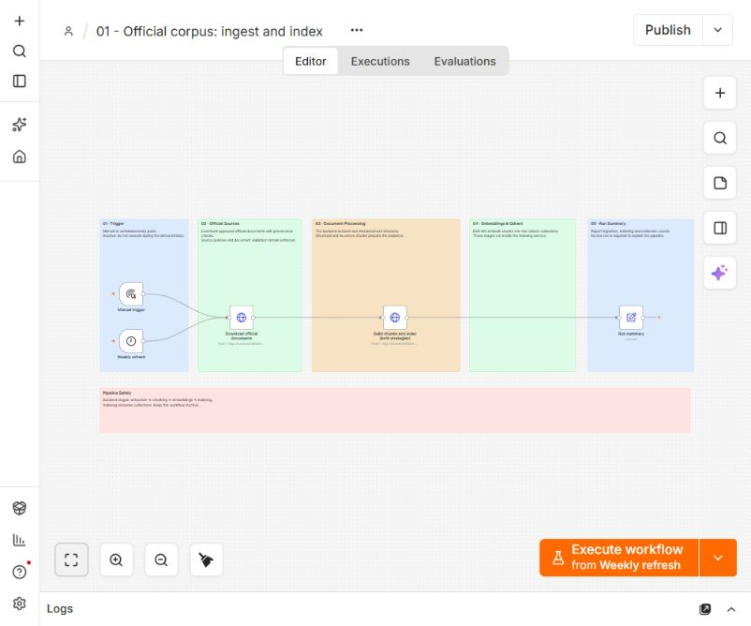
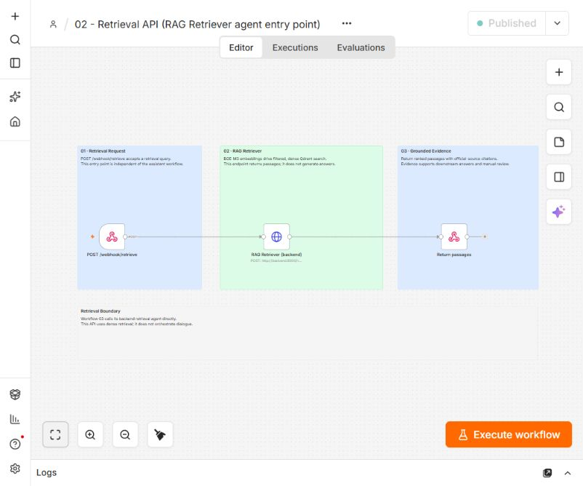
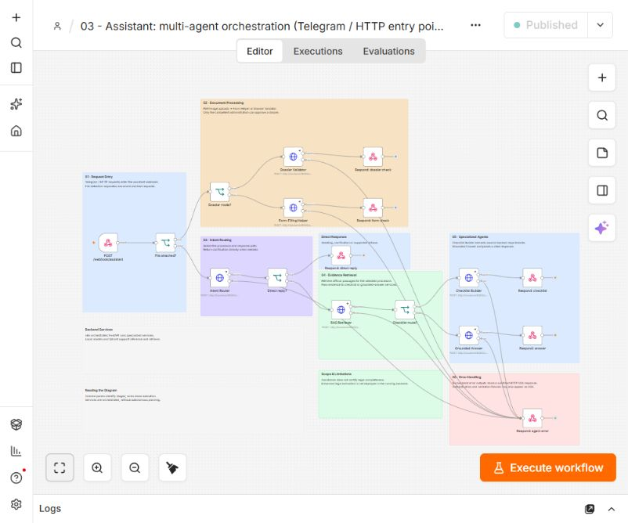
2 · System Architecture and Automation Workflow
Member 2
Three real n8n workflows
Screenshots of the live editor (Zoom to Fit), 2026-10-18
01 · Ingest and index
02 · Retrieval API
03 · Assistant orchestration
5 nodes · inactive · admin-only backend calls
3 nodes · published · POST /webhook/retrieve
17 nodes · published · POST /webhook/assistant
Sticky-note frames document each stage; every agent call in 03 has an error output to a sanitised HTTP 503 reply.
Source: workflows/*.json = live published versions (verified 2026-10-18); n8n editor screenshots
Tunisian Administrative Procedures Assistant · Advanced Deep Learning · October 2026
5
Notes:
These are real screenshots of our three workflows in the n8n editor.
- **Workflow 01** downloads the official documents and rebuilds both indexes. It is deliberately inactive and
calls privileged backend endpoints, so it cannot run by accident.
- **Workflow 02** is a small retrieval API: a webhook, one call to the retriever, and the passages returned
with their sources.
- **Workflow 03** is the assistant itself: seventeen executable nodes. The coloured frames are sticky notes that
document each stage. Every agent call has an error output that ends in a single sanitised error reply.

Slide 6
2 · System Architecture and Automation Workflow
Member 2
One request, end to end
Workflow 03 routes on file, dossier mode and the router's decision
Telegram
user message
Bridge
language, session context
Webhook
File attached?
Intent Router
rules first, LLM fallback
Direct reply?
greeting / clarification
RAG Retriever
hybrid or exact code
Checklist?
next_agent
Builder / Answer
verbatim or verified
Uploads (PDF, PNG, JPEG, Telegram photo) go to the Form-Filling Helper, or to the Dossier Validator in /dossier_check mode.
Errors from any of the six agent calls go to one sanitised 503 reply; the bridge retries, then shows a localised message.
Measured latency, final candidate alone on the GPU (median of 3):
0.08 s
RNE row
0.19 s
FR checklist
0.25 s
Legal article
0.16 s
PDF form
1.72 s
Image OCR
17.5 s
EN checklist
20–70 s
LLM answer
Source: workflows/03_assistant_multi_agent.json; report §7 latency (final candidate)
Tunisian Administrative Procedures Assistant · Advanced Deep Learning · October 2026
6
Notes:
Let me follow one request.
1. The webhook first checks whether a file is attached. Uploads go to the Form-Filling Helper, or to the
Dossier Validator in dossier mode.
2. Text goes to the Intent Router. It detects the language, the procedure and the intent, using rules first and
the language model only as a fallback.
3. If the router can answer directly, with a greeting, a clarifying question or a limits notice, n8n replies at
once.
4. Otherwise the RAG Retriever finds the evidence, and n8n branches. Lists of required documents and fees go
to the Checklist Builder, which quotes the official text. Other questions go to the Grounded Answer agent.
The latencies here are measured.
- **Deterministic paths are fast:** an RNE row in 0.08 seconds, a French checklist in 0.19, a PDF form check in
0.16.
- **Language-model paths are slow** on our GPU: an English checklist needs translation and takes about 17
seconds; a generated answer takes 20 to 70 seconds.
That difference shaped the whole design, as Member 3 will explain with the prompts.
---
## Member 3: Prompt Engineering (slides 7–10, 3:20)

Slide 7
3 · Prompt Engineering
Member 3
Prompt library: versioned and validated
Language models are used only where rules cannot decide
Prompt | Role (model) | Active | Versions | Output validated in code
intent_router | Fallback classifier (Mistral 7B) | v1 | v1 | JSON; enums checked
grounded_answer | Answer from numbered passages (Mistral) | v2 | v1 · v2 · v3 | [n] citations exist; numbers in cited text
dialogue_understanding | User-declared facts (Mistral) | v3 | v1 · v2 · v3 | JSON schema; evidence = exact substring
translate_items | FR→EN checklist lines (TranslateGemma 4B) | v1 | v1 | same numbered lines and numbers
evidence_topic | Topic consistency (Mistral) | v1 (off) | v1 | disabled: unstable verdicts
Techniques used
Role prompting
Grounding rules
Citation format [n]
Structured JSON / schema
Few-shot examples
Untrusted-input framing
Language variable
Length limits
temperature 0
Files: prompts/<name>/<version>.yaml · registry selects the active version · every response records its prompt_ref · versions are never edited in place
Source: prompts/registry.yaml; agents/llm.py; agents/prompts.py; report Annex A
Tunisian Administrative Procedures Assistant · Advanced Deep Learning · October 2026
7
Notes:
We use a language model only where rules cannot decide, and we keep prompts as versioned files.
- **Versioning.** Each prompt has its own folder, a registry selects the active version, and every response
records which prompt version produced it. A version is never edited in place.
- **The four key prompts:**
- the router fallback;
- the grounded answer;
- the dialogue fact extractor;
- the checklist translator.
A fifth, the topic checker, is disabled because its verdicts were unstable.
- **Techniques:** role prompting, grounding rules, checkable citations, JSON outputs, few-shot examples and
untrusted-input framing.
- **Validation.** Every output is checked by code before it reaches the user.

Slide 8
3 · Prompt Engineering
Member 3
Before / after 1: grounded_answer v1 → v2
Stored versions v1, v2, v3 — v3 was measured and not adopted
BEFORE · v1
num_predict: 600
7. Be concise: at most 8 short sentences or bullet points.
Problem: an Arabic answer was cut mid-sentence at 600 tokens; lists were summarised.
AFTER · v2 (active)
num_predict: 900
7. ... When the passages contain a list (documents, conditions), reproduce the relevant list items faithfully instead of summarising.
Technique: output-length budget + explicit list-fidelity constraint
Same 12 answer-routed dev questions | v1 | v2 | v3 (run B)
Answer accepted by citation validation | 0.667 | 0.750 | 0.750
Response language correct | 0.917 | 1.000 | 1.000
Verified evidence span present | 0.273 | 0.091 | 0.182
Median seconds | 29.2 | 26.5 | 31.7
Same input R29 “What shareholding threshold makes someone a beneficial owner?”
v1: LLM answer rejected → Arabic passage quoted to an English user
v2: “...hold 20% or more of the capital...” [1, 2] — correct, in English
Source: prompts/grounded_answer/v1-v3.yaml; data/evaluation/agent_results_hybrid.json (v1,v2) and agent_results_prompt_v3.json (v2,v3)
Tunisian Administrative Procedures Assistant · Advanced Deep Learning · October 2026
8
Notes:
Our grounded-answer prompt went through three versions, all stored.
- **Version 1** limited the output to 600 tokens, and we saw an Arabic answer cut in the middle of a sentence.
Lists of documents were also being summarised.
- **Version 2** raised the budget to 900 tokens and added one rule: reproduce list items faithfully.
On the same twelve development questions, acceptance rose from 0.667 to 0.750, and the share of answers in the
correct language rose from 0.917 to one. Look at the same input on the right. With version 1, the answer was
rejected, so an English user received an Arabic passage. With version 2, they get a correct English answer,
"twenty percent or more of the capital", with citations.
The cost: version 2 paraphrased more. A version 3 that quotes first gained one verbatim quote but was seven
seconds slower, so we did not adopt it.

Slide 9
3 · Prompt Engineering
Member 3
Before / after 2 and 3: intent router and dialogue extractor
intent_router: B0 → v1
B0 (controlled baseline, written 2026-10-18 — not historical): same enums and JSON mode; no role, no Derja/Latin-script note, no category definitions.
v1 adds: role · multilingual + Arabizi notice · definitions (RNE, CIN) · “do not answer”.
dialogue_understanding: v1 → v2 → v3
v1: schema in prose, pipe-separated enum hints. v2: “default {items: []}”, two few-shot examples, “never write 'not provided'”.
v3: same text + JSON response schema enforced by Ollama (constrained decoding).
84 dev questions, LLM only | B0 | v1
Category accuracy | 0.714 | 0.881
Intent accuracy | 0.619 | 0.655
Both correct | 0.452 | 0.643
Valid enums | 0.988 | 0.952
Median seconds | 3.7 | 3.1
18 synthetic declarations | v1 | v2 | v3
Schema-valid outputs (raw) | 7/18 | 4/18 | 18/18
Invented application / residence (raw) | 15 | 0 | 0
Item precision after code validation | 0.727 | 0.818 | 0.632
Item recall after code validation | 0.421 | 0.474 | 0.632
Median seconds | 10.2 | 4.2 | 4.4
Reading: v1's RNE definition fixed most 'general' errors (category +0.167); Derja intent did not improve and invalid enums rose slightly — the code rejects them. v2 removed 15 invented scenario facts; v3's schema made 18/18 outputs valid. Invented quantities are removed by code validation, not by the prompt.
Source: data/evaluation/prompt_experiments/intent_router_results.json, dialogue_understanding_results.json (scripts/prompt_experiments.py)
Tunisian Administrative Procedures Assistant · Advanced Deep Learning · October 2026
9
Notes:
For the router, only one version exists, so we wrote a clearly labelled control baseline without our role,
language notice and definitions. On 84 development questions, category accuracy rose from 0.714 to 0.881. The
baseline called most business-registration questions "general".
- **What did not improve:** Derja intent stayed weak, and the current prompt more often outputs a label outside
the allowed list. The code rejects those labels.
For the dialogue extractor:
- **Version 1** invented facts, such as "first application" for a plain question.
- **Version 2** removed them.
- **Version 3** added a JSON schema: all 18 outputs became valid.
The code still removes invented quantities: prompts and validation work together.

Slide 10
3 · Prompt Engineering
Member 3
Before / after 4: translation — and the lesson we drew
translate_items: B0 → v1
B0 (controlled baseline): “Translate this text from French into English.”
v1: “...one line per item, keeping exactly the same numbering. Keep all numbers, amounts and measurements exactly as they are.”
Withdrawn, not re-prompted: FR → AR
“veuve” (widow) → “العوراء” (one-eyed woman); “timbre” → “الطوابق” (floors). Both passed format validation.
Decision: Arabic and Derja users receive the official text.
11 official FR checklist scenarios | B0 | v1
Same numbered structure | 10/11 | 10/11
Accepted by production validator | 4/11 | 10/11
Median seconds | 17.0 | 15.9
Lesson
No prompt version made a 7B model paraphrase law reliably (Law 2018-52 Art. 16 was fabricated behind a valid citation). Fix was architectural: legal articles and table rows are now extracted verbatim, not generated.
Compliance | intent_router | grounded_answer | dialogue_und. | translate_items
Before version | B0 (labelled baseline) | v1 (historical) | v1 (historical) | B0 (labelled baseline)
Documented failure / test / outputs | yes / 84 dev / JSON | yes / 12 dev / JSON | yes / 18 synth. / JSON | yes / 11 official / JSON
Source: prompt_experiments/translate_items_results.json; docs/PROMPT_ENGINEERING.md; report §7; presentation/PROMPT_ENGINEERING_EVIDENCE.md
Tunisian Administrative Procedures Assistant · Advanced Deep Learning · October 2026
10
Notes:
For translation, a plain "translate this" baseline rewrote dates and dropped a photo size. Our prompt keeps
numbering and numbers, and the validator now accepts ten of eleven official checklists instead of four.
French-to-Arabic translation was withdrawn instead: it turned "widow" into "one-eyed woman", while passing
format checks.
The general lesson: no prompt made a 7B model paraphrase law reliably. So legal articles are now extracted
verbatim instead of generated. Member 4 explains how we find them.
---
## Member 4: Retrieval-Augmented Generation (slides 11–13, 3:20)

Slide 11
4 · Retrieval-Augmented Generation
Member 4
Official corpus: 12 documents, provenance first
Publisher | Indexed documents | Language
Ministry of the Interior | Passport guide (FR), passport guide (AR), national ID guide (FR) | FR · AR
RNE (registre-entreprises.tn) | Formalities table (95 procedures), forms F-001 and F-002 | FR · FR/AR
Legal texts via RNE | Law 2018-52 (AR), Decree 2022-298 fees (FR), Decree-law 2022-18 (FR) | AR · FR
Legal texts via RNE | Decrees 2019 (beneficial owners, name reservation, AR), Order of 13 Jan 2026 (FR) | AR · FR
18 candidate sources
robots.txt + AI opt-out + TLS
original + SHA-256 manifest
typed text blocks (PyMuPDF / HTML)
272
174
1024-d
two chunkers
structure-aware chunks (≤1200 chars)
recursive chunks (1000 chars, 150 overlap)
BGE-M3 embeddings, cosine (Qdrant)
Excluded with a recorded reason: birth certificate and passport-form pages (robots), one scanned decree without text layer
Source: data/raw/manifest.json; config/sources.yaml; rag/chunking.py; Qdrant collection info (read-only, 2026-10-18)
Tunisian Administrative Procedures Assistant · Advanced Deep Learning · October 2026
11
Notes:
Our knowledge base is small on purpose: twelve official documents, each downloaded with its provenance.
- **Provenance.** A registry lists eighteen candidate sources. The downloader respects robots files and AI
opt-outs and verifies TLS. It stores every original unmodified, with its SHA-256 checksum.
- **What is indexed:**
- the passport guides in French and Arabic;
- the identity-card guide;
- the RNE table of ninety-five procedures;
- the two registration forms;
- six legal texts.
- **Extraction.** Each document becomes typed blocks: headings, paragraphs, list items and table rows, with
page numbers.
- **Two chunkers read the same blocks.** The structure-aware chunker keeps a heading with its list, or a table
row as one unit, and produces 272 chunks. The recursive splitter cuts every thousand characters with overlap,
and produces 174.
- **Embeddings.** Both collections are embedded with BGE-M3 in 1024 dimensions, one multilingual space for
French, Arabic, English and Derja.

Slide 12
4 · Retrieval-Augmented Generation
Member 4
Retrieval: hybrid fusion, exact keys, and a per-document cap
Dense: raw query
Question + route
category, intent, code?
Reciprocal rank fusion
k = 60, category filter
≤ 2 chunks per document
in the top 5
Dense: expanded query
BM25 + term normalisation
▪ Retrieval only finds the document and section;
▪ agents then read complete official units (section, row, article).
▪ Citations are copied from the payload, never generated.
RNE code in the question → exact payload scroll: the table row by key (a code is a key, not a meaning)
Arabizi word map and company-type normalisation feed BM25 (e.g. charika → شركة, “public limited company” → Société anonyme). No neural reranker (4 GB GPU).
Source: rag/hybrid.py; agents/retriever.py; backend/settings.py (retrieval_mode=hybrid); report §4
Tunisian Administrative Procedures Assistant · Advanced Deep Learning · October 2026
12
Notes:
At query time the router's category becomes a filter.
- **Exact codes.** If the question names an RNE code, we do not search by similarity at all: a code is a key,
not a meaning, so we read that exact row.
- **Fusion.** Otherwise we fuse three ranked lists with reciprocal rank fusion: dense search on the raw
question, dense search on an expanded question, and BM25 keyword search with normalisation of company types
and common Arabizi words.
- **The cap.** At most two chunks per document reach the top five.
- **After retrieval.** Retrieval only locates the evidence. The agents then read the complete official unit,
and citations are copied from the stored metadata, never generated.

Slide 13
4 · Retrieval-Augmented Generation
Member 4
Retrieval evaluation on verified evidence spans
71 labelled dev questions, k = 5; relevance = the official span occurs in the chunk
Chunking (Hit@5) | Dense raw | Hybrid + cap
Structure-aware (272) | 0.732 | 0.873
Recursive (174) | 0.817 | 0.775
▪ Ranking reverses: recursive wins dense, structure wins hybrid (one table row = one chunk).
▪ Held-out (20): hybrid ties dense at Hit@5 0.750; MRR@5 0.531 vs 0.635 — part of the dev gain was overfitting.
▪ Latin-script Derja: 0.000 → 0.714 Hit@5 (parallel subset).
Source: retrieval_results_improved.json; docs/EVALUATION.md §2, §6; re-run read-only on 2026-10-18: identical Hit@5/MRR@5 for all 4 configurations (retrieval_results_reproduce_20261018.json)
Tunisian Administrative Procedures Assistant · Advanced Deep Learning · October 2026
13
Notes:
We measured retrieval against evidence spans verified verbatim in the official text, on 71 labelled development
questions.
- **Hit@5** asks whether at least one relevant chunk is in the top five. **MRR** rewards ranking it first.
- Raw dense retrieval reaches 0.732. Our earlier agent retriever was worse, at 0.704. Fusion raised it to 0.845,
and the cap to 0.873, with MRR 0.675.
The chunking result is interesting: the winner depends on the retriever. With dense search alone, recursive
chunks win. With fusion and the cap, structure-aware chunks win, because one table row becomes one exact match.
Be careful with these gains. On 20 held-out questions the hybrid only ties dense retrieval, so part of the
improvement was overfitting. And Latin-script Derja remains our weakest language. Member 5 now explains the
agents that use these passages.
---
## Member 5: Multi-Agent Architecture and Multimodality (slides 14–15, 3:20)

Slide 14
5 · Multi-Agent Architecture
Member 5
Orchestrated multi-agent architecture
Specialised agents coordinated by n8n — no agent plans or chooses tools at run time
Why separate agents?
Component | Decision it owns | Type | LLM use
n8n workflow 03 | Branch on file, mode, next_agent; error replies | Orchestrator | none
Intent Router | Language, procedure, intent, clarification, dialogue state | Agent (rule-first) | fallback only
RAG Retriever | Which passages are evidence (fusion, exact key) | Deterministic | embeddings only
Checklist Builder | Official scenario and sections quoted verbatim; FR/AR conflicts | Deterministic + LLM | FR→EN translation
Grounded Answer | Extract article/row, generate, or refuse | Agent | Mistral 7B + verifiers
Form-Filling Helper | Form identity, field statuses | Deterministic | none (OCR)
Dossier Validator | Readiness report; composes 3 agents | Deterministic | none
▪ Lists must be complete and verbatim
▪ Procedure codes are keys
▪ Legal text must not be paraphrased by a 7B model
▪ Forms need geometry and OCR
▪ Readiness is never certified by a model
Evidence of the cost of one generic path: before the dedicated paths, all 190 RNE follow-ups returned only links, and the official legal passage appeared in 1 of 30 legal answers. After: 190/190 and 26/30 on the same 728 replayed cases.
Source: backend/agents_api.py; agents/*.py; report Table 1 and Table 7 (final_regression.tex)
Tunisian Administrative Procedures Assistant · Advanced Deep Learning · October 2026
14
Notes:
We describe our system honestly as an orchestrated multi-agent architecture, not an autonomous one. n8n decides
the flow; no agent plans or chooses tools at run time.
- **The Intent Router** is a rule-first agent. It owns the language, procedure, intent and dialogue state, and
asks clarifying questions. It calls the language model only when no rule applies.
- **The Retriever** is deterministic.
- **The Checklist Builder** quotes official sections verbatim and uses a model only to translate into English.
- **The Grounded Answer agent** decides between extracting an article or table row, generating a verified
answer, or refusing.
- **The Form-Filling Helper and the Dossier Validator** use no language model at all.
Why separate them? Lists must be complete and verbatim. Codes are keys. Legal text must not be paraphrased by a
seven-billion-parameter model. Forms need geometry. And readiness must never be certified by a model.
We have direct evidence for this choice. When RNE follow-ups and legal questions went through one generic
path, all 190 RNE follow-ups returned only source links, and the official legal passage appeared in one answer
out of thirty. After the dedicated paths: 190 out of 190, and 26 out of 30.

Slide 15
6 · Multimodality
Member 5
Multimodality: official forms as PDF, scan or photo
Upload
type, signature, ≤10 MB
Text layer?
PDF geometry
Deskew + OCR
Tesseract ara+fra
RANSAC homography
anchor words → blank form
Ink per field
vs blank template
Statuses
filled / empty / unreadable
Case (fixtures derived from official blank forms) | Method | Result | s
Official blank F-001 (PDF) | text_layer | 0 filled / 7 fields | 0.08
Official blank F-002 (PDF) | text_layer | 0 filled / 8 fields | 0.06
F-002 with 5 fields filled ('placeholder', synthetic) | text_layer | 5 filled / 8 fields | 0.08
F-001 with 3 filled fields rendered to PNG (200 dpi) | ocr_ink | 3 filled / 7 fields | 2.27
F-001 with 3 filled fields rendered to JPEG, rotated 3 degrees | ocr_ink | 3 filled / 7 fields | 2.44
Corrupt PDF (first 5 KB of F-001) | ocr | not recognised | 0.02
Unsupported type (text/plain) | — | unsupported file type text/plain | 0.00
Oversized upload (11 MB of zeros declared as PNG) | — | file larger than 10 MB | 0.22
13/13
multimodal cases behave as expected (candidate backend, 2026-10-18)
Dossier Validator
Keeps apart: field status · official requirements quoted verbatim · completeness, which is never certified (no official RNE list exists).
Source: agents/form_helper.py; agents/dossier_validator.py; data/evaluation/multimodal_eval_results.json (scripts/multimodal_eval.py). Filled text = neutral word 'placeholder'.
Tunisian Administrative Procedures Assistant · Advanced Deep Learning · October 2026
15
Notes:
Citizens can also send a form as a PDF, a scan or a phone photo.
1. We check the type, the file signature and the size, up to ten megabytes.
2. A digital PDF is compared geometrically with the official blank form.
3. A photo is first deskewed and read with Tesseract OCR in Arabic and French. Then a RANSAC homography aligns it
with the blank form, using anchor words.
4. Finally we measure the ink inside each field band, because OCR alone cannot read handwriting on dotted
lines.
The table shows real results we ran on the candidate backend. Blank forms are recognised with every field empty.
A form with three filled fields, rotated as a JPEG photo, still shows three filled. Corrupt, unsupported and
oversized files are handled safely. Thirteen of thirteen cases behave as expected, and an image takes about 2.5
seconds. The filled text in these fixtures is the neutral word "placeholder", never personal data.
The Dossier Validator builds on this. It reports field status, quotes the official requirements verbatim, and
never certifies completeness, because no official list of RNE supporting documents exists.
Now Member 6 will show the system live.
---
## Member 6: Live Demonstration, Evaluation and Conclusion (slides 16–19, 3:20 including about 90 s of demo)

Slide 16
7 · Live Demonstration and Evaluation
Member 6
Live demonstration
Four interactions chosen for fast, deterministic paths (≈ 90 s in total)
1
FR
Quels documents pour renouveler mon passeport ? J'habite en Tunisie.
Checklist Builder · verbatim official list + source
≈ 0.2 s
2
FR
Et combien ça coûte ?
Follow-up keeps context · fee section (timbre) + FR/AR conflict note
≈ 0.2 s
3
Derja
9adech el ma3loum mta3 RNE C 012?
Exact official RNE row by key · Arabic header
< 1 s
4
Photo
/form_check + photo of blank F-001
OCR + homography · 7 fields reported empty
≈ 2.5 s
Fallback: if the live bot is slow, show the recorded results in data/evaluation/rc_20261018b_multilingual_results.json and the n8n execution view. Grounded LLM answers (20–70 s) are shown from recordings only.
Source: presentation/LIVE_DEMO_SCRIPT.md; latencies from report §7 and data/evaluation/rc_20261018b_multilingual_results.json
Tunisian Administrative Procedures Assistant · Advanced Deep Learning · October 2026
16
Notes:
We chose four interactions on fast, deterministic paths, so that the demo does not depend on a slow model.
- **First,** I ask in French which documents are needed to renew a passport, living in Tunisia. You see the
official list, quoted, with its source. *(Show the n8n execution briefly.)*
- **Second,** a follow-up: "and how much does it cost?". The context is kept, and we get the fee section,
including the warning about the French and Arabic difference.
- **Third,** in Latin-script Derja: the fee for procedure RNE C 012. The exact official row comes back.
- **Fourth,** a photo of the blank F-001 form in form-check mode: seven fields reported empty.
If the bot is slow, we show the recorded results from today's evaluation run instead.

Slide 17
7 · Live Demonstration and Evaluation
Member 6
Evaluation: what the end-to-end audit changed
Same 728 audit cases replayed through n8n: original production vs final candidate
before → after
before → after
before → after
before → after
0/190 → 190/190
281/480 → 480/480
1/30 → 26/30
0/10 → 10/10
RNE fee/deadline with chat context: exact row
Targeted official facts present
Legal answers containing the official passage
Form-instruction answers with the official passage
Check | Result
Fabricated legal provision (Law 2018-52 Art. 16) | yes → no
Citation URLs found in the official manifest | 1547/1547
Release candidate rc-20261018b, same 728 cases: all 17 replay metrics | identical to final candidate
Multilingual parallel subset, 36 questions (rc-20261018b): 18 evidence, 4 correct refusals, 14 clarification questions, 0 failures | 0 failures (36/36 as designed)
Behaviour cases: clarification, follow-up, RNE codes, out-of-scope, carte grise, injection | 13/13
Unit and regression tests (no services needed) | 1097 passed, 5 skipped; integration 37/37 on the rc stack
Source: report/tables/final_regression.tex; rc_20261018b_replay_results.jsonl (scripts/score_replay.py); rc_20261018b_multilingual_results.json; pytest
Tunisian Administrative Procedures Assistant · Advanced Deep Learning · October 2026
17
Notes:
Before release, an independent audit replayed 728 end-to-end cases through n8n.
- **What the earlier metrics missed.** Our citation metric had always been perfect, and it still hid two
serious problems: every RNE follow-up returned only links, and one legal provision was fabricated behind a
valid citation.
- **After the corrections, on the same cases:**
- exact RNE rows went from 0 to 190 out of 190;
- targeted official facts from 281 to all 480;
- legal answers with the official passage from 1 to 26 out of 30;
- form instructions from 0 to 10.
- **The fabricated provision is gone,** and every citation points to the official manifest. Today's
multilingual and unit-test runs are on the slide.

Slide 18
8 · Conclusion and Future Improvements
Member 6
Limitations and future improvements
Limitations
Future improvements
▪ Small corpus (12 documents); legal currency unverified
▪ No official RNE list of supporting documents
▪ Latin-script Derja retrieval weakest (0.714 Hit@5)
▪ LLM answers slow on 4 GB (20–70 s)
▪ No evaluation on real handwriting or photographs
▪ Labels written by the team; human review pending
▪ Human-reviewed labels and a larger held-out set
▪ Activate agent and webhook keys (phase 2 plan ready)
▪ Arabic legal translation with expert validation
▪ Semantic answer–evidence check (H17 type errors)
▪ More procedures from official sources that allow reuse
▪ GPU with more memory → reranker, faster answers
Source: report §8; docs/EVALUATION.md; docs/SECURITY_PHASE2_ACTIVATION_PLAN.md
Tunisian Administrative Procedures Assistant · Advanced Deep Learning · October 2026
18
Notes:
Our limits are real:
- a small corpus whose legal currency is not verified;
- no official list of RNE supporting documents;
- weak Latin-script Derja retrieval;
- slow model answers;
- no tests on real handwriting;
- labels written by the team.
Next we would add human-reviewed labels, activate the prepared security keys, validate legal translation with
experts, and add a semantic check between answer and evidence.

Slide 19
8 · Conclusion and Future Improvements
Member 6
Conclusion
Grounded by construction
Lists, table rows, legal articles and form instructions are quoted verbatim; generation is fenced and verified.
Measured, not assumed
Retrieval on verified spans, held-out and independent end-to-end audit; failures reported, not hidden.
Local and multilingual
FR, EN, AR and Derja on one laptop: no paid API, no data leaves the machine.
Main lesson
Perfect citation metrics hid empty and fabricated answers. The fix was architectural: extract, do not paraphrase.
Thank you — questions welcome (10 minutes).
Tunisian Administrative Procedures Assistant · Advanced Deep Learning · October 2026
19
Notes:
To conclude:
- **Grounded by construction.** Lists, rows, articles and form instructions are quoted, and generation is
fenced and verified.
- **Measured, not assumed.** Our evaluation reports failures as well as successes.
- **Local and multilingual,** on one laptop.
Our main lesson: perfect citation metrics can hide wrong answers. The fix that worked was architectural:
extract, do not paraphrase. Thank you. We are happy to take your questions.
---
## Backup slides (spoken only if asked)

Slide 20
Backup slides (not part of the 20-minute talk)
Notes:
Backup divider: no speech.

Slide 21
7 · Live Demonstration and Evaluation
All members
Backup · Security controls and phase-2 activation
Control | Status in validated candidate | Production today
Admin endpoints (/ingestion/run, /index/run) | 403 unless ADMIN_API_KEY set; 401 on wrong key | no authentication (older image)
Agent endpoints (/agents/*, /retrieve) | open while AGENT_API_KEY unset; 401 when set | open
Assistant webhook (X-Assistant-Key) | bridge sends it when configured; n8n Header Auth | not configured
Request size | 413 above 15 MB; uploads ≤ 10 MB | uploads ≤ 10 MB
Network | all ports on 127.0.0.1; Ollama loopback only | same
▪ Order: create n8n Header Auth credentials → attach to the 7 agent nodes (harmless while keys unset) → set AGENT_API_KEY and recreate backend → set ASSISTANT_WEBHOOK_KEY and recreate bridge → enable webhook auth.
▪ Workflow 03 maps any backend error (including 401) to 503: a key mismatch looks like an outage — smoke-test after every step.
▪ No step is executed without the owner's approval.
Source: backend/main.py; backend/agents_api.py; docs/SECURITY_PHASE2_ACTIVATION_PLAN.md
Tunisian Administrative Procedures Assistant · Advanced Deep Learning · October 2026
21
Notes:
Security. The candidate closes the admin endpoints by default, and makes agent and webhook keys optional. We
will activate them in a separate, ordered phase, with callers configured first and enforcement last. The
reason: n8n turns any error, including authentication errors, into a 503, so a mismatch would look like an
outage.

Slide 22
4 · Retrieval-Augmented Generation
Member 4
Backup · Full retrieval comparison (71 dev questions, k = 5)
Configuration | R@1 | R@3 | R@5 | MRR@5 | Hit@5
Dense raw · structure | 0.465 | 0.676 | 0.718 | 0.575 | 0.732
Dense raw · recursive | 0.528 | 0.725 | 0.803 | 0.642 | 0.817
Agent + normalisation · structure | 0.507 | 0.662 | 0.711 | 0.591 | 0.718
Agent + normalisation · recursive | 0.415 | 0.556 | 0.648 | 0.504 | 0.662
Hybrid RRF · structure | 0.549 | 0.768 | 0.831 | 0.668 | 0.845
Hybrid + cap 2 · structure | 0.549 | 0.782 | 0.859 | 0.675 | 0.873
Hybrid + cap 2 · recursive | 0.507 | 0.711 | 0.768 | 0.613 | 0.775
Hybrid + cap 3 · structure | 0.549 | 0.768 | 0.852 | 0.669 | 0.859
Source: data/evaluation/retrieval_results_improved.json (overall and parallel_by_language)
Tunisian Administrative Procedures Assistant · Advanced Deep Learning · October 2026
22
Notes:
Full retrieval table. All eight configurations, plus Hit@5 per language on the parallel subset.

Slide 23
7 · Live Demonstration and Evaluation
Member 6
Backup · Numeric evidence verifier (off → on)
Set | False accept off | on | False refusal off | on | Unsupp. numbers off | on
Development | 0.000 | 0.000 | 0.058 | 0.058 | 2/85 | 0/78
Regression | 0.143 | 0.000 | 0.000 | 0.125 | 1/9 | 0/1
Held-out | 0.250 | 0.000 | 0.000 | 0.125 | 1/9 | 0/1
Test 1 | 0.250 | 0.250 | 0.000 | 0.100 | 2/19 | 0/17
Test 2 | 0.167 | 0.167 | 0.833 | 1.000 | 2/7 | 0/8
▪ Every number written with digits in an LLM answer must occur in the cited passage (digits or number words: “خمسون ألف” = 50,000).
▪ H14: Mistral wrote “510,000 TND” for fifty thousand dinars — now refused instead of shown. Median cost 3 ms.
Source: report/tables/verification.tex; agents/verification.py; docs/EVALUATION.md §7
Tunisian Administrative Procedures Assistant · Advanced Deep Learning · October 2026
23
Notes:
Numeric verifier. Every digit in a generated answer must appear in the cited passage, as digits or as number
words. It removed every unsupported number on five sets, at a cost of about three milliseconds.

Slide 24
3 · Prompt Engineering
Member 3
Backup · dialogue_understanding outputs (identical inputs)
Metric (18 synthetic messages, 4 languages) | v1 | v2 | v3
Valid JSON (raw) | 16 | 18 | 18
Schema-valid (raw) | 7 | 4 | 18
Item precision (raw) | 0.643 | 0.619 | 0.619
Item recall (raw) | 0.474 | 0.684 | 0.684
Evidence exact substring (raw) | 30/37 | 16/21 | 20/21
Spurious items on questions / injection (raw) | 3 | 5 | 5
Invented quantities (raw) | 3 | 4 | 12
Expected application / residence found (raw) | 6/6 | 0/6 | 0/6
Invented application / residence (raw) | 15 | 0 | 0
Item precision / recall after code validation | 0.727 / 0.421 | 0.818 / 0.474 | 0.632 / 0.632
Invented quantities after code validation | 0 | 0 | 0
Median seconds | 10.2 | 4.2 | 4.4
Source: data/evaluation/prompt_experiments/dialogue_understanding_results.json; dialogue_messages.jsonl (synthetic, labelled)
Tunisian Administrative Procedures Assistant · Advanced Deep Learning · October 2026
24
Notes:
Dialogue prompt detail. The raw and the validated metrics for v1, v2 and v3 on identical inputs.

Slide 25
3 · Prompt Engineering
Member 3
Backup · intent_router B0 vs v1 by language (LLM path only)
Source: data/evaluation/prompt_experiments/intent_router_results.json. In production the keyword rules answer first; this measures the fallback prompt alone.
Tunisian Administrative Procedures Assistant · Advanced Deep Learning · October 2026
25
Notes:
Router baseline vs v1 per language. The improvement is largest in English and smallest in Derja.
---
## Word counts and estimated durations (measured with `presentation/check_timing.py`)
See `PRESENTATION_TIMELINE.md` for the measured totals.

