Slide 1

Information Technology Cloud Computing by Prof: Damir Dobric / Andreas Pech
Image Reconstruction as a Cloud Service
HTM + KNN Reconstruction, Orchestrated by an AI Agent over Azure
Eyad Elsheita · Khaled Kandil
Cloud Project — Frankfurt University of Applied Sciences

Slide 2



The Problem: Storage Doesn't Scale
Raw image storage grows expensive at scale — Fashion-MNIST is our benchmark for testing reconstruction quality.
Prior work compressed images into Sparse Distributed Representations (SDRs) via an HTM spatial pooler — but only as a local ML experiment.
This project's job: turn that pipeline into an engineered, cloud-hosted, AI-operated service — and disclose exactly how AI helped build it.
10,000 train
2,000 test images
2 / 11

Slide 3



Our Approach: Three Moves
Tool-ized Pipeline
Cloud-Native Storage
AI Agent as Driver
Seven independent MCP tools replace one monolithic handler — each pipeline stage is testable on its own.
Images, trained classifier models, and reconstruction metrics all move from local disk into Azure Blob and Table Storage.
An AI agent — not a human — calls these tools in production, reaching our Azure deployment through one configurable endpoint.
3 / 11

Slide 4
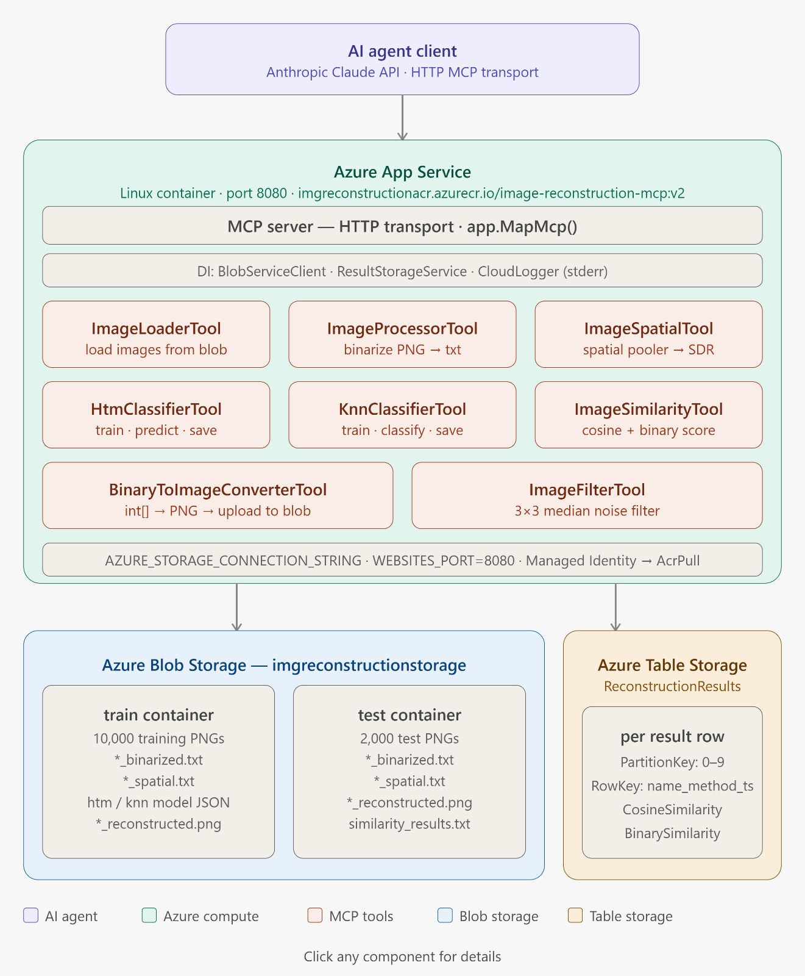
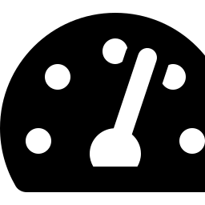
System Architecture — Deployed on Azure
Azure App Service
Linux container running the MCP server, pulled via Managed Identity.
Blob Storage
Fashion-MNIST images and persisted classifier models.
Table Storage
Per-reconstruction similarity metrics, written live.
4 / 11

Slide 5
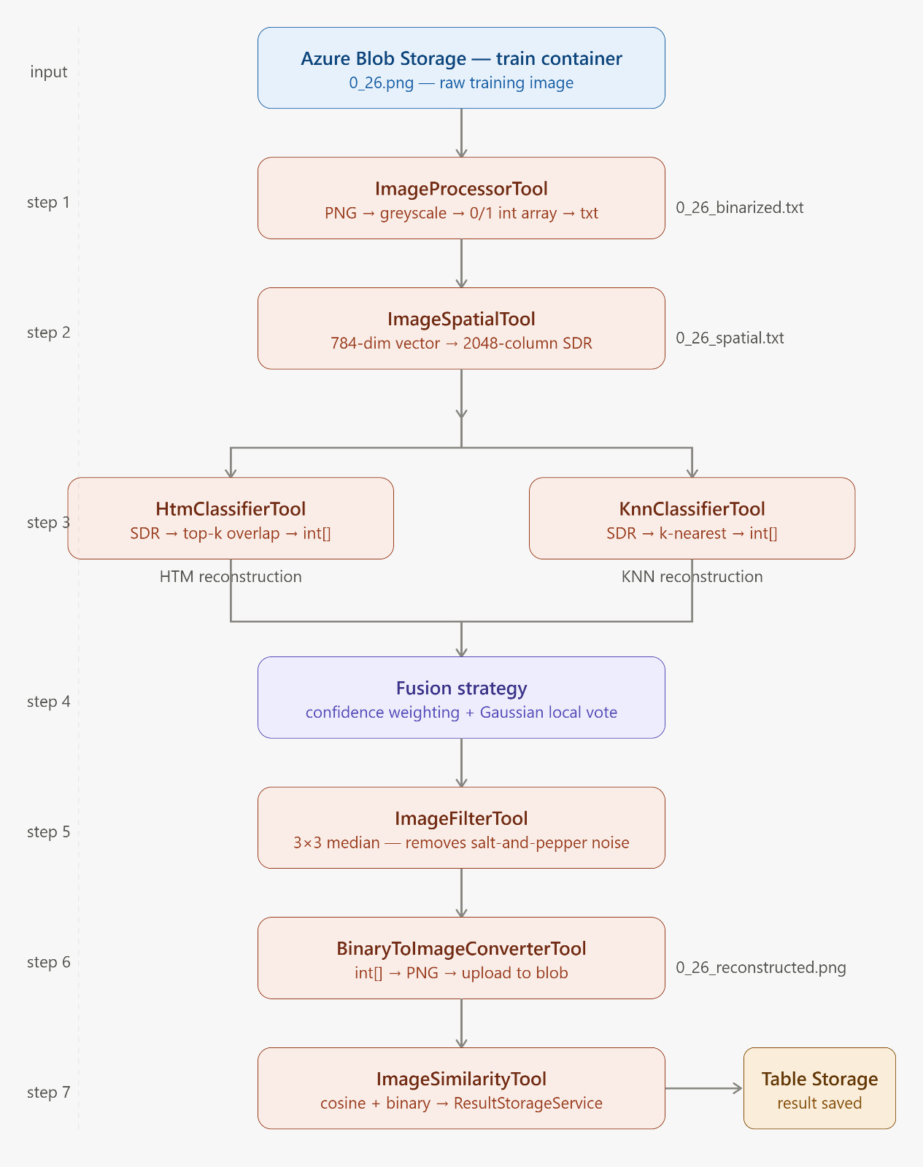

Anatomy of One Reconstruction Request
7 tools, 1 boundary
Every step is an independently callable, independently testable MCP tool.
Confidence-weighted fusion
Cosine-similarity weighting + Gaussian local voting + median filtering.
Scores land in Table Storage
The final similarity scores are written to Azure Table Storage — live.
5 / 11

Slide 6


Catching Our Own Gap — Then Closing It
Before
Now
• Runs on one machine — no scaling, no concurrent requests
• Containerized on Azure App Service — scales horizontally
• Requires local setup: .NET SDK, libraries, env vars by hand
• Zero local dependencies — agent connects to one HTTPS endpoint
• Pipeline knowledge lives in code — no natural-language interface
• AI agent drives the full pipeline in natural language via MCP
This unblocks horizontal scaling — validating it under real multi-replica load is still ahead of us.
6 / 10

Slide 7


Two Kinds of AI — Disclosed Separately
Run-time Agent
Coding Assistants
Part of the delivered product itself — decides which MCP tool to call from a natural-language request.
Used during development to help write and scaffold code — disclosed per-contribution, separate from the run-time agent.
Every significant AI contribution — prompt, raw output, manual change — is logged in PROMPTS.md, not reconstructed from memory into this deck or the paper.
7 / 10

Slide 8
Key Design Decisions & Trade-offs
Decision
We chose
Instead of
Why
Storage structure
2 containers (train / test)
4+ containers
Same cost — naming convention replaces container separation
Database
Azure Table Storage
SQL Database
Results are flat records — no joins needed, same storage account
MCP transport
HTTP transport
STDIO transport
STDIO only works locally — HTTP works across Azure App Service instances
Logging output
CloudLogger → stderr
Console.WriteLine → stdout
MCP uses stdout for tool messages — mixing logs corrupts the stream
8 / 10

Slide 9


What We Built & What We Learned
A local ML experiment — turned into a containerized, Azure-deployed service, operated by an AI agent through the Model Context Protocol.
What we built
How we decided
What we learned
A cloud service with 7 MCP tools, Azure Blob + Table Storage, and an AI agent as the operator.
Every design choice had a reason — transport, storage, logging, containers.
AI accelerates development — but human review catches what compiles and still breaks.
9 / 10

Slide 10
Thank You
Eyad Elsheita — eyad.elsheita@stud.fra-uas.de
Khaled Kandil — khaled.kandil@stud.fra-uas.de

