Slide 1

1
The Wellbeing Landscape in Jordan
Where Data Meets Human Experience

Slide 2


2
What did we want to understand?
Are all students experiencing wellbeing the same way?
What factors place some students at higher risk?
Can resilience protect students from stress and hardship?

Slide 3
3
Let's first look at what the data is telling us

Slide 4
4
The Data at a Glance
Over 1,000 participants
Multiple wellbeing indicators
Captures psychological and socioeconomic aspects

Slide 5
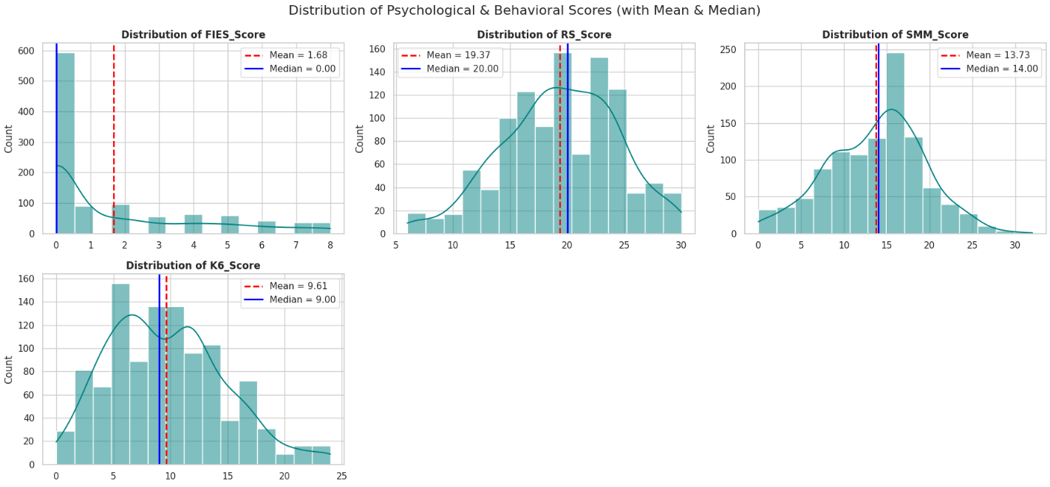
5
How Are Wellbeing Scores Distributed?

Slide 6
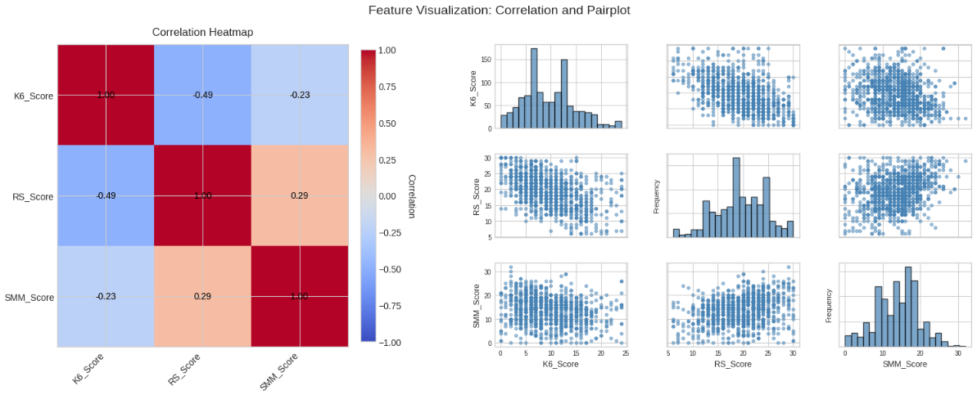
6
How Do Wellbeing Factors Relate to Each Other?

Slide 7
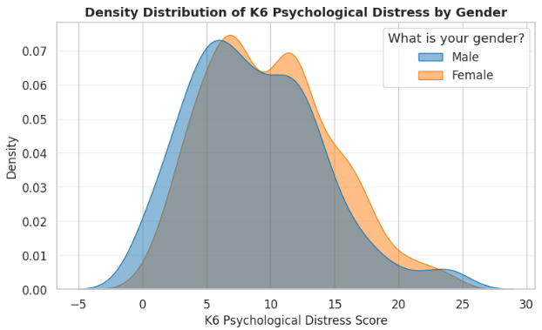

7
Here, we're comparing psychological distress levels between male and female students
A Welch t-test was applied and showed a statistically significant difference between males and females (p = 0.001).
The difference in average distress levels is small (Male = 8.76, Female = 9.92).

Slide 8
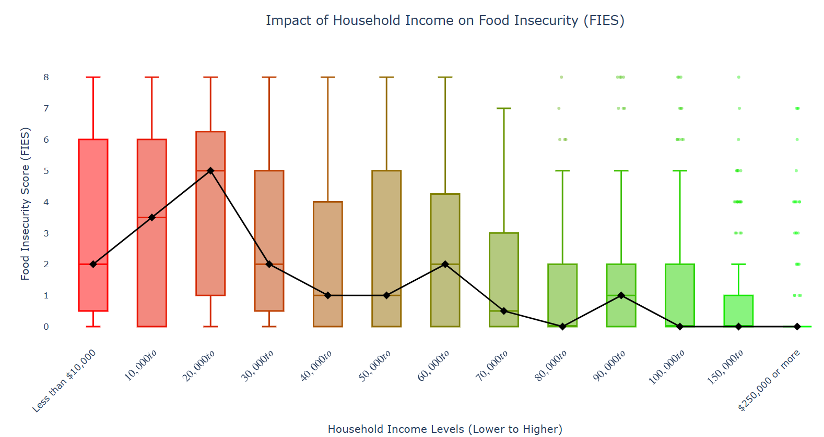
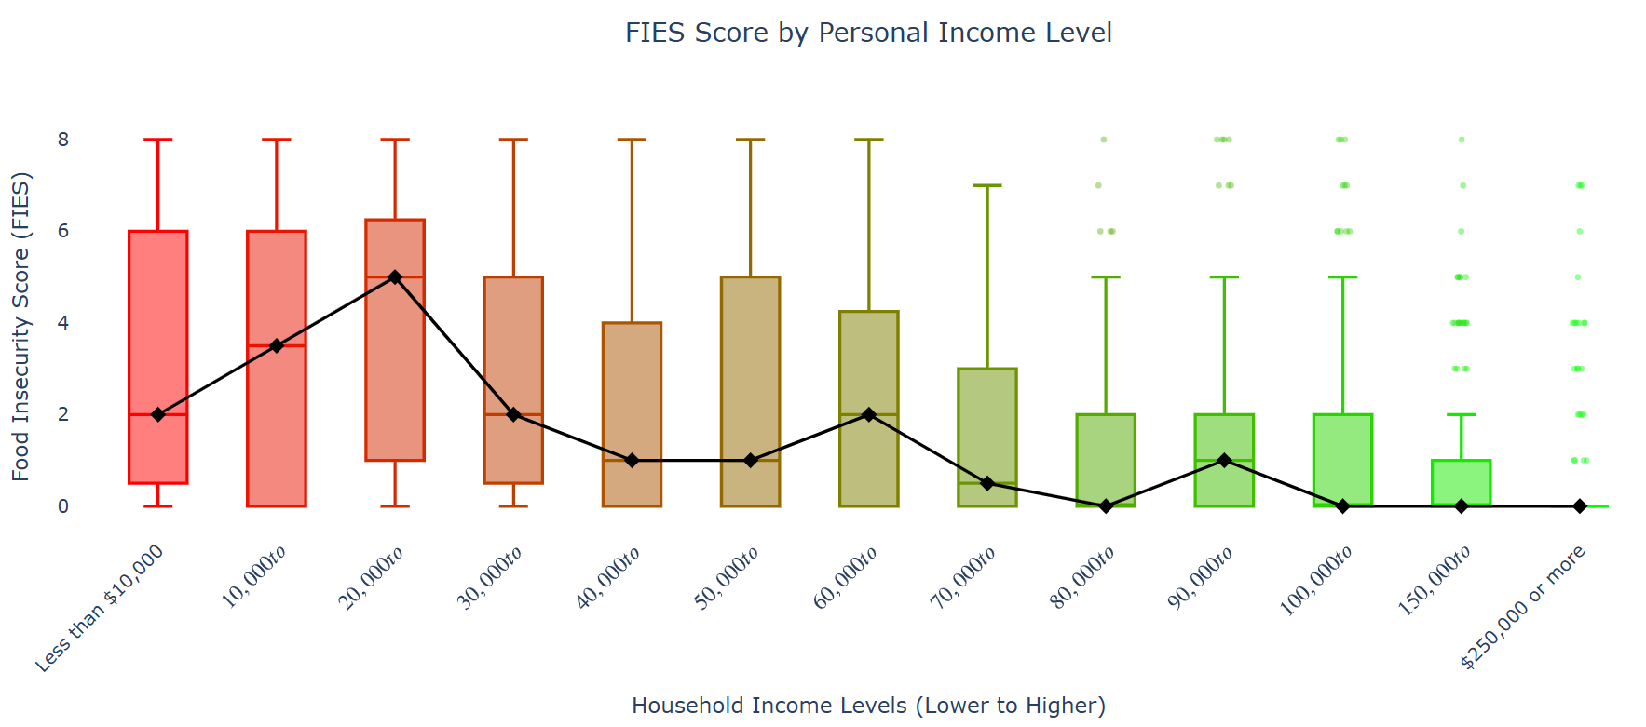
How Income Relates to Food Insecurity
8
House Hold
Personal Income

Slide 9

9
Key Questions We Asked

Slide 10
10
Q1—Can we identify distinct latent psychological–behavioral profiles among college students?
Students do not form one homogeneous group
Distinct psychological patterns clearly emerge
These patterns reflect different levels of risk and resilience

Slide 11
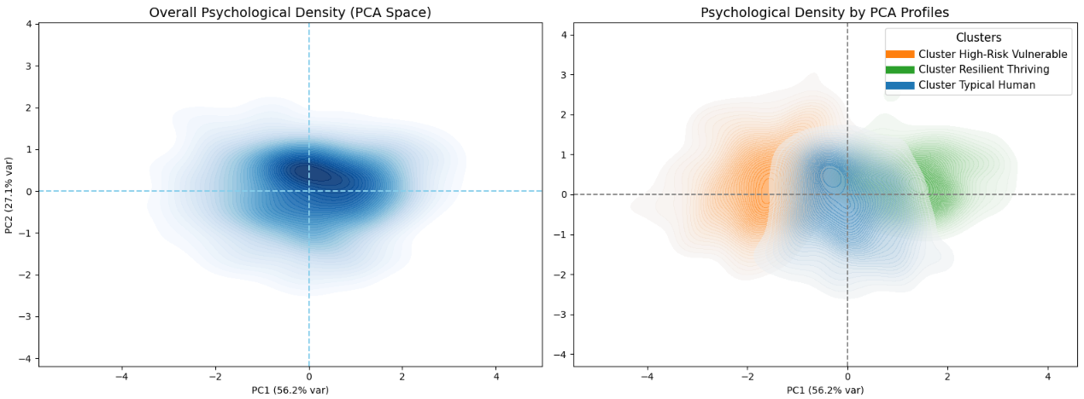
11
On the left, we see the overall distribution of students when we combine mental distress, resilience, and stress mindset into one space.

Slide 12
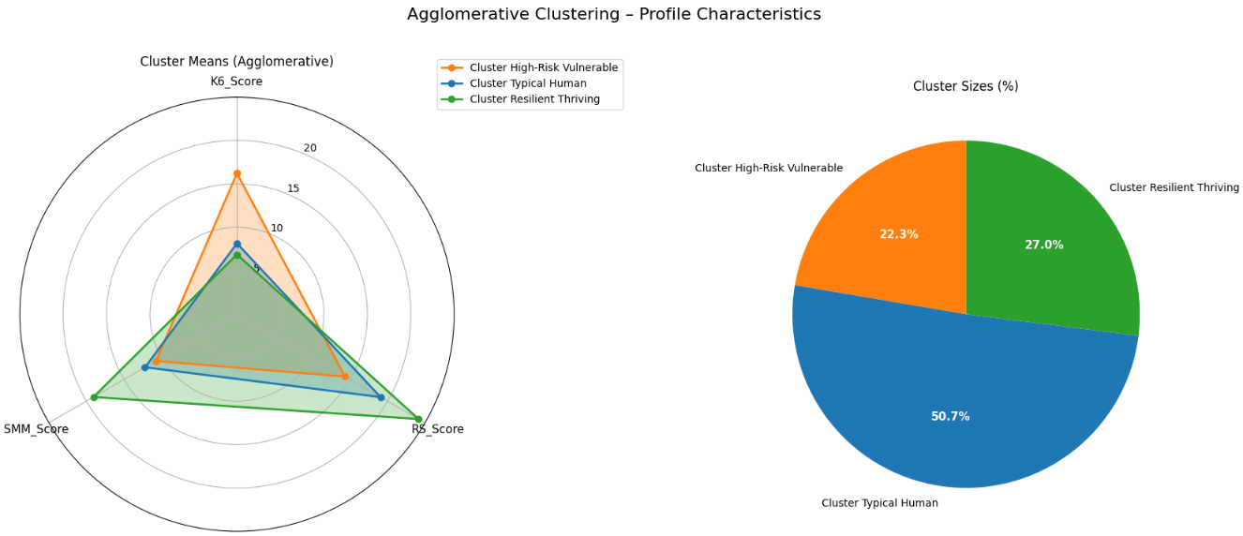

12
Psychological Profiles and Group Differences

Slide 13
13
Are These Differences Real?
To confirm what we saw visually, we tested whether these differences are real or just apparent.
Statistical testing showed that all three groups differ clearly and consistently across mental distress, resilience, and stress mindset.

Slide 14
14
Q2-Does the experience of food insecurity significantly differ across distinct psychological-behavioral profiles?

Slide 15
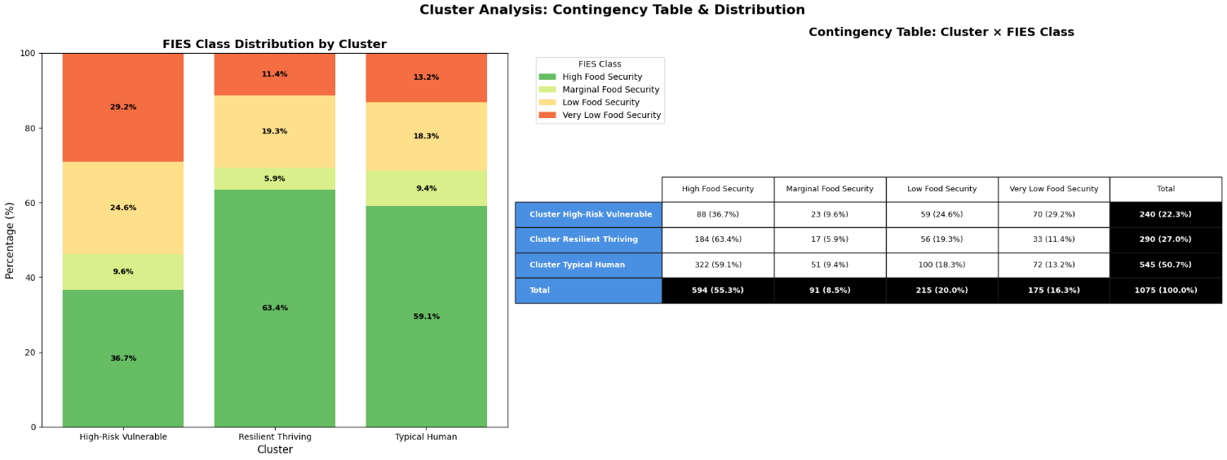
15

Slide 16
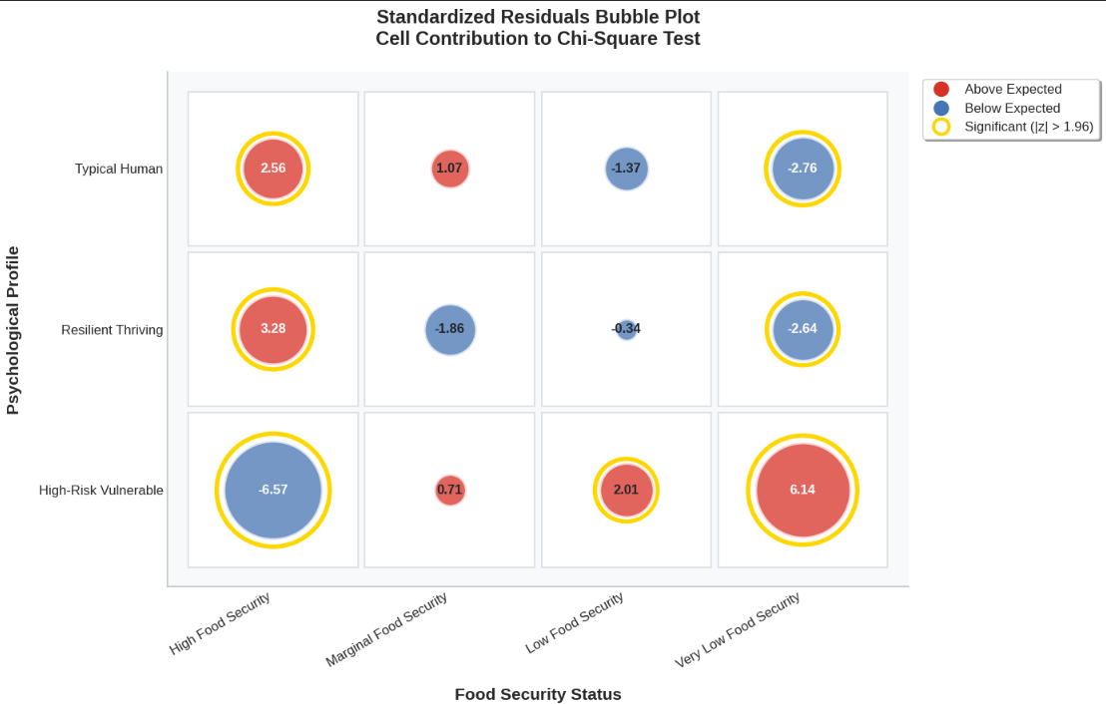
Food Insecurity and Psychological Profiles
16
Analysis of the relationship between food insecurity and distinct psychological profiles.
Chi-square testing demonstrated a significant difference in food insecurity across psychological profiles (p < 0.001).

Slide 17

17
Q3-Are certain demographic patterns linked to psychological risk or resilience?

Slide 18
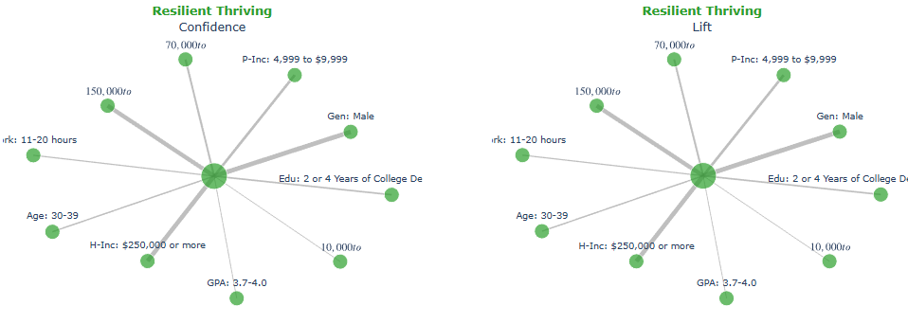
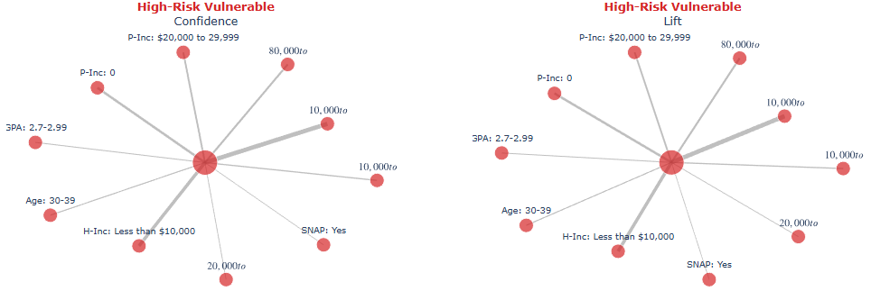
18
Psychological risk and
resilience are closely
linked to economic and
academic factors

Slide 19
19
For the high-risk group, we consistently see a combination of lower household income and lower academic performance.
These factors tend to cluster together rather than appear in isolation.
In contrast, the resilient thriving group is strongly associated with higher income levels and higher GPAs.
This suggests that academic success is often supported by both financial stability and psychological resilience.

Slide 20
20
Q4-Can resilience protect academic performance under psychological distress and food insecurity?

Slide 21
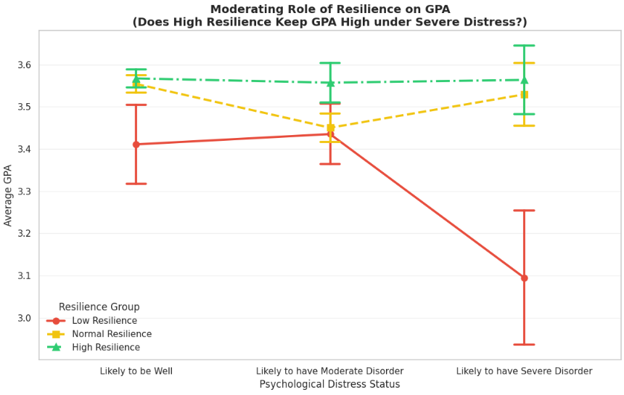

21
Resilience Protects Academic Performance Under Psychological Distress
Psychological distress alone does not fully explain changes in academic performance.
When resilience is low, GPA declines sharply as distress increases.
High resilience buffers this effect and helps maintain GPA even at high distress levels.
Statistical analysis confirms this protective effect.

Slide 22
22
Q5-How do income levels shape students' psychological wellbeing?

Slide 23
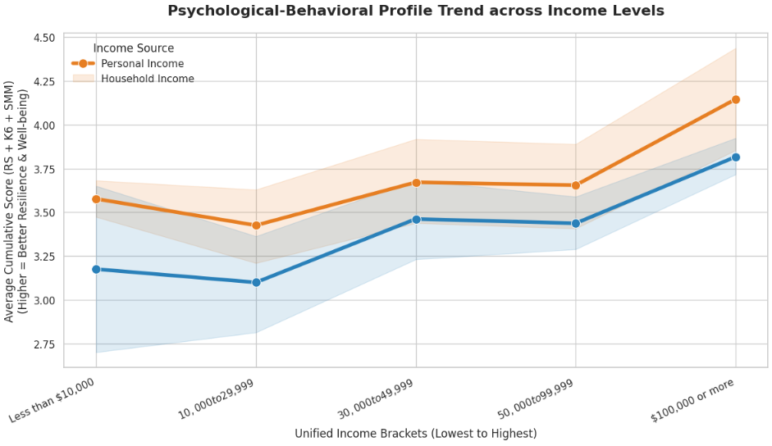
23

Slide 24
24
The Economic Gradient of Psychological Wellbeing
Psychological wellbeing improves steadily as income levels increase.
Household income shows a stronger and more consistent association than personal income.
Economic stability provides the baseline for resilience and mental wellbeing.
Chi-square tests confirm that both personal and household income are significantly associated with wellbeing profiles (p < 0.01).

Slide 25
25
Policy Actions for the Ministry of Health
1
Target High-Risk Students Early
2
Invest in Resilience-Building Programs
3
Integrate Food Security with Mental Health Services
Develop a risk-screening framework combining psychological distress and food insecurity indicators.
Introduce resilience and stress-management training as preventive mental health tools.
Coordinate with universities to provide targeted food support programs.
Focus on students exposed to high psychological distress.
Prioritize students in the High-Risk vulnerable profile for early intervention.

Slide 26
26
Thank You for Your Attention
We welcome your questions and reflections

