Slide 1
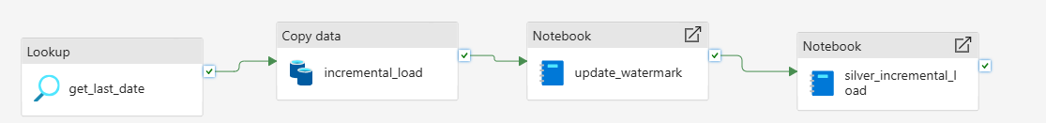
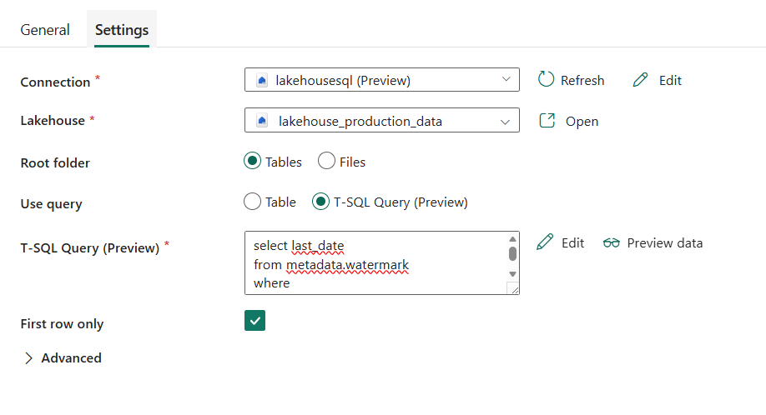
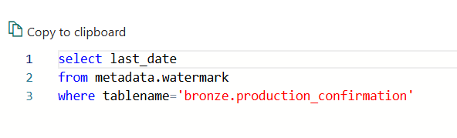
The purpose of the incremental load is to load the data in an incremental mode into the bronze layer and after that process the data using spark notebook and load it incrementally into the silver layer. This pipeline is scheduled once a day
Lookup activity
It applies a query to the watermark table to get the last loaded date for the table

Slide 2
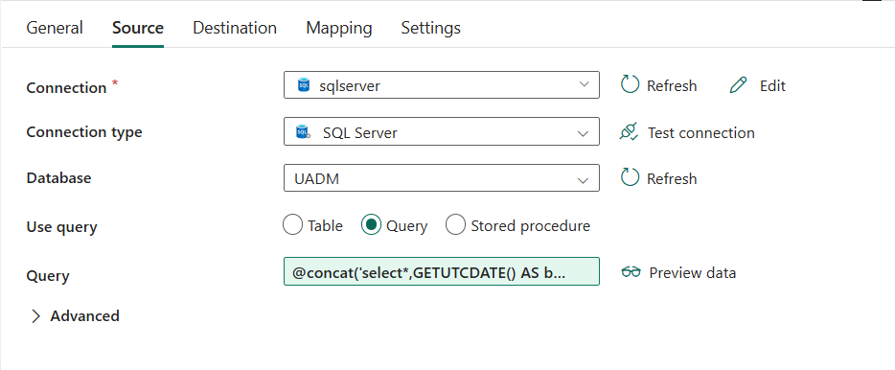
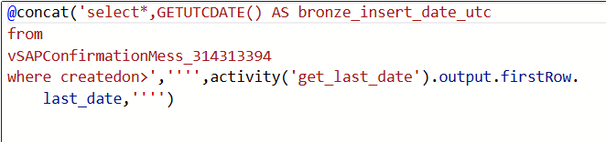
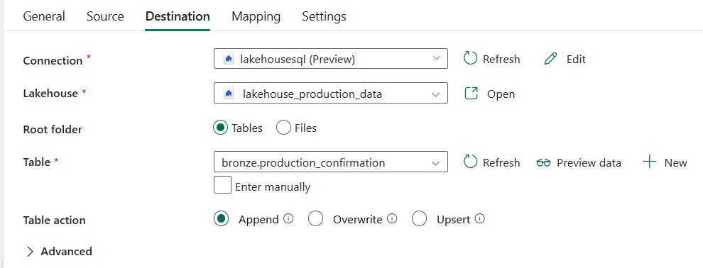
First copy activity
Source: It queries the source table to get only the new inserted data using the output of the lookup activity
Destination: delta table in the lakehouse bronze layer. Append mode

Slide 3
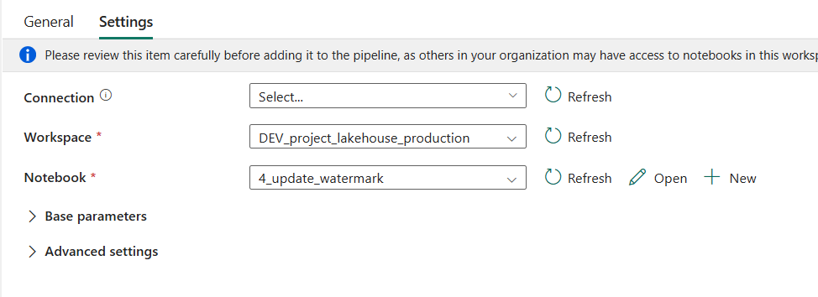
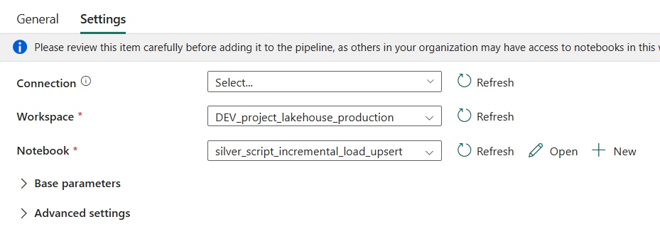
First notebook
-it invokes the notebook 4_update_watermark to get the maximum timestamp of the bronze layer table and update the watermark table
Second notebook
-it invokes the notebook silver_script_incremental_load_upsert which processes the data from the bronze layer and insert them in the silver layer

