Slide 1
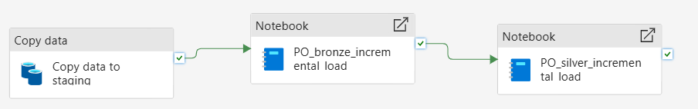
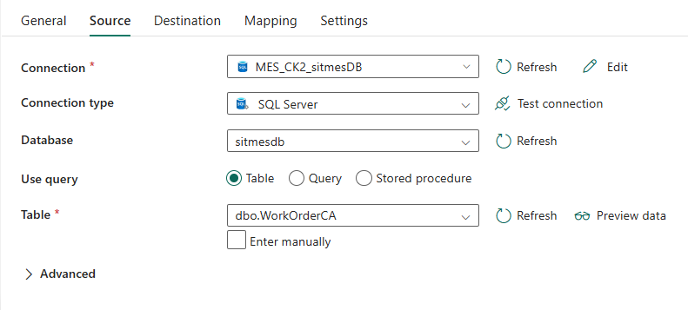
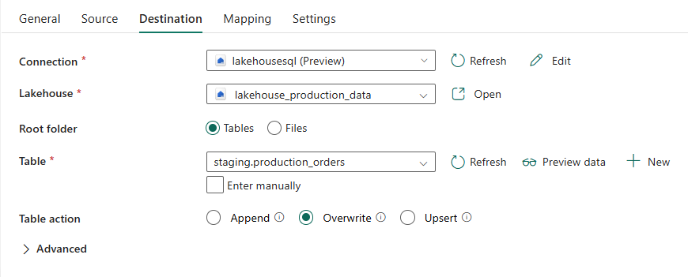
The purpose of the incremental load is to load the data in an incremental mode into the bronze layer and after that process the data using spark notebook and load it incrementally into the silver layer. This pipeline is scheduled once a day. The pipeline handles both inserted rows and updated rows (SCD type2)
Copy activity settings
- it overwrites the data in the staging layer
Source: on premise SQL server table. The full table is read without any data enrichment (snapshot)
Destination: delta table in the lakehouse staging layer. Overwrite mode

Slide 2
First notebook
- it invokes the notebook PO_bronze_incremental_load which compares the staging layer with the bronze layer (using join operations) and it extracts:
The new inserted rows
The updated rows
For the new inserted rows: it appends those rows to the bronze layer table
For the updated rows it does two operations:
Append those rows to the bronze layer table while setting the valid from to the current timestamp and valid to as Null (last version of the rows)
For the old records of those rows, it updates the valid to as the current timestamp (invalid rows)

Slide 3
Second notebook
it invokes the notebook PO_silver_incremental_load which
reads the full data from the bronze layer,
apply all the necessary transformations
Created a temporary view for the transformed data
Merge this view to the table in the silver layer (to insert the new rows and update the updated ones)

