Slide 1
This table has several operations made on it like (insert, update, and delete). The SCD type 2 is applied to keep a full history of each row. the valid rows are those that will have valid to column as Null

Slide 2
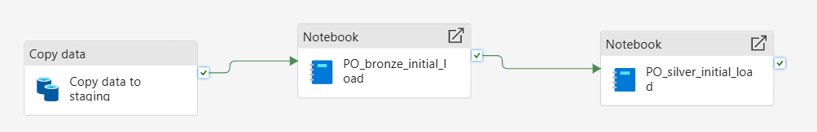
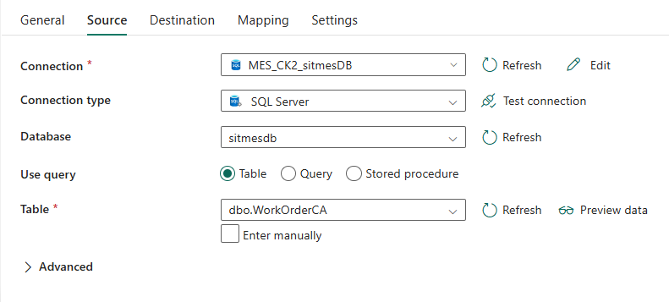
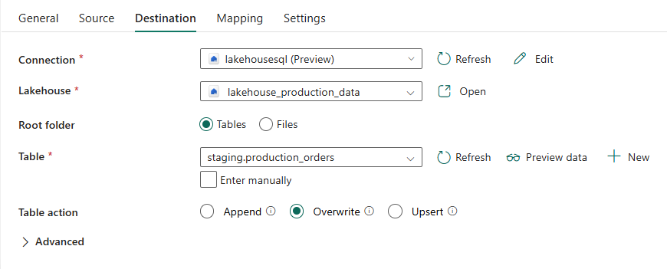
The purpose of the initial load is to load the data in a full mode into the staging layer first in full mode (taking a snapshot of the source data) then to bronze layer and after that process the data using spark notebook and load it into the silver layer. This pipeline needs to be triggered manually as it will run only once
Copy activity settings
Source: on premise SQL server table. The full table is read without any data enrichment (snapshot)
Destination: delta table in the lakehouse staging layer. Overwrite mode

Slide 3
First notebook
It invokes the notebook PO_bronze_initial_load which
reads data from staging layer
Add two columns valid from and valid to.
Valid from is set the current timestamp
Valid to is set to null (which means a valid record)
Second notebook
It invokes the notebook PO_silver_initial_load which read data from the bronze layer, transform it using spark and save it as a delta table in the silver layer

