Slide 1
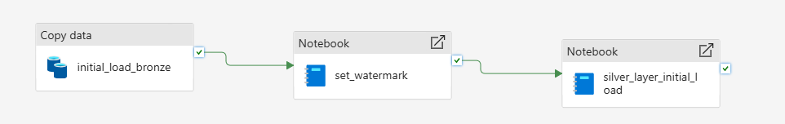
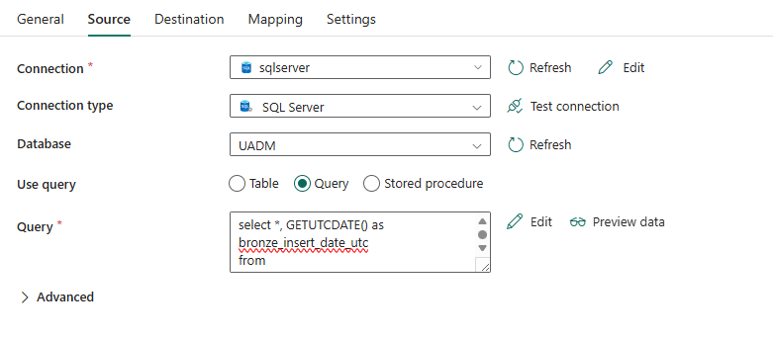
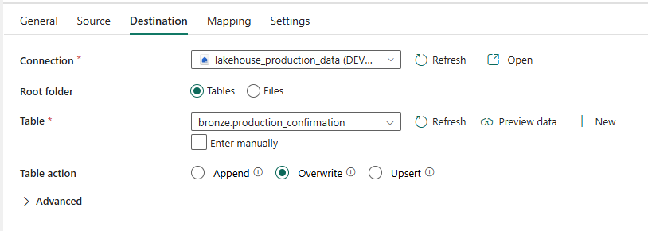
The purpose of the initial load is to load the data in a full mode into the bronze layer and after that process the data using spark notebook and load it into the silver layer. This pipeline needs to be triggered manually as it will run only once
Copy activity settings
Source: on premise SQL server table, in the query the current timestamp is to be added as the insert_date
Destination: delta table in the lakehouse bronze layer. Overwrite mode

Slide 2
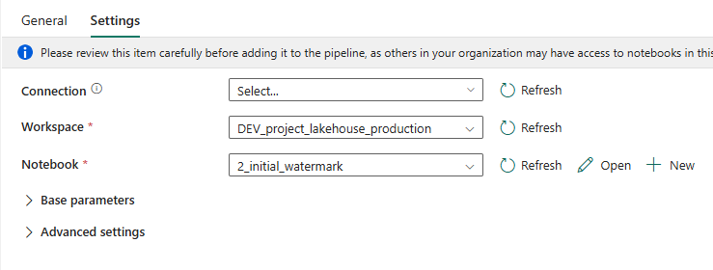
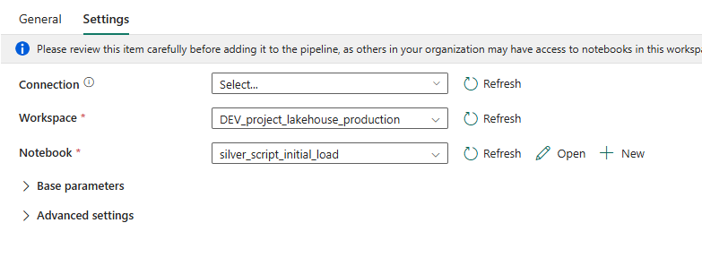
First notebook
It invokes the notebook 2_initial_watermark which is responsible for the update of the watermark in a separate table
(the watermark is the maximum timestamp of the table loaded in the bronze)
Second notebook
It invokes the notebook silver_script_initial_load which is responsible for the transformation of the data and load it in the silver layer

