Slide 1
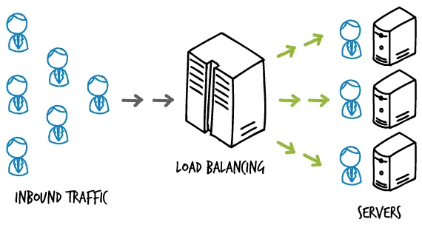
High Speed Networks and Switching
Mininet Final Project: Test & Analyze Packet Switching Algorithms as a Load-Balancing Method
Assigned by: Eyal Zvi, 319067732 Efi Korenfeld, 208838359 Saar Ben-Yochana, 313234155

Slide 2
Introduction
With the ongoing increase of users online, one of the major factors of network efficiency is congestion control
Many service providers try to solve this problem by using load balancing algorithms when the main goal is to minimize service time and reduce congestion in each server individually
In this project we will simulate and compare different scheduling algorithms in order to determine which of the algorithms tested is optimal for each scenario

Slide 3
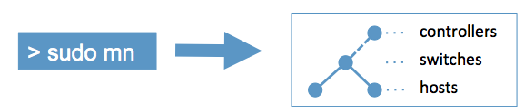
Implementation
Simulation environment – Mininet
Algorithms – RR, Random, WFQ (pre-defined weights)
Model – Clients send HTTP Requests to a load balancing node that decides according to the algorithm tested which server handles the request
Measurements - Clients collect and record response time measurements according to the received HTTP replies
Control – A worst case scenario is tested where the slowest server receives all HTTP Requests

Slide 4
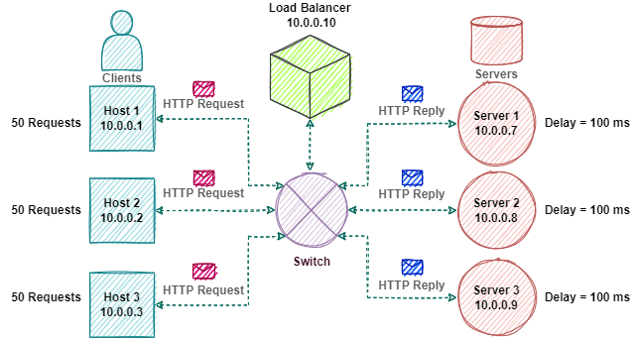
Test Cases
Topology 1: 3 Clients vs. 3 Servers - All servers with equal service times

Slide 5
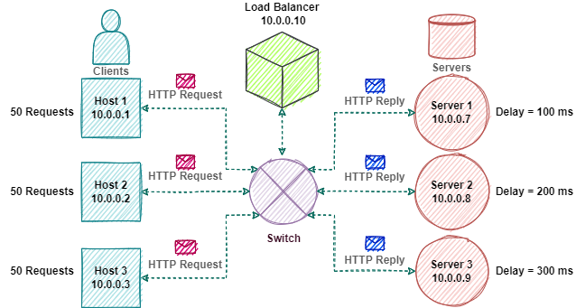
Test Cases
Topology 1: 3 Clients vs. 3 Servers - Servers with different service times

Slide 6
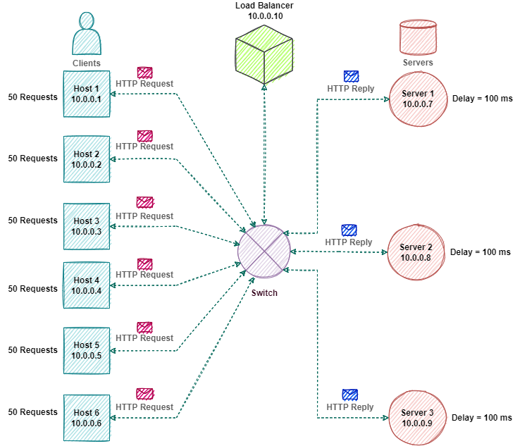
Test Cases
Topology 2: 6 Clients vs. 3 Servers - All servers with equal service times

Slide 7
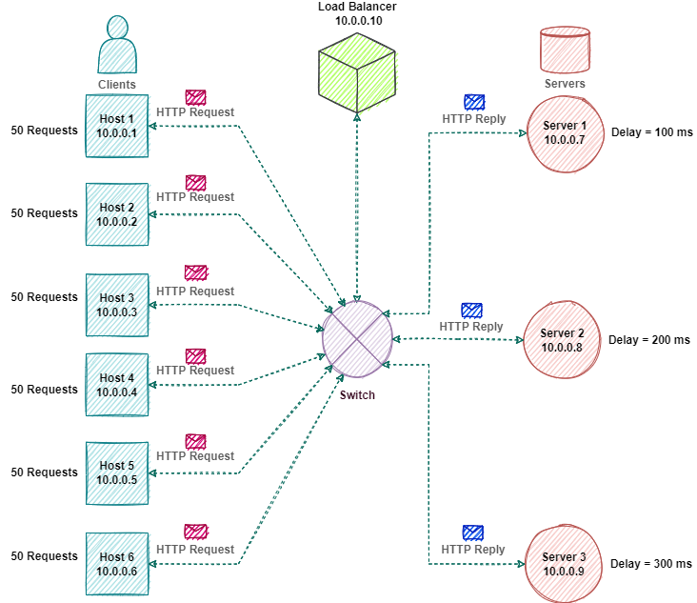
Test Cases
Topology 2: 6 Clients vs. 3 Servers - Servers with different service times

Slide 8
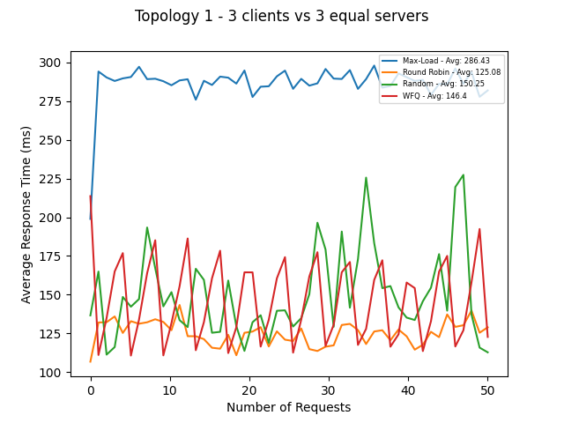
Results
RR is the optimal algorithm
WFQ and Random algorithms are almost equally efficient

Slide 9
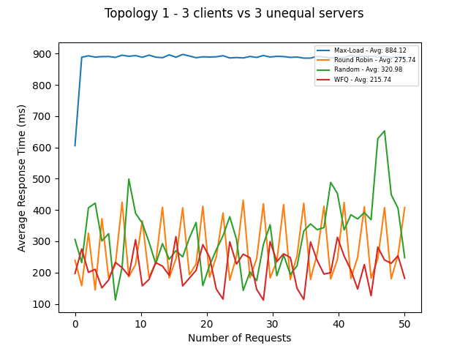
Results
WFQ is the optimal algorithm
Although RR is not destined for unequal weighted servers it functions well and is relatively stable

Slide 10
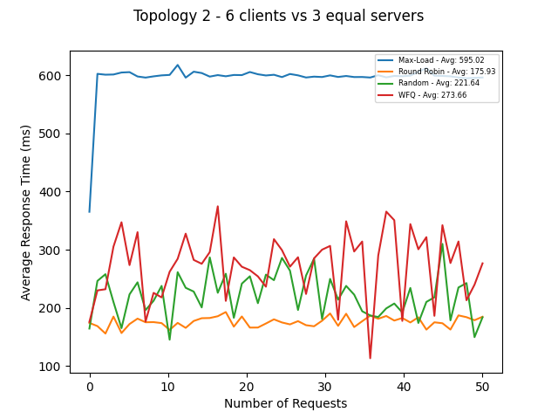
Results
RR is the optimal algorithm
Note that Random algorithm overtakes WFQ

Slide 11
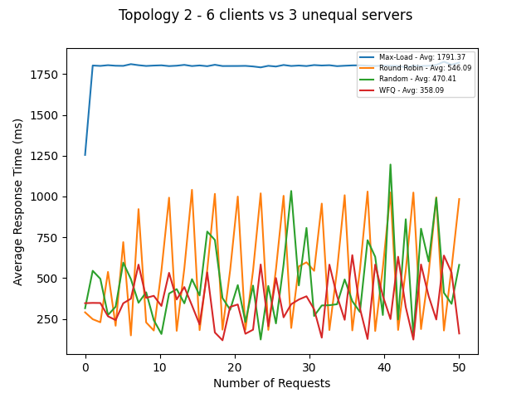
Results
WFQ is the optimal algorithm
Note that Random algorithm overtakes RR

Slide 12
Conclusions
According to our model and simulation results:
WFQ is optimal¹ for servers with different service times
Given identical service times the optimal algorithm is RR
As the number of clients increase the Random algorithm shows more efficiency and becomes the 2nd optimal choice
We conclude that when the topology and weights are known it is most efficient using RR or WFQ according to the ratio between server weights. Otherwise, using the Random algorithm can result in higher efficiency than choosing one of the other algorithms.
[1] - Given that the weights are properly assigned

Slide 13

Thank You!

