Slide 1
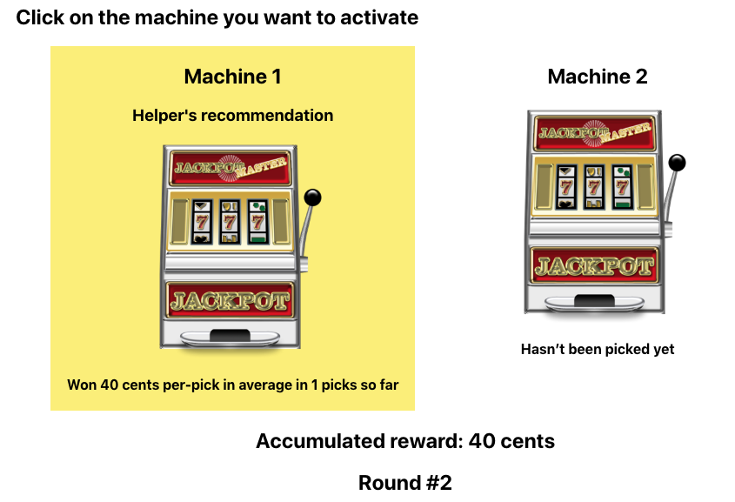
2 Machines to choose from each round
Your score so far
Round number
The machine recommended by the
helper is highlighted in yellow

