Slide 1

SHARED BIKES ENGINEERING ASSIGNMENT
Shared Bike Monitoring System
A Dockerized data platform combining Airflow ETL, PostgreSQL history, Kafka streaming, predictive alerts, and an operator dashboard.
Eyasu Araya | September 2026
01

Slide 2
CAPITAL BIKESHARE OPERATIONS
Full Architecture
BATCH PATH | every 5 minutes
Capital Bikeshare GBFS API
Airflow ETL
PostgreSQL
Express API
(Back-End)
React Dashboard
(Front-End)
STREAMING PATH | every 60 seconds
Capital Bikeshare GBFS API
Station producer
Kafka topic station-status
Alert consumer
The platform uses two connected data-processing paths. In the batch path, Apache Airflow runs an ETL pipeline every five minutes to retrieve Capital Bikeshare GBFS data, clean and validate it, and store raw data, station information, and availability history in PostgreSQL. In the streaming path, the station producer retrieves new observations every minute and publishes them to the Kafka station-status topic. The alert consumer processes these events, identifies stations at risk of bike depletion, and stores warning or critical alerts in the same PostgreSQL database. The Express API reads station information, historical data, and active alerts from PostgreSQL and provides them to the React dashboard, where operators can monitor inventory, view alerts, inspect station history, and explore station locations on a map. All components run together as an isolated and reproducible environment using Docker Compose.

Slide 3
CAPITAL BIKESHARE OPERATIONS
Project Structure and Component Responsibilities
Component | Folder | Responsibility
Frontend | client/ | React and Leaflet dashboard for station inventory, maps, alerts, and history.
Backend | server/ | Express API that retrieves PostgreSQL data and provides it to the frontend.
Database | database/ | PostgreSQL schema for raw data, stations, status history, and alerts.
Data pipeline | pipeline/ | Python code for extracting, cleaning, validating, and loading bikeshare data.
Orchestration | airflow/ | Airflow DAG that schedules and monitors the ETL pipeline every five minutes.
Event streaming | streaming/ | Kafka producer, alert consumer, depletion-detection rules, and tests.

Slide 4
CAPITAL BIKESHARE OPERATIONS
Capital Bikeshare GBFS API
The project uses the Capital Bikeshare General Bikeshare Feed Specification (GBFS) API.
API/feed | Exact endpoint | Why it is used | Code location
GBFS discovery | https://gbfs.capitalbikeshare.com/gbfs/2.3/gbfs.json | Provides the current URLs of all available feeds, avoiding hard-coded data-feed addresses. | DEFAULT_DISCOVERY_URL and discover_feed_urls() in pipeline/extract.py
Station information | https://gbfs.lyft.com/gbfs/2.3/dca-cabi/en/station_information.json | Supplies station IDs, names, coordinates and capacities for PostgreSQL and the dashboard map. | Retrieved by fetch_station_feeds() in pipeline/extract.py
Station status | https://gbfs.lyft.com/gbfs/2.3/dca-cabi/en/station_status.json | Supplies current bikes, docks, operating flags and timestamps for history and depletion alerts. | Retrieved by fetch_station_feeds() in pipeline/extract.py

Slide 5
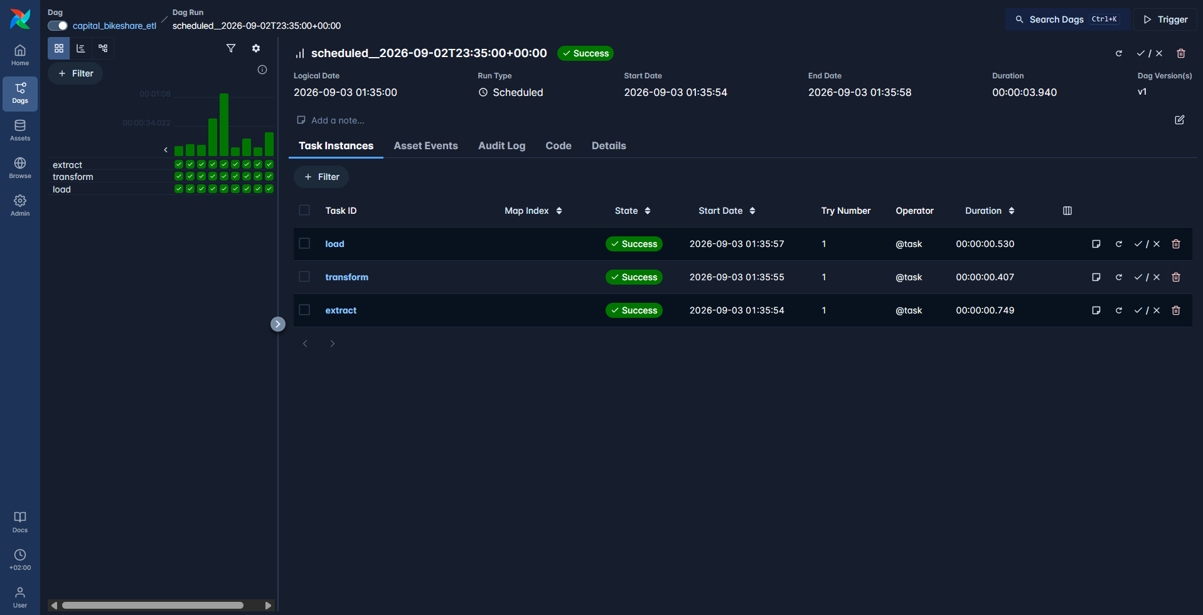
CAPITAL BIKESHARE OPERATIONS
Airflow
Apache Airflow automatically executes the ETL pipeline every five minutes:
extract – fetches the latest Capital Bikeshare data.
transform – cleans and validates the records.
load – stores the results in PostgreSQL.

Slide 6
CAPITAL BIKESHARE OPERATIONS
Airflow Implementation: Automated ETL Orchestration
Implementation | What was done | Code location
DAG | Created capital_bikeshare_etl to coordinate the complete ETL workflow. | airflow/dags/capital_bikeshare_etl.py
Scheduling | Configured automatic execution every five minutes. | airflow/dags/capital_bikeshare_etl.py
Extract task | Reads the Capital Bikeshare GBFS discovery API to locate current feed URLs. It downloads station_information for station metadata and station_status for live availability. | pipeline/extract.py
Transform task | Normalizes timestamps, text, booleans, coordinates, and availability counts. It validates records and joins both feeds using station_id. | pipeline/transform.py
Load task | Uses Psycopg and a PostgreSQL transaction to store raw responses, update station metadata, and append new status observations without duplicates. | pipeline/load.py
Data exchange | Saves temporary JSON artifacts and passes their file paths between Airflow tasks through XCom. | pipeline/artifacts.py and the Airflow DAG
Reliability | Uses two retries, a 30-second retry delay, no historical catch-up, and one active run at a time. | airflow/dags/capital_bikeshare_etl.py

Slide 7
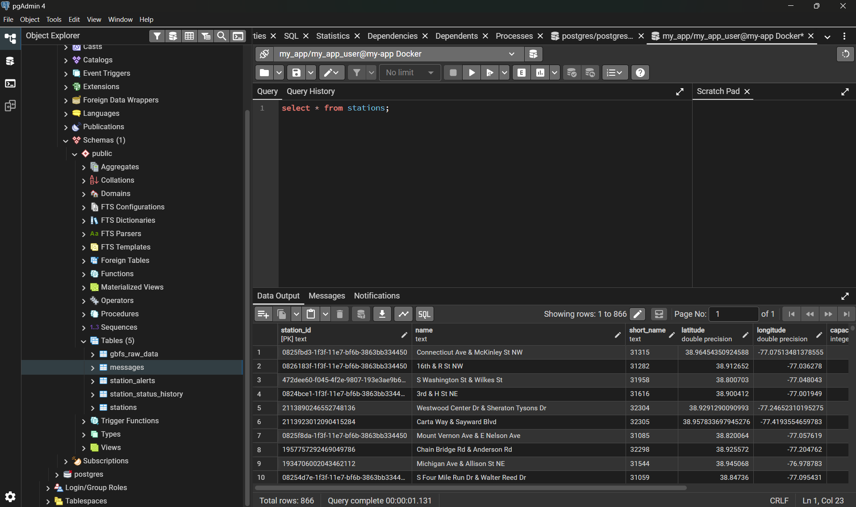
CAPITAL BIKESHARE OPERATIONS
PostgreSQL

Slide 8
CAPITAL BIKESHARE OPERATIONS
PostgreSQL Tables and Attributes
Table | Main attributes | Why they are stored
gbfs_raw_data | id, feed_name, gbfs_version, source_last_updated, fetched_at, payload | Preserves original API responses for auditing, troubleshooting, and replaying transformations.
stations | station_id, name, short_name, latitude, longitude, capacity, source_last_updated | Stores the latest descriptive information for each station and provides coordinates for the map.
station_status_history | station_id, reported_at, bikes_available, bikes_disabled, docks_available, docks_disabled, is_installed, is_renting, is_returning | Records changing availability over time for trend analysis and depletion prediction.
station_alerts | station_id, station_name, severity, bikes_available, depletion_rate_per_minute, predicted_minutes_to_empty, reason, first_reported_at, last_reported_at, resolved_at | Stores warning and critical alerts, their cause, prediction values, duration, and resolution status.

Slide 9
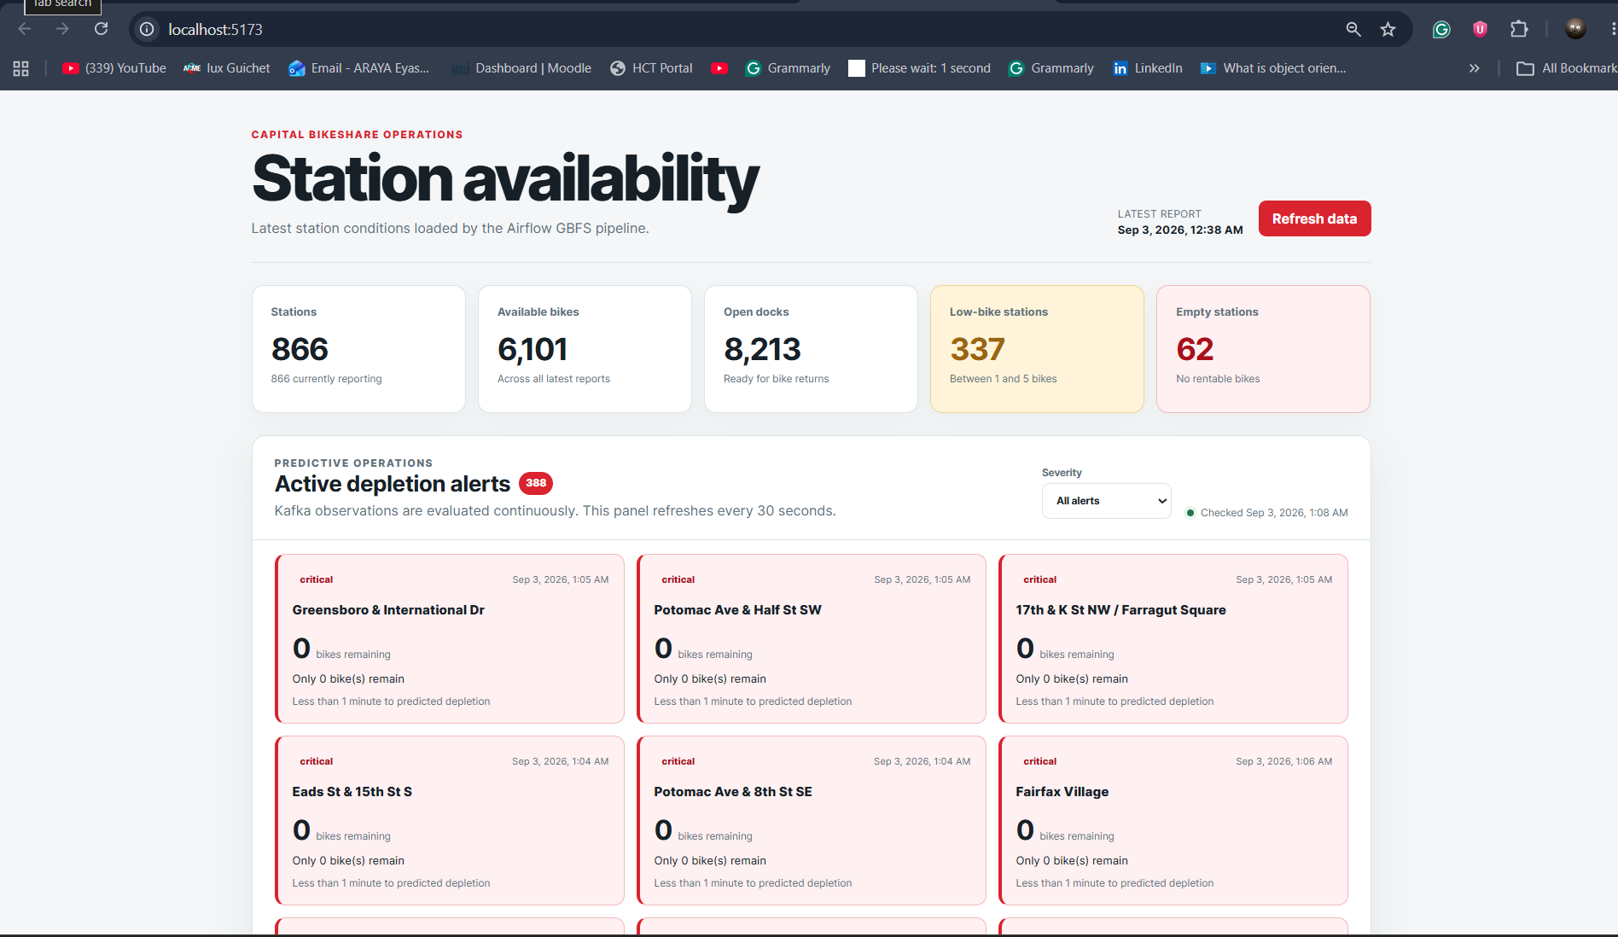
CAPITAL BIKESHARE OPERATIONS
Kafka
Kafka supports the real-time alerting :
station-producer fetches new station observations every minute.
Observations are published to the station-status Kafka topic.
alert-consumer processes the events and detects depletion risks.
Warning and critical alerts are stored in PostgreSQL and displayed on the dashboard.

Slide 10
CAPITAL BIKESHARE OPERATIONS
Kafka Implementation: Real-Time Alert Processing
Implementation | What was done | Code location
Kafka broker | Configured a single Apache Kafka broker using KRaft mode. | compose.yaml
Kafka topic | Created the station-status topic with three partitions using the one-time kafka-init container. | compose.yaml
Station producer | Calls the Capital Bikeshare GBFS API every 60 seconds and retrieves the latest station information and availability data. | streaming/producer.py and pipeline/extract.py
Event creation | Converts each new station observation into a JSON event containing the station ID, name, timestamp, available bikes, docks, and operating status. | streaming/producer.py
Message key | Uses station_id as the Kafka message key so events for the same station remain in the same partition and maintain order. | streaming/producer.py
Duplicate filtering | Publishes an observation only when its reported_at timestamp differs from the last observation published for that station. | streaming/producer.py
Alert consumer | Subscribes to station-status using the station-depletion-alerts-v1 consumer group and processes events continuously. | streaming/alert_consumer.py
Alert rules | Creates critical alerts at two bikes or five predicted minutes to empty, and warnings at five bikes or fifteen predicted minutes. | streaming/alert_rules.py
Alert storage | Creates, updates, escalates, or resolves alerts in PostgreSQL. Kafka offsets are committed only after the database operation succeeds. | streaming/alert_store.py and streaming/alert_consumer.py
Deployment | Packages the producer and consumer with their Python and Kafka dependencies and runs them as separate Docker services. | streaming/Dockerfile, streaming/requirements.txt, and compose.yaml

Slide 11
CAPITAL BIKESHARE OPERATIONS
Express (Back-End)
Implementation | What was done | Code location
Express API | Created an Express server that provides bikeshare data to the React dashboard through REST endpoints. | server/index.js
Database connection | Uses a PostgreSQL connection pool and the DATABASE_URL environment variable to connect to the Dockerized database. | server/index.js and compose.yaml
Summary endpoint | Calculates total stations, available bikes and docks, low-bike stations, empty stations, and offline stations. | GET /api/bikeshare/summary in server/index.js
Alerts endpoint | Returns active warning and critical alerts, ordered by severity and depletion risk, with filtering and pagination. | GET /api/bikeshare/alerts in server/index.js
Map endpoint | Returns lightweight station coordinates and current availability for displaying markers on the Leaflet map. | GET /api/bikeshare/stations/map in server/index.js
Stations endpoint | Provides searchable and sortable station inventory, including current bikes, docks, capacity, and operational status. | GET /api/bikeshare/stations in server/index.js
History endpoint | Retrieves timestamped bike and dock availability for a selected station to support the historical chart. | GET /api/bikeshare/stations/:stationId/history in server/index.js
Input validation | Validates pagination limits, offsets, alert severity, station conditions, and sorting options before building queries. | server/index.js
Error handling | Catches database failures and returns safe HTTP error responses without exposing internal details. | server/index.js
Testing | Tests validation, sorting, API responses, database failures, alerts, and map data using Node’s built-in test runner. | server/index.test.js
Deployment | Packages the API and Node.js dependencies in Docker and exposes it through port 5000. | server/Dockerfile, server/package.json, and compose.yaml

Slide 12
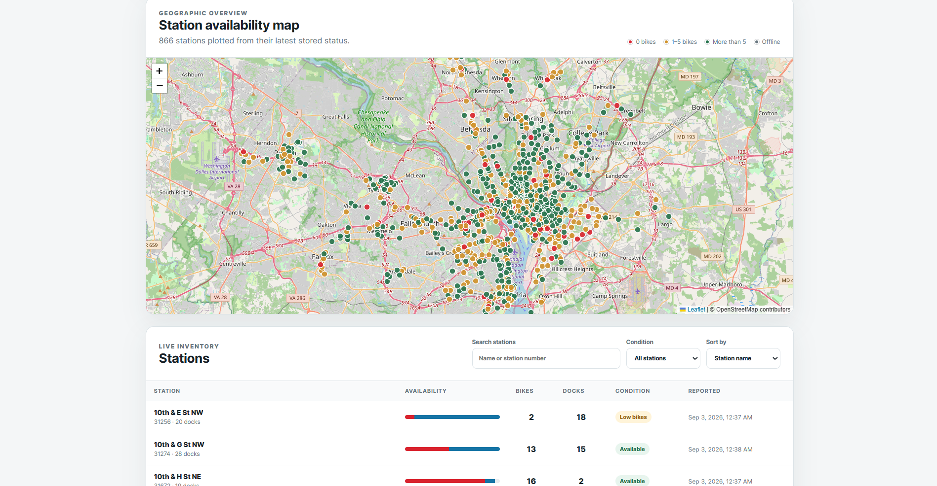
CAPITAL BIKESHARE OPERATIONS
Dashboard(React Front-End)
The Dashboard features the following:
Network summary showing total stations, available bikes, empty stations, and low-bike stations.
Interactive map with red, yellow, and green markers based on bike availability.
Active warning and critical depletion alerts.
Searchable and sortable live station inventory.
Station details including bikes, docks, capacity, and location.
Historical availability chart for each selected station.

Slide 13
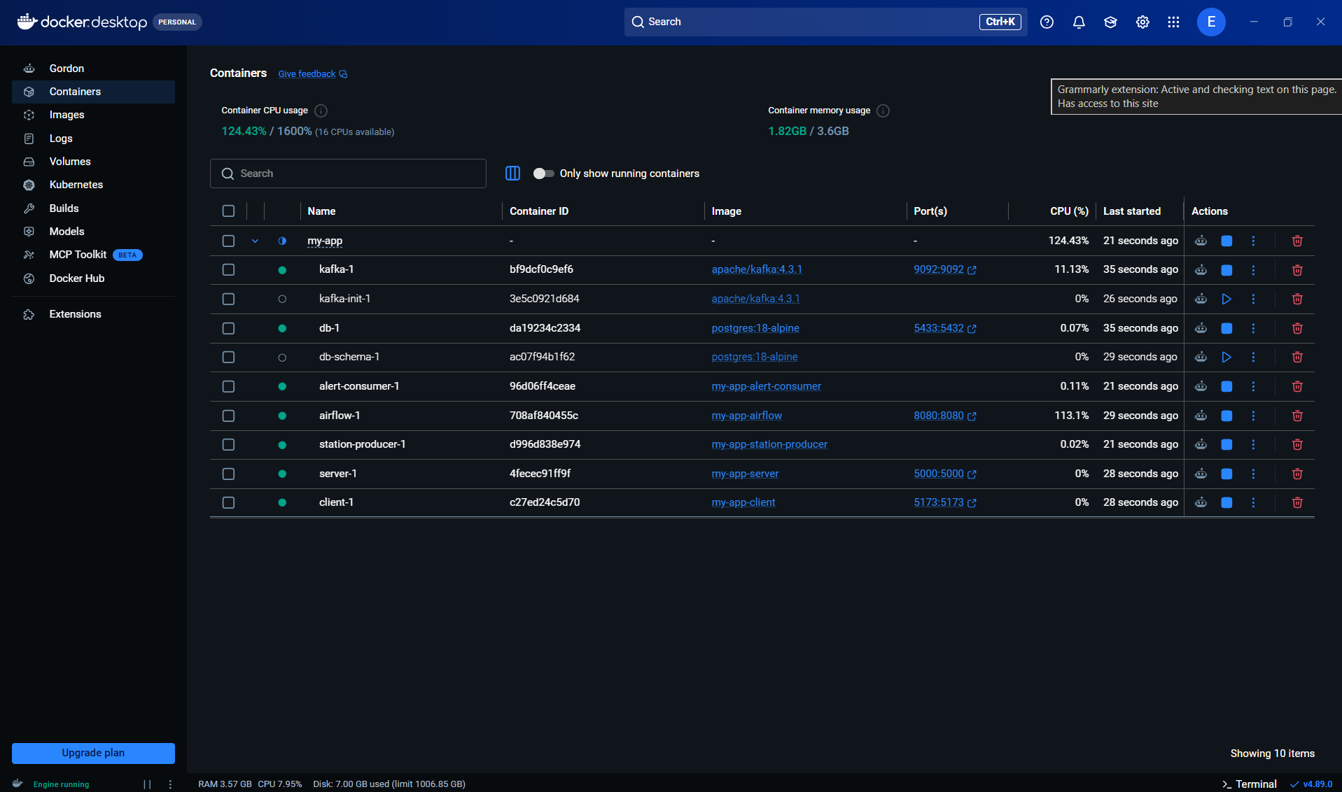
CAPITAL BIKESHARE OPERATIONS
Docker Configuration
Complete application running as one Docker Compose project. Docker Compose creates and connects nine containers, with each container responsible for one part of the system.
client-1: Serves the React dashboard on port 5173.
server-1: Provides the Express API on port 5000.
db-1: Runs PostgreSQL 18. Port 5433 on the host maps to PostgreSQL's internal port 5432.
airflow-1: Schedules and monitors the ETL pipeline through port 8080.
kafka-1: Runs the Kafka broker and exposes port 9092.
station-producer-1: Fetches station data and publishes new observations to Kafka.
alert-consumer-1: Consumes Kafka events, detects depletion risks, and stores alerts in PostgreSQL.
kafka-init-1: Creates the station-status topic and then exits.
db-schema-1: Applies the database schema and then exits.

Slide 14
The End. Thank you

