Slide 1
ENVISION discovery pipeline
Multi-source harvesting · archive-aware metadata · few-shot classification
ENVISION Portal · EyeACT
github.com/EyeACT/envision-discovery · github.com/EyeACT/envision-classifier

Slide 2
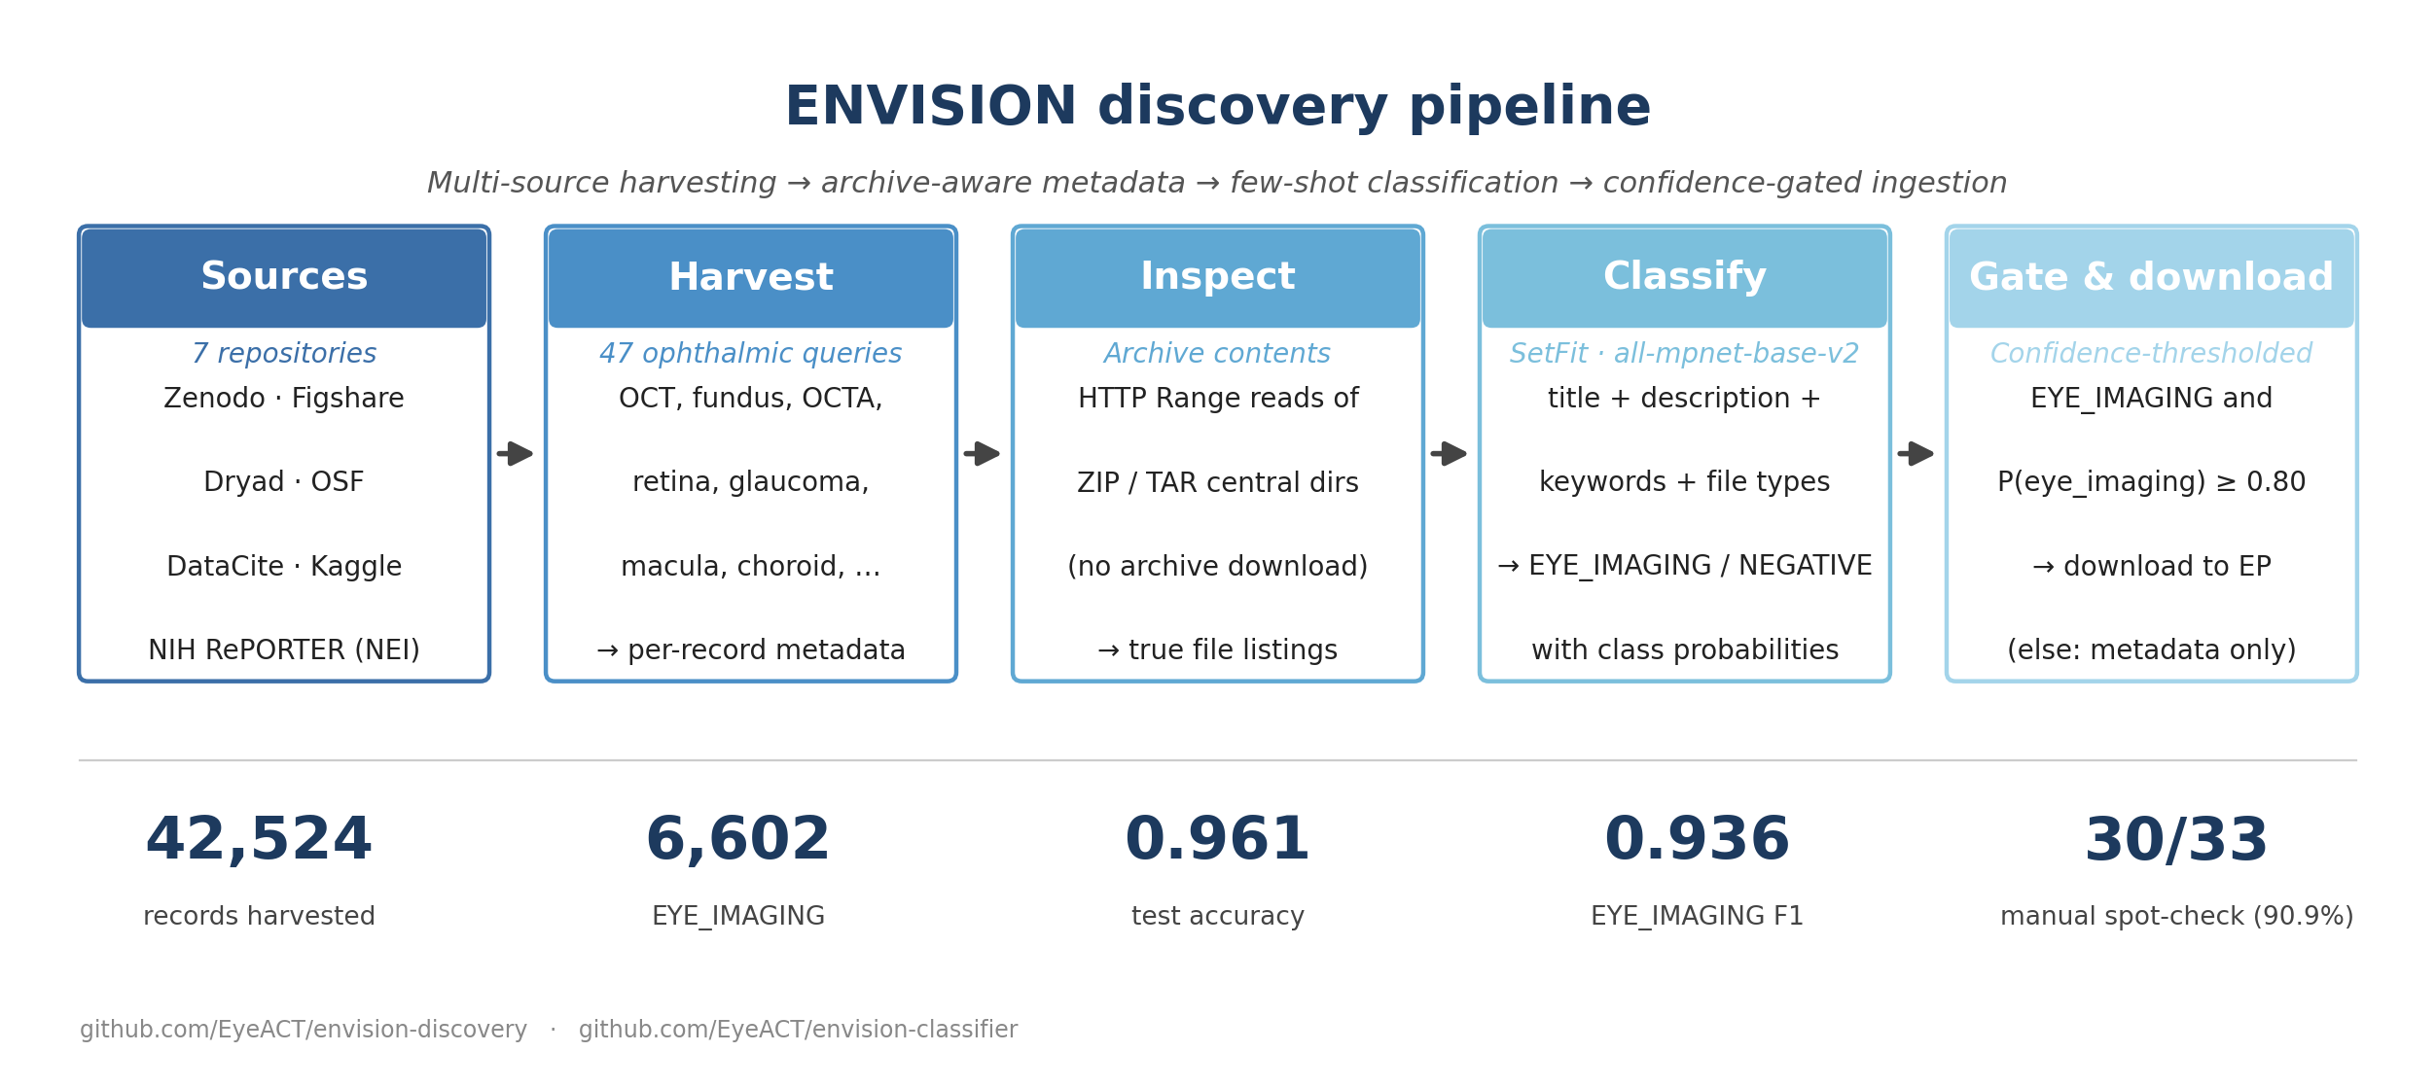
Method
Each scientific dataset record (title + description + keywords + file types) is encoded with sentence-transformers/all-mpnet-base-v2 and classified by a SetFit head trained on 891 curated examples (262 EYE_IMAGING, 629 NEGATIVE).

Slide 3
Source repositories
Seven public repositories harvested with 47 ophthalmology-specific queries (OCT, fundus, OCTA, retina, glaucoma, macula, choroid, …)
Source | EYE_IMAGING | Total records | %
Zenodo | 1,974 | 30,501 | 6.5%
Figshare | 1,827 | 3,439 | 53.1%
DataCite | 1,172 | 2,416 | 48.5%
NIH RePORTER (NEI) | 920 | 2,737 | 33.6%
Kaggle | 431 | 968 | 44.5%
Open Science Framework | 252 | 2,375 | 10.6%
Dryad | 26 | 88 | 29.5%
Total | 6,602 | 42,524 | 15.5%

Slide 4
Validation
0.961
0.936
test accuracy
EYE_IMAGING F1
binary classification on a held-out 20% split
precision/recall balanced on the positive class
90.9%
891
manual spot-check
training examples
30/33 EYE_IMAGING predictions confirmed by hand
262 EYE_IMAGING + 629 NEGATIVE, manually curated
Ongoing: ophthalmologist Yes/No/I-can't-tell survey on the public EnvisionPortal validation site (100-record batches; inter-rater agreement reported once responses accumulate).

Slide 5
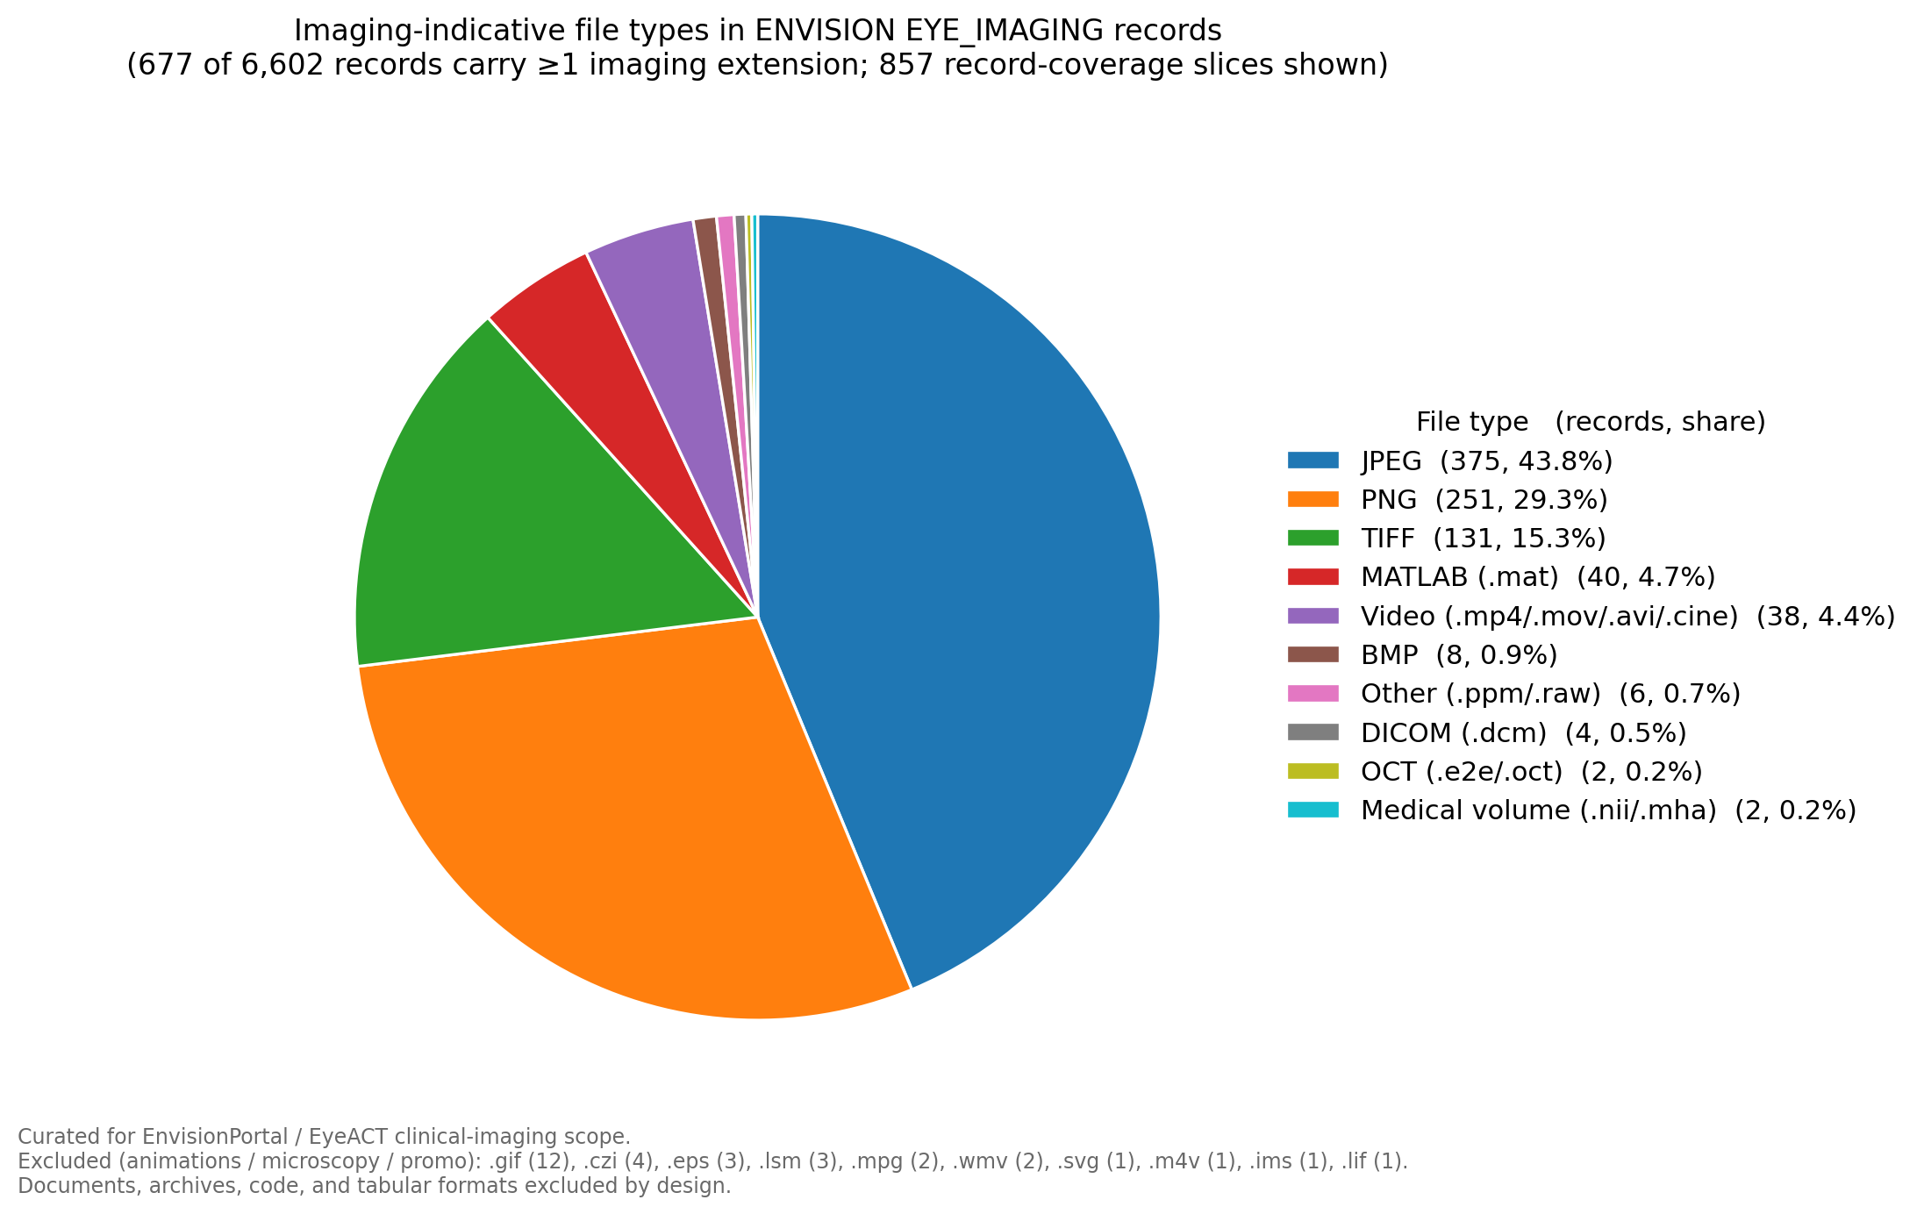
What's actually in the EYE_IMAGING records?
Allow-list curated for clinical eye-imaging:
JPEG / PNG / TIFF / BMP — fundus, OCT exports
DICOM (.dcm) — medical imaging standard
OCT-native (.e2e Heidelberg, .oct)
Video (.mp4 / .mov / .avi / .cine) — slit-lamp, OCTA
Medical volume (.nii / .mha)
MATLAB (.mat) — common OCT array container
Excluded: documents, archives, code, microscopy (.lsm/.lif/.czi/…), animations (.gif/.eps/.svg).

Slide 6
By the numbers
42,524
6,602
1,896
records harvested across 7 repositories
classified EYE_IMAGING
currently registered on EnvisionPortal
Difference between 6,602 and 1,896: ENVISION classifies the full harvested corpus; EnvisionPortal currently shows the records that have been ingested through its data-conversion pipeline (in progress).

