Slide 1
The Mythical Man-Month
20150888, CSE, Kanghee Park

Slide 2
Chapter 2: The Mythical Man-Month
Why software project have gone awry for lack of calendar time?
Techniques of estimating are porly developed
Confuse efforts with progress
Lack the courteous stubbornness of Antoine’s chef (Good cooking takes time)
Schedule progress is poorly monitored
Add manpower when schedule slippage is recognized

Slide 3
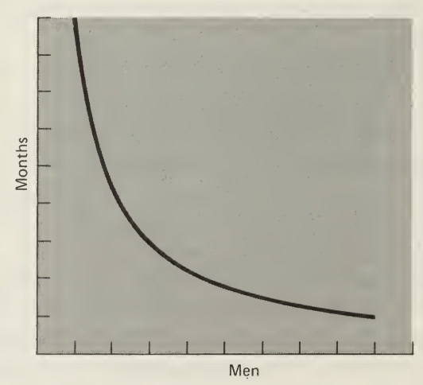

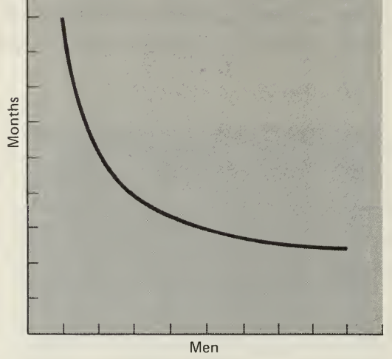
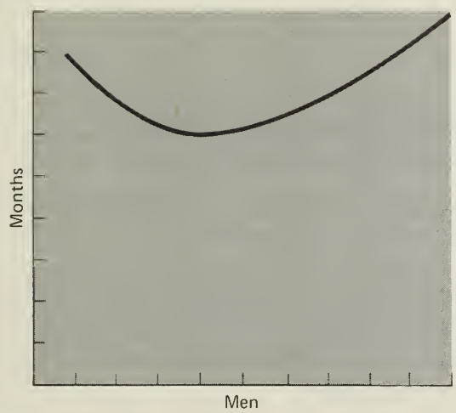
Chapter 2: The Mythical Man-Month
All programmers are optimists
Scheduling under false assumption ‘all will go well’
Our ideas become clear only during implementation
We expect few difficulties on implementation
Progress does not vary as (# of men) * (# of month)
Perfectly
Partitionable task
Unpartitionable task
Partitionable task
Requiring communication
Task with complex
interrelationships

Slide 4
Chapter 2: The Mythical Man-Month
Scheduling a software task
1/3 planning, 1/6 coding
¼ component test and early system test
¼ system test
Adding manpower to a late software project make it later
New men requires training
Repartitioning and system test effects

Slide 5
Chapter 3: The Surgical Team
The surgeon
Personally defines the functional and performance specifications,
Designs the program, codes it, tests it,
And writes its documentation
Needs talent, experience, and considerable systems and application knowledge
The copilot
Alter ego of the surgeon, able to do any part of job, but is less experienced
Share in the design as a thinker, discussant, and evaluator
The administrator
Handles money, people, space, and machines
Interfaces with the administrative machinery of the rest of the organization

Slide 6
Chapter 3: The Surgical Team
The administrator
Handles money, people, space, and machines
Interfaces with the administrative machinery of the rest of the organization
The editor
Takes the draft or dictated manuscript produced by the surgeon
And criticizes it, reworks it, provides it with references and bibliography,
Nurses it through several versions, and oversees the mechanics of production
Two secretaries (for the administrator and the editor)

Slide 7
Chapter 3: The Surgical Team
The program clerk
Maintain all the technical records of the team in a programming-product library
Make all the computers runs visible to team members and identifying all programs and data as team property
The toolsmith
Ensure adequacy of the basic service and constructing, maintaining,
and upgrading special tools needed by his team

Slide 8
Chapter 3: The Surgical Team
The tester
Devises system test cases from the functional specs,
Is an assistant who devises test data for the day-by-day debugging
Plan testing sequences and set up the scaffolding required component tests
The language lawyer
Find a neat and efficient way to use the language to do difficult, obscure, or tricky things

Slide 9
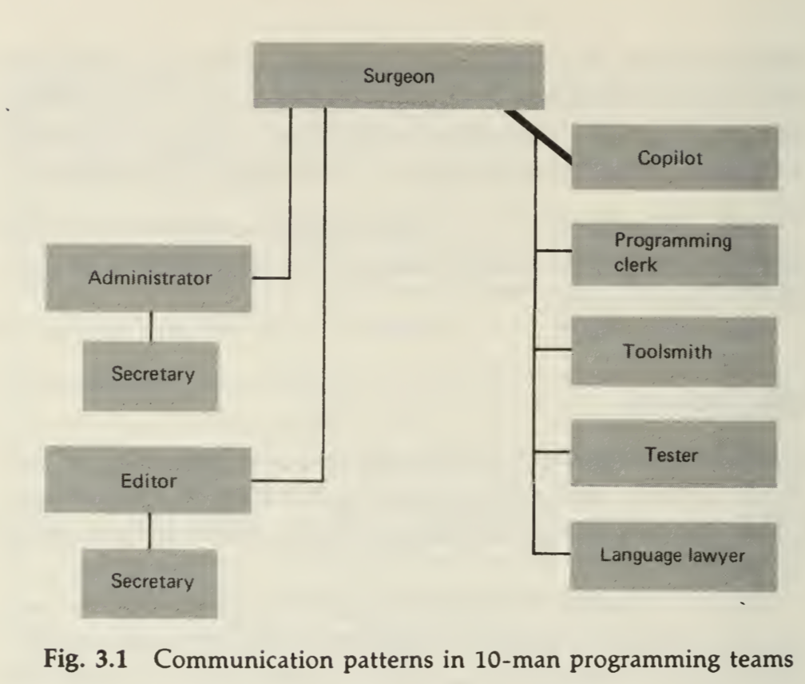
Chapter 3: The Surgical Team

