Slide 1
CS490P Project Design
20150888, CSE, Park Kanghee

Slide 2
Conventions

Slide 3
Message, Data
Use pickling library
Define SendableMessage, simplified message to use pickling library
ConnectionListener accepts socket connection only
SocketHandler handles messages first
StateManagers have its message queue

Slide 4
Message
abstract class Message
case class ConnectionMessage(socket: SocketChannel) extends Message
case class SampleMessage(numData: Long, keys: Array[Key], handler: SocketHandler) extends Message
case class PivotMessage(pivots: List[Key]) extends Message
case class DoneMessage(handler: SocketHandler) extends Message
abstract class SendableMessage extends Message
case class SendableSampleMessage(numData: Long, sampleSize: Int) extends SendableMessage
case class SlaveInfoMessage(slaveIP: Array[String], pivots: String, slaveNum: Int) extends SendableMessage
case object SendableDoneMessage extends SendableMessage

Slide 5
Slave -> Master (SocketHandler)
SampleMsg
ComputeDoneMsg
Purpose | Send sample to master | Notify sort is finished
When | Sampling is finished | Sorting is finished
Content | # of data Sample data
 | SendableSampleMsg = SampleMsg + handler | - SendableDoneMsg = ComputeDoneMsg + handler

Slide 6
ConnectionListener -> Master
ConnectionMsg
Purpose | Notify connection request to master
When | Server socket accepts a client
Content | SocketChannel

Slide 7
PivotCalculator -> Master
PivotMsg
Purpose | Send selected pivot
When | Pivot calculation is finished
Content | Pivot values

Slide 8
Master(SocketHandler) -> Slave
SlavesInfoMsg
Purpose | Send information of other slaves and partition
When | PivotMsg arrived in MasterStateManager
Content | IP of slaves Pivot values

Slide 9
Sorter -> Slave
SortDoneMsg
Purpose | Notify completion of sort for Slave
When | Finished sorting
Content

Slide 10
PartitionReceiver -> Slave
ReceivedAllPartitionMsg
Purpose | Notify termination of PartitionListener
When | Received partitions from all slaves
Content

Slide 11
PartitionSender -> Slave
SendedAllPartitionMsg
Purpose | Notify termination of PartitionSender
When | Sended partitions to all other slaves
Content

Slide 12
Shuffler -> Slave
ShufflingDoneMsg
Purpose | Notify termination of Shuffler
When | Finished shuffling
Content

Slide 13
PartitionSender -> PartitionReceiver
DataInfoMsg
DataMsg
Purpose | Send information of partitioned data | Send partitioned data
When | Finished partitioning | After send DataInfoMsg
Content | Size of each partition | Partition # Index (idx-th data of partition x) Data
Format | Message type (4 bytes, Integer) Size (4 bytes, Integer) * (# of partition) | Message type (4 bytes, Integer) Partition # (4 bytes, Integer) Index (4 bytes, Integer) Data (3000 bytes, Array[byte])

Slide 14
Modules

Slide 15
Overall Communication
Internal (Appending Message to queue)
Slave <-> Master
Slave -> Slave
Slave
Main
Partition
Listener
Partition
Sender
Socket
Handler
Socket
Handler
Master
Main
Socket
Handler
Socket
Handler
Slave
Main
Partition
Listener
Partition
Sender

Slide 16
Master Modules
Socket
Handler
Master
Main
Socket
Handler
Pivot
Calculator
Connection
Listener

Slide 17
Slave Modules
File
Handler
File
Handler
File
Handler
File
Handler
File
Handler
File
Handler
Partition
Sender
Shuffler
Partitioner
Sorter
Partition
Listener
Partition
Listener
File
Handler
Slave Main
(Used for simple file IO
e.g. sampling)
Socket
Handler

Slide 18
State Diagrams

Slide 19
State name
State variables
Action on start
Action on end
Invariants
SampleMsg
ConnectionMsg
Messages
…
Condition
…
Do ~~~ if …
Action
~~~

Slide 20
Master
ConnectionMsg
Create SlaveHandler
SampleMsg
Append handler to slaves
Append sample to samples
Remove handler from connected
Init
connected
: MutableList[SocketHandler]
slaves: MutableList[SocketHandler]
samples: MutableList[Key]
slaves.size
== numSlave
Create ConnectionListener
Sample
Terminate ConnectionListener
and elements of connected
Create PivotCalculator
slaves.size < numSlave
PivotMsg
ComputeDoneMsg
Send SlavesInfoMsg to slaves
- Append to finishedSlaves
Compute
finishedSlaves: Set[Slave]
finishedSlaves.size
== numSlave
finishedSlaves.size<numSlave
Success
Close all sockets
Terminate SlaveListeners

Slide 21
Slave
SortDoneMsg
Create PartitionSender
Set sortingFinished = True
Connect
ReceivedAllPartition
Create MasterHandler
Create Sampler
Create Shuffler
ReceivedAllPartitionMsg
Set receivedAllPartition = True
SlavesInfoMsg
sortingFinished
Create PartitionListener
Create Partitioner + Sorter
Create Shuffler
SendedAllPartitionMsg
Set sentAll = True
ShufflingDoneMsg
Set shufflingFinished = True
Compute
sortingFinished: Boolean
receivedAllPartition: Boolean
sentAll: Boolean
shufflingFinished: Boolean
sentAll && shufflingFinished
Send ComputeDoneMsg to Master
sortingFinished = False
receivedAllPartition = False
Success
Close all sockets
! (sentAll && shufflingFinished)

Slide 22
State Description

Slide 23
A
B
A extends B
A
B
A creates (and starts) B
A
Message
B
A sends Message to B
A
B
A terminates B
Condition
First arrow initiates the second arrow
Message

Slide 24
Init - Connection (Master)
ConnectionListener
serverSocket: ServerSocket master: Master
+ start(): Unit + terminate(): Unit - addConnectionMessage(Socket): Unit
《abstract》 StateManager
# messageQueue: LinkedBlockingQueue[Message]
+ addMessage(Message): Unit + run(): Unit # handleMessage(Message): Unit
ConnectionMsg
MasterStateManager
numSlave: Int connectionListener: ConnectionListener connected: MutableList[SocketHandler] slaves: MutableList[SocketHandler] samples: MutableList[Key] state: MasterState
# handleMessage(Message): Unit initHandleMessage(Message): Unit handleConnectionMessage(Socket): Unit handleSampleMessage(Long, Array[Key], SocketHandler)
SocketHandler
socket: Socket messageHandler: SendableMessage => Unit
+ run(): Unit + terminate(): Unit + sendMessage(SendableMessage): Unit + sendString(String): Unit

Slide 25
Init - RecvSample (Master)
ConnectionListener
serverSocket: ServerSocket master: Master
+ start(): Unit + terminate(): Unit - addConnectionMessage(Socket): Unit
《abstract》 StateManager
# messageQueue: LinkedBlockingQueue[Message]
+ addMessage(Message): Unit + run(): Unit # handleMessage(Message): Unit
slaves.size
== numSlave
SocketHandler
socket: Socket messageHandler: SendableMessage => Unit
+ run(): Unit + terminate(): Unit + sendMessage(SendableMessage): Unit + sendString(String): Unit
MasterStateManager
numSlave: Int connectionListener: ConnectionListener connected: MutableList[SocketHandler] slaves: MutableList[SocketHandler] samples: MutableList[Key] state: MasterState
# handleMessage(Message): Unit initHandleMessage(Message): Unit handleSampleMessage(Long, Array[Key], SocketHandler) changeToSampleState(): Unit printSlaveIP(): Unit
SendableSampleMsg
SampleMsg
slaves.size == numSlave
! (slaves contains handler)
SocketHandler
…
…

Slide 26
Sample (Master)
《abstract》 StateManager
# messageQueue: LinkedBlockingQueue[Message]
+ addMessage(Message): Unit + run(): Unit # handleMessage(Message): Unit
MasterStateManager
numSlave: Int slaves: MutableList[SocketHandler] samples: MutableList[Key] state: MasterState
# handleMessage(Message): Unit sampleHandleMessage(Message): Unit handlePivotMessage(Socket): Unit sendSlavesInfoMessage(pivots: List[Key]) changeToComputeState(): Unit
PivotCalculator
serverSocket: ServerSocket master: Master
+ getPivot(List[Key]): Future[List[Key]]
PivotMsg
SlavesInfoMsg

Slide 27
Compute (Master)
《abstract》 StateManager
# messageQueue: LinkedBlockingQueue[Message]
+ addMessage(Message): Unit + run(): Unit # handleMessage(Message): Unit
SendableDoneMsg
MasterStateManager
numSlave: Int slaves: MutableList[SocketHandler] finishedSlaves: MutableList[SocketHandler] samples: MutableList[Key] state: MasterState
# handleMessage(Message): Unit computeHandleMessage(Message): Unit handleDoneMessage(SocketChannel): Unit changeToSuccessState(): Unit
SocketHandler
socket: Socket messageHandler: SendableMessage => Unit
+ run(): Unit + terminate(): Unit + sendMessage(SendableMessage): Unit + sendString(String): Unit
ComputeDoneMsg

Slide 28
Success (Master)
《abstract》 StateManager
# messageQueue: LinkedBlockingQueue[Message]
+ addMessage(Message): Unit + run(): Unit # handleMessage(Message): Unit
MasterStateManager
numSlave: Int slaves: MutableList[SocketHandler] state: MasterState
# handleMessage(Message): Unit successHandleMessage(Message): Unit terminate(): Unit
SocketHandler
socket: Socket messageHandler: SendableMessage => Unit
+ run(): Unit + terminate(): Unit + sendMessage(SendableMessage): Unit + sendString(String): Unit

Slide 29
Connect (Slave)
《abstract》 StateManager
# messageQueue: LinkedBlockingQueue[Message]
+ addMessage(Message): Unit + run(): Unit # handleMessage(Message): Unit
SlaveStateManager
masterSocketHandler: SocketHandler state: SlaveState
# handleMessage(Message): Unit connectHandleMessage(Message): Unit sampleFromInput(): String sendPivots(): Unit changeToComputeState(): Unit
SocketHandler
socketChannel: SocketChennel stateManager: StateManager
+ run(): Unit + terminate(): Unit + sendMessage(SendableMessage): Unit
SlavesInfoMsg
SlavesInfoMsg

Slide 30
Compute (Slave) - Skip
《abstract》 StateManager
# messageQueue: LinkedBlockingQueue[Message]
+ addMessage(Message): Unit + run(): Unit # handleMessage(Message): Unit
SlaveStateManager
masterSocketHandler: SocketHandler state: SlaveState
# handleMessage(Message): Unit computeHandleMessage(Message): Unit changeToSuccessState(): Unit
Compute modules
…
…
SomeDoneMsg
SendableDoneMsg

Slide 31
Success (Slave)
《abstract》 StateManager
# messageQueue: LinkedBlockingQueue[Message]
+ addMessage(Message): Unit + run(): Unit # handleMessage(Message): Unit
SlaveStateManager
masterSocketHandler: SocketHandler state: SlaveState
# handleMessage(Message): Unit terminate()
SocketHandler
socketChannel: SocketChennel stateManager: StateManager
+ run(): Unit + terminate(): Unit + sendMessage(SendableMessage): Unit

Slide 32
Master: Init – Slave: Connect
SocketHandler (Master)
enough samples received
No SampleMsg from this
MasterStateManager
ConnectionMsg
SampleMsg
enough samples received
ConnectionListener
SocketHandler (Master)
SocketConnectionRequest
SendableSampleMsg
SocketHandler (Slave)
SlaveStateManager
Use sendMessage()
of socketHandler

Slide 33
Master: Sample – Slave: Connect
MasterStateManager
PivotMsg
SocketHandler (Master)
PivotCalculator
SlavesInfoMsg
SocketHandler (Slave)
SlavesInfoMsg
SlaveStateManager

Slide 34
Master: Compute – Slave: Compute
MasterStateManager
ComputeDoneMsg
SocketHandler (Master)
SendableDoneMsg
Skip details now
SocketHandler (Slave)
SlaveStateManager

Slide 35
Master: Success – Slave: Success
MasterStateManager
Terminate
SocketHandler (Master)
SocketHandler (Slave)
SlaveStateManager
Terminate

Slide 36
Master Sample
Calculate pivot values
Sort first and
Choose values from 1/n, 2/n, …, (n-1)/n position

Slide 37
Client Sample
Get number of key-value pairs
From file size
Sample from data (Sample size is proportional to data size)
Does not open all the files (Just some files)
Sample by random access
Send samples to master
Wait SlaveInfoMsg

Slide 38
Slave Compute Order
Listen
Shuffle
Terminate
Partition
Sort
Send

Slide 39
Tests

Slide 40
PivotSuite
sampleKey = {{0, 0, …, 0}, {1, 1, …, 1}, …, {0xff, 0xff, …, 0xff}}
Calculates correct pivot for sampleKey
Calculates correct pivot for sampleKey.reverse

Slide 41
etc

Slide 42
Possible improvements
Sample by main thread -> Sample by futures?
Actually, sampling does not take much time
But this change increase complexity of connect state much

Slide 43
Experiment on cluster machines

Slide 44
Program print sum strings for debug (e.g. Messages, pivots)

Slide 45
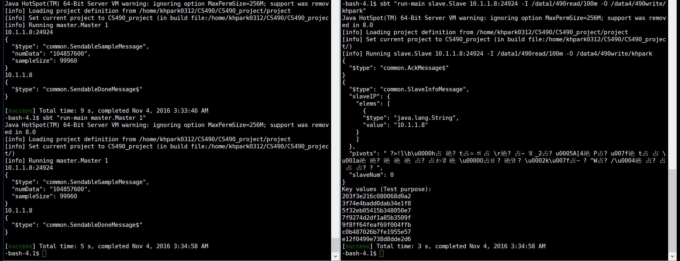
100m, single slave, single input dir

Slide 46
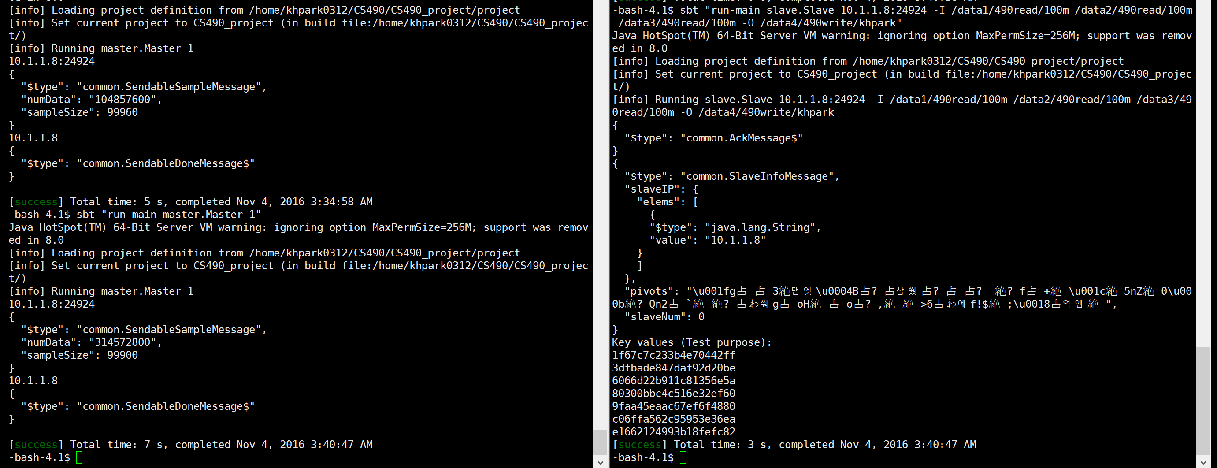
100m, single slave, multiple input dir

Slide 47
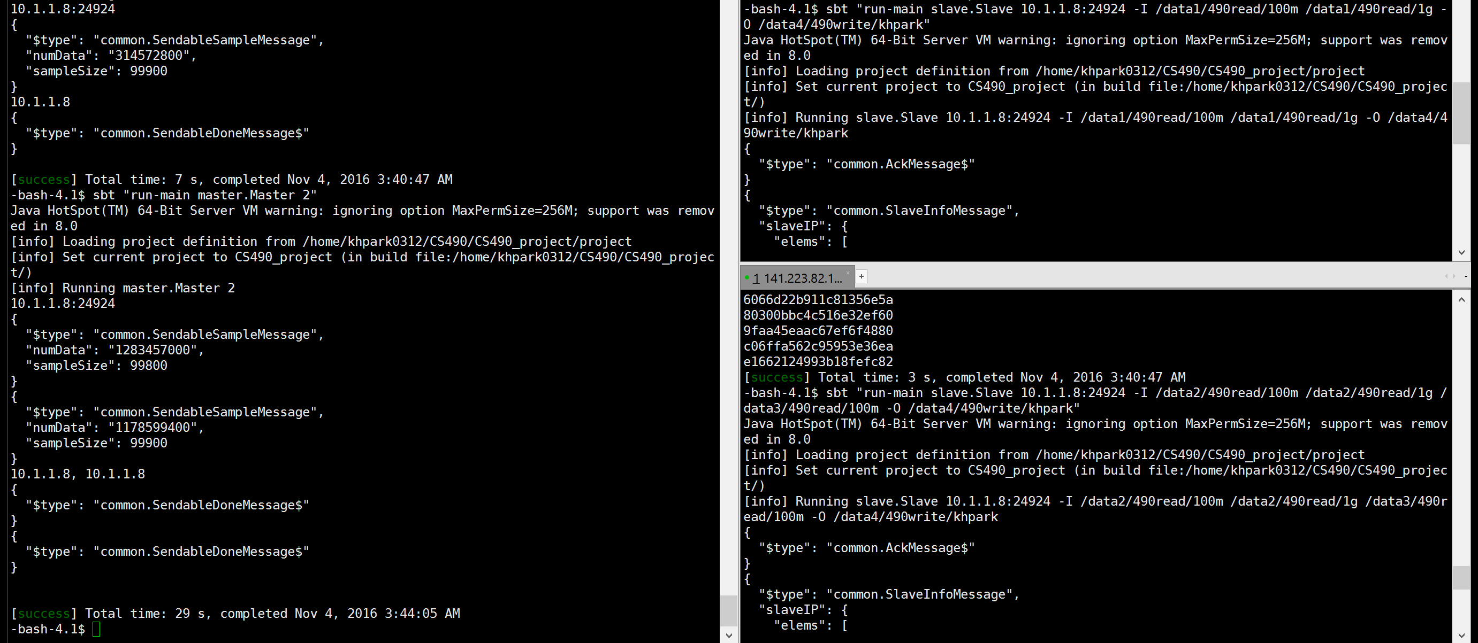
1g, multiple slaves, multiple input dir

Slide 48
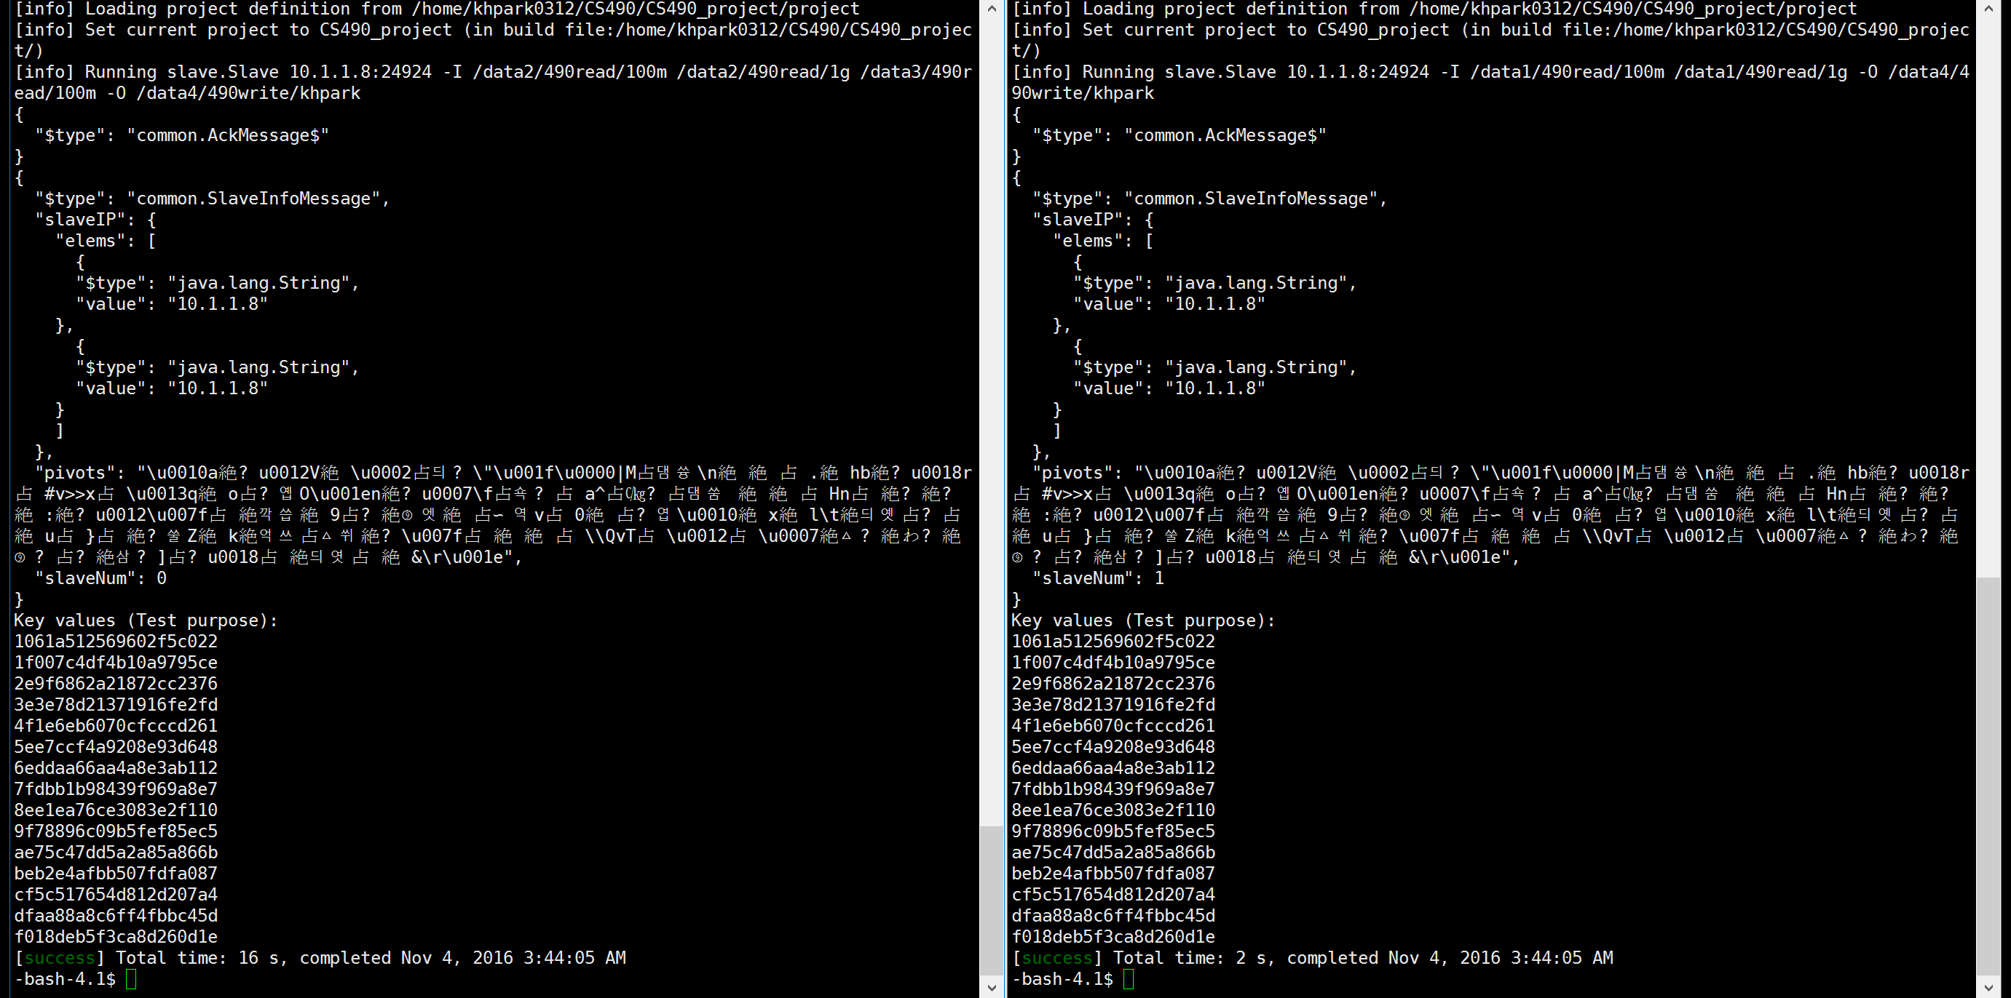
1g, multiple slaves, multiple input dir

