Slide 1
CS490P Project Design
20150888, CSE, Park Kanghee

Slide 2
Conventions

Slide 3
Message, Data
Use pickling library
Define SendableMessage, simplified message to use pickling library
ConnectionListener accepts socket connection only
SocketHandler handles messages first
StateManagers have its message queue

Slide 4
Message
abstract class Message
case class PivotMessage(pivots: List[Key]) extends Message
case class SampleMessage(address:String, numData: Long, sample: String) extends Message
case class SlaveInfoMessage(slaveIP: Array[String], pivots: String) extends Message
case class PartitionDoneMessage(partitions: Vector[Vector[String]]) extends Message
case class FileInfoMessage(files: String, ownerIP: String) extends Message
case class FileRequestDoneMessage(ownerIP: String) extends Message
case object MergeDoneMessage extends Message
case object SlaveFullMessage extends Message
case object DoneMessage extends Message
case object TerminateMessage extends Message

Slide 5
Slave -> Master
SampleMsg
DoneMsg
Purpose | Send sample to master | Notify sort is finished
When | Sampling is finished | Sorting is finished
Content | # of data Sample data

Slide 6
Slave -> Master
TerminateMsg
Purpose | Terminate Slaves
When | Master is on success state
Content

Slide 7
PivotCalculator -> Master
PivotMsg
Purpose | Send selected pivot
When | Pivot calculation is finished
Content | Pivot values

Slide 8
Master(SocketHandler) -> Slave
SlavesInfoMsg
SlavesFullMsg
Purpose | Send information of other slaves and partition | Notify that enough # of slaves are connected already
When | PivotMsg arrived in MasterStateManager | Is changing to sample state
Content | IP of slaves Pivot values

Slide 9
Partitioner -> Slave
PartitionDoneMsg
Purpose | Notify completion of partition to Slave
When | Finished partition
Content | Name of partition files

Slide 10
Merger -> Slave
MergeDoneMsg
Purpose | Notify completion of merge to Slave
When | Merged all files
Content

Slide 11
ShufflingHandler -> Slave
PartitionRequestDoneMsg
Purpose | Notify partition request for some slave is done
When | Partition request is finished for a slave
Content | IP of the partition owner

Slide 12
Slave -> Master -> All slaves
FileInfoMessage
Purpose | Notify termination of PartitionListener
When | Received partitions from all slaves
Content

Slide 13
Modules

Slide 14
Overall Communication
Internal (Appending Message to queue)
Slave <-> Master
Slave -> Slave
Slave
Main
File
Request
Client
Master
Network
Handler
Slave
Network
Handler
File
Request
Server
Master
Main
Slave
Network
Handler
File
Request
Server
Master
Network
Handler
Slave
Main
File
Request
Client

Slide 15
Master Modules
Master
Network
Handler
Master
Main
Master
Network
Handler
Pivot
Calculator

Slide 16
Slave Modules
File
Handler
File
Handler
File
Handler
File
Request
Server
File
Request
Client
Partitioner
File
Handler
Slave Main
(Used for simple file IO
e.g. sampling)
Slave
Network
Handler

Slide 17
State Diagrams

Slide 18
State name
State variables
Action on start
Action on end
Invariants
SampleMsg
DoneMsg
Messages
…
Condition
…
Do ~~~ if …
Action
~~~

Slide 19
Master
SampleMsg
Append received sample
Append slaveAddressList
Remove handler from connected
Init
connected: DefaultChannelGroup
slaves: DefaultChannelGroup
slaveAddressList: MutList[String]
samples: MutableList[Key]
numSampleFinishedSlaves: Int
numSampleFinishedSlaves == numSlave
Sample
FileInfoMsg
numSampleFinishedSlaves < numSlave
Create PivotCalculator
Send same message to all slaves
PivotMsg
DoneMsg
Send SlavesInfoMsg to slaves
- Append to finishedSlaves
Compute
numComputeFinishedSlaves: Int
finishedSlaves.size
== numSlave
numComputeFinishedSlaves
< numSlave
Success
Close all channels

Slide 20
Slave
Connect
PartitionDoneMsg
Send FileInfoMessage
Create MasterHandler
Create Sampler
requestNotFinished.isEmpty
Start Merger
FileInfoMsg
SlavesInfoMsg
Save file names
Create FileRequestClient
SlavesFullMsg
Create PartitionListener
Create Partitioner + Sorter
FileRequestDoneMsg
Remove from requestNotFinished
partitionFinished & requestNotFinished.isEmpty
Failure
Start Merger
Close all channels
Compute
TerminateMsg
requestNotFinished: mutable.Set[String]
mergeFinished: Boolean
MergeDoneMsg
Terminate
Send DoneMessage to Master
mergeFinished = False
requestNotFinished =
slaveIP - { myIP }
Success

Slide 21
State Description

Slide 22
A
B
A extends B
A
B
A creates (and starts) B
A
Message
B
A sends Message to B
A
B
A terminates B
Condition
First arrow initiates the second arrow
Message

Slide 23
Master: Init – Slave: Connect
Slave
SlavesFullMsg
Master
SocketConnectionRequest
SampleMsg
Slave

Slide 24
Master: Sample – Slave: Connect
(Delay)
Master
PivotMsg
SampleMsg
PivotCalculator
SlavesInfoMsg
Slave

Slide 25
Master, Slave: Partition - Shuffle
FileRequestServer
Slave
PartitionDoneMsg
FileRequest
DoneMsg
Partitioner
FileInfoMsg
FileRequestClient
SlavesInfoMsg
File
Master
(Delay)
FileInfoMsg
FileRequest
SlavesInfoMsg
Partitioner
FileRequestClient
PartitionDoneMsg
FileRequest
DoneMsg
Slave
FileRequestServer

Slide 26
Master, Slave: Merge
Master
DoneMsg
Merger
partitionFinished &
requestNotFinished.isEmpty
MergeDoneMsg
Slave
FileRequestServer

Slide 27
Master: Success – Slave: Success
Master
Terminate
DoneMsg
TerminateMsg
Slave
Terminate

Slide 28
Master Sample
Calculate pivot values
Sort first and
Choose values from 1/n, 2/n, …, (n-1)/n position

Slide 29
Client Sample
Get number of key-value pairs
From file size
Sample from data (Sample size is proportional to data size)
Does not open all the files (Just some files)
Sample by random access
Send samples to master
Wait SlaveInfoMsg

Slide 30
Slave Compute Order
Request
Merge
Partition
Sort
Create
Request
Server

Slide 31
Tests

Slide 32
PivotSuite
sampleKey = {{0, 0, …, 0}, {1, 1, …, 1}, …, {0xff, 0xff, …, 0xff}}
Calculates correct pivot for sampleKey
Calculates correct pivot for sampleKey.reverse

Slide 33
Experiment on cluster machines

Slide 34
Program spec
The program write the log of
Received messages
Start of partition (of each file)
Received, or sent file request
Partition name is partition_{file #}_{partition #}_{owner #}

Slide 35
Milestone 1

Slide 36
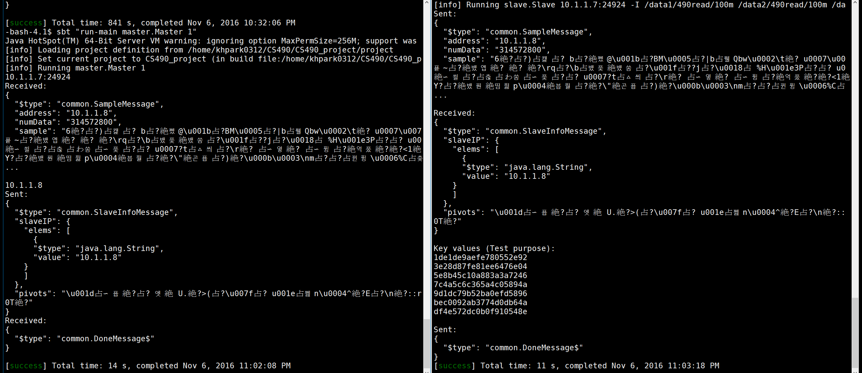
Scenario:
Master wait 1 slave
1 slave try to connect to master

Slide 37
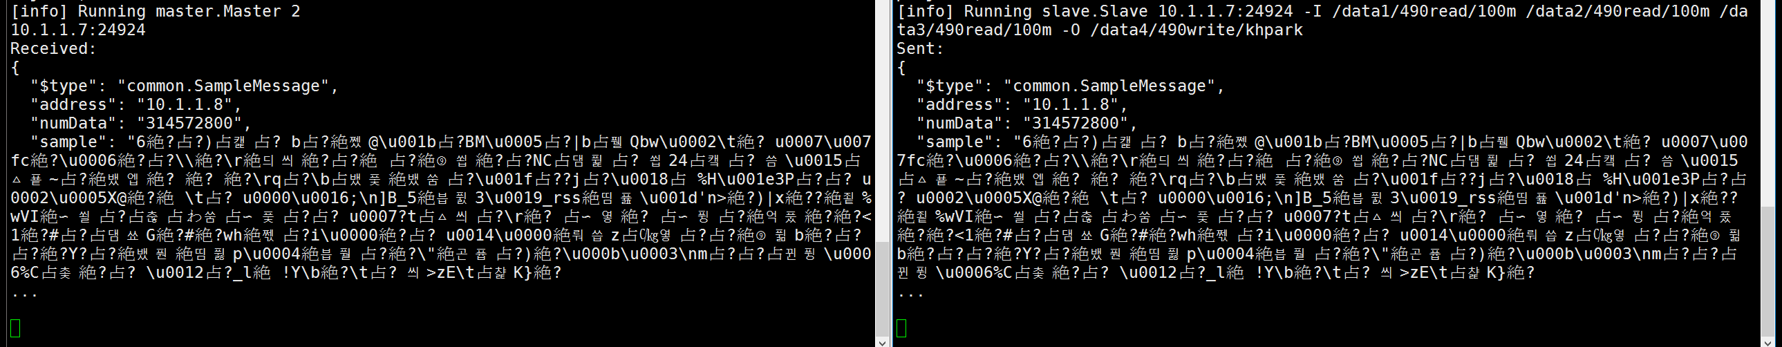
Scenario:
Master wait 2 slaves
Only 1 slave try to connect to master
No progress

Slide 38
Scenario:
Master wait 1 slave
1 slave try to connect to master

Slide 39
Scenario:
Master wait 2 slaves
2 slaves try to connect to master

Slide 40
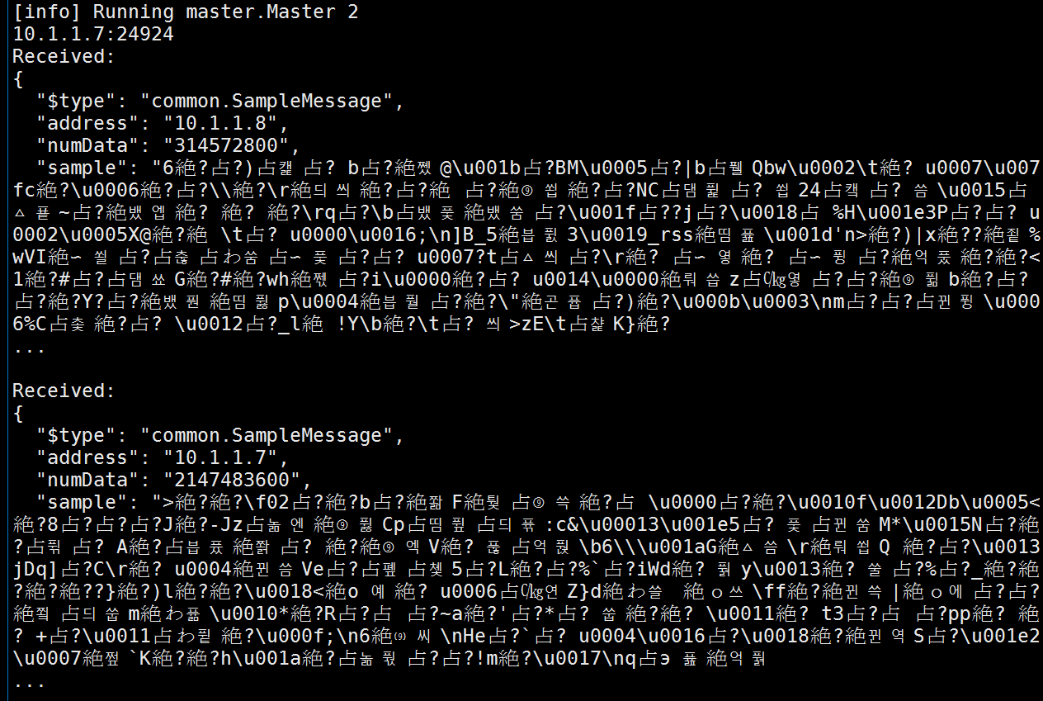
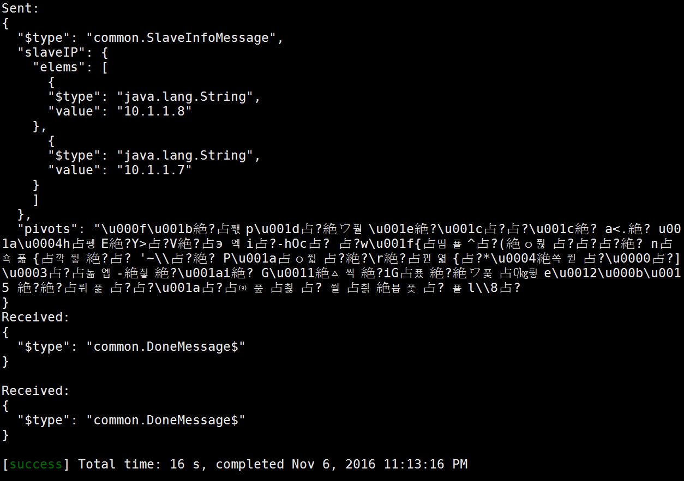
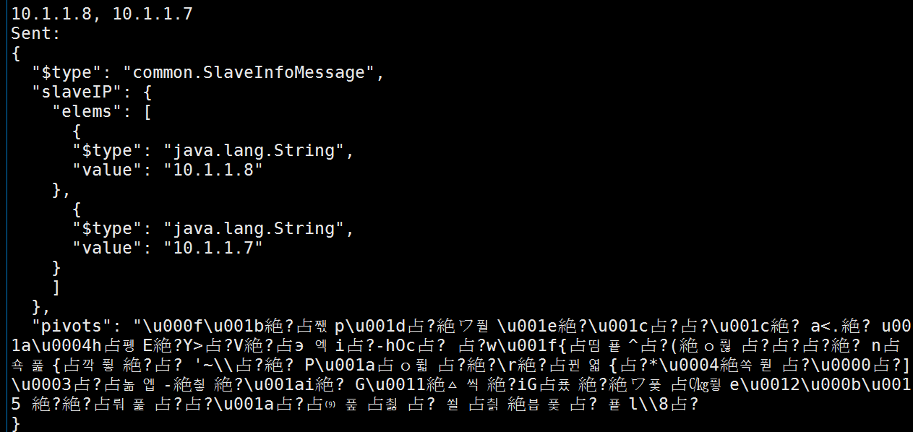
Master

Slide 41
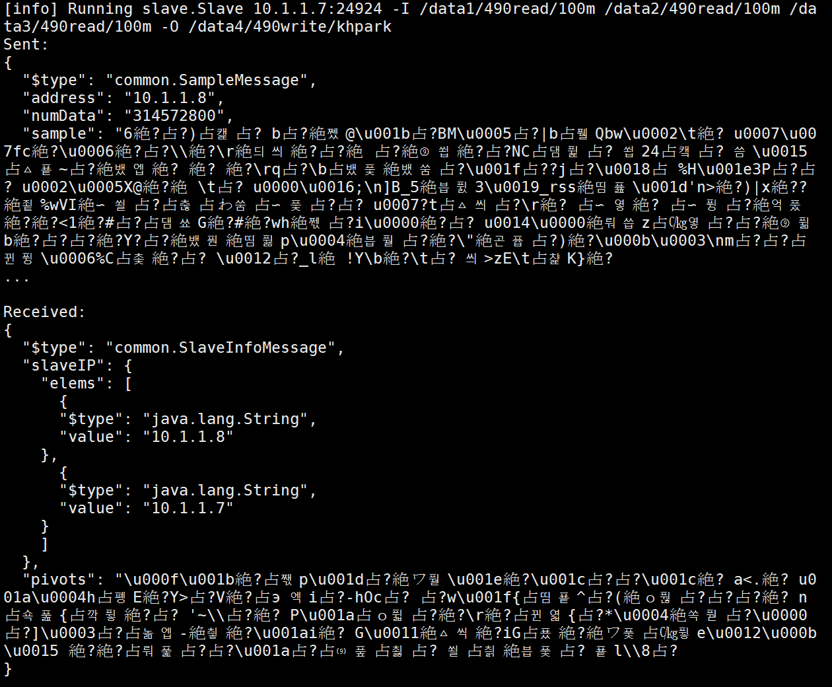
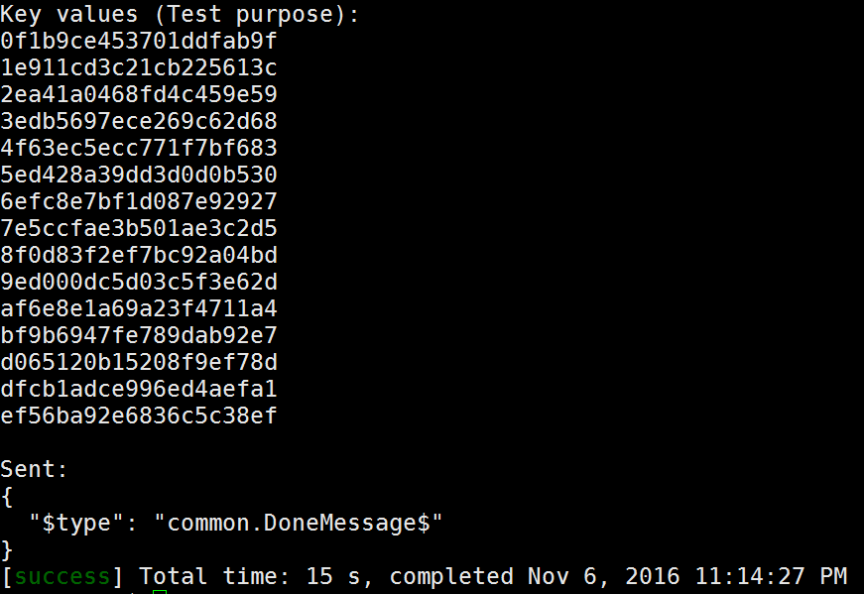
Slave 1

Slide 42
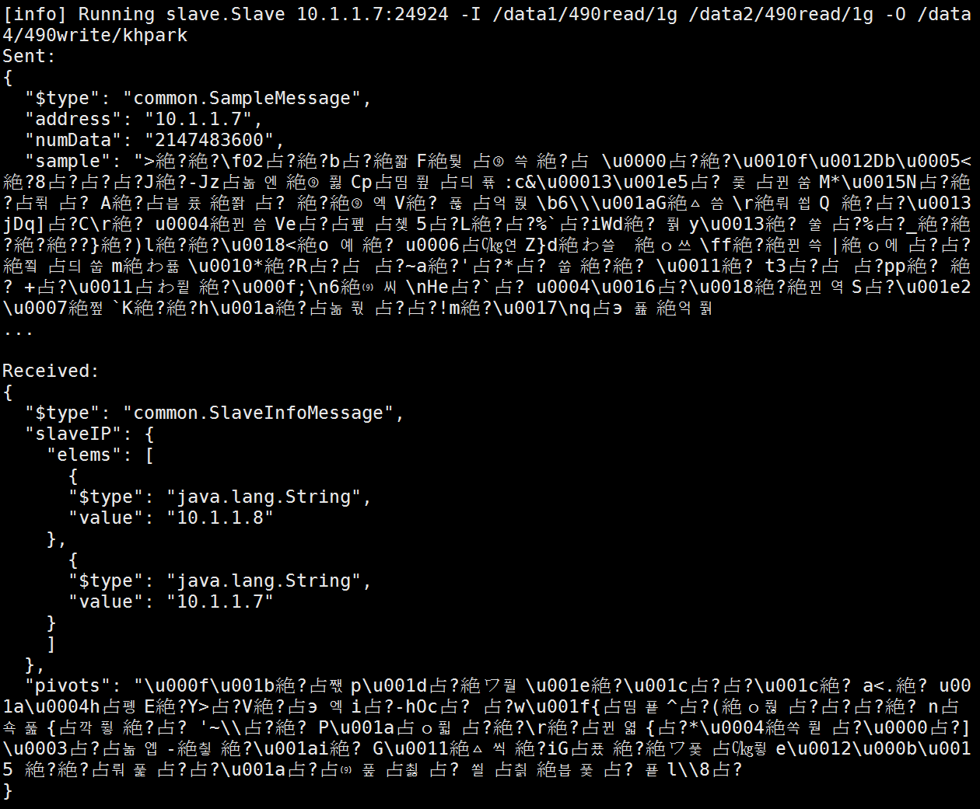
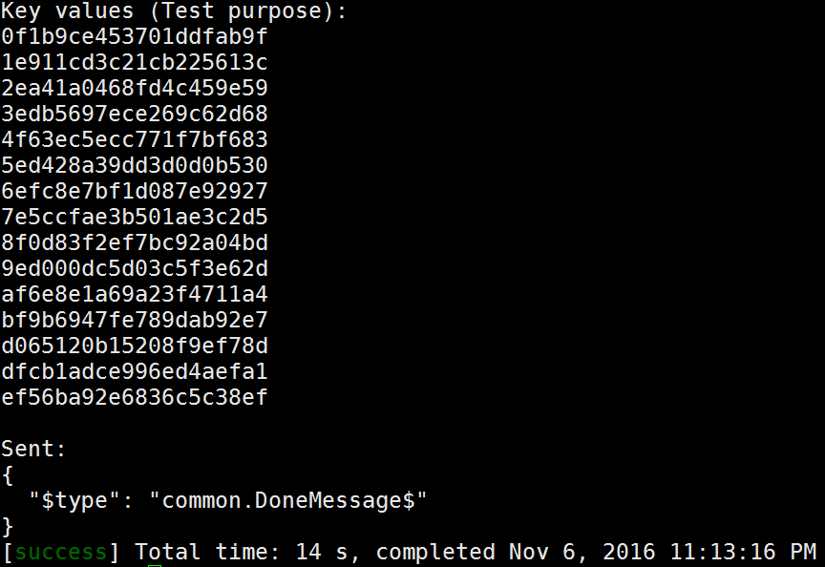
Slave 2

Slide 43
Scenario:
Master wait 1 slave
2 slaves try to connect to master

Slide 44
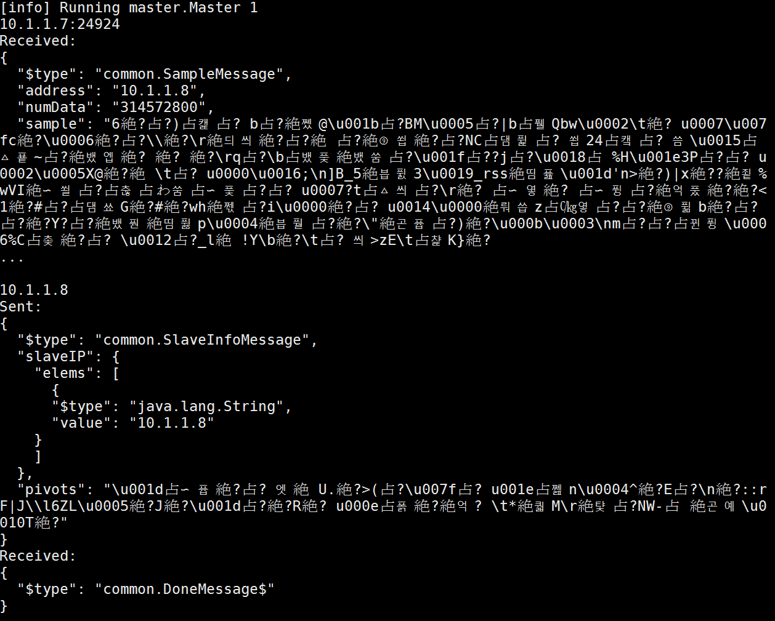
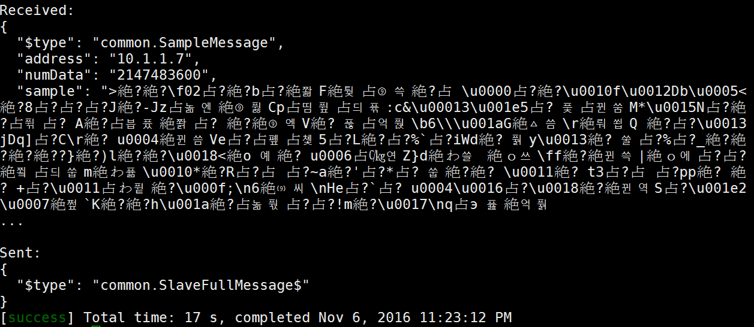
Master

Slide 45
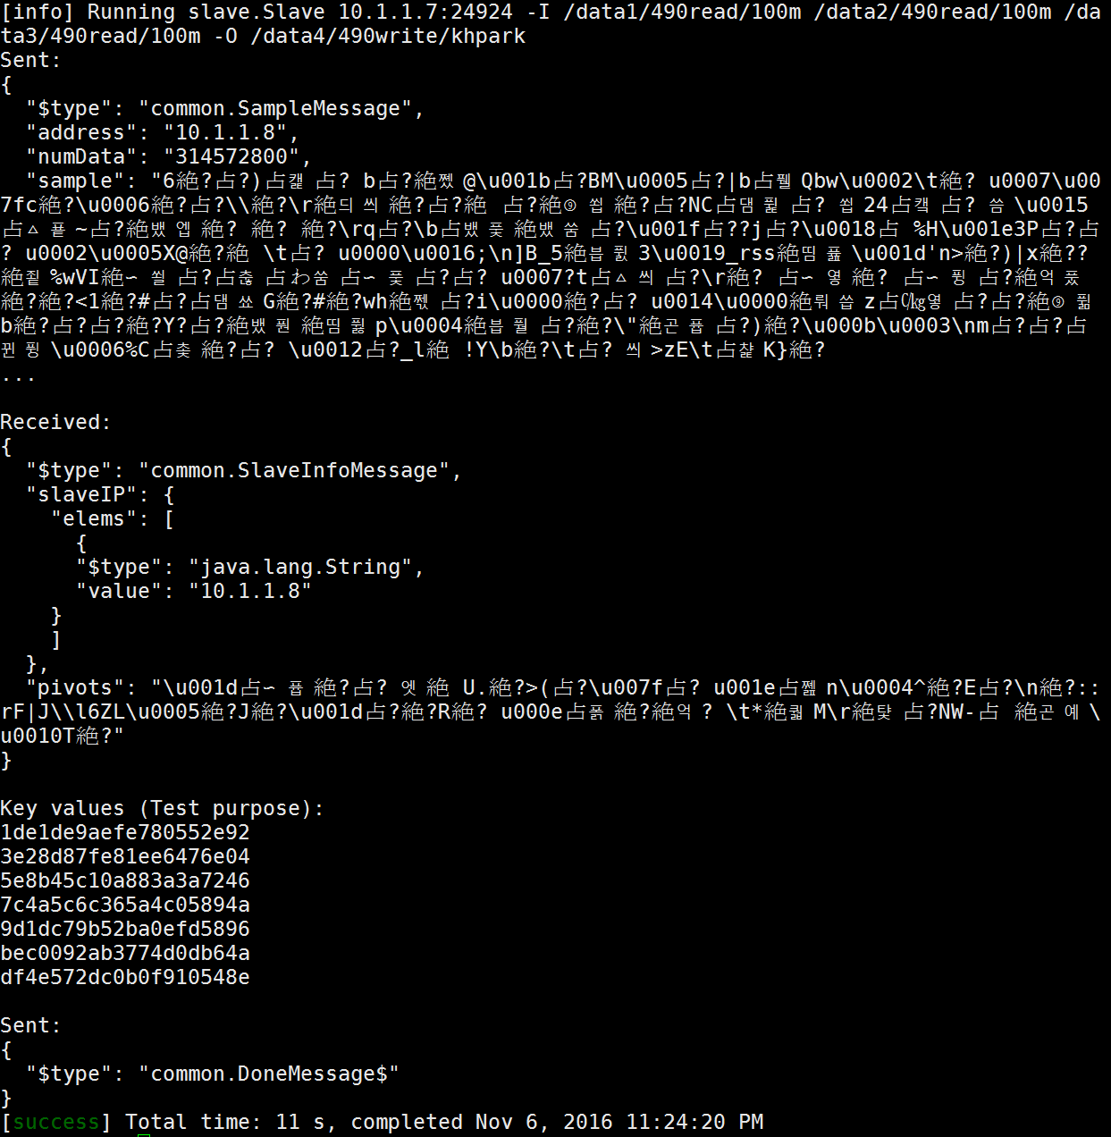
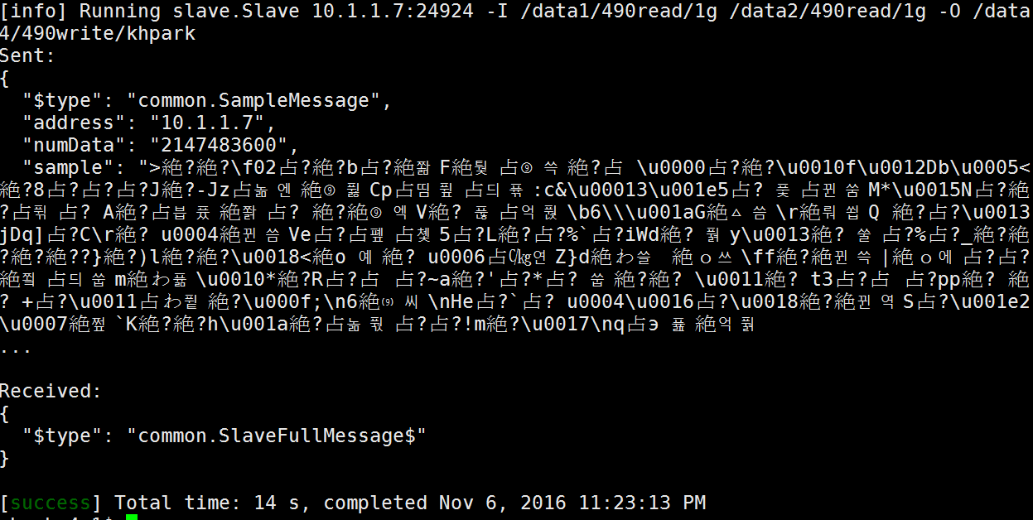
Slave 1
Slave 2

Slide 46
Milestone 2

Slide 47
Scenario:
Master wait 2 slaves
2 slaves try to connect to master
They write (intermediate) partition files to output directory
Partition name is partition_{file #}_{partition #}_{owner #}
Partitions
0~7 are for machine 0
8~15 are for machine 1
8 partitions for single machine

Slide 48
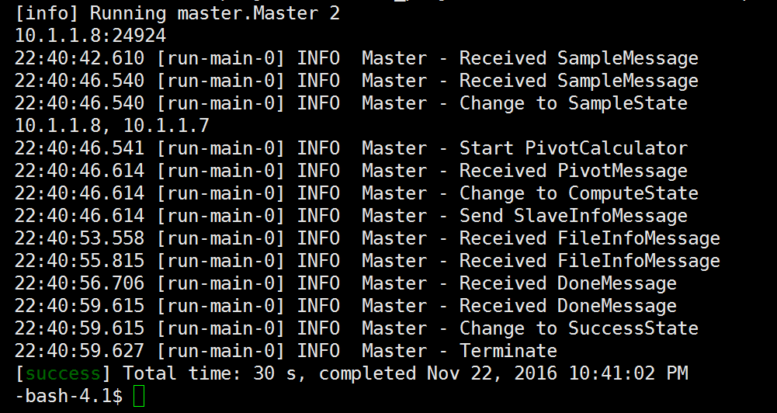
Master

Slide 49
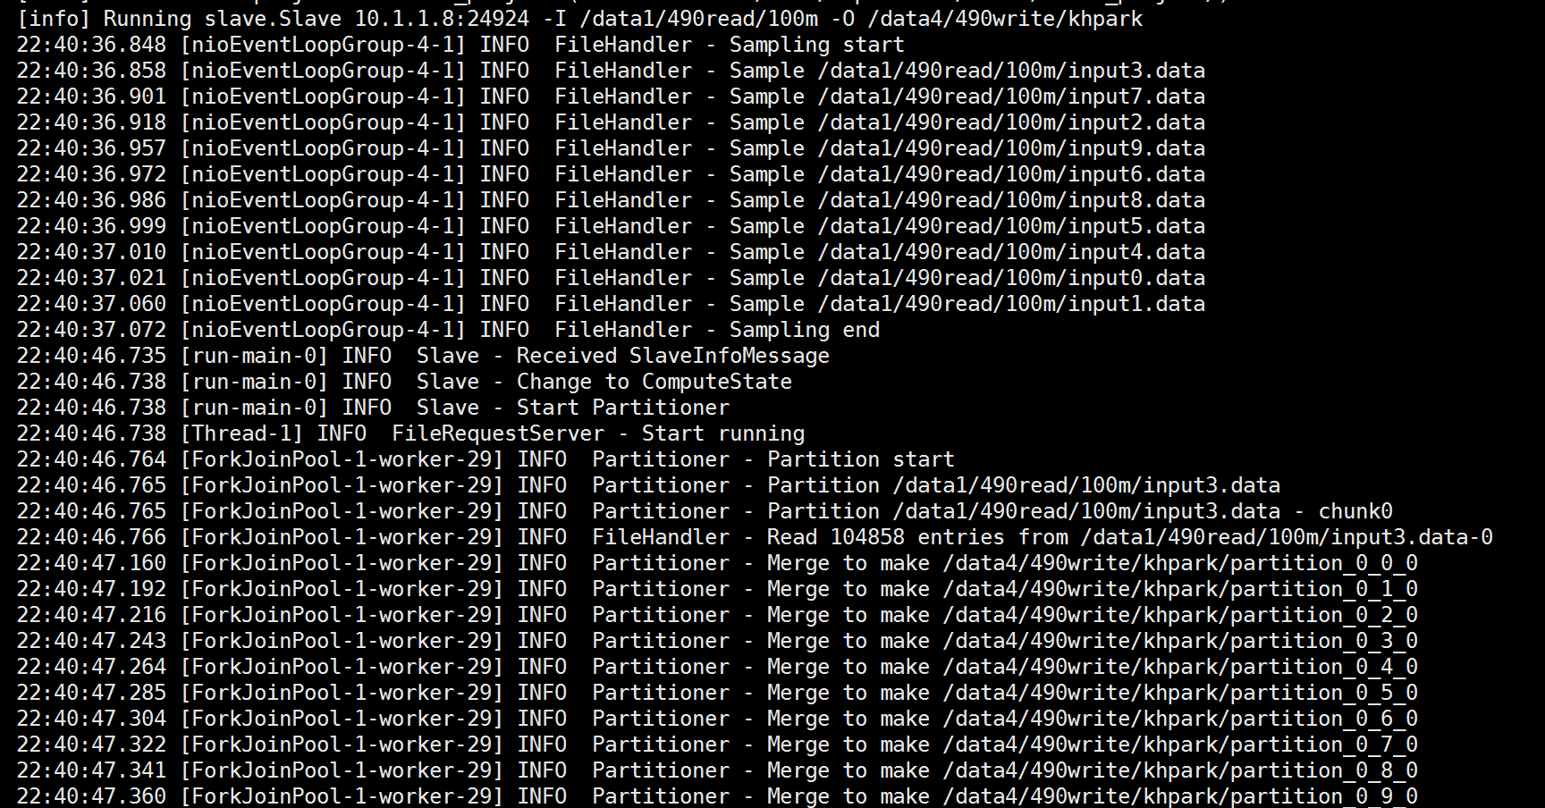
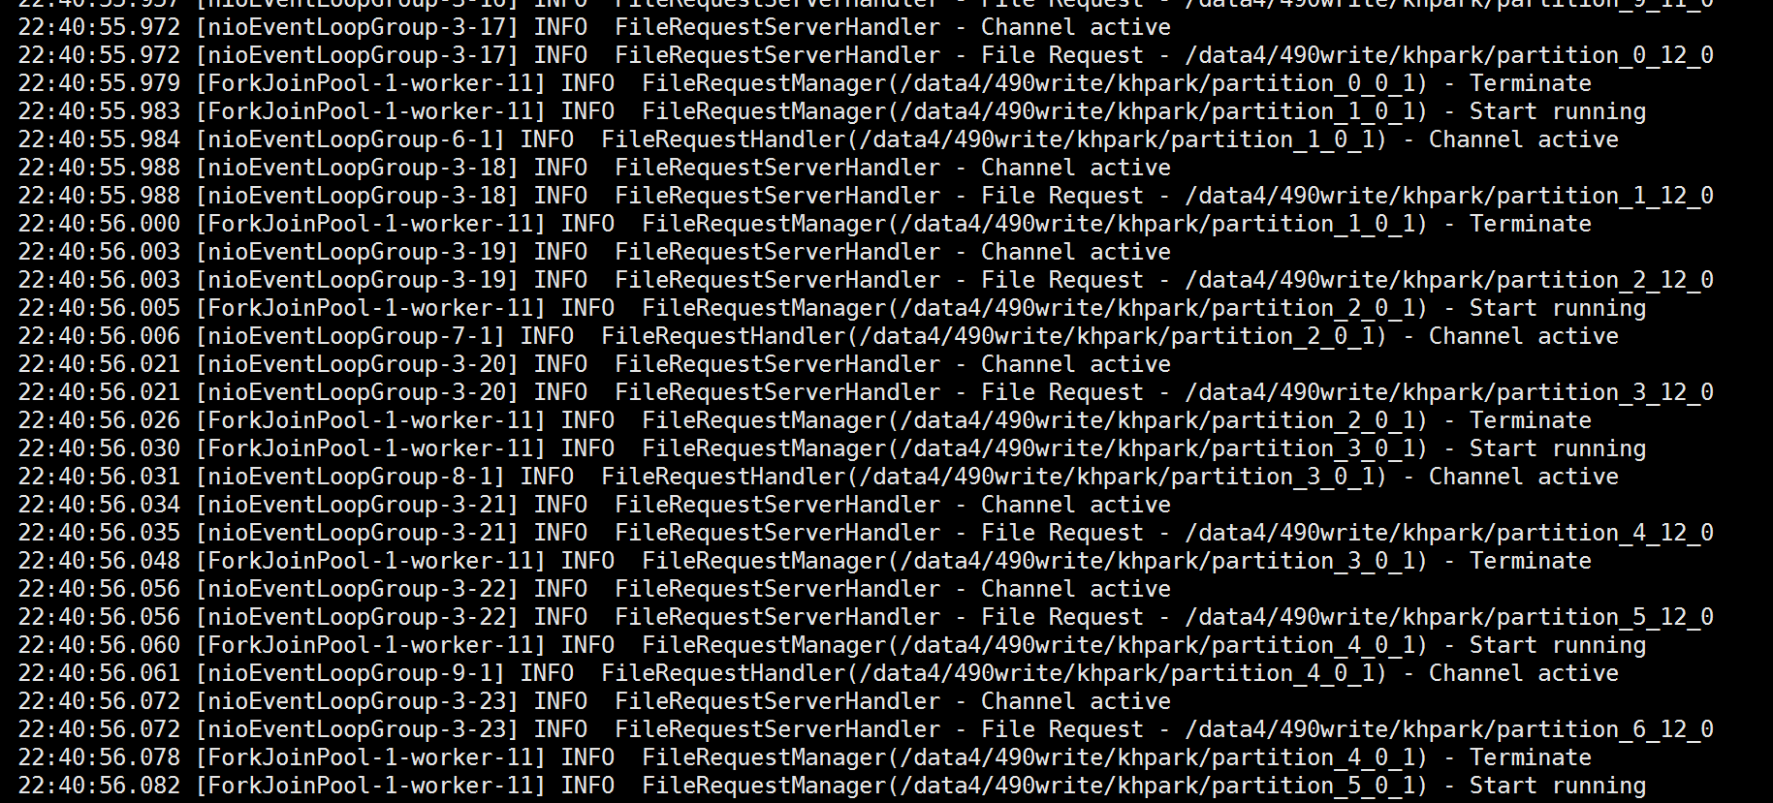
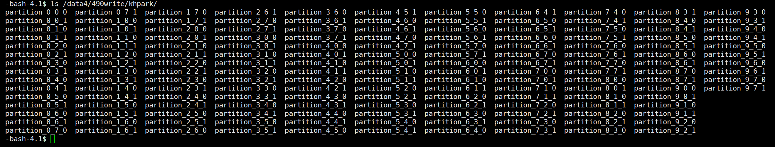
Slave 1
The log is too long. So I will just show some part of log and the result.
...

Slide 50
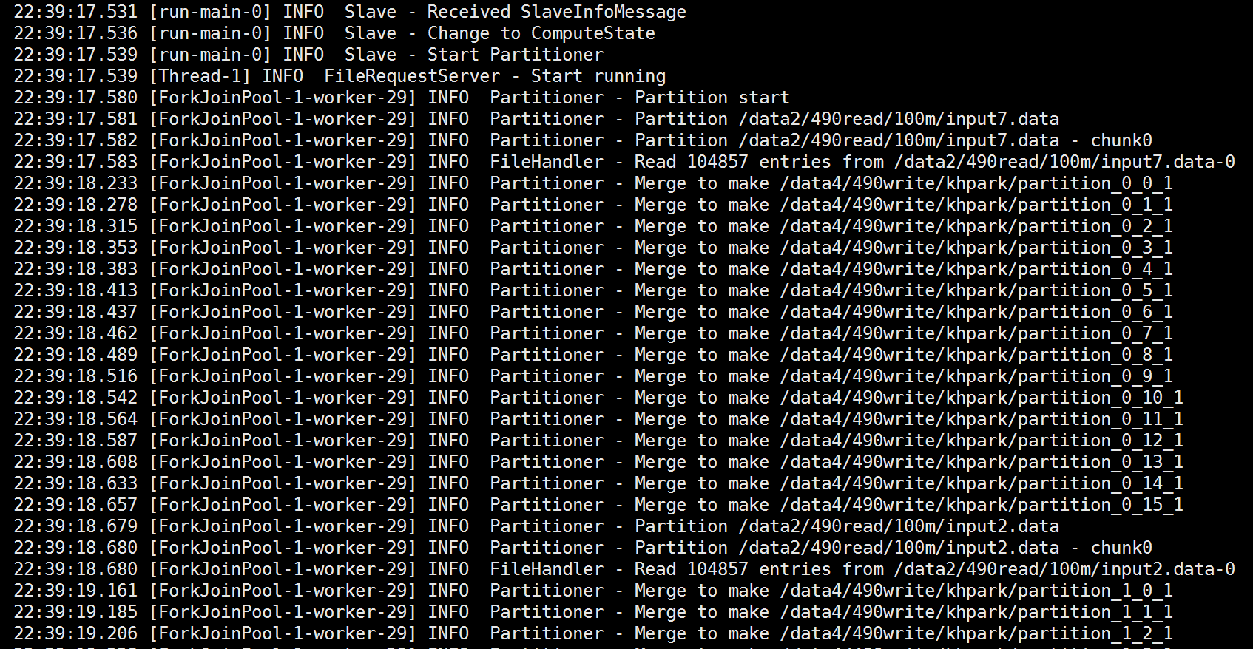
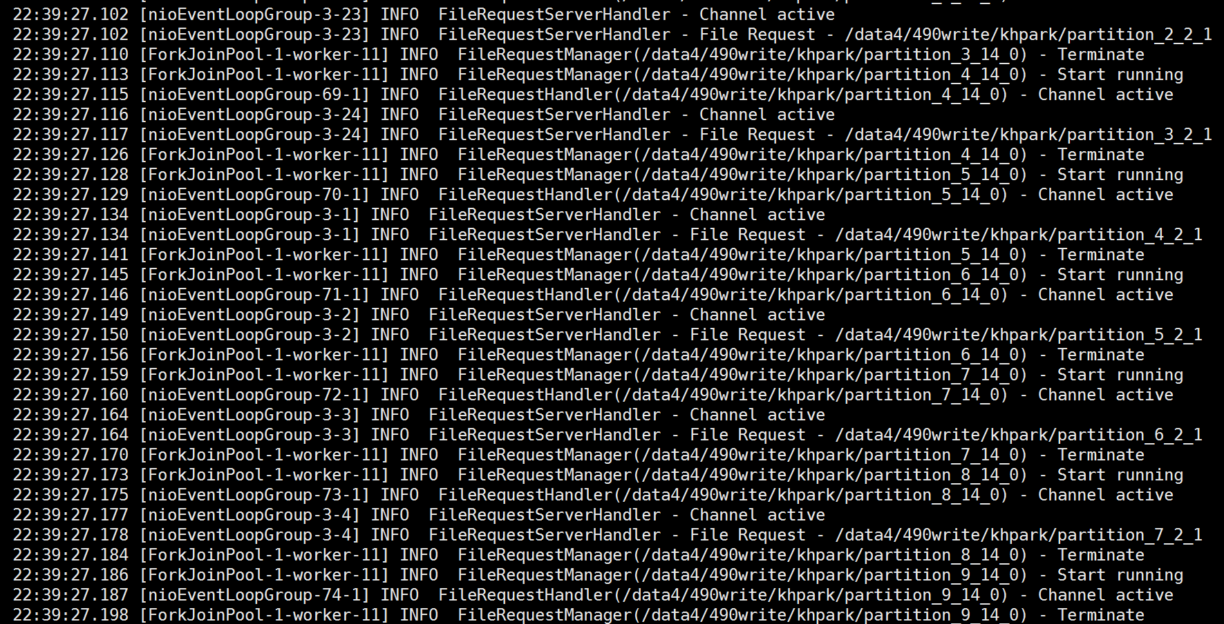
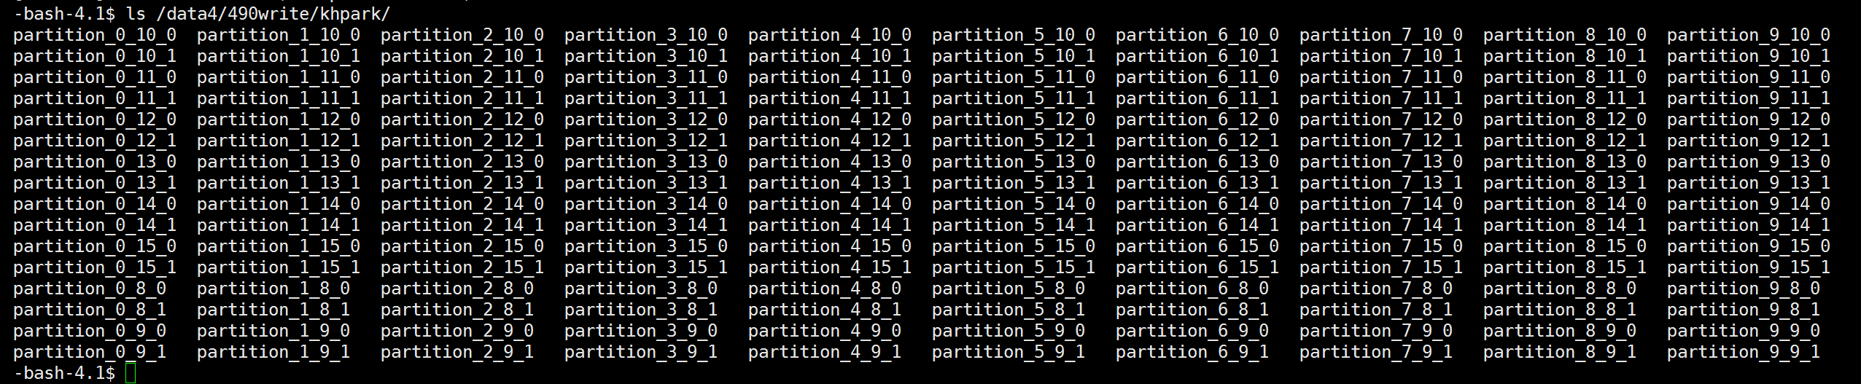
Slave 2
Similar to Slave 1
...

