Slide 1
CS490P Project Design
20150888, CSE, Park Kanghee

Slide 2
Conventions

Slide 3
Message, Data
Use pickling library
Define SendableMessage, simplified message to use pickling library
ConnectionListener accepts socket connection only
SocketHandler handles messages first
StateManagers have its message queue

Slide 4
Message
abstract class Message
case class PivotMessage(pivots: List[Key]) extends Message
case class SampleMessage(address: String, numData: Long, sample: String) extends Message
case class SlaveInfoMessage(slaveIP: Array[String], pivots: String) extends Message
case object SlaveFullMessage extends Message
case object DoneMessage extends Message

Slide 5
Slave -> Master
SampleMsg
DoneMsg
Purpose | Send sample to master | Notify sort is finished
When | Sampling is finished | Sorting is finished
Content | # of data Sample data

Slide 6
Slave -> Master
TerminateMsg
Purpose | Terminate Slaves
When | Master is on success state
Content

Slide 7
PivotCalculator -> Master
PivotMsg
Purpose | Send selected pivot
When | Pivot calculation is finished
Content | Pivot values

Slide 8
Master(SocketHandler) -> Slave
SlavesInfoMsg
SlavesFullMsg
Purpose | Send information of other slaves and partition | Notify that enough # of slaves are connected already
When | PivotMsg arrived in MasterStateManager | Is changing to sample state
Content | IP of slaves Pivot values

Slide 9
Partitioner -> Slave
PartitionDoneMsg
Purpose | Notify completion of partition to Slave
When | Finished partition
Content | Name of partition files

Slide 10
ShufflingHandler -> Slave
PartitionRequestDoneMsg
Purpose | Notify partition request for some slave is done
When | Partition request is finished for a slave
Content | IP of the partition owner

Slide 11
Slave -> Master -> All slaves
FileInfoMessage
Purpose | Notify termination of PartitionListener
When | Received partitions from all slaves
Content

Slide 12
Modules

Slide 13
Overall Communication
Internal (Appending Message to queue)
Slave <-> Master
Slave -> Slave
Slave
Main
File
Request
Client
Master
Network
Handler
Slave
Network
Handler
File
Request
Server
Master
Main
Slave
Network
Handler
File
Request
Server
Master
Network
Handler
Slave
Main
File
Request
Client

Slide 14
Master Modules
Master
Network
Handler
Master
Main
Master
Network
Handler
Pivot
Calculator

Slide 15
Slave Modules
File
Handler
File
Handler
File
Handler
File
Request
Server
File
Request
Client
Partitioner
File
Handler
Slave Main
(Used for simple file IO
e.g. sampling)
Slave
Network
Handler

Slide 16
State Diagrams

Slide 17
State name
State variables
Action on start
Action on end
Invariants
SampleMsg
DoneMsg
Messages
…
Condition
…
Do ~~~ if …
Action
~~~

Slide 18
Master
SampleMsg
Append received sample
Append slaveAddressList
Remove handler from connected
Init
connected: DefaultChannelGroup
slaves: DefaultChannelGroup
slaveAddressList: MutList[String]
samples: MutableList[Key]
numSampleFinishedSlaves: Int
numSampleFinishedSlaves == numSlave
Sample
FileInfoMsg
numSampleFinishedSlaves < numSlave
Create PivotCalculator
Send same message to all slaves
PivotMsg
DoneMsg
Send SlavesInfoMsg to slaves
- Append to finishedSlaves
Compute
numComputeFinishedSlaves: Int
finishedSlaves.size
== numSlave
numComputeFinishedSlaves
< numSlave
Success
Close all channels

Slide 19
Slave
Connect
PartitionDoneMsg
Send FileInfoMessage
Create MasterHandler
Create Sampler
FileInfoMsg
Save file names
Create FileRequestClient
SlavesFullMsg
SlavesInfoMsg
Create PartitionListener
Create Partitioner + Sorter
FileRequestDoneMsg
Remove from requestNotFinished
Failure
Close all channels
Compute
TerminateMsg
requestNotFinished: mutable.Set[String]
mergeFinished
Terminate
Send DoneMessage to Master
mergeFinished = False
Success
! mergeFinished

Slide 20
State Description

Slide 21
A
B
A extends B
A
B
A creates (and starts) B
A
Message
B
A sends Message to B
A
B
A terminates B
Condition
First arrow initiates the second arrow
Message

Slide 22
Master: Init – Slave: Connect
Slave
SlavesFullMsg
Master
SocketConnectionRequest
SampleMsg
Slave

Slide 23
Master: Sample – Slave: Connect
Master
PivotMsg
SampleMsg
PivotCalculator
SlavesInfoMsg
Slave

Slide 24
Master, Slave: Partition - Shuffle
FileRequestServer
Slave
PartitionDoneMsg
FileRequest
DoneMsg
Partitioner
FileInfoMsg
FileRequestClient
SlavesInfoMsg
File
Master
FileInfoMsg
FileRequest
SlavesInfoMsg
Partitioner
FileRequestClient
PartitionDoneMsg
FileRequest
DoneMsg
Slave
FileRequestServer

Slide 25
Master, Slave: Merge
FileRequestServer
Slave
Omit detail now
Master
Slave
FileRequestServer

Slide 26
Master: Success – Slave: Success
Master
Terminate
DoneMsg
TerminateMsg
Slave
Terminate

Slide 27
Master Sample
Calculate pivot values
Sort first and
Choose values from 1/n, 2/n, …, (n-1)/n position

Slide 28
Client Sample
Get number of key-value pairs
From file size
Sample from data (Sample size is proportional to data size)
Does not open all the files (Just some files)
Sample by random access
Send samples to master
Wait SlaveInfoMsg

Slide 29
Slave Compute Order
Listen
Merge
Terminate
Partition
Sort
Shuffle

Slide 30
Tests

Slide 31
PivotSuite
sampleKey = {{0, 0, …, 0}, {1, 1, …, 1}, …, {0xff, 0xff, …, 0xff}}
Calculates correct pivot for sampleKey
Calculates correct pivot for sampleKey.reverse

Slide 32
etc

Slide 33
Possible improvements
Sample by main thread -> Sample by futures?
Actually, sampling does not take much time
But this change increase complexity of connect state much

Slide 34
Experiment on cluster machines

Slide 35
Program spec
The program write the log of
Received messages
Start of partition (of each file)
Received, or sent file request
Partition name is partition_{file #}_{partition #}_{owner #}

Slide 36
Milestone 1

Slide 37
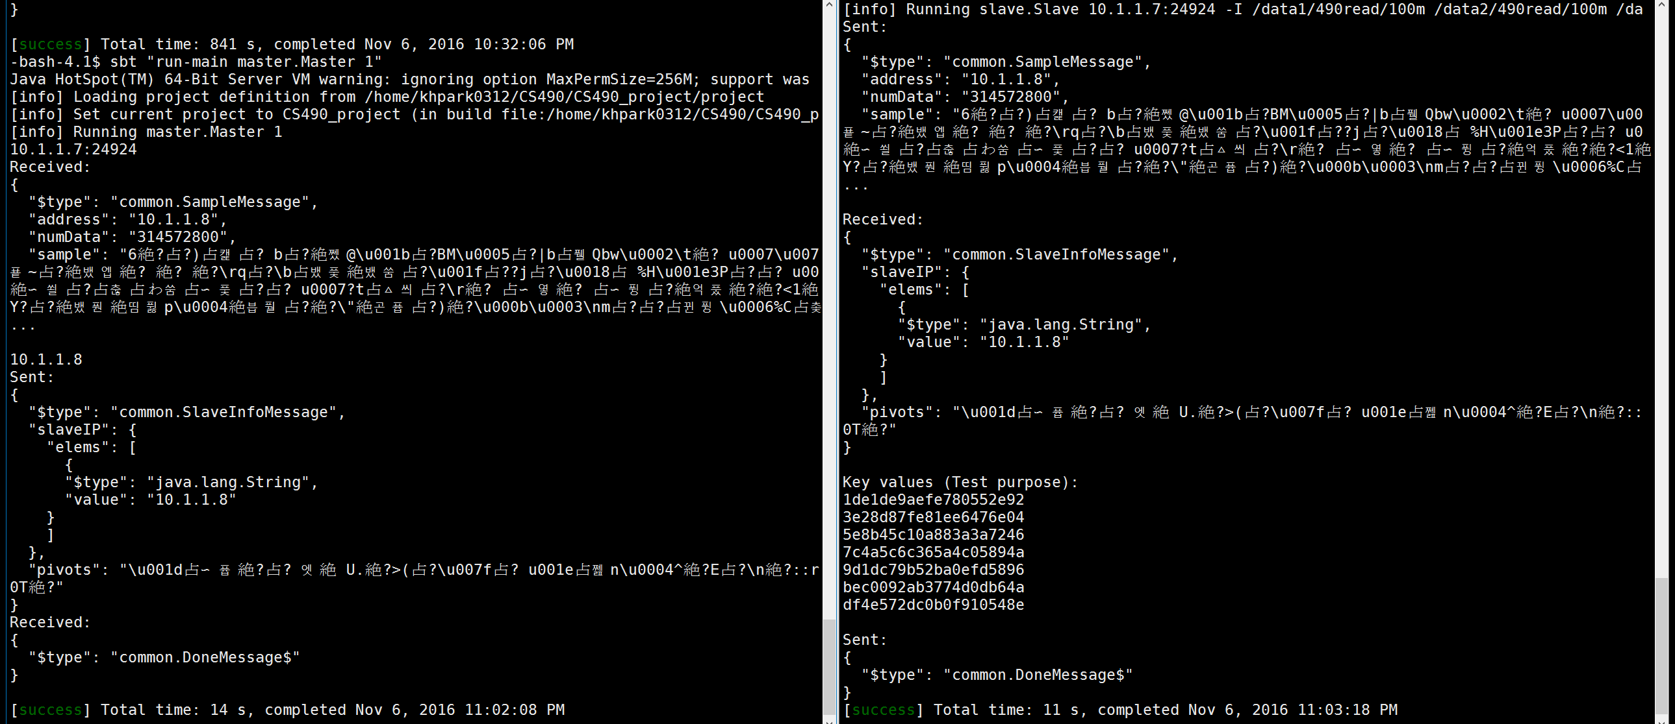
Scenario:
Master wait 1 slave
1 slave try to connect to master

Slide 38
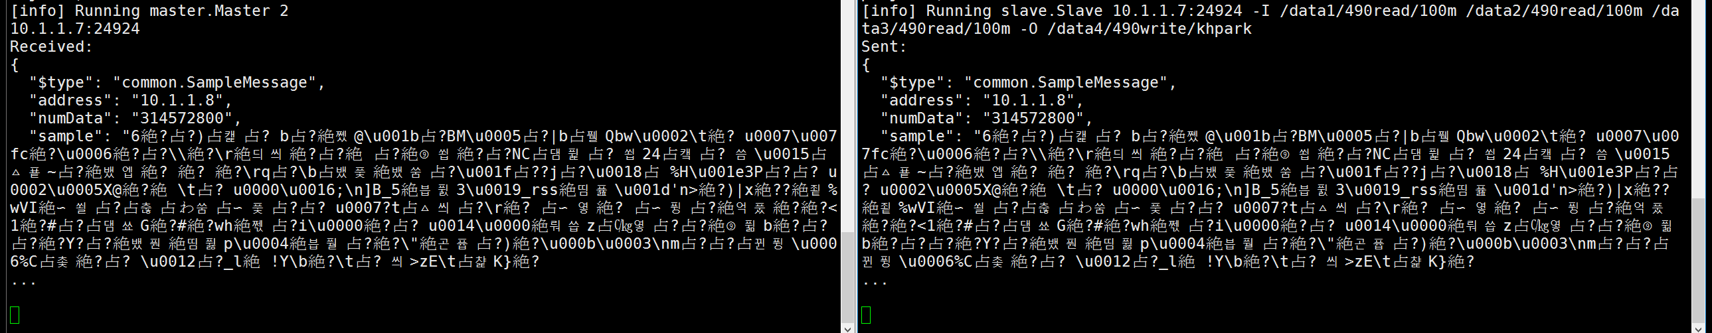
Scenario:
Master wait 2 slaves
Only 1 slave try to connect to master
No progress

Slide 39
Scenario:
Master wait 1 slave
1 slave try to connect to master

Slide 40
Scenario:
Master wait 2 slaves
2 slaves try to connect to master

Slide 41
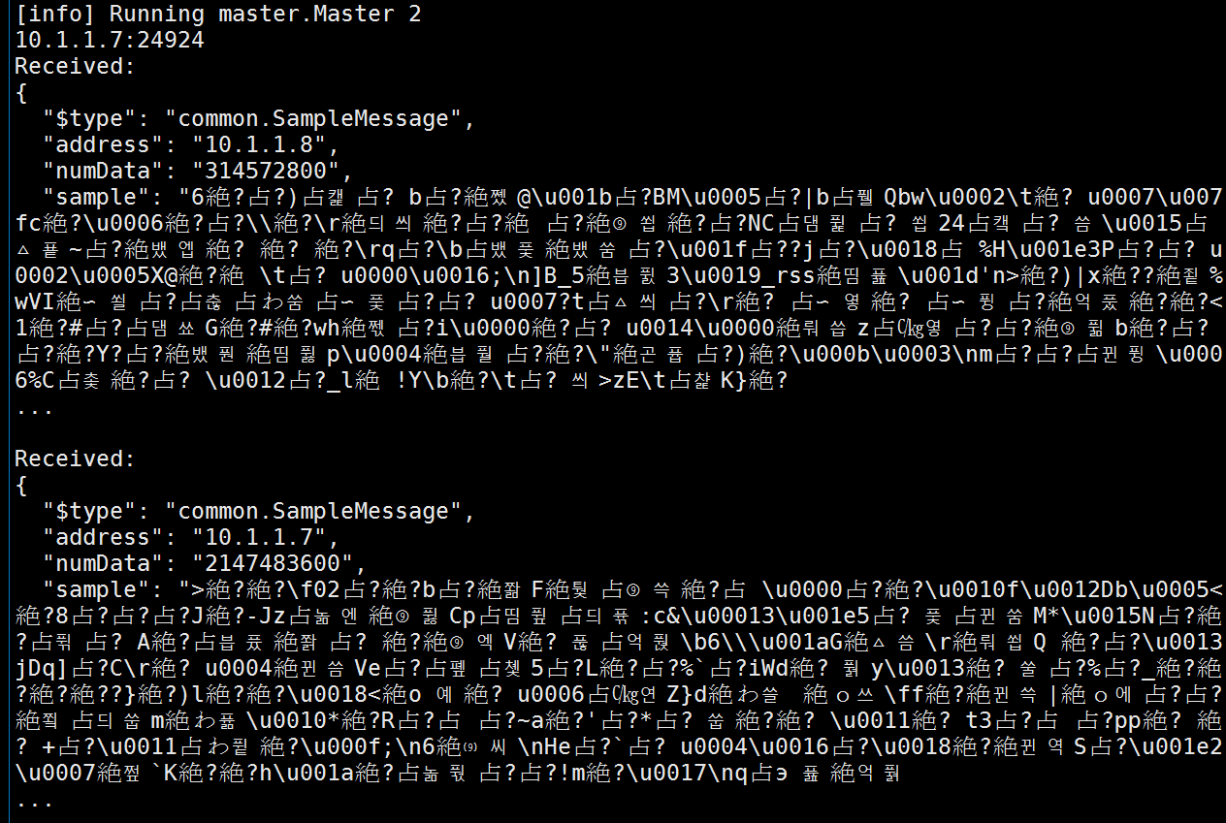
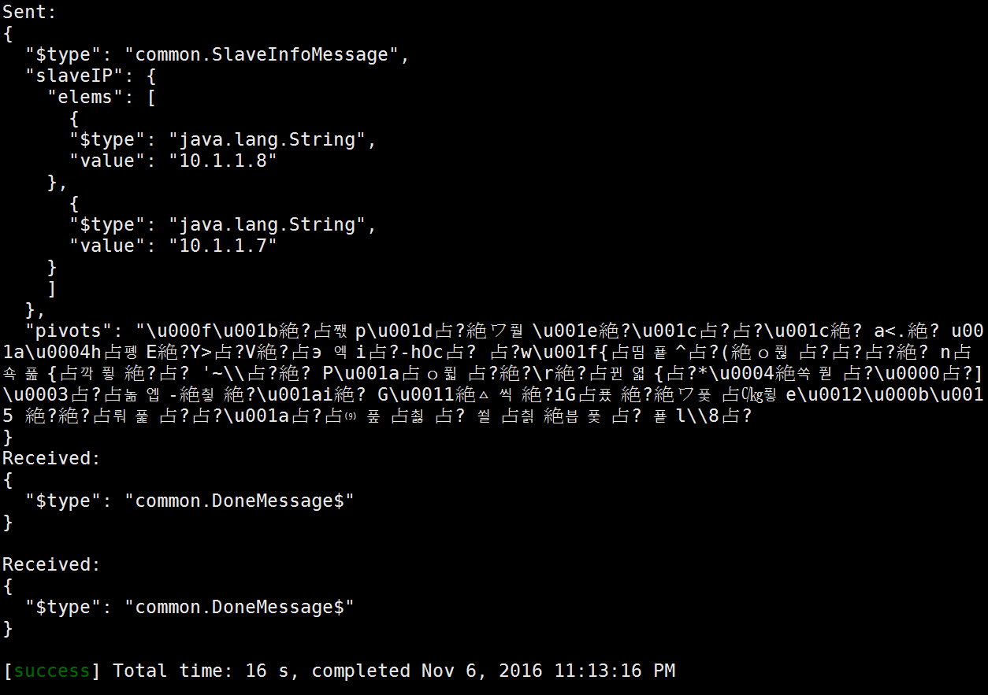
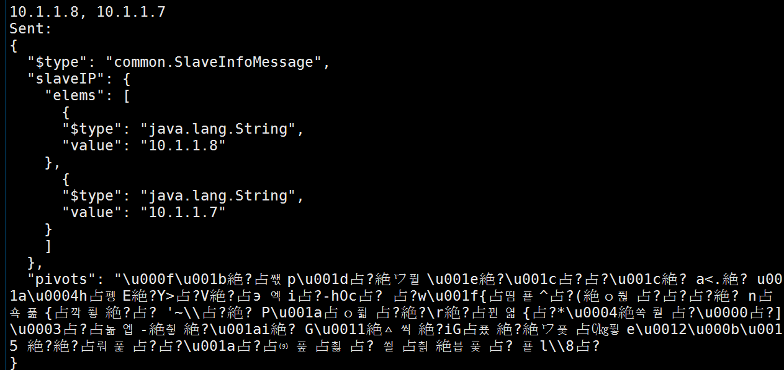
Master

Slide 42
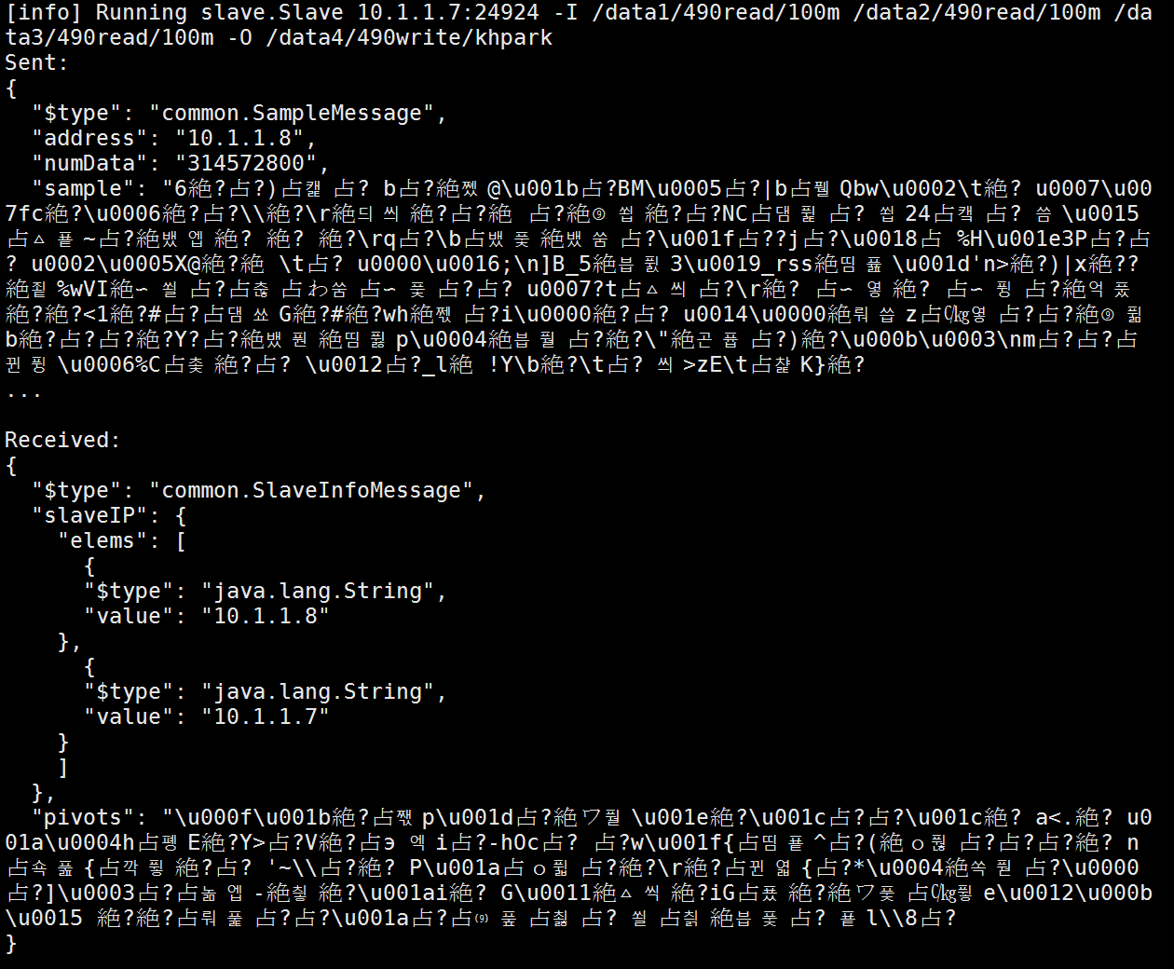
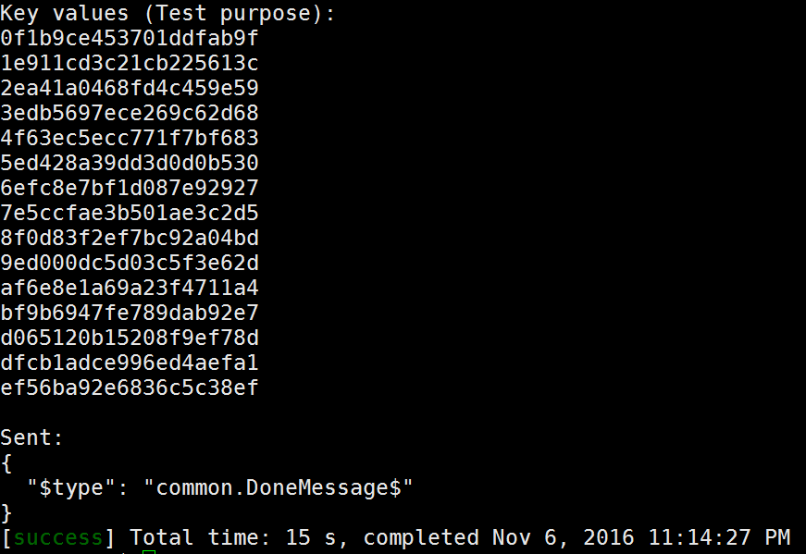
Slave 1

Slide 43
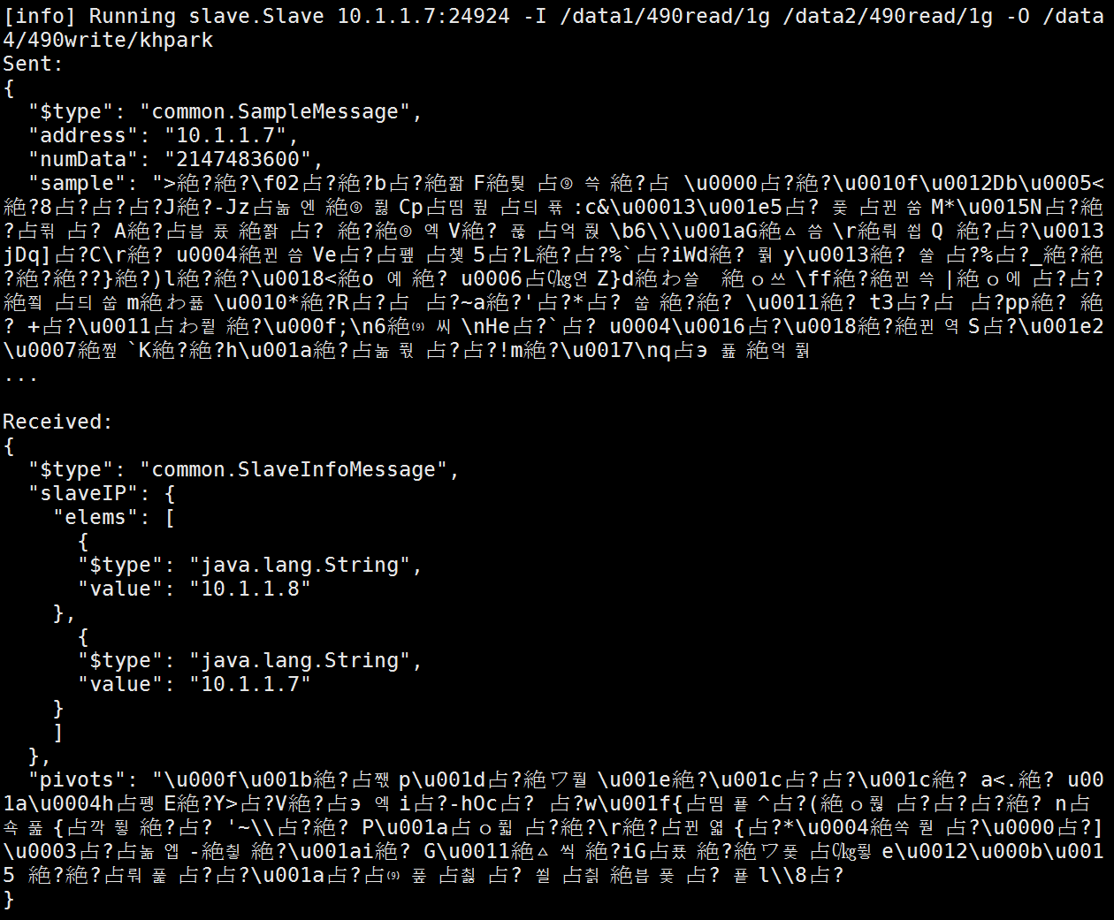
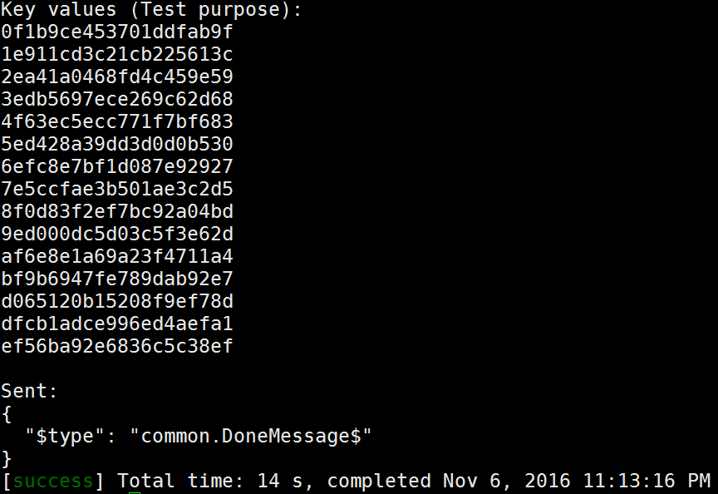
Slave 2

Slide 44
Scenario:
Master wait 1 slave
2 slaves try to connect to master

Slide 45
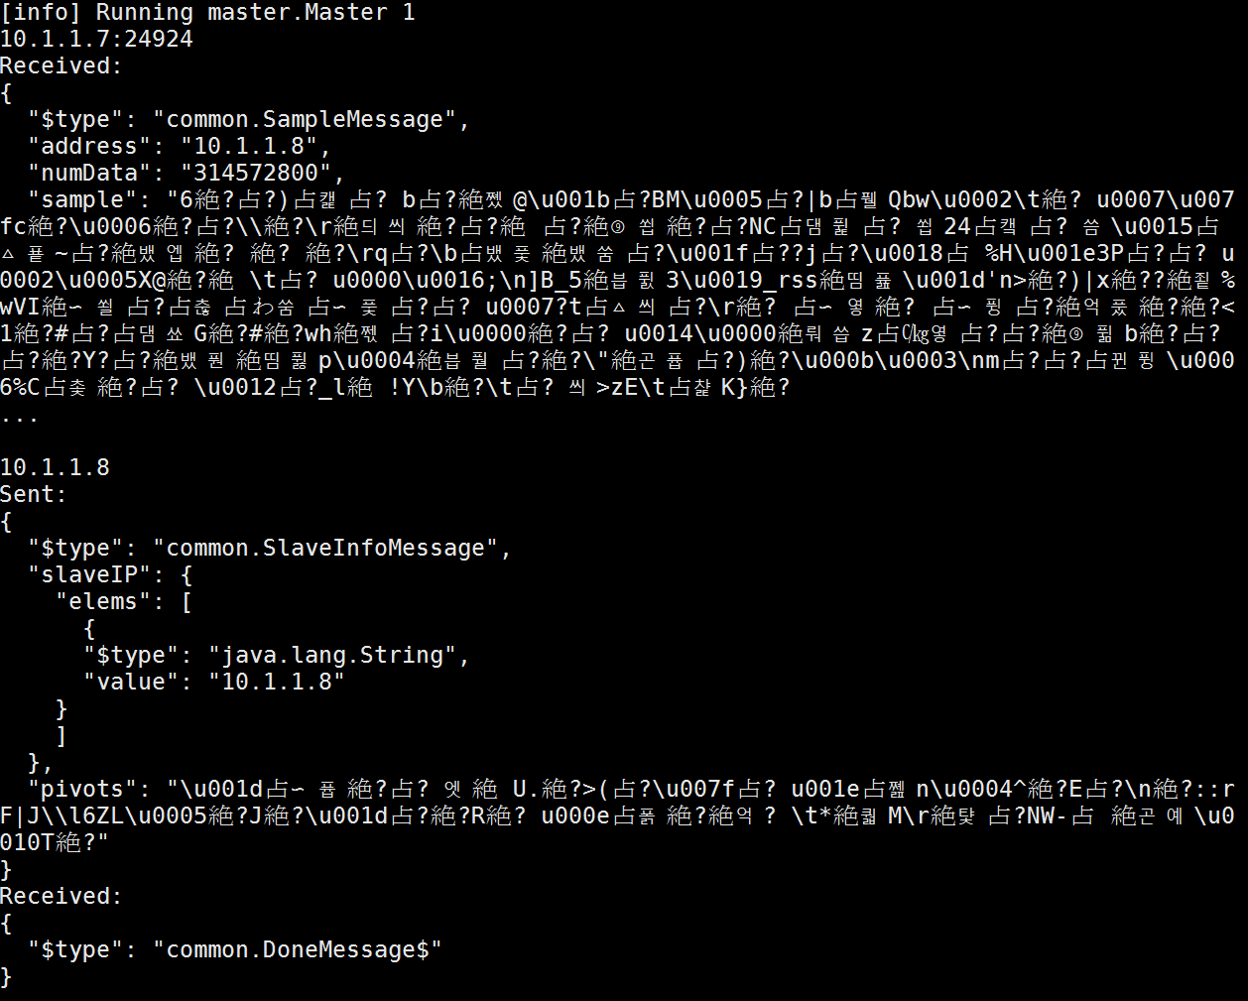
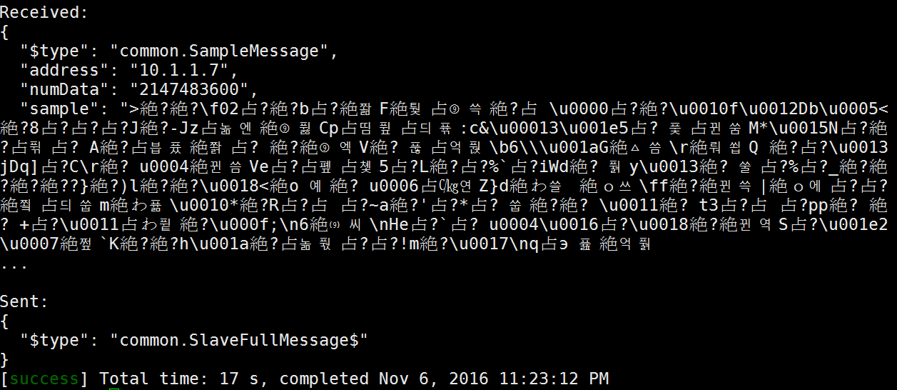
Master

Slide 46
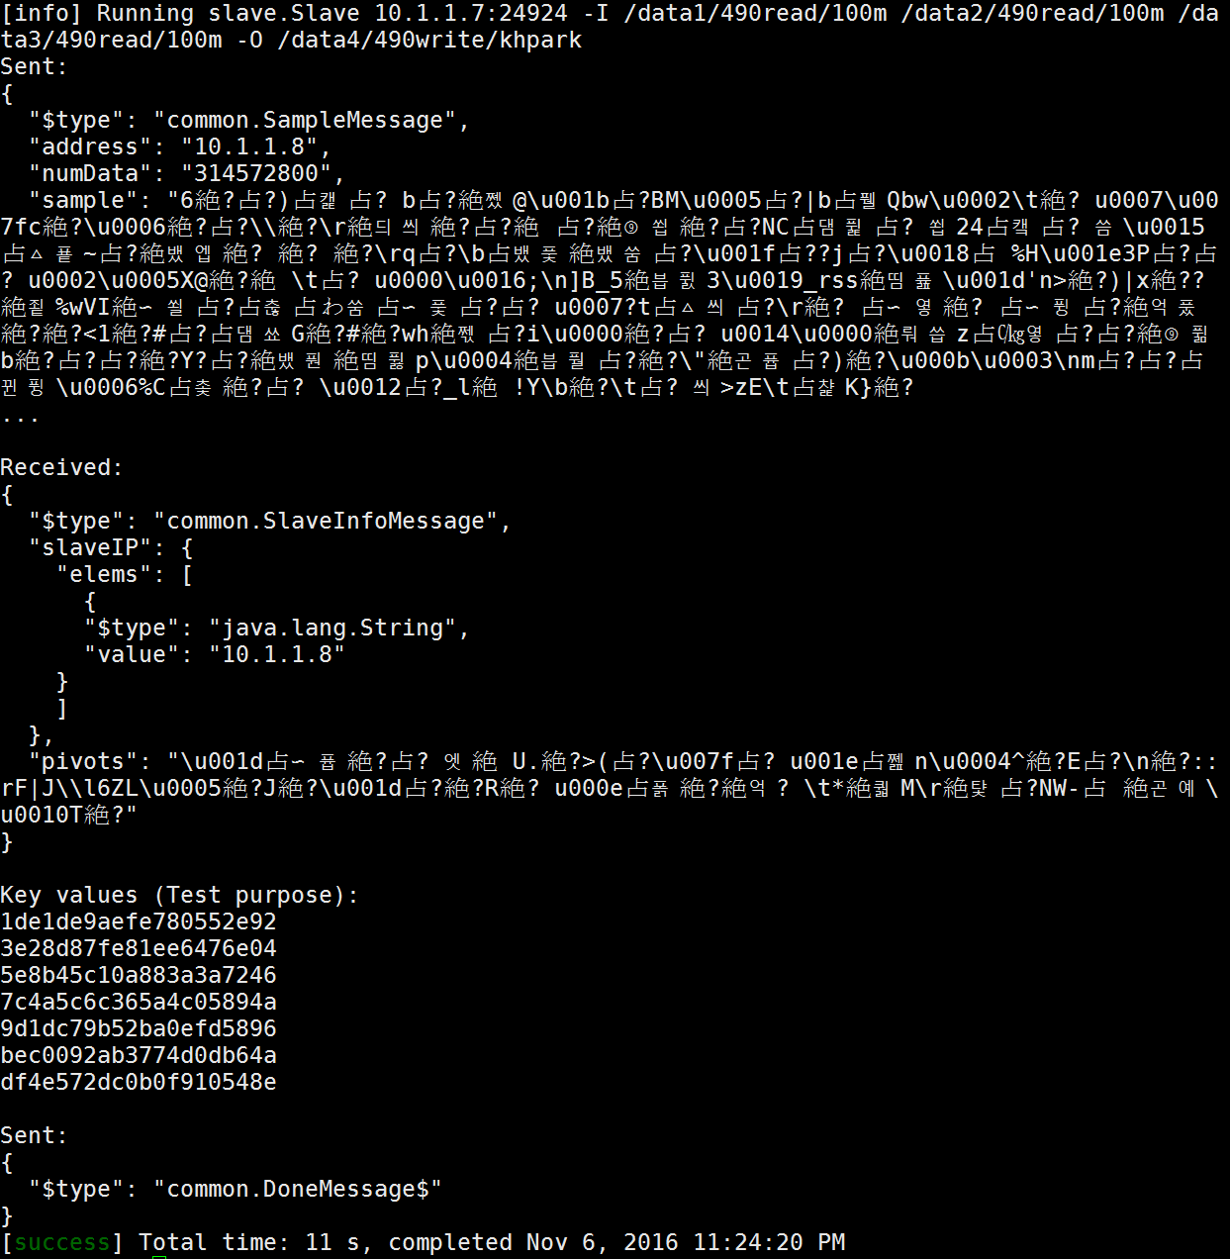
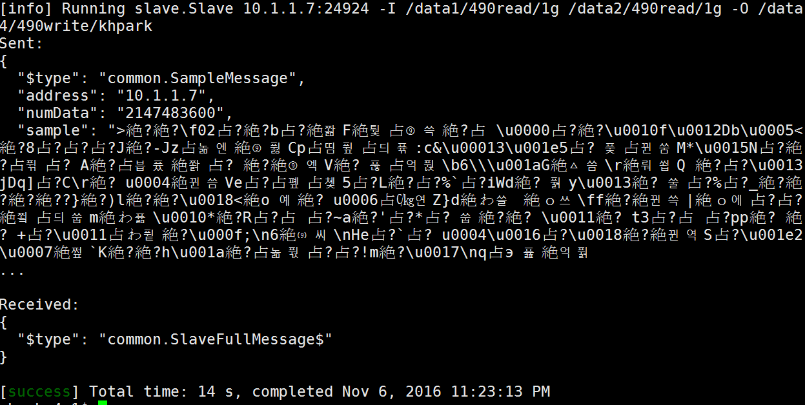
Slave 1
Slave 2

Slide 47
Milestone 2

Slide 48
Scenario:
Master wait 2 slaves
2 slaves try to connect to master
They write (intermediate) partition files to output directory
Partition name is partition_{file #}_{partition #}_{owner #}
Partitions
0~7 are for machine 0
8~15 are for machine 1
8 partitions for single machine

Slide 49
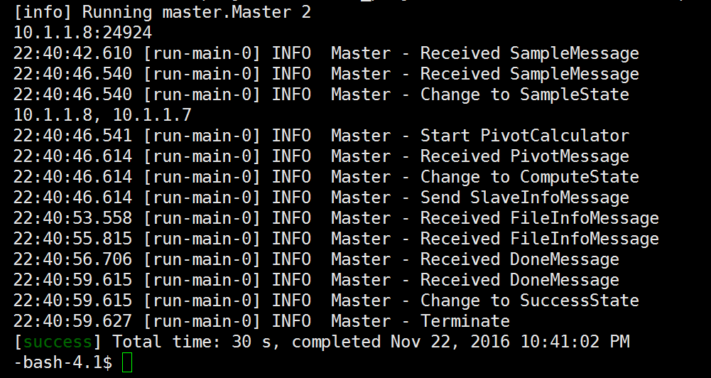
Master

Slide 50
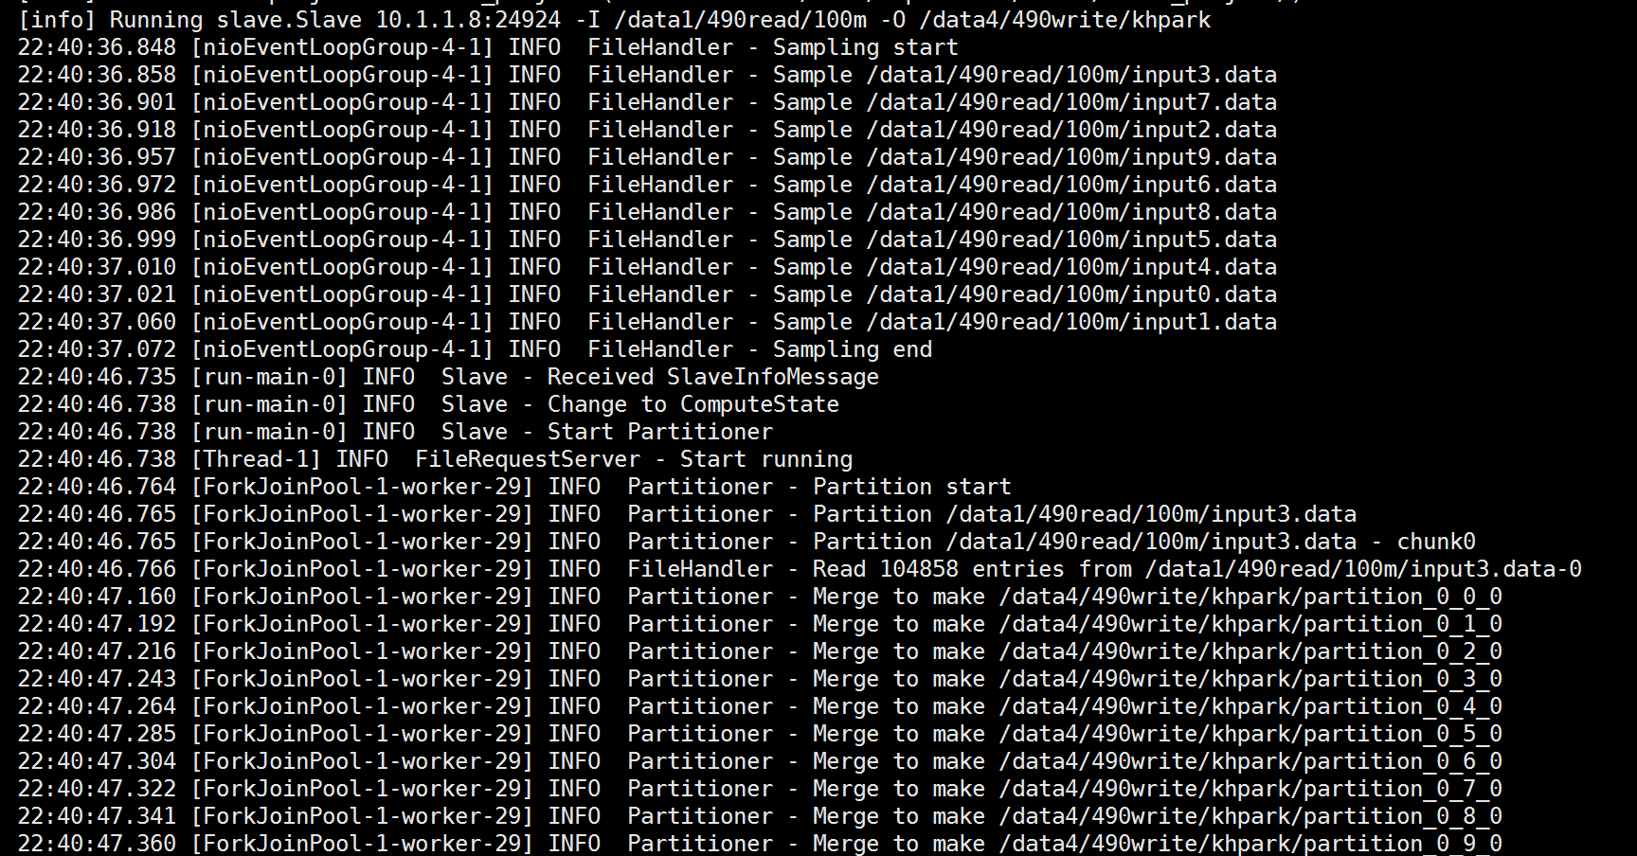
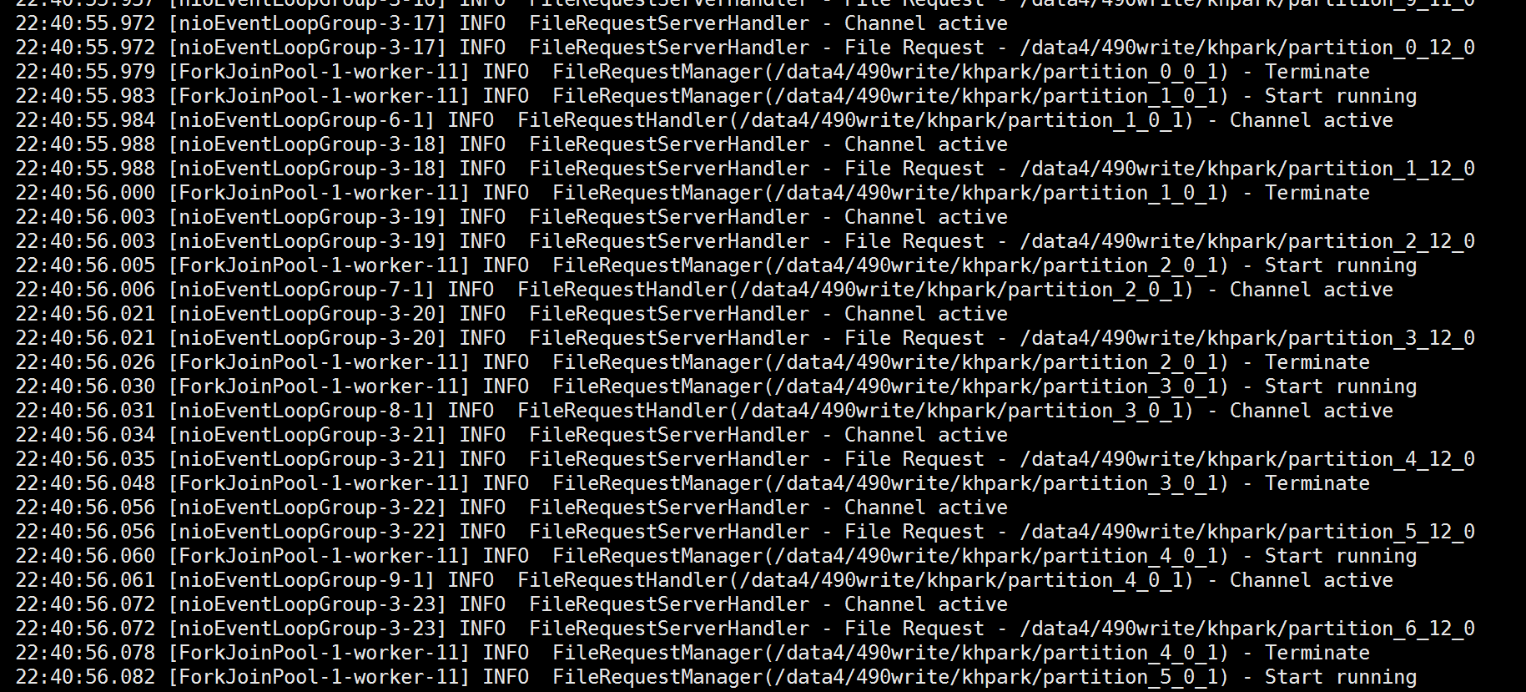
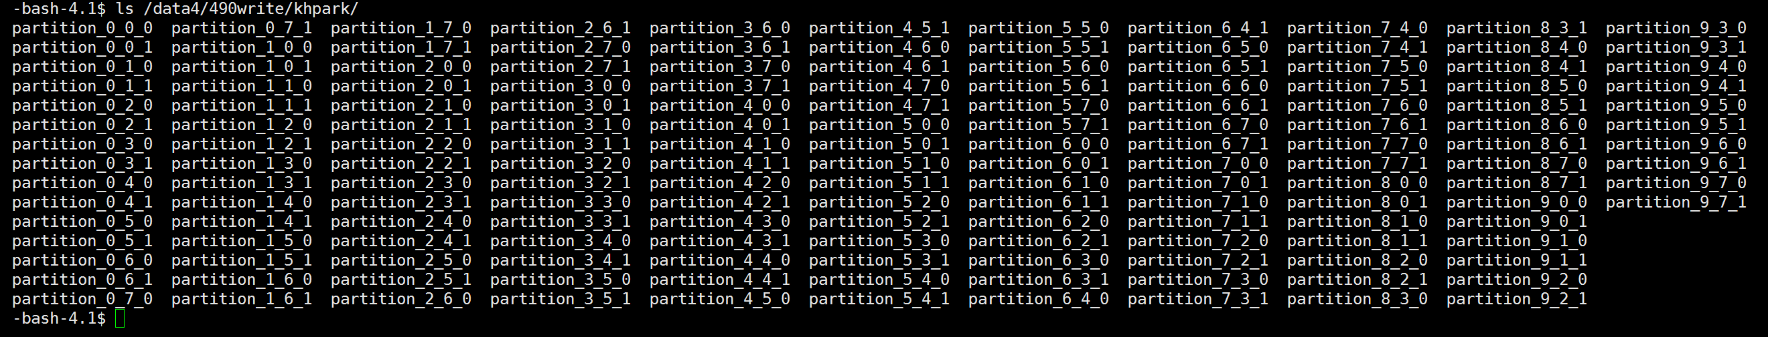
Slave 1
The log is too long. So I will just show some part of log and the result.
...

Slide 51
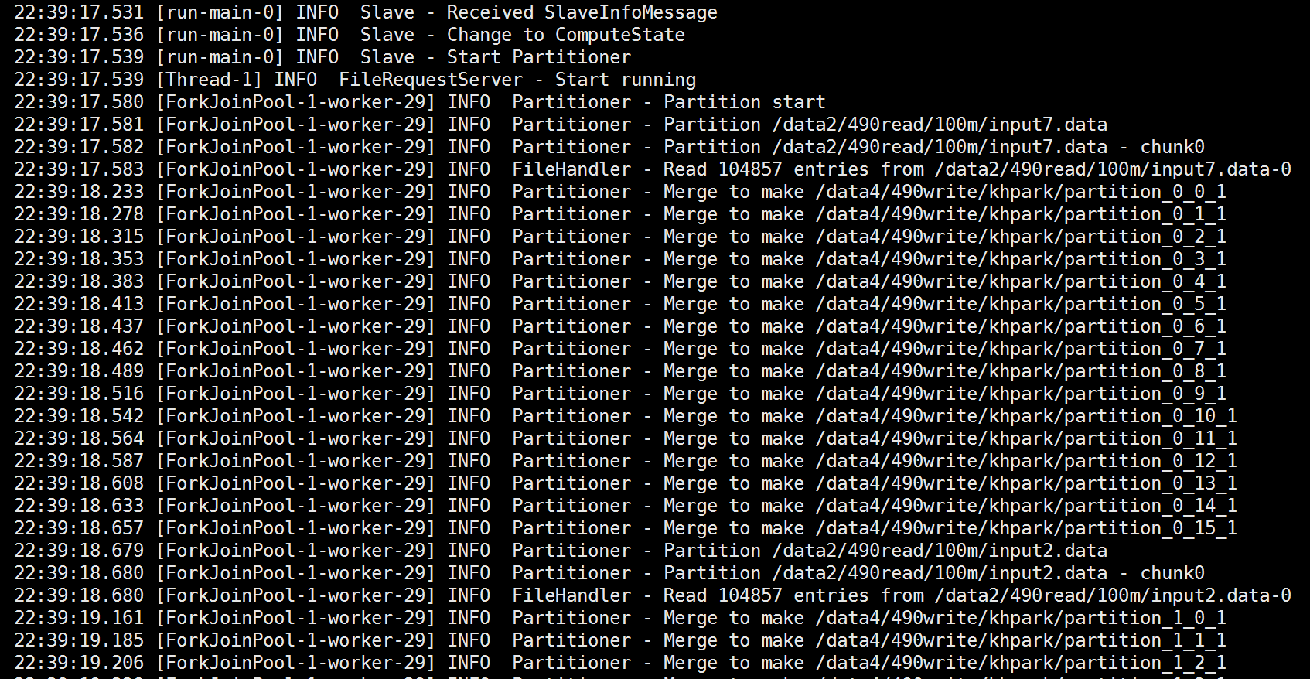
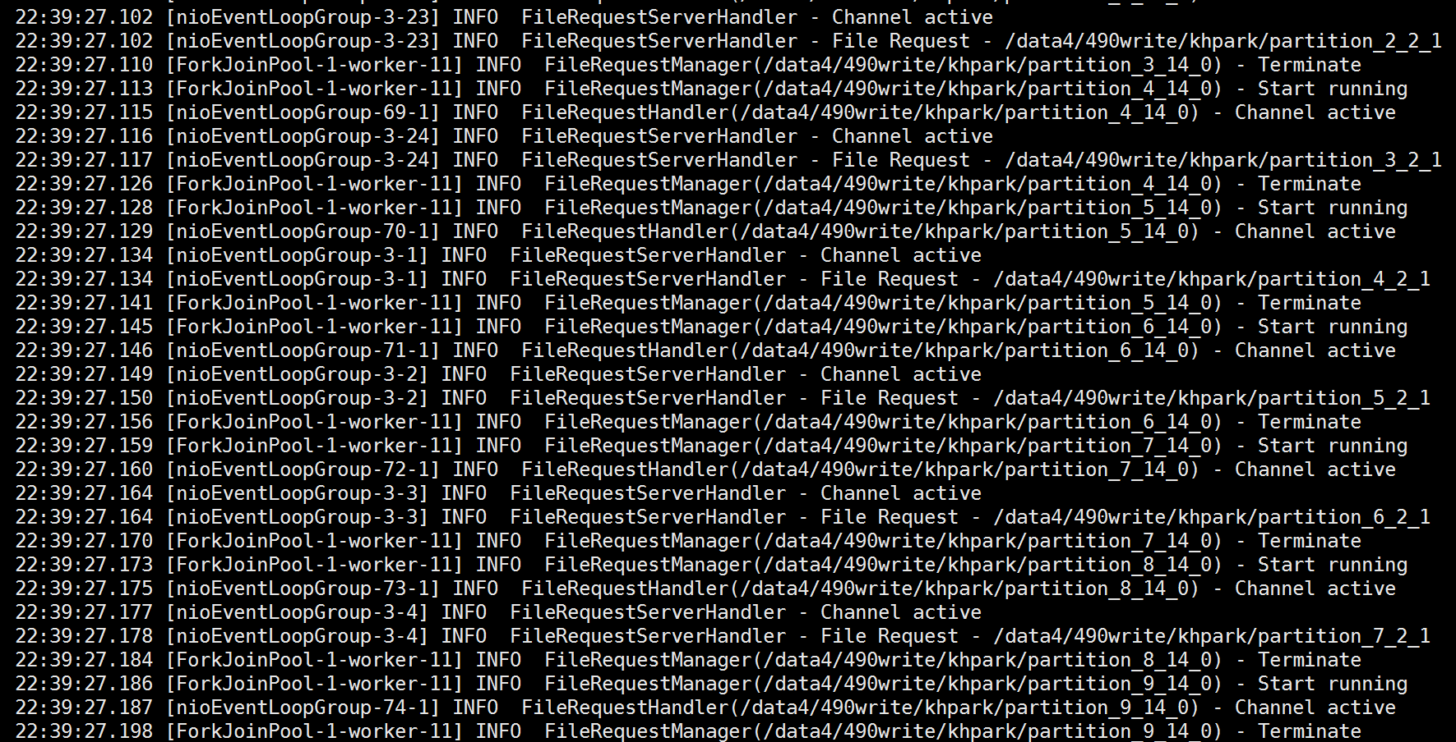
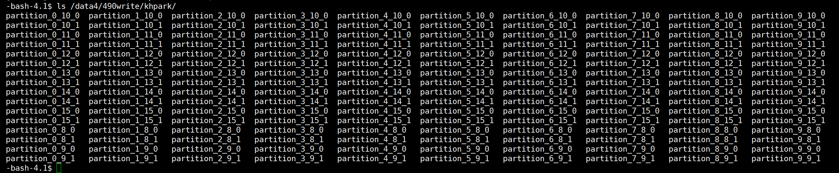
Slave 2
Similar to Slave 1
...

