Slide 1
Out of the Tar Pit
20150888, CSE, Kanghee Park

Slide 2
Section 2, 3
Complexity
The root cause of the vast majority of problems with software
Makes large systems hard to understand
Simplicity is Hard
Approaches to Understanding
Testing vs. Informal Reasoning
Improvements in informal reasoning will lead to less errors being created
Improvements in testing lead to more errors being detected
All ways have their limitations
Simplicity is more important than either

Slide 3
4. Cause of Complexity
State
Many systems have errors in their handling of state
Presence of state makes programs hard to understand
Test on particular state tells you nothing at all about the system
Possible states grows exponentially w.r.t. number of state bits
Contamination: “When you let the nose of the camel into the tent, the rest of him tends to follow”
Code Volume
Intellectual effort needed grows with the square of program length

Slide 4
4. Cause of Complexity
Control
Most programming languages force over-specify the ordering
It complicates the process of informal reasoning
In case of concurrency problem, we can no longer even be assured of result consistency when repeating tests on a system
Complexity breeds complexity
Simplicity is Hard
More powerful language makes harder to understand

Slide 5
5. Classical approaches
Object-Orientation
Encapsulation: strongly biased toward single-object constraint
Internal identity vs. External identity
Additional concept of identity adds complexity to reasoning
Rely on object state
Functional programming
Avoid state -> referential transparency
Abstract use of control using functionals (e.g. fold / map)
Forced to make changes to every part affected (adding parameter)
Can always tell exactly what will control the outcome

Slide 6
5. Classical approaches
Logic Programming
Specifying what needs to be done rather than how to do it
Making statements about the problem
No use of mutable state, implicit ordering

Slide 7
6. Accidents and Essence
Essential Complexity: inherent in the problem
Accidental Complexity: all the rest, doesn’t exist in ideal world
Much complexity existing software is not essential

Slide 8
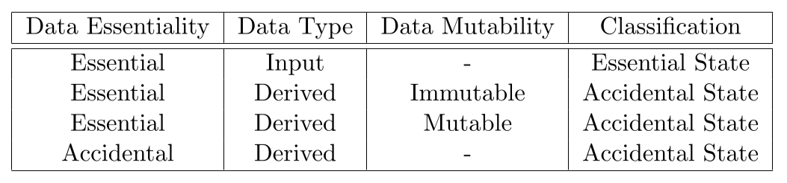
7. Recommended General Approach
Most system state is accidental
Input data is essential
Even though the data is essential, we don’t need to store it

Slide 9
7. Recommended General Approach
Control considered entirely accidental
The results of the system should be independent of the actual control mechanism
Practical problems
Ease of Expression: Accidental state can be the most natural way
Performance: Accidental state can be required for efficiency
Recommendations
Avoid if possible
Otherwise, separate into Logic + Control

Slide 10
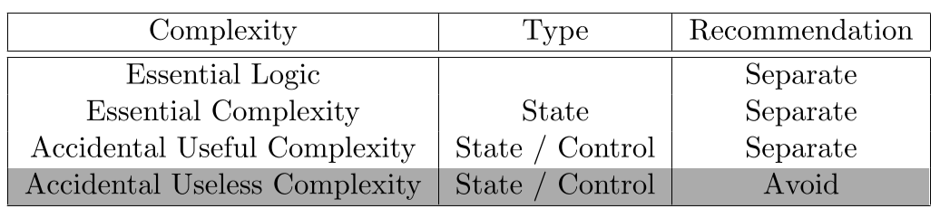
7. Recommended General Approach
Simply declare what accidental state should be used, and leave it to a completely separate infrastructure
Separate essential / accidental
Separate logic / state

Slide 11
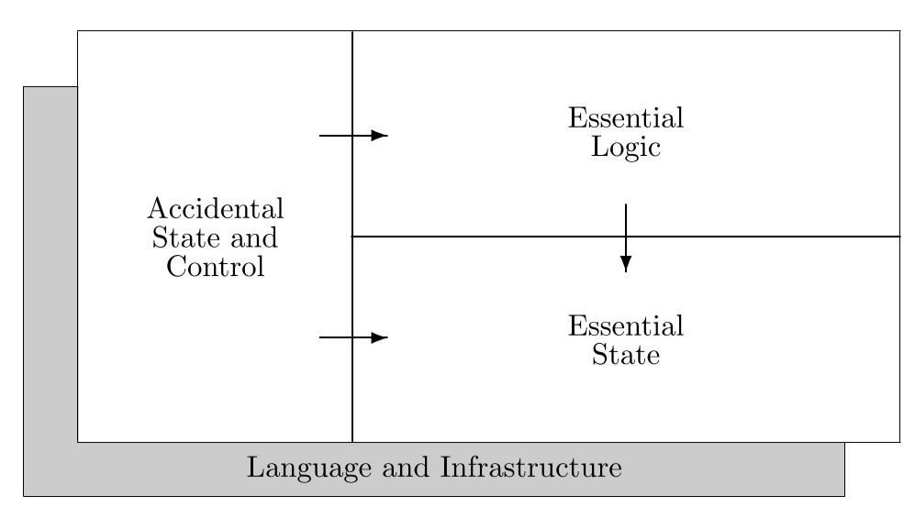
7. Recommended General Approach

Slide 12
7. Recommended General Approach
Essential State
Make no reference to either of the other parts
Might change dynamically
Essential Logic
Make no reference to any part of the accidental
Accidental State / Control
Changes to it can never affect the other specifications
Changes to either of the others may require changes here

Slide 13
8. The Relational Model
Relation: homogeneous set of records
Basic Relations: stored directly
Derived Relations: defined in terms of other relations
Manipulation
Restrict, project, product, union, intersection, difference, join, divide
Data Independence
One of the original motivations for the relational model
Very close parallel to the accidental / essential split

Slide 14
9. Functional Relational Programming
Essential state
Relational definition of the stateful components
Essential logic
Relational algebra + Derived-relation definitions
Accidental State and Control
Declarative specification of a set of performance optimizations for the system
Other
A specification of the required interfaces to the outside world
Feeders: Components which convert input into relational assignments
Observers: Components which generate output using relvars

Slide 15
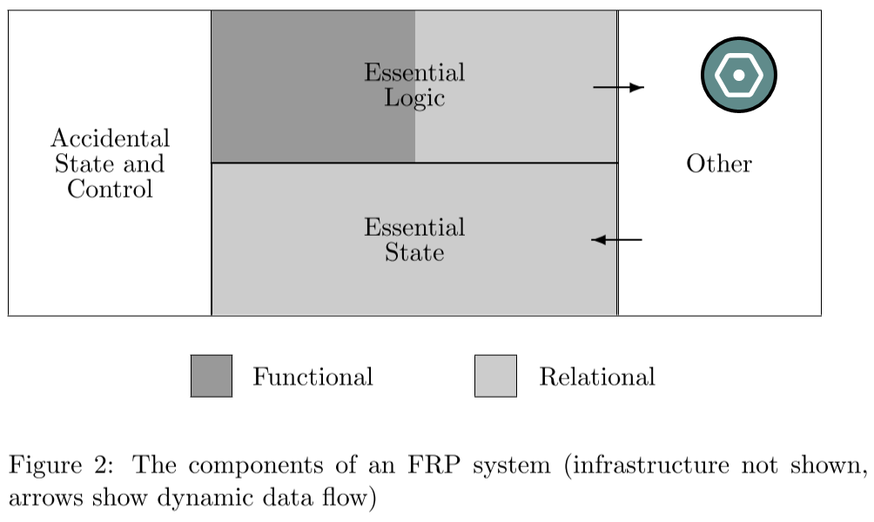
9. Functional Relational Programming

Slide 16
9. Functional Relational Programming
State
Separation of (logic / state), (accidental / essential)
Functional component has no access to any state at all
Control
Control is avoided completely, and also avoids any explicit parallelism (but provides for the possibility of separated accidental control)
Benefits for Code Volume
Less code

Slide 17
9. Functional Relational Programming
Data Abstraction
In many cases, un-needed data abstraction is cause of complexity
Subjectivity: Grouping of data items together into larger compound
Data Hiding: Data abstraction can erode the benefits of referential transparency
Types
Provides limited ability
Permits the creation of disjoint union types, but not permit product

Slide 18
12. Conclusions
Complexity causes more problems than anything else
Separate into three main parts
essential state, essential logic, accidental state and control
The way out of the tar pit? Silver bullet? - Simplicity

