Slide 1
CS490P Project Design
20150888, CSE, Park Kanghee

Slide 2
Conventions

Slide 3
Message, Data
Use pickling library
Define SendableMessage, simplified message to use pickling library
ConnectionListener accepts socket connection only
SocketHandler handles messages first
StateManagers have its message queue

Slide 4
Message
abstract class Message
case class PivotMessage(pivots: List[Key]) extends Message
case class SampleMessage(address: String, numData: Long, sample: String) extends Message
case class SlaveInfoMessage(slaveIP: Array[String], pivots: String) extends Message
case object SlaveFullMessage extends Message
case object DoneMessage extends Message

Slide 5
Slave -> Master (SocketHandler)
SampleMsg
DoneMsg
Purpose | Send sample to master | Notify sort is finished
When | Sampling is finished | Sorting is finished
Content | # of data Sample data

Slide 6
PivotCalculator -> Master
PivotMsg
Purpose | Send selected pivot
When | Pivot calculation is finished
Content | Pivot values

Slide 7
Master(SocketHandler) -> Slave
SlavesInfoMsg
SlavesFullMsg
Purpose | Send information of other slaves and partition | Notify that enough # of slaves are connected already
When | PivotMsg arrived in MasterStateManager | Is changing to sample state
Content | IP of slaves Pivot values

Slide 8
Sorter -> Slave
SortDoneMsg
Purpose | Notify completion of sort for Slave
When | Finished sorting
Content

Slide 9
PartitionReceiver -> Slave
ReceivedAllPartitionMsg
Purpose | Notify termination of PartitionListener
When | Received partitions from all slaves
Content

Slide 10
PartitionSender -> Slave
SentAllPartitionMsg
Purpose | Notify termination of PartitionSender
When | Sended partitions to all other slaves
Content

Slide 11
Shuffler -> Slave
ShufflingDoneMsg
Purpose | Notify termination of Shuffler
When | Finished shuffling
Content

Slide 12
PartitionSender -> PartitionReceiver
DataInfoMsg
DataMsg
Purpose | Send information of partitioned data | Send partitioned data
When | Finished partitioning | After send DataInfoMsg
Content | Size of each partition | Partition # Index (idx-th data of partition x) Data
Format | Message type (4 bytes, Integer) Size (4 bytes, Integer) * (# of partition) | Message type (4 bytes, Integer) Partition # (4 bytes, Integer) Index (4 bytes, Integer) Data (3000 bytes, Array[byte])

Slide 13
Modules

Slide 14
Overall Communication
Internal (Appending Message to queue)
Slave <-> Master
Slave -> Slave
Slave
Main
Partition
Listener
Partition
Sender
Master
Network
Handler
Slave
Network
Handler
Master
Main
Master
Network
Handler
Slave
Network
Handler
Slave
Main
Partition
Listener
Partition
Sender

Slide 15
Master Modules
Master
Network
Handler
Master
Main
Master
Network
Handler
Pivot
Calculator

Slide 16
Slave Modules
File
Handler
File
Handler
File
Handler
File
Handler
File
Handler
File
Handler
Partition
Sender
Shuffler
Partitioner
Sorter
Partition
Listener
Partition
Listener
File
Handler
Slave Main
(Used for simple file IO
e.g. sampling)
Slave
Network
Handler

Slide 17
State Diagrams

Slide 18
State name
State variables
Action on start
Action on end
Invariants
SampleMsg
DoneMsg
Messages
…
Condition
…
Do ~~~ if …
Action
~~~

Slide 19
Master
SampleMsg
Append received sample
Append slaveAddressList
Remove handler from connected
Init
connected: DefaultChannelGroup
slaves: DefaultChannelGroup
slaveAddressList: MutList[String]
samples: MutableList[Key]
numSampleFinishedSlaves: Int
numSampleFinishedSlaves == numSlave
Sample
numSampleFinishedSlaves < numSlave
Create PivotCalculator
PivotMsg
ComputeDoneMsg
Send SlavesInfoMsg to slaves
- Append to finishedSlaves
Compute
numComputeFinishedSlaves: Int
finishedSlaves.size
== numSlave
numComputeFinishedSlaves
< numSlave
Success
Close all channels

Slide 20
Slave
SortDoneMsg
Create PartitionSender
Set sortingFinished = True
Connect
ReceivedAllPartition
Create MasterHandler
Create Sampler
Create Shuffler
ReceivedAllPartitionMsg
Set receivedAllPartition = True
SlavesInfoMsg
sortingFinished
SlavesFullMsg
Create PartitionListener
Create Partitioner + Sorter
Create Shuffler
SendedAllPartitionMsg
Set sentAll = True
ShufflingDoneMsg
Set shufflingFinished = True
Failure
Close all channels
Compute
sortingFinished: Boolean
receivedAllPartition: Boolean
sentAll: Boolean
shufflingFinished: Boolean
sentAll && shufflingFinished
Send ComputeDoneMsg to Master
sortingFinished = False
receivedAllPartition = False
Success
Close all channels
! (sentAll && shufflingFinished)

Slide 21
State Description

Slide 22
A
B
A extends B
A
B
A creates (and starts) B
A
Message
B
A sends Message to B
A
B
A terminates B
Condition
First arrow initiates the second arrow
Message

Slide 23
Master: Init – Slave: Connect
Slave
SocketConnectionRequest
SlavesFullMsg
SlaveNetworkHandler
Master
MasterNetworkHandler
SampleMsg
SocketConnectionRequest
SampleMsg
SlaveNetworkHandler
Slave

Slide 24
Master: Sample – Slave: Connect
Master
PivotMsg
MasterNetworkHandler
PivotCalculator
SlavesInfoMsg
SlaveNetworkHandler
SlavesInfoMsg
Slave

Slide 25
Master: Compute – Slave: Compute
Master
ComputeDoneMsg
MasterNetworkHandler
SendableDoneMsg
Skip details now
SlaveNetworkHandler
Slave

Slide 26
Master: Success – Slave: Success
Master
Terminate
MasterNetworkHandler
SlaveNetworkHandler
Slave
Terminate

Slide 27
Master Sample
Calculate pivot values
Sort first and
Choose values from 1/n, 2/n, …, (n-1)/n position

Slide 28
Client Sample
Get number of key-value pairs
From file size
Sample from data (Sample size is proportional to data size)
Does not open all the files (Just some files)
Sample by random access
Send samples to master
Wait SlaveInfoMsg

Slide 29
Slave Compute Order
Listen
Shuffle
Terminate
Partition
Sort
Send

Slide 30
Tests

Slide 31
PivotSuite
sampleKey = {{0, 0, …, 0}, {1, 1, …, 1}, …, {0xff, 0xff, …, 0xff}}
Calculates correct pivot for sampleKey
Calculates correct pivot for sampleKey.reverse

Slide 32
etc

Slide 33
Possible improvements
Sample by main thread -> Sample by futures?
Actually, sampling does not take much time
But this change increase complexity of connect state much

Slide 34
Experiment on cluster machines

Slide 35
Program spec
Program prints
Sent or received messages (as JSON format)
Pivot value (slave only)

Slide 36
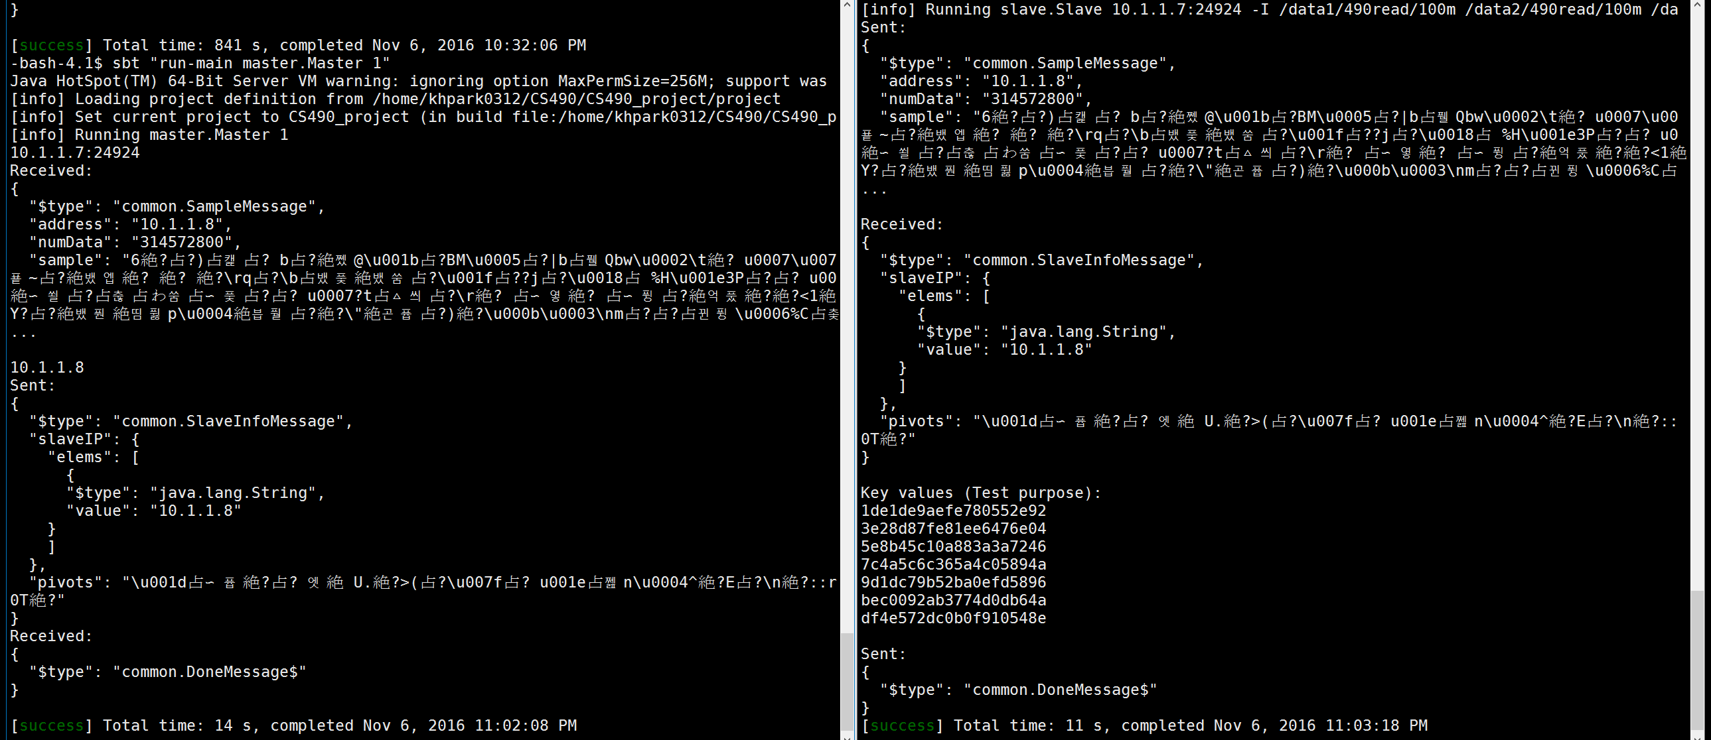
Scenario:
Master wait 1 slave
1 slave try to connect to master

Slide 37
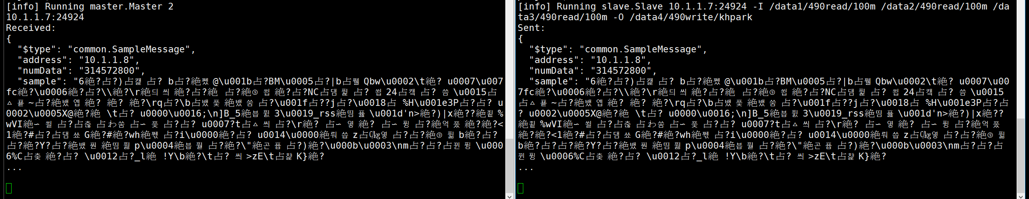
Scenario:
Master wait 2 slaves
Only 1 slave try to connect to master
No progress

Slide 38
Scenario:
Master wait 1 slave
1 slave try to connect to master

Slide 39
Scenario:
Master wait 2 slaves
2 slaves try to connect to master

Slide 40
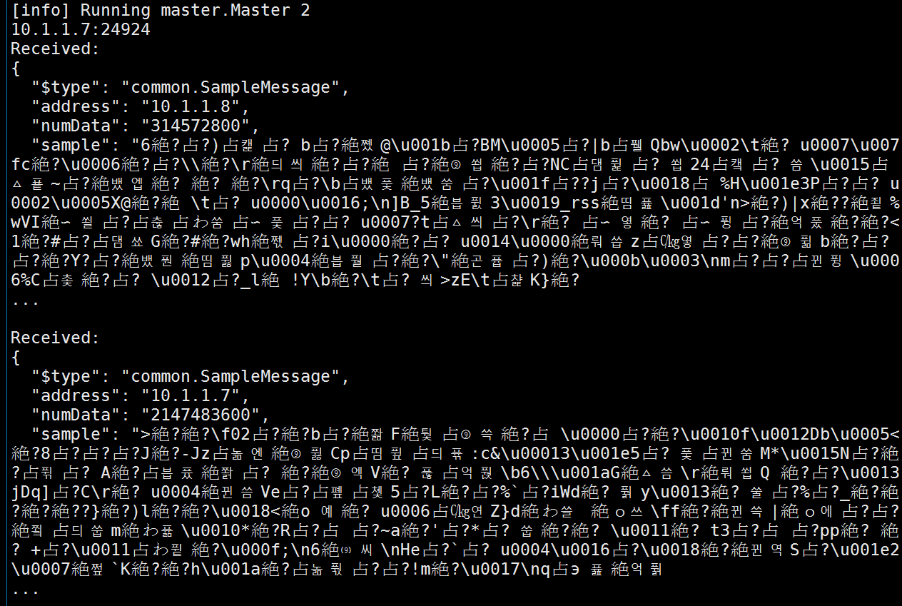
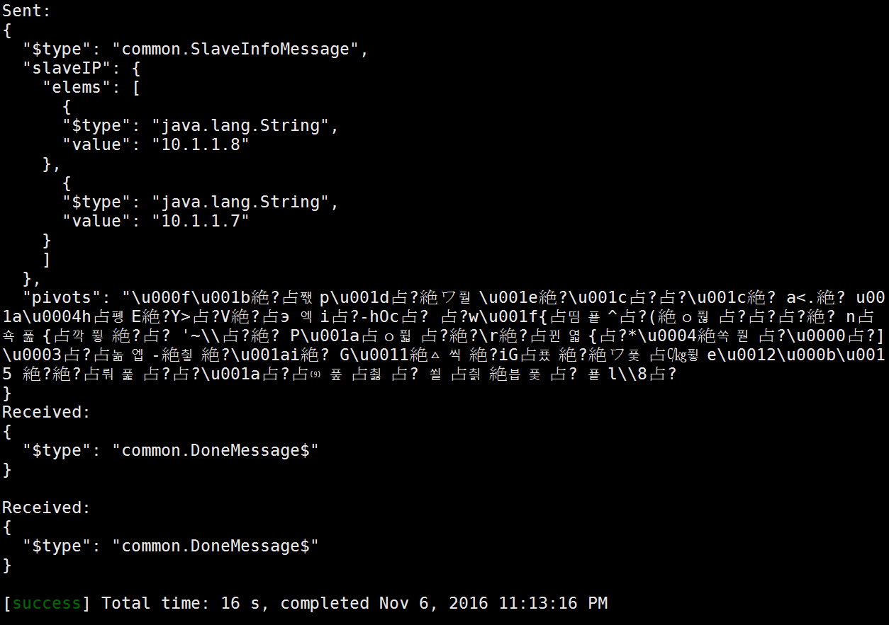
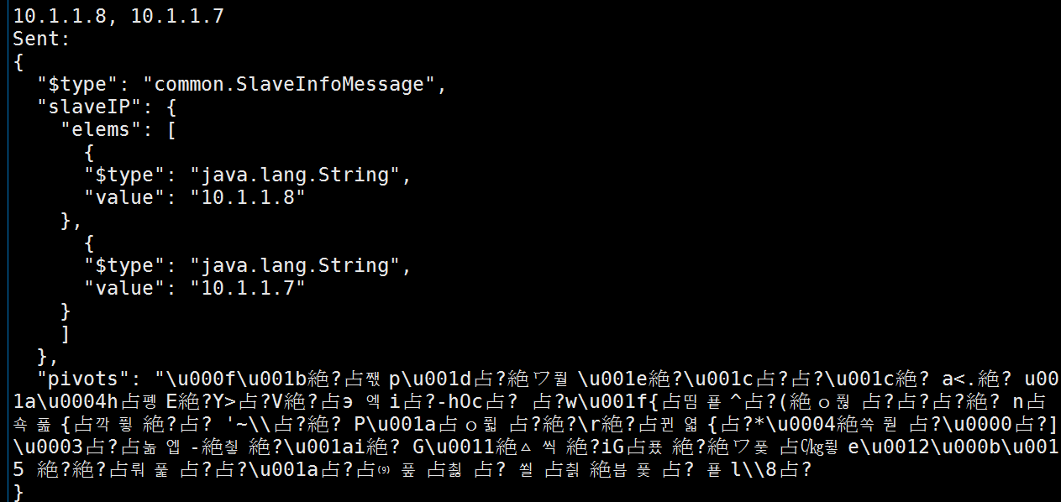
Master

Slide 41
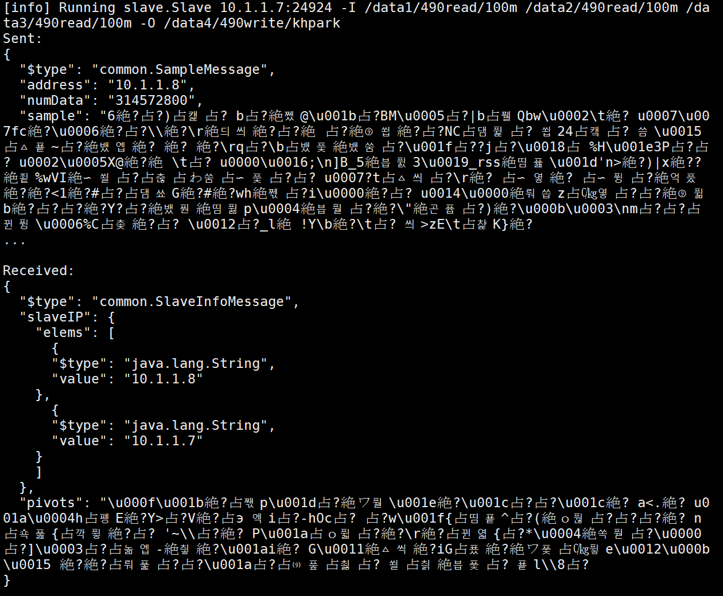
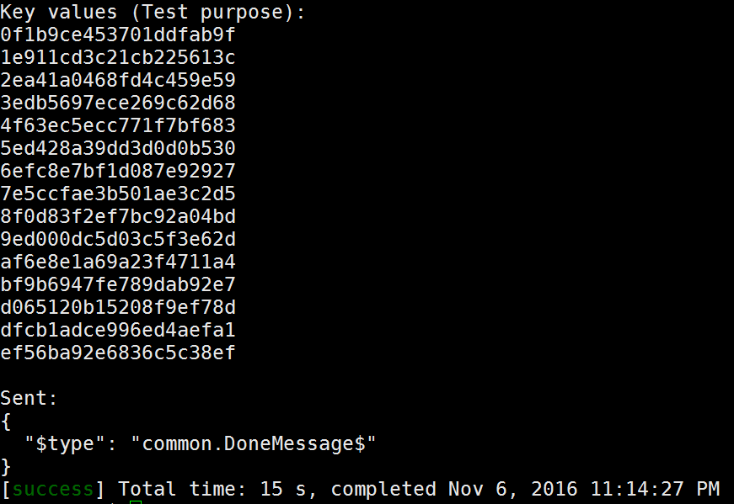
Slave 1

Slide 42
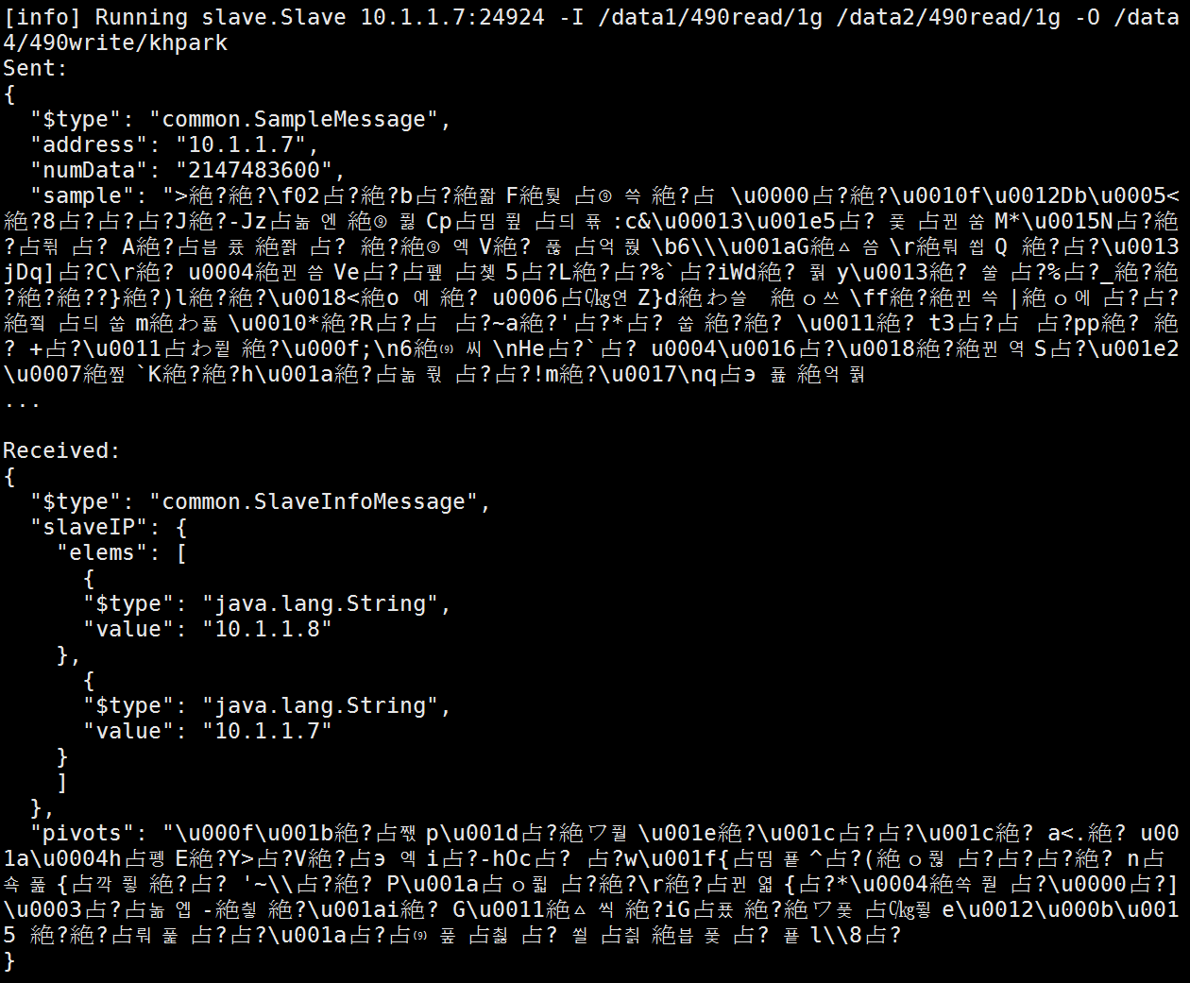
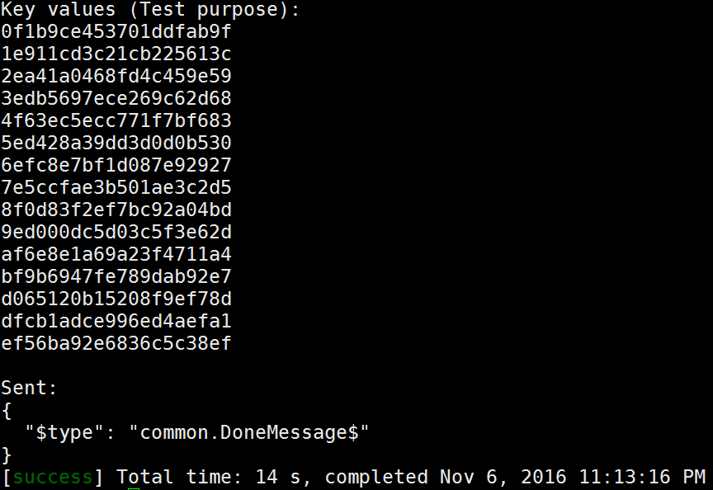
Slave 2

Slide 43
Scenario:
Master wait 1 slave
2 slaves try to connect to master

Slide 44
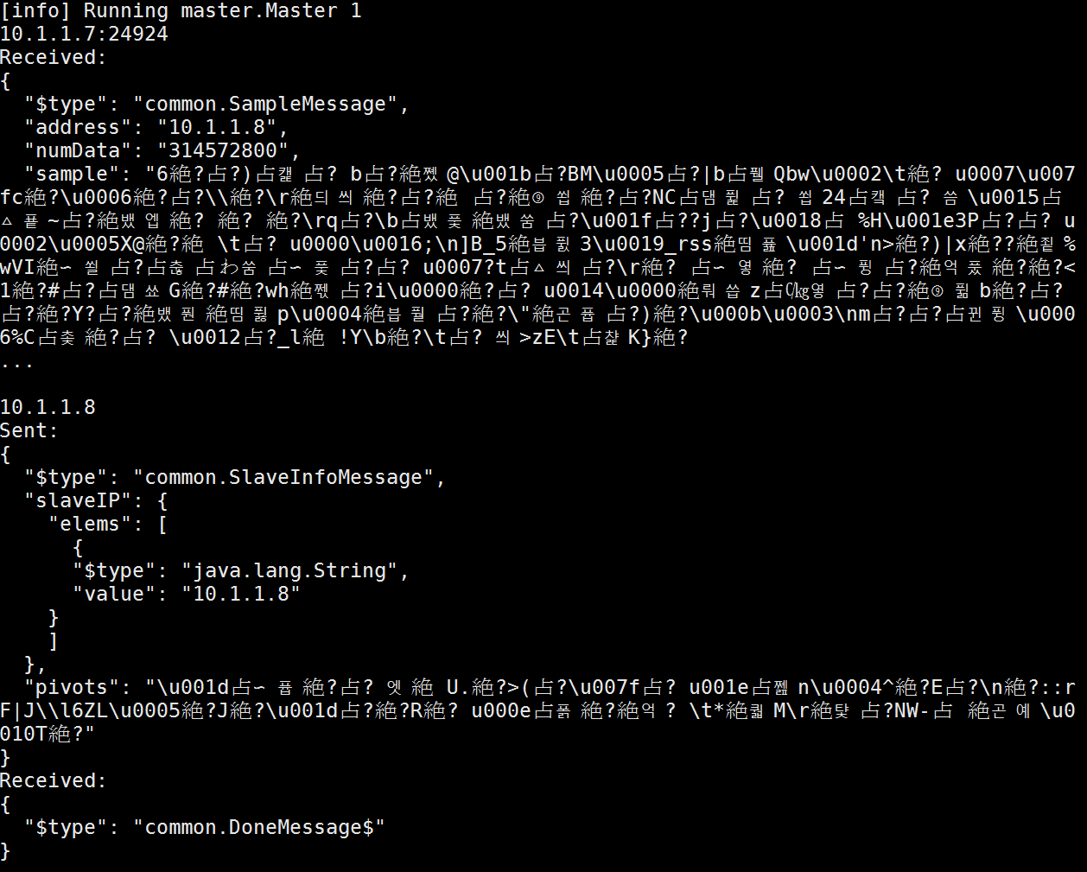
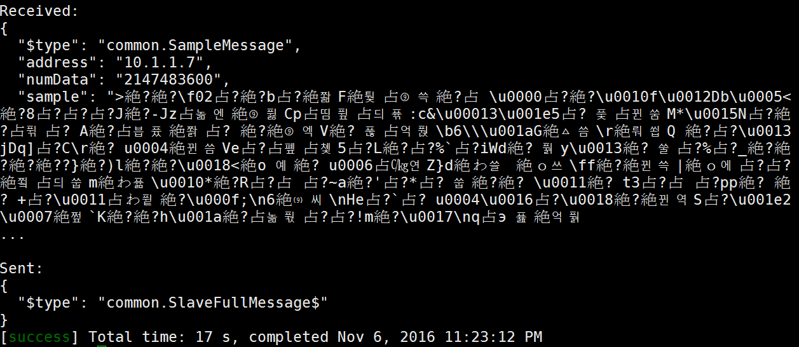
Master

Slide 45
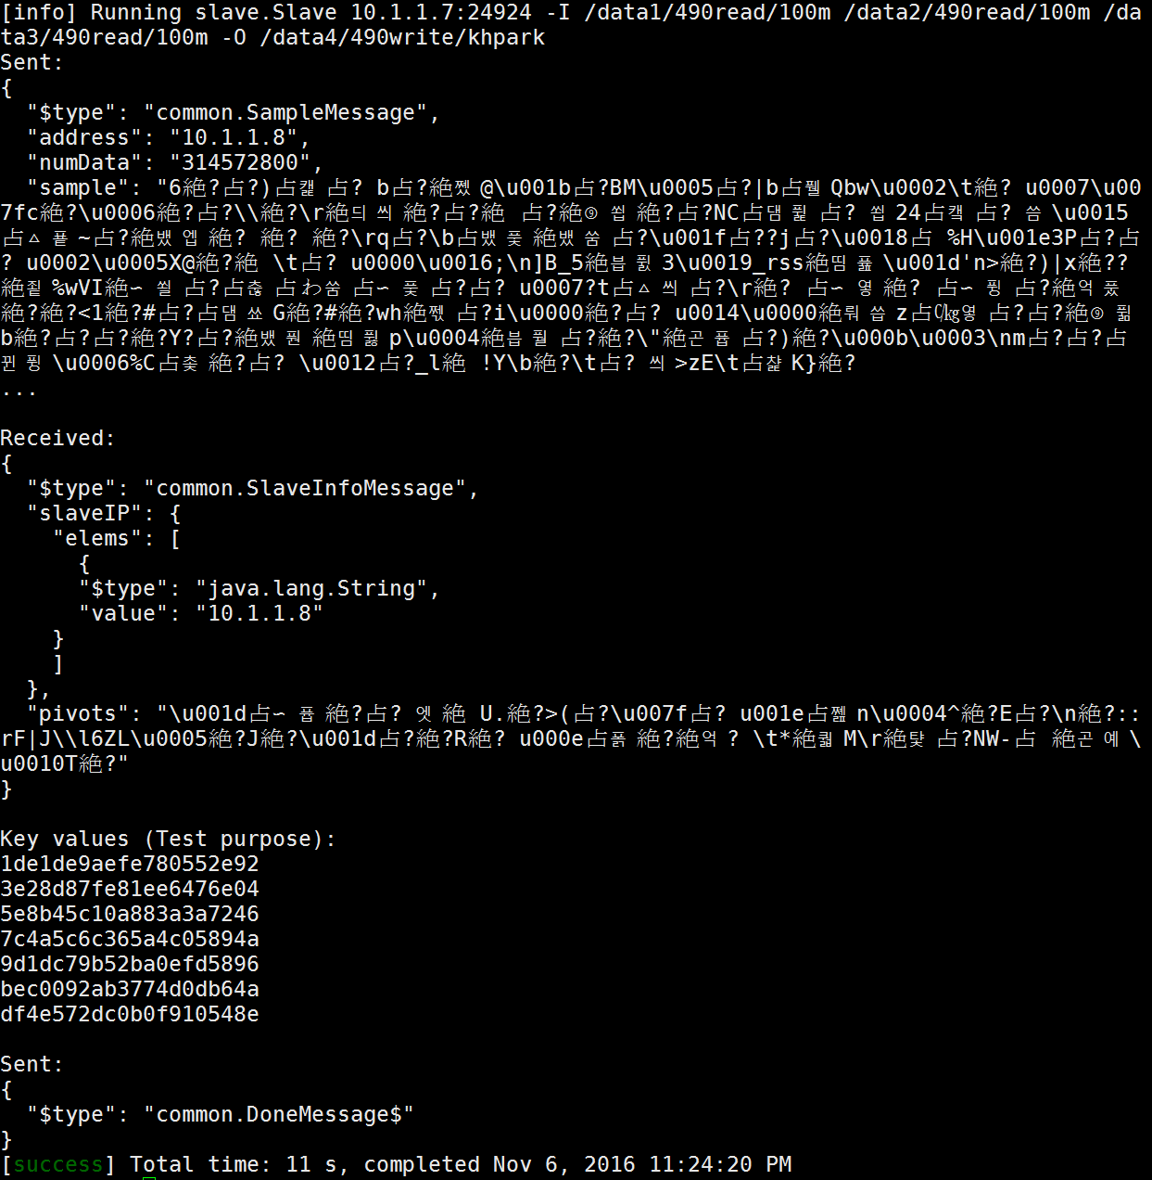
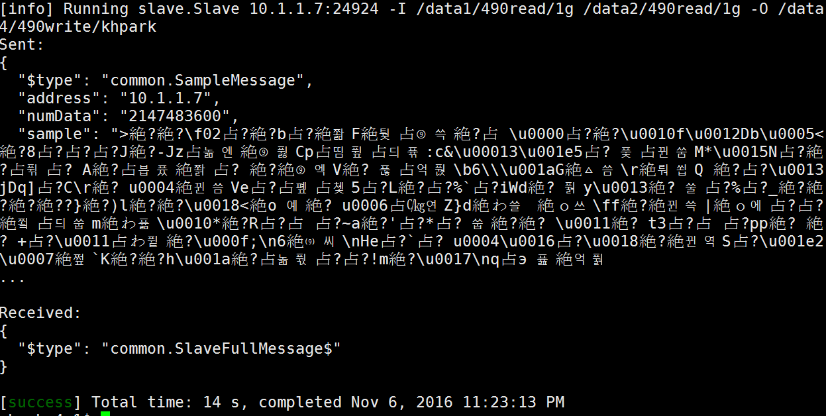
Slave 1
Slave 2

