Slide 1



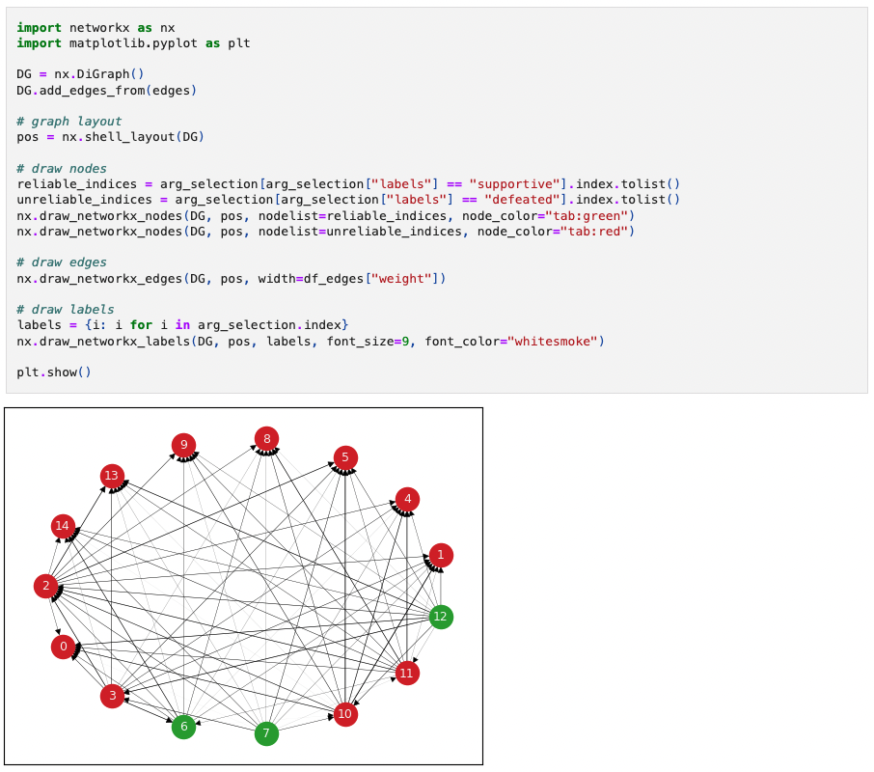
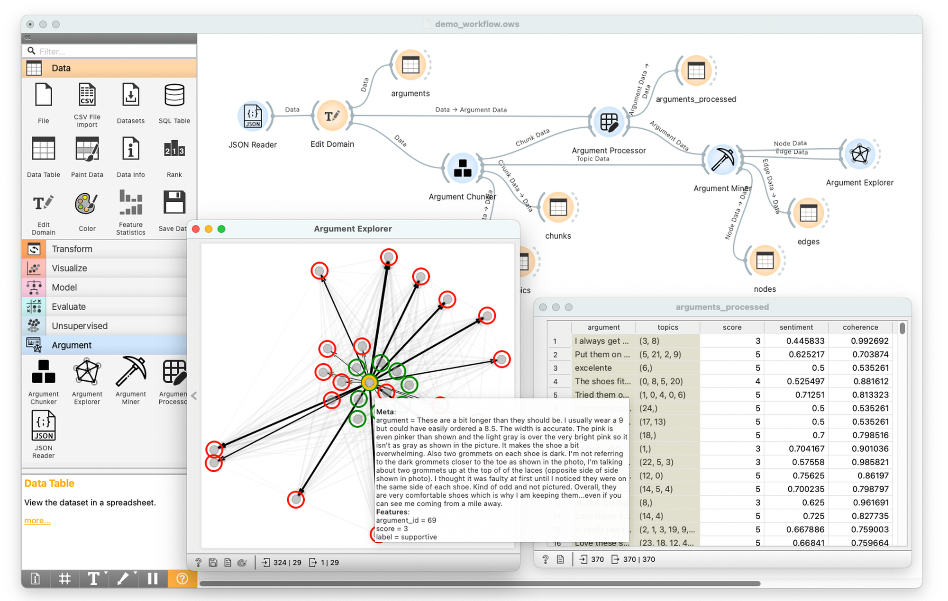
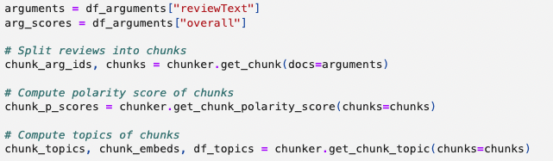
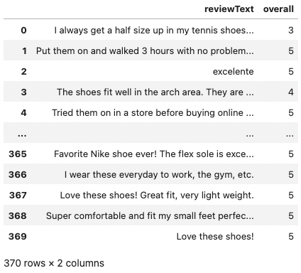

Modeling Interactions in Product Reviews
Centrum Wiskunde & Informatica
Utilizing Formal Argumentation to Assess Strengths and Weaknesses of Products Across Different Aspects
Ji Qi, Research Software Engineer, Social Science and Humanities Section, Netherlands eScience Center, The Netherlands
Atefeh Keshavarzi Zafarghandi, Human-Centered Data Analysis, Centrum Wiskunde & Informatica;
Vrije Universiteit Amsterdam, The Netherlands
Davide Ceolin, Human-Centered Data Analysis, Centrum Wiskunde & Informatica, The Netherlands
j.qi@esciencecenter.nl, akz@cwi.nl, davide@cwi.nl
Introduction
This study focuses on the creation of a valuable resource powered by formal argumentation for new users by effectively analyzing product reviews and highlighting the strengths and weaknesses associated with different aspects of a product.
Imagine that there are three reviews given for shoes:
★★★★☆ R1: “They are always well built and last me quite a few years. The only downside is they tend to be a bit pricey.”
★☆☆☆☆ R2: “My shoes are damaged in its warranty but the team has no response. Don’t buy, very expensive.”
★★★★☆ R3: “Largely my fault for not reading carefully, but it is very uncomfortable.”
They describe the shoes on different aspects, e.g., quality, price, service, and comfort. Here is the question we aim to answer: In case reviews conflict regarding one aspect (well built vs. damaged in its warranty regarding the quality of the shoes), which ones should we trust?
Methods
We use Abstract Argumentation Frameworks to address the question in three steps:
Review Segregation
Parsing review into chunks
Topic modeling of chunks
Importance rank of chunks
Sentiment of chunks
Review Rejoin
Topics of reviews
Sentiment of reviews
Coherence of reviews
Attack mining
Attack detection
Review labeling
C1-1 (…well built…) T=“Quality” | S=0.8 | IR=0.5
C1-1
R1 (…well built…a bit pricey) T=(“Quality”, ”Price”) | S=0.2 | C=0.4
In terms of Quality
R1
C1-2
R2
R1
C1-2 (…a bit pricey.)
T=“Price” | S=-0.4 | IR=0.5
Reliable
UnReliable
Implementation
A Python package is developed to implement the pipeline, as well as GUIs for user-friendly interaction.
Find our work on GitHub

