Slide 1


Console App
Bank Operations

Slide 2

CONTENT
01
Python and it’s Implementation
02
SCOPE OF PROJECT
03
Class Design 1
04
Class Design 2
05
Requirement Framing
06
Operating Environment
07
Summary of Application

Slide 3


Python
Python and it’s Implementation
High-level programming language
Many purposes

Slide 4

SCOPE OF PROJECT
Banking operating system
Deposit Money
Withdraw Money
Fund Transfer
Balance Enquiry

Slide 5
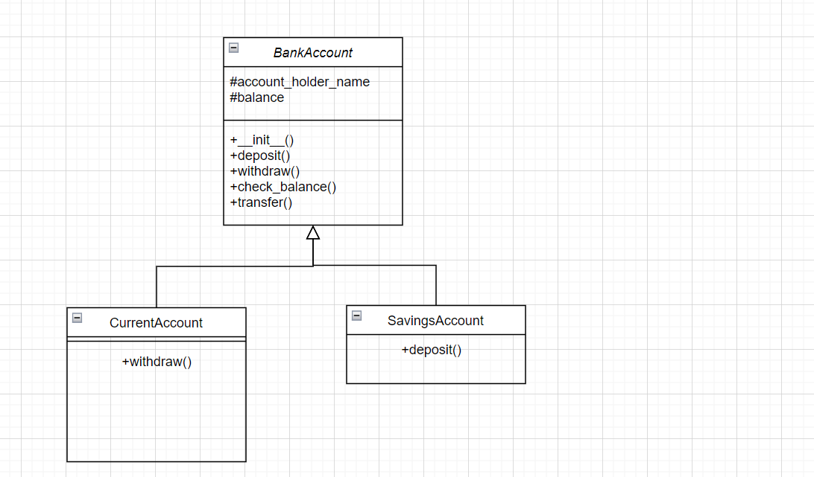
Class Design -Individual Classes

Slide 6

Class Design – On a Single Canvas

Slide 7
Functional Requirements of App

Slide 8
Requirement ID | Requirement CATEGORY | Requirement TYPE | PRIORITY | HIERARCHY | REF
R001 | FUNCTIONAL | STATED | HIGH
Requirement DESCRIPTION | Deposit money, Withdraw money, Transfer money from one account to another account
SCOPE | Protected ( The method will be visible in the classes that extend the current class)
METHODOLOGICAL DETAILS of Requirement | The money should be consistent through out the process Deposited and withdrawl money should be reflected in the corresponding account In code, the methods should have Single Responsibility each The methods should be reused

Slide 9


Windows Pycharm or Spyder
OPERATING ENVIRONMENT
01
02
03
04
Windows
Ex-
Pycharm
Mac Os
Ex-
Pycharm
Linux
Ex-
EasyEclipse
Docker

Slide 10
SUMMARY OF APPLICATION
The Banking application is based on python and is designed to manage banking activities such as deposit, withdrawal, transfers, and balance inquiries.
This project is based on the concepts of object oriented programming (oops).
The project includes classes like BankAccount, SavingsAccount, and CurrentAccount, each with specific functionalities.
The Banking application aims to provide efficient and organized banking operations through a console interface.

Slide 11

THANK YOU
By :Dhanesh Tekwani

