Slide 1
? Performant Python ?

Slide 2



Who am I ?
A simple tech guy at:
Our clients:

Slide 3
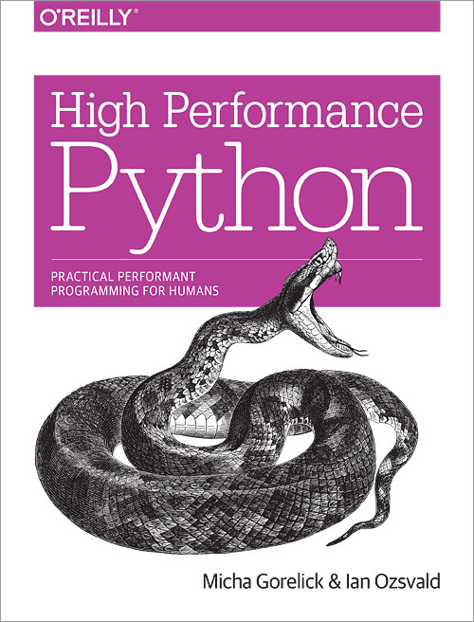
The book you must read:

Slide 4
Benchmarks on the kitchen table
wrk -t12 -c400 -d30s http://localhost:8000/agents

Slide 5

REST/JSON WebServices
Performance
Simple

Slide 6
Future
Documentation
Better multiprocessing (certainly with Gunicorn)
http://www.api-hour.io/

Slide 7
Thanks
ALLOcloud/Eyepea
  Especially:
    Nicolas Stein (Nike)
    Sylvain Francis (iCart)
Aiorest, aiohttp, AsyncIO et Gunicorn devs
Python community
FOSS

