Slide 1
Development of a Parallel
OpenGL Polygon Renderer
Semester Thesis:
Tobias Wolf
19. December 2007

Slide 2
Outline
Introduction
Application Design
  Equalizer
  eqPly
Data Structure
  Old
  New
Rendering
Summary

Slide 3
Introduction
Subject of this semester thesis
  Development of an application for the efficient presentation of
  polygonal data based upon the Equalizer framework and OpenGL
Sub goals
  Development of an efficient data structure for the polygonal data
  Implementation of an efficient and visually appealing rendering
  using Vertex Buffer Objects and GLSL shaders
Old eqPly

Slide 4
Outline
Introduction
Application Design
  Equalizer
  eqPly
Data Structure
  Old
  New
Rendering
Summary

Slide 5
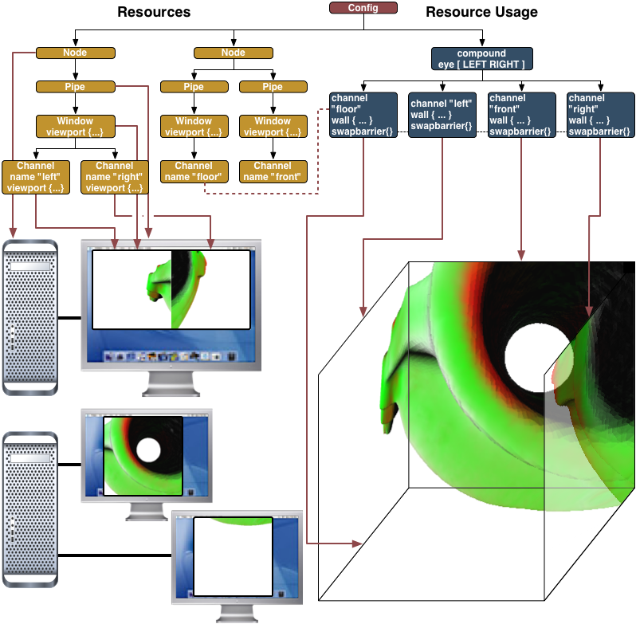
Equalizer concepts and classes (1)
Configuration
  Description of physical and logical rendering resources
  Description of resource usage
Equalizer sample configuration (source: Equalizer web site)

Slide 6
Equalizer concepts and classes (1)
Configuration
  Description of physical and logical rendering resources
  Description of resource usage
Node
  Representation of an individual computer in the rendering cluster
Equalizer sample configuration (source: Equalizer web site)

Slide 7
Equalizer concepts and classes (1)
Configuration
  Description of physical and logical rendering resources
  Description of resource usage
Node
  Representation of an individual computer in the rendering cluster
Pipe
  Representation of the graphics cards (GPUs) of a single node
Equalizer sample configuration (source: Equalizer web site)

Slide 8
Equalizer concepts and classes (2)
Window
  Holds drawable and
  OpenGL context
Equalizer sample configuration (source: Equalizer web site)

Slide 9
Equalizer concepts and classes (2)
Window
  Holds drawable and
  OpenGL context
Channel
  Abstraction of viewport
  within the parent window
  Entity responsible for the
  main rendering work
Equalizer sample configuration (source: Equalizer web site)

Slide 10
Equalizer concepts and classes (2)
Window
  Holds drawable and
  OpenGL context
Channel
  Abstraction of viewport
  within the parent window
  Entity responsible for the
  main rendering work
Distributed objects
  Static (unversioned)
  Dynamic (versioned)
Equalizer sample configuration (source: Equalizer web site)

Slide 11
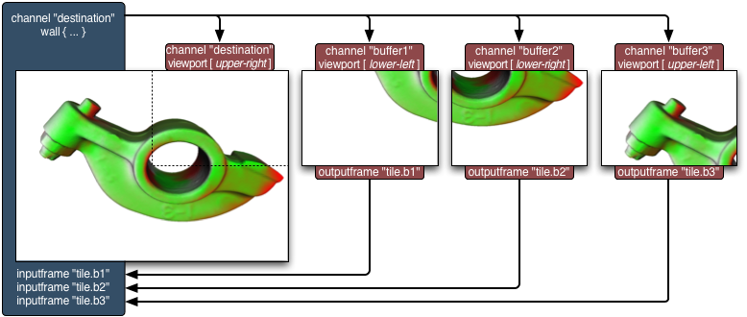
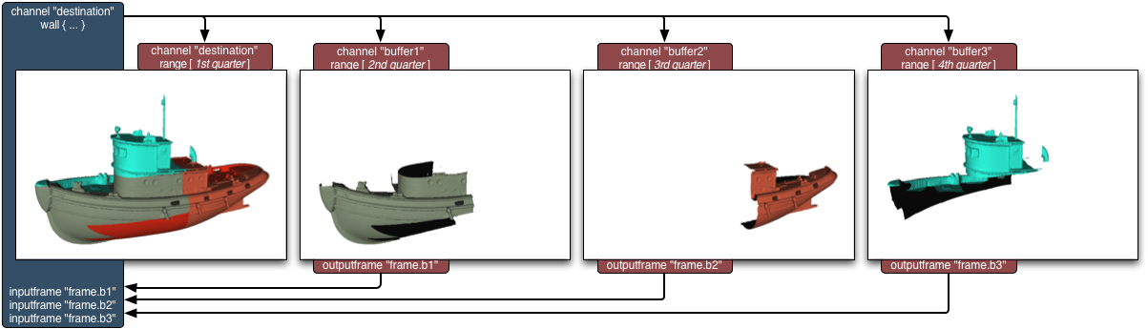
Equalizer decomposition modes
2D
  Partitions 2D screen space
  into multiple tiles
  Relies on view frustum culling
DB
  Partitions data structure
  Requires range support
Eye
  Partitions eye passes
  Used for stereo rendering
Equalizer 2D decomposition (source: Equalizer web site)
Equalizer DB decomposition (source: Equalizer web site)

Slide 12
Outline
Introduction
Application Design
  Equalizer
  eqPly
Data Structure
  Old
  New
Rendering
Summary

Slide 13
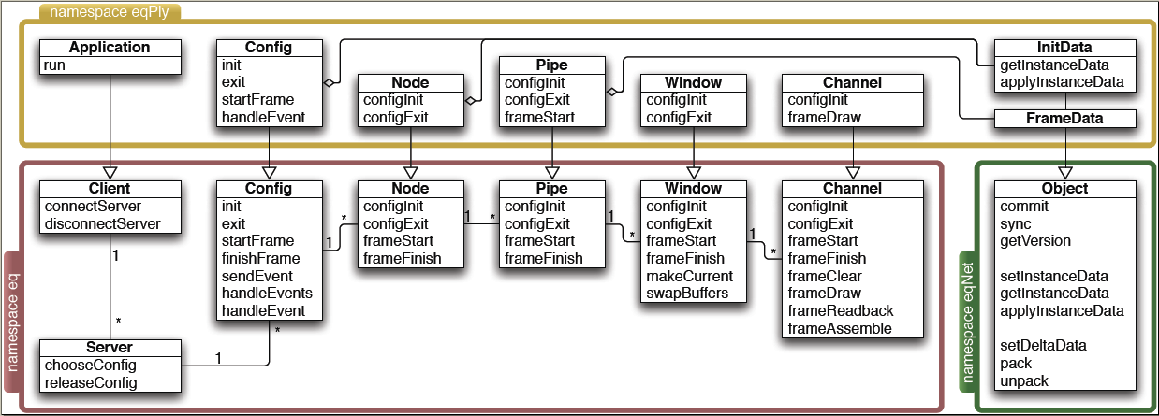
eqPly overview
UML diagram of important Equalizer and eqPly classes
(source: Equalizer Programming Guide)

Slide 14
Outline
Introduction
Application Design
  Equalizer
  eqPly
Data Structure
  Old
  New
Rendering
Summary

Slide 15
Old data structure (1)
Bounding box octree
Recursive algorithm
  Nodes are filled with data until a certain threshold is reached
  On overflow space is partitioned through the midpoint into equal sized octants
  Recursion stops when data size in leaf stays below the given threshold,
  or a predefined maximum tree depth has been reached
Implementation
  Heavily template based
  Structs for Vertex type, Face type and BBox node type

Slide 16
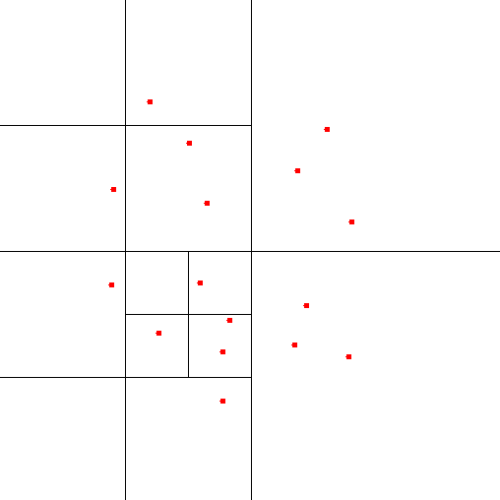
Old data structure (2)
Algorithm problems
  Space partitioned evenly without regard to actual data distribution
  Little control over resulting leaf sizes or overall tree balance
Implementation problems
  Large memory footprint
  Potential memory leaks
  Loss of structural information
  Restriction to flat shading
  Legacy C based code
2D space partitioning with a quadtree

Slide 17
Outline
Introduction
Application Design
  Equalizer
  eqPly
Data Structure
  Old
  New
Rendering
Summary

Slide 18
New data structure (1)
Requirements
  Avert the problems found in the old data structure
  Keep structural information, support smooth shading
  Optimize for Vertex Buffer Object (VBO) usage
  Use contemporary object-oriented design and C++ features

Slide 19
New data structure (1)
Requirements
  Avert the problems found in the old data structure
  Keep structural information, support smooth shading
  Optimize for Vertex Buffer Object (VBO) usage
  Use contemporary object-oriented design and C++ features
kd-tree
  Sort data along one axis, rotated every recursion step
  Determine median in regard to the chosen axis
  Partition data into two halves, elements < median and elements ≥ median
  Continue recursion until leaf size remains below wanted threshold

Slide 20
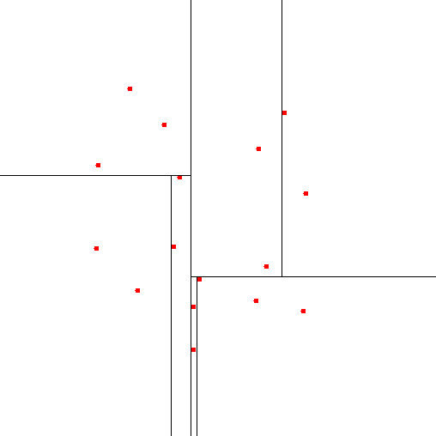
New data structure (2)
Direct advantages
  Smaller number of total nodes
  (Nearly) equal data distribution
  Well-balanced tree
Remaining requirements
  Preservation of the
  structural information
  …
  → Design and implementation
2D space partitioning with a kd-tree

Slide 21
New design (1)
class VertexData
{
public:
VertexData();
bool readPlyFile( const char* file, const bool ignoreColors );
void sort( const Index start, const Index length, const Axis axis );
void scale( const float baseSize );
void calculateNormals( const bool vertexNormals );
void calculateBoundingBox();
const BoundingBox& getBoundingBox() const;
std::vector< Vertex > vertices;
std::vector< Color > colors;
std::vector< Normal > normals;
std::vector< Triangle > triangles;
private:
...
BoundingBox _boundingBox;
};

Slide 22
New design (2)
class VertexBufferData
{
public:
void clear();
void toStream( std::ostream& os );
void fromMemory( char** addr );
std::vector< Vertex > vertices;
std::vector< Color > colors;
std::vector< Normal > normals;
std::vector< ShortIndex > indices;
private:
...
};
class VertexBufferState
{
public:
virtual bool useColors() const;
virtual void setColors( const bool colors );
virtual RenderMode getRenderMode() const;
virtual void setRenderMode( const RenderMode mode );
virtual GLuint getDisplayList( const void* key );
virtual GLuint newDisplayList( const void* key );
virtual GLuint getBufferObject( const void* key );
virtual GLuint newBufferObject( const void* key );
virtual void deleteAll();
virtual const GLFunctions* getGLFunctions() const;
protected:
VertexBufferState( const GLFunctions* glFunctions );
virtual ~VertexBufferState();
const GLFunctions* _glFunctions;
bool _useColors;
RenderMode _renderMode;
};

Slide 23
New design (3)
class VertexBufferBase
{
public:
virtual void render( VertexBufferState& state ) const;
const BoundingSphere& getBoundingSphere() const;
const float* getRange() const;
virtual const VertexBufferBase* getLeft() const;
virtual const VertexBufferBase* getRight() const;
protected:
VertexBufferBase();
virtual ~VertexBufferBase();
virtual void toStream( std::ostream& os );
virtual void fromMemory( char** addr, VertexBufferData& globalData );
virtual void setupTree( VertexData& data, const Index start, const Index length, const
Axis axis, const size_t depth, VertexBufferData& globalData );
virtual BoundingBox updateBoundingSphere();
virtual void updateRange();
void calculateBoundingSphere( const BoundingBox& bBox );
BoundingSphere _boundingSphere;
Range _range;
};

Slide 24
New design (4)
class VertexBufferNode : public VertexBufferBase
{
...
private:
size_t countUniqueVertices( VertexData& data, const Index start, const Index length ) const;
VertexBufferBase* _left;
VertexBufferBase* _right;
};
class VertexBufferLeaf : public VertexBufferBase
{
...
private:
...
VertexBufferData& _globalData;
Index _vertexStart;
ShortIndex _vertexLength;
Index _indexStart;
Index _indexLength;
};

Slide 25
New design (5)
class VertexBufferRoot : public VertexBufferNode
{
public:
virtual void render( VertexBufferState& state ) const;
void beginRendering( VertexBufferState& state ) const;
void endRendering( VertexBufferState& state ) const;
void setupTree( VertexData& data );
bool writeToFile( const char* filename );
bool readFromFile( const char* filename );
bool hasColors() const;
protected:
virtual void toStream( std::ostream& os );
virtual void fromMemory( char* start );
private:
bool constructFromPly( const char* filename );
VertexBufferData _data;
};

Slide 26
New implementation (1)
void VertexBufferNode::setupTree( VertexData& data, const Index start,
const Index length, const Axis axis,
const size_t depth,
VertexBufferData& globalData )
{
data.sort( start, length, axis );
const Index median = start + ( length / 2 );
// left child will include elements smaller than the median
const Index leftLength = length / 2;
const bool subdivideLeft =
countUniqueVertices( data, start, leftLength ) > LEAF_SIZE || depth < 3;
if( subdivideLeft )
_left = new VertexBufferNode;
else
_left = new VertexBufferLeaf( globalData );
...

Slide 27
New implementation (2)
...
// right child will include elements equal or greater median
const Index rightLength = ( length + 1 ) / 2;
const bool subdivideRight =
countUniqueVertices( data, median, rightLength ) > LEAF_SIZE || depth < 3;
if( subdivideRight )
_right = new VertexBufferNode;
else
_right = new VertexBufferLeaf( globalData );
// move to next axis and continue contruction in the child nodes
const Axis newAxis = static_cast< Axis >( ( axis + 1 ) % 3 );
static_cast< VertexBufferNode* >
( _left )->setupTree( data, start, leftLength, newAxis,
depth + 1, globalData );
static_cast< VertexBufferNode* >
( _right )->setupTree( data, median, rightLength, newAxis,
depth + 1, globalData );
}

Slide 28
New implementation (3)
void VertexBufferLeaf::setupTree( VertexData& data, const Index start,
const Index length, const Axis axis,
const size_t depth,
VertexBufferData& globalData )
{
data.sort( start, length, axis );
_vertexStart = globalData.vertices.size();
_vertexLength = 0;
_indexStart = globalData.indices.size();
_indexLength = 0;
const bool hasColors = ( data.colors.size() > 0 );
// stores the new indices (relative to _start)
map< Index, ShortIndex > newIndex;
...

Slide 29
New implementation (4)
...
for( Index t = 0; t < length; ++t )
{
for( Index v = 0; v < 3; ++v )
{
Index i = data.triangles[start + t][v];
if( newIndex.find( i ) == newIndex.end() )
{
newIndex[i] = _vertexLength++;
// assert number does not exceed SmallIndex range
MESHASSERT( _vertexLength );
globalData.vertices.push_back( data.vertices[i] );
if( hasColors )
globalData.colors.push_back( data.colors[i] );
globalData.normals.push_back( data.normals[i] );
}
globalData.indices.push_back( newIndex[i] );
++_indexLength;
}
}
}

Slide 30
Outline
Introduction
Application Design
  Equalizer
  eqPly
Data Structure
  Old
  New
Rendering
Summary

Slide 31
Rendering
Vertex Buffer Objects
  Originally an extension, since OpenGL 1.5 core functionality
  “Vertex arrays on steroids”, stored directly on the GPU
  Static and dynamic data supported
Performance considerations
  Multiple function calls
  Choice of batch size ,data types
Shading algorithms
  Flat shading
  Gouraud shading
  Phong shading

Slide 32
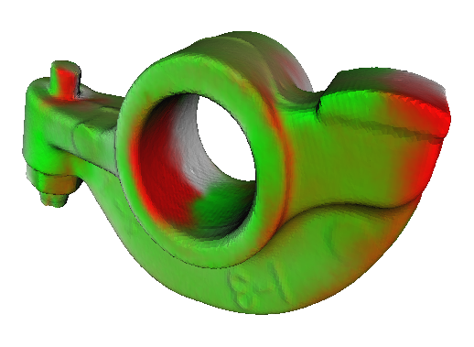
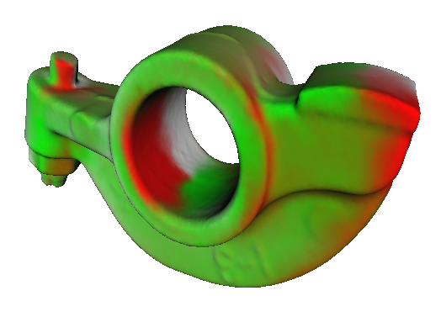
Flat vs. smooth shading
RockerArm model with original flat shading
RockerArm model with new smooth shading

Slide 33
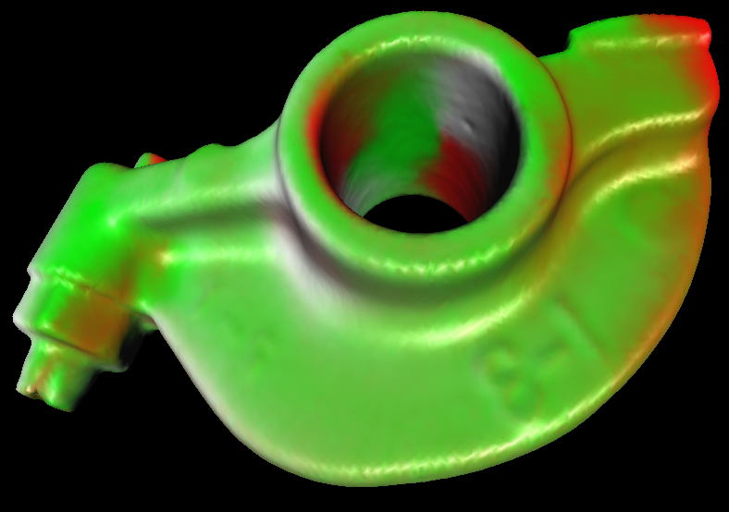
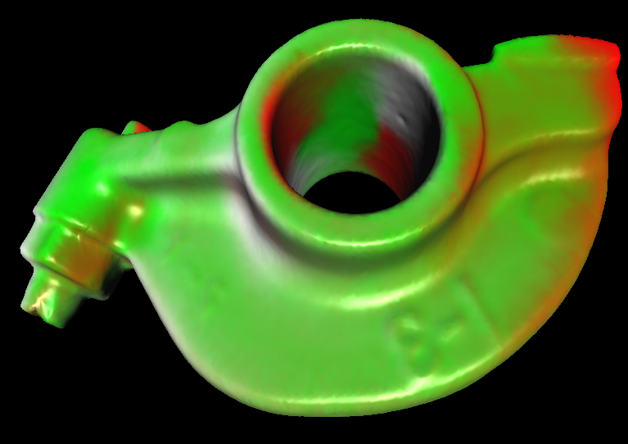
Gouraud vs. Phong shading
Shiny RockerArm model with Gouraud shading
Shiny RockerArm model with Phong shading

Slide 34
Outline
Introduction
Application Design
  Equalizer
  eqPly
Data Structure
  Old
  New
Rendering
Summary

Slide 35
Summary (1)
First goal fully achieved
  Only drawback is the slow tree setup time
  Alleviated by the use of binary representations
Model | Binary octree [MB] | Binary kd-tree [MB] | Ratio [%]
Armadillo | 27.72 | 6.09 | 21.96
Dragon | 69.83 | 15.34 | 21.97
Happy Buddha | 87.16 | 19.05 | 21.86
Lucy | n/a | 494.58 | n/a
Stanford Bunny | 5.56 | 1.20 | 21.56
File size differences between the binary representations

Slide 36
Summary (2)
Second goal partially achieved
  Vertex Buffer Object rendering
  OpenGL 1.1 display list fallback
  Overall better performance
  GLSL shader support
  Gouraud and Phong shading
But
  VBO performance difference varying wildly
  Out of time to implement further shader effects

Slide 37
Summary (3)
Model | Number of triangles | Number of leaves | Triangles per leaf | Vertices per leaf | Old DL [fps] | New DL [fps] | New VBO [fps]
Stanford Bunny | 69’451 | 16 | 4’340 | 2’329 | 406.82 | 436.67 | 617.00
Rocker Arm | 80’354 | 16 | 5’022 | 2’797 | 445.61 | 445.57 | 301.67
Goddess 1 | 274’822 | 16 | 17’176 | 9’252 | 142.20 | 162.45 | 70.94
Armadillo | 345’944 | 16 | 21’621 | 11’218 | 118.30 | 136.43 | 92.17
Boat | 776’374 | 32 | 24’261 | 12’769 | 29.25 | 20.06 | 28.47
Dragon | 871’414 | 32 | 27’231 | 14’138 | 17.06 | 45.02 | 38.19
Goddess 2 | 1’047’330 | 32 | 32’729 | 17’430 | 10.02 | 9.32 | 42.99
Hip | 1’060’346 | 32 | 33’135 | 17’307 | 11.10 | 9.24 | 29.37
Happy Buddha | 1’087’716 | 32 | 33’991 | 17’509 | 9.54 | 29.27 | 34.88
Performance and statistical data for a few selected models

Slide 39
Questions or comments?

Slide 40
Development of a Parallel
OpenGL Polygon Renderer
Semester Thesis:
Tobias Wolf
19. December 2007

