Slide 1
CMSC424: Database Design Module: Introduction/Overview
Instructor: Amol Deshpande
amol@umd.edu

Slide 2
CMSC424: Database Design Module: Introduction/Overview
Welcome and Logistics
Instructor: Amol Deshpande
amol@umd.edu

Slide 3
Welcome to CMSC424: Database Design
Course description
Students are introduced to database systems and motivates the database approach as a mechanism for modeling the real world. An in-depth coverage of the relational model, logical database design, query languages, and other database concepts including query optimization, concurrency control; transaction management, and log based crash recovery. Distributed and Web database architectures are also discussed.
I understand this semester will be challenging for everyone, and we will try to do what we can to make things easier
Typical in-person instruction, 2 classes a week etc.
Will record lectures but quality may not be as good
Will make available pre-recorded videos from Fall 2020
Expect about 90% overlap – will try to keep slides the same for most material
Use the discussion forums, office hours as much as possible – assignments are to be done individually, but you are allowed to discuss among yourselves
Fill out the survey covering your background, your expectations, and potential issues (https://forms.gle/kgEtv8zBt7r12T4s9 -- will post on CampusWire)
No Laptops without permission !

Slide 4
Welcome to CMSC424: Database Design
COVID Specific Notes
You should let me know of any excused absences due to COVID
We have built in enough flexibility to handle any excused absences without extra accommodations
e.g., 10 late days in total – try to keep them for excused absences
Any additional accommodations MAY NOT be made
Masks are required
I will try to teach with a mask, but may have to adjust depending on how well you can hear me
Scan the QR Codes on your desks for contact-tracing
See here for more details: https://provost.umd.edu/node/4243
If you are not registered for the class (or aren’t on a waitlist), you cannot be here
No Laptops without permission !

Slide 5
Logistics
Instructor: Amol Deshpande
5154 IRB, amol@umd.edu
Class Webpage: ELMS
Email to me: write CMSC424 in the title
Only if CampusWire not suitable for some reason
CampusWire allows personal messages
Won’t be able to stick around after class for long (for first few classes)
Stop by (virtual) office hours tomorrow or Wednesday, or schedule separately
Will post final office hours later today
TAs: Minghui Liu, Nitin Balchandran, Qingyang Tan, Saptarashmi Bandyopadhyay, Yixuan Ren, Zhenghang Hu

Slide 6
Logistics
Textbook:
Database System Concepts
Seventh Edition (6th Edition will be fine too)
Abraham Silberschatz, Henry F. Korth, S. Sudarshan
GitHub:
To distribute programming assignments
https://github.com/umddb/cmsc424-fall2021
CampusWire: First resort for any questions
Will re-evaluate based on your feedback in a few weeks
ELMS: General announcements will be posted there
GradeScope
We will use this for assignments, grading exams, etc.

Slide 7
Grading
12 short weekly quizzes (10%)
No late submissions, but will drop the lowest two
Two Midterms (30%), Final (25%) – minimum of 40% on all combined to pass
Will weigh the higher-scoring midterm at 18%, and the lower-scoring midterm at 12%
6 Assignments – 4 programming, 2 non-programming (35%)
10 total late days without penalty
Beyond that: every late day will result in 20% penalty for that project
Maximum 5 days late on any project
Projects typically due on Friday night – so must submit before Wednesday night
Example:
Assignment 1 → 5 days late, Assignment 2 → 4 days late, Assignment 3 → 3 days late
No penalty for the first two assignments; for Assignment 3, 2 days over → 40% penalty
These are supposed to be used for handling emergencies/excused absences
We will likely not make additional accommodations
The projects will be released sufficiently in advance for you to plan

Slide 8
To-Dos
Sign up for CampusWire, and GradeScope !
Set up the computing environment (Assignment 0), and make sure you can run Vagrant, PostgreSQL, Jupyter, etc.
Make sure you are aware of the key deadlines

Slide 9
CMSC424: Database Design Module: Introduction/Overview
Motivation
Instructor: Amol Deshpande
amol@umd.edu

Slide 10
Motivation
Book Chapters (6th Edition)
1.1, 1.2
Key Topics
Data-driven world and Big Data
Why managing large volumes of data is difficult
Drawbacks of using File Systems to store data
What we will cover in this course

Slide 11
Motivation: Data Overload
Explosion of data, in pretty much every domain
Sensing devices and sensor networks that can monitor everything 24/7 from temperature to pollution to vital signs
Increasingly sophisticated smart phones
Internet, social networks makes it easy to publish data
Scientific experiments and simulations produce astronomical volumes of data
Internet of Things
Dataification: taking all aspects of life and turning them into data (e.g., what you like/enjoy turned into a stream of your "likes”)
How to handle that data? How to extract interesting actionable insights and scientific knowledge?
Data volumes expected to get much worse

Slide 12
Four V’s of Big Data
Increasing data Volumes
Scientific data: 1.5GB/genome -- can be sequenced in .5 hrs; LHC generates 100TB of data a day
500M tweets per day
As of 2012: 2.5 Exabytes of data created every day
EBay: Two data warehouses with 7.5PB and 40PB
Walmart: 583 terabytes of sales and inventory data
FICO monitors 2.5 billion active accounts worldwide
Variety:
Structured data, spreadsheets, photos, videos, natural text, ...
Velocity
Veracity

Slide 13
Four V’s of Big Data
Increasing data Volumes
Variety
Velocity
Sensors, smart watches, etc., everywhere -- can generate tremendous volumes of "data streams"
Real-time analytics requires data to be consumed as fast as it is generated
Veracity
How do you decide what to trust? How to remove noise? How to fill in missing values?
By various accounts, 90% or so of the time is spent in data cleaning and preparation, vs 10% or so on the machine learning/data science

Slide 14
Big Data and Data Science to the Rescue
Terms increasingly used synonymously: also data analytics, data mining, business intelligence
Loosely used for any process where interesting things are inferred from data
Google search: “How Big Data Will Change”
Data scientist called the sexiest job of the 21st century
The term has becoming very muddled at this point

Slide 15
Is it all hype?
No: Extracting insights and knowledge from data very important, and will continue to increase in importance
Big data techniques are revolutionizing things in many domains like Education, Food Supply, Disease Epidemics, ...
But: it is not much different from what we, especially statisticians, have been doing for many years
What is different?
Much more data is digitally available than was before
Inexpensive computing + Cloud + Easy-to-use programming frameworks = Much easier to analyze it
Often: large-scale data + simple algorithms > small data + complex algorithms
Changes how you do analysis dramatically

Slide 16
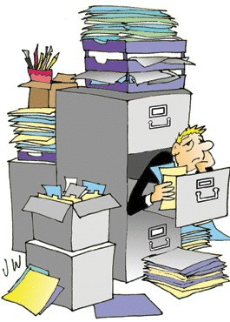
Motivation: Data Overload
How do we do anything with this data?
Where and how do we store it ?
Disks are doubling every 18 months or so -- not enough
In many cases, the data is not actually recorded as it is; summarized first
What if the disks crash ?
Very common, especially with 10,000’s of disks
How do we ensure “correctness” ?
What if the system crashes in the middle of an ATM transaction ?
Can’t have money disappearing
What happens when a million people try to buy tickets to <your favorite artist>’s concert at the same time ?

Slide 17
Motivation: Data Overload
What to do with the data ? How to process/analyze it ?
text search ?
Very limited
“find the stores with the maximum increase in sales in last month”
We can’t expect the users to write Java programs
“how much time from here to Pittsburgh if I start at 2pm ?”
Data is there; more will be soon (GPS, live traffic data)
Requires predictive capabilities
Increasing need to convert “information” to “knowledge”: Data mining/Machine Learning
“How many DVDs should we order?” (Netflix)
Find videos with this type of an event (say car break-ins)
Mine the “blogs” to detect “buzz”

Slide 18
Motivation: Data Overload
Speed !!
With TB’s of data, just finding something (even if you know what), is not easy
Reading a file with TB of data can take hours
Imagine a bank and millions of ATMs
How much time does it take you to do a withdrawal ?
The data is not local
How do we guarantee the data will be there 10 years from now ?
Privacy and security !!!
Every other day we see some database leaked on the web
How to make sure different users’ data is protected from each other

Slide 19
Why not use file systems ?
Drawbacks of using file systems to store data:
Data redundancy and inconsistency
Multiple file formats, duplication of information in different files
Difficulty in accessing data
Need to write a new program to carry out each new task
Data isolation — multiple files and formats
Integrity problems
Integrity constraints (e.g., account balance > 0) become “buried” in program code rather than being stated explicitly
Hard to add new constraints or change existing ones

Slide 20
Why not use file systems ?
Drawbacks of using file systems to store data:
Atomicity of updates
Failures may leave database in an inconsistent state with partial updates carried out
Example: Transfer of funds from one account to another should either complete or not happen at all
Concurrent access by multiple users
Concurrent access needed for performance
Uncontrolled concurrent accesses can lead to inconsistencies
Example: Two people reading a balance (say 100) and updating it by withdrawing money (say 50 each) at the same time
Security problems
Hard to provide user access to some, but not all, data

Slide 21
What we will cover…
We will mainly discuss structured data
That can be represented in tabular forms (called Relational data)
We will spend some time on JSON/Document Data Model (MongoDB)
We will also spend some time on Mapreduce-like stuff (Apache Spark)
Still the biggest and most important business (?)
Well defined problem with really good solutions that work
Contrast XQuery for XML vs SQL for relational
Solid technological foundations
Many of the basic techniques however are directly applicable
E.g. reliable data storage etc.
Cf. Many recent attempts to add SQL-like capabilities, transactions to Mapreduce and related technologies
E.g., Spark DataFrames

Slide 22
Structure of the Course
Introduction
Motivation, data abstraction, common data systems architectures today
Relational Model + SQL (Two programming assignments)
Schema Design: Entity-relationship Models and Normalization (Long-form Assgn)
How to create a database schema, and how to ensure it is “good”
Implementation Issues (Programming assignment)
Different types of storage, and how to ensure reliability in presence of failures
Indexes for faster retrieval of data
How an SQL query is processed and optimized
NoSQL (somewhat of a misnomer) (Programming assignment)
Document, key-value, and graph data models
MongoDB and its Query Language
Map-reduce Model and Apache Spark
Transactions (Long-form Assignment)
How to do concurrent updates correctly
How to ensure consistency in presence of failures
Programming assignments may have small non-programming component, and vice versa

Slide 23
Main Changes from Fall 2020
Web App Development and Programming Project
An important topic, but insufficient time to cover it in sufficient depth
Less Detailed Discussion of Indexing and Query Processing
More in-depth NoSQL
MongoDB (including a programming project)
Deeper discussion of other NoSQL data models
(MapReduce/Spark has been covered in the past)
Replace implementation project for Transactions with a long-form assignment instead

Slide 24
Summary
Why study databases ?
Shift from computation to information
Always true in corporate domains
Increasing true for personal and scientific domains
Need has exploded in recent years
Data is growing at a very fast rate
Solving the data management problems is going to be a key
Database Management Systems provide
Data abstraction: Key in evolving systems
Guarantees about data integrity
In presence of concurrent access, failures…
Speed !!

Slide 25
CMSC424: Database Design Module: Introduction/Overview
Data Models and Data Abstraction
Instructor: Amol Deshpande
amol@cs.umd.edu

Slide 26
Motivation
Book Chapters (6th Edition)
1.3
Key Topics
Data Models and Why Capturing “Structure” is Important
Data Abstraction, and Views
Logical and Physical Data Independence

Slide 27
Database Management Systems
Provide a systematic way to solve data management issues
Aim is to allow easy management of high volumes of data
Storing , Updating, Querying, Analyzing ….
What is a Database ?
A large, integrated collection of (mostly structured) data
Typically models and captures information about a real-world enterprise
Entities (e.g. courses, students)
Relationships (e.g. John is taking CMSC 424)
Usually also contains:
Knowledge of constraints on the data (e.g. course capacities)
Business logic (e.g. pre-requisite rules)
Encoded as part of the data model (preferable) or through external programs

Slide 28
Database Management Systems
Massively successful for highly structured data
Why ? Structure in the data (if any) can be exploited for ease of use and efficiency
If there is no structure in the data, hard to do much
Contrast managing emails vs managing photos
Much of the data we need to deal with is highly structured
Some data is semi-structured
E.g.: Resumes, Webpages, Blogs etc.
Some has complicated structure
E.g.: Social networks
Some has no structure
E.g.: Text data, Video/Image data etc.

Slide 29
Structured vs Unstructured Data
A lot of the data we encounter is structured
Some have very simple structures
E.g. Data that can be represented in tabular forms
Significantly easier to deal with
We will focus on such data for much of the class
Account
bname | acct_no | balance
Downtown Mianus Perry R.H | A-101 A-215 A-102 A-305 | 500 700 400 350
Customer
cname | cstreet | ccity
Jones Smith Hayes Curry Lindsay | Main North Main North Park | Harrison Rye Harrison Rye Pittsfield

Slide 30
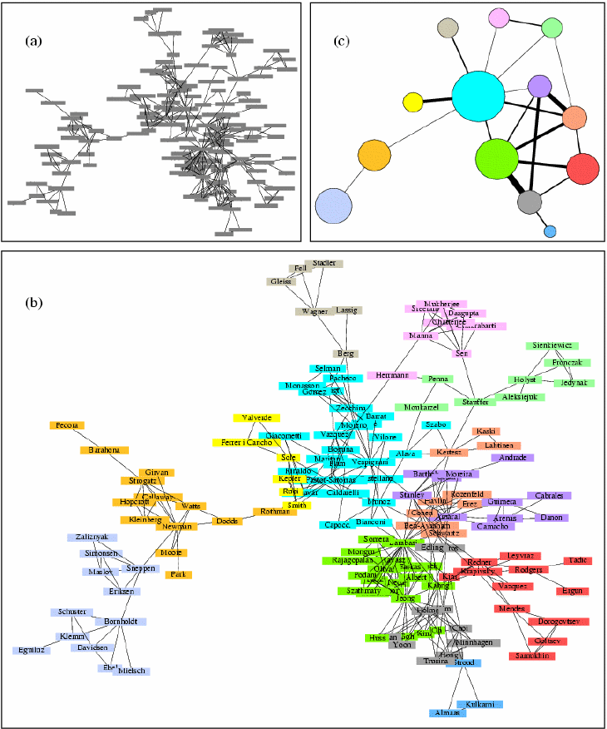
Structured vs Unstructured Data
Some data has a little more complicated structure
E.g graph structures
Map data, social networks data, the web link structure etc
Can convert to tabular forms for storage, but may not be optimal
Queries often reason about graph structure
Find my “Erdos number”
Suggest friends based on current friends
Growing importance in recent years in a variety of domains: Biological, social networks, web…

Slide 31
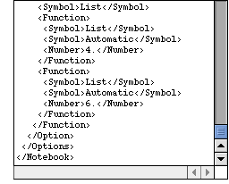
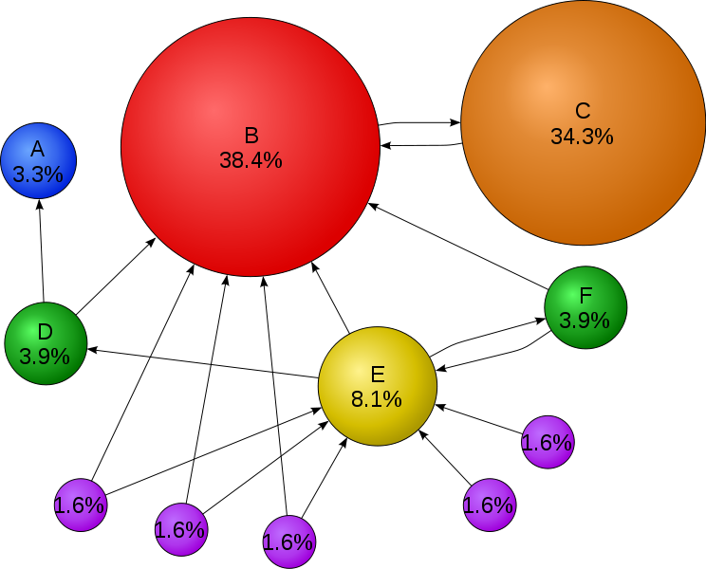
Structured vs Unstructured Data
Increasing amount of data in a semi-structured format
XML – Self-describing tags (HTML ?)
Complicates a lot of things
We will discuss this toward the end
A huge amount of data is unfortunately unstructured
Books, WWW
Amenable to pretty much only text search… so far
Information Retreival research deals with this topic
What about Google search ?
Google search is mainly successful because it uses the structure (in its original incarnation)
Video ? Music ?
Can represent in DBMS’s, but can’t really operate on them
circle size == page importance == pagerank
more incoming links → higher pagerank
incoming links from important pages → higher pagerank

Slide 32
Database Management Systems
Massively successful for highly structured data
Why ? Structure in the data (if any) can be exploited for ease of use and efficiency
How ?
Two Key Concepts:
Data Modeling: Allows reasoning about the data at a high level
e.g. “emails” have “sender”, “receiver”, “…”
Once we can describe the data, we can start “querying” it
Data Abstraction/Independence:
Layer the system so that the users/applications are insulated from the low-level details

Slide 33
Data Modeling
Data modeling
Data model: A collection of concepts that describes how data is represented and accessed
Schema: A description of a specific collection of data, using a given data model
Some examples of data models that we will see
Relational, Entity-relationship model, XML, JSON…
Object-oriented, object-relational, semantic data model, RDF…
Why so many models ?
Tension between descriptive power and ease of use/efficiency
More powerful models → more data can be represented
More powerful models → harder to use, to query, and less efficient

Slide 34
Data Abstraction
Probably the most important purpose of a DBMS
Goal: Hiding low-level details from the users of the system
Alternatively: the principle that
applications and users should be insulated from how data is structured and stored
Also called data independence
Through use of logical abstractions

Slide 35
Data Abstraction
View Level
What data users and application programs see ?
…
View 1
View 2
View n
Logical
Level
What data is stored ?
describe data properties such as
data semantics, data relationships
How data is actually stored ?
e.g. are we using disks ? Which
file system ?
Physical
Level

Slide 36
Data Abstraction
View Level
…
View 1
View 2
View n
Logical Data Independence
Protection from logical changes
to the schema
Logical
Level
Physical Data Independence
Protection from changes to the
physical structure of the data
Physical
Level

Slide 37
Data Abstractions: Example
A View Schema
course_info(#registered,…)
View Level
…
View 1
View 2
View n
Logical Schema
students(sid, name, major, …)
courses(cid, name, …)
enrolled(sid, cid, …)
Logical
Level
Physical Schema
all students in one file ordered by sid
courses split into multiple files by colleges
Physical
Level

Slide 38
CMSC424: Database Design Module: Introduction/Overview
DBMS Architectures; Industry Outlook
Instructor: Amol Deshpande
amol@umd.edu

Slide 39
Motivation
Book Chapters (6th Edition)
1.4, 1.9 (to some extent)
Key Topics
Data Definition and Data Manipulation Languages
Typical Database Architecture
Current Industry Outlook

Slide 40
Database System
A DBMS is a software system designed to store, manage, facilitate access to databases
Typically uses a specific data model, and
Supports some level of physical and logical data independence
Provides:
Data Definition Language (DDL)
For defining and modifying the schemas
Data Manipulation Language (DML)
For retrieving, modifying, analyzing the data itself
Guarantees about correctness in presence of failures and concurrency, data semantics etc.
Common use patterns
Handling transactions (e.g. ATM Transactions, flight reservations)
Archival (storing historical data)
Analytics (e.g. identifying trends, Data Mining)

Slide 41
Example: Relational DBMS and SQL
SQL (sequel): Structured Query Language
Data definition (DDL)
create table instructor ( ID char(5), name varchar(20), dept_name varchar(20), salary numeric(8,2))
Data manipulation (DML)
Example: Find the name of the instructor with ID 22222 select name from instructor where instructor.ID = ‘22222’

Slide 42
Database Architecture: Pre-2000’s
All data was typically in hard disks or arrays of hard disks
RAM (Memory) was never enough
So always had to worry about what was in memory vs not
Almost no real “distributed” execution
Different from “parallel”, i.e., on co-located clusters of computers
Relatively well-understood use cases
Report generation
Interactive data analysis and exploration
Supporting transactions
From Chapter 20

Slide 43
Traditional RDBMS Architecture
Clients may be anywhere – e.g., ATMs, desktops, laptops, web apps etc.
Talk to the database using standard protocols like JDBC/ODBC, SOAP, or REST (today), or proprietary protocols
Some sort of load balancer or intake mechanism
Typical components in a database system: some for queries, some for transactions
Maybe on a single physical computer or a cluster connected by a fast network
Data Storage Systems:
Punch cards (long time ago)
Hard disks (still prevalent)
SSDs
Need “redundancy” and “fault-tolerance”
Data once stored should always be there
RAID = Redundant Array of Independent Disks

Slide 44
Database Architecture : Today
Much more diversity in the architectures that we see
More modern hardware architectures
Massively parallel computers
SSDs
Massive amounts of RAM – often don’t need to worry about data fitting in memory
Much faster networks, even over a wide area
Virtualization and Containerization
Cloud Computing
As a result: Data and execution typically distributed all over the place
Much more diversity in data processing applications
Much more non-relational data (images, text, video)
Data Analytics/Machine learning more common use-cases
Much more diversity in “data models”
Document data models (JSON, XML), Key-value data model, Graph data model, RDF

Slide 45
Current Industry Outlook
Relational DBMSs
Oracle, IBM DB2, Microsoft SQL Server, Sybase, Amazon RDS/Aurora
Open source alternatives
MySQL, PostgreSQL, BerkeleyDB (mainly a storage engine – no SQL) …
Other Data Models
Neo4j (Graph), MongoDB (Document), CosmosDB (many)
Data Warehousing Solutions
Geared towards very large volumes of data and on analyzing them
Long list: Teradata, Oracle Exadata, Netezza (based on FPGAs), Aster Data (founded 2005), Vertica (column-based), Kickfire, Xtremedata..
Usually sell package/services and charge per TB of managed data
Many (especially recent ones) start with MySQL or PostgreSQL and make them parallel/faster etc..

Slide 46
Web Scale Data Management, Analysis
Ongoing debate/issue
Cloud computing seems to eschew DBMSs in favor of homegrown solutions
E.g. Google, Facebook, Amazon etc…
MapReduce: A paradigm for large-scale data analysis
Hadoop: An open source implementation
Apache Spark: a better open source implementation
Why ?
DBMSs can’t scale to the needs, not fault-tolerant enough
These apps don’t need things like transactions, that complicate DBMSs (???)
Mapreduce favors Unix-style programming, doesn’t require SQL
Try writing SVMs or decision trees in SQL
Cost
Companies like Teradata may charge $100,000 per TB of data managed

Slide 47
Current Industry Outlook
Bigtable-like
Called “key-value stores”
Think highly distributed hash tables
Allow some transactional capabilities – still evolving area
PNUTS (Yahoo), Apache Cassandra (Facebook), Dynamo (Amazon), and many many others
Mapreduce-like
Hadoop (open source), Pig (@Yahoo), Dryad (@Microsoft), Spark
Amazon EC2 Framework
Not really a database – but increasing declarative SQL-like capabilities are being added (e.g. HIVE at Facebook)
Much ongoing research in industry and academia

Slide 48
In This Class…
We have to limit the scope drastically
Focus on:
Single-server Relational Databases
Assume hard disks are still important and memory is limited
Go deep into different ways to execute queries, and find the best queries
Will briefly discuss:
Parallel architectures and query processing there
Map-reduce architectures and considerations there-in
Most of the key concepts valid in modern databases (including NoSQL) and Big Data Frameworks

Slide 49
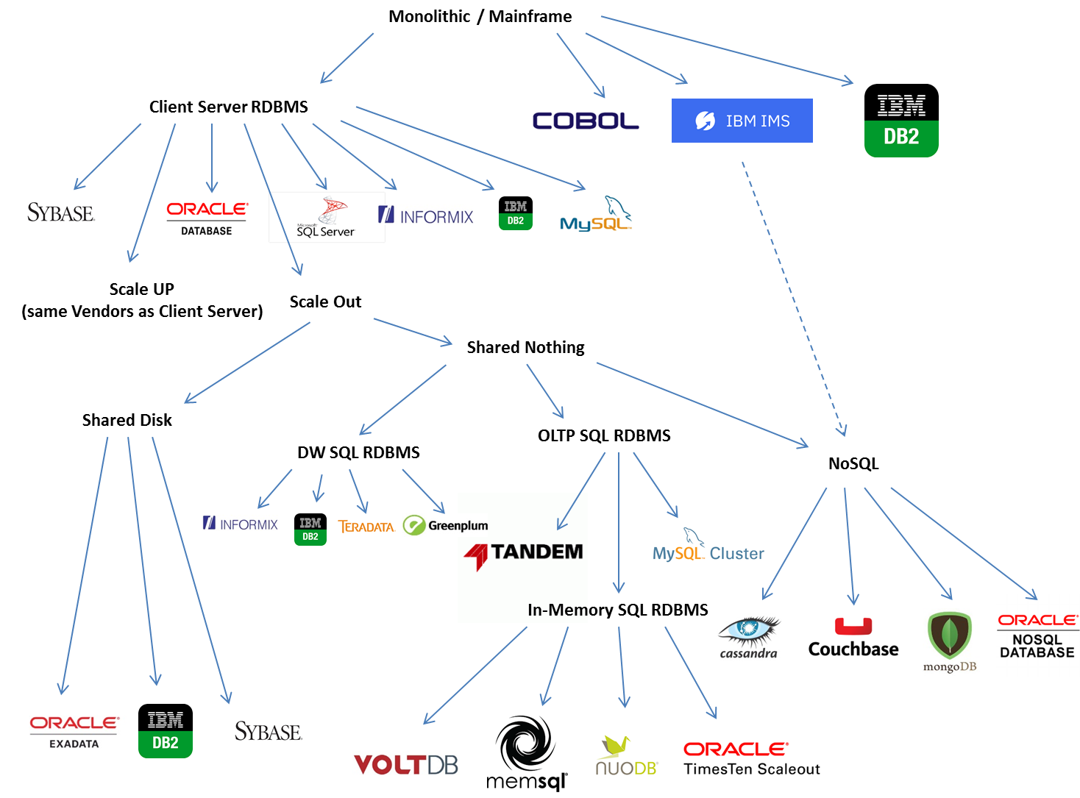
From: https://blogs.oracle.com/timesten/the-evolution-of-db-architectures
(Oracle-focused)

Slide 50
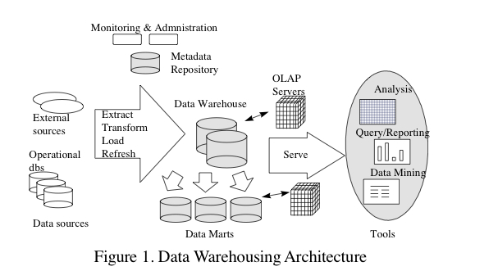
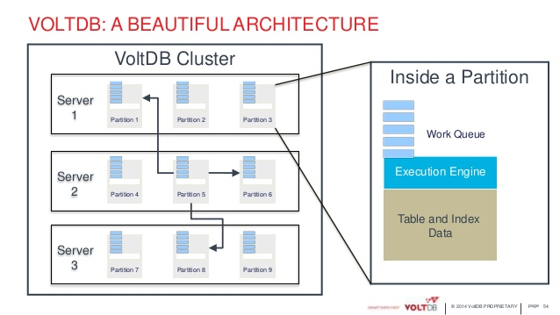
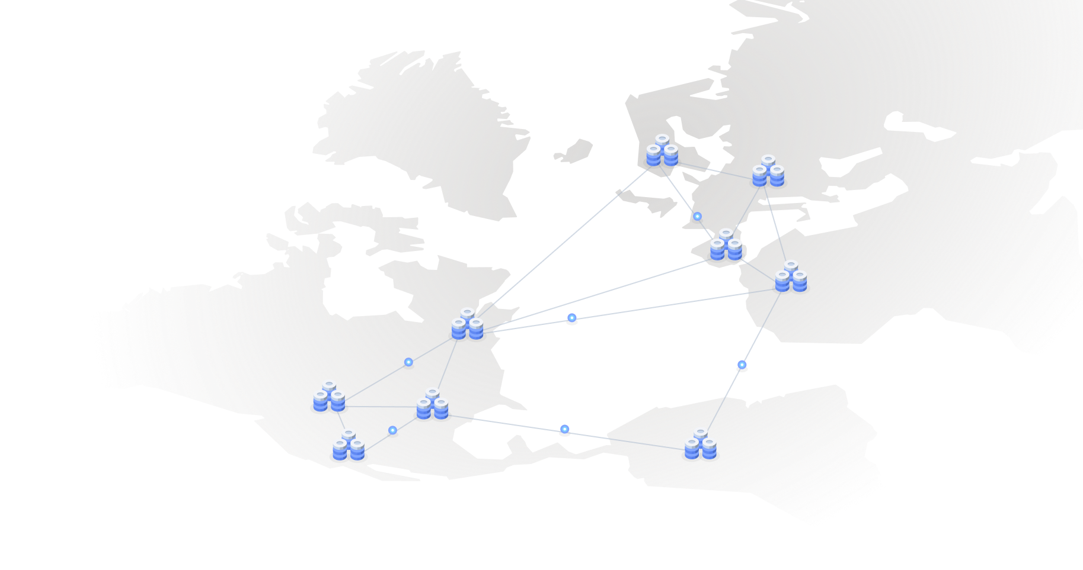
Data Warehouses
For: Large-scale data processing (TBs to PBs)
Parallel architectures (lots of co-located computers)
SQL and Reporting
No transactions
In-memory OLTP (on-line transaction processing)
For: Extremely fast transactions
Many-core or parallel architectures
Very limited SQL – mostly focused on “writes”
Typically assume data fits in memory across servers
Highly available, distributed OLTP
For: Distributed scenarios where clients are all over the world
Focus on “consistency” – how to make sure all users see the same data
Limited SQL – mostly focused on “writes”
Considerations of memory vs disk less important

Slide 51
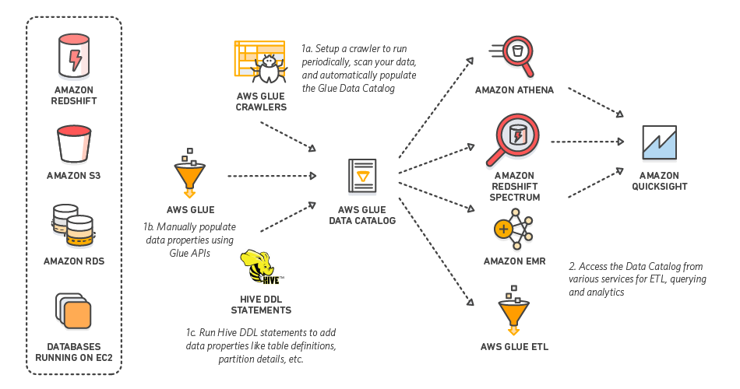
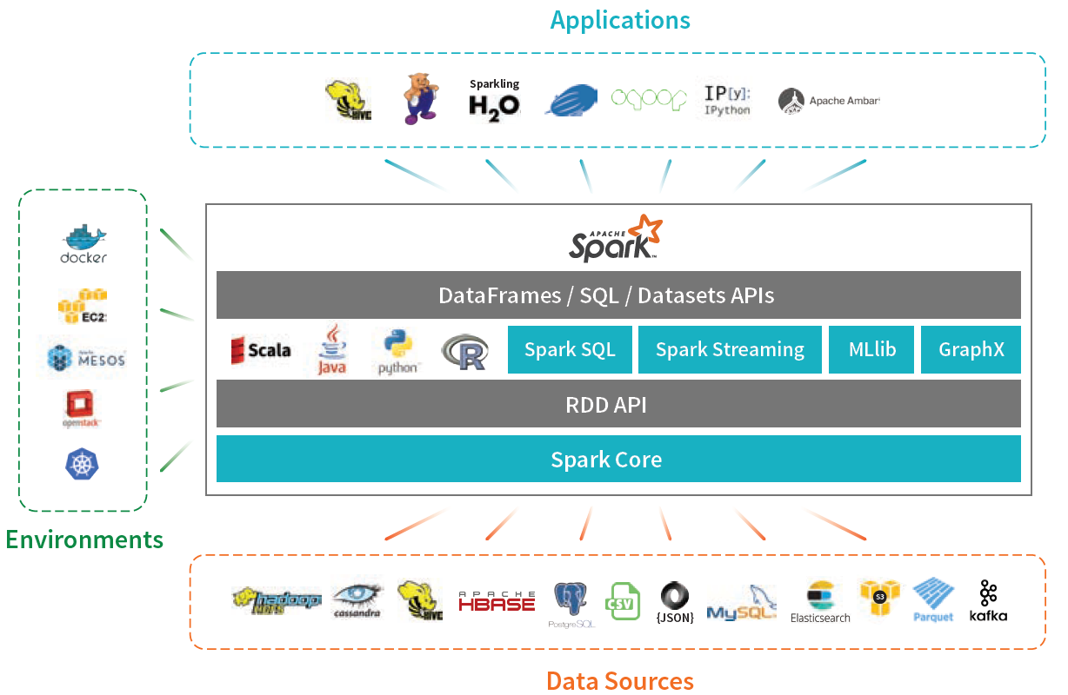
Extract-Transform-Load Systems, or Map-Reduce, or Big Data Frameworks
For: Large-scale, “ad hoc” data analysis
Mix of parallel and distributed architectures
Data usually coming from many different sources
Mix of SQL, Machine Learning, and ad hoc tasks (e.g., do image analysis, followed by SQL)
AWS Glue
Apache Spark

Slide 52
Okay…
Key takeaway: Modern data architectures are a mess
We haven’t talked about NoSQL (MongoDB, etc.), Machine Learning, “Streaming”…
Fundamentals haven’t changed that much though
We are still either:
Going from some “input datasets” to an “output dataset” (queries/analytics)
Modifying data (transactions)
SQL is still very common, albeit often disguised
Spark RDD operations map nicely to SQL joins and aggregates (unified now)
MongoDB lookups, filters, and aggregates map to joins, selects, and aggregates in SQL
But “performance trade-offs” are all over the place now
30 years ago, we worried a lot about hard disks and things fitting in memory
Today, focus more on networks
Focus has shifted to other aspects of data processing pipelines
Analytics/Machine learning, data cleaning, statistics

Slide 53
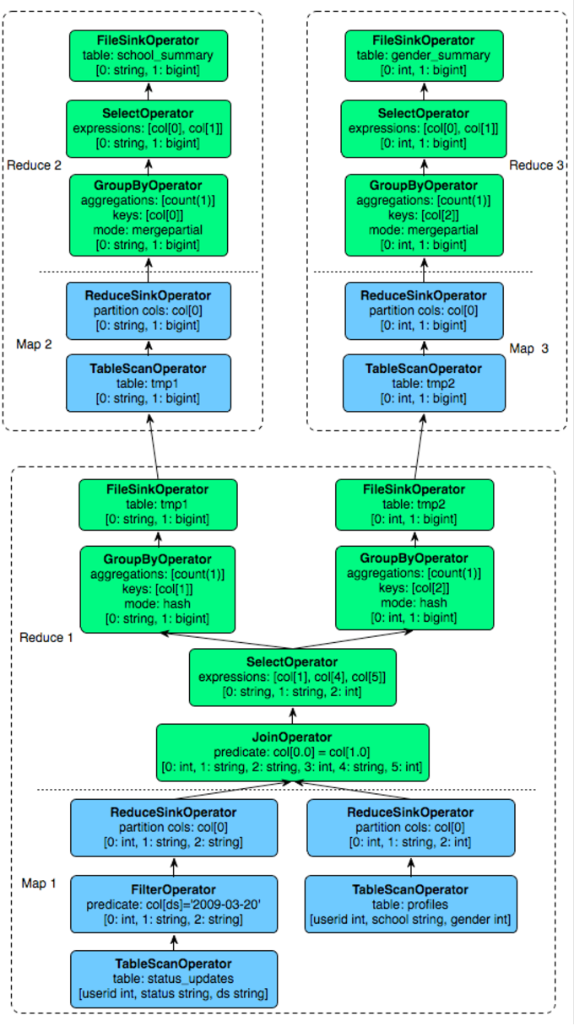
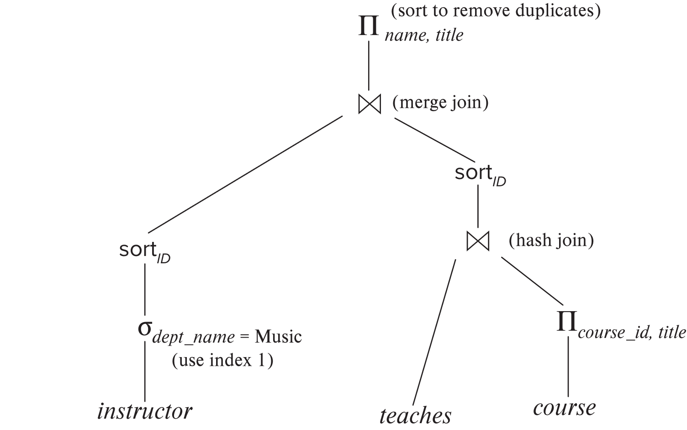
Query Plans vs…
SQL ”Query Plan”
Apache Hive ”Query Plan”
(Hive is an SQL layer on top of Hadoop)

Slide 54
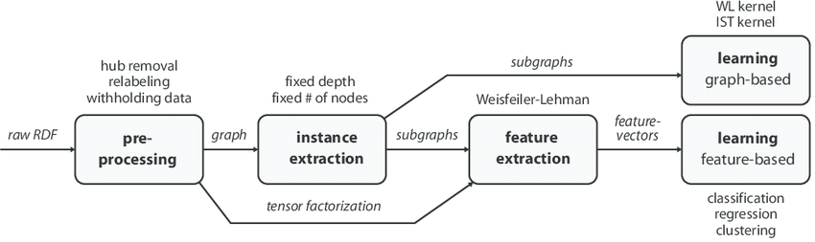
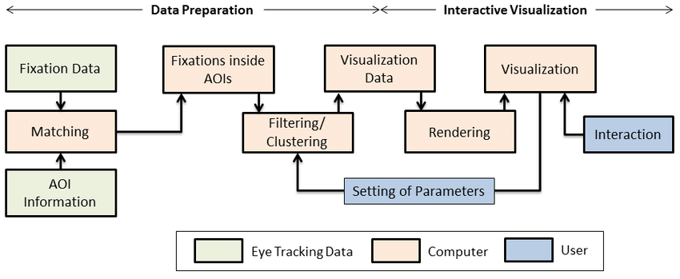
vs … Data Transformation Pipelines
Machine Learning Pipeline
Data Preparation and Visualization Pipeline

Slide 55
Okay…
Many similarities across different ways to process and analyze data
At its simplest:
Maybe Tables in an RDBMS, Files in HDFS, or Images in a key-value store
Maybe Joins, or Aggregates, or Machine Learning Tasks, or Data Cleaning Tasks, or…
Dataset 1
Binary Operation 1
Dataset 2
Dataset 3
Binary Operation 2
Ternary Operation 1
Dataset 4
Dataset 5
Unary Operation 1
Unary Operation 1
Output Dataset 1
Maybe Another RDBMS Table, a New File, or a Machine Learning Model

Slide 56
Okay…
Many similarities across different ways to process and analyze data
Some considerations that we see repeated:
Are there multiple ways to accomplish the goals?
i.e., are there multiple pipelines or SQL Query Plans that will accomplish the same task
How to “enumerate” all of them?
i.e., how to automatically come up with all the different options?
How to decide which is the ”best”?
Ideally based on some consideration of total cost (e.g., total CPU time)
How to ”find” the best plan?
Called “query optimization” in databases
RDBMSs have been doing this for 4-5 decades now
The classic paper on SQL query optimization is from 1979
Outlined the approach still in use today
Same ideas re-discovered repeatedly in other contexts (e.g., Hadoop)

Slide 57
How important is this today?
Trade-offs shifted drastically over last 10-15 years
Especially with fast network, SSDs, and high memories
However, the volume of data is also growing quite rapidly
Some observations:
Cheaper to access another computer’s memory than accessing your own disk
Cache is playing more and more important role
Enough memory around that data often fits in memory of a single machine, or a cluster of machines
“Disk” considerations less important
Still: Disks are where most of the data lives today
Similar reasoning/algorithms required though

