Slide 1
CMSC424: Database Design Module: Relational Model; SQL
Instructor: Amol Deshpande
amol@umd.edu

Slide 2
CMSC424: Database Design Module: Relation Model + SQL
Relational Model
Instructor: Amol Deshpande
amol@cs.umd.edu

Slide 3
Relational Model
Book Chapters (6th Edition)
2.1, 2.2, 2.4
Key Topics
Relational Model Key Concepts
Domains of Table Attributes
Null Values
Schema Diagrams

Slide 4
Relational Data Model
Introduced by Ted Codd (late 60’s – early 70’s)
Before = “Network Data Model” (Cobol as DDL, DML)
Very contentious: Database Wars (Charlie Bachman vs. Ted Codd)
Relational data model contributes:
Separation of logical, physical data models (data independence)
Declarative query languages
Formal semantics
Query optimization (key to commercial success)
1st prototypes:
Ingres → CA
Postgres → Illustra → Informix → IBM
System R → Oracle, DB2

Slide 5
Key Abstraction: Relation
bname | acct_no | balance
Downtown Brighton Brighton | A-101 A-201 A-217 | 500 900 500
Account =
Terms:
Tables (aka: Relations)
Why called Relations?
Closely correspond to mathematical concept of a relation

Slide 6
Relations
bname | acct_no | balance
Downtown Brighton Brighton | A-101 A-201 A-217 | 500 900 500
Account =
Considered equivalent to…
{ (Downtown, A-101, 500),
(Brighton, A-201, 900),
(Brighton, A-217, 500) }
Relational database semantics defined in terms of mathematical relations

Slide 7
Relations
bname | acct_no | balance
Downtown Brighton Brighton | A-101 A-201 A-217 | 500 900 500
Account =
Considered equivalent to…
{ (Downtown, A-101, 500),
(Brighton, A-201, 900),
(Brighton, A-217, 500) }
Terms:
Tables (aka: Relations)
Rows (aka: tuples)
Columns (aka: attributes)
Schema (e.g.: Acct_Schema = (bname, acct_no, balance))

Slide 8
Definitions
Relation Schema (or Schema)
A list of attributes and their domains
E.g. account(account-number, branch-name, balance)
Relation Instance
A particular instantiation of a relation with actual values
Will change with time
Programming language equivalent: A variable (e.g. x)
bname | acct_no | balance
Downtown Brighton Brighton | A-101 A-201 A-217 | 500 900 500
Programming language equivalent: Value of a variable

Slide 9
Definitions
Domains of an attribute/column
The set of permitted values
e.g., bname must be String, balance must be a positive real number
We typically assume domains are atomic, i.e., the values are treated as indivisible (specifically: you can’t store lists or arrays in them)
Null value
A special value used if the value of an attribute for a row is:
unknown (e.g., don’t know address of a customer)
inapplicable (e.g., “spouse name” attribute for a customer)
withheld/hidden
Different interpretations all captured by a single concept – leads to major headaches and problems

Slide 10
Tables in a University Database
classroom(building, room_number, capacity)
department(dept_name, building, budget)
course(course_id, title, dept_name, credits)
instructor(ID, name, dept_name, salary)
section(course_id, sec_id, semester, year, building,
room_number, time_slot_id)
teaches(ID, course_id, sec_id, semester, year)
student(ID, name, dept_name, tot_cred)
takes(Id, course_id, sec_id, semester, year, grade)
advisor(s_ID, i_ID)
time_slot(time_slot_id, day, start_time, end_time)
prereq(course_id, prereq_id)

Slide 11
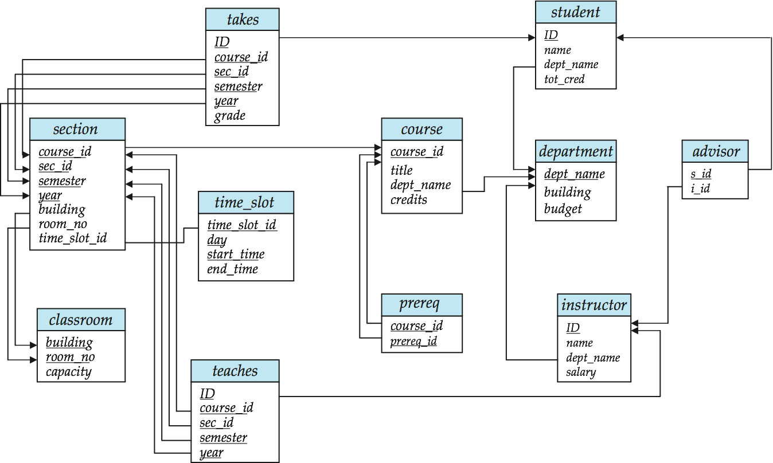
Schema Diagram for University Database

Slide 12
CMSC424: Database Design Module: Relation Model + SQL
Keys
Instructor: Amol Deshpande
amol@cs.umd.edu

Slide 13
Relational Model: Keys
Book Chapters (6th Edition)
2.3
Key Topics
Keys as a mechanism to uniquely identify tuples in a relation
Super key vs Candidate key vs Primary key
Foreign keys and Referential Integrity
How to identify keys of a relation

Slide 14
Keys
Let K ⊆ R
K is a superkey of R if values for K are sufficient to identify a unique tuple of any possible relation r(R)
Example: {ID} and {ID,name} are both superkeys of instructor.
Superkey K is a candidate key if K is minimal (i.e., no subset of it is a superkey)
Example: {ID} is a candidate key for Instructor
One of the candidate keys is selected to be the primary key
Typically one that is small and immutable (doesn’t change often)
Primary key typically highlighted (e.g., underlined)

Slide 15
Tables in a University Database
classroom(building, room_number, capacity)
department(dept_name, building, budget)
course(course_id, title, dept_name, credits)
instructor(ID, name, dept_name, salary)

Slide 16
Tables in a University Database
takes(ID, course_id, sec_id, semester, year, grade)
What about ID, course_id?
No. May repeat:
(“1011049”, “CMSC424”, “101”, “Spring”, 2014, D)
(“1011049”, “CMSC424”, “102”, “Fall”, 2015, null)
What about ID, course_id, sec_id?
May repeat:
(“1011049”, “CMSC424”, “101”, “Spring”, 2014, D)
(“1011049”, “CMSC424”, “101”, “Fall”, 2015, null)
What about ID, course_id, sec_id, semester?
Still no: (“1011049”, “CMSC424”, “101”, “Spring”, 2014, D)
(“1011049”, “CMSC424”, “101”, “Spring”, 2015, null)

Slide 17
Tables in a University Database
classroom(building, room_number, capacity)
department(dept_name, building, budget)
course(course_id, title, dept_name, credits)
instructor(ID, name, dept_name, salary)
section(course_id, sec_id, semester, year, building,
room_number, time_slot_id)
teaches(ID, course_id, sec_id, semester, year)
student(ID, name, dept_name, tot_cred)
takes(ID, course_id, sec_id, semester, year, grade)
advisor(s_ID, i_ID)
time_slot(time_slot_id, day, start_time, end_time)
prereq(course_id, prereq_id)

Slide 18
Keys
Foreign key: Primary key of a relation that appears in another relation
{ID} from student appears in takes, advisor
student called referenced relation
takes is the referencing relation
Typically shown by an arrow from referencing to referenced
Foreign key constraint: the tuple corresponding to that primary key must exist
Imagine:
Tuple: (‘student101’, ‘CMSC424’) in takes
But no tuple corresponding to ‘student101’ in student
Also called referential integrity constraint

Slide 19
Schema Diagram for University Database

Slide 20
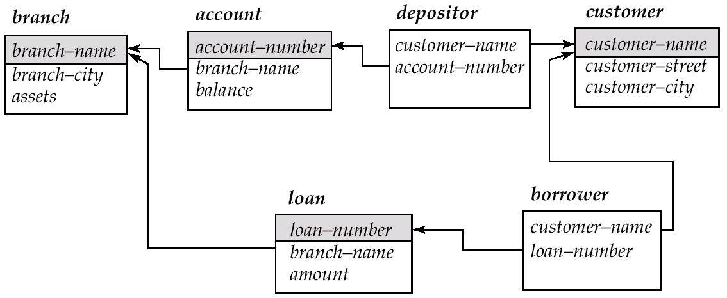
Schema Diagram for the Banking Enterprise

Slide 21
Examples
Married(person1_ssn, person2_ssn, date_married, date_divorced)
Account(cust_ssn, account_number, cust_name, balance, cust_address)
RA(student_id, project_id, superviser_id, appt_time, appt_start_date, appt_end_date)
Person(Name, DOB, Born, Education, Religion, …)
Information typically found on Wikipedia Pages

Slide 22
Examples
Married(person1_ssn, person2_ssn, date_married, date_divorced)
Account(cust_ssn, account_number, cust_name, balance, cust_address)
If a single account per customer, then: cust_ssn
Else: (cust_ssn, account_number)
In the latter case, this is not a good schema because it requires repeating information
RA(student_id, project_id, superviser_id, appt_time, appt_start_date, appt_end_date)
Could be smaller if there are some restrictions – requires some domain knowledge of the data being stored
Person(Name, DOB, Born, Education, Religion, …)
Information typically found on Wikipedia Pages
Unclear what could be a primary key here: you could in theory have two people who match on all of those

Slide 23
CMSC424: Database Design Module: Relation Model + SQL
SQL: Basics and DDL
Instructor: Amol Deshpande
amol@cs.umd.edu

Slide 24
SQL Basics and DDL
Book Chapters (6th Edition)
3.1, 3.2
Key Topics
SQL Overview
How to create relations using SQL
How to insert/delete/update tuples

Slide 25
History
IBM Sequel language developed as part of System R project at the IBM San Jose Research Laboratory
Renamed Structured Query Language (SQL)
ANSI and ISO standard SQL:
SQL-86, SQL-89, SQL-92
SQL:1999, SQL:2003, SQL:2008
Commercial systems offer most, if not all, SQL-92 features, plus varying feature sets from later standards and special proprietary features.
Not all examples here may work on your particular system.
Several alternative syntaxes to write the same queries

Slide 26
Different Types of Constructs
Data definition language (DDL): Defining/modifying schemas
Integrity constraints: Specifying conditions the data must satisfy
View definition: Defining views over data
Authorization: Who can access what
Data-manipulation language (DML): Insert/delete/update tuples, queries
Transaction control:
Embedded SQL: Calling SQL from within programming languages
Creating indexes, Query Optimization control…

Slide 27
Data Definition Language
The SQL data-definition language (DDL) allows the specification of information about relations, including:
The schema for each relation.
The domain of values associated with each attribute.
Integrity constraints
Also: other information such as
The set of indices to be maintained for each relations.
Security and authorization information for each relation.
The physical storage structure of each relation on disk.

Slide 28
SQL Constructs: Data Definition Language
CREATE TABLE <name> ( <field> <domain>, … )
create table department
(dept_name varchar(20),
building varchar(15),
budget numeric(12,2) check (budget > 0),
primary key (dept_name)
);
create table instructor (
ID char(5), name varchar(20) not null, dept_name varchar(20), salary numeric(8,2),
primary key (ID), foreign key (dept_name) references department
)

Slide 29
SQL Constructs: Data Definition Language
CREATE TABLE <name> ( <field> <domain>, … )
create table department
(dept_name varchar(20) primary key,
building varchar(15),
budget numeric(12,2) check (budget > 0)
);
create table instructor (
ID char(5) primary key,
name varchar(20) not null, d_name varchar(20), salary numeric(8,2), foreign key (d_name) references department
)

Slide 30
SQL Constructs: Data Definition Language
drop table student
delete from student
Keeps the empty table around
alter table
alter table student add address varchar(50);
alter table student drop tot_cred;

Slide 31
SQL Constructs: Insert/Delete/Update Tuples
INSERT INTO <name> (<field names>) VALUES (<field values>)
insert into instructor values (‘10211’, ’Smith’, ’Biology’, 66000);
insert into instructor (name, ID) values (‘Smith’, ‘10211’);
-- NULL for other two
insert into instructor (ID) values (‘10211’);
-- FAIL
DELETE FROM <name> WHERE <condition>
delete from department where budget < 80000;
Syntax is fine, but this command may be rejected because of referential integrity constraints.

Slide 32
SQL Constructs: Insert/Delete/Update Tuples
DELETE FROM <name> WHERE <condition>
delete from department where budget < 80000;
We can choose what happens:
Reject the delete, or
Delete the rows in Instructor (may be a cascade), or
Set the appropriate values in Instructor to NULL
Instructor relation

Slide 33
SQL Constructs: Insert/Delete/Update Tuples
DELETE FROM <name> WHERE <condition>
delete from department where budget < 80000;
create table instructor
(ID varchar(5),
name varchar(20) not null,
dept_name varchar(20),
salary numeric(8,2) check (salary > 29000),
primary key (ID),
foreign key (dept_name) references department
on delete set null
);
We can choose what happens:
Reject the delete (nothing), or
Delete the rows in Instructor (on delete cascade), or
Set the appropriate values in Instructor to NULL (on delete set null)

Slide 34
SQL Constructs: Insert/Delete/Update Tuples
DELETE FROM <name> WHERE <condition>
Delete all classrooms with capacity below average
delete from classroom where capacity <
(select avg(capacity) from classroom);
Problem: as we delete tuples, the average capacity changes
Solution used in SQL:
First, compute avg capacity and find all tuples to delete
Next, delete all tuples found above (without recomputing avg or retesting the tuples)
E.g. consider the query: delete the smallest classroom

Slide 35
SQL Constructs: Insert/Delete/Update Tuples
UPDATE <name> SET <field name> = <value> WHERE <condition>
Increase all salaries’s over $100,000 by 6%, all other receive 5%.
Write two update statements:
update instructor set salary = salary ∗ 1.06 where salary > 100000;
update instructor set salary = salary ∗ 1.05 where salary ≤ 10000;
The order is important
Can be done better using the case statement

Slide 36
SQL Constructs: Insert/Delete/Update Tuples
UPDATE <name> SET <field name> = <value> WHERE <condition>
Increase all salaries’s over $100,000 by 6%, all other receive 5%.
Can be done better using the case statement
update instructor set salary =
case
when salary > 100000
then salary ∗ 1.06
when salary <= 100000
then salary ∗ 1.05
end;

Slide 37
CMSC424: Database Design Module: Relation Model + SQL
SQL: Querying Basics
Instructor: Amol Deshpande
amol@cs.umd.edu

Slide 38
SQL Querying Basics
Book Chapters (6th Edition)
3.3
Key Topics
Single-table Queries in SQL
Multi-table Queries using Cartesian Product
Difference between Cartesian Product and “Natural Join”
Careful with using “natural join” keyword

Slide 39
Basic Query Structure
Attributes or expressions
select A₁, A₂, ..., A_{n} from r₁, r₂, ..., r_{m} where P
Relations (or queries returning tables)
Predicates
Find the names of all instructors: select name from instructor

Slide 40
Basic Query Structure
Attributes or expressions
select A₁, A₂, ..., A_{n} from r₁, r₂, ..., r_{m} where P
Relations (or queries returning tables)
Predicates
Find the names of all instructor departments: select dept_name from instructor

Slide 41
Basic Query Structure
Attributes or expressions
select A₁, A₂, ..., A_{n} from r₁, r₂, ..., r_{m} where P
Relations (or queries returning tables)
Predicates
Remove duplicates: select distinct name from instructor
Order the output:
select distinct name from instructor
order by name asc
Find the names of all instructors: select name from instructor
Apply some filters (predicates):
select name from instructor
where salary > 80000 and dept_name = ‘Finance’;

Slide 42
Basic Query Constructs
Select all attributes: select * from instructor
Expressions in the select clause:
select name, salary < 100000 from instructor
Find the names of all instructors: select name from instructor
More complex filters:
select name from instructor
where (dept_name != ‘Finance’ and salary > 75000)
or (dept_name = ‘Finance’ and salary > 85000);
A filter with a subquery:
select name from instructor
where dept_name in (select dept_name from
department where budget < 100000);

Slide 43
Basic Query Constructs
Renaming tables or output column names: select i.name, i.salary * 2 as double_salary from instructor i
where i.salary < 80000 and i.name like ‘%g_’;
Find the names of all instructors: select name from instructor
More complex expressions:
select concat(name, concat(‘, ’, dept_name))
from instructor;
Careful with NULLs:
select name from instructor
where salary < 100000 or salary >= 100000;
Wouldn’t return the instructor with NULL salary (if any)

Slide 44
Multi-table Queries
Cartesian product:
select * from instructor, teaches

Slide 45
Multi-table Queries
Use predicates to only select “matching” pairs: select * from instructor i, teaches t
where i.ID = t.ID;
Cartesian product:
select * from instructor, teaches
Identical (in this case) to using a natural join:
select * from instructor natural join teaches;

Slide 46
Multi-table Queries
Cartesian product:
select * from instructor natural join teaches

Slide 47
Multi-table Queries
Use predicates to only select “matching” pairs: select * from instructor i, teaches t
where i.ID = t.ID;
Cartesian product:
select * from instructor, teaches
Identical (in this case) to using a natural join:
select * from instructor natural join teaches;
Natural join does an equality on common attributes – doesn’t work here:
select *
from instructor natural join advisor;
Instead can use “on” construct (or where clause as above):
select *
from instructor join advisor on (i_id = id);

Slide 48
Multi-table Queries
3-Table Query to get a list of instructor-teaches-course information:
select i.name as instructor_name, c.title as course_name from instructor i, course c, teaches
where i.ID = teaches.ID and c.course_id = teaches.course_id;
Beware of unintended common names (happens often)
You may think the following query has the same result as above – it doesn’t
select name, title from instructor natural join course natural join teaches;
I prefer avoiding “natural joins” for that reason
Note: On the small dataset, the above two have the same answer, but not on the large dataset.
Large dataset has cases where an instructor teaches a course from a different department.

Slide 49
CMSC424: Database Design Module: Relation Model + SQL
SQL: Aggregates
Instructor: Amol Deshpande
amol@cs.umd.edu

Slide 50
SQL Aggregates
Book Chapters (6th Edition)
3.7.1-3.7.3
Key Topics
Basic aggregates
Aggregation with “grouping”
“Having” clause to select among groups

Slide 51
Aggregates
Other common aggregates:
max, min, sum, count, stdev, …
select count (distinct ID) from teaches where semester = ’Spring’ and year = 2010
Find the average salary of instructors in the Computer Science
select avg(salary) from instructor
where dept_name = ‘Comp. Sci’;
Can specify aggregates in any query.
Find max salary over instructors teaching in S’10.
select max(salary) from teaches natural join instructor where semester = ’Spring’ and year = 2010;
Aggregate result can be used as a scalar.
Find instructors with max salary:
select * from instructor where salary = (select max(salary) from instructor);

Slide 52
Aggregates
Aggregate result can be used as a scalar.
Find instructors with max salary:
select * from instructor where salary = (select max(salary) from instructor);
Following doesn’t work:
select * from instructor where salary = max(salary);
select name, max(salary)
from instructor where salary = max(salary);

Slide 53
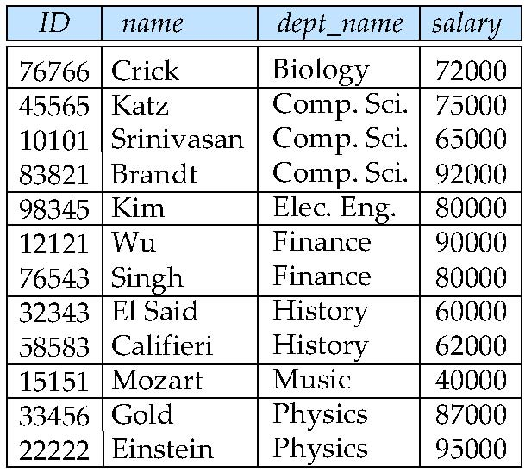
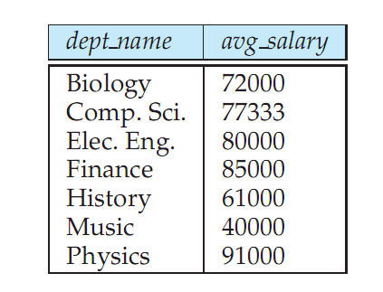
Aggregates: Group By
Split the tuples into groups, and computer the aggregate for each group
select dept_name, avg (salary) from instructor group by dept_name;

Slide 54
Aggregates: Group By
Find the number of instructors in each department who teach a course in the Spring 2010 semester.
Partial Query 1:
select
from instructor natural join teaches
where semester = ‘Spring’ and year = 2010

Slide 55
Aggregates: Group By
Find the number of instructors in each department who teach a course in the Spring 2010 semester.
Partial Query 2:
select dept_name, count(*)
from instructor natural join teaches
where semester = ‘Spring’ and year = 2010
group by dept_name
Doesn’t work – double counts “Katz” who teaches twice in Spring 2010
Final:
select dept_name, count(distinct ID)
from instructor natural join teaches
where semester = ‘Spring’ and year = 2010
group by dept_name

Slide 56
Aggregates: Group By
Attributes in the select clause must be aggregates, or must appear in the group by clause. Following wouldn’t work
select dept_name, ID, avg (salary) from instructor group by dept_name;
“having” can be used to select only some of the groups.
select dept_name, ID, avg (salary) from instructor group by dept_name
having avg(salary) > 42000;

Slide 57
CMSC424: Database Design Module: Relation Model + SQL
SQL: Different Types of Joins, and Set Operations
Instructor: Amol Deshpande
amol@cs.umd.edu

Slide 58
SQL Querying Basics
Book Chapters (6th Edition)
4.1, 3.5
Key Topics
Outer Joins
Anti-joins, Semi-joins
Set Operations

Slide 59
Multi-table Queries
Cartesian product:
select * from R, S
A | B
a | 1
b | 1
c | 2
B | C
1 | x
3 | y
4 | z
R.A | R.B | S.B | S.C
a | 1 | 1 | x
a | 1 | 3 | y
a | 1 | 4 | z
b | 1 | 1 | x
b | 1 | 3 | y
b | 1 | 1 | x
c | 2 | 3 | y
c | 2 | 1 | x
c | 2 | 3 | y
×
=
R
S

Slide 60
Multi-table Queries
Natural Join:
select * from R natural join S
A | B
a | 1
b | 1
c | 2
B | C
1 | x
3 | y
4 | z
R.A | B | S.C
a | 1 | x
b | 1 | x
⋈
=
R
S
Equivalent to:
select R.A, R.B, S.C from R, S
where R.B = S.B
Equivalent to:
select R.A, R.B, S.C from R join S on (R.B = S.B)
Equivalent to:
select R.A, R.B, S.C from R join S on (B)

Slide 61
Outer joins: Why?
Natural Join:
select * from R natural join S
A | B
a | 1
b | 1
c | 2
B | C
1 | x
3 | y
4 | z
R.A | B | S.C
a | 1 | x
b | 1 | x
⋈
=
R
S
Often need the ”non-matching” tuples in the result

Slide 62
“Left” Outerjoin
select * from R natural left outer join S
A | B
a | 1
b | 1
c | 2
B | C
1 | x
3 | y
4 | z
R.A | B | S.C
a | 1 | x
b | 1 | x
c | 2 | NULL
⟕
=
R
S
select * from R left outer join S on (R.B = S.B)

Slide 63
“Right” Outerjoin
select * from R right natural outer join S
A | B
a | 1
b | 1
c | 2
B | C
1 | x
3 | y
4 | z
R.A | B | S.C
a | 1 | x
b | 1 | x
NULL | 3 | y
NULL | 4 | z
⟖
=
R
S
select * from R right outer join S on (R.B = S.B)

Slide 64
“Full” Outerjoin
select * from R natural full outer join S
A | B
a | 1
b | 1
c | 2
B | C
1 | x
3 | y
4 | z
R.A | B | S.C
a | 1 | x
b | 1 | x
c | 2 | NULL
NULL | 3 | y
NULL | 4 | z
⟗
=
R
S
select * from R full outer join S on (R.B = S.B)

Slide 65

Semi-joins
R SEMI-JOIN S = tuples of R that do have a “match” in S
Not an SQL keyword, but useful concept to understand – often implemented in database systems as an operator
A | B
a | 1
b | 1
c | 2
B | C
1 | x
3 | y
4 | z
R.A | R.B
a | 1
b | 1
=
Can be written in SQL as:
select *
from R
where B in (select B from S);

Slide 66
Semi-joins
R SEMI-JOIN S = tuples of R that do have a “match” in S
Not an SQL keyword, but useful concept to understand – often implemented in database systems as an operator
A | B
a | 1
b | 1
c | 2
B | C
1 | x
3 | y
4 | z
R.A | R.B
a | 1
b | 1
=
A | B
a | 1
b | 1
c | 2
B | C
1 | x
3 | y
4 | z
S.B | S.C
1 | x
=

Slide 67
Anti-joins
R ANTI-JOIN S = tuples of R that do NOT have a “match” in S
Not an SQL keyword, but useful concept to understand – often implemented in database systems as an operator
A | B
a | 1
b | 1
c | 2
B | C
1 | x
3 | y
4 | z
R.A | R.B
c | 2
=
▷
Can be written in SQL as:
select *
from R
where B not in (select B from S);

Slide 68
Anti-joins
R ANTI-JOIN S = tuples of R that do NOT have a “match” in S
Not an SQL keyword, but useful concept to understand – often implemented in database systems as an operator
A | B
a | 1
b | 1
c | 2
B | C
1 | x
3 | y
4 | z
R.A | R.B
c | 2
=
▷
A | B
a | 1
b | 1
c | 2
B | C
1 | x
3 | y
4 | z
S.B | S.C
3 | y
4 | z
▷
=

Slide 69
Set operations
Find courses that ran in Fall 2009 or Spring 2010
(select course_id from section where semester = ‘Fall’ and year = 2009) union (select course_id from section where semester = ‘Spring’ and year = 2010);
In both:
(select course_id from section where semester = ‘Fall’ and year = 2009) intersect (select course_id from section where semester = ‘Spring’ and year = 2010);
In Fall 2009, but not in Spring 2010:
(select course_id from section where semester = ‘Fall’ and year = 2009) except (select course_id from section where semester = ‘Spring’ and year = 2010);

Slide 70
Set operations: Duplicates
Union/Intersection/Except eliminate duplicates in the answer (the other SQL commands don’t) (e.g., try ‘select dept_name from instructor’).
Can use “union all” to retain duplicates.
NOTE: The duplicates are retained in a systematic fashion (for all SQL operations)
Suppose a tuple occurs m times in r and n times in s, then, it occurs:
m + n times in r union all s
min(m,n) times in r intersect all s
max(0, m – n) times in r except all s

Slide 71
CMSC424: Database Design Module: Relation Model + SQL
SQL: Nested Subqueries
Instructor: Amol Deshpande
amol@cs.umd.edu

Slide 72
SQL Nested Subqueries
Book Chapters (6th Edition)
3.8
Key Topics
Subqueries
Boolean operations with Subqueries

Slide 73
Nested Subqueries
A query within a query – can be used in select/from/where and other clauses

Slide 74
Nested Subqueries
A query within a query – can be used in select/from/where and other clauses
Uncorrelated subquery – the subquery makes no reference to the enclosing queries, and can be evaluated by itself
* Correlated subquery – the subquery has a reference to the enclosing query
* For every tuple of department, the subquery returns a different result

Slide 75
Set Membership: ”IN” and “NOT IN”
Can also be written using Set Intersection
(select course_id from section where semester = ‘Fall’ and year = 2009) intersect (select course_id from section where semester = ‘Spring’ and year = 2010);

Slide 76
Set Membership: ”IN” and “NOT IN”
Can do this with “tuples” as well:

Slide 77
Set Comparisons

Slide 78
Testing for Empty Results
Also: “Not Exists”

Slide 79
Uniqueness
There are usually alternatives to using these constructs (e.g., group by + having instead of “unique”), but these can often make queries more readable and more compact

Slide 80
“With” Clause
Used for creating “temporary” tables within the context of the query

Slide 81
Scalar Subqueries
A scalar subquery is one that returns exactly one tuple with exactly one attribute (so typically some sort of aggregate) – can be used in “select”, “where”, and “having” clauses

Slide 82
CMSC424: Database Design Module: Relation Model + SQL
SQL: NULLs
Instructor: Amol Deshpande
amol@cs.umd.edu

Slide 83
SQL: NULLs
Book Chapters (6th Edition)
3.6, 3.7.4
Key Topics
Operating with NULLs
”Unknown” as a new Boolean value
Operating with UNKNOWNs
Aggregates and NULLs

Slide 84
SQL: Nulls
Can cause headaches for query semantics as well as query processing and optimization)
Can be a value of any attribute
e.g: branch =
bname | bcity | assets
Downtown | Boston | 9M
Perry | Horseneck | 1.7M
Mianus | Horseneck | .4M
Waltham | Boston | NULL
What does this mean?
(unknown) We don’t know Waltham’s assets?
(inapplicable) Waltham has a special kind of account without assets
(withheld) We are not allowed to know

Slide 85
SQL: Nulls
Arithmetic Operations with Null
n + NULL = NULL (similarly for all arithmetic ops: +, -, *, /, mod, …)
e.g: branch =
bname | bcity | assets
Downtown | Boston | 9M
Perry | Horseneck | 1.7M
Mianus | Horseneck | .4M
Waltham | Boston | NULL
=
bname | a2
Downtown | 18M
Perry | 3.4M
Mianus | .8M
Waltham | NULL
SELECT bname, assets * 2 as a2
FROM branch
Counter-intuitive: NULL * 0 = NULL

Slide 86
SQL: Nulls
Boolean Operations with Null
n < NULL = UNKNOWN (similarly for all boolean ops: >, <=, >=, <>, =, …)
e.g: branch =
bname | bcity | assets
Downtown | Boston | 9M
Perry | Horseneck | 1.7M
Mianus | Horseneck | .4M
Waltham | Boston | NULL
assets < 10M will evaluate to UNKNOWN for the last tuple
But what about:
(assets < 10M) or (bcity = ‘Boston’) ?
(assets < 10M) and (bcity = ‘Boston’)?

Slide 87
SQL: Unknown
FALSE OR UNKNOWN = UNKNOWN
TRUE AND UNKNOWN = UNKNOWN
FALSE AND UNKNOWN = FALSE
TRUE OR UNKNOWN = TRUE
UNKNOWN OR UNKNOWN = UNKNOWN
UNKNOWN AND UNKNOWN = UNKNOWN
NOT (UNKNOWN) = UNKNOWN
Intuition: substitute each of TRUE, FALSE for unknown. If different answer results, results is unknown
Values | Expression | Result
x = NULL, y = 10 | (x < 10) and (y = 20) | UNKNOWN and FALSE = FALSE
x = NULL, y = 10 | (x is NULL) and (y = 20) | TRUE and FALSE = FALSE
x = NULL, y = 10 | (x < 10) and (y = 10) | UNKNOWN and TRUE = UNKNOWN
x = NULL, y = 10 | (x < 10) is UNKNOWN | TRUE
x = NULL, y = 10 | ( (x < 10) is UNKNOWN) and (y = 10) | TRUE AND TRUE = TRUE
UNKNOWN tuples are not included in final result

Slide 88
Aggregates and NULLs
Given
branch =
bname | bcity | assets
Downtown | Boston | 9M
Perry | Horseneck | 1.7M
Mianus | Horseneck | .4M
Waltham | Boston | NULL
Aggregate Operations
SELECT SUM (assets) =
FROM branch
SUM
11.1 M
NULL is ignored for SUM
Same for AVG (3.7M), MIN (0.4M), MAX (9M)
Also for COUNT(assets) -- returns 3
But COUNT (*) returns
COUNT
4

Slide 89
Aggregates and NULLs
Given
branch =
bname | bcity | assets
SELECT SUM (assets) =
FROM branch
SUM
NULL
COUNT
0
Same as AVG, MIN, MAX
But COUNT (assets) returns

Slide 90
CMSC424: Database Design Module: Relational Model + SQL
SQL: Views, Authorization
Instructor: Amol Deshpande
amol@umd.edu

Slide 91
SQL Views
Book Chapters (6th Edition)
3.8, 4.6
Key Topics
Defining Views and Use Cases
Difference between a view and a table
Updating a view
Authorization

Slide 92
Views
Provide a mechanism to hide certain data from the view of certain users. To create a view we use the command:
Can be used in any place a normal table can be used
For users, there is no distinction in terms of using it
create view v as <query expression>
where:
<query expression> is any legal expression
The view name is represented by v

Slide 93
Example Queries
A view consisting of courses and sections for Physics in Fall 2009
Find all physics fall 2009 courses in a building.

Slide 94
Views
Is it different from DBMS’s side ?
Yes; a view may or may not be materialized
Pros/Cons ?
Updates into views have to be treated differently
In most cases, disallowed.

Slide 95
Views vs Tables
Creating
Create view V
as (select *
from A, B
where …)
Create table T
as (select *
from A, B
where …)
Can be used
In any select query.
Only some update queries.
It’s a new table.
You can do what you want.
Maintained as
1. Evaluate the query and store it on disk as if a table.
2. Don’t store. Substitute in queries when referenced.
It’s a new table.
Stored on disk.
What if a tuple inserted in A ?
1. If stored on disk, the stored table is automatically updated to be accurate.
2. If we are just substituting, there is no need to do anything.
T is a separate table; there is no reason why DBMS should keep it updated. If you want that, you must define a trigger.

Slide 96
Views vs Tables
Views strictly supercede “create a table and define a trigger to keep it updated”
Two main reasons for using them:
Security/authorization
Can provide a user with ”read” access to only the view
Ease of writing queries
E.g. PresidentStateReturns , or a view listing who won which state
Perhaps the only reason to create a table is to force the DBMS to choose the option of “materializing”
That has efficiency advantages in some cases
Especially if the underlying tables don’t change

Slide 97
Update of a View
Create a view of all instructors while hiding the salary
Add a new tuple to the view
insert into faculty values (’30765’, ’Green’, ’Music’);
Options:
Reject because we don’t “salary” information, or
Insert into “instructors”: (’30765’, ’Green’, ’Music’, NULL);
Updates on more complex views are difficult or impossible to translate, and hence are disallowed.
Many SQL implementations allow updates only on simple views (without aggregates) defined on a single relation

Slide 98
Authorization/Security
GRANT and REVOKE keywords
grant select on instructor to U₁, U₂, U₃
revoke select on branch from U₁, U₂, U₃
Can provide select, insert, update, delete privileges
Can provide this for tables, schemas, “functions/procedures”, etc.
Some databases support doing this at the level of individual “tuples”
MS SQL Server: https://docs.microsoft.com/en-us/sql/relational-databases/security/row-level-security?view=sql-server-ver15
PostgreSQL: https://www.postgresql.org/docs/10/ddl-rowsecurity.html
Can also create “Roles” and do security at the level of roles
Notes:
⁹⁸

Slide 99
CMSC424: Database Design Module: Relation Model + SQL
SQL: Integrity Constraints
Instructor: Amol Deshpande
amol@umd.edu

Slide 100
SQL Integrity Constraints
Book Chapters (6th Edition)
4.4
Key Topics
Why Constraints
Different Types of Integrity Constraints
Referential Integrity
How to specify in SQL

Slide 101
IC’s
Goal: Avoid Semantic Inconsistencies in the Data
An IC is a predicate on the database
Must always be true (checked whenever DB gets updated)
There are the following 4 types of IC’s:
Key constraints (1 table)
e.g., 2 accts can’t share the same acct_no
Attribute constraints (1 table)
e.g., accts must have nonnegative balance
Referential Integrity constraints ( 2 tables)
E.g. bnames associated w/ loans must be names of real branches
Global Constraints (n tables)
E.g., all loans must be carried by at least 1 customer with a savings acct

Slide 102
Key Constraints
Idea: specifies that a relation is a set, not a bag
SQL examples:
1. Primary Key:
CREATE TABLE branch(
bname CHAR(15) PRIMARY KEY,
bcity CHAR(20),
assets INT);
or
CREATE TABLE depositor(
cname CHAR(15),
acct_no CHAR(5),
PRIMARY KEY(cname, acct_no));
2. Candidate Keys:
CREATE TABLE customer (
ssn CHAR(9) PRIMARY KEY,
cname CHAR(15),
address CHAR(30),
city CHAR(10),
UNIQUE (cname, address, city));

Slide 103
Key Constraints
Effect of SQL Key declarations
PRIMARY (A1, A2, .., An) or
UNIQUE (A1, A2, ..., An)
Insertions: check if any tuple has same values for A1, A2, .., An as any
inserted tuple. If found, reject insertion
Updates to any of A1, A2, ..., An: treat as insertion of entire tuple
Primary vs Unique (candidate)
1 primary key per table, several unique keys allowed.
Only primary key can be referenced by “foreign key” (ref integrity)
DBMS may treat primary key differently
(e.g.: create an index on PK)

Slide 104
Attribute Constraints
Idea:
Attach constraints to values of attributes
Enhances types system (e.g.: >= 0 rather than integer)
In SQL:
1. NOT NULL
e.g.: CREATE TABLE branch(
bname CHAR(15) NOT NULL,
....
)
Note: declaring bname as primary key also prevents null values
2. CHECK
e.g.: CREATE TABLE depositor(
....
balance int NOT NULL,
CHECK( balance >= 0),
....
)
affect insertions, update in affected columns

Slide 105
Attribute Constraints
Domains: can associate constraints with DOMAINS rather than attributes
e.g: instead of: CREATE TABLE depositor(
....
balance INT NOT NULL,
CHECK (balance >= 0)
)
One can write:
CREATE DOMAIN bank-balance INT (
CONSTRAINT not-overdrawn CHECK (value >= 0),
CONSTRAINT not-null-value CHECK( value NOT NULL));
CREATE TABLE depositor (
.....
balance bank-balance,
)
Advantages?

Slide 106
Attribute Constraints
Advantage of associating constraints with domains:
1. can avoid repeating specification of same constraint
for multiple columns
2. can name constraints
e.g.: CREATE DOMAIN bank-balance INT (
CONSTRAINT not-overdrawn
CHECK (value >= 0),
CONSTRAINT not-null-value
CHECK( value NOT NULL));
allows one to:
1. add or remove:
ALTER DOMAIN bank-balance
ADD CONSTRAINT capped
CHECK( value <= 10000)
2. report better errors (know which constraint violated)

Slide 107
Referential Integrity Constraints
Idea: prevent “dangling tuples” (e.g.: a loan with a bname, Kenmore, when no Kenmore tuple in branch)
Referencing
Relation
(e.g. loan)
Referenced
Relation
(e.g. branch)
“foreign key”
bname
primary key
bname
Ref Integrity:
ensure that:
foreign key value → primary key value
(note: don’t need to ensure ←, i.e., not all branches have to have loans)

Slide 108
Referential Integrity Constraints
bname
bname
Referencing
Relation
(e.g. loan)
x
Referenced
Relation
(e.g. branch)
x
x
In SQL:
CREATE TABLE branch(
bname CHAR(15) PRIMARY KEY
....)
CREATE TABLE loan (
.........
FOREIGN KEY bname REFERENCES branch);
Affects:
1) Insertions, updates of referencing relation
2) Deletions, updates of referenced relation

Slide 109
Referential Integrity Constraints
c
c
t_{i}
x
t_{j}
x
x
what happens when
we try to delete
this tuple?
A
B
Ans: 3 possibilities
1) reject deletion/ update
2) set t_{i} [c], t_{j}[c] = NULL
3) propagate deletion/update
DELETE: delete ti, tj
UPDATE: set ti[c], tj[c] to updated values

Slide 110
Referential Integrity Constraints
c
c
t_{i}
x
t_{j}
x
x
what happens when
we try to delete
this tuple?
A
B
CREATE TABLE A ( .....
FOREIGN KEY c REFERENCES B action
.......... )
Action: 1) left blank (deletion/update rejected)
2) ON DELETE SET NULL/ ON UPDATE SET NULL
sets ti[c] = NULL, tj[c] = NULL
3) ON DELETE CASCADE
deletes ti, tj
ON UPDATE CASCADE
sets ti[c], tj[c] to new key values
Notes:
Use board to give the interesting example.
Also talk about transactions, and delayed constraint checking.
How about we set the manager to the manager of that guy ? Well that requires triggers.

Slide 111
Global Constraints
Idea: two kinds
1) single relation (constraints spans multiple columns)
E.g.: CHECK (total = svngs + check) declared in the CREATE TABLE
2) multiple relations: CREATE ASSERTION
SQL examples:
1) single relation: All Bkln branches must have assets > 5M
CREATE TABLE branch (
..........
bcity CHAR(15),
assets INT,
CHECK (NOT(bcity = ‘Bkln’) OR assets > 5M))
Affects:
insertions into branch
updates of bcity or assets in branch

Slide 112
Global Constraints
SQL example:
2) Multiple relations: every loan has a borrower with a savings account
CHECK (NOT EXISTS (
SELECT *
FROM loan AS L
WHERE NOT EXISTS(
SELECT *
FROM borrower B, depositor D, account A
WHERE B.cname = D.cname AND
D.acct_no = A.acct_no AND
L.lno = B.lno)))
Problem: Where to put this constraint? At depositor? Loan? ....
Ans: None of the above:
CREATE ASSERTION loan-constraint
CHECK( ..... )
Checked with EVERY DB update!
very expensive.....

Slide 113
Summary: Integrity Constraints
Constraint Type | Where declared | Affects... | Expense
Key Constraints | CREATE TABLE (PRIMARY KEY, UNIQUE) | Insertions, Updates | Moderate
Attribute Constraints | CREATE TABLE CREATE DOMAIN (Not NULL, CHECK) | Insertions, Updates | Cheap
Referential Integrity | Table Tag (FOREIGN KEY .... REFERENCES ....) | 1.Insertions into referencing rel’n 2. Updates of referencing rel’n of relevant attrs 3. Deletions from referenced rel’n 4. Update of referenced rel’n | 1,2: like key constraints. Another reason to index/sort on the primary keys 3,4: depends on a. update/delete policy chosen b. existence of indexes on foreign key
Global Constraints | Table Tag (CHECK) or outside table (CREATE ASSERTION) | 1. For single rel’n constraint, with insertion, deletion of relevant attrs 2. For assesrtions w/ every db modification | 1. cheap 2. very expensive

Slide 114
CMSC424: Database Design Module: Relation Model + SQL
Relational Algebra
Instructor: Amol Deshpande
amol@umd.edu

Slide 115
Relational Operations
Book Chapters (6th Edition)
2.5, 2.6, 6.1.1-6.1.3 (expanded treatment of 2.5, 2.6)
Key Topics
Relational query languages and what purpose they serve
Basic unary and binary relational operations
Mapping between relational operations and SQL

Slide 116
Relational Query Languages
Example schema: R(A, B)
Practical languages
SQL
select A from R where B = 5;
Datalog (sort of practical)
q(A) :- R(A, 5)
Formal languages
Relational algebra
π_{A} ( σ_{B=5} (R) )
Tuple relational calculus
{ t : {A} | ∃ s : {A, B} ( R(A, B) ∧ s.B = 5) }
Domain relational calculus
Similar to tuple relational calculus

Slide 117
Relational Operations
Some of the languages are “procedural” and provide a set of operations
Each operation takes one or two relations as input, and produces a single relation as output
Examples: SQL, and Relational Algebra
The “non-procedural” (also called “declarative”) languages specify the output, but don’t specify the operations
Relational calculus
Datalog (used as an intermediate layer in quite a few systems today)

Slide 118
Relational Algebra
Procedural language
Six basic operators
select
project
union
set difference
Cartesian product
rename
The operators take one or more relations as inputs and give a new relation as a result.

Slide 119
Select Operation
^{Relation r}
^{A}
^{B}
^{C}
^{D}
^{σ}_{A=B ∧ D > 5} ^{(r)}
^{A}
^{B}
^{C}
^{D}
⍺
⍺
^{β}
^{β}
⍺
^{β}
^{β}
^{β}
¹
⁵
¹²
²³
⁷
⁷
³
¹⁰
⍺
^{β}
⍺
^{β}
¹
²³
⁷
¹⁰
SQL Equivalent:
select distinct *
from r
where A = B and D > 5
Unfortunate naming confusion

Slide 120
Project
^{Relation r}
^{A}
^{B}
^{C}
^{D}
^{π}_{A,D} ^{(r)}
^{A}
^{D}
^{A}
^{D}
⍺
⍺
^{β}
^{β}
⍺
^{β}
^{β}
^{β}
¹
⁵
¹²
²³
⁷
⁷
³
¹⁰
⍺
⍺
^{β}
^{β}
⁷
⁷
³
¹⁰
⍺
^{β}
^{β}
⁷
³
¹⁰
SQL Equivalent:
select distinct A, D
from r

Slide 121
Set Union, Difference
^{Relation r, s}
A
B
A
B
r ⋃ s:
A
B
r – s:
A
B
⍺
⍺
β
1
2
1
⍺
β
2
3
⍺
⍺
β
β
1
2
1
3
⍺
β
1
1
s
r
Must be compatible schemas
What about intersection ?
Can be derived
r ∩ s = r – ( r – s);
SQL Equivalent:
select * from r
union/except/intersect
select * from s;
This is one case where duplicates are removed.

Slide 122
Cartesian Product
^{Relation r, s}
A
B
C
D
E
r × s:
A
B
C
D
E
⍺
β
1
2
⍺
β
β
γ
10
10
20
10
a
a
b
b
⍺
⍺
⍺
⍺
β
β
β
β
1
1
1
1
2
2
2
2
⍺
β
β
γ
⍺
β
β
γ
10
10
20
10
10
10
20
10
a
a
b
b
a
a
b
b
r
s
SQL Equivalent:
select distinct *
from r, s
Does not remove duplicates.

Slide 123
Rename Operation
Allows us to name, and therefore to refer to, the results of relational-algebra expressions.
Allows us to refer to a relation by more than one name.
Example:
ρ _{x} (E)
returns the expression E under the name X
If a relational-algebra expression E has arity n, then
ρ_{x} _{(A1, A2, …, An)} (E)
returns the result of expression E under the name X,
and with the attributes renamed to A1, A2, …., An.

Slide 124
Relational Algebra
Those are the basic operations
What about SQL Joins ?
Compose multiple operators together
σ_{A=C}(r x s)
Additional Operations
Set intersection
Natural join
Division
Assignment

Slide 125
Additional Operators
Set intersection (∩ )
r ∩ s = r – ( r – s);
SQL Equivalent: intersect
Assignment (←)
A convenient way to right complex RA expressions
Essentially for creating “temporary” relations
temp1 ← ∏_{R-S} (r)
SQL Equivalent: “create table as…”

Slide 126
Additional Operators: Joins
Natural join (⋈)
A Cartesian product with equality condition on common attributes
Example:
if r has schema R(A, B, C, D), and if s has schema S(E, B, D)
Common attributes: B and D
Then:
r ⋈ s = ∏_{r.A, r.B, r.C, r.D, s.E} (σ_{r.B = s.B ∧ r.D = s.D} (r x s)
SQL Equivalent:
select r.A, r.B, r.C, r.D, s.E from r, s where r.B = s.B and r.D = s.D, OR
select * from r natural join s

Slide 127
Additional Operators: Joins
Equi-join
A join that only has equality conditions
Theta-join (⋈_{θ} )
r ⋈_{θ} s = σ_{θ}(r x s)
Left outer join (⟕)
Say r(A, B), s(B, C)
We need to somehow find the tuples in r that have no match in s
Consider: (r – π_{r.A, r.B}(r ⋈ s))
We are done:
(r ⋈ s) ⋃ ρ_{temp} _{(A, B, C)} ( (r – π_{r.A, r.B}(r ⋈ s)) × {(NULL)} )

Slide 128
Additional Operators: Join Variations
Tables: r(A, B), s(B, C)
name | Symbol | SQL Equivalent | RA expression
cross product | × | select * from r, s; | r × s
natural join | ⋈ | natural join | π_{r.A, r.B, s.C}σ_{r.B = s.B}(r x s)
theta join | ⋈_{θ} | from .. where θ; | σ_{θ}(r x s)
equi-join | ⋈_{θ} (theta must be equality)
left outer join | r ⟕ s | left outer join (with “on”) | (see previous slide)
full outer join | r ⟗ s | full outer join (with “on”) | -
(left) semijoin | r ⋉ s | none | π_{r.A, r.B}(r ⋈ s)
(left) antijoin | r ⊲ s | none | r - π_{r.A, r.B}(r ⋈ s)

Slide 129
Example Query
Find the largest salary in the university
Step 1: find instructor salaries that are less than some other instructor salary (i.e. not maximum)
using a copy of instructor under a new name d
∏_{instructor.salary} (σ _{instructor.salary < d,salary} (instructor x ρ_{d} (instructor)))
Step 2: Find the largest salary
∏_{salary} (instructor) – ∏_{instructor.salary} (σ _{instructor.salary < d,salary} (instructor x ρ_{d} (instructor)))

Slide 130
Example Queries
Find the names of all instructors in the Physics department, along with the course_id of all courses they have taught
Query 1 ∏_{instructor.ID,course_id} (σ_{dept_name=“Physics”} ( σ _{instructor.ID=teaches.ID} (instructor x teaches)))
Query 2 ∏_{instructor.ID,course_id} (σ_{instructor.ID=teaches.ID} ( σ _{dept_name=“Physics”} (instructor) x teaches))

Slide 131
CMSC424: Database Design Module: Relation Model + SQL
SQL “Multi-Set/Bag” Semantics
Instructor: Amol Deshpande
amol@umd.edu

Slide 132
Relational Operations
Book Chapters (6th Edition)
Multiset Relational Algebra Paragraph (Section 6.1, page 238)
Key Topics
SQL ”Bag”/”Multiset” Semantics
Operations on multisets

Slide 133
Duplicates
By definition, relations are sets
So → No duplicates allowed
Problem:
Not practical to remove duplicates after every operation
Why ?
So…
SQL by default does not remove duplicates
SQL follows bag semantics, not set semantics
Implicitly we keep count of number of copies of each tuple

Slide 134
Formal Semantics of SQL
RA can only express SELECT DISTINCT queries
To express SQL, must extend RA to a bag algebra
Bags (aka: multisets) like sets, but can have duplicates
e.g: {5, 3, 3}
e.g: homes =
cname | ccity
Johnson Smith Johnson Smith | Brighton Perry Brighton R.H.
Next: will define RA*: a bag version of RA

Slide 135
Formal Semantics of SQL: RA*
1. σ*_{p} (r): preserves copies in r
e.g: σ*_{city = Brighton} (homes) =
cname | ccity
Johnson Johnson | Brighton Brighton
π*_{A1, …, An} (r): no duplicate elimination
e.g: π *_{cname} (homes) =
cname
Johnson Smith Johnson Smith

Slide 136
Formal Semantics of SQL: RA*
3. r ∪* s : additive union
A | B
1 1 2 2 3 1 | α α β β α α
A | B
1 1 2 | α α β
A | B
2 3 1 | β α α
∪*
=
r
s
r -* s: bag difference
e.g: r -* s = s -* r =
A | B
3 | α
A | B
1 | α

Slide 137
Formal Semantics of SQL: RA*
5. r ×* s: cartesian product
A | B
1 1 2 | α α β
A | B | C
1 1 1 1 2 2 | α α α α β β | + - + - + -
C
+ -
×*
=

Slide 138
Formal Semantics of SQL
Query:
SELECT a₁, ….., a_{n}
FROM r₁, ….., r_{m}
WHERE p
Semantics:
π*_{A1, …, An} (σ*_{p} (r₁ × * … × * r_{m}) ) (1)
Query:
SELECT DISTINCT a₁, ….., a_{n}
FROM r₁, ….., r_{m}
WHERE p
Semantics:
What is the only operator to change in (1)?
π _{A1, …, An} (σ*_{p} (r₁ × * … × * r_{m}) ) (2)

Slide 139
Set/Bag Operations Revisited
Set Operations
UNION ≡ U
INTERSECT ≡ ∩
EXCEPT ≡ -
Bag Operations
UNION ALL ≡ U*
INTERSECT ALL ≡ ∩*
EXCEPT ALL ≡ -*
Duplicate Counting:
Given m copies of t in r, n copies of t in s, how many copies of t in:
r UNION ALL s?
A: m + n
r INTERSECT ALL s?
A: min (m, n)
r EXCEPT ALL s?
A: max (0, m-n)

Slide 140
CMSC424: Database Design Module: Relation Model + SQL
SQL: Transactions, Functions, Procedures, Recursive Queries, Authorization
Instructor: Amol Deshpande
amol@cs.umd.edu

Slide 141
Transactions
A transaction is a sequence of queries and update statements executed as a single unit
Transactions are started implicitly and terminated by one of
commit work: makes all updates of the transaction permanent in the database
rollback work: undoes all updates performed by the transaction.
Motivating example
Transfer of money from one account to another involves two steps:
deduct from one account and credit to another
If one steps succeeds and the other fails, database is in an inconsistent state
Therefore, either both steps should succeed or neither should
If any step of a transaction fails, all work done by the transaction can be undone by rollback work.
Rollback of incomplete transactions is done automatically, in case of system failures

Slide 142
Transactions (Cont.)
In most database systems, each SQL statement that executes successfully is automatically committed.
Each transaction would then consist of only a single statement
Automatic commit can usually be turned off, allowing multi-statement transactions, but how to do so depends on the database system
Another option in SQL:1999: enclose statements within begin atomic … end

Slide 143
CMSC424: Database Design Module: Advanced SQL
SQLMan: Wielding the Superpower of SQL
Instructor: Amol Deshpande
amol@umd.edu

Slide 144
Fun with SQL
https://blog.jooq.org/2016/04/25/10-sql-tricks-that-you-didnt-think-were-possible/
Long slide-deck linked off of this page
Complex SQL queries showing how to do things like: do Mandelbrot, solve subset sum problem etc.
The MADlib Analytics Library or MAD Skills, the SQL; https://arxiv.org/abs/1208.4165
https://www.red-gate.com/simple-talk/blogs/statistics-sql-simple-linear-regressions/

Slide 145
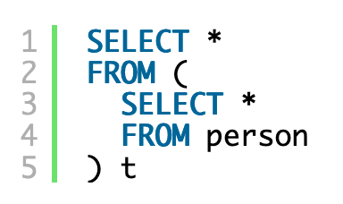
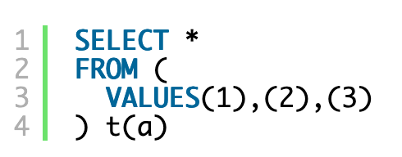
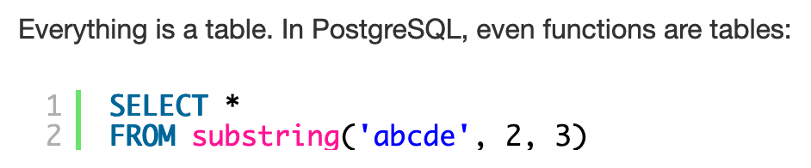
1. Everything is a Table
https://blog.jooq.org/2016/04/25/10-sql-tricks-that-you-didnt-think-were-possible/

Slide 146
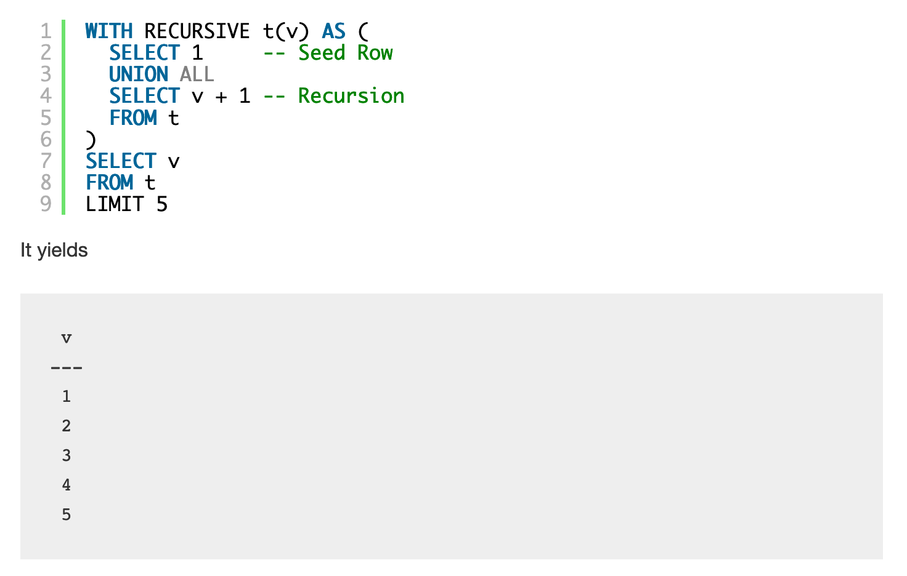
2. Recursion can be very powerful
Makes SQL Turing-Complete
https://blog.jooq.org/2016/04/25/10-sql-tricks-that-you-didnt-think-were-possible/

Slide 147
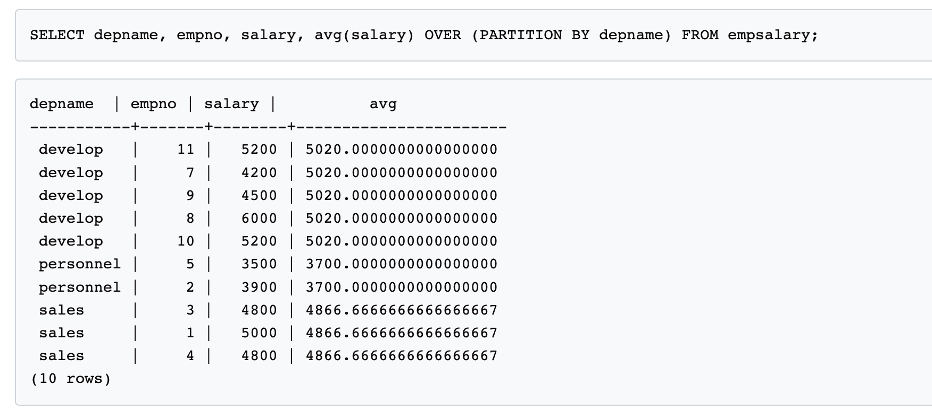
3. Window Functions
https://www.postgresql.org/docs/9.3/tutorial-window.html

Slide 148
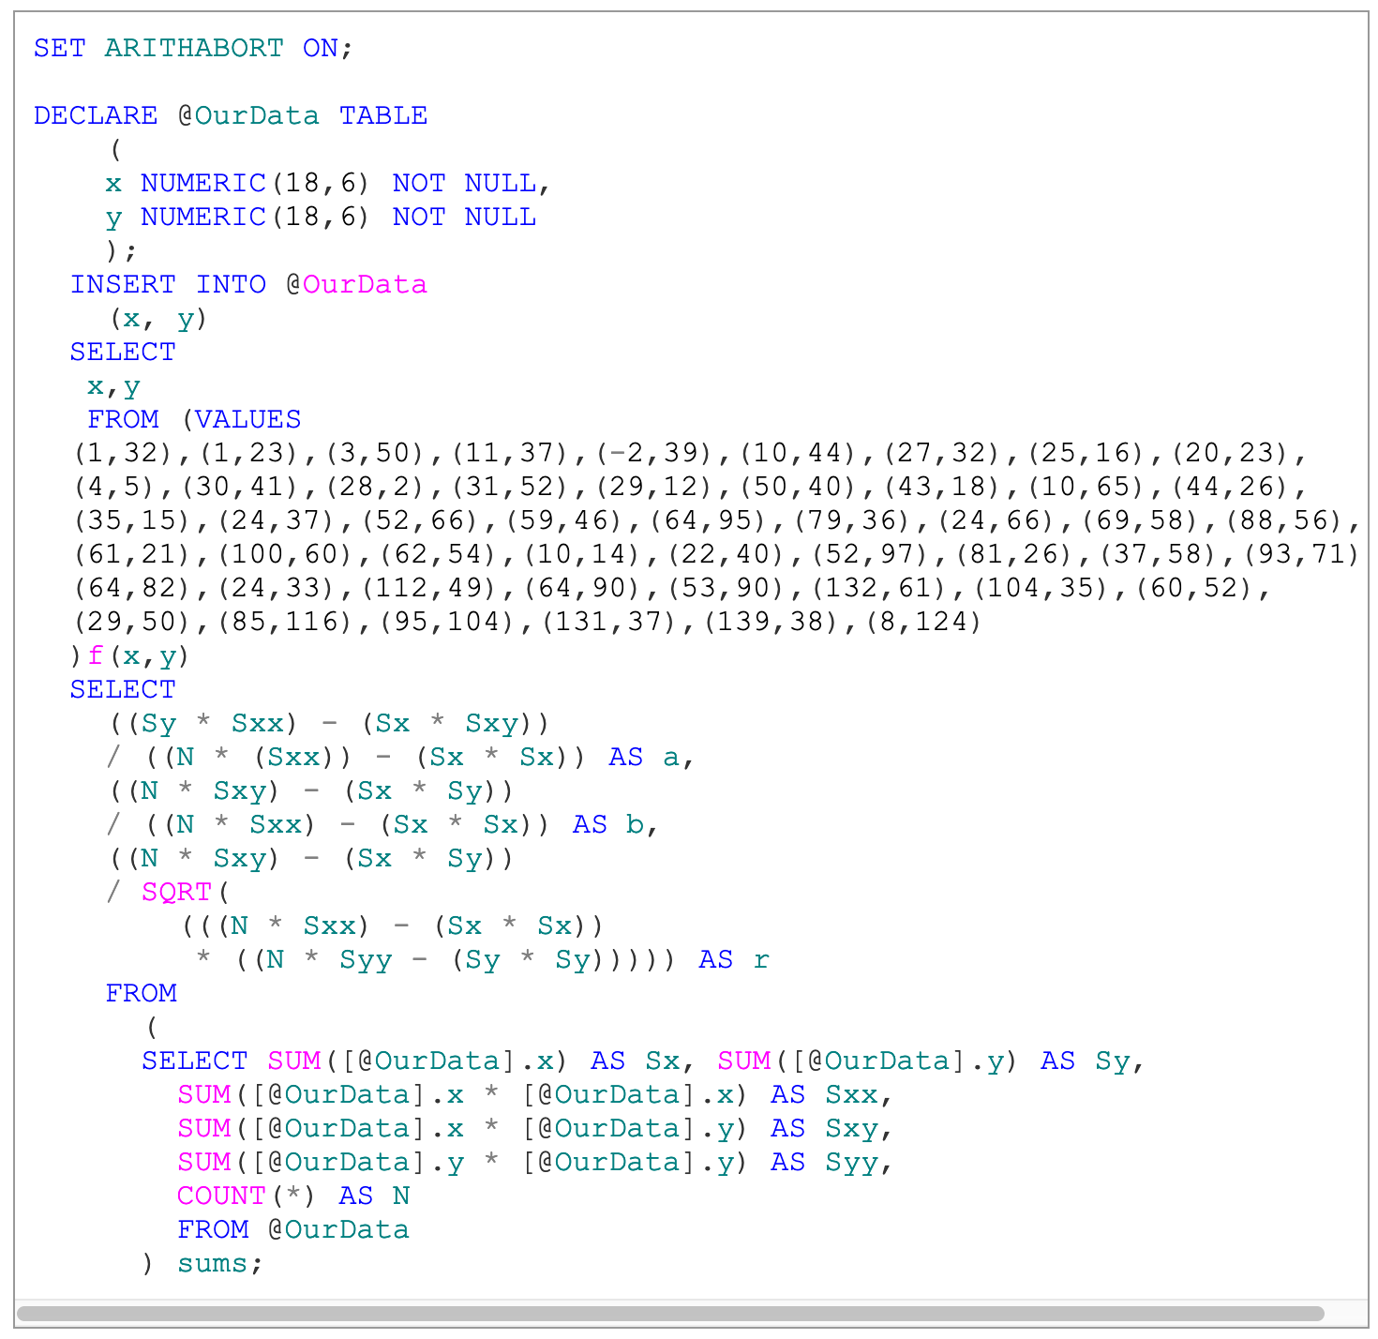
4. Correlation Coefficient
https://www.red-gate.com/simple-talk/blogs/statistics-sql-simple-linear-regressions/

Slide 149
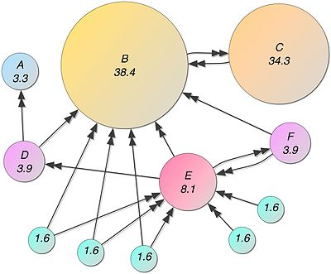
5. Page Rank
Recursive algorithm to assign weights to the nodes of a graph (Web Link Graph)
Weight for a node depends on the weights of the nodes that point to it
Typically done in iterations till “convergence”
Not obvious that you can do it in SQL, but:
Each iteration is just a LEFT OUTERJOIN
Stopping condition is trickier
Other ways to do it as well
https://devnambi.com/2013/pagerank.html

Slide 150
