Slide 1
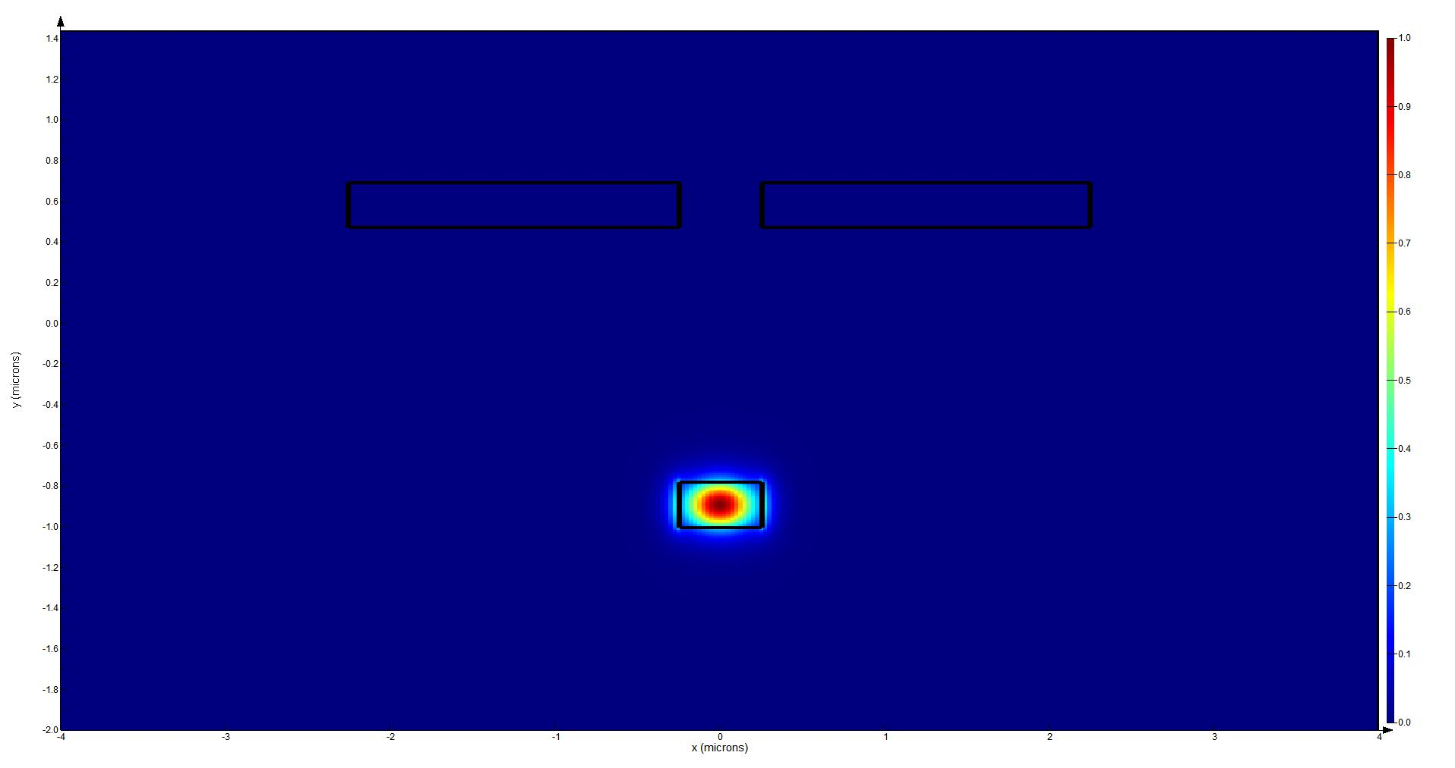

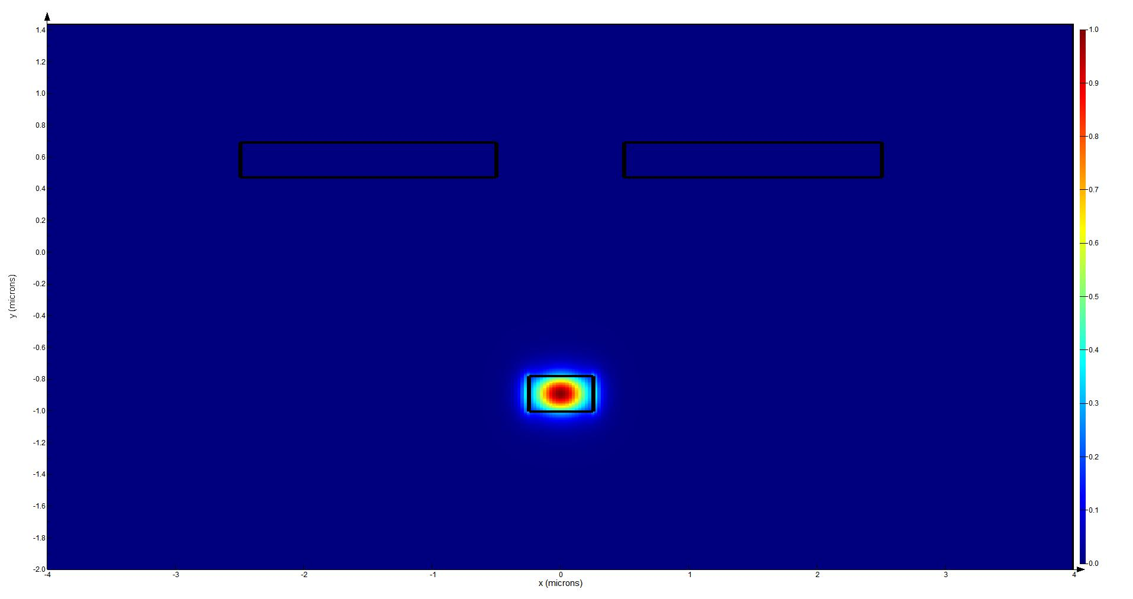
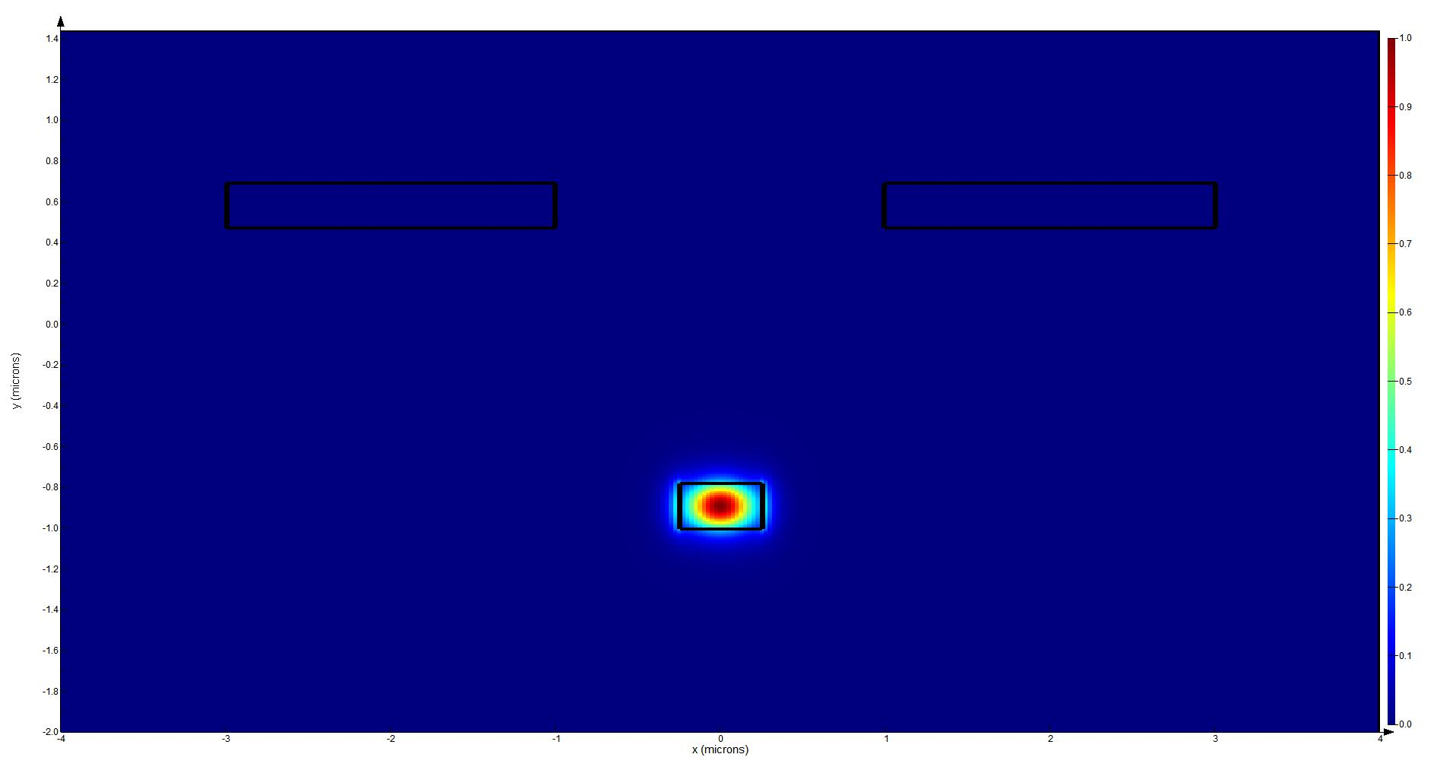

























$$ⅆ_{TiN}=0.5μm$$
$V_{π}$ $=2.391V$
$n_{eff}=$ $2.4498$
$$(a)$$
$λ=$ $1550nm$
$$ⅆ_{TiN}=0.75μm$$
$V_{π}$ $=2.419V$
$n_{eff}=$ $2.4498$
$$(b)$$
$λ=$ $1550nm$
$$ⅆ_{TiN}=1μm$$
$V_{π}$ $=2.448V$
$n_{eff}=$ $2.4497$
$$(c)$$
$λ=$ $1550nm$
$$ⅆ_{TiN}=2μm$$
$V_{π}$ $=2.557V$
$n_{eff}=$ $2.4495$
$$(d)$$
$λ=$ $1550nm$
$$ⅆ_{TiN}=3μm$$
$V_{π}$ $=2.713V$
$n_{eff}=$ $2.4493$
$$(e)$$
$λ=$ $1550nm$

