Slide 1
Is Tip worker make good money for living

Slide 2
The dataset and libraries
total_bill | tip | sex | smoker | day | time | size | Total
0 | 16.99 | 1.01 | Female | No | Sun | Dinner | 2 | 18.00
1 | 10.34 | 1.66 | Male | No | Sun | Dinner | 3 | 12.00
2 | 21.01 | 3.50 | Male | No | Sun | Dinner | 3 | 24.51
3 | 23.68 | 3.31 | Male | No | Sun | Dinner | 2 | 26.99
4 | 24.59 | 3.61 | Female | No | Sun | Dinner | 4 | 28.20
5 | 25.29 | 4.71 | Male | No | Sun | Dinner | 4 | 30.00
6 | 8.77 | 2.00 | Male | No | Sun | Dinner | 2 | 10.77
7 | 26.88 | 3.12 | Male | No | Sun | Dinner | 4 | 30.00
8 | 15.04 | 1.96 | Male | No | Sun | Dinner | 2 | 17.00
9 | 14.78 | 3.23 | Male | No | Sun | Dinner | 2 | 18.01
10 | 10.27 | 1.71 | Male | No | Sun | Dinner | 2 | 11.98
11 | 35.26 | 5.00 | Female | No | Sun | Dinner | 4 | 40.26
12 | 15.42 | 1.57 | Male | No | Sun | Dinner | 2 | 16.99
13 | 18.43 | 3.00 | Male | No | Sun | Dinner | 4 | 21.43
14 | 14.83 | 3.02 | Female | No | Sun | Dinner | 2 | 17.85
15 | 21.58 | 3.92 | Male | No | Sun | Dinner | 2 | 25.50
16 | 10.33 | 1.67 | Female | No | Sun | Dinner | 3 | 12.00
17 | 16.29 | 3.71 | Male | No | Sun | Dinner | 3 | 20.00
18 | 16.97 | 3.50 | Female | No | Sun | Dinner | 3 | 20.47
19 | 20.65 | 3.35 | Male | No | Sat | Dinner | 3 | 24.00
df = pd.read_csv("tips.csv")
df.head()
Range Index: 244 entries, 0 to 243
Data columns (total 7 columns)on
the original dataset we add Total to see how much is the total bill including tip

Slide 3
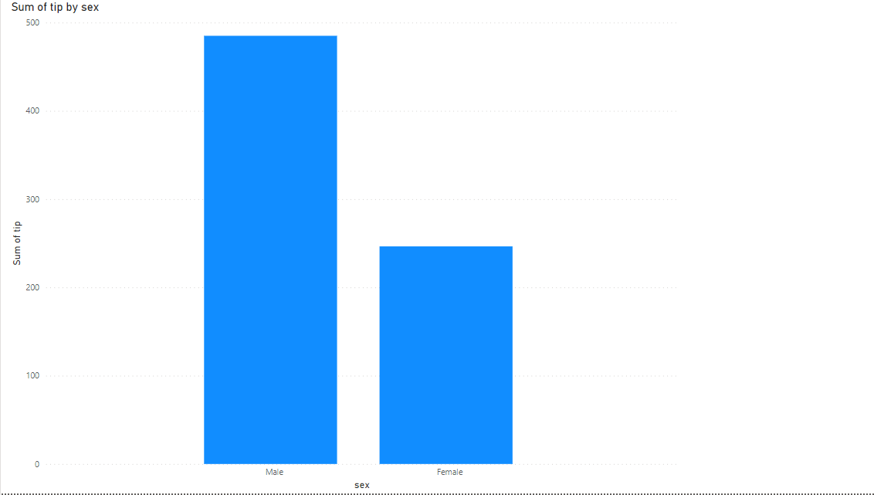
Sum of tip by sex

Slide 4
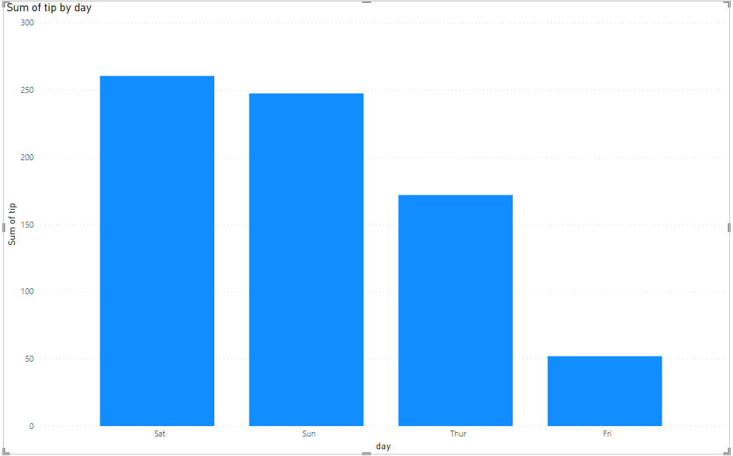
Sum of tip by day

Slide 5
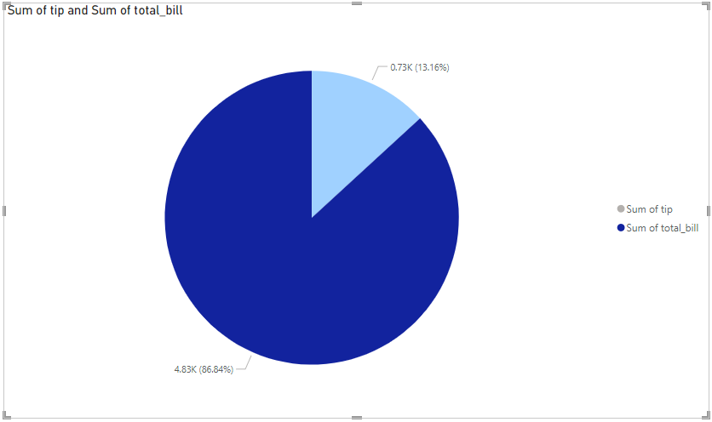
Sum of tip in percent from total bill

Slide 6
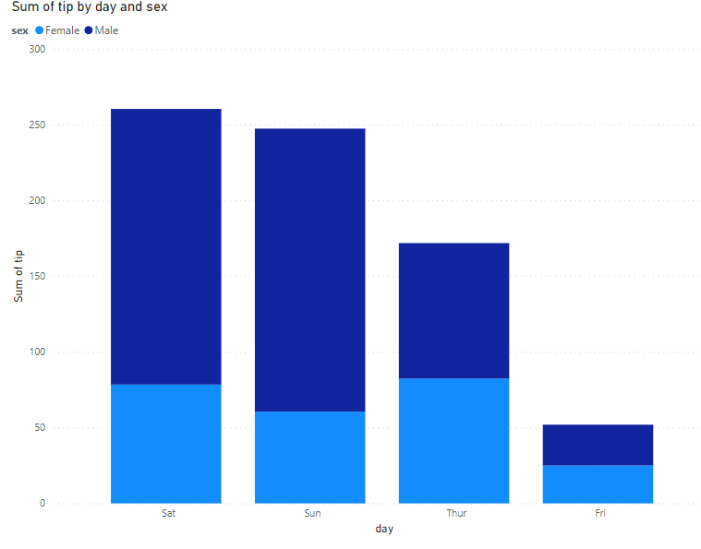
Sum of Tip by sex and day

Slide 7
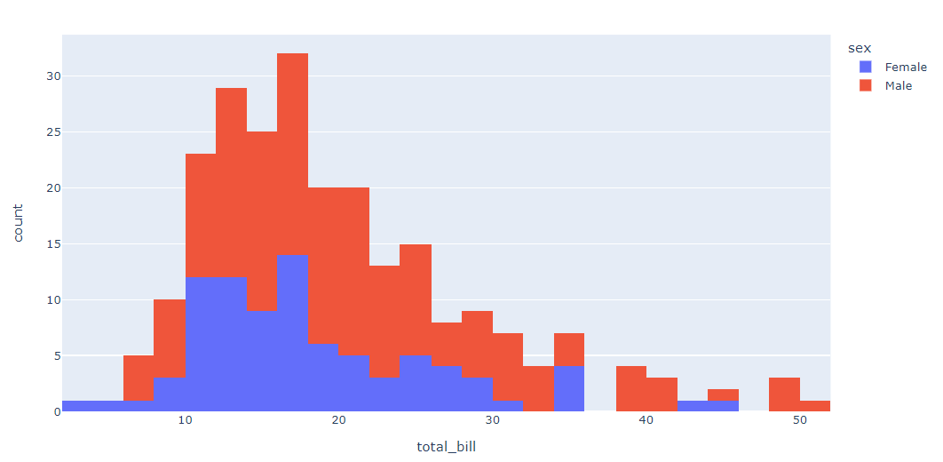
Sum of Tip by sex and day

Slide 8
Summary
Total Sum of tip was higher for Male (485.07) than Female (246.51).
﻿Average Sum of tip was higher for Male (121.27) than Female (61.63).
Sum of tip for Male and Female diverged the most when the day was Sun, when Male were 126.17 higher than Female

Slide 9
Conclusion
From this what we see is that male tip workers make good money then female
﻿Is Tip workers make money for their service?
Sum of tip for Male and Female diverged the most when the day was Sun, when Male were 126.17 higher than Female

