Slide 1
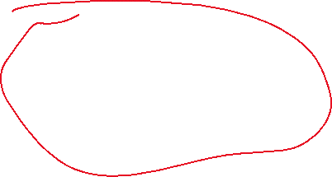
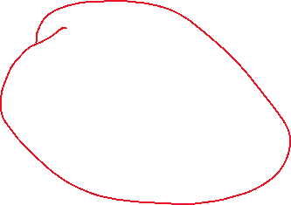
FUNDAMENTALS OF AI BOOTCAMP · WEEK 3
From Regression to Neural Networks
We start from one straight line. We finish with a neuron.
Revision
Something new
Machine learning with ONE input:
prediction = w × x + b
Why one line is not enough,
and what a neuron adds
Core message: a neural network is not magic. It is a weighted sum plus a decision.
Notes:
Say: last week we made a computer learn a straight line from data. Today we ask what happens when one line is not enough. Two parts: revision, then neurons. Keep energy high, ask for answers out loud.

Slide 2
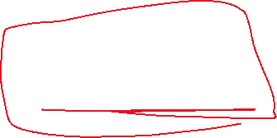











How do we update the parameters?
From the loss we compute the gradient!!... Gradient tells us the direction to minimize the loss!!
Who deterins in what steps I would reach the minima: learning rate
Hyper parameter search: we have multiple learning rates, and our model tries them all and we take the best
Lr = [2*10^-3, 5*10-^-2, 1.2*10^-5].. We have lits of learning rate
Scheduler: … optimization!!

Slide 3











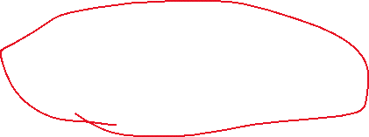

Where we are in the journey
Same learning loop, richer model shape
1
WEEK 1
2
WEEK 2
3
TODAY
4
NEXT
Search AI
Regression
Neuron
Network
Explore states.
Nothing is learned.
Learn w and b.
Predict a number.
Weighted sum
+ activation.
Many neurons
working together.
Checkpoint from last week: learning = changing parameters so that the loss goes down.
Today's new question: what if the shape of the model itself is too simple for the pattern?
WARM-UP: Was the Week 1 maze solver machine learning? Why or why not?
Week 3 · From Regression to Neural Networks
2
Notes:
Expected answer: the maze solver is AI but NOT machine learning — it never improved from data, it just searched. ML changes parameters. Point at box 3 and say: that is where we arrive today.

Slide 4





THE ONE IDEA BEHIND ALL OF IT
Instead of programming the answer,
can we let the computer improve from examples?
Traditional program
Machine learning
You write the rule.
The computer follows it.
You show examples.
The computer finds the rule.
The examples are the teacher. The mistake — the error — is the feedback.
Notes:
Slow down here. This is THE slide. Ask: who is the teacher in machine learning? Answer: the loss / the error. Nobody tells the model the rule — the mistakes push it toward the rule.

Slide 5

Start tiny: learn a hidden rule
Before any physics or code - just three examples
THE DATA WE SHOW
WHAT WE DO NOT SAY
THE QUESTION
x = 0
y = 1
We never tell the
computer the rule.
We only show it
these pairs.
What should the model
predict when
x = 1
y = 3
x = 3 ?
x = 2
y = 5
…and how would it
figure that out?
Machine learning always starts here: with examples, not with a formula.
PREDICT: Look at the pattern. Say out loud - what is y when x = 3?
Week 3 · From Regression to Neural Networks
4
Notes:
Let them shout the answer (7). Then the key line: YOU saw the pattern instantly. The computer cannot. It has to search for it using numbers. That search is training.

Slide 6









Step 1 - Choose the shape of the model
A rule with adjustable numbers inside it
prediction = w × x + b
w
the weight (slope)
b
the bias (shift)
How much the output changes when the input goes up by 1.
What the model predicts when the input is 0. It moves the line up or down.
Definition of learning: changing w and b so that the predictions are less wrong on the examples. The computer is not choosing words or ideas - it is only changing numbers.
PREDICT: If w and b are terrible at the start, is the model still allowed to make a prediction?
Week 3 · From Regression to Neural Networks
5
Notes:
Common beginner confusion: they think a model must be good before it can predict. Clarify — it predicts from second one, it just predicts badly. Training is what makes it good.

Slide 7

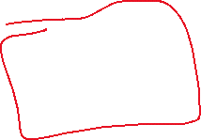


Step 2 - Start with a bad guess
Prediction happens before learning
STARTING PARAMETERS
TRY ONE EXAMPLE: x = 2
HOW WRONG WERE WE?
w = 1
ŷ = 1 × 2 + 0 = 2
error = prediction − actual
b = 0
prediction = 2
= 2 − 5 = −3
actual = 5
The model is 3 too low.
It must change its numbers.
Chosen with no thought at all.
Nothing here is intelligent yet. It is arithmetic — and a signal that says “you are wrong, and by how much.”
ASK: Should w increase, decrease, or stay the same? Why?
Week 3 · From Regression to Neural Networks
6
Notes:
Expected: w should increase, because predictions are too low for positive x. Keep it intuitive — no calculus. The sign of the error tells you the direction to move.

Slide 8









Step 3 - Turn many mistakes into ONE score
That single score is called the loss
1
error
2
squared error
3
loss (MSE)
prediction − actual
error × error
average of squared errors
−3
9
one number
Why square the error?
MSE = average( (prediction − actual)² )
1. Negative and positive errors stop cancelling out.
2. Big mistakes are punished much more than small ones.
one number that says how bad the whole model is
PREDICT: If the loss gets smaller after training, what does that mean in plain English?
Week 3 · From Regression to Neural Networks
7
Notes:
Expected: predictions are closer to the real values on average. Emphasise: the whole of training is a hunt for the numbers that make this one score small.

Slide 9






Step 4 - Training changes the numbers
Same data, same code - different parameters
BEFORE TRAINING
AFTER TRAINING
w = 1 b = 0
w ≈ 2 b ≈ 1
for x = 3 → ŷ = 3
for x = 3 → ŷ = 7
Far from the pattern.
Matches the pattern.
What actually changed? Not the code. Not the data. Only the parameters w and b. That is the whole idea of machine learning.
CHECKPOINT: Which two numbers did the model learn in this tiny example?
Week 3 · From Regression to Neural Networks
8
Notes:
Expected: w and b. Repeat it: the code stayed the same, the data stayed the same, the PARAMETERS moved. Anyone who understands this slide understands machine learning.

Slide 10
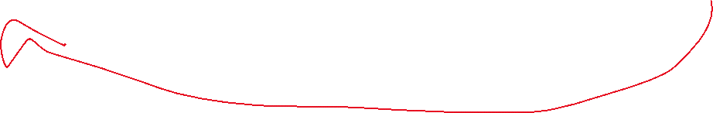




The machine learning loop
Four steps, repeated many times - that is all training is
1
2
3
4
PREDICT
MEASURE
UPDATE
REPEAT
Use the current w and b
to guess an output.
Compare with the truth.
Compute the loss.
Nudge w and b in the
direction that helps.
Do it again, hundreds
or thousands of times.
…and back to the start
Every model you will ever meet — regression, neurons, deep networks, ChatGPT - runs this same loop.
Week 3 · From Regression to Neural Networks
9
Notes:
Draw the loop with your hand in the air while you say it. Ask them to repeat the four words back: predict, measure, update, repeat.

Slide 11

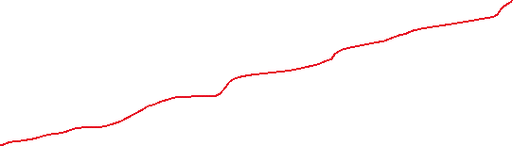

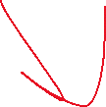


Same idea, now with real-life data
Predict delivery time from distance
THE MEASUREMENTS
distance (km)
time (min)
1.0
8.5
2.0
11.4
3.0
15.0
4.0
18.0
5.0
21.0
6.0
24.8
ASK: The points are close to a line but not exactly on it. What real-life things cause that?
Week 3 · From Regression to Neural Networks
10
Notes:
Answers: traffic, rain, elevators, restaurant prep time, driver availability. Key point: noisy data is imperfect, not useless. A straight line is still a good first model here.

Slide 12




Notebook 1 - Be the learning algorithm yourself
Try candidate numbers, compare the evidence
candidate_ws = [1.5, 2.0, 2.5, 3.0, 3.5]
b = 5
for w in candidate_ws:
loss = mean_squared_error(data, w, b)
print(w, loss)
WHY DO THIS BY HAND?
Before we automate anything, you should feel what learning is:
searching for better numbers, guided by the loss.
Week 1 was search over states.
Today it is search over numbers.
Later, gradient descent will do this search for you - automatically and far faster. It is not a different idea.
PREDICT FIRST: Which value of w will give the lowest loss? Guess before you run the cell.
Week 3 · From Regression to Neural Networks
11
Notes:
Run this live if you have the notebook open. Make them commit to a guess first — prediction before evidence is the habit we are building all bootcamp.

Slide 13











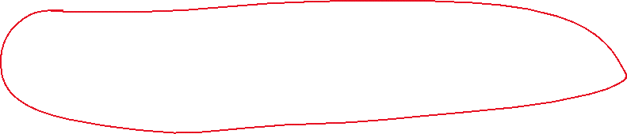


Regression predicts a NUMBER
Input in, number out
INPUT
MODEL
OUTPUT
distance = 5 km
w × x + b
21 minutes
This is still machine learning — as long as w and b were learned from data instead of typed in by a human.
ASK: If I hard-code w = 3.5 myself, is it still machine learning?
Week 3 · From Regression to Neural Networks
12
Notes:
Answer: no — nothing was learned. The label ML depends on where the parameters came from, not on how complicated the formula looks.

Slide 14






Distance alone is useful - but not enough
Where the single straight line starts to break
Two deliveries are both 5 km. One takes 21 minutes. The other takes 40.
DELIVERY A — 21 min
DELIVERY B — 40 min
Clear road
Heavy traffic
No rain
Raining
Low demand
Peak hour
Ground floor
12th floor, no lift
The model only sees distance - so it must predict the same number for both. It has no way to be right.
ASK: What extra inputs should we give the model?
Week 3 · From Regression to Neural Networks
13
Notes:
Collect their suggestions on the board: traffic, weather, time of day, number of items, floor number. This motivates multiple inputs — the door into neurons.

Slide 15


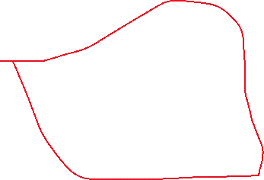

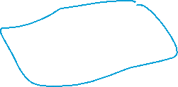
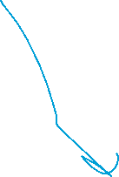






Careful: many inputs is still not a neural network
The most common misunderstanding today
Distance, traffic and rain are called, independent variables
MULTIPLE-INPUT LINEAR MODEL
NEURON
prediction =
w1×distance + w2×traffic
+ w3×rain + b
score = weighted sum
output = activation(score)
One weighted sum. One simple, straight decision rule.
A weighted sum PLUS a decision step. That extra step is the whole difference.
The bridge: a neuron = weighted sum + activation. Adding more inputs makes a model bigger; adding an activation makes it a neuron.
Time is dependent variable. It depends on the indepdent variables(distance, traffic, rain).
Rule of Thumb, as our parameter size
Increases, the performance increases!..
Week 3 · From Regression to Neural Networks
14
Notes:
Say it twice. Students leave this lecture thinking 'more inputs = neural network'. Correct that here, explicitly, before moving on.

Slide 16

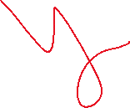
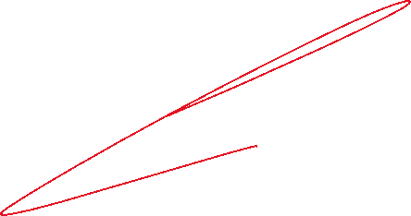











Slide 17



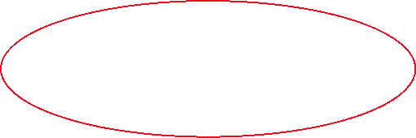






The neuron, drawn
We need Activation, so that we introduce non-linearity
To the network!
Multiply, add, then decide
distance
x1
w1
w2
Σ
activation
output
traffic
x2
one number
the decision
w3
rain
x3
weighted sum
z = w1·x1 + w2·x2 + w3·x3 + b output = activation(z)
Not a brain cell. A computation: multiply, add, then decide.
Week 3 · From Regression to Neural Networks
15
Notes:
Point at the Σ and say: you already know this part — it is w×x+b with more inputs. The only new box on this slide is the orange one.

Slide 18



Activation - from a score to a decision
Sometimes we want a category, not a number
REGRESSION OUTPUT
CLASSIFICATION OUTPUT
How many minutes?
Will it be late?
output = 21.4
if z ≥ 30 → late
else → on time
a continuous number
a category
The simplest activation is a threshold: below the line, output 0 - above it, output 1.
Later we will meet smoother activations — sigmoid and ReLU — but the job is always the same: turn the score into an output.
ASK: Give me another yes/no question a delivery company would want answered.
Week 3 · From Regression to Neural Networks
16
Notes:
Examples they may give: will the customer tip, will the order be cancelled, is this address risky. Good — same neuron, different label.

Slide 19
Notebook 2 - Code the neuron in plain Python
Small code, big idea
def weighted_sum(inputs, weights, bias):
total = bias
for x, w in zip(inputs, weights):
total += x * w
return total
def step_activation(score, threshold):
return 1 if score >= threshold else 0
WHAT TO NOTICE
1
Each input has its own weight.
2
The bias shifts the score.
3
The activation turns the score into an output.
4
Every step is inspectable — no magic.
TRY IT: Set weights by hand and see how the output flips from 0 to 1.
Week 3 · From Regression to Neural Networks
17
Notes:
If time is short, just read the two functions aloud and move on. The point is that a neuron is eight lines of ordinary Python, not a mystery.

Slide 20










What ONE neuron can do
It draws one straight boundary
x2
INTERPRETATION
one straight boundary
A single neuron is enough when one simple rule separates the examples.
The weights decide the tilt of the line.
The bias decides where the line sits.
Change the numbers → the boundary moves. That is exactly the same “learning” as Week 2, just drawn in two dimensions.
x1
PREDICT: Can every dataset be split by one straight line?
Week 3 · From Regression to Neural Networks
18
Notes:
Set them up for the next slide. Let a few say yes. Then show XOR.

Slide 21
XOR rule:
If the numbers are d/t 1
If the numbers are same 0
OR
If there is a singel 1, it is 1
Otehrwise 0
Why one neuron is not enough
XOR — the classic tiny failure case
XOR TRUTH TABLE
x2
THE LESSON
x1
x2
XOR
The problem is not that ML cannot handle many inputs.
The problem is that ONE simple boundary is too limited a shape.
0
0
0
0
1
1
1
0
1
1
1
0
x1
No single straight line separates orange from teal.
AND
If both are 1 then 1
Otehrwise 0
ASK: How could two straight lines together solve this?
Week 3 · From Regression to Neural Networks
19
Notes:
Draw two lines on the board with your finger and shade the middle band. That is literally what the hidden layer will do on the next slide.

Slide 22
x1 | x2 | XOR
0 | 0 | 0
0 | 1 | 1
1 | 0 | 1
1 | 1 | 0
x1 | x2 | OR
0 | 0 | 0
0 | 1 | 1
1 | 0 | 1
1 | 1 | 1
N stands for not! NAND, not AND
x1 | x2 | AND
0 | 0 | 0
0 | 1 | 0
1 | 0 | 0
1 | 1 | 1
x1 | x2 | NAND
0 | 0 | 1
0 | 1 | 1
1 | 0 | 1
1 | 1 | 0

Slide 23











A tiny network combines simple neurons
x1 | x2 | OR
0 | 0 | 0
0 | 1 | 1
1 | 0 | 1
1 | 1 | 1
x1 | x2 | AND
0 | 0 | 0
0 | 1 | 0
1 | 0 | 0
1 | 1 | 1
Layers let simple rules work together
OR
neuron
x1
AND
neuron
XOR
x1 | x2 | NAND
0 | 0 | 1
0 | 1 | 1
1 | 0 | 1
1 | 1 | 0
x1 | x2 | XOR
0 | 0 | 0
0 | 1 | 1
1 | 0 | 1
1 | 1 | 0
x2
NAND
neuron
inputs
hidden layer
output layer
Do not memorise XOR. Remember the lesson: stacking simple decisions into layers produces behaviour that no single neuron could produce.
Week 3 · From Regression to Neural Networks
20
Notes:
Each hidden neuron draws one line. The output neuron combines them. That combination is what 'deep learning' scales up — nothing more mysterious than this picture.

Slide 24









So this is all a neural network is
Inputs, hidden layers, output — every line is a weight
inputs
hidden layer 1
hidden layer 2
output
Every circle is a neuron: weighted sum → activation. Every line is a weight the model learns. “Deep” just means more layers.
Week 3 · From Regression to Neural Networks
21
Notes:
Count the lines out loud on the first two layers — 16 weights already in this toy picture. Then say: a real model has billions. Same rule, more of it.

Slide 25





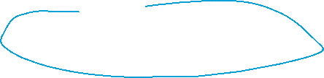

What changes during training?
Not the examples. Not the code. The parameters.
BEFORE
THE LOOP
AFTER
random or bad weights
predict
better weights
high loss
measure the loss
lower loss
weak predictions
update the weights
better predictions
repeat
Today we mostly chose tiny weights by hand, so we could see them. Next session we let the machine improve them from data.
CHECKPOINT: In the delivery model, what exactly did the computer learn?
Week 3 · From Regression to Neural Networks
22
Notes:
Answer: the values of w and b — nothing else. Reconnect it to slide 8: same message, bigger model.

Slide 26
SUMMARY CHECKPOINT
Can you answer these five?
1
What do w and b mean in the delivery-time model?
2
Why was distance alone useful but incomplete?
3
What are inputs, weights, bias and activation in a neuron?
4
How is a neuron similar to linear regression — and what does it add?
5
Why can layers do more than one neuron ever could?
Next session: we train a small neural network, so the weights improve from data instead of being chosen by us.
Notes:
Put students in pairs for 2 minutes and have them answer these to each other. Then take answers for questions 3 and 5 — those are the two that matter most.

