Slide 1

Data Scrapping and Category Classification

Slide 2
Agenda
Proposed Methodology
How to extract data and images?
Text Classification/ Categories
Data Analysis/ Exploration Data Analysis
Dashboard Development
Conclusion

Slide 3
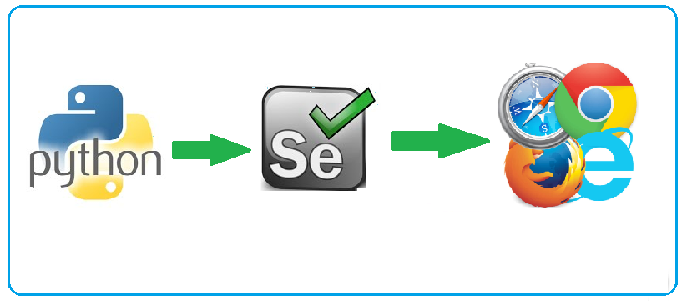


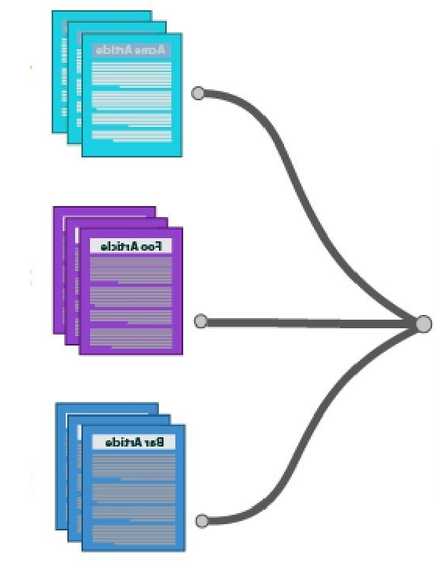


Proposed Methodology
.
Selenium will conteniously scroll down the website to show more images AND text (caption) from images
Selenium Automation for Extraction
Selenium will open website for exraction
Visualization in PowerBI
Data Analysis
Store Text and Images in DB
Text Classification

Slide 4
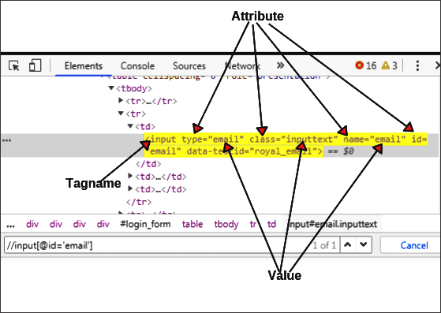
Data Scrapping
The website is dynamic, like you have few images and text in first page, as you scroll down the page, you will see more images. So we need to automation of the page to scrap data.
Dynamic websites are built with code that is rendered once the page loads on a browser. As a result, the content to be scraped does not exist before the page is loaded.
We are using Selenium for data scrapping (best for scrapping data from such websites) - https://selenium-python.readthedocs.io/
For webpage, we have different tags, ids, classes to extract data through.
CSS Selectors, Xpaths, etc. required to get data.
We can get or input value into text box above using “class = inputtext”

Slide 5
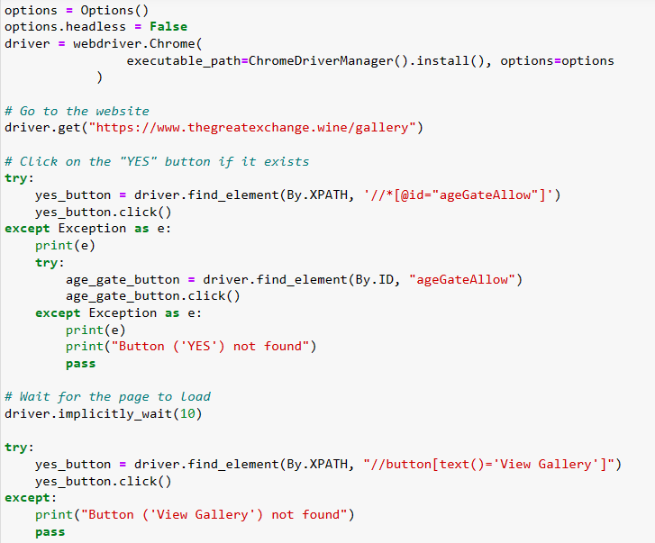
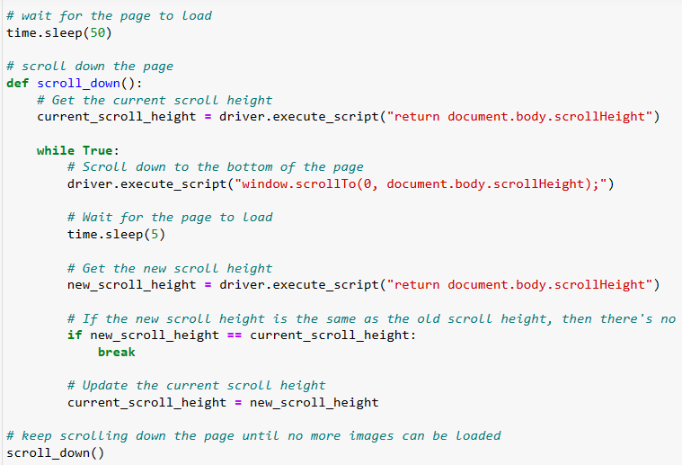
Sample Code to Extract Data
Sample code

Slide 6
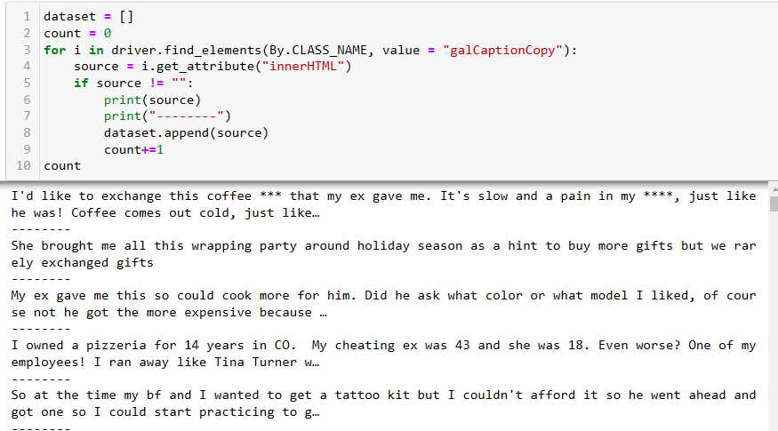
How to Extract text?
The caption of image can be accessed using class = galCaptionCopy

Slide 7
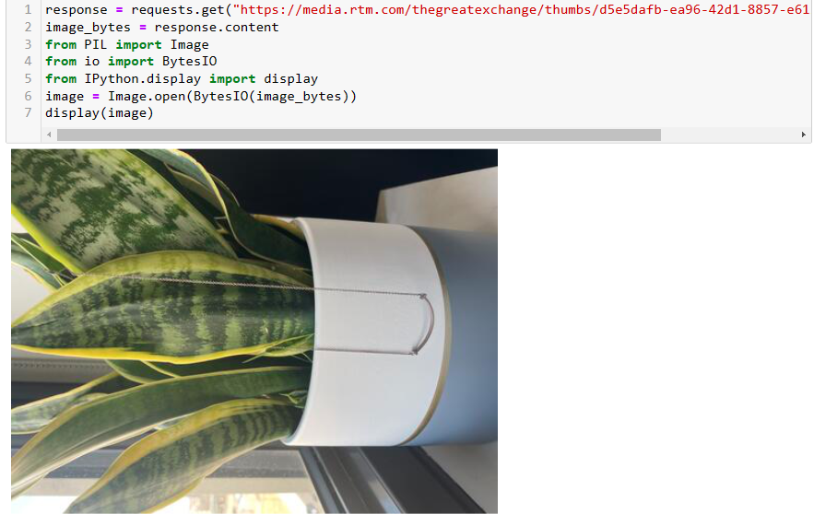
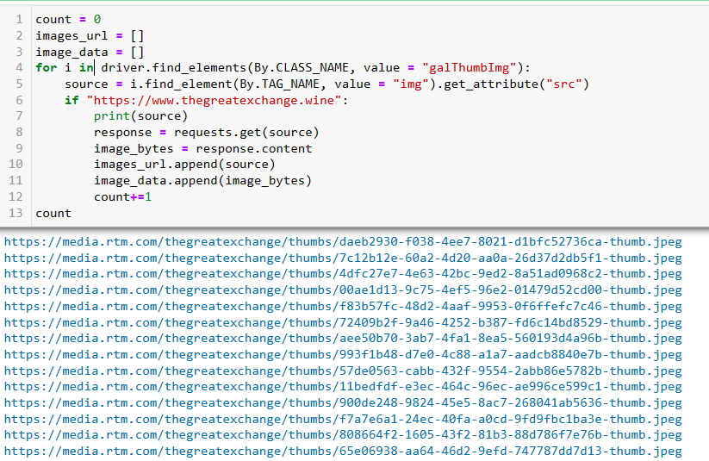
How to Extract Images?
The image can be accessed using class = galThumbImg
Image can be read from URL

Slide 8
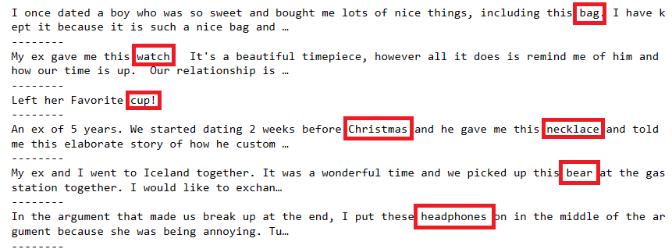
Text Classification
Every image has caption → represent different category
There is specific keywords such as ring, braclet, necklace → JEWELARRY
We have following categories
BIRTHDAY
ROSES
LONG DISTANCE
CHEATED
CHRISTMAS
VALENTINE
JEWELARY
HOLIDAY
TATTOO KIT
CLOTHING
ITEM
GIFT
OTHER

Slide 9
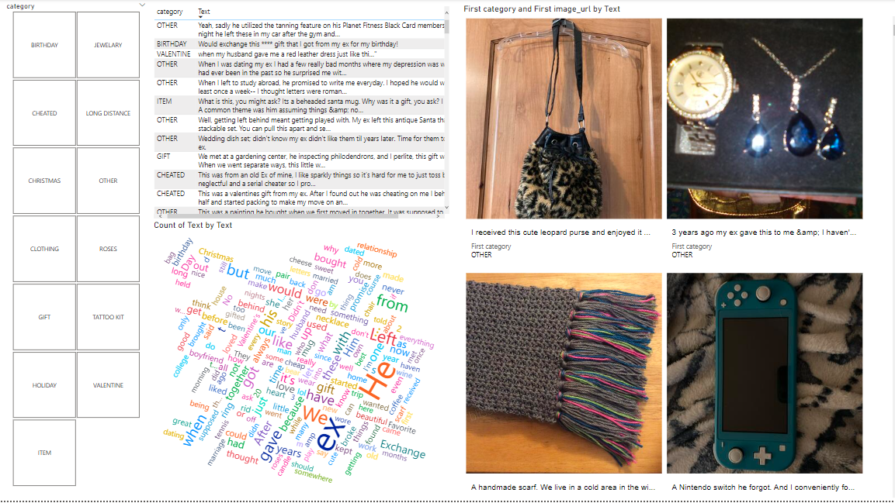
Dashboard
Detailed drill down capability in dashboard
You can have a lot filters such as Categories
You can have the main discussed themes using wordcloud
You can see caption in table as well by hovering over image
Can be extended and scale as per requirements

Slide 10
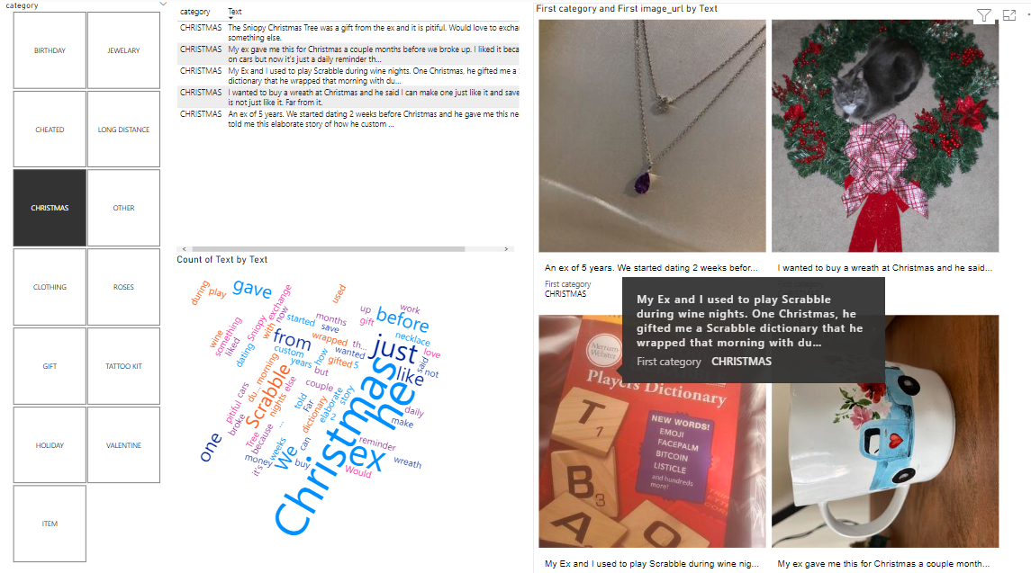
Dashboard Example
Let say we select Christmas category

Slide 11

Final Comments
We have used small amount of data (because the website is closed now → the contest ended)
Unable to extract data further
We can use Machine Learning based automated technique to classify images based on captions into different categories

Slide 12
Thank you

