Slide 1

Android Activities
Highlights

Slide 2
Background
An activity is a single, focused thing that the user can do in your app
Almost all activities interact with the user, so the Activity class takes care of creating a window for you in which you can place your UI
Activities are components managed by Android. They have lifecycle reflected to the application using callbacks

Slide 3
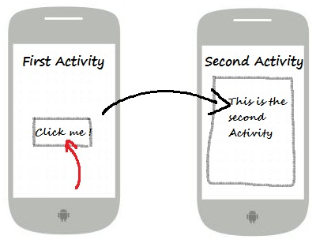
Navigating
Typical application includes one or more activities which can be thought of as “views”. The user can navigate from one activity to another using all kinds of navigation controls.

Slide 4
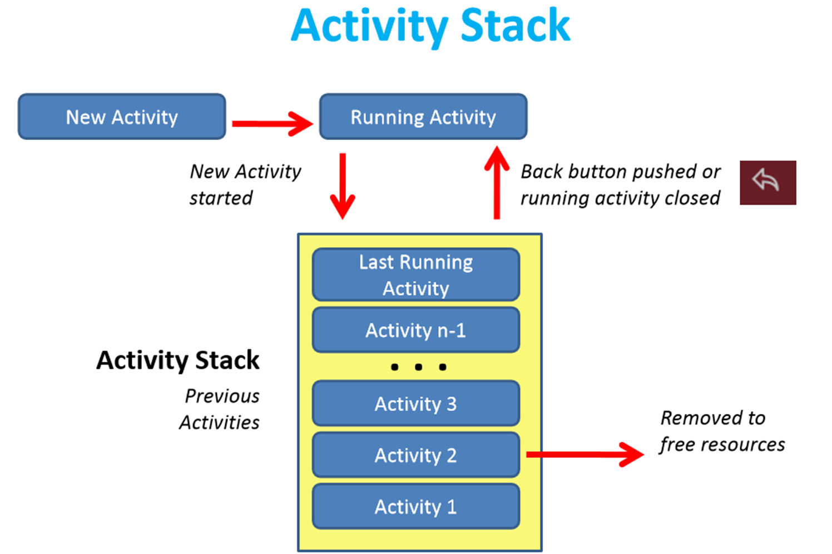
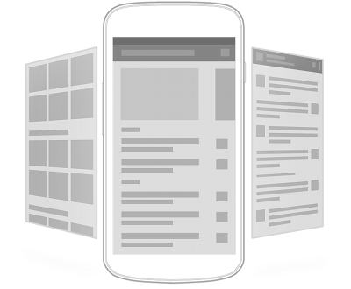
Activity Stack
Android provides “history” of used activities so you can easily go back to one you already used before.

Slide 5
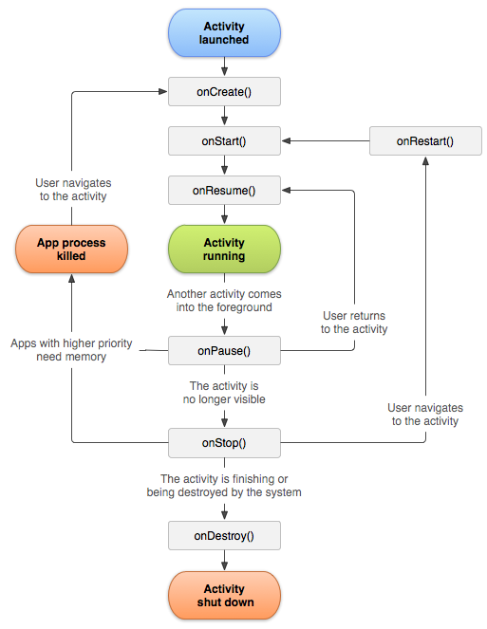
Lifecycle
Android manages the Activity lifecycle and calls app’s callback method to notify the app on any change to the activity state.
Full lifecycle ref

