Slide 1

Android Adapters
Highlights

Slide 2
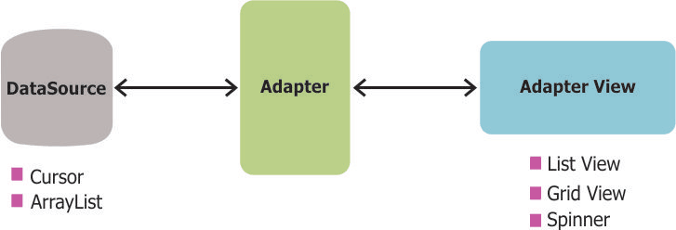
Background
Adapters are used to show some data in the activity UI
An Adapter object acts as a bridge between an AdapterView and the underlying data for that view
The Adapter provides access to the data items
The Adapter is also responsible for making a View for each item in the data

Slide 3

Adapter Views
Views using adapter extends AdapterView.
Known Direct Subclasses (all abstract)
AbsListView, AbsSpinner, AdapterViewAnimator
Known Indirect Subclasses
AdapterViewFlipper, AppCompatSpinner, ExpandableListView, Gallery, GridView, ListView, Spinner, StackView

Slide 4
Adapter Sources
Adapter source is different from adapter to adapter, each adapter handles different source types.
Main Adapters
SimpleAdapter
ArrayAdapter
ListAdapter
CursorAdapter / SimpleCursorAdapter
Other Adapters
HeaderViewListAdapter
ResourceCursorAdapter
SpinnerAdapter
ThemedSpinnerAdapter
WrapperListAdapter
The main difference between SimpleAdapter and ArrayAdapter is that the SimpleAdapter is static and cannot be refreshed once created

Slide 5
Array Adapter – Main Components
Array adapters are a simple way to bind a ListView to any array or List.
To use array adapters you need:
Array (or ArrayList)
ArrayAdapter
ListView
Item layout
There is also a ListAdapter but the ArrayAdapter handles both arrays and lists

Slide 6
Array Adapter - Implementation
ArrayAdapter<String> cheeseAdapter =
new ArrayAdapter<String>(this,
R.layout.item,
R.id.cheese_name,
cheeses
);
<?xml version="1.0" encoding="utf-8"?>
<LinearLayout xmlns:android="http://schemas.android.com/apk/res/android"
android:orientation="vertical"
android:layout_width="match_parent"
android:layout_height="match_parent">
<TextView
android:layout_width="wrap_content"
android:layout_height="wrap_content"
android:text="Hello World!"
android:id="@+id/textView"/>
</LinearLayout>
String[] cheeses = {
"Parmesan",
"Ricotta",
"Fontina",
"Mozzarella",
"Cheddar"
};
ListView list = (ListView)findViewById(R.id.listView);
list.setAdapter(adapter);

Slide 7
Array Adapter - Constructor
The full ArrayAdapter constructor consists of:
Context – the current activity
Int – id of the item layout (xml)
Int – id of the field in the layout that will show single value (row)
List – the list object

Slide 8
Array Adapter – Adding Items
When using ArrayList as source, adding to the adapter will automatically add the item to the ArrayList and also to the ListView.
Adding items to the ArrayList will not automatically reflect in the ListView but only when the adapter is refreshed (e.g. by calling notifyDataSetChanged).
When using array as source changes can only be made to the array and the adapter must be manually refreshed.

