Slide 1
Programming in C
Control Structures
Notes:
1

Slide 2
Control Structures
Control Structures are also known as control statements.
They control the flow of program execution.
Generally program executes from top to bottom and left to right.
Control structures allows us to change the normal flow of program with or without condition.
Notes:
2

Slide 3
Conditional Operator [ ?: ]
A conditional expression is of the form
expr1 ? expr2 : expr3
The expressions can recursively be conditional expressions.
A substitute for if-else
Example :
(a<b)?((a<c)?a:c):((b<c)?b:c)
What does this expression evaluate to?
6

Slide 4
Ternary Operator
#include<stdio.h>
void main(){
int a=5;
int b=6;
a>b? printf(“Hi”):printf(“Bye”);
}
Notes:
4

Slide 5
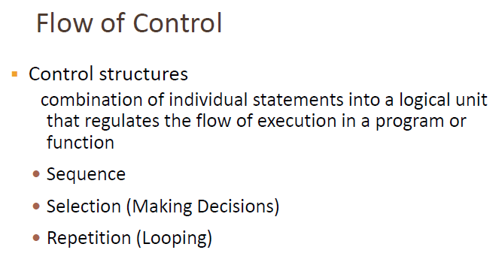
Notes:
5

Slide 6
Selection Statement (Branching)
Allows to jump from one statement to another with or without condition.
It means execution does not occurs normally.
Branching is process of jumping.
if statement, goto statement, and select case statement
Notes:
6

Slide 7
GOTO Branching
Unconditional branching statement
Jumps from one line to another.
It helps to repeat the execution of some statements.
It also helps to exit the nested loop.
We need to use line label for goto.
Line label is the name of line followed by colon.
Since goto is unconditioned, it makes program less readable and difficult to debug.
GOTO is avoided
Notes:
7

Slide 8
GOTO Branching
#include<stdio.h>
void main(){
first:
printf(“first”);
goto third;
second:
prinf(“second);
third:
printf(“third”);
}
Notes:
8

Slide 9
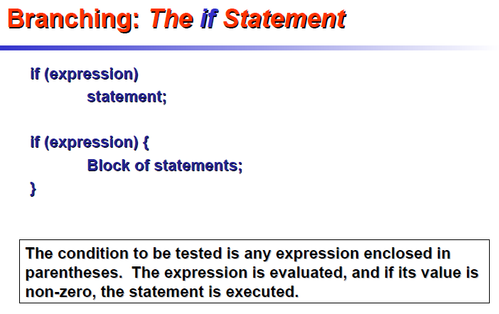
Notes:
9

Slide 10
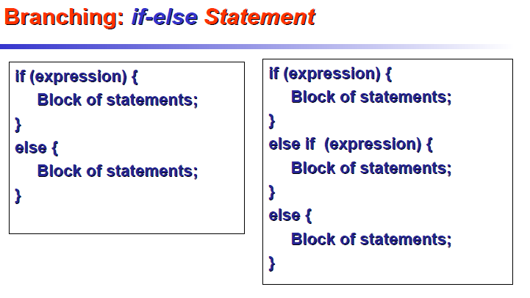
Notes:
10

Slide 11
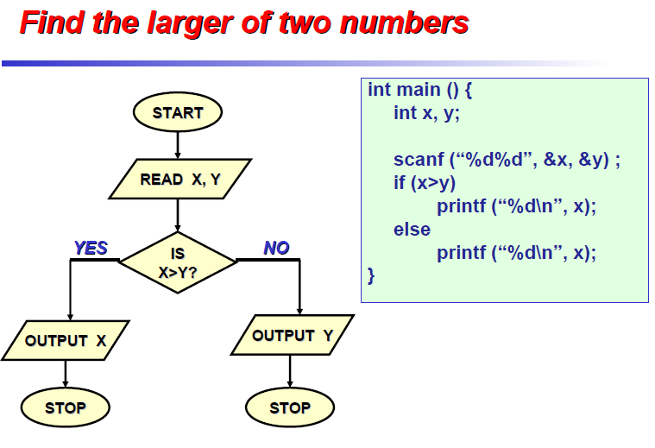
Notes:
11

Slide 12
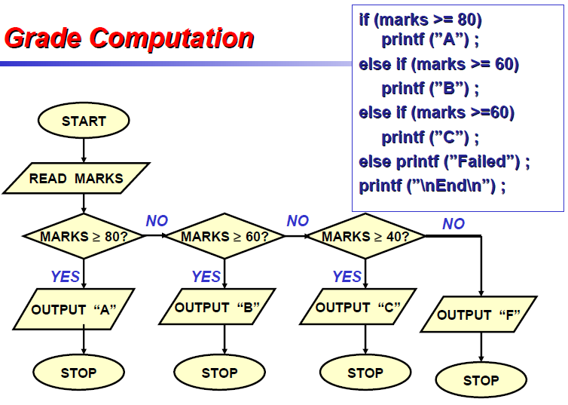
Notes:
12

Slide 13
If Statement
#include<stdio.h>
void main(){
float cgpa;
scanf(“%f”,&cgpa);
if(cgpa>4.0)
printf(“Wrong CGPA”);
else if (cgpa>=3.6)
printf(“A+”);
else
printf(“A”);
}
Notes:
13

Slide 14
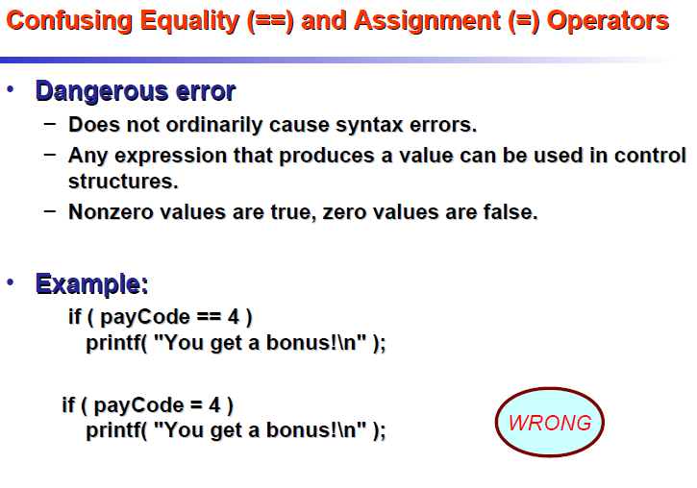
Notes:
14

Slide 15
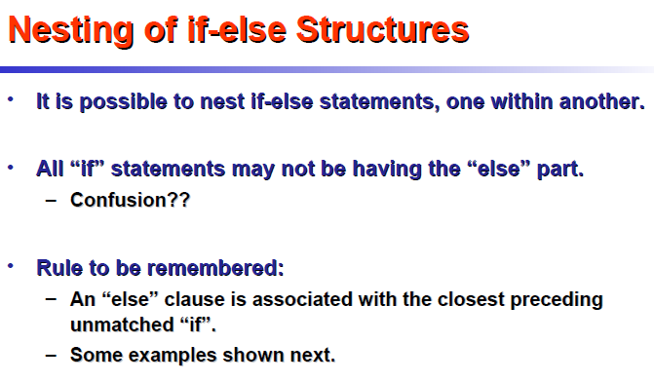
Notes:
15

Slide 16
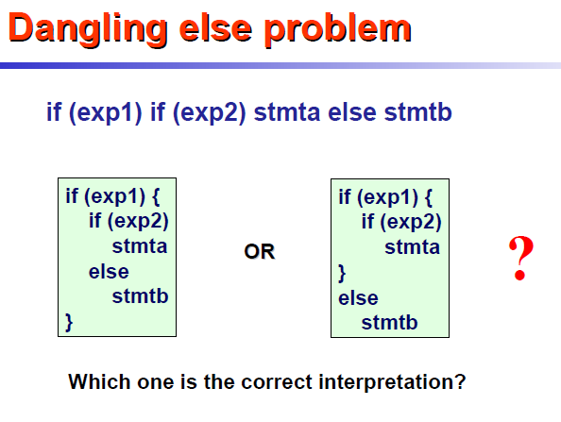
Notes:
16

Slide 17
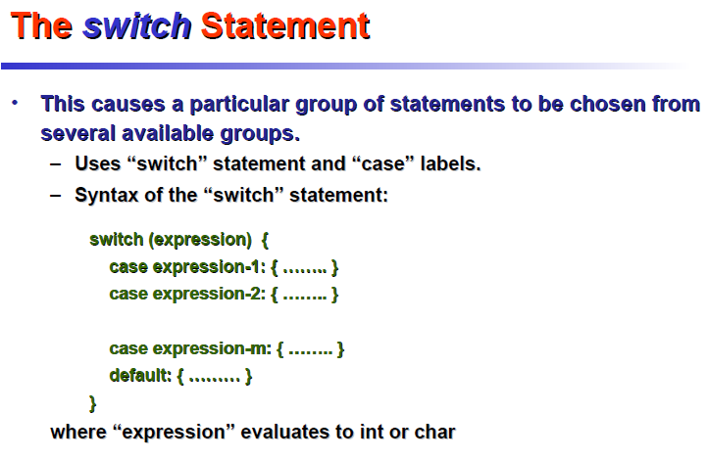
Notes:
17

Slide 18
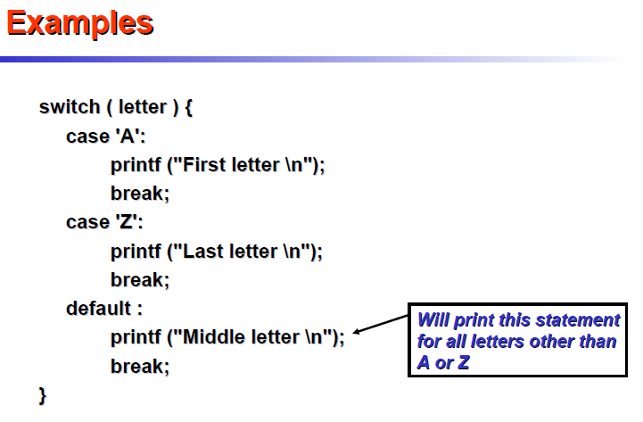
Notes:
18

Slide 19
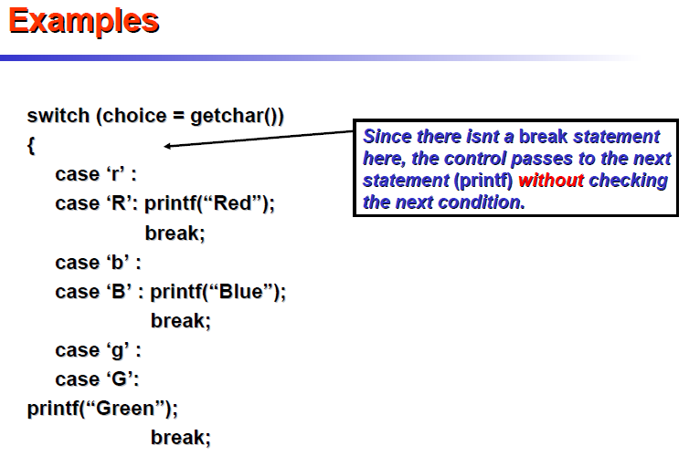
Notes:
19

Slide 20
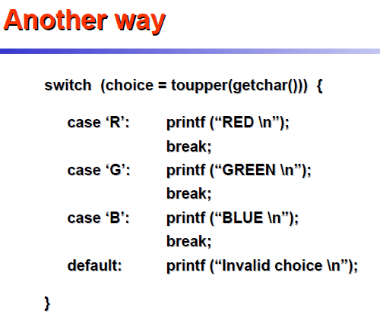
Notes:
20

Slide 21
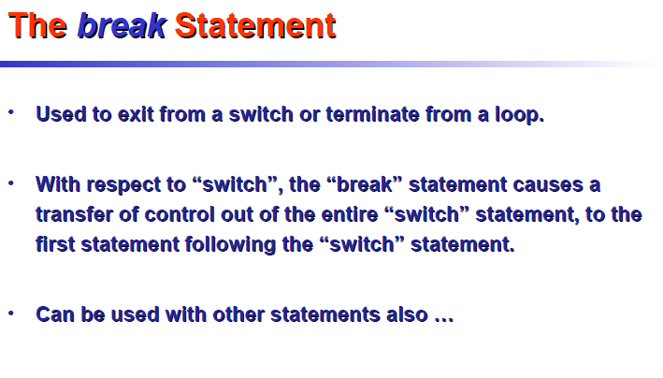
Notes:
21

Slide 22
Loop Statement
Loop Statement executes set of statements repeatedly till the condition is true.
Notes:
22

Slide 23
Why Looping?

Slide 24
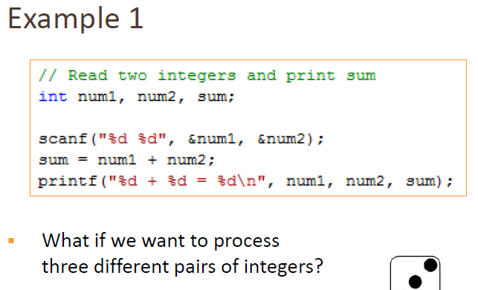
Notes:
24

Slide 25
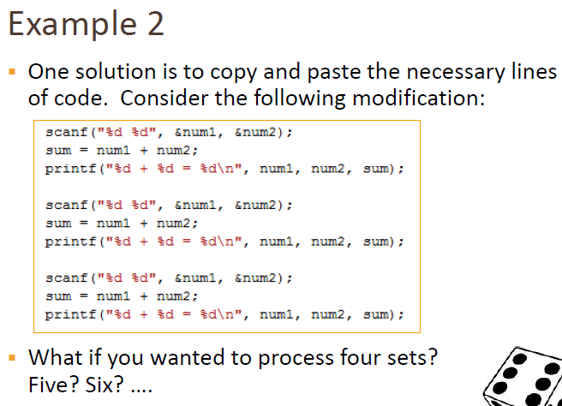
Notes:
25

Slide 26
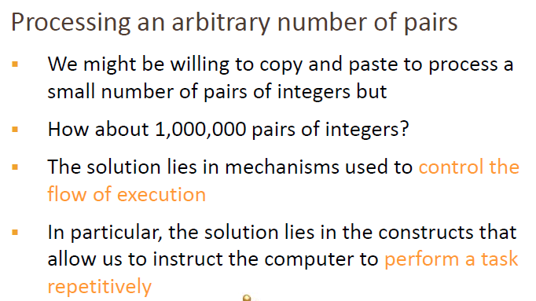
Notes:
26

Slide 27
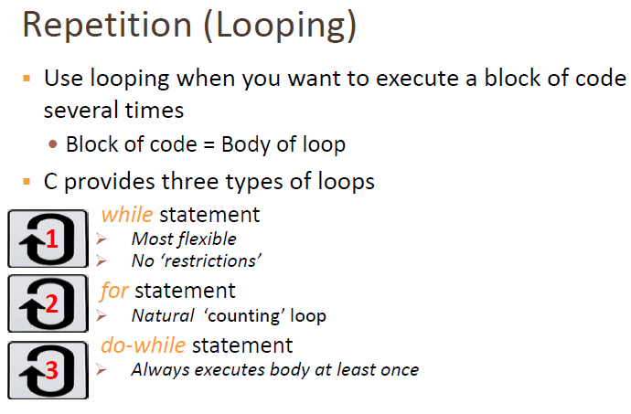
Notes:
27

Slide 28
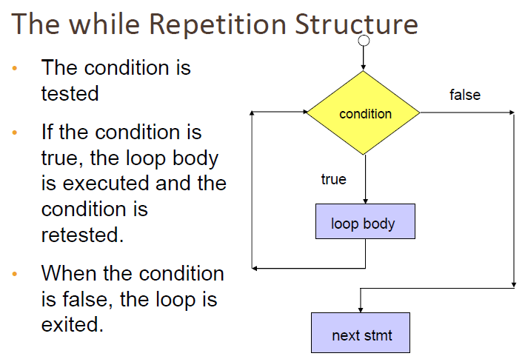
Notes:
28

Slide 29
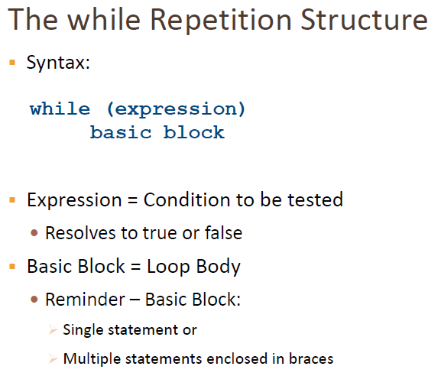
Notes:
29

Slide 30
While LOOP
#include<stdio.h>
void main(){
int count=1;
int num=10;
while (count<=10){
printf(“%d\n”,count);
count++;
}
}
Notes:
30

Slide 31
While LOOP: sum of digits
#include<stdio.h>
void main(){
int N,sum=0,R;
scanf(“%d”,&N);
while (N>0){
R= N % 10;
sum=sum+R;
N=N/10;
}
printf(“%d”,sum);
}
Notes:
31

Slide 32
While LOOP: reverse of number
#include<stdio.h>
void main(){
int N,rev=0,R;
scanf(“%d”,&N);
while (N>0){
R= N % 10;
rev=rev*10+R;
N=N/10;
}
printf(“%d”,rev);
}
Notes:
32

Slide 33
While LOOP: prime or not
#include<stdio.h>
#include<math.h>
#include<stdlib.h>
int main(){
int N,count,i=2;
scanf(“%d”,&N);
while (i<sqrt(N))
{
if(N % i==0)
{
count++;
}
i++;
}
if(count==0)
printf(“prime”);
else
printf(“Composite”);
}
Notes:
33

Slide 34
While LOOP: a^{b}
#include<stdio.h>
void main(){
int a,b,i=0,res;
scanf(“%d %d”,&a,&b);
res=a;
while (i<b-1){
res=res*a;
i++;
}
printf(“Result is %d”,res);
}
Notes:
34

Slide 35
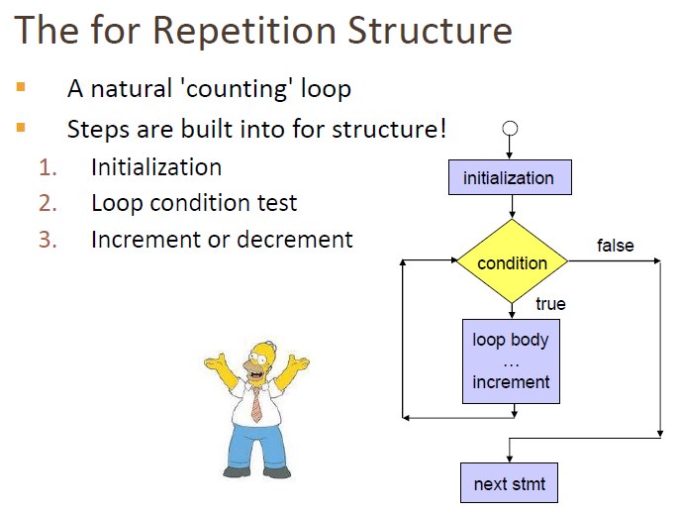
Notes:
35

Slide 36
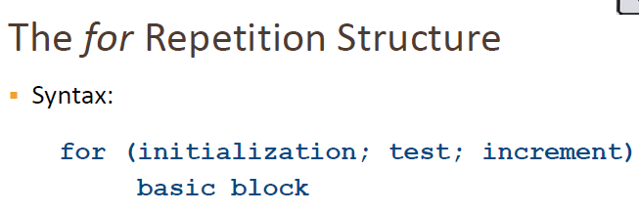
Notes:
36

Slide 37
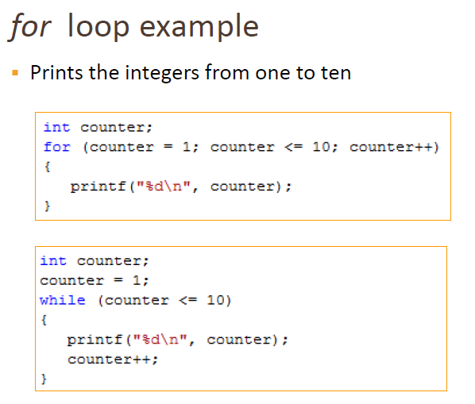
Notes:
37

Slide 38
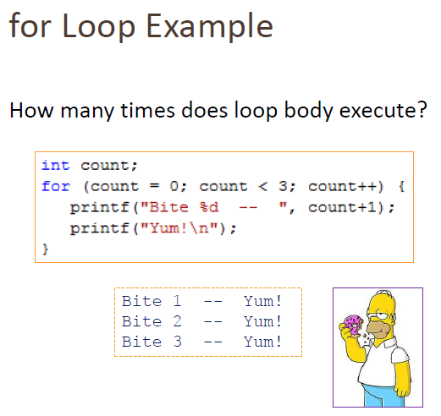
Notes:
38

Slide 39
For LOOP:
#include<stdio.h>
void main(){
int i;
for(i=0;i<5;i++){
printf(“%d”,i);
}
printf(“%d”,i);
}
Output 012345
Notes:
39

Slide 40
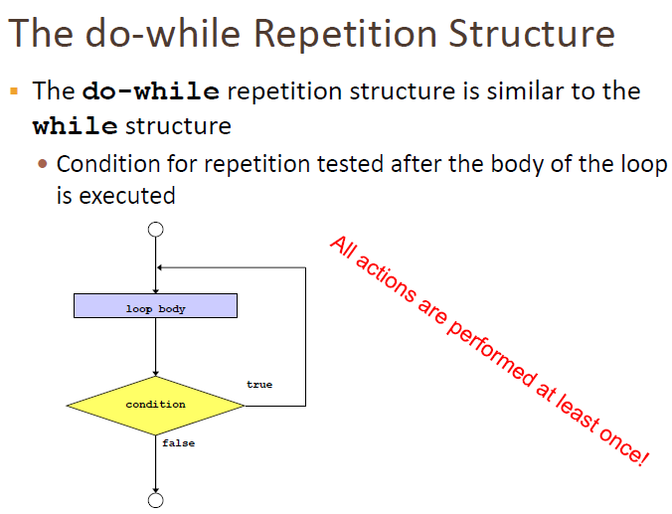
Notes:
40

Slide 41
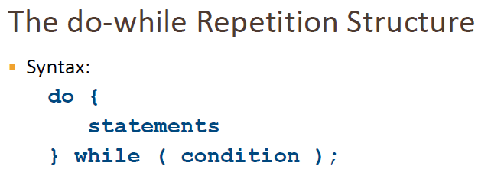
Notes:
41

Slide 42
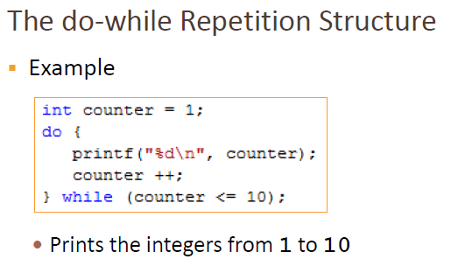
Notes:
42

Slide 43
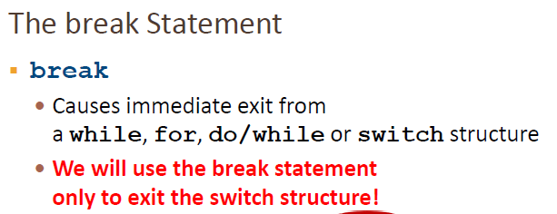
Notes:
43

Slide 44
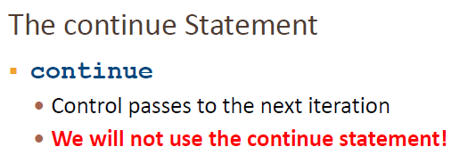
Notes:
44

Slide 45
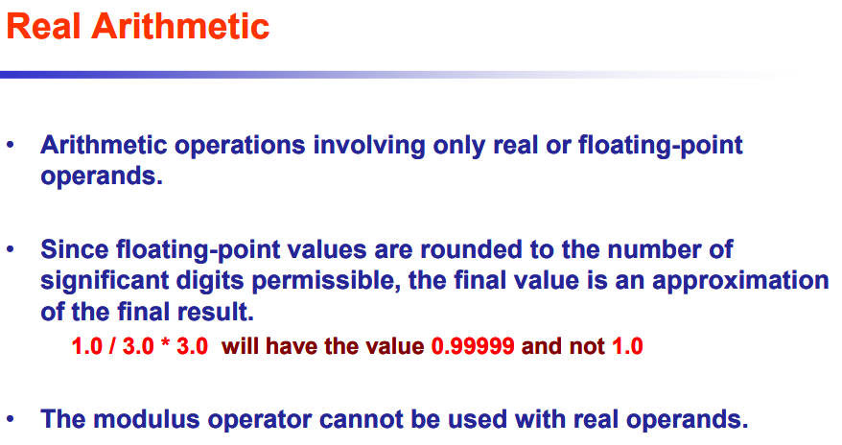
Notes:
45

Slide 46
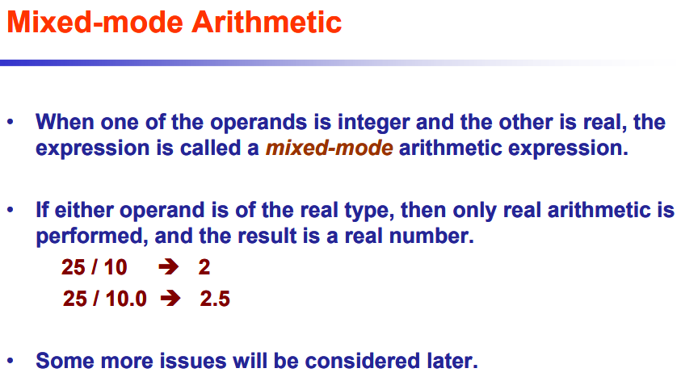
Notes:
46

Slide 47
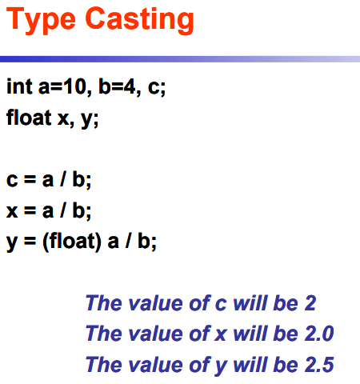
Notes:
47

Slide 48
Arithmetic Operator
#include<stdio.h>
void main(){
printf("%f\n",1.0/3.0*3.0);
printf("%d\n",8/4/2);
printf("%d\n",8%6/2*5);
}
Notes:
48

Slide 49
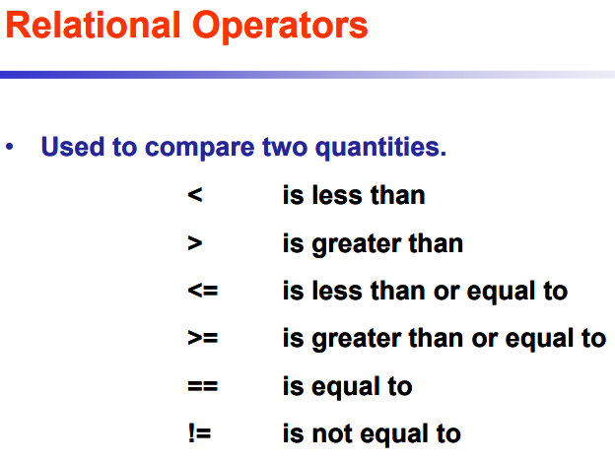
Notes:
49

Slide 50
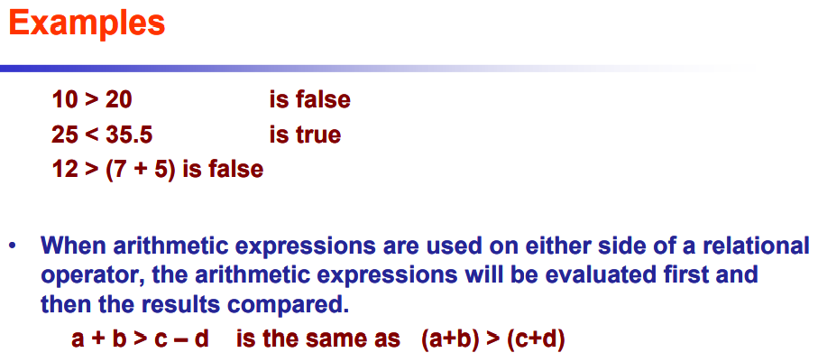
Notes:
50

Slide 51
#include<stdio.h>
void main(){
int a=5;
int b=6;
printf("%d\n",a>b);
printf("%d\n",a<b);
printf("%d\n",a>=b);
printf("%d\n",a<=b);
printf("%d\n",a==b);
printf("%d\n",a!=b);
printf("%d\n",4>5+6-a-- <9);}
Relational Operator
Notes:
51

Slide 52
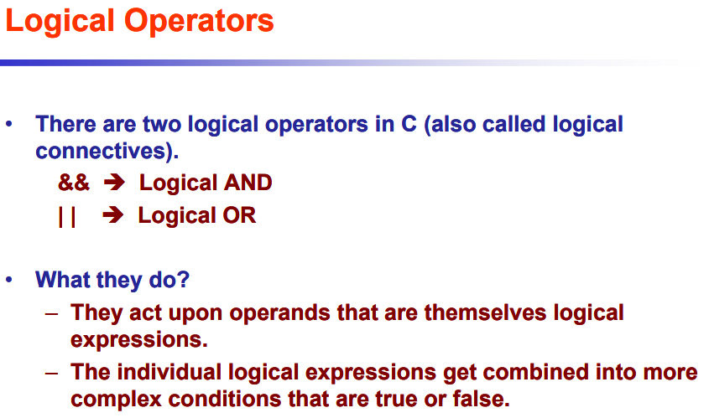
Notes:
52

Slide 53
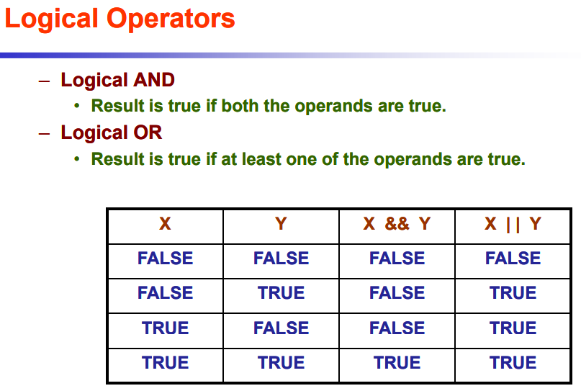
Notes:
53

Slide 54
#include<stdio.h>
void main(){
int a=5;
int b=6;
printf("%d\n",a>b&&a<b);
printf("%d\n",!a);
printf("%d\n",!a-a);
printf("%d\n",!++a-a);
printf("%d\n",4>5+6||!8+9 ==9);
}
Logical Operator
Notes:
54

Slide 55
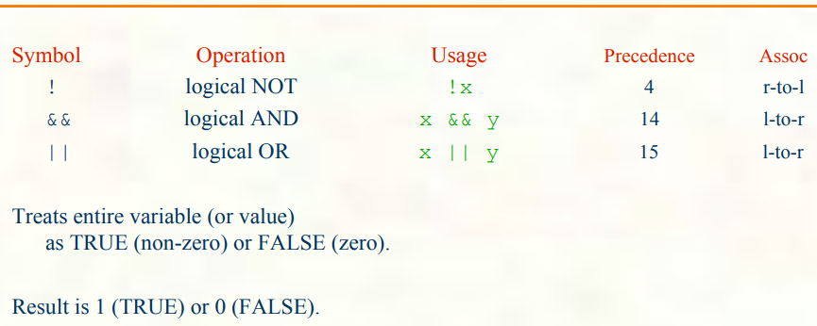
Notes:
55

Slide 56
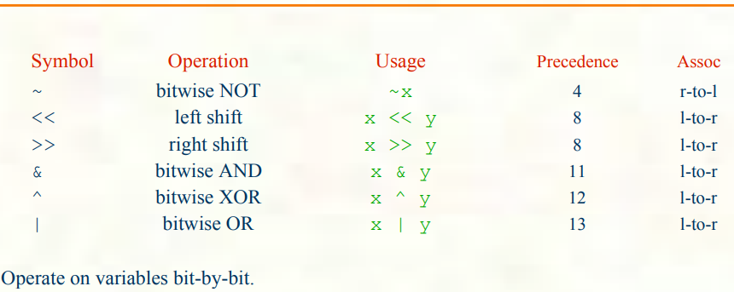
Notes:
56

Slide 57
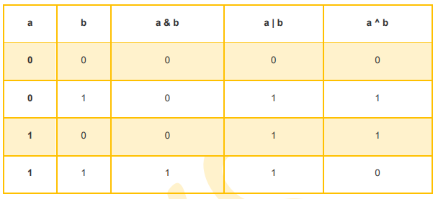
Notes:
57

Slide 58
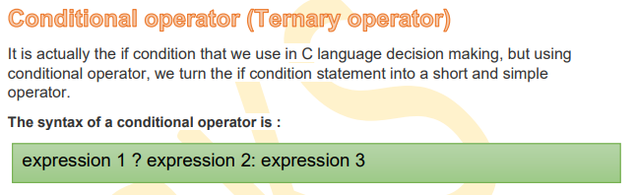
Notes:
58

Slide 59
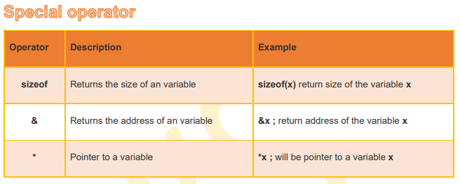
Notes:
59

Slide 60
Comma operator
Comma operator is generally used for separating variables or arguments.
Comma operator can be used to separate expressions also.
x=(a++,b++)
Here, x is assigned with value of b.
Then a is increased and then be is increased.
Bracket is important here since comma operator has low precedence than assignment operator.
Notes:
60

Slide 61
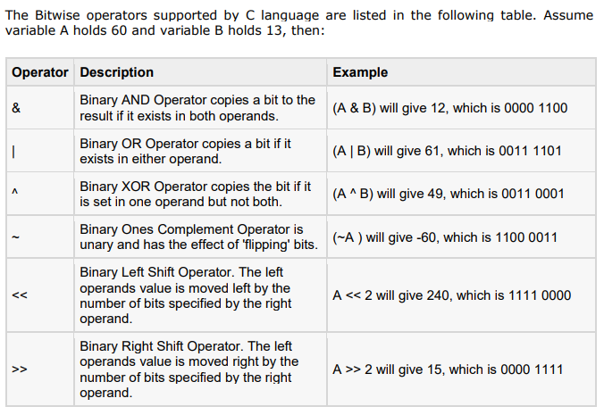
Notes:
61

Slide 62
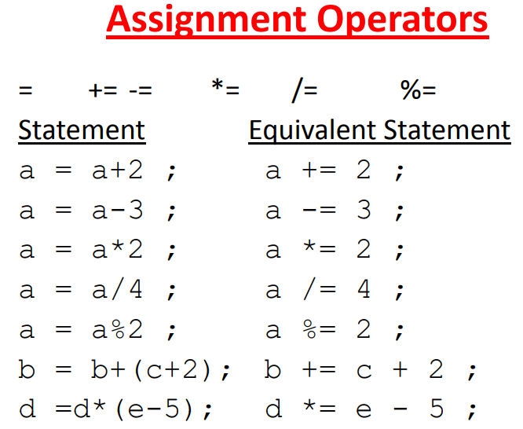
Notes:
62

Slide 63
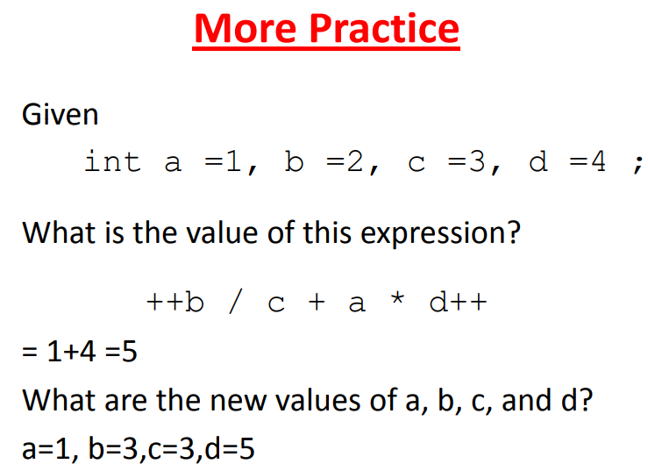
Notes:
63

Slide 64
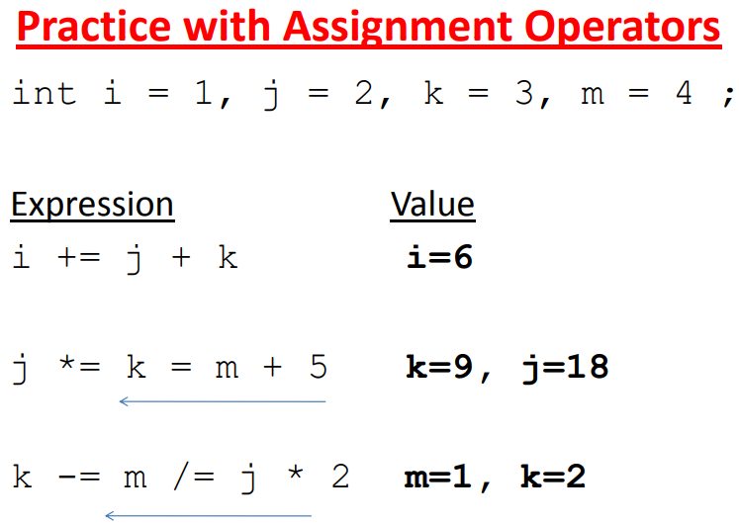
Notes:
64

Slide 65
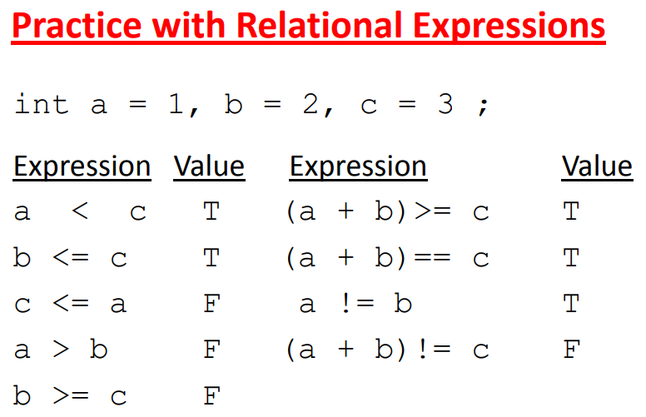
Notes:
65

Slide 66
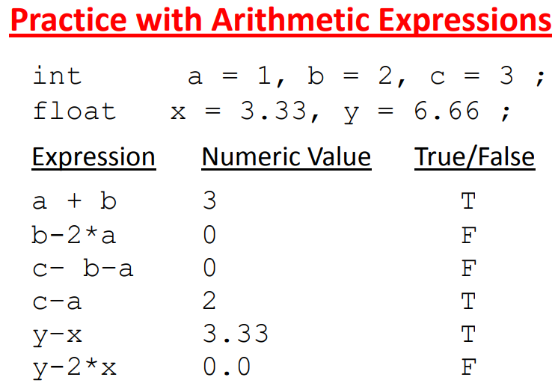
Notes:
66

Slide 67
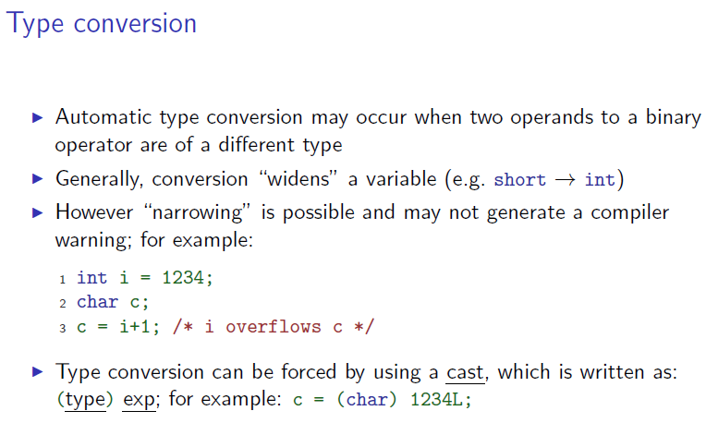
Notes:
67

Slide 68
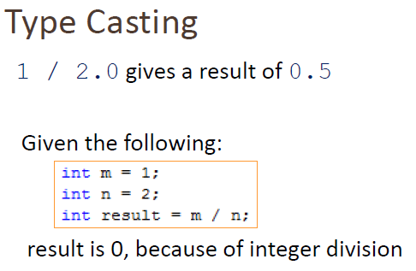
Notes:
68

Slide 69
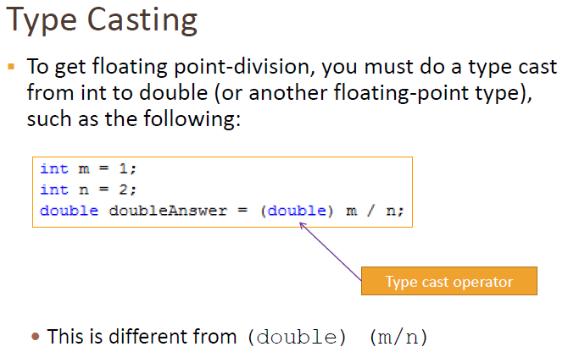
Notes:
69

Slide 70
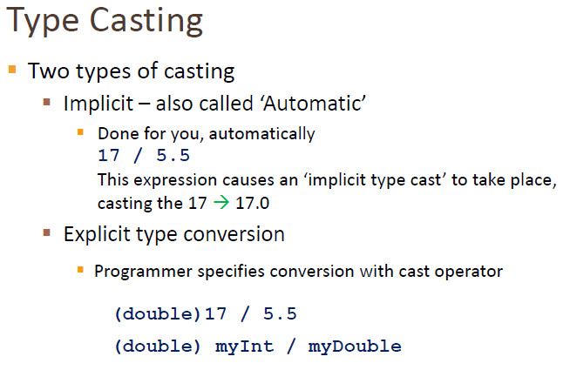
Notes:
70

Slide 71

Notes:
71

