Slide 1
Chapter – 6
Public-Key Cryptography
Notes:
Lecture slides by Lawrie Brown for “Cryptography and Network Security”, 4/e, by William Stallings, Chapter 9 – “Public Key Cryptography and RSA”.

Slide 2
Private-Key Cryptography
traditional private/secret/single key cryptography uses one key
shared by both sender and receiver
if this key is disclosed communications are compromised
also is symmetric, parties are equal
hence does not protect sender from receiver forging a message & claiming is sent by sender
Notes:
So far all the cryptosystems discussed, from earliest history to modern times, have been private/secret/single key (symmetric) systems.
All classical, and modern block and stream ciphers are of this form, and still rely on the fundamental building blocks of substitution and permutation (transposition).

Slide 3
Public-Key Cryptography
probably most significant advance in the 3000 year history of cryptography
uses two keys – a public & a private key
asymmetric since parties are not equal
uses clever application of number theoretic concepts to function
complements rather than replaces private key crypto
Notes:
Will now discuss the radically different public key systems, in which two keys are used. The development of public-key cryptography is the greatest and perhaps the only true revolution in the entire history of cryptography. It is asymmetric, involving the use of two separate keys, in contrast to symmetric encryption,which uses only one key. Anyone knowing the public key can encrypt messages or verify signatures, but cannot decrypt messages or create signatures, counter-intuitive though this may seem. It works by the clever use of number theory problems that are easy one way but hard the other. Note that public key schemes are neither more nor less secure than private key (security depends on the key size for both), nor do they replace private key schemes (they are too slow to do so), rather they complement them. Both also have issues with key distribution, requiring the use of some suitable protocol.

Slide 4
Why Public-Key Cryptography?
developed to address two key issues:
  key distribution – how to have secure communications in general without having to trust a KDC with your key
  digital signatures – how to verify a message comes intact from the claimed sender.
Notes:
The concept of public-key cryptography evolved from an attempt to attack two of the most difficult problems associated with symmetric encryption: key distribution and digital signatures. The idea of public key schemes, and the first practical scheme, which was for key distribution only, was published in 1977 by Diffie & Hellman. The concept had been previously described in a classified report in 1970 by James Ellis (UK CESG) - and subsequently declassified [ELLI99]. Its interesting to note that they discovered RSA first, then Diffie-Hellman, opposite to the order of public discovery! There is also a claim that the NSA knew of the concept in the mid-60’s [SIMM93].

Slide 5
Public-Key Cryptography
public-key/two-key/asymmetric cryptography involves the use of two keys:
  a public-key, which may be known by anybody, and can be used to encrypt messages, and verify signatures
  a private-key, known only to the recipient, used to decrypt messages, and sign (create) signatures.
Notes:
Emphasize here the radical difference with Public-Key Cryptography is the use of two related keys but with very different roles and abilities. Anyone knowing the public key can encrypt messages or verify signatures, but cannot decrypt messages or create signatures, all thanks to some clever use of number theory.

Slide 6
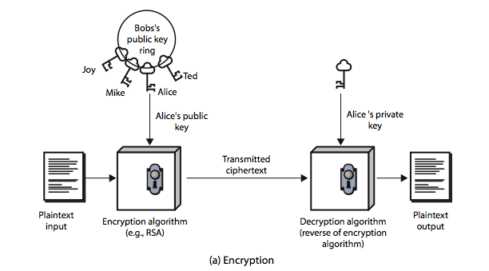
Public-Key Cryptography
Notes:
Stallings Figure 9.1a “Public-Key Cryptography”, shows that a public-key encryption scheme has six ingredients: plaintext, encryption algorithm, public & private keys, ciphertext & decryption algorithm.
Consider the following analogy using padlocked boxes: traditional schemes involve the sender putting a message in a box and locking it, sending that to the receiver, and somehow securely also sending them the key to unlock the box. The radical advance in public key schemes was to turn this around, the receiver sends an unlocked box (their public key) to the sender, who puts the message in the box and locks it (easy - and having locked it cannot get at the message), and sends the locked box to the receiver who can unlock it (also easy), having the (private) key. An attacker would have to pick the lock on the box (hard).

Slide 7
RSA
by Rivest, Shamir & Adleman of MIT in 1977
best known & widely used public-key scheme
based on exponentiation in a finite (Galois) field over integers modulo a prime
uses large integers (e.g., 1024 bits)
security due to cost of factoring large numbers
Notes:
RSA is the best known, and by far the most widely used general public key encryption algorithm, and was first published by Rivest, Shamir & Adleman of MIT in 1978 [RIVE78]. Since that time RSA has reigned supreme as the most widely accepted and implemented general-purpose approach to public-key encryption. It is based on exponentiation in a finite (Galois) field over integers modulo a prime, using large integers (eg. 1024 bits). Its security is due to the cost of factoring large numbers.

Slide 8
RSA Key Setup
each user generates a public/private key pair by:
selecting two large primes at random - p,q
computing their system modulus n=p.q
  -define ø(n)=(p-1)(q-1)
selecting at random the encryption key e
    where 1<e<ø(n), gcd(e,ø(n))=1
solve following equation to find decryption key d
  e.d=1 mod ø(n) and 0≤d≤n
publish their public encryption key: KU={e,n}
keep secret private decryption key: KR={d,n}
Notes:
RSA key setup is done once (rarely) when a user establishes (or replaces) their public key, using the steps as shown. The exponent e is usually fairly small, just must be relatively prime to ø(n). Need to compute its inverse mod ø(n) to find d. It is critically important that the factors p & q of the modulus n are kept secret, since if they become known, the system can be broken. Note that different users will have different moduli n.

Slide 9
RSA Use
to encrypt a message M the sender:
  obtains public key of recipient KU={e,n}
  computes: C = Me mod n, where 0≤M<n
to decrypt the ciphertext C the owner:
  uses their private key KR={d,n}
  computes: M = C^{d} mod n
note that the message M must be smaller than the modulus n (block if needed)
Notes:
The actual RSA encryption and decryption computations are each simply a single exponentiation mod (n). Note that the message must be smaller than the modulus. The “magic” is in the choice of the exponents which makes the system work.

Slide 10
RSA Example - Key Setup
Select primes: p=17 & q=11
Compute n = pq =17 x 11=187
Compute ø(n)=(p–1)(q-1)=16 x 10=160
Select e: gcd(e,160)=1; choose e=7
Determine d: de=1 mod 160 and d < 160 Value is d=23 since 23x7=161= 10x160+1
Publish public key KU={7,187}
Keep secret private key KR={23,187}
Notes:
Here walk through example RSA key generation using “trivial” sized numbers.
Selecting primes requires the use of a primality test.
Finding d as inverse of e mod ø(n) requires use of Euclid’s Inverse algorithm (see Ch4)

Slide 11
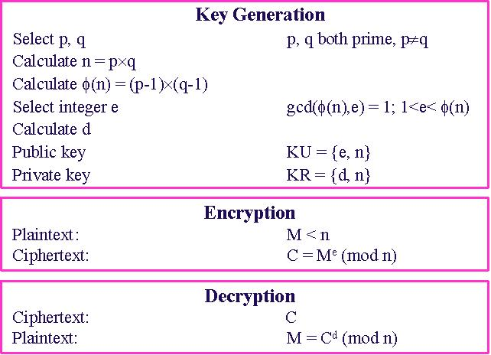

Slide 12
RSA Example - En/Decryption
sample RSA encryption/decryption is:
given message M = 88
encryption:
  C = 88⁷ mod 187 = 11
decryption:
  M = 11²³ mod 187 = 88
Notes:
Then show that the encryption and decryption operations are simple exponentiations mod 187.
Rather than having to laborious repeatedly multiply, can use the "square and multiply" algorithm with modulo reductions to implement all exponentiations quickly and efficiently (see next).

Slide 13
Encryption
Decryption
Ciphertext
Plaintext
11
Plaintext
88
7
mod
187
=
11
11
23
mod
187
=
88
88
88
KU
=
7
,
187
KR
=
23
,
187
Figure
1
.
Example of RSA Algorithm

Slide 14
RSA Key Generation
users of RSA must:
  determine two primes at random - p, q
  select either e or d and compute the other
primes p,q must not be easily derived from modulus n=p.q
  means must be sufficiently large
  typically guess and use probabilistic test
exponents e, d are inverses, so use Inverse algorithm to compute the other
Notes:
Before the application of the public-key cryptosystem, each participant must generate a pair of keys, which requires finding primes and computing inverses. Both the prime generation and the derivation of a suitable pair of inverse exponents may involve trying a number of alternatives. Typically make random guesses for a possible p or q, and check using a probabalistic primality test whether the guessed number is indeed prime. If not, try again. Note that the prime number theorem shows that the average number of guesses needed is not too large. Then compute decryption exponent d using Euclid’s Inverse Algorithm, which is quite efficient.

