Slide 1


Your ai-powered, all-in-one form solution: Build, deploy, and streamline your workflow effortlessly!

Slide 2
The need for Online Form applications
If your company or organisation needs others to fill in some forms, then you need an Online Form application. Some examples:
The Human Resources wants to candidates to fill in job application forms
The Finance Department needs employees to fill in reimbursement forms
The Health and Safety Department needs health forms to be filled
Your construction engineering company needs some forms to be filled by contractors
You are a car dealer and want your customers to fill in finance application forms
The Student Affairs department wants students to fill in financial aid or transcript request form
You have a restaurant and want to hear complaints or feedback from your customers
You want meeting notes and actions to be taken in a form
Basically, whenever you need data to be entered in a structured form with an online device, you need Online Form!

Slide 3

the functions of Online Form applications
Helps you design forms
Delivers forms to the right audience
Processes submitted form data
Integrates form data with other workflows
Enables viewing and managing submitted data and uploaded/exported files

Slide 4
Why yet another online form app?
Leading Online Form providers, such as Microsoft Forms and Google Forms, are excellent products.
Allow only the creation of standard forms with a limited set of question types
Support basic form-delivery scenarios
Provide minimal options for end-user verification
Require integration with other apps within their own ecosystem
Offer restricted access to form data
Have limited integration with clients’ digital systems
Overall, lack the customization, extensibility, and flexibility needed for more advanced use cases
However, they primarily offer general solutions that:

Slide 5
Data sovereignty
these industry leaders store the form data submitted by the end user.
they store the submitted form data on their own servers for all clients globally, which poses challenges for:
Security
Compliance requirements for collecting and storing sensitive data
Addressing clients' non-standard needs and use cases

Slide 6

Your form, your data!
FlexiForms stores all form-related data on your own system, whether on your server or in your cloud space. This gives you immediate and full control over:
Form designs
Form data
Uploaded files
Exported files
Logs

Slide 7
flexiforms
highly flexible
easy-to-use & intuitive
extendible
all-in-one
application suite to streamline designing, delivering, processing, integrating and monitoring Online Form
secure
AI-powered form design

Slide 8
All-in-one solution for Online Form
FlexiForms does not require you to use different products for different scenarios. It is designed to support many different sorts of use cases with only ONE product with two applications:
FlexiForms is the platform where the users will display and fill-in the forms and where the jobs are run against the form data provided by the user
FlexiForms Admin is the application where the form-owners design the forms and configure the workflow for them.

Slide 9
Designing Capabilities of flexiforms
Large variety of question types to meet diverse data collection needs
Powerful built-in validation features for questions, plus the ability to add custom validation
Detailed conditional logic to control the flow of the form based on user input
Fully customizable styling to match your branding and design preferences
Full control over the structure and appearance of the form, including pages, sections, and HTML blocks
Preview the form (including resulting form data) to ensure it meets your requirements
JSON editor for advanced users to fine-tune form design and structure
Reusable panels (collections of questions)
AI generated forms

Slide 10
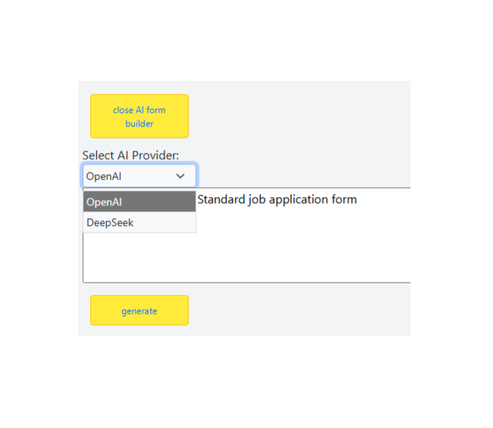

Slide 11
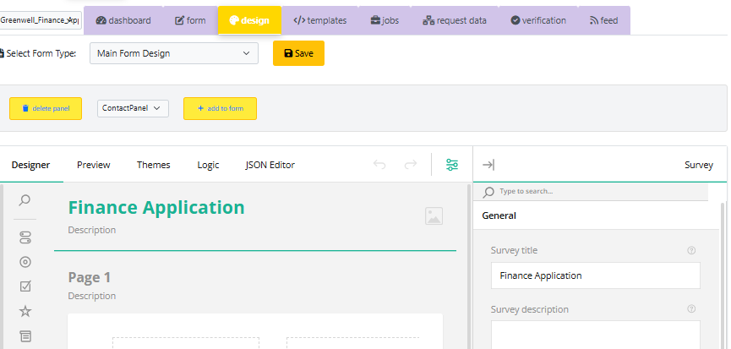

Slide 12
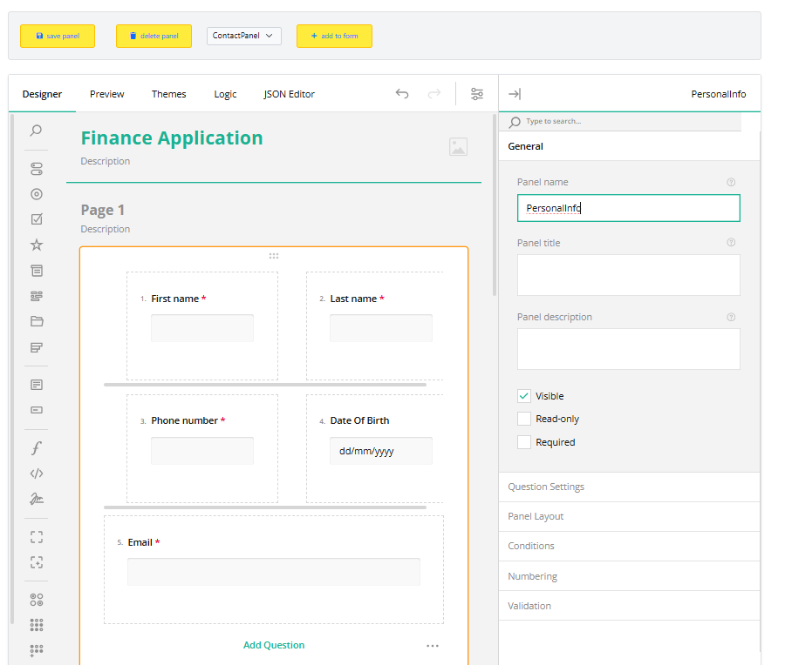
Reusable panels
The Reusable Panels feature allows the form designer to add commonly used questions in the form of panels, making it easier to reuse sections across multiple forms.

Slide 13
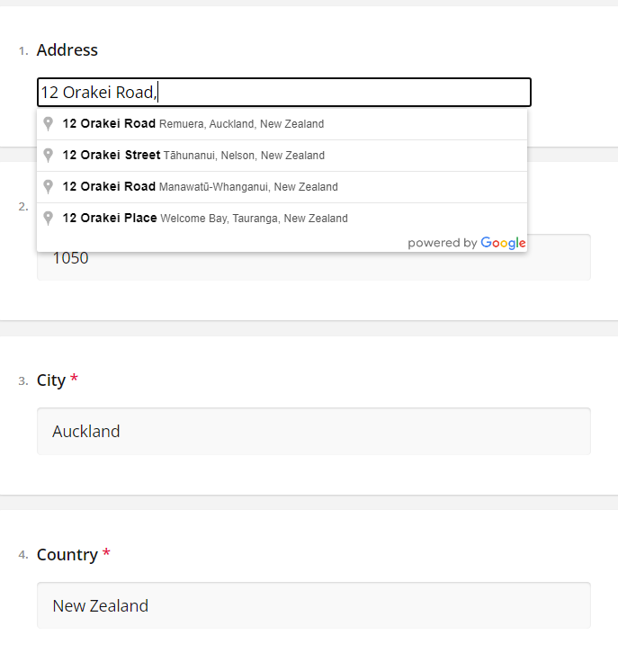
Special question types
Auto-complete text box for addresses and auto-extraction of address parts help streamline the form-filling process by automatically suggesting and filling in address details, reducing manual input and ensuring accuracy.

Slide 14
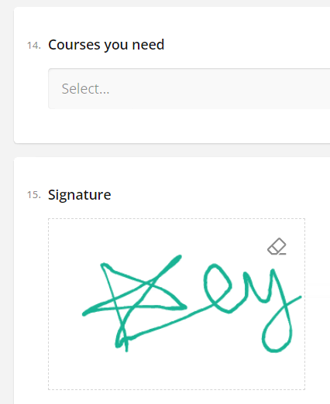
Special question types
Signatures

Slide 15
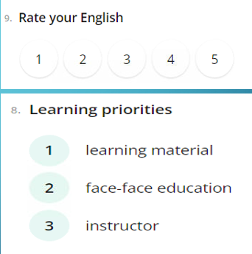
Special question types
Rating Scales
Rankings

Slide 16
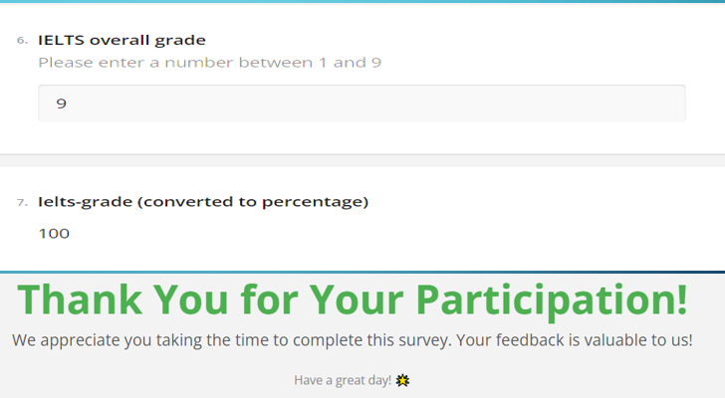
Special question types
Expressions (Calculated fields)
HTML Blocks

Slide 17
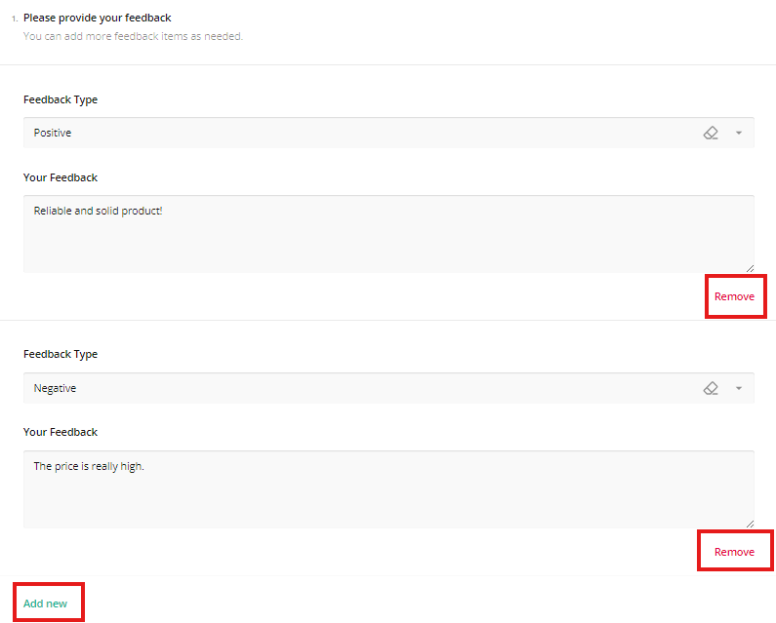
complex question types : dynamic panel
Dynamic panels allow users to enter multiple answers to the same question, enabling flexible data collection for scenarios that require multiple responses.

Slide 18
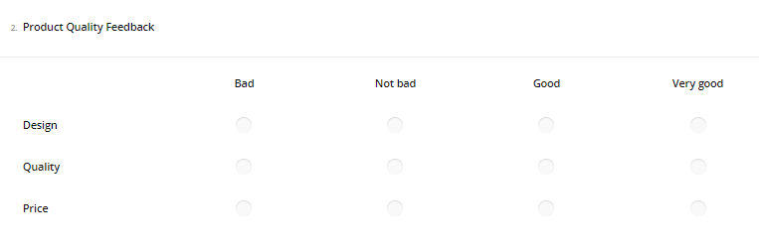
complex question types : single-select matrix
Single-select matrix questions allow users to choose a single set of options for multiple questions presented in a matrix layout, making it easier to compare and answer related questions in a structured format.

Slide 19
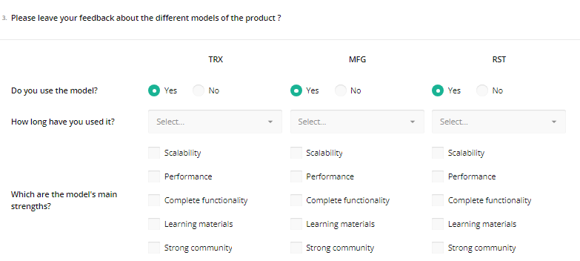
complex question types : multi-select matrix
Multi-select matrix questions allow users to answer the same set of questions for different alternatives in a matrix format, eliminating the need to repeat the same questions for each alternative in a row.

Slide 20
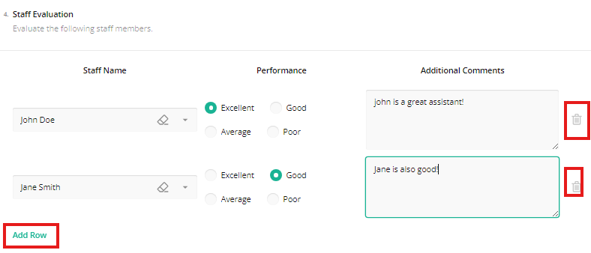
complex question types : DYNAMIC matrix
Dynamic matrix questions, like dynamic panels, allow users to provide multiple answers to the same set of questions. However, unlike dynamic panels, the questions are displayed horizontally in a matrix layout, rather than vertically.

Slide 21
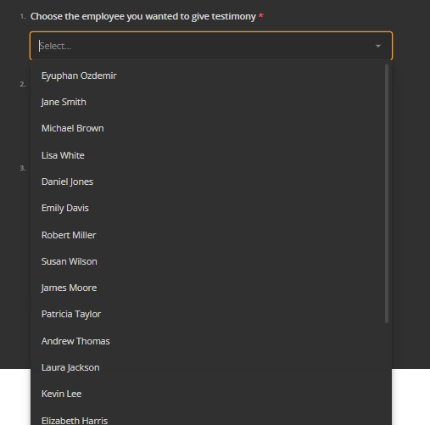
dynamic DATA INJECTION
FlexiForms has a highly useful feature called API Data Sources, which we'll explore in detail later. Here's how it is used for dynamic data injection:

Slide 22
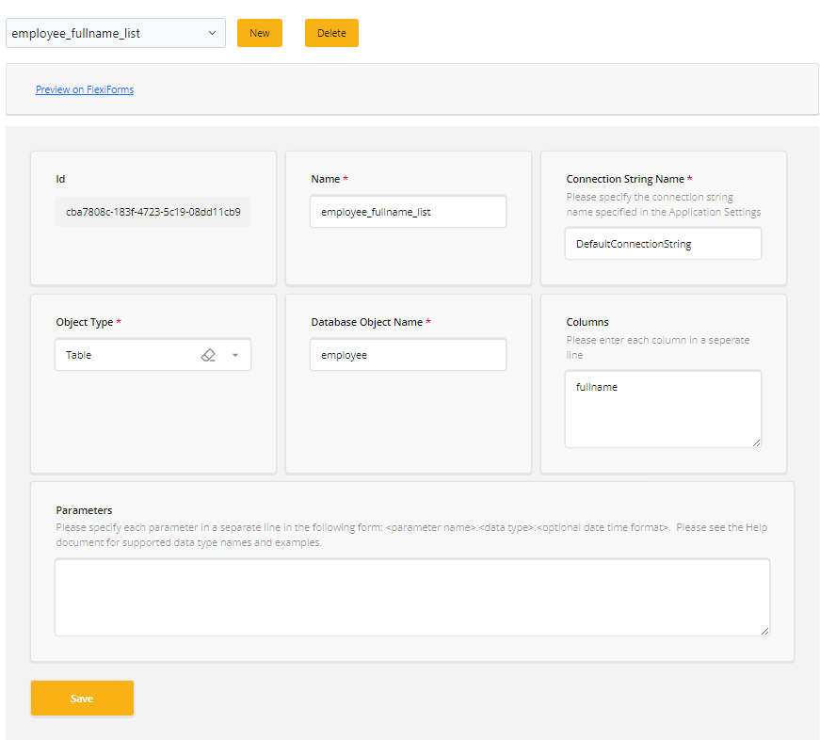
dynamic DATA INJECTION
Here, the choices for employees are fetched from the client’s database using the API Data Source setting, which can be easily configured as shown.

Slide 23
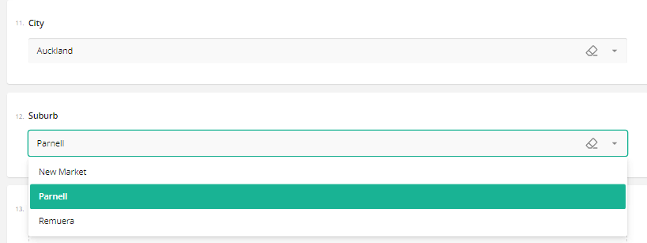
dynamic DATA INJECTION
Here is another example: The cities are fetched from a database, and when a city is selected, the suburbs of the selected city are automatically populated, all thanks to the API Data Source.

Slide 24

Uploads
FlexiForms allows end users to upload files, either as multiple uploads or single uploads, with customizable file size and type options.
Uploaded files can be easily accessed through the Admin app.
They can be attached to emails.
They can be used in email or export templates.

Slide 25
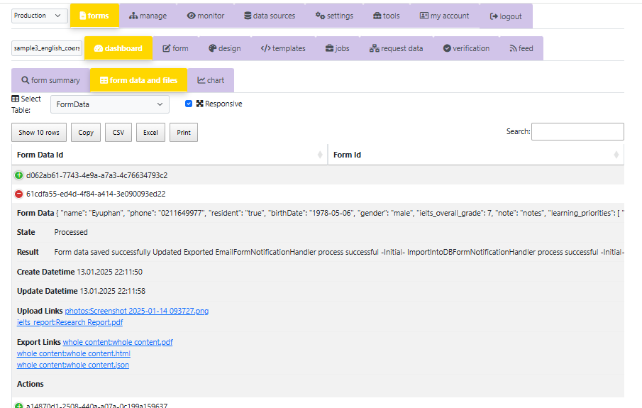
Uploads
Accessing uploaded files through the Admin app is very easy. The uploaded files can be injected into an email (either in the content or as an attachment) or into a PDF/HTML file.

Slide 26
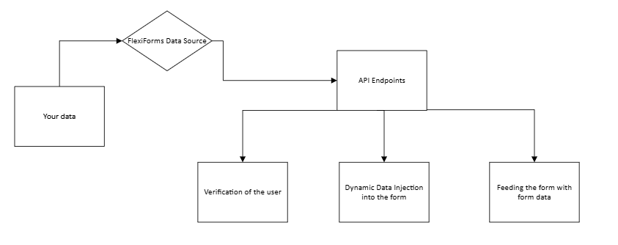
Api data sources
API Data Sources make your data easily accessible to FlexiForms. Essentially, it allows your data to be communicated to FlexiForms through API endpoints, which can be used for various purposes.
We’ve already seen the first example: Dynamic Data Injection into Forms.
Other uses include:
User Verification: FlexiForms can use these endpoints to verify whether the end-user is authorized. For example, we can allow only certain users to fill out the form by checking if their email is in your whitelist. We will explore the details of verification later.
Pre-populating (Feeding) Form Data: API endpoints can be used to feed a form with previously filled-in data.

Slide 27
Verification of the user
FlexiForms, by default, allows anyone with the form link to fill out the form. However, there are scenarios where we may want to restrict access to the form. For example, we may want the form audience to be:
Only the employees in our organization
Only users who have a specific type of passport
Only people who are registered in our database
Only people who have unique links
Only people who have not filled out the form before

Slide 28
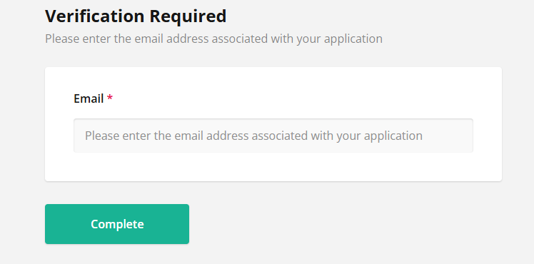
Verification of the user
FlexiForms offers a highly flexible verification mechanism where a source is matched with a target.
Sources can be any piece of information the user provides on the verification screen, as shown in the examples below.

Slide 29

Verification of the user
When it comes to targets, they can be almost anything:
A fixed text
A piece of information returned from an API endpoint
Data inside the URL, cookies, etc.
A third-party verification
For example:
If the source is a piece of information in the URL (such as an encoded text) and the target is a password (the decoded version of that text) provided by the user on the verification screen—voilà! You have a password-protected form.
If the source is an email entered on the verification screen and the target is an API endpoint, you can check whether the email exists in a third-party tool’s database (e.g., an HR system used by your organization).
FlexiForms allows you to freely design the Verification Screen. Any question added to this screen becomes an integral part of the form data, making it available for jobs and rules.

Slide 30
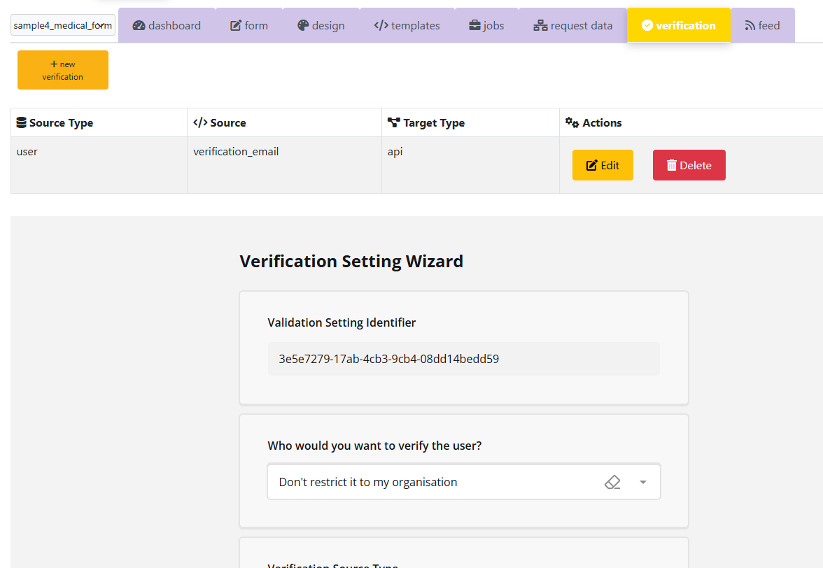
Verification of the user
FlexiForms allows you to design the Verification Screen freely. Any question on this screen becomes an integral part of the form data, making it available for jobs and rules.

Slide 31

Verification of the user
The flexibility of this source-target matching mechanism allows FlexiForms to support a wide range of verification scenarios.For example, suppose you want to send unique links to specific individuals who need to fill out the form. In this case:
Source: A piece of information in the form link’s URL (e.g., a user key).
Target: An API data source that checks the user key against a database table.
This setup ensures that only authorized users can access the form. Even more, you can define multiple verification steps for the same form! For instance, you can restrict access to:
Only users stored in a specific database table.
Only users who have not yet completed the form.

Slide 32
FlexiForms workflow: JOBS
Jobs are processes applied to the form data submitted by users. FlexiForms offers six standard jobs:
Emailing
You can select none, any, some, or all of these jobs for the form data. Once the user completes the form, the selected jobs will be executed using the provided form data.
Additionally, you can add multiple jobs of the same type! For example, you might want certain pieces of form data to be emailed to Person 1 while sending other pieces to Person 2.
Importing data into your SQL Server database
Transferring data to any API endpoint
Exporting form data as PDF, HTML, or JSON files
Sending data directly to database processes
Importing form data into Access, Excel, or CSV files

Slide 33
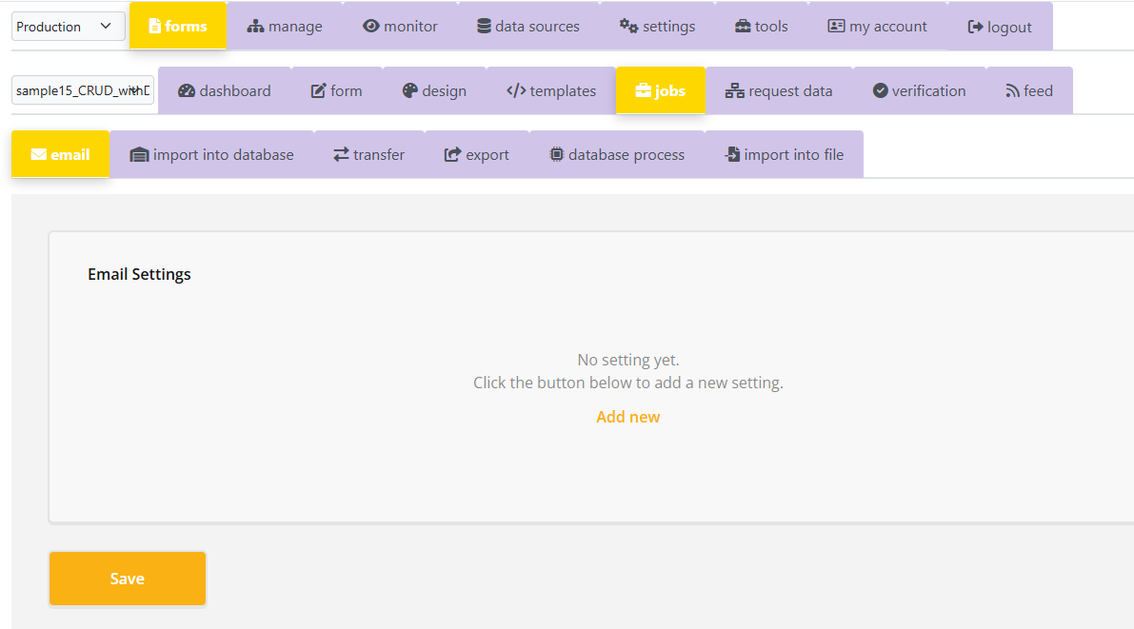

Slide 34
FlexiForms workflow: rules for jobs
You can define rules for when a job should run. These rules are expressions like “age >= 18,” meaning the job will execute only if the user meets the specified condition, such as being an adult.
For example, you might want FlexiForms to send an email to a specific address only if the user indicates in the form that they live in Auckland.
Otherwise, the email should be sent to a different address. To achieve this, you can set up two email jobs with the following rules: (1) location == "Auckland", and (2) location != "Auckland". That’s it!

Slide 35
Email job
Email jobs use email templates, which you can easily design using the template editor in the Admin app. If you're looking for a standard template, you can even utilize the Auto-Template feature of the editor.
The template can include uploaded or exported images, meaning these images will be displayed in your email.
You can also attach both uploaded and exported files to your email.
You can use dynamic recipients for emails. For instance, if you want the email to be sent to the address the user entered for the question named "recruiter_email," you simply set the recipient as {recruiter_email}. That's it! Similarly, you can send confirmation emails to the user by setting the recipient to {user_email}.
The subject of the email can also be dynamic. For example, the subject could be "An application from {user_fullname} has been received for {recruiter_name}."

Slide 36
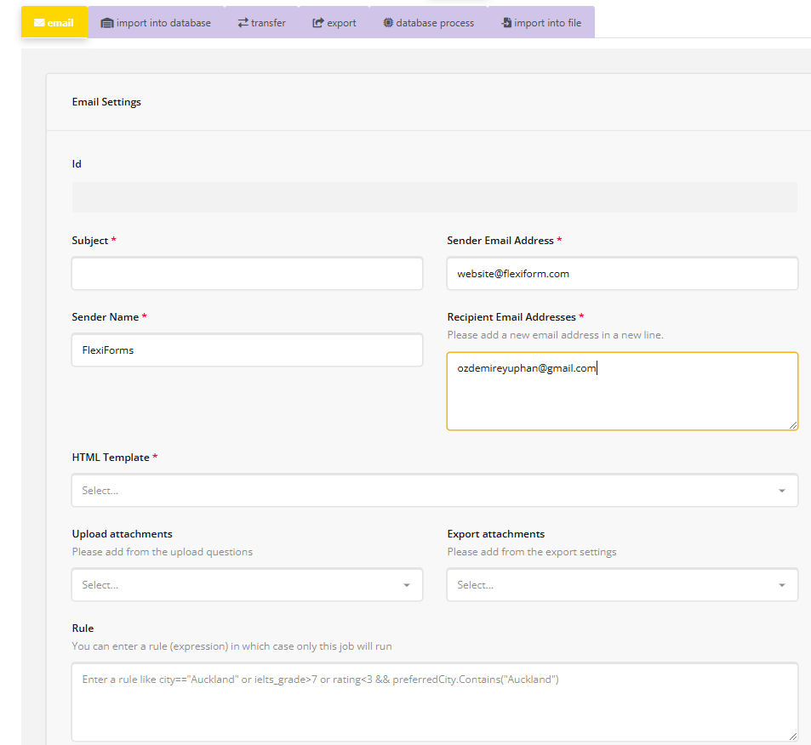

Slide 37
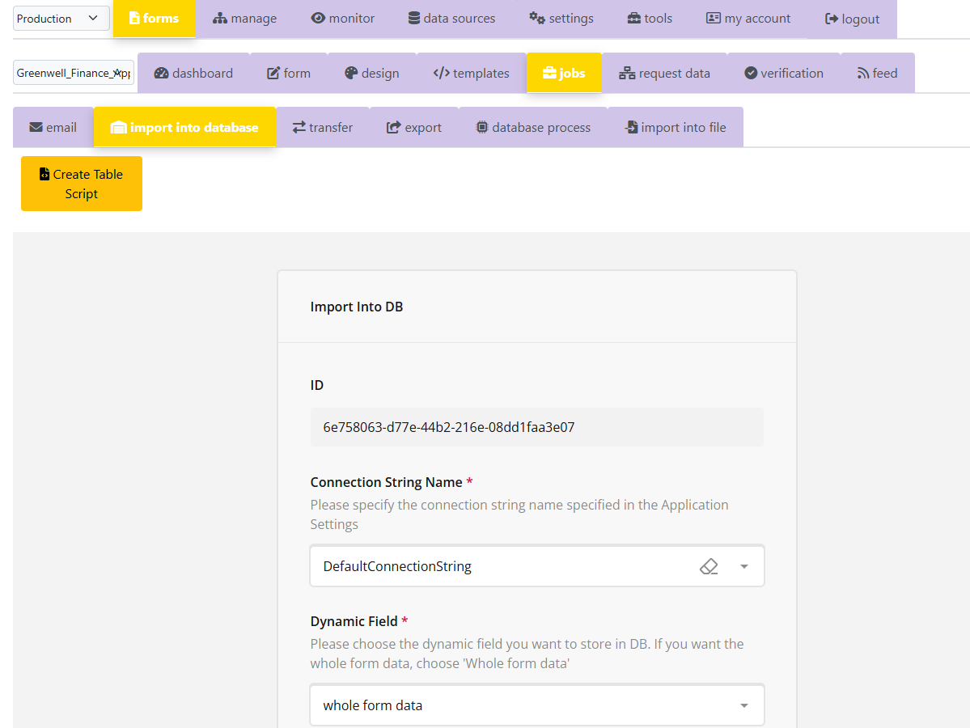
Import into database job
FlexiForms makes it very easy to store form data into your SQL Server database.
With just one click, you can create the target table and automatically specify that the form data should be imported into it. Even better, if your form contains complex fields, the same click will create separate tables to store both the entire form data and the data from each complex field.

Slide 38
Transfer jobs FOR INTEGRATION
Imagine you want to send the form data to a web API, whether it's your own API or a third-party API.
FlexiForms allows you to connect to these APIs (by providing the necessary credentials, if required) and send the form data to the specified endpoints.
You can set up multiple transfers.
You can use rules for transfers, allowing FlexiForms to send the data to the appropriate target based on specific information in the form data.
Since transfer job allows to call standard API endpoint, it can be used to transfer the form data to a large variety of external systems such as Microsoft Power Platform or popular CRM or ERP applications.
Transfer jobs make easy to integrate with any external system.
For example, if you want the form data to be automatically inserted into a Dataverse table on Azure, you can specify the necessary details (such as authorization credentials, target database, and table) in the transfer settings, and voilà! The form data will be immediately uploaded to the cloud database once the user completes the form. Or you can send the data to Azure Functions!
Transfer jobs are not limited to API calls to external systems. You can send the data to Azure Storage Queues, Azure Service Bus Queues as messages, or to Azure Event Grid as Form Completed notification.
What is more, you can trigger the other workflow platforms such as Azure Logic App or n8n.
Similarly, by using post-api option, you can integrate the form data with any external integration platform such as Zapier or Mulesoft easily.

Slide 39
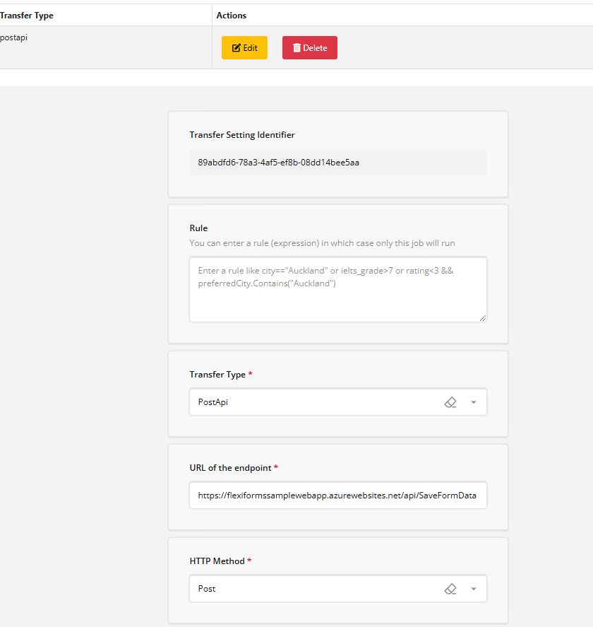

Slide 40
Export job
FlexiForms can convert the form data into PDF, HTML, or JSON files.
Similar to email jobs, exports require you to specify templates. However, as mentioned, you can use the auto-template feature if the layout of your PDF is fairly standard.
Similar to uploaded files, you can easily access the exported files on the Display Data page in the Admin App.
You can attach exported files to your emails.
You can export form data to PDF using the form's existing layout, no separate template needed.

Slide 41
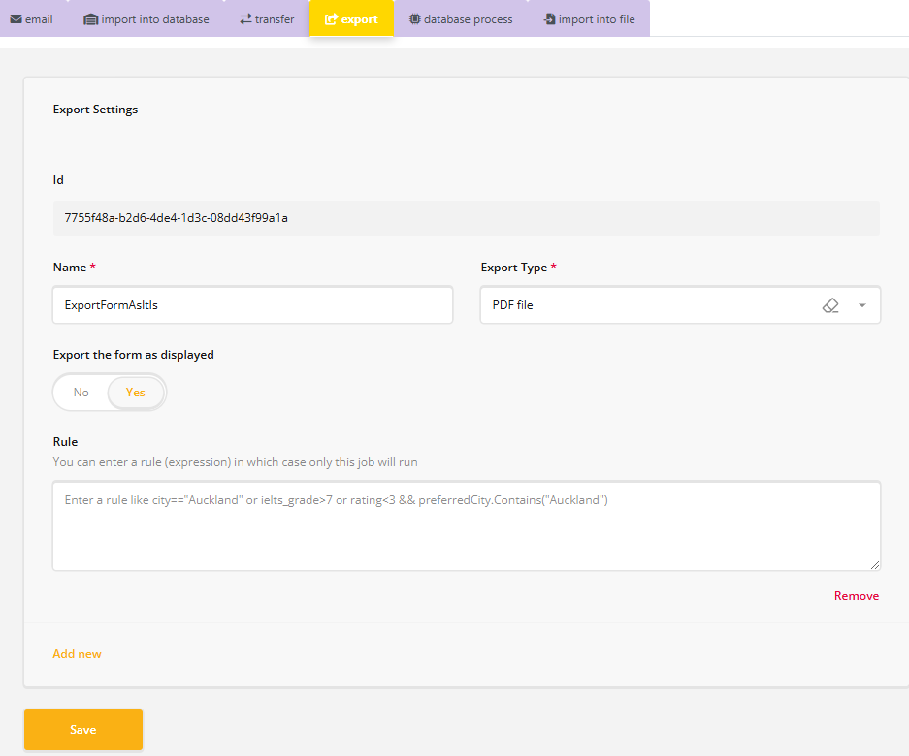

Slide 42
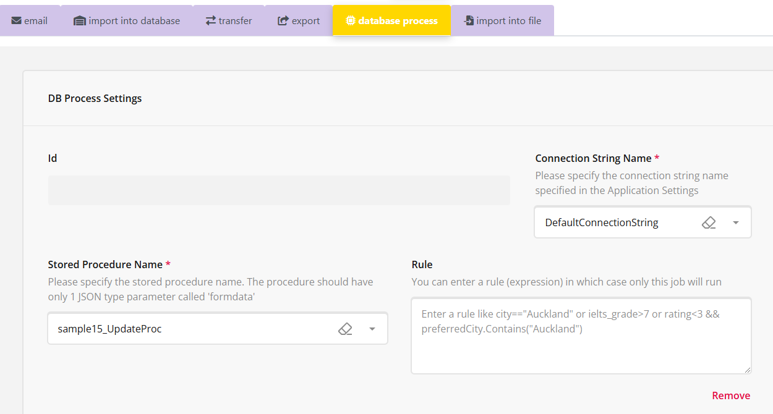
Database process job
This job allows you to send the form data directly to specific processes in the SQL Server, providing users with a lot of flexibility. For example, with this job, you can not only insert but also delete and update the form data.

Slide 43
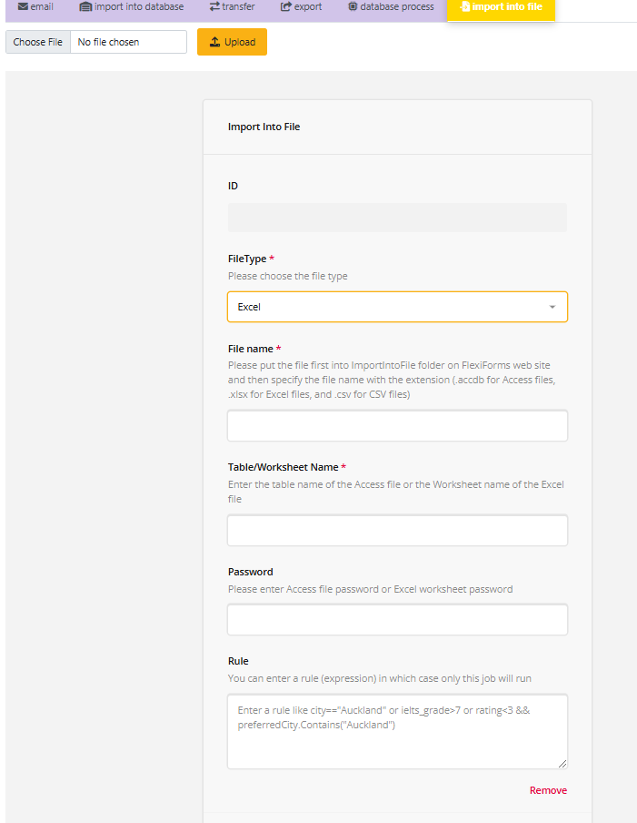
Import into file job
This job allows you to add the form data to existing Access, Excel, or CSV files. You can easily download the updated file from the Form Data and Files page whenever you need it.

Slide 44
Request data
When you request a page (or any resource) on the internet, your request includes information such as the URL of the page, cookies sent by your browser, and more. This is referred to as (Web/HTTP) Request Data.
Request data contains important information, such as special key-value pairs (e.g., user_id=1456921) in the URL, your IP address, the origin of the request (the website from which you requested the resource), the browser you're using, the server that sent your request, and more.
Once you specify which parts of the request data you're interested in, FlexiForms makes good use of the specified data, especially the information from the URLs, in the following ways:
It makes that data available for your jobs. For example, you can display the user ID (from the URL) in an email or store it in the database. Similarly, you can store other details such as the IP address, browser, origin, etc., in the database.
You can use a piece of request data in your verification specifications. For example, the encoded value in the URL should match the passport provided by the user on the verification screen.
You can also use some request data to feed the form. This is especially useful to run different jobs by relying on a rule that will check the value of the passed query parameter. For example, if the form link has the query parameter mode=update (as in https://flexiformsqa.azurewebsites.net/e9460139-691f-4c08-a0b7-0b0c863ea5d6?mode=update), and if the rule for the Database Process Job (that is designed to update an existing job) is defined as mode="update", then the update job (rather than insert or delete job) is run.

Slide 45
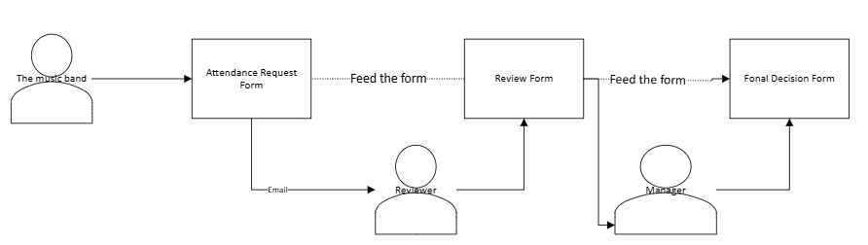
Feeding the form
Imagine you've designed a form for a music event, called the Attendance Request form, for bands wishing to attend. After the band fills out the form, you want the app to send you an email with a link to the Review form. The Review form will display the content of the Attendance Request. You can add your comments, ratings, etc., and complete the form. Once you finish, an email will be sent to the manager, containing a link to the Final Decision form, which will include the content from both the Attendance Request and the Review forms. The manager will decide based on the request and your review, and the data will be stored in the database.

Slide 46
Feeding the form
FlexiForms is capable of handling scenarios where a form contains the data from a previously filled-out form.
In the described scenario, there are three different forms, and the form data is passed on to the next form. FlexiForms can also handle situations where a form is populated with data from the same form type. For example, you may need to send the same form back to the user for corrections, view the content in read-only mode, or use the same form for inserting, updating, or only viewing data.
To support these different scenarios, FlexiForms offers various feeding options, as follows:
The easiest way to feed a form is by passing query parameters directly in the link.
Direct feeding with the form data is another simple method to populate forms.
Posting the data to FlexiForms is the most customizable, "freest" method of feeding the forms.
For feeding the form with an API endpoint, you can easily use API data sources.

Slide 47
Self-feed forms
A form in FlexiForms can feed itself, a feature known as "Self-Feed." This is especially useful if you want to view the form data within the form itself in a read-only mode for easier and more organized review. Additionally, you can pass special request data through the link and utilize rules, enabling a different process to run on the same form data.
With FlexiForms Admin’s Form Data & Files module, you can view form data within the form layout if it’s a self-feed form. When a self-feed form is reviewed through this module, FlexiForms displays the form in a read-only mode.

Slide 48
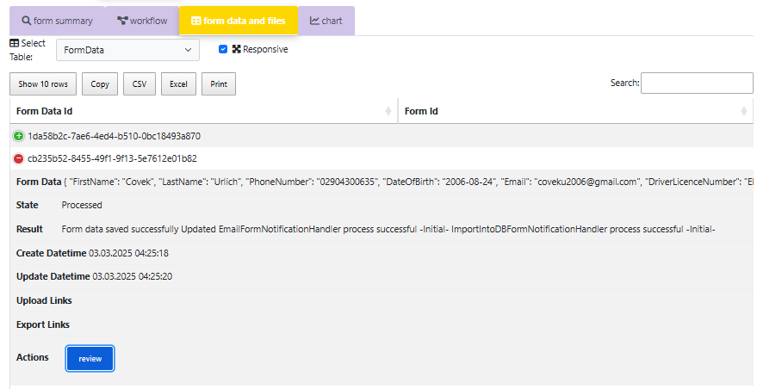
Reviewing self-feed forms

Slide 49
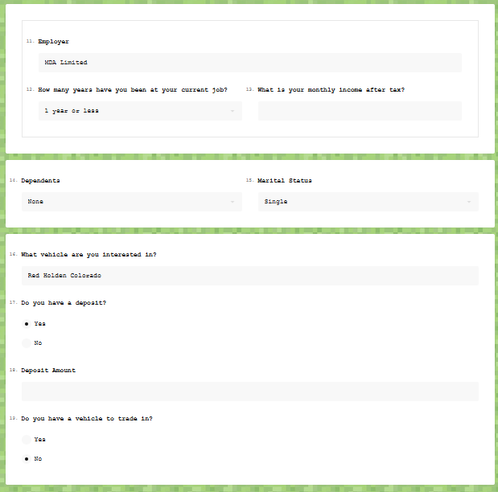
Reviewing self-feed forms

Slide 50
Unique user links
In certain scenarios, you may need to send unique links to specific users. FlexiForms can handle this by allowing you to provide unique identifiers within the form link.
And if you store the unique links in a database table, FlexiForms can ensure that each user receives the correct, personalized link, managing the process efficiently.
Only the links stored in your database can be used.
This scenario is made possible with the usage of:
API Data Sources
Request Data
Verification (Request versus API)
Import Into DB Job
Each user is allowed to fill out only one form, even without a verification screen.

Slide 51
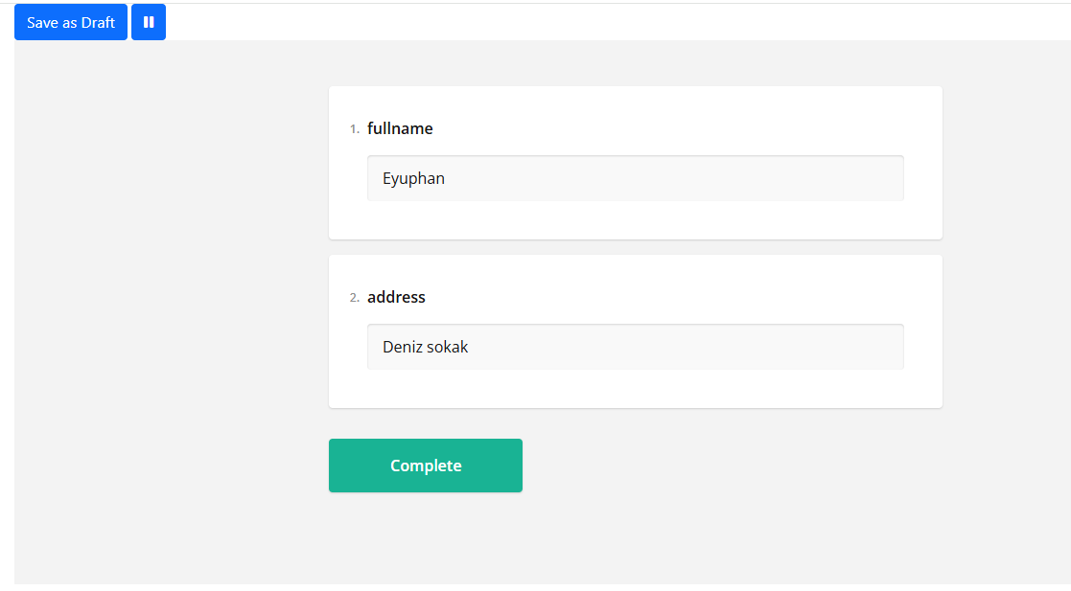
Saving drafts
If the unique user link scenario is used, FlexiForms supports a feature called "Saving Drafts" (or Drafting), allowing users to temporarily save their form data. This feature is especially useful for long forms with many questions, providing a more user-friendly experience.
Essentially, the user saves their progress as a draft and can return to the same link to continue filling out the form. They can keep doing this until the form is completed. Once the form is finished, the unique user link will no longer be available.

Slide 52
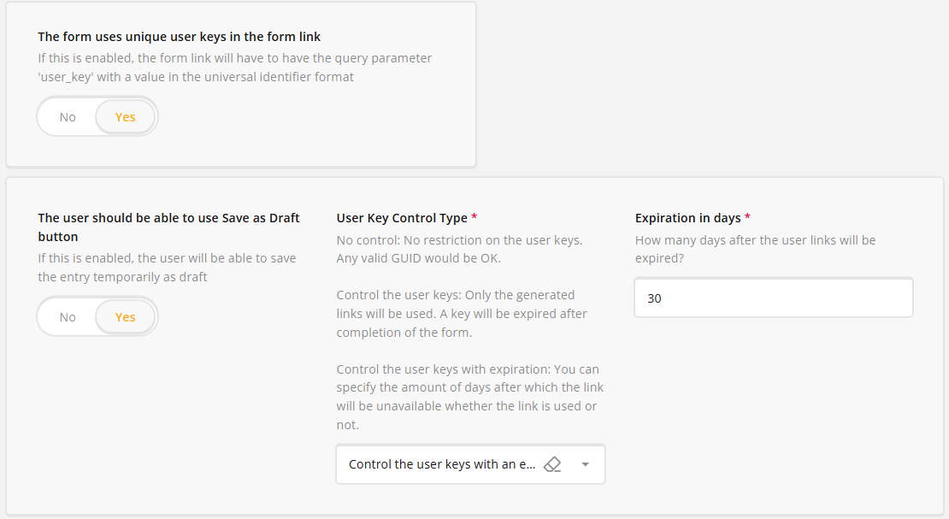
Controlled Unique links
Some forms require not only unique links for each user but also greater control over these links. For example, you may want a link to be completed only once or set an expiration period for each link. This functionality is referred to as Controlled Unique Links.

Slide 53
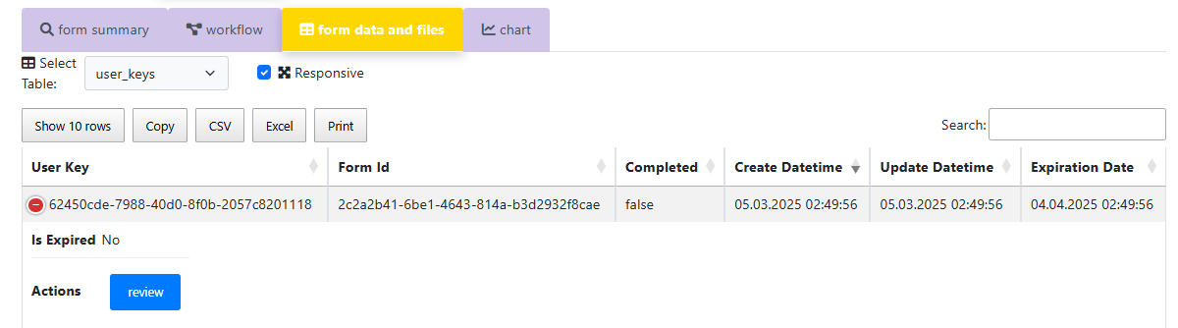
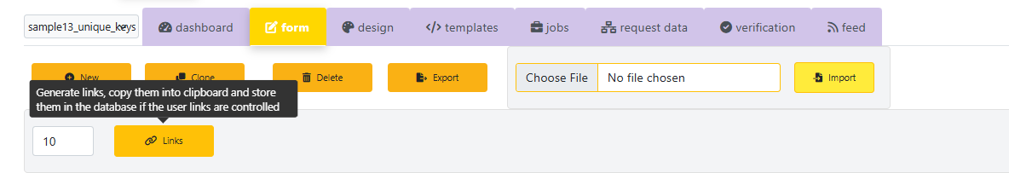
Controlled Unique links
FlexiForms allows you to generate, track, and review these controlled unique links directly within the platform.

Slide 54
Form data expiration
If the form data contains sensitive information that needs to be removed after a certain period for legal or security reasons, you can take advantage of FlexiForms' Form Expiration feature.
This way, for example, any form data older than 14 days will be automatically deleted.
The related uploaded files and exported files will also be deleted along with the form data.

Slide 55
Failover mechanism
Jobs are the core of any Online Form Application, as they transform the user-provided form data and present it in the desired format (such as database records, files, emails, etc.). Therefore, monitoring and recovering failed jobs is crucial.
FlexiForms offers a reliable failover mechanism:
You can track failed jobs on the Display Data page of the Admin app.
When a job fails, notifications will be sent immediately to the specified email addresses.
Failed jobs will be re-run automatically when the app is restarted, ensuring immediate recovery.
FlexiForms will identify which tasks from the failed job types need to be re-run, even if multiple jobs are specified for the same job type (e.g., multiple email jobs).
You can set specific Recover Times when FlexiForms will automatically re-run the failed jobs.

Slide 56
Embedded forms
Imagine you have a website and need forms to be filled out directly on your site. You want to use Online Form apps to handle this, but these apps typically display the form on their own platforms. However, you prefer not to have your users leave your website.
With FlexiForms, this is not a problem at all! You can seamlessly embed the form and workflow functionality directly into your website.
This way, the user won't even realize they're filling out the form on FlexiForms! The entire job workflow will run seamlessly when the user completes the form, just as if everything were happening on the FlexiForms platform.

Slide 57
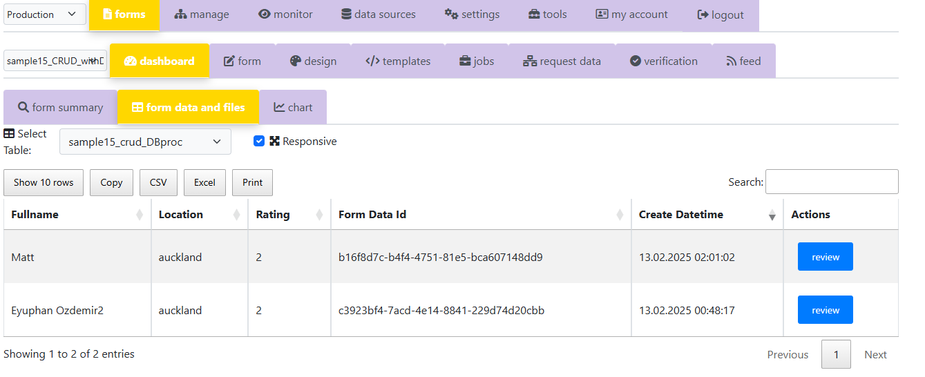
Read-only mode
FlexiForms simplifies the review process by displaying form entries in a read-only mode when necessary. With the Feed feature and an indicator on the link, the form data will be shown to you without the ability to make changes. In this mode:
The questions and answers are visible, but they cannot be edited.
The Complete button will not be displayed.
This read-only mode is activated automatically on the Form Data and Files page through Review links when one form feeds another. This ensures that the data remains intact during the review process without any alterations.

Slide 58
FlexiForms for developers
The flexibility, ease of use, building-block structure, and embeddability of FlexiForms make it an ideal tool for developers. These features allow developers to easily integrate and customize forms within their applications, providing a seamless user experience while maintaining control over the form data and workflows.
Not only does FlexiForms handle standard form requirements by delegating them to its platform (e.g., sending the user to the FlexiForms platform instead of developing a new small app for certain forms), but it also enables developers to seamlessly integrate forms into any web application they are maintaining or developing.
Imagine you're tasked with designing a long form with complex inner logic for a new entity. You don't have to create everything from scratch. With FlexiForms, you can save weeks, or even months, of tedious work by configuring the form and leveraging built-in features. Here's how:
Configure the form: Define the fields, rules, and behavior within FlexiForms.
Use the Feed feature: Easily populate the form with existing data or pass data between forms.
Utilize Request Data: Dynamically pull in data from URLs or APIs to pre-fill or conditionally display form fields.
Apply Transfer-type jobs: Automatically send form data to databases, APIs, or email, saving time on backend development.
Leverage rules for jobs: Set up custom logic to control how and when data is processed, ensuring the workflow aligns with your business needs.
This streamlined approach allows you to focus on your app's core functionality, while FlexiForms handles the heavy lifting of form management, data integration, and job automation.

Slide 59
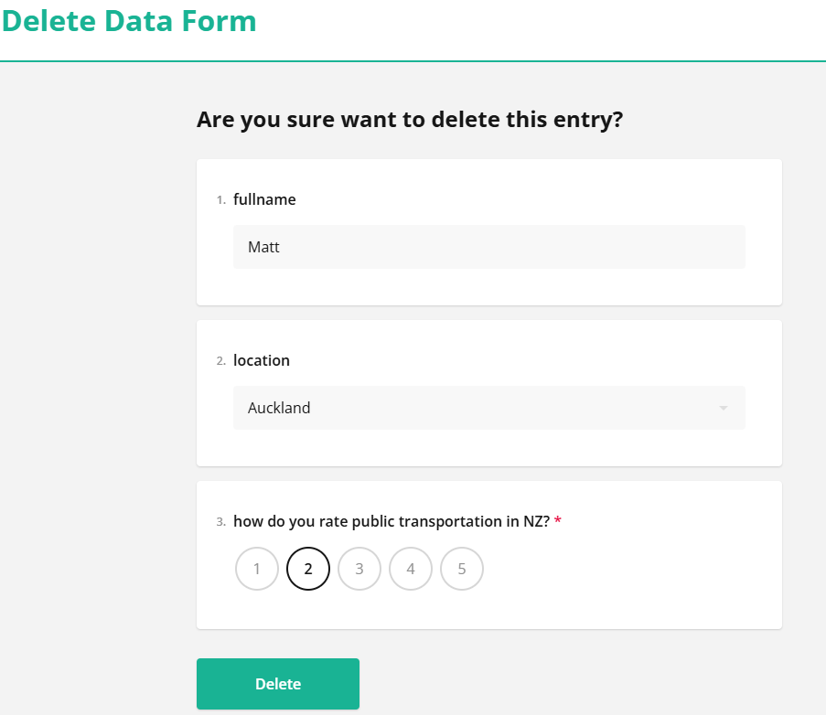
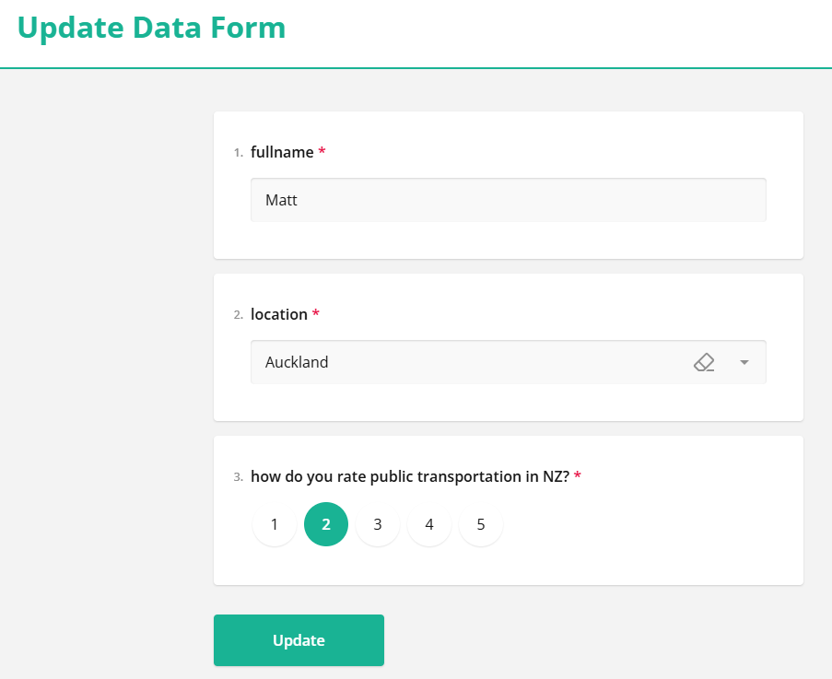
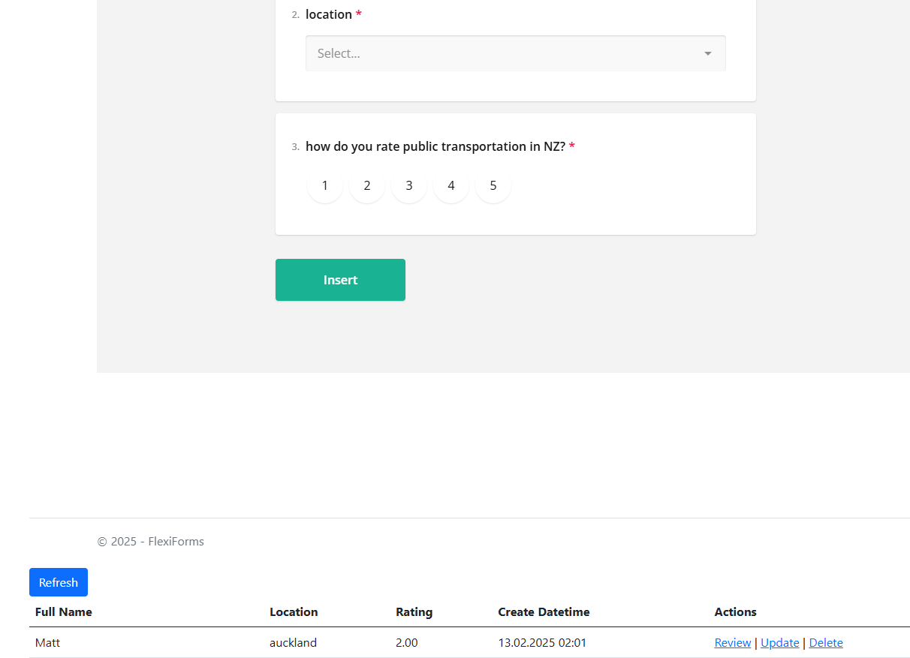
FlexiForms for developers
By using Feed and database-related jobs (like Database Processes or Import into DB), along with transfer jobs, you can quickly create insert, update, delete, and review pages for any entity. This approach minimizes development effort by automatically populating forms with data, and allows seamless integration with the database, saving time on complex workflows.

Slide 60
Set up and monitor forms on the admin app
The FlexiForms Admin App allows you to design and configure forms, workflows, and logic, as well as manage verification forms, email and export templates, API data sources, jobs, request data collection, and feed settings, while also providing easy access to form data, uploaded files, and exports.

Slide 61
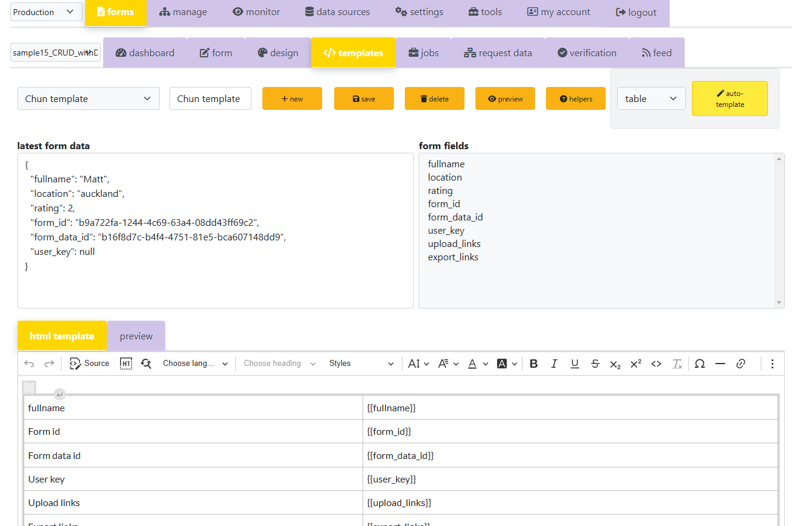
Templates MODULE
Email, PDF, and HTML export jobs require templates to define the layout and appearance by merging data into placeholders within the template.

Slide 62
Template MODULEs
The FlexiForms Template module simplifies template creation with the following features:
Lists available fields (main form questions, request data, verification questions, meta-data).
Double-click to insert fields into the template.
Auto-Template button creates a standard template in table or name:value form.
Latest Form Data section displays user-submitted raw data, with a preview of your template using the Result button.
A powerful HTML template editor with Code and Result modes.
Helpers button provides useful examples for formatting and displaying data, such as date-time and file display.

Slide 63
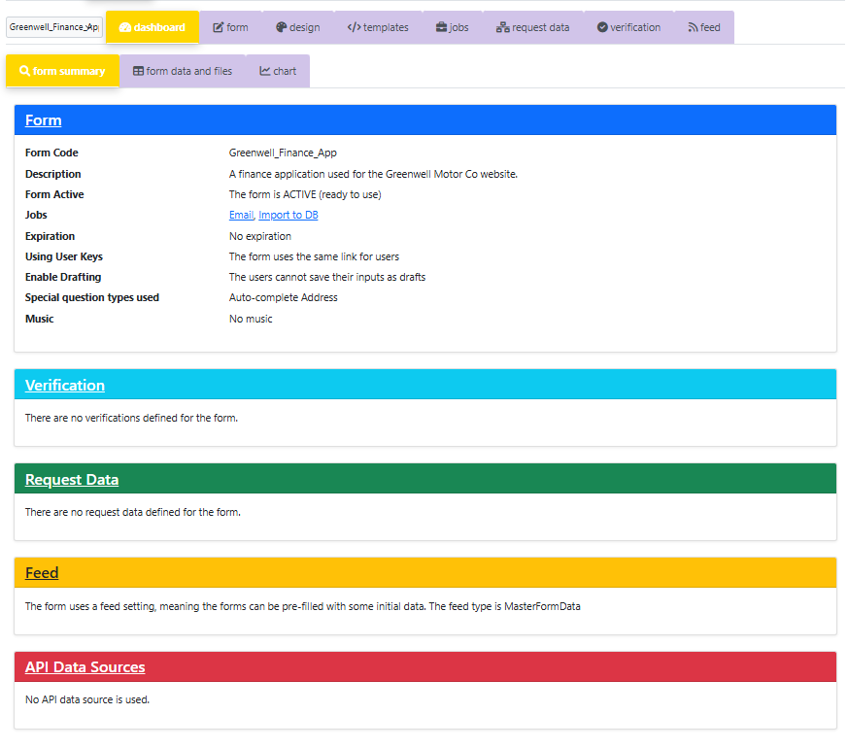
Form summary
The Form Summary page is the Admin app's landing page, offering a comprehensive overview of your form and easy navigation to key features of FlexiForms.

Slide 64
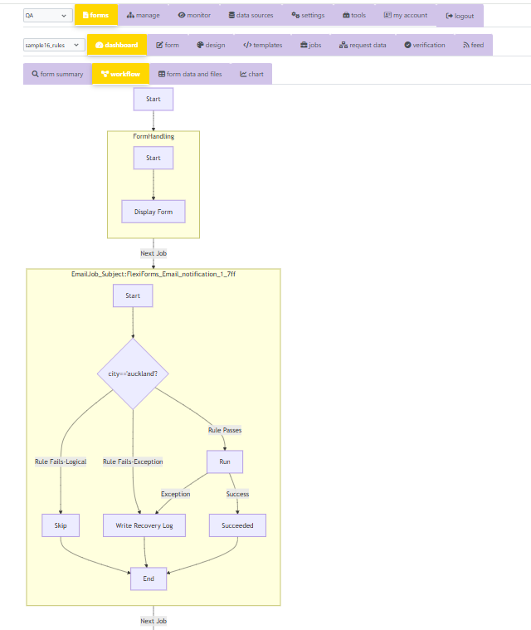
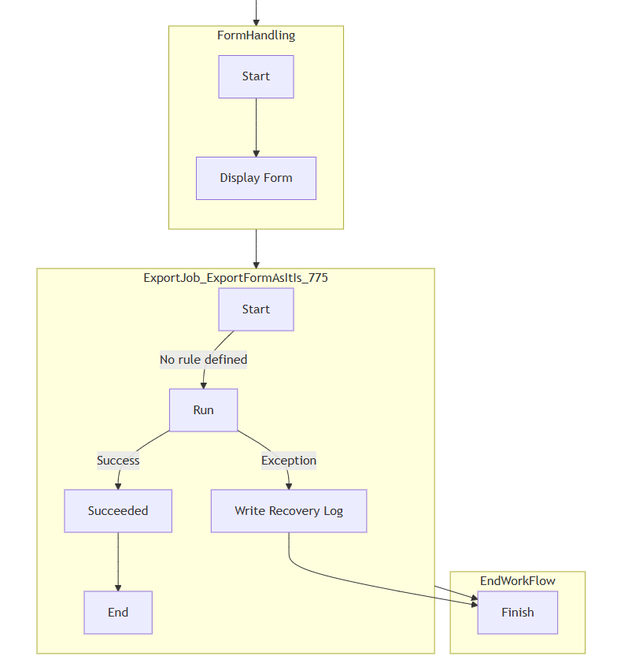
workflow
The FlexiForms Admin app provides a workflow chart that outlines each step of the form's process, from the user's initial link click to form completion, including request data collection, data feeding, verification steps, API data sources, and jobs, with decision points based on job rules.

Slide 65
form data and files module
The Display Data module is a versatile tool that goes beyond simply showing form data. It enables users to search, sort, and export data, as well as download files associated with import processes. For forms that link to other forms (or themselves), it generates review links, allowing read-only viewing of form data within the form itself.
This module doesn't just display the raw form data; it also presents data from tables populated by import-into-database jobs. When a form is completed, the raw data is stored initially, then transferred to specified tables.
The Display Data module lets you view these table rows. It also handles complex questions like dynamic panels and matrices, showing the extracted data from them.
The module provides easy access to uploaded and exported files through direct links.
Finally, you can monitor unique user keys or links to determine which ones have been utilized and which ones have expired.

Slide 66
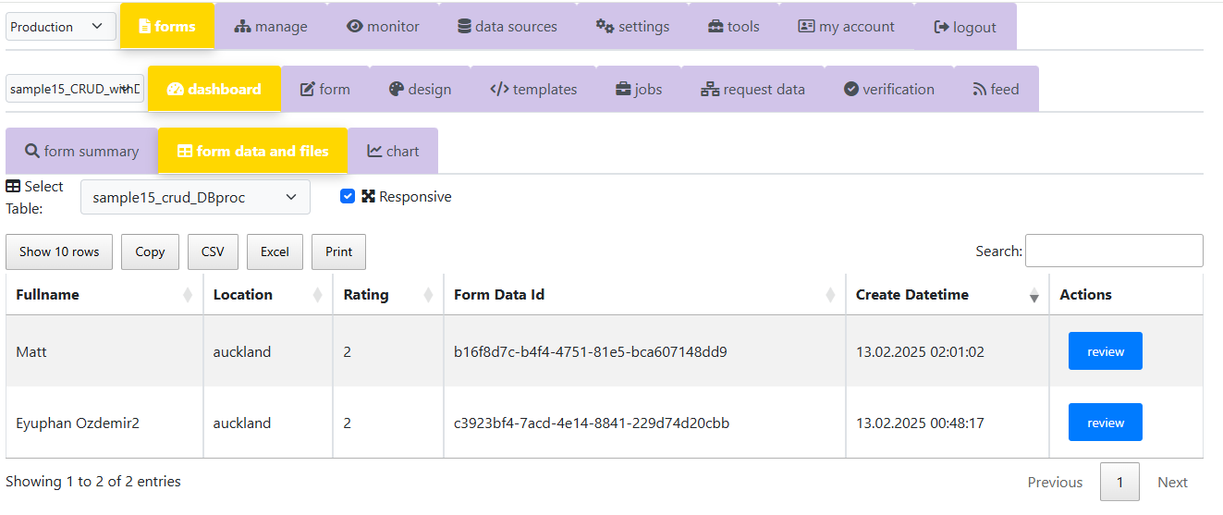
form data and files module

Slide 67
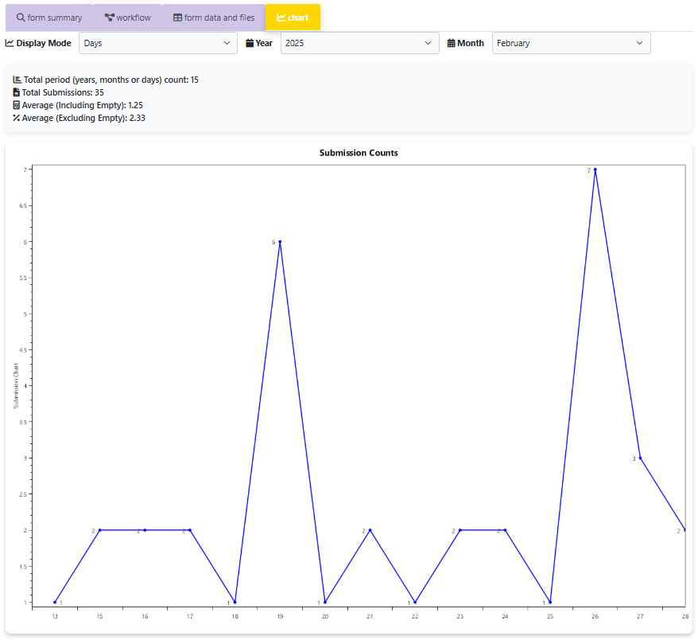
Submission chart

Slide 68
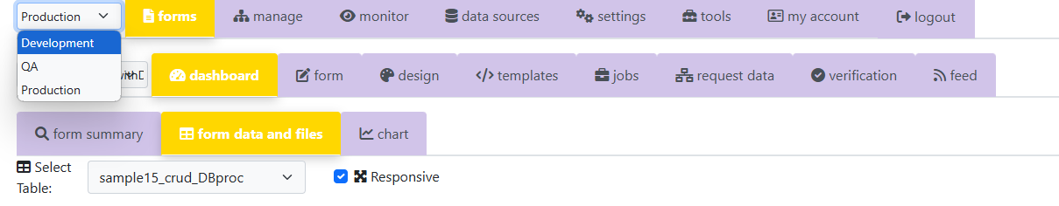
Support for different environments
The FlexiForms Admin app is designed to work seamlessly across multiple environments. It includes
a Development environment for creating and experimenting with form designs and configurations,
a QA environment where testers can thoroughly evaluate the forms,
a Production environment where the finalized forms are made available for actual use.
Switching between these environments is incredibly simple—just select the desired environment from a dropdown menu!
If you only need a single environment, there’s no need to worry. By default, all environments are connected to the same database, ensuring smooth and consistent functionality.

Slide 69
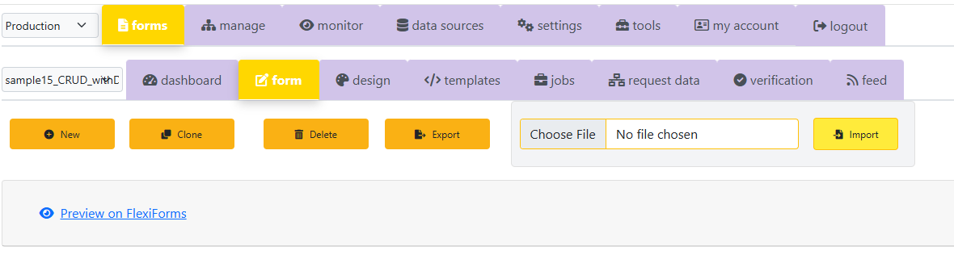
Cloning, exporting and importing forms
The Admin app allows you to
Clone
Export
Import
forms, saving you from the hassle of repeating tasks. This functionality eliminates the need to redesign similar forms or recreate them in different environments.
For example, once you’ve finalized a form in the QA environment and want to move it to the Production environment, you can simply export the form from the QA environment and import it into the Production environment. This streamlined process ensures efficiency and consistency across environments.

Slide 70
Authorization on flexiforms admin app
The FlexiForms Admin app employs a tiered user system:
Administrators utilize the User Management module to add or remove user accounts.
The Form Permissions module controls user access to specific forms.
System Administrators have complete, unrestricted access across all FlexiForms environments (development, testing, and production), and can seamlessly move between them.
Administrators have complete access to all forms and features within the FlexiForms app, but their access is restricted to a single, designated environment
Restricted users in FlexiForms have access solely to the specific forms that have been assigned to them by administrators

Slide 71
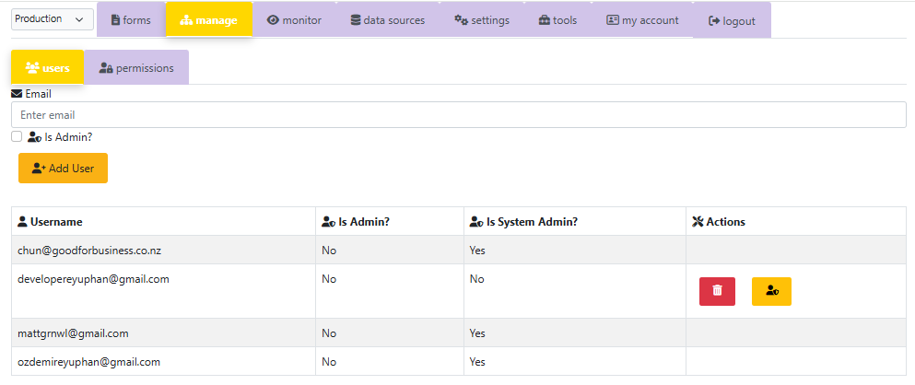
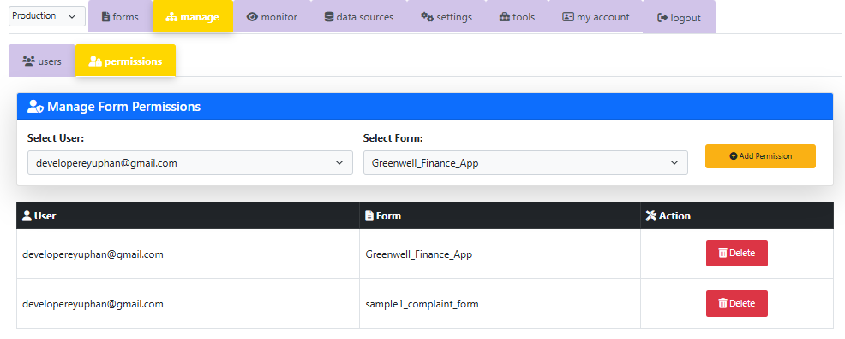

Slide 72
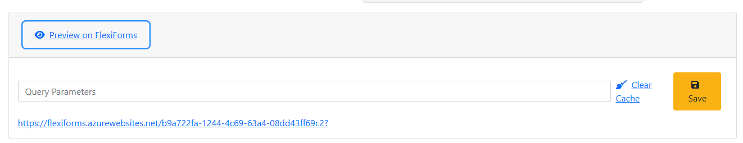
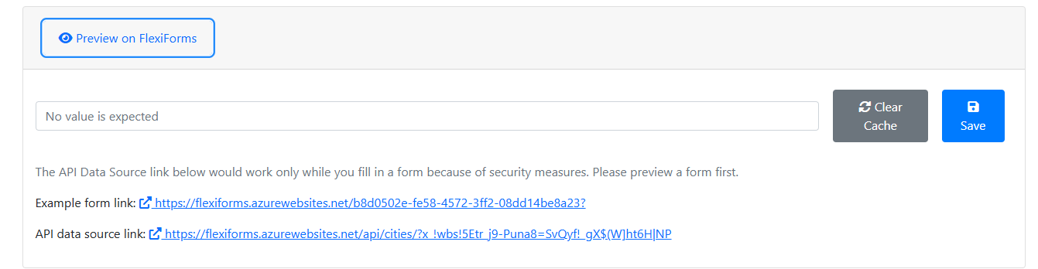
Preview the forms and api data sources
You can use FlexiForms Admin app to see what the form looks like in the main FlexiForms application.
You can also preview the API data sources within the application.

Slide 73
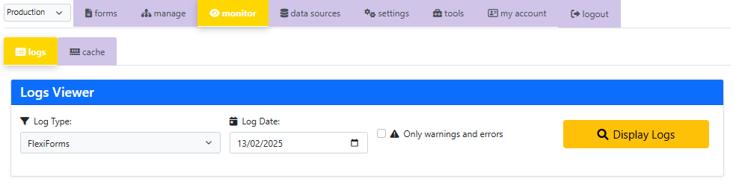
Monitoring
The FlexiForms Admin app enables you to keep track of activities across the entire system. It provides access to FlexiForms Admin, FlexiForms, and Audit Logs, along with the ability to view Cache settings and clear the cache for either the FlexiForms or FlexiForms Admin applications.

Slide 74
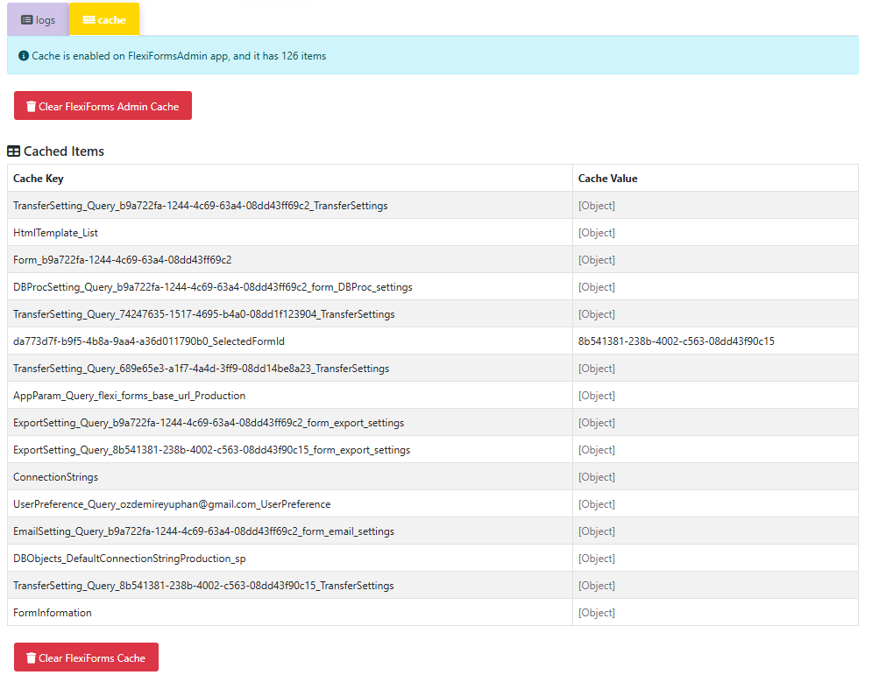

Slide 75

tools
The Admin app includes two useful tools:
a tool for encoding and decoding texts you may need to verify the user
another tool for generating links that contain encoded parameters and universal identifiers.

Slide 76


Slide 77

Live support
While using Admin, if you ever need support, we will be one message away with the help of Live Chat.

Slide 78

Sample forms, KNOWLEDGE BASE AND TRAINING VIDEOS
The FlexiForms website offers
Comprehensive help document,
Numerous sample forms showcasing various use cases that you can download, import, and experiment with. In many cases, just a few adjustments will be sufficient.
Additionally, there are concise and to-the-point training videos available.

Slide 79
extendibility
FlexiForms certainly lives up to its name, appearing highly flexible right out of the box. However, there’s even more potential to unlock! You can extend its capabilities to make it even more adaptable and tailored to your specific needs. Here’s how:
Custom Validation Functions: Enhance how answers are validated by adding new validation rules.
Template Helper Functions: Introduce new helper functions to transform or display answers in your templates, such as customizing how uploaded files are shown.
Rule Functions for Jobs: Create new rule functions to evaluate answers, like checking if a multi-select question (e.g., “Which courses interest you?”) includes a specific option (e.g., “Programming”).
New Job Types: Introduce entirely new job types that integrate seamlessly into FlexiForms, functioning as if they were part of the original system!
With these extensions, FlexiForms becomes even more powerful and customizable, perfectly suited to your unique requirements!

Slide 80

security
FlexiForms ensures secure form delivery, going beyond standard security measures by leveraging its highly customizable and versatile verification options. In addition, FlexiForms is also secure in exposing data sources and in accessing form data, including uploaded or exported files. Its robust authentication system incorporates multiple checkpoints, utilizing various types of information such as IP addresses, request origins, session details, API keys, and more to safeguard the entire system. Furthermore, you have the flexibility to enable or disable these checkpoints based on different scenarios, enhancing both security and adaptability.

Slide 81

Building block approach
By leveraging the core "building blocks" of FlexiForms—such as Jobs, Rules, API Data Sources, Request Data, Verification, the draft-saving feature, and more—your business can implement a wide variety of scenarios. The flexibility is so extensive that even the developers of FlexiForms cannot provide a complete list of all the unique and atypical use cases the product can support!

Slide 82
flexiforms features
Reusable Panels: A collection of commonly used questions for easy reuse.
Support for Various Form Delivery Scenarios: Adaptable to different use cases.
Customizable Verification: Ensures forms reach the correct audience.
Workflow Specification with Jobs: Define and automate workflows.
Rules for Jobs: Create conditions and logic for workflows.
Request Data Collection and Usage: Gather and utilize data efficiently.
Feeding: Reuse pre-filled data across multiple forms.
AI-Powered, Flexible, Intelligent, and Customizable Form Designs: Includes special fields (e.g., signatures), complex fields (e.g., dynamic matrix questions), file uploads and more, all customizable with themes.
Integration with Azure Queues, Azure Functions and Event Grid, with other workflows (such as Azure Logic Apps or N8N) and integration platforms (such as Zapier and Mulesoft)

Slide 83
flexiforms features
API Data Sources: Inject dynamic data, enable verification, and support feeding.
Embeddability: Easily integrate forms into other platforms.
Read-Only Mode: View forms without editing.
Intuitive Admin Application: A user-friendly interface for form management. Live support, extensive knowledgebase and training videos.
Form and template designer modules, Display data, files, submission charts, and workflows; generate and test links; and review forms.
Unique User Links: Personalized links for individual users.
Draft Saving: Save progress and return to incomplete forms.
Extendibility: Add custom features and functionalities.
Automatic Failover Mechanism: Ensures reliability and continuity.

Slide 84
Summary
FlexiForms is a AI-powered, versatile, user-friendly, extensible and secure all-in-one solution for online forms.
Its building block approach along with Jobs and rules, Feeding, Request Data harvesting, API data sources and more allows FlexiForms to support a wide range of scenarios, making it highly adaptable to diverse needs.
It does not only simplify form creation and management but also makes developers' lives easier by offering a robust, flexible, and scalable platform for online forms.
With API data sources, your data becomes ready for dynamic data injection, feeding the data or verification.
Usage of pre-filled form data (Feeding) in other forms makes easy to define business workflows.
You can embed a FlexiForms form into your web site very easily.
The Admin application is designed to be user-friendly and intuitive, allowing you to create forms and workflows, access form data and files, and monitor all system activities. With live support, a comprehensive knowledge base, explanatory samples and training videos, designing forms and workflows becomes a straightforward task.
Unlike with the leading online forms products, FlexiForms is highly customizable and offers solutions tailored. Also, with FlexiForms, you will have full control over the FlexiForms applications, form data and files.
What is more, you can create your own job types.
With FlexiForms, you can easily setup workflows for the form data that supports standard jobs & job rules: Emailing, Export the form data in PDF, HTML or CSV format, Transfer jobs for integration, Importing data into SQL Server, Serving the data to SQL Server processes, and Importing the data into Access, Excel and CSV files
Integration with ERP, CRM systems, Azure Queues, Event Grid and Functions by sending form data
Integration with other Workflows or integration platforms such as Azure Logic Apps, N8N, Mulesoft and Zapier.
FlexiForms has a very flexible verification mechanism using API, database connections, encrypted URL parts and more to specify the form audience. It allows you to design your custom verification screen and choose the best way of verification for you.
Support for many different form delivery scenarios from common links to controlled unique links for each user.
What is more, FlexiForms is extendible! You can create new validation scripts, rule and template functions, even new job types!

Slide 85
thanks
Thanks for listening this epic-long presentation.
We would be delighted to discuss your business needs and explore potential solutions tailored to them.

