Slide 1




kd34403 - machine learning for data science
MILESTONE 3: THE TRAINING LOOP
PIMA INDIANS DIABETES | 768 INSTANCES | 8 FEATURES
group 13
Training Loop & Baseline Evaluation Using Random Forest
Prepared for Prof. Dr. Jason Teo

Slide 2

training loop pipeline
START
Phase | Description
Load Cleaned Data | 768 samples, 8 Features Class 0: 500 (65%) Class 1: 268 (35%)
Stratified Split | Train: 537 (70%) Val: 115 (15%) Test: 116 (15%)
Feature Scaling | Fitted on training set only
Train random | Tested 7 Configs 10 → 200 trees
Results & Metrics | Compare metrics & conclude the results
Load Cleaned Data
Stratified Split
Feature Scaling
Train Random Forest
Results &
Metrics
END

Slide 3

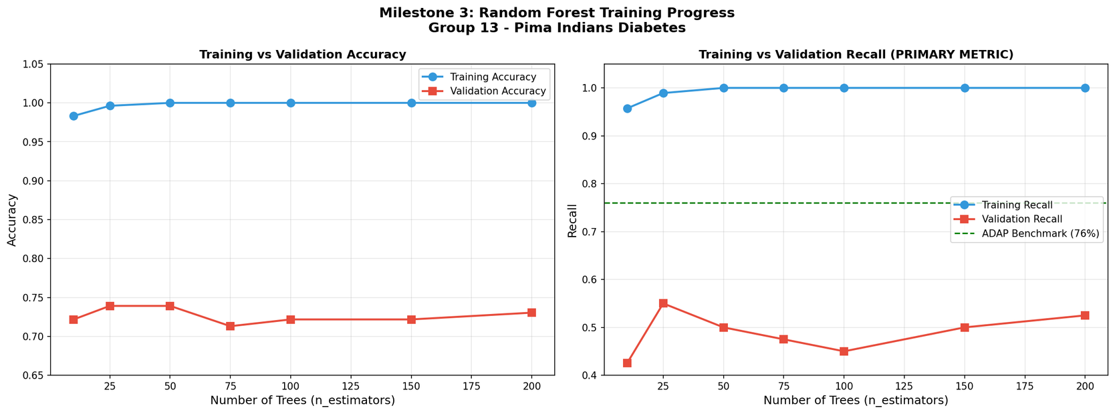
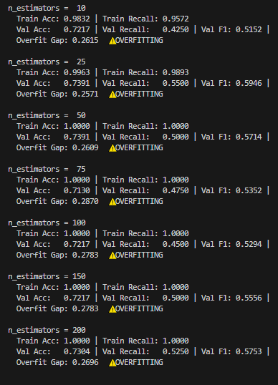
training progress
Trees | Train Acc | Val Acc | Val Recall
10 | 98.3% | 72.2% | 42.5%
25 | 99.6% | 73.9% | 55.0%
50 | 100.0% | 73.9% | 50.0%
75 | 100.0% | 71.3% | 47.5%
100 | 100.0% | 71.3% | 45.0%
150 | 100.0% | 71.3% | 50.0%
200 | 100.0% | 73.0% | 52.5%

Slide 4

training progress
Trees | Train Acc | Val Acc | Val Recall
10 | 98.3% | 72.2% | 42.5%
25 | 99.6% | 73.9% | 55.0%
50 | 100.0% | 73.9% | 50.0%
75 | 100.0% | 71.3% | 47.5%
100 | 100.0% | 71.3% | 45.0%
150 | 100.0% | 71.3% | 50.0%
200 | 100.0% | 73.0% | 52.5%

Slide 5
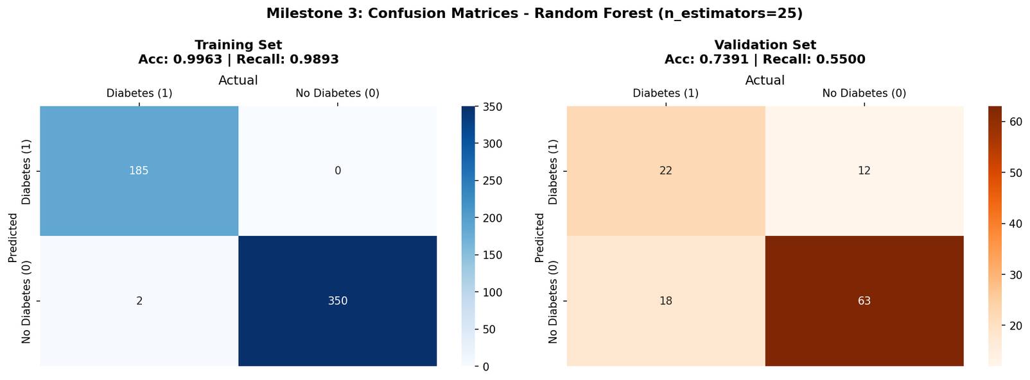

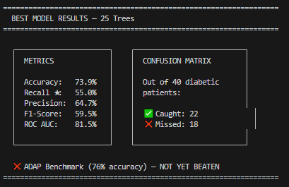

best model results
Best Model | 25 Trees
Accuracy | 73.9%
Recall | 55.0%
Precision | 64.7%
F1-Score | 59.5%
ROC AUC | 81.6%

Slide 6

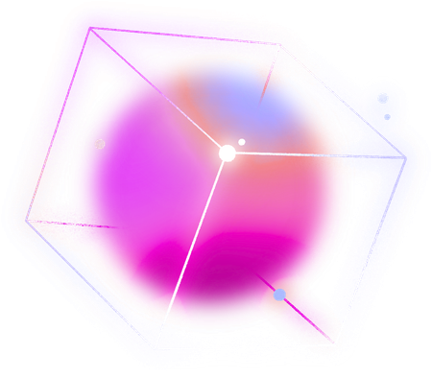
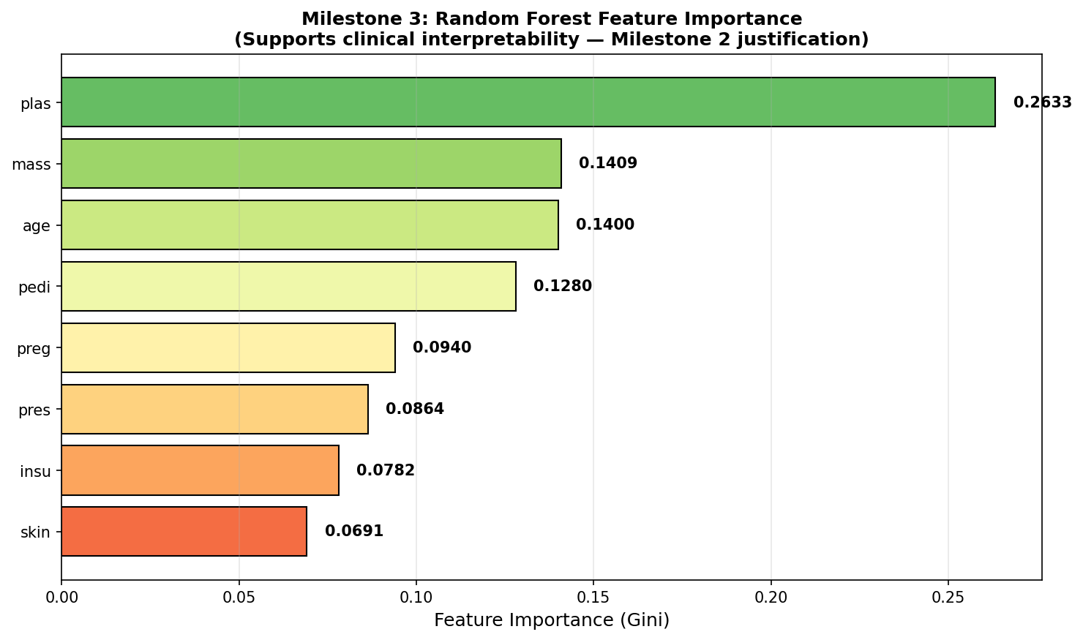
feature importance
Key Findings | Key Findings
Glucose is #1 Predictor (26.3%) BMI (14.1%) & Age (14.0%) are close behind Top 4 Features account for 67% of model decisions Insulin (7.8%) & Skin (6.9%) are lowest | Glucose is #1 Predictor (26.3%) BMI (14.1%) & Age (14.0%) are close behind Top 4 Features account for 67% of model decisions Insulin (7.8%) & Skin (6.9%) are lowest
Glucose is #1 Predictor (26.3%) BMI (14.1%) & Age (14.0%) are close behind Top 4 Features account for 67% of model decisions Insulin (7.8%) & Skin (6.9%) are lowest | Glucose is #1 Predictor (26.3%) BMI (14.1%) & Age (14.0%) are close behind Top 4 Features account for 67% of model decisions Insulin (7.8%) & Skin (6.9%) are lowest
Glucose is #1 Predictor (26.3%) BMI (14.1%) & Age (14.0%) are close behind Top 4 Features account for 67% of model decisions Insulin (7.8%) & Skin (6.9%) are lowest | Glucose is #1 Predictor (26.3%) BMI (14.1%) & Age (14.0%) are close behind Top 4 Features account for 67% of model decisions Insulin (7.8%) & Skin (6.9%) are lowest
Glucose is #1 Predictor (26.3%) BMI (14.1%) & Age (14.0%) are close behind Top 4 Features account for 67% of model decisions Insulin (7.8%) & Skin (6.9%) are lowest | Glucose is #1 Predictor (26.3%) BMI (14.1%) & Age (14.0%) are close behind Top 4 Features account for 67% of model decisions Insulin (7.8%) & Skin (6.9%) are lowest
Glucose is #1 Predictor (26.3%) BMI (14.1%) & Age (14.0%) are close behind Top 4 Features account for 67% of model decisions Insulin (7.8%) & Skin (6.9%) are lowest | Glucose is #1 Predictor (26.3%) BMI (14.1%) & Age (14.0%) are close behind Top 4 Features account for 67% of model decisions Insulin (7.8%) & Skin (6.9%) are lowest

Slide 7


THANK YOU
Thank you for your attention.

