Slide 1
CONTENTS
Abstract
Introduction
Purpose
Scope
Existing System
Disadvantages
Proposed System
Advantages
Hardware Requirements
Software Requirements
Any Queries

Slide 2
Abstract
Vehicle speed detection is used to estimate the velocity of the moving vehicle using image and video processing techniques.
Without any camera calibrations video is captured and analyzed for speed in real time.
By employing frame subtraction and masking techniques, moving vehicles are segmented out.
Speed is calculated using the time taken between frames and segmented object traversed in that frames.
Finally frame making is used to differentiate between one or more vehicles.
With an average error of +/- 2 km/h speed detection was achieved for different video sequences.

Slide 3
Purpose
To develop machine learning algorithms vehicle speed detection is used to estimate the velocity of the moving vehicle using image and video processing techniques

Slide 4
Scope
This paper explicitly concentrates on the speed of the vehicles, which is one of the important parameters to make roads safe. To estimate the velocity of the moving vehicle using image and video processing techniques.
Without any camera calibrations video is captured and analyzed for speed in real time.
By employing frame subtraction and masking techniques, moving vehicles are segmented out.
Speed is calculated using the time taken between frames and segmented object traversed in that frames.
Finally frame masking is used to differentiate between one or more vehicles. With an average error of +/- 2 km/h speed detection was achieved for different video sequences.

Slide 5
Introduction
Vehicle speed detection is useWith the increase in urban population in many cities, amounts of vehicles have also been drastically increased.
In a recent study over-speeding caused most of the accidents, followed by drunken driving.
Over-speeding of two-wheelers and threewheelers is one of the major reasons of accidents.
In order to support traffic management system in our country we need to build economical traffic monitoring systems.
In recent times image and video processing has been applied to the field of traffic management system.

Slide 6
Literature Survey
Relatively few efforts have been attempted to measure speed by using video images from uncalibrated cameras.
Similarly, several other papers suggest estimating speed by first placing two detection lines (separated by a known distance) and then measuring travel times between the lines.
But All Previous Algorithms are not showing Accurate Results

Slide 7
[1] Raad Ahmed Hadi1,Ghazali Sulong and Loay Edwar George, “Vehicle detection and tracking techniques :A concise review”, in Signal & Image Processing : An International Journal (SIPIJ) Vol.5, No.1, February 2014
Recognition of change in location of a non-stationary object in a series of images captured of a definite region at equal intervals of time is considered as an interesting topic in computer vision.
A plethora of application from multiple nuances are deployed to function in real time environments; video surveillance, identifying objects lying underwater, diagnosing abnormalities in patient and providing proper treatment in the medical department.
Among these, one of the applications is detection of vehicle in traffic and identifying the speed of the vehicle. However, there are certain factors which should be considered for detection of constantly moving vehicles at every interval of time.
It mainly comprises of three techniques to detect a vehicle namely: 1) Background Subtraction Methods 2) Feature Based Methods 3) Frame Differencing and motion-based methods

Slide 8
Existing System
One of the technologies our law enforcement department uses to measure the speed of a moving vehicle is Doppler radar.
It beams a radio wave at a vehicle, and then estimate the vehicles speed by measuring change in reflected wave frequency.
It is a fixed or hand-held device and is reliable when a moving object is in the field of view and no other moving objects are nearby.
Cosine error has to be taken care if the gun is not in the line of sight. Also Radio interference which causes errors in speed detection has to be taken care.
Some of the previous works using image and video processing applied for vehicle detection and speed measurements are vehicle detection based on frame difference, calibrated camera, motion trajectories, Optics and digital aerial images.

Slide 9
Dis Advantages
Also, blurred images were used to find out the vehicle speed along with high-end camera motion detection for automated speed measurements and feature point tracking for vehicle speed measurements were used.
Currently highly reliable GPS systems are used to track vehicle speeds in US. Cost-effectiveness is a concern in such a case.
In our method moving vehicle video from any video camera or mobile source is utilized.
The algorithms are implemented in ‘C’ language using OpenCV and Visual Studio. Later this code can be ported to a simple processor where vehicle speed can be measured.
Example: a simple smart phone with average processing capacity. Our aim was to implement real- time vehicle speed detector.

Slide 10
Proposed System
A video signal is the term used to describe any sequence of time varying images.
A still image is a spatial distribution of intensities that remain constant with time while a time varying image has a spatial intensity distribution that varies with time.
Videos can be in various formats based on the different cameras or mobile phones used. The video format used is an AVI file with the extension .avi

Slide 11
Advantages
This video is converted into frames. Since the video had 30 frames per second, extracting all the frames would lead to unwanted redundancy and these increases the delay time to execute the program. Hence we sampled the frames so that we get 3 frames per second, which serves the need.
Further above reference frames which are consecutive in nature are selected and converted into grayscale. Conversion to grayscale further reduces the amount of computation.
Next steps include preprocessing, moving edge detection, morphological operations, edge detection, vehicle segmentation and corner detection.

Slide 12
Hardware Requirements
System : Intel core
Hard Disk : 1 TB
RAM : 4 GB

Slide 13
Software Requirements
Operating system : Windows 10 or more
Coding Language : Python

Slide 14
Modules
To implement this project we have designed following modules
Upload Video
button to upload Video
2.Detect Cloud & Movement :
button to detect cloud movement. Application will continuously display all 45 original and cloud movement detection image with one second pause

Slide 15
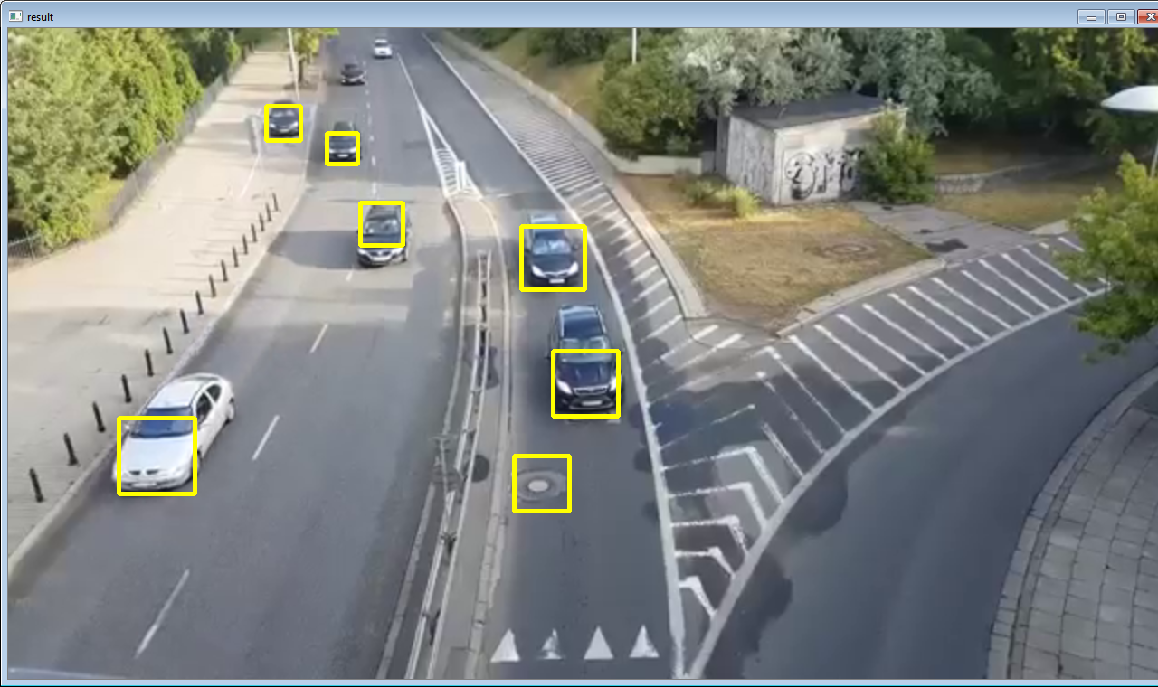
Results

Slide 16
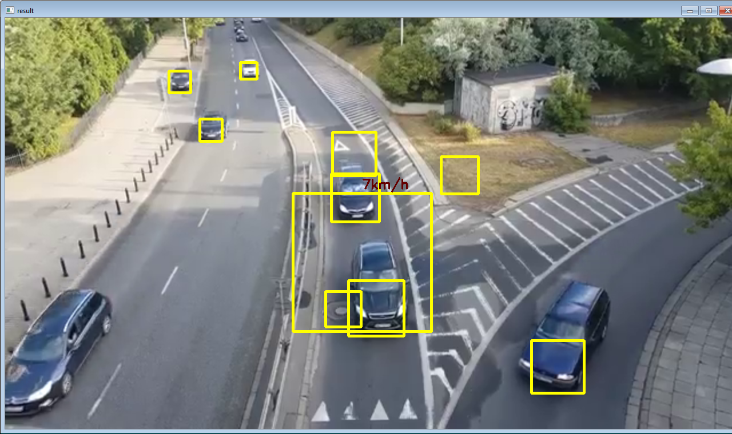

Slide 17
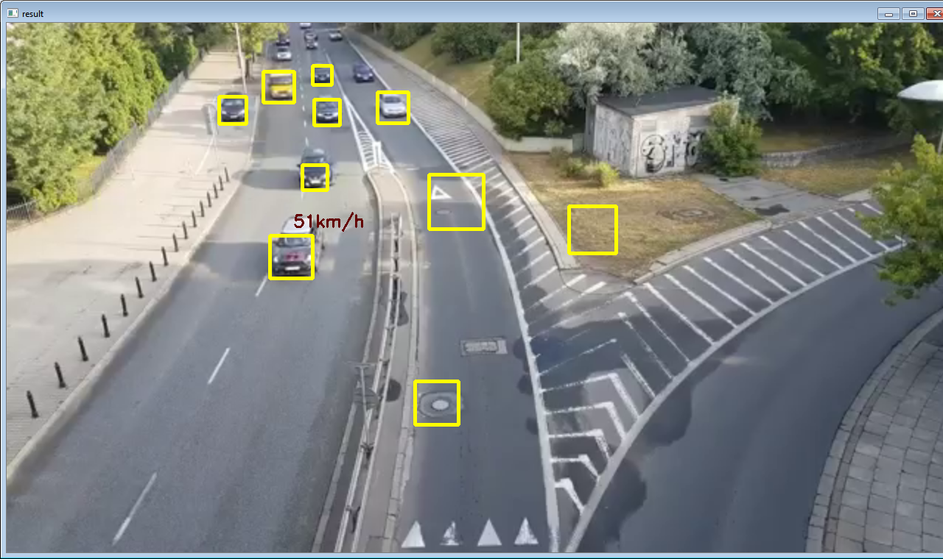

Slide 18
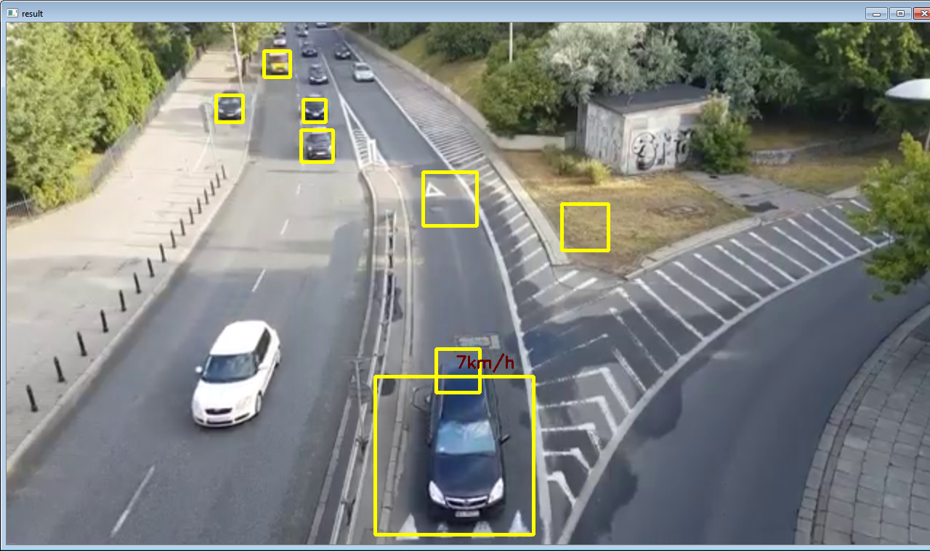

Slide 19
REFERENCES
[1] J. Boyle et al., ``Predicting emergency department admissions,'' Emerg. Med. J., vol. 29, pp. 358365, May 2012, doi: 10.1136/emj.2010.103531.
[2] S. L. Bernstein et al., ``The effect of emergency department crowding on clinically oriented outcomes,'' Acad. Emerg. Med., vol. 16, no. 1, pp. 110,
2009, doi: 10.1111/j.1553-2712.2008.00295.x.
[3] D. M. Fatovich, Y. Nagree, and P. Sprivulis, ``Access block causes emergency department overcrowding and ambulance diversion in Perth, Western Australia,'' Emerg. Med. J., vol. 22, no. 5, pp. 351354, 2005, doi: 10.1136/emj.2004.018002.
[4] M. L. McCarthy et al., ``Crowding delays treatment and lengthens emergency department length of stay, even among high-acuity patients,'' Ann. Emerg. Med., vol. 54, no. 4, pp. 492503, 2009, doi: 10.1016/j.annemergmed.2009.03.006.

Slide 20
THANK U

