Slide 1
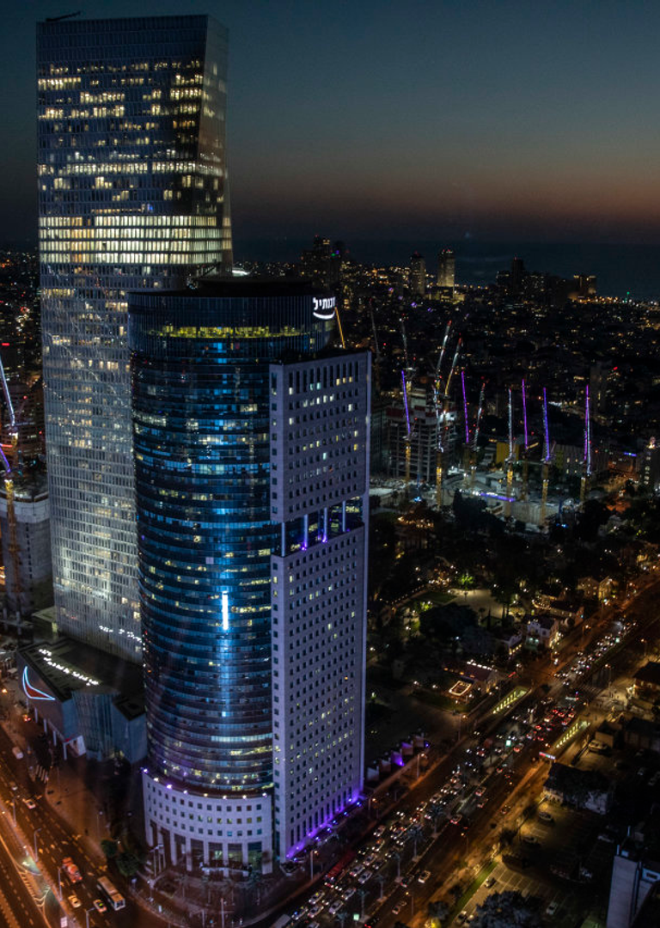


aisalon
EMPOWERING AI CONNECTIONS
TEL AVIV CHAPTER · SPONSORSHIP PROPOSAL
The AI Ecosystem Engine
AliExpress × AI Salon Tel Aviv — a 12-month exclusive partnership anchoring AliExpress at the heart of Israel's AI community.
PREPARED FOR ALIEXPRESS · AUGUST 2026
Notes:
- Open with the strategic narrative — AI Salon Tel Aviv is the central hub for Israeli AI talent. - AliExpress has the opportunity to anchor this hub for 12 months. - Frame as an active investment in the heart of the Israeli tech ecosystem — not a marketing spend. - Pause briefly after the headline so the visual weight of "The AI Ecosystem Engine" lands before continuing. - Signal the deck arc: Partnership → Value Proposition → Economics.

Slide 2
aisalon
01
THE PARTNERSHIP
A 12-month exclusive anchor partnership — engineered for ecosystem access.
02 / 10
Notes:
- Section walks through the structure of the partnership. - Six bi-monthly flagship events anchor the year; top billing on every chapter communication. - Exclusive 20-minute thought-leadership slot per event for an AliExpress technical or executive voice. - Always-on digital reach between events — monthly email blast + bi-monthly WhatsApp community update. - Frame the package as an active investment, not a marketing cost.

Slide 3
SPONSOR PLAN
Six activation pillars across 12 months
Each pillar is engineered for maximum integration across the Tel Aviv tech community — bi-monthly physical events plus always-on digital channels.
▦
★
◖
Bi-Monthly Event Sponsorship
Top-Tier Brand Billing
Thought Leadership Slots
AliExpress presents 6 flagship AI Salon Tel Aviv events across 12 months — every two months, the community convenes under the AliExpress banner.
“AI Salon Tel Aviv, Presented by AliExpress” on every email, social post, Luma/Meetup page, and opening slide.
A 20-minute “AI Insight” talk per event from an AliExpress technical/executive expert — retail-tech, global commerce, or ML infrastructure.
PILLAR 02
PILLAR 01
PILLAR 03
◖
♟
▣
Community Digital Reach
Opening + Networking Access
Co-Branded Merch + Content
Monthly email blast + bi-monthly WhatsApp community update featuring AliExpress tools, dev integrations, and exclusive advantages.
60-second Community Welcome spot per event, private pre-event briefings with speakers, 5 complimentary tickets per event.
High-utility co-branded merchandise distributed at events. Post-event Thank You emails link to AliExpress whitepapers + dev portal.
PILLAR 04
PILLAR 05
PILLAR 06
AI SALON TEL AVIV · SPONSORSHIP PROPOSAL
03 / 10
Notes:
Speaker notes: - Walk through each of the 6 pillars briefly — they form one integrated system, not a list of disconnected line items. - Physical events anchor the relationship; digital channels sustain momentum between events; merch + content extends the brand beyond the room. - Emphasize that thought-leadership slots are explicitly NOT sales pitches — they are technical insights positioning AliExpress as a serious partner. - Highlight Pillar 02 (Top-Tier Brand Billing) — naming rights on every email, social post, Luma/Meetup page, and opening slide. - Pillar 04 (Community Digital Reach) is the always-on engine: monthly email + bi-monthly WhatsApp keeps AliExpress continuously visible.

Slide 4






12-MONTH QWEN ACTIVATION CALENDAR · ALIEXPRESS EXCLUSIVE
Six flagship events, all anchored by the Qwen model family
An exclusive 12-month series built entirely around Alibaba's Qwen LLM family — Qwen-Max, Qwen-VL-Max, Qwen-Coder, Qwen3 open weights, Qwen-Agent, and a Qwen-Next preview. Each bi-monthly event pairs a technical deep-dive with a dedicated session and early-access benefits for the AI Salon TLV community.
Qwen-Max Unveiled — Agentic Commerce at Scale
M4 · APR
Qwen-VL-Max
M6 · JUN
Qwen-Coder
M2 · FEB
Qwen-Max
Visual Commerce — From Search to Multimodal Discovery
Qwen-Coder Live — Building Commerce-Aware Agents
⚿
EARLY ACCESS
⚿
EARLY ACCESS
⚿
EARLY ACCESS
Live demo of Qwen-Max powering agent-driven product discovery, cross-language search, and global catalog reasoning at marketplace scale. Community gets: private Qwen-Max API sandbox + $2K in credits.
Qwen-VL-Max for retail: multimodal product understanding, image-based search, visual QA at catalog scale. Community gets: Qwen-VL-Max preview + sample retail vision dataset for benchmarks.
Hands-on workshop with Qwen-Coder building tools that read, query, and reason over the AliExpress catalog. Community gets: Qwen-Coder dev seats + pair-programming lab with AliExpress engineers.
SESSION
Qwen-Max in Production: Powering Agent-Driven Catalog Reasoning at AliExpress
SESSION
Qwen-VL-Max for Retail: Multimodal Product Understanding at Scale
SESSION
Agentic Coding with Qwen-Coder: Building Tools for the AliExpress Catalog
M8 · AUG
Qwen3 Open
M10 · OCT
Qwen-Agent
M12 · DEC
Qwen-Next
Qwen3 Open Lab — Fine-Tune for Israeli Retail & Hebrew
Agentic Ops — Qwen-Agent in Production
Year-Cap — The 2027 Qwen Roadmap
⚿
EARLY ACCESS
⚿
EARLY ACCESS
★
HEADLINE STAGE
Hands-on fine-tuning lab on Qwen3 open weights for Israeli-domain use cases (Hebrew, retail, commerce). Community gets: free fine-tuned Qwen3 instance per startup + H100 compute hours.
Production deployment of Qwen-Agent: multi-step commerce workflows, tool-use, RAG over AliExpress APIs. Community gets: Qwen-Agent framework early access + reference implementations for retail ops.
Qwen leadership team previews the 2027 roadmap — Qwen-Next architecture, on-device, agentic capabilities. Community gets: Qwen-Next closed-beta seats + co-authored whitepaper with AliExpress.
SESSION
Open-Weight Qwen3 Fine-Tuning Lab: Hebrew, Retail, and Beyond
SESSION
Qwen-Agent at Scale: Orchestrating Multi-Step Commerce Workflows
SESSION
Qwen-Next Preview: Inside the Roadmap with the Qwen Leadership Team
6 FLAGSHIP EVENTS · $12K EACH
6 DEDICATED SESSIONS · 1 PER EVENT
12 MONTHLY + 24 WHATSAPP DROPS
All themed around the Qwen family — Qwen-Max, Qwen-VL-Max, Qwen-Coder, Qwen3, Qwen-Agent, Qwen-Next
AliExpress technical speakers deliver the keynote session at every flagship
Always-on digital keeps AliExpress visible between events
12-MONTH ANNUAL PARTNERSHIP · QWEN-EXCLUSIVE CALENDAR
04 / 10
Notes:
Speaker notes: - Open with the strategic positioning: the entire 12-month calendar is built exclusively around the Qwen model family — AliExpress's in-house LLM. This is the strongest possible brand alignment: every event is a Qwen event. - Walk through the Qwen lineup: M2 Qwen-Max flagship, M4 Qwen-VL-Max for vision, M6 Qwen-Coder for dev tools, M8 Qwen3 open weights for fine-tuning, M10 Qwen-Agent for production agents, M12 Qwen-Next roadmap preview. - Each event has a dedicated session with an AliExpress technical speaker — that's 6 sessions over the year, each one positioning AliExpress as a serious AI builder, not just a marketplace. - Emphasize the early-access layer: every event pairs the deep-dive with concrete perks — API credits, preview access, fine-tuning compute, closed-beta seats. Hundreds of dollars of community value per event. - Close with the rhythm: 6 flagship Qwen events + 12 monthly email blasts + 24 WhatsApp community drops = continuous visibility for AliExpress as the exclusive Qwen partner in Israel.

Slide 5
aisalon
SECTION 02 / 03
SPONSORSHIP PROPOSAL
02
THE VALUE PROPOSITION
Direct, curated access to the most influential AI audience in Israel.
05 / 10
Notes:
Speaker notes: - This section answers the question: who exactly does AliExpress reach through this partnership? - The audience is highly specialized — investors, founders, technologists, and ecosystem players. - We will break down the exact demographics and the global network this partnership plugs AliExpress into. - Mirror of slide 02 layout — but in AIS Cyan with black typography (opposite color per brand book §8). - Next slide drills into the audience composition: 40% founders/builders, 20% investors, 20% engineers, 20% diverse ecosystem.

Slide 6
TARGETED AUDIENCE ACCESS
A highly specialized, influential audience
Mirrors the core demographic breakdown of the global AI Salon network.
40%
20%
AI Founders & Builders
Investors
Entrepreneurs and core developers building cutting-edge technologies. The bleeding edge of Israeli AI.
Active venture capitalists and institutional investors seeking high-growth opportunities in early-stage AI.
20%
20%
Founders & Builders
Investors
Technologists & Engineers
Diverse Ecosystem
Technologists
Diverse Ecosystem
Skilled engineers and AI professionals providing direct access to top-tier technical talent.
University researchers, corporate innovators, accelerator managers, and small business owners shaping the broader ecosystem.
AI Salon Tel Aviv community composition
AUDIENCE COMPOSITION · AI SALON NETWORK-WIDE
06 / 10
Notes:
Speaker notes: - 40% of the audience are founders and builders — the people building the next generation of retail-tech, commerce infrastructure, and ML platforms. - Another 20% are investors who fund them — direct line into early-stage AI capital flows. - Remaining 40% split between engineers (20%) and the broader ecosystem (research, corporate innovation, accelerators, SMBs). - This is not a generic tech audience — it is the most curated AI community in Israel. - Demographics mirror the global AI Salon network, so the Tel Aviv chapter inherits a proven composition.

Slide 7
59
GLOBAL ECOSYSTEM ASSOCIATION
A prestigious global network, by the numbers
Partnering with AI Salon Tel Aviv aligns AliExpress with a globally-recognized tech community spanning 59 chapters across 5 continents.
59+
500+
130K+
1,500+
CHAPTERS WORLDWIDE
GLOBAL EVENTS
ATTENDEE REGISTRATIONS
PARTICIPATING STARTUPS
Hosted since 2024
Cumulative community reach
Active community members
Across 5 continents
◯
“A single Tel Aviv partnership plugs AliExpress into a worldwide AI community — Tel Aviv is the local anchor, the global network is the multiplier.”
AISALON GLOBAL NETWORK
07 / 10
Notes:
Speaker notes: - These numbers are the leverage play — AliExpress is sponsoring Tel Aviv, but really buying into a 59-chapter global network. - A Tel Aviv keynote speaker's content can be amplified across the entire global AI Salon community. - 130K+ cumulative registrations is the reach AliExpress is buying into; 1,500+ participating startups signals real density. - 500+ global events since 2024 validates the network's operational throughput. - Frame Tel Aviv as the local anchor; the global network is the multiplier.

Slide 8

PRESTIGIOUS GLOBAL PEER GROUP
AliExpress joins an elite roster of tech leaders
Past and present global partners that have anchored AI Salon initiatives worldwide.
☁
➤
✦
Amazon Web Services
Google for Startups
Microsoft for Startups
🏛
✦
🏪
Dubai International Finance Center
Appier
AliExpress
AliExpress would be the first retail-commerce platform to anchor an AI Salon Tel Aviv partnership — a category-defining position.
PEER SPONSORS · GLOBAL AI SALON NETWORK
08 / 10
Notes:
Speaker notes: - Peer group is the social proof: AWS, Google for Startups, Microsoft for Startups, Appier, and Dubai International Finance Center have all partnered with AI Salon globally. - AliExpress would be the first retail-commerce platform to anchor a Tel Aviv chapter partnership — a category-defining position. - The brand halo from this peer set positions AliExpress alongside cloud and AI infrastructure leaders. - Use this slide to land the "you'd be in elite company, and uniquely so" narrative. - Lead into Section 03: this positioning justifies the investment math that follows.

Slide 9

aisalon
SECTION 03 / 03
SPONSORSHIP PROPOSAL
03
THE ECONOMICS
Predictable, high-value asset allocation over a committed 12-month term.
09 / 10
Notes:
Speaker notes: - The final section is the financial framework — intentionally simple and predictable. - Flat monthly commitment, 12-month term, total $72K. - Allocation maps every dollar to either a flagship event or always-on digital value. - Mirror of slides 02 and 05 layout, but on AIS Black with a gradient divider bar. - Lead into the closing slide: investment summary + contact + 30-minute alignment call ask.

Slide 10

INVESTMENT SUMMARY
A predictable 12-month commitment
Structured for maximum ROI across bi-monthly activations.
$6K
12
$72K
PER MONTH
MONTH TERM
TOTAL ANNUAL INVESTMENT
6 FLAGSHIP EVENTS · $12K VALUE-EQUIVALENT PER ACTIVATION
·
MONTHLY EMAIL BLASTS
·
BI-MONTHLY WHATSAPP UPDATES
·
PERSISTENT CHAPTER WEBPAGE BRANDING
NEXT STEPS
Anchor the Israeli AI ecosystem.
CONTACT
AI Salon Tel Aviv
We propose a 30-minute alignment call to finalize the 12-month activation calendar, confirm the AliExpress thought-leadership speakers, and lock the first flagship event date. The partnership can launch within 30 days of signature.
Eze Caz · Chapter Lead
eze@massapro.com
aisalon.massapro.com
▦
BOOK A 30-MIN ALIGNMENT CALL
SPONSORSHIP PROPOSAL · AUGUST 2026
10 / 10
Notes:
Speaker notes: - Close with the ask: $6K/month, 12-month term, $72K total annual investment. - Walk through allocation: 6 flagship events at $12K value-equivalent each, plus always-on digital (email + WhatsApp) and persistent webpage branding. - Propose a 30-minute alignment call to finalize the calendar, confirm AliExpress thought-leadership speakers, and lock the first event date. - The partnership can launch within 30 days of signature — emphasize speed and low-friction onboarding. - Hand off contact: Eze Caz, Chapter Lead, eze@massapro.com, aisalon.massapro.com.

